Slide 2
CNS Module 2ndYear MBBS(SGD)Triglyceride Metabolism
Presenter: Dr Uzma Zafar Date: 01-02-25
Dept of Biochemistry
RMU

Slide 3
Motto, Vision, Dream
To impart evidence based research oriented medical education
To provide best possible patient care
To inculcate the values of mutual respect and ethical practice of medicine
Wisdom
Truth
Service

Slide 4
Professor Umar Model of Integrated Lecture

Slide 5
Learning Objectives
At the end of this session students should be able to
Explain synthesis and degradation of triglycerides
Discuss different enzymes involved in triglyceride metabolism
Describe regulation of triglyceride metabolism

Slide 6
Structure of Triacylglycerol
A triacylglycerol with an unsaturated fatty acid on carbon
2. Orange denotes the hydrophobic portions of the molecule.

Slide 7
Synthesis of Glycerol-3-Phosphate

Slide 8
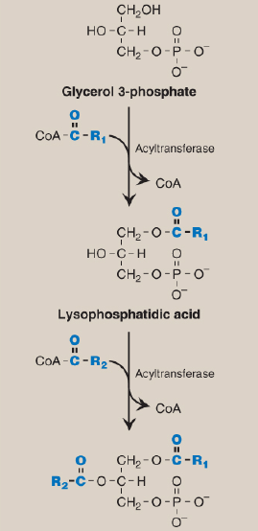
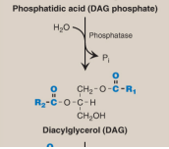
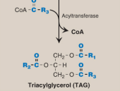
Synthesis of Triacylglycerol
Synthesis of TAG. R1–R3 = activated fatty acids. CoA = coenzyme A; Pi = inorganic phosphate.

Slide 9
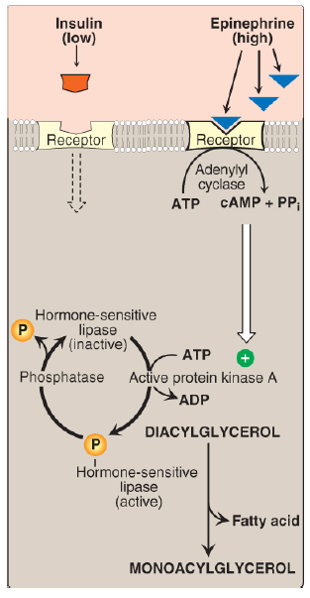
Lipolysis
Hormonal regulation of diacylglycerol degradation in the adipocyte.
(Note: Triacylglycerol is degraded to diacylglycerol by adipose
triglyceride lipase.) cAMP = cyclic adenosine monophosphate; PPi
= pyrophosphate; ADP = adenosine diphosphate; = phosphate.

Slide 10
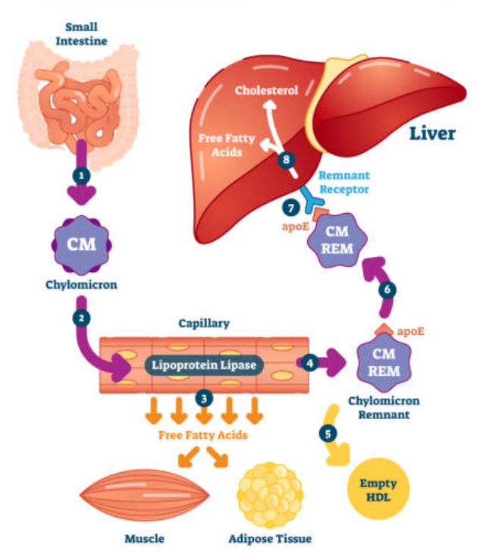
Horizontal Integration

Slide 11
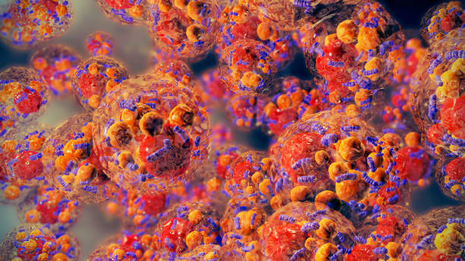
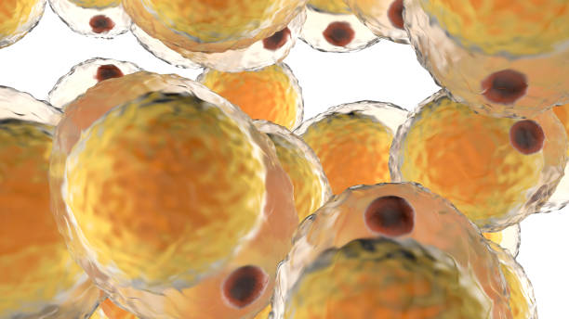
Horizontal Integration
A cluster of fat cells

Slide 12
Horizontal Integration
Functions of TAG
Triacylglycerol (TAG), also known as triglyceride, plays several important roles in the body. Here are the primary functions:
1) Primary Energy Reserve
2) Thermal Insulation. Cushioning and Protection
3) Cell Membrane Integrity
4) Carrier of Fat-Soluble Vitamins
5) Precursor for Hormones

Slide 13
Vertical Integration

Slide 14
Spiral Integration
Family Medicine
Family Medicine plays important role in following manner:
Diagnosis
Education & counselling
Dietary Guidance
Monitoring and follow up
Refer to Specialists

Slide 15
Spiral Integration
Bioethics
Ethical Considerations
From an ethical standpoint, the scenario raises considerations regarding patient autonomy, informed consent, and confidentiality
The physician must ensure that patient fully understands her diagnosis, treatment options, and potential implications
Discuss the necessity of a healthy lifestyle & treatment plan. This requires clear communication and understanding of risks and benefits.
Additionally, the physician must respect patient’s privacy and confidentiality throughout the diagnostic and treatment process

Slide 16
Spiral Integration
Artificial Intelligence
Role of AI in Management
AI can potentially aid in enhancing diagnostic accuracy and efficiency.
AI-powered decision support systems can also help clinicians in selecting appropriate treatment modalities
AI-driven predictive models may help anticipate the risk of complications of the Disease in susceptible populations

Slide 17
Suggested Research Article
Spiral Integration
Research Article
Introduction
Congestive heart failure (CHF), as the terminal stage of various cardiac diseases, has emerged as a significant public health concern impacting residents’ well-being. In the United States alone, CHF affects six million adults over the age of 20 [1, 2], and its mortality rate is rapidly increasing worldwide, imposing a significant social and economic burden on human society [2]. Therefore, to mitigate the incidence and progression of heart failure, it is imperative to concentrate on high-risk cohorts for CHF, such as patients with diabetes and prediabetes.
To address the research gap concerning the interplay between metabolic factors and heart failure, we leveraged the comprehensive National Health and Nutrition Examination Survey Database, which encompasses a substantial sample size within the US. Our study aimed to investigate the association between the TyG index and CHF among patients with abnormal glucose metabolism. Introduction
k: https://nutritionandmetabolism.biomedcentral.com/
Journal Name:
BMC
Title:
U shape association between triglyceride glucose index and congestive heart failure in patients with diabetes and prediabetes
Author Name:
Yumeng Shi

Slide 18
How To Access Digital Library
Steps to Access HEC Digital Library
Go to the website of HEC National Digital Library
On Home Page, click on the INSTITUTES
A page will appear showing the universities from Public and Private Sector and other Institutes which have access to HEC National Digital Library HNDL
Select your desired Institute
A page will appear showing the resources of the institution
Journals and Researches will appear
You can find a Journal by clicking on JOURNALS AND DATABASE and enter a keyword to search for your desired journal

Slide 19
Learning Resources
Lippincott Illustrated Reviews 8th Edition, -
Harper’s Illustrated Biochemistry 32nd Edition
Google images
Digital Library

Slide 20
THANK YOU

