Slide 2
CNS Module 2ND Year MBBS(LGIS) Phospholipid Metabolism
Presenter: Dr Uzma Zafar Date: 01-02-25
Dept of Biochemistry
RMU

Slide 3
Motto, Vision, Dream
To impart evidence based research oriented medical education
To provide best possible patient care
To inculcate the values of mutual respect and ethical practice of medicine
Wisdom
Truth
Service

Slide 4
Professor Umar Model of Integrated Lecture

Slide 5
Learning Objectives
At the end of this session students should be able to understand
Phospholipids metabolism (Core concept)
Related anatomy and Physiology (Horizontal Integration)
Related clinical/congenital abnormalities (Vertical integration)
Research article related to topic

Slide 6
Phospholipids
Core Knowledge
OVERVIEW
Membrane lipids are composed of four major types: phospholipids, sphingolipids, glycolipids, and cholesterol
Phospholipids are ionic compounds composed of an alcohol that is attached by a phosphodiester bond to either diacylglycerol (DAG) or sphingosine
Like fatty acids (FA), phospholipids are amphipathic in nature
Hydrophilic head, which is the phosphate group plus whatever alcohol is attached to it (e.g., serine, ethanolamine, and choline, and a long, hydrophobic tail containing FA or FA-derived hydrocarbons
Phospholipids are the predominant lipids of cell membranes
In membranes, the hydrophobic portion of a phospholipid molecule is associated with the nonpolar portions of other membrane constituents, such as glycolipids, proteins, and cholesterol

Slide 7
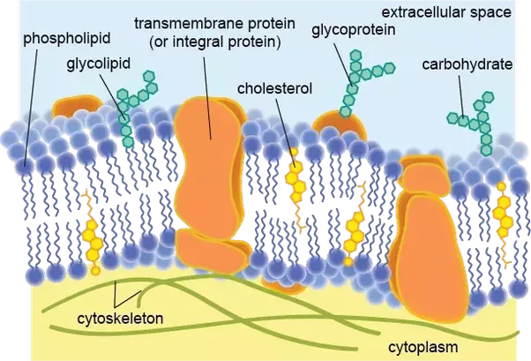
Phospholipids
Core Knowledge

Slide 8
Phospholipids
Core Knowledge
The hydrophilic (polar) head of the phospholipid extends outward, interacting with the intracellular or extracellular aqueous environment
Membrane phospholipids also function as a reservoir for intracellular messengers, and, for some proteins, phospholipids serve as anchors to cell membranes
Nonmembrane phospholipids serve additional functions in the body, for example, as components of lung surfactant and essential components of bile, where their detergent properties aid cholesterol solubilization

Slide 9
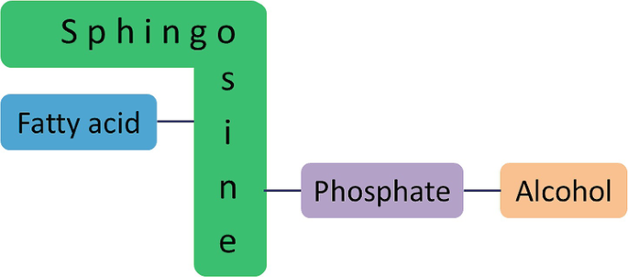
Core Knowledge
Types and structure of phospholipids
Glycerophospholipids
Sphingophospholipids

Slide 10
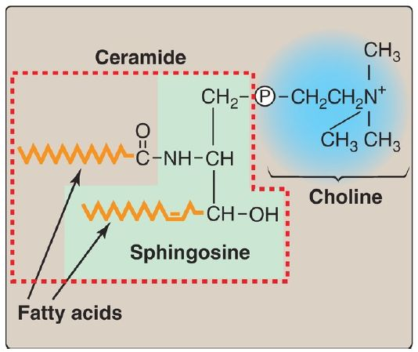
Core Knowledge
Types and structure of phospholipids
Glycerophospholipids
Sphingophospholipids

Slide 11
Core Knowledge
Examples of phospholipids
Glycerophospholipids
Sphingophospholipids
Phosphatidylserine
Phosphatidylethanolamine (PE) (cephalin)
Phosphatidylcholine (PC) (lecithin)
Inositol + PA → phosphatidylinositol (PI)
Cardiolipin
Plasmalogen
Platelet activating factors
Sphingomyelin

Slide 12
Core
Knowledge
Structure of phospholipids
There are two classes of phospholipids: those that have glycerol (from glucose) as a
backbone and those that have sphingosine (from serine and palmitate). Both classes are found as structural components of membranes, and both play a role in the generation of lipid-signaling molecules.
A. Glycerophospholipids
Phospholipids that contain glycerol are called glycerophospholipids (or
phosphoglycerides). Glycerophospholipids constitute the major class of phospholipids and are the predominant lipids in membranes.
Glycerophospholipids from phosphatidic acid and an alcohol: The phosphate
group on PA can be esterified to another compound containing an alcohol group For example:
Serine + PA → phosphatidylserine (PS)
Ethanolamine + PA → phosphatidylethanolamine (PE) (cephalin)
Choline + PA → phosphatidylcholine (PC) (lecithin)
Inositol + PA → phosphatidylinositol (PI)
Glycerol + PA → phosphatidylglycerol (PG)

Slide 13
Structures of glycerophospholipids
Core Knowledge

Slide 14
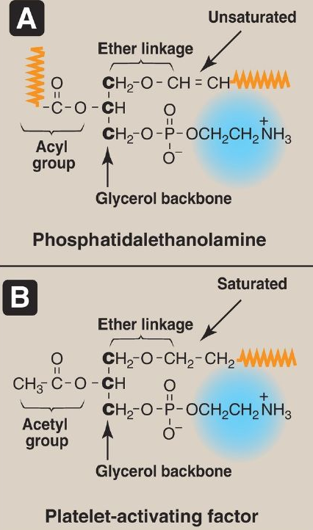
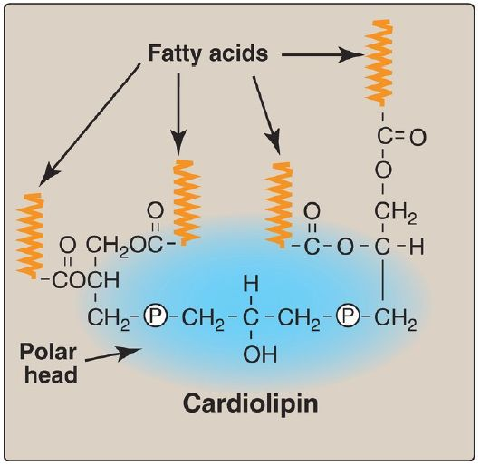
Structures of glycerophospholipids
Core Knowledge

Slide 15
Sphingophospholipids
Core Knowledge
Sphingomyelin
The backbone of sphingomyelin is the amino alcohol sphingosine, rather than glycerol
A long-chain fatty acid is attached to the amino group of sphingosine through an amide linkage, producing a ceramide, which can also serve as a precursor of glycolipids
The alcohol group at carbon 1 of sphingosine is esterified to phosphorylcholine, producing sphingomyelin, the only significant sphingophospholipid in humans
Sphingomyelin is an important constituent of the myelin sheath of nerve fibers
[Note: The myelin sheath is a layered, membranous structure that insulates and protects neuronal fibers of the central nervous system (CNS)]

Slide 16
Structure of sphingolipid (Sphingomyelin)
Core Knowledge

Slide 17
Synthesis of Glycerophospholipids
Core Knowledge

Slide 18
Synthesis of phosphatidylcholine from phosphatidylserine in the liver
Core Knowledge

Slide 19
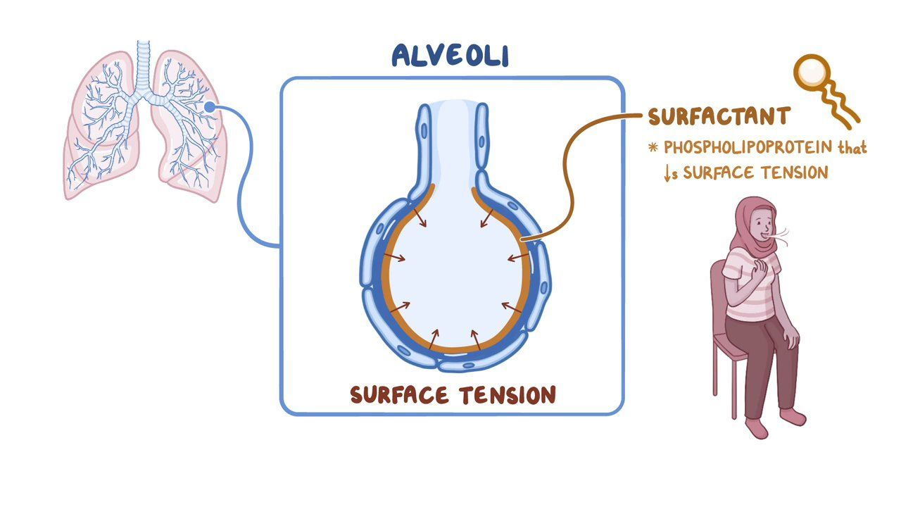
DPPC as lung surfactant
Core Knowledge

Slide 20
Structure of phosphatidylinositol 4,5-bisphosphate
Core Knowledge

Slide 21
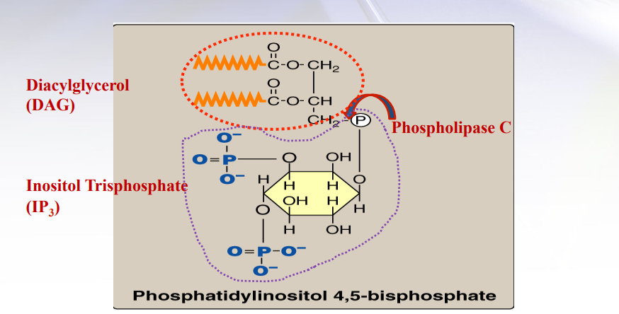
Structure of phosphatidylinositol 4,5-bisphosphate
Core Knowledge

Slide 22
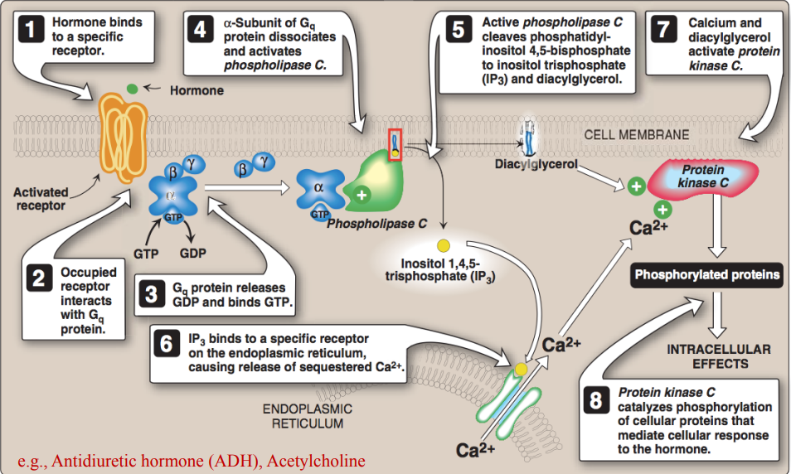
Role of inositol trisphosphate and diacylglycerol in intracellular signalling
Core Knowledge

Slide 23
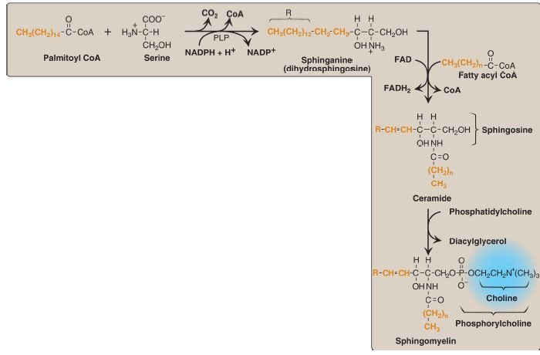
Synthesis of sphingomyelin
Core Knowledge

Slide 24
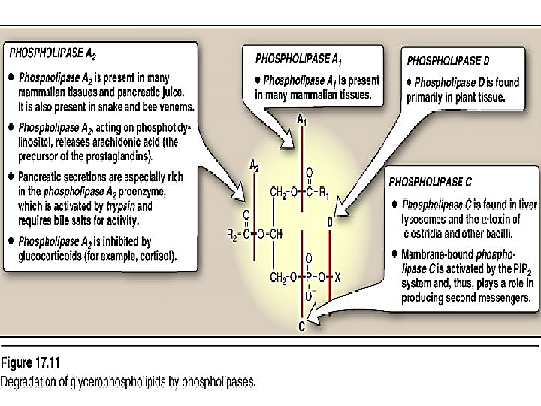
Glycerophospholipid degradation
Core Knowledge

Slide 25
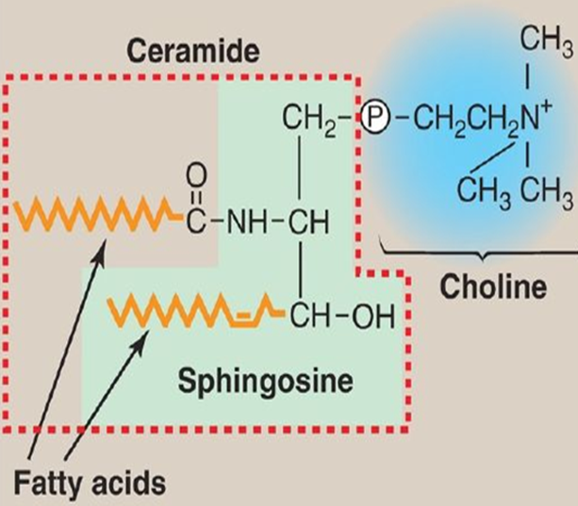
Sphingomyelin degradation
Core Knowledge
Sphingomyelinase

Slide 26
Anatomical and physiological aspects
Horizontal Integration

Slide 27
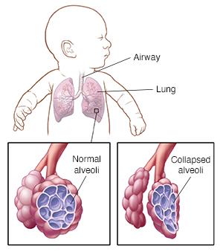
Clinical integration Respiratory distress syndrome (RDS)
Vertical Integration
RDS occurs in premature whose lungs are not fully developed. The earlier the infant is born, the more likely it is for them to have RDS and need extra oxygen and help breathing. RDS is caused by the baby not having enough surfactant in the lungs

Slide 28
Respiratory distress syndrome (RDS)
Vertical Integration
RDS in preterm infants is associated with insufficient surfactant production and/or secretion and is a significant cause of all neonatal deaths in Western countries
[Note: Surfactant is a complex mixture of lipids (90%) and proteins (10%), with DPPC being the major component for reducing surface tension]
Lung maturity of the fetus can be gauged by determining the ratio of DPPC to
sphingomyelin, usually written as the L (for lecithin)-to-S ratio, in amniotic
fluid. A value of two or above is evidence of maturity, because it reflects the
major shift from sphingomyelin to DPPC synthesis that occurs in the pneumocytes at about 32 weeks of gestation
[Note: Acute respiratory distress syndrome (ARDS), seen in all age groups, is the result of alveolar damage (due to infection, injury, or aspiration) that causes fluid to accumulate in the alveoli, impeding the exchange of oxygen and carbon dioxide]

Slide 29
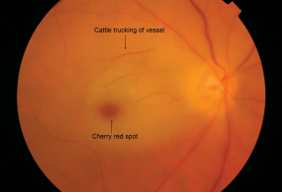
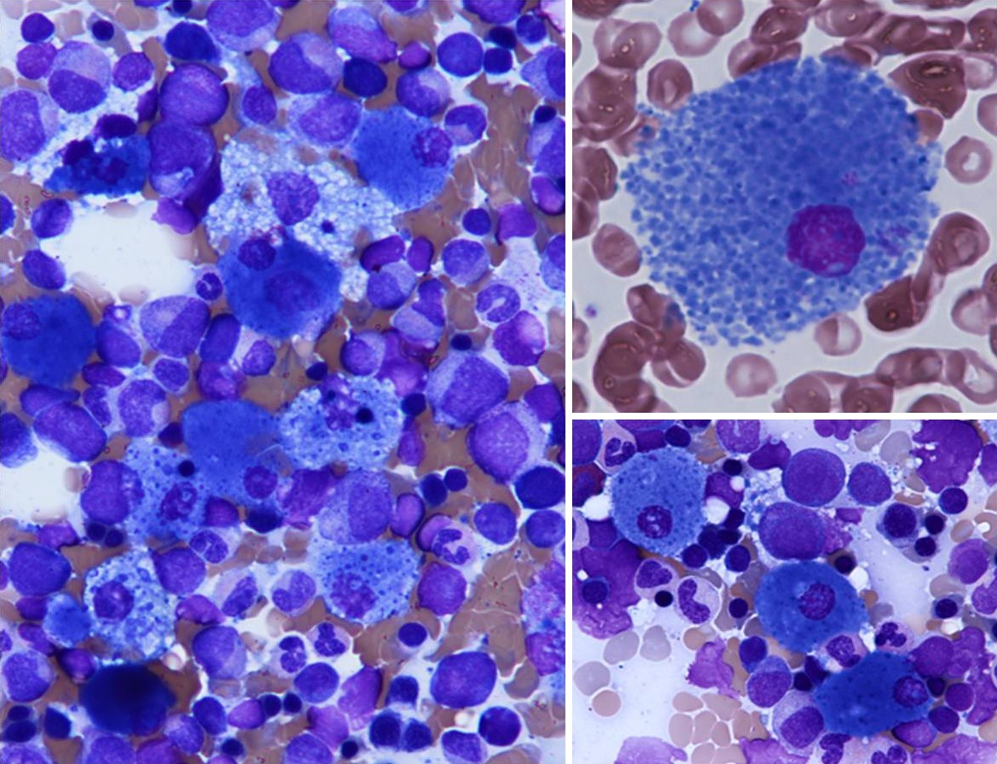
Niemann–Pick disease
Vertical Integration
Severe infantile form type A
a cherry-red spot in the macula of the eye develops due to lipid deposition
Less severe variant type B
little to no damage to neural tissue, but lungs, spleen, liver, and bone marrow are affected, resulting in a chronic form of the disease

Slide 30
Family Medicine
Family Medicine plays important role in following manner:
Diagnosis
Education
Dietary Guidance
Monitoring
Refer to Specialists
Notes:
Thickening of the superficial layer of the epithelium due to increased keratinization.
Destruction or atrophy of the finger-like projections on the dorsal surface of the tongue.
Increased proliferation of epithelial cells in response to the inflammatory process.
Invasion of fungal elements, such as hyphae and spores, within the superficial layers of the epithelium.

Slide 31
Spiral Integration
Bioethics
Ethical Considerations
From an ethical standpoint, the scenario raises considerations regarding patient autonomy, informed consent, and confidentiality
The physician must ensure that patient fully understands her diagnosis, treatment options, and potential implications
Discuss the necessity of a healthy lifestyle & treatment plan. This requires clear communication and understanding of risks and benefits.
Additionally, the physician must respect patient’s privacy and confidentiality throughout the diagnostic and treatment process

Slide 32
Spiral Integration
Artificial Intelligence
Role of AI in Management
AI can potentially aid in enhancing diagnostic accuracy and efficiency.
AI-powered decision support systems can also help clinicians in selecting appropriate treatment modalities
AI-driven predictive models may help anticipate the risk of complications of the Disease in susceptible populations

Slide 33
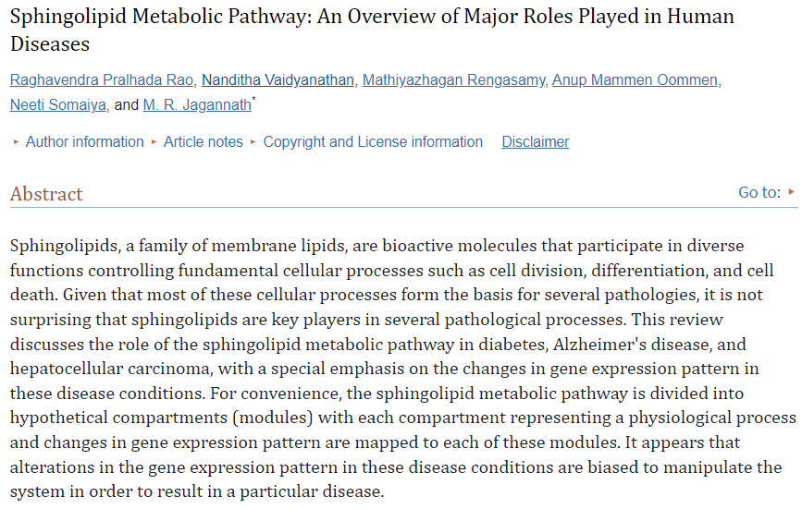
Suggested research articles
Spiral Integration
Research Article
https://doi.org/10.1155%2F2013%2F178910

Slide 34
How To Access Digital Library
Steps to Access HEC Digital Library
Go to the website of HEC National Digital Library
On Home Page, click on the INSTITUTES
A page will appear showing the universities from Public and Private Sector and other Institutes which have access to HEC National Digital Library HNDL
Select your desired Institute
A page will appear showing the resources of the institution
Journals and Researches will appear
You can find a Journal by clicking on JOURNALS AND DATABASE and enter a keyword to search for your desired journal

Slide 35
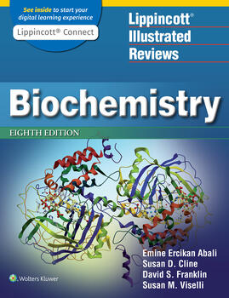
Learning Resources
Lippincott Illustrated Review,
Biochemistry, (Eighth edition,
chapter 17, Pages 201-208)
Related articles
Google images

Slide 36
Assessment
---
1. Which of the following is the backbone structure of glycerophospholipids?
a) Sphingosine
b) Glycerol*
c) Ceramide
d) Fatty acid
e) Inositol
2. Which enzyme is responsible for the hydrolysis of phosphatidylcholine to release arachidonic acid?
a) Phospholipase A1
b) Phospholipase A2
c) Phospholipase C
d) Phospholipase D
e) Sphingomyelinase

Slide 37
3. Sphingomyelin is classified as a:
a) Glycerophospholipid
b) Glycolipid
c) Sterol
d) Sphingolipid*
e) Triacylglycerol
4. Which of the following glycerophospholipids is the major component of pulmonary surfactant?
a) Phosphatidylinositol
b) Phosphatidylcholine*
c) Phosphatidylethanolamine
d) Phosphatidylserine
e) Phosphatidic acid

Slide 38
5. In the synthesis of sphingolipids, which molecule combines with serine to form sphinganine?
a) Acetyl-CoA
b) Malonyl-CoA
c) Palmitoyl-CoA*
d) Myristoyl-CoA
e) Succinyl-CoA
6. Which enzyme is deficient in Niemann-Pick disease, leading to the accumulation of sphingomyelin?
a) Hexosaminidase A
b) Sphingomyelinase*
c) Glucocerebrosidase
d) Galactosidase
e) Arylsulfatase A

Slide 39
7. The head group of phosphatidylinositol is derived from:
a) Glycerol
b) Serine
c) Inositol*
d) Choline
e) Ethanolamine
8. The major difference between glycerophospholipids and sphingolipids lies in their:
a) Fatty acid composition
b) Backbone structure*
c) Head group
d) Function
e) Cellular location

Slide 40
9. Which of the following is a common function of both glycerophospholipids and sphingolipids?
a) Energy storage
b) Hormone synthesis
c) Structural component of membranes*
d) Protein synthesis
e) Signal transduction
10. Which of the following is NOT a component of sphingolipids?
a) Sphingosine
b) Fatty acid
c) Phosphate
d) Glycerol
e) Polar head group

Slide 41
THANK YOU

