Slide 2
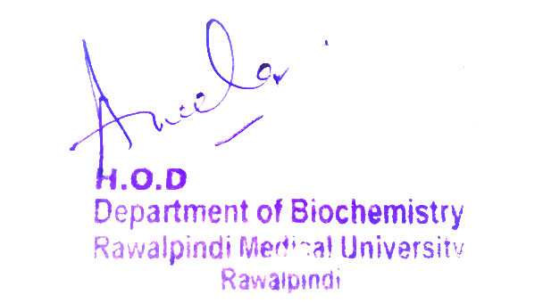
CNS Module 2nd Year MBBS(LGIS)
Presenter: Dr Uzma Zafar Date: 01-02-25
Dept of Biochemistry
RMU

Slide 3
Motto, Vision, Dream
To impart evidence based research oriented medical education
To provide best possible patient care
To inculcate the values of mutual respect and ethical practice of medicine
Wisdom
Truth
Service

Slide 4
Professor Umar Model of Integrated Lecture

Slide 5
Learning Objectives
At the end of this session students should be able to
Understand metabolism of HDL and LDL
Understand biochemical aspects of fatty liver
Integrate anatomical and physiological aspects
Associated clinicopathological conditions

Slide 6
Core Knowledge
Metabolism of low-density lipoproteins (LDL)
LDL particles contain much less TAG than their VLDL predecessors and have a high concentration of cholesterol and cholesteryl esters
Receptor-mediated endocytosis: The primary function of LDL particles is to provide cholesterol to the peripheral tissues (or return it to the liver). They do so by binding to cell surface membrane LDL receptors that recognize apo B-100
A similar mechanism of receptor-mediated endocytosis is used for the cellular uptake and degradation of chylomicron remnants and IDLs by the liver

Slide 7
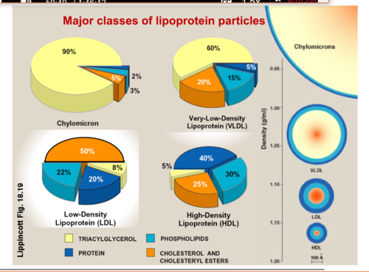
Core Knowledge
Composition of the plasma lipoproteins

Slide 8
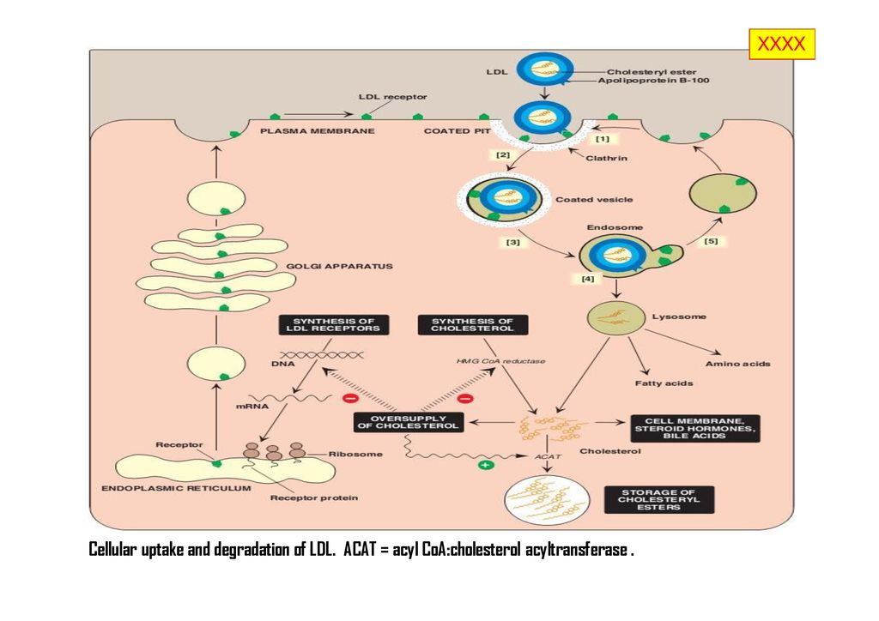
Core Knowledge
Cellular uptake and degradation of LDL

Slide 9
Core Knowledge
Effect of endocytosed cholesterol on cellular cholesterol homeostasis
The chylomicron remnant-, IDL-, and LDL-derived cholesterol affects cellular cholesterol content in several. First, expression of the gene for HMG CoA reductase is inhibited by high cholesterol, as a result of which, de novo cholesterol synthesis decreases. Additionally, degradation of the reductase is accelerated Second, synthesis of new LDL receptor protein is reduced by decreasing the expression of the LDL receptor gene, thus limiting further entry of LDL cholesterol into cells. [Note: Regulation of the LDL receptor gene involves a SRE and SREBP-2, as was seen in the regulation of the gene for HMG CoA reductase This allows coordinate regulation of the expression of these proteins]

Slide 10
Core Knowledge
Synthesis of intracellular cholesteryl ester by ACAT

Slide 11
Core Knowledge
Uptake of chemically modified LDL by macrophage scavenger receptors:
In addition to the highly specific and regulated receptor-mediated pathway for LDL uptake described above, macrophages possess high levels of scavenger receptor activity. These receptors, known as scavenger receptor class A (SR-A), can bind a broad range of ligands and mediate the endocytosis of chemically modified LDL in which the lipid components or apo B have been oxidized. Unlike the LDL receptor, the scavenger receptor is not downregulated in response to increased intracellular cholesterol
Cholesteryl esters accumulate in macrophages and cause their transformation into “foam” cells, which participate in the formation of atherosclerotic plaque

Slide 12
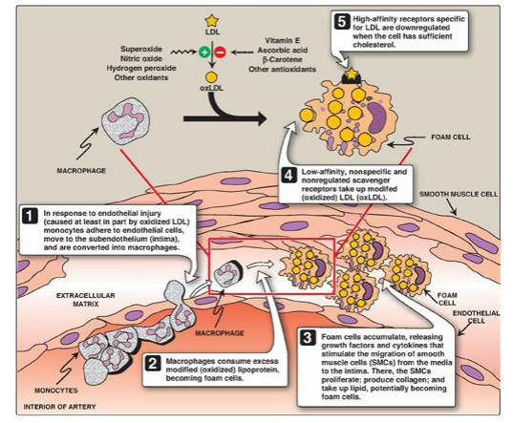
Core Knowledge
Role of oxidized lipoproteins in plaque formation in an arterial wall

Slide 13
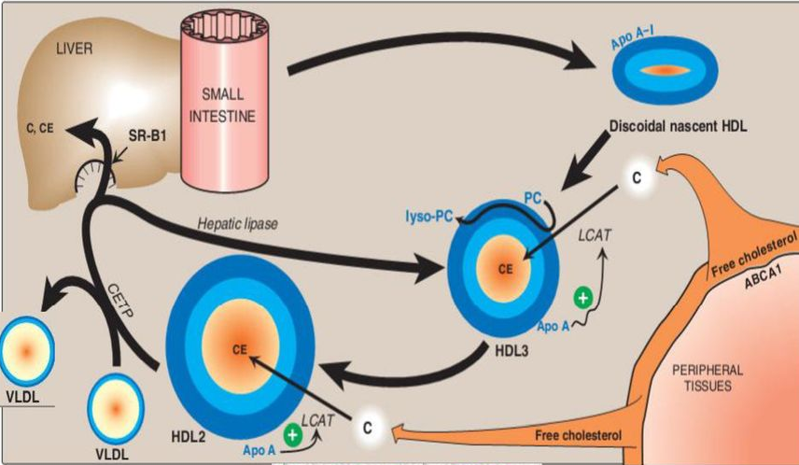
Core Knowledge
Metabolism of HDL particles
Apo- E Apo -CII
FA

Slide 14
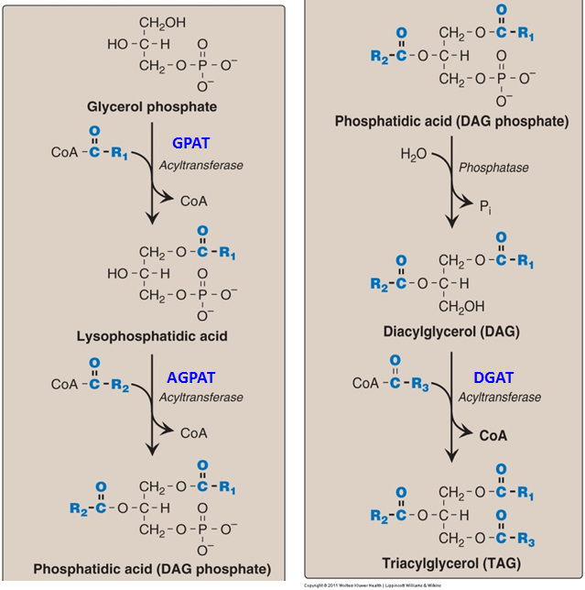
Synthesis of TAG
Core Knowledge

Slide 15
Core Knowledge
Metabolism of high-density lipoproteins
HDLs comprise a heterogeneous family of lipoproteins with a complex metabolism that is not yet completely understood. HDL particles are formed in blood by the addition of lipid to apo A-1, an apolipoprotein made by the liver and intestine and secreted into blood
Apo A-1 accounts for about 70% of the apolipoproteins in HDL
HDLs perform a number of important functions, including the following
Apolipoprotein supply: HDL particles serve as a circulating reservoir of apo C-II (the apolipoprotein that is transferred to VLDL and chylomicrons and is an activator o f LPL) and apo E (the apolipoprotein required for the receptor-mediated endocytosis of IDLs and chylomicron remnants)

Slide 16
Core Knowledge
Reverse cholesterol transport
The selective transfer of cholesterol from peripheral cells to HDL, from HDL to the liver for bile acid synthesis or disposal via the bile, and to steroidogenic cells for hormone synthesis, is a key component of cholesterol homeostasis
Reverse cholesterol transport involves efflux of cholesterol from peripheral cells to HDL, esterification of the cholesterol by LCAT, binding of the cholesteryl ester–rich HDL (HDL2) to liver (and steroidogenic cells), the selective transfer of the cholesteryl esters into these cells, and the release of lipid-depleted HDL (HDL3)
The efflux of cholesterol from peripheral cells is mediated, at least in part, by the transport protein ABCA1

Slide 17
Reverse cholesterol transport
Core Knowledge
Apo- E Apo -CII
FA

Slide 18
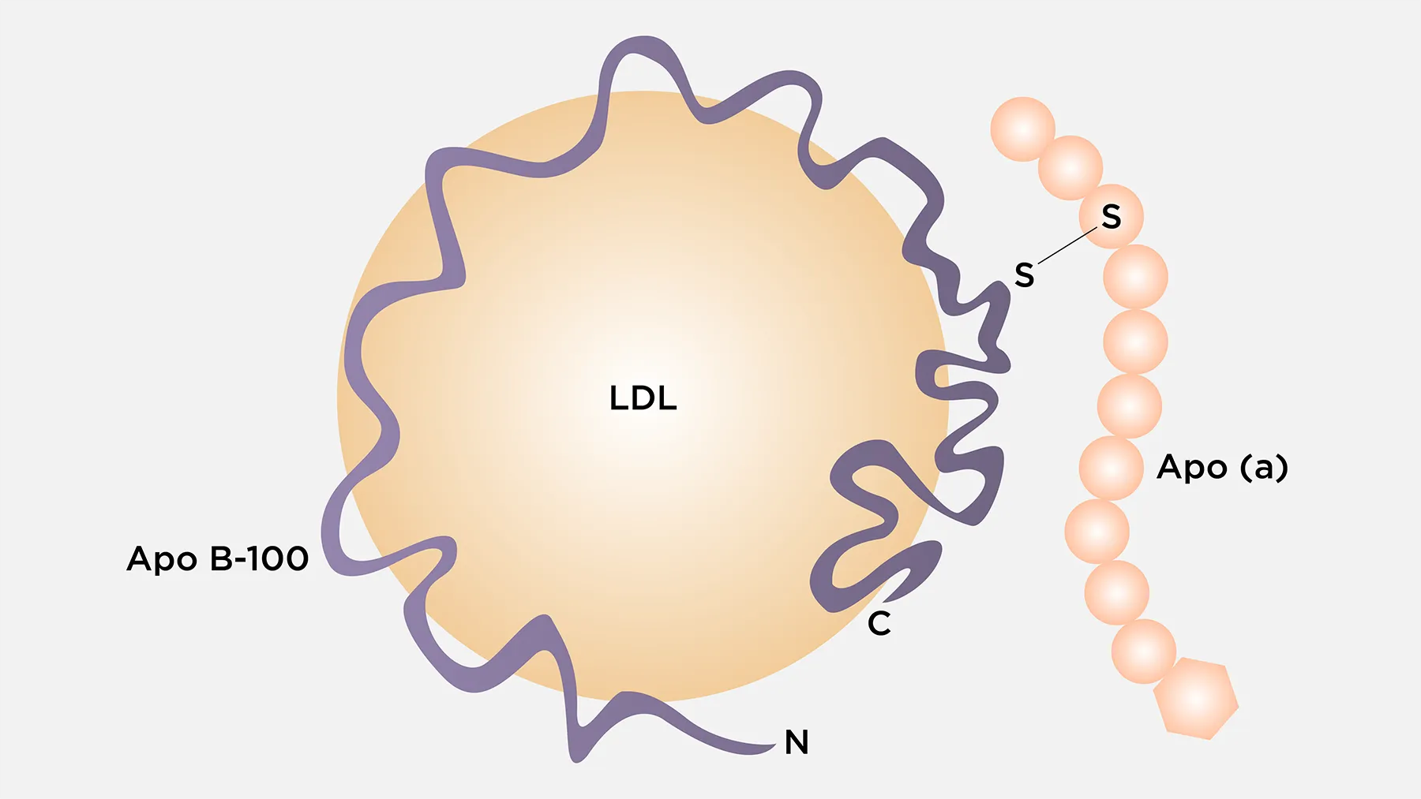
Core Knowledge
Lipoprotein (a)
Is a LDL variant containing a protein called apolipoprotein (a) Lp (a) is nearly identical in structure to an LDL particle
Its distinguishing feature is the presence of an additional apolipoprotein molecule, apo (a), that is covalently linked at a single site to apo B-100

Slide 19
Anatomical and physiological aspects of cholesterol
Horizontal Integration

Slide 20
Horizontal Integration
HDL function
HDL cholesterol, sometimes called “good” cholesterol, absorbs cholesterol in the blood and carries it back to the liver

Slide 21
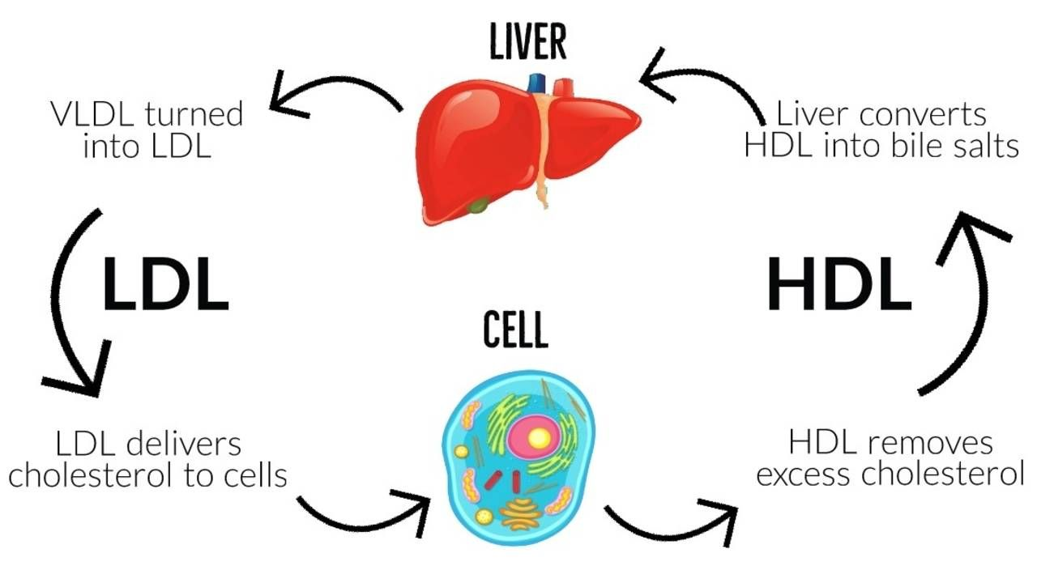
Horizontal Integration
LDL function
LDL cholesterol, sometimes called “bad” cholesterol, it is responsible for carrying cholesterol to peripheral tissue

Slide 22
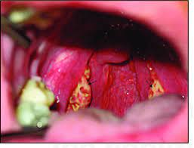
Vertical Integration
Tangier disease
Rare deficiency of ABCA1
Inherited disorder characterized by significantly reduced levels of HDL in the blood
Characterized by enlarged orange- or yellow-colored tonsils. This discoloration is due to fatty deposits accumulating in the tonsils. Fatty deposits can also form in other organs causing enlargement of the throat, liver, spleen, or lymph nodes

Slide 23
Fatty liver

Slide 24
Types of fatty liver
Core Knowledge
Alcoholic fatty liver
Non- alcoholic fatty liver

Slide 25
Causes of fatty liver
Core Knowledge
Increase synthesis of TAG
Decrease utilization of fats
Decrease removal of fats
High fat diet
Starvation
Diabetes
Chronic ethanol consumption
Impaired VLDL synthesis

Slide 26
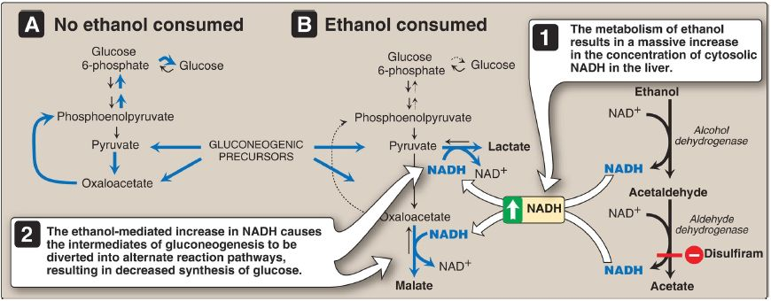
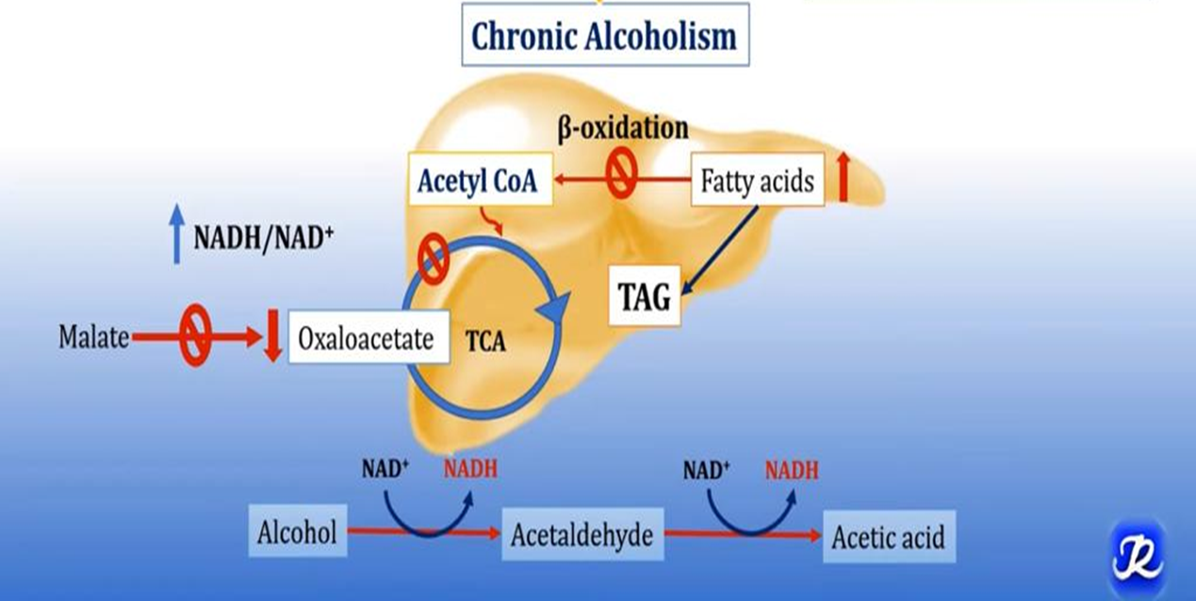
Core Knowledge
Chronic alcoholism leads to fatty liver

Slide 27
Fatty liver
Core Knowledge

Slide 28
Fatty liver
Core Knowledge

Slide 29
Fatty liver
Core Knowledge
In each reaction, electrons are transferred to oxidized NAD+, resulting in an increase in the concentration of cytosolic NADH
The abundance of NADH favours the reduction of pyruvate to lactate and of oxaloacetate (OAA) to malate, that pyruvate and OAA are intermediates in the synthesis of glucose
Thus, the ethanol-mediated increase in NADH causes these intermediates of gluconeogenesis to be diverted into alternate pathways, resulting in the decreased synthesis of glucose
Chronic alcohol consumption can also result in alcoholic fatty liver due to increased hepatic synthesis of TAGs coupled with impaired formation or release of VLDLs. This occurs as a result of decreased fatty acid oxidation due to a fall in the NAD+/NADH ratio and increased lipogenesis due to the increased availability of fatty acids (decreased catabolism) and of glyceraldehyde 3-phosphate (the dehydrogenase is inhibited by the low NAD+/NADH ratio). With continued alcohol consumption, alcoholic fatty liver can progress first to alcoholic hepatitis and then to alcoholic cirrhosis

Slide 30
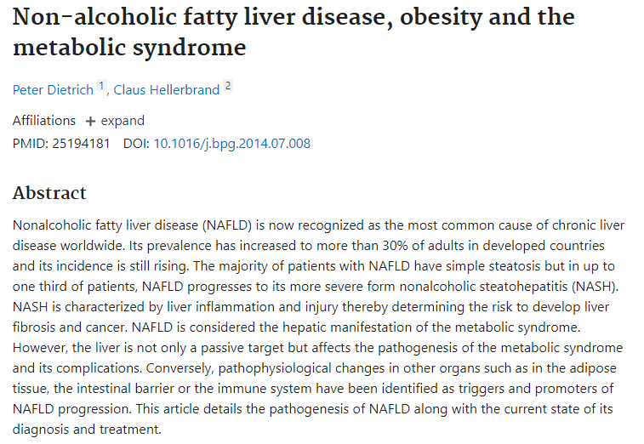
Suggested research articles
Spiral Integration
https://doi.org/10.1016/j.bpg.2014.07.008

Slide 31
Family Medicine
Spiral Integration
Diagnosis
Family Medicine plays important role in following manner:
Education & Counselling
Dietary Guidance
Monitoring
Refer to Specialists

Slide 32
Spiral Integration
Bioethics
Ethical Considerations
From an ethical standpoint, the scenario raises considerations regarding patient autonomy, informed consent, and confidentiality
The physician must ensure that patient fully understands her diagnosis, treatment options, and potential implications
Discuss the necessity of a healthy lifestyle & treatment plan. This requires clear communication and understanding of risks and benefits.
Additionally, the physician must respect patient’s privacy and confidentiality throughout the diagnostic and treatment process

Slide 33
Spiral Integration
Artificial Intelligence
Role of AI in Management
AI can potentially aid in enhancing diagnostic accuracy and efficiency.
AI-powered decision support systems can also help clinicians in selecting appropriate treatment modalities
AI-driven predictive models may help anticipate the risk of complications of the Disease in susceptible populations

Slide 34
How To Access Digital Library
Steps to Access HEC Digital Library
Go to the website of HEC National Digital Library
On Home Page, click on the INSTITUTES
A page will appear showing the universities from Public and Private Sector and other Institutes which have access to HEC National Digital Library HNDL
Select your desired Institute
A page will appear showing the resources of the institution
Journals and Researches will appear
You can find a Journal by clicking on JOURNALS AND DATABASE and enter a keyword to search for your desired journal

Slide 35
Learning Resources
Lippincott Illustrated Reviews 8th Edition, Chap , pages -
Harper’s Illustrated Biochemistry 32nd Edition, Chap , pages –
Google images

Slide 36
THANK YOU

