Slide 2
CNS Module 2nd Year MBBS(SGD) Ketone Bodies
Presenter: Dr Uzma Zafar Date: 01-02-25
Dept of Biochemistry
RMU

Slide 3
Motto, Vision, Dream
To impart evidence based research oriented medical education
To provide best possible patient care
To inculcate the values of mutual respect and ethical practice of medicine
Wisdom
Truth
Service

Slide 4
Professor Umar Model of Integrated Lecture

Slide 5
Learning Objectives
At the end of this session, students will be able to:
Describe ketone body synthesis by the liver: Ketogenesis
Explain the steps of ketone body synthesis
Elaborate the ketone body use by the peripheral tissues: Ketolysis
Study the mechanism of diabetic ketoacidosis

Slide 6
Core Knowledge
Ketone Bodies Metabolism
Ketone body synthesis by the liver: ketogenesis
During a fast, the liver is flooded with fatty acids mobilized from adipose tissue.
The resulting elevated hepatic acetyl CoA produced by fatty acid oxidation inhibits pyruvate dehydrogenase and activates pyruvate carboxylase (PC).
The OAA produced by PC is used by the liver for gluconeogenesis rather than for the TCA cycle.

Slide 7
Core Knowledge
Ketone Body Metabolism
Ketone body synthesis by the liver: ketogenesis
4) Additionally, fatty acid oxidation decreases the NAD+ /NADH ratio, and the rise in NADH shifts OAA to malate.
5) The decreased availability of OAA for condensation with acetyl CoA results in the increased use of acetyl CoA for ketone body synthesis
12

Slide 8
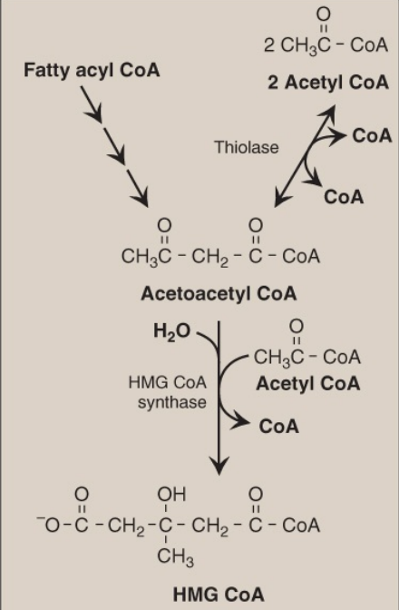
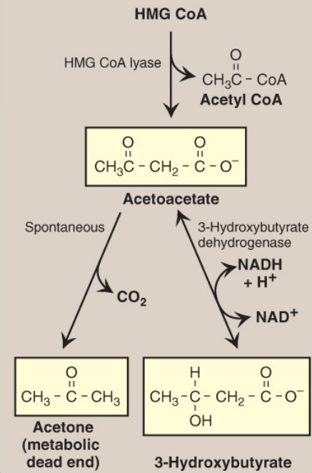
Core Knowledge
Ketogenesis
Synthesis of HMG CoA
Synthesis Of Ketone Bodies
13

Slide 9
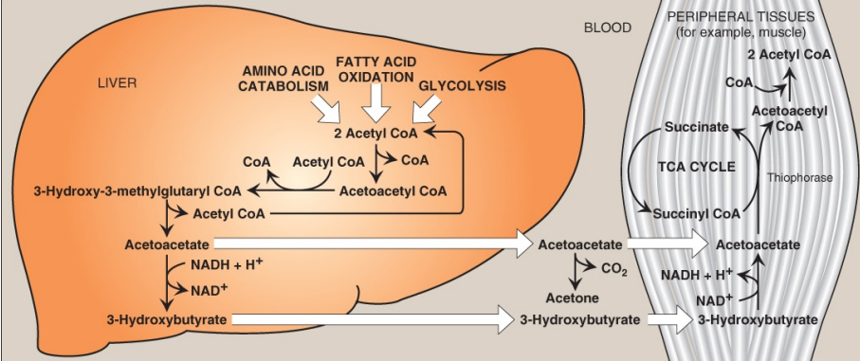
Core Knowledge
Ketogenesis
Ketone body synthesis in the liver and use in peripheral tissues
14

Slide 10
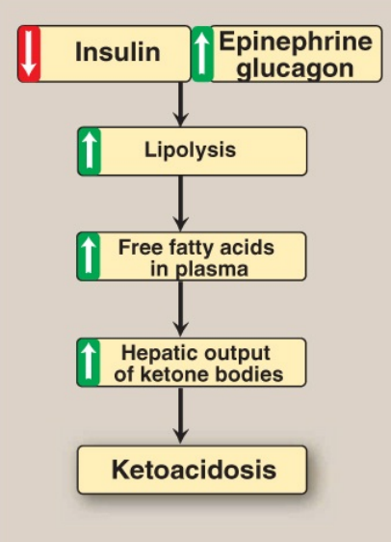
Core Knowledge
Mechanism of diabetic ketoacidosis seen in uncontrolled type 1 diabetes.
15

Slide 11
Core Knowledge
Mechanism of diabetic ketoacidosis seen in uncontrolled type 1 diabetes
The elevation of the ketone body concentration in the blood can result in acidemia
The carboxyl group of a ketone body has a pKa of 4. Therefore, each ketone body loses a proton [H+ ] as it circulates in the blood, which lowers the pH.
Also, in uncontrolled T1D, urinary loss of glucose and ketone bodies results in dehydration.
Therefore, the increased number of H+ circulating in a decreased volume of plasma can cause a severe acidosis known as diabetic ketoacidosis [DKA].)
16

Slide 12
Vertical Integration
17

Slide 13
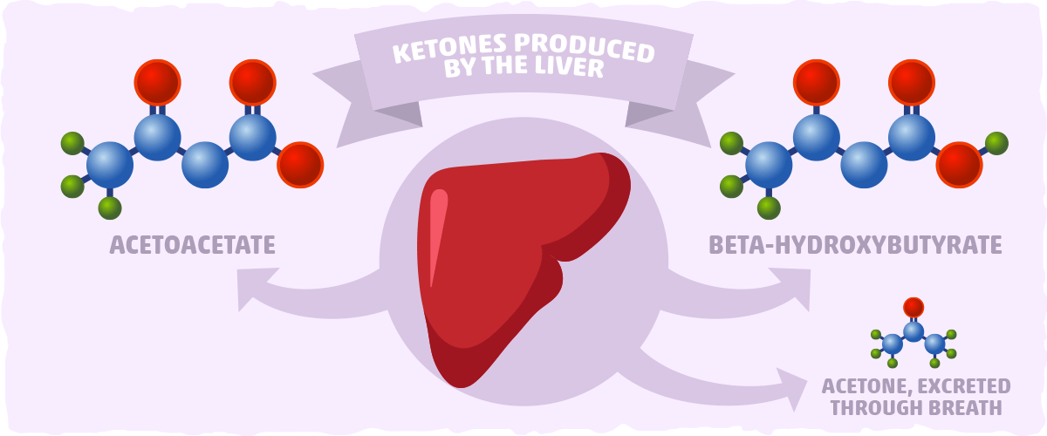
Horizontal Integration
Ketone Bodies
3

Slide 14
Horizontal Integration
Horizontal Integration

Slide 15
Horizontal Integration
Functions of Ketone bodies
Ketone bodies are important sources of energy for the peripheral tissues because
They are soluble in aqueous solution and, therefore, do not need to be incorporated into lipoproteins or carried by albumin as do the other lipids
They are produced in the liver during periods when the amount of acetyl CoA present exceeds the oxidative capacity of the liver;
They are used in proportion to their concentration in the blood by extrahepatic tissues, such as skeletal and cardiac muscle, the intestinal mucosa, and the renal cortex. Even the brain can use ketone bodies to help meet its energy needs.

Slide 16
Vertical Integration
17

Slide 17
Spiral Integration
Family Medicine
Family Medicine plays important role in following manner:
Diagnosis
Education & Counselling
Dietary Guidance
Monitoring
Refer to Specialists

Slide 18
Spiral Integration
Bioethics
Ethical Considerations
From an ethical standpoint, the scenario raises considerations regarding patient autonomy, informed consent, and confidentiality
The physician must ensure that patient fully understands her diagnosis, treatment options, and potential implications
Discuss the necessity of a healthy lifestyle & treatment plan. This requires clear communication and understanding of risks and benefits.
Additionally, the physician must respect patient’s privacy and confidentiality throughout the diagnostic and treatment process

Slide 19
Spiral Integration
Artificial Intelligence
Role of AI in Management
AI can potentially aid in enhancing diagnostic accuracy and efficiency.
AI-powered decision support systems can also help clinicians in selecting appropriate treatment modalities
AI-driven predictive models may help anticipate the risk of complications of the Disease in susceptible populations

Slide 20
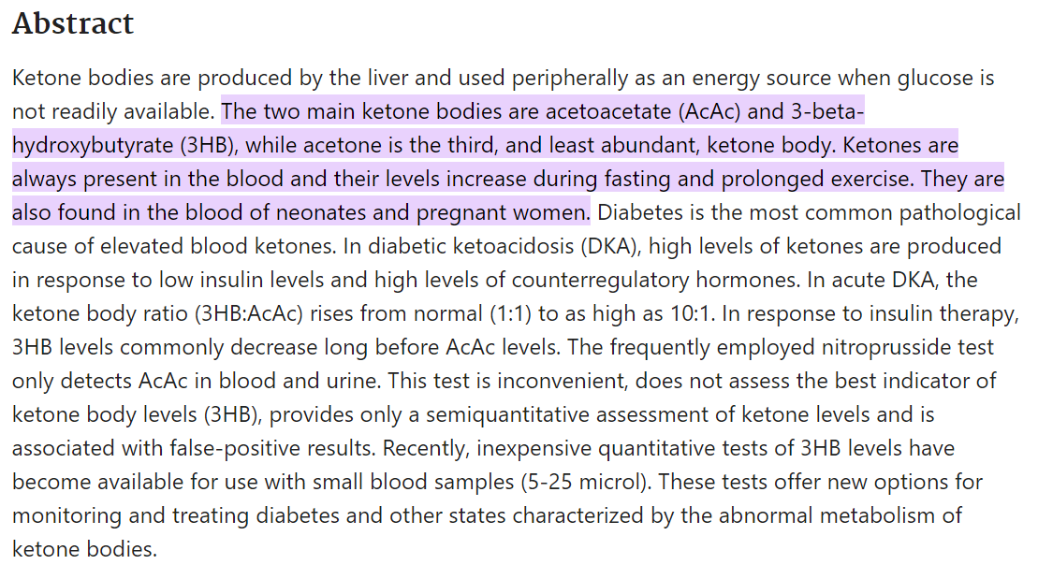
Spiral Integration
Research Article
https://pubmed.ncbi.nlm.nih.gov/10634967/#:~:text=The%20two%20main%20ketone%20bodies,of%20neonates%20and%20pregnant%20women.

Slide 21
How To Access Digital Library
Steps to Access HEC Digital Library
Go to the website of HEC National Digital Library
On Home Page, click on the INSTITUTES
A page will appear showing the universities from Public and Private Sector and other Institutes which have access to HEC National Digital Library HNDL
Select your desired Institute
A page will appear showing the resources of the institution
Journals and Researches will appear
You can find a Journal by clicking on JOURNALS AND DATABASE and enter a keyword to search for your desired journal

Slide 22
Learning Resources
Lippincott Illustrated Reviews 8th Edition
Harper’s Illustrated Biochemistry 32nd Edition
Google images

Slide 23
THANK YOU

