Slide 2
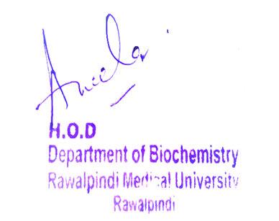
CNS Module 2nd Year MBBS(Metabolism of Chylomicron&VLDL
Presenter: Dr Uzma Zafar Date: 01-02-25
Dept of Biochemistry
RMU

Slide 3
Motto, Vision, Dream
To impart evidence based research oriented medical education
To provide best possible patient care
To inculcate the values of mutual respect and ethical practice of medicine
Wisdom
Truth
Service

Slide 4
Professor Umar Model of Integrated Lecture

Slide 5
Learning Objectives
At the end of this session students should be able to
Explain chylomicrons and VLDL metabolism
Describe its disorders

Slide 6
Core Knowledge
Re esterification of dietary lipids in the intestine

Slide 7
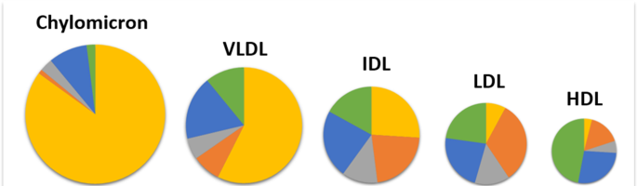
Plasma lipoproteins
Core Knowledge
The plasma lipoproteins are spherical macromolecular complexes of lipids and proteins (apolipoproteins)
Chylomicrons
VLDL
IDL
LDLs
HDLs
Lp [a]

Slide 8
Plasma lipoproteins
Core Knowledge
The plasma lipoproteins are spherical macromolecular complexes of lipids and proteins (apolipoproteins). The lipoprotein particles include chylomicrons, chylomicron remnants, very–low-density lipoproteins (VLDLs), VLDL remnants, also known as intermediate density lipoproteins (IDLs), low-density lipoproteins (LDLs), high-density lipoproteins (HDLs) and lipoprotein (a) (Lp [a])
They differ in lipid and protein composition, size, density, and site of origin. (Note: Because lipoprotein particles constantly interchange lipids and apolipoproteins, the actual apolipoprotein and lipid content of each class of particles is somewhat variable)
Lipoproteins function both to keep their component lipids soluble as they transport them in the plasma and to provide an efficient mechanism for transporting their lipid contents to (and from) the tissues
In humans, there is a gradual deposition of lipid (especially cholesterol) in tissues

Slide 9
Core Knowledge
Size and
density of
serum
lipoproteins

Slide 10
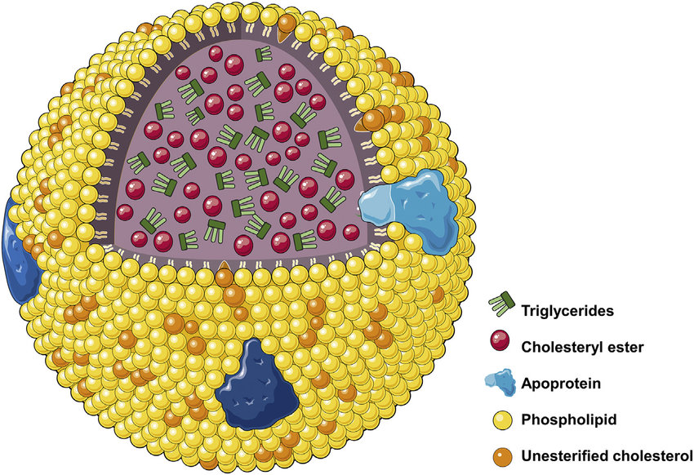
Chylomicron
Core Knowledge

Slide 11
Composition
Core Knowledge
Lipoproteins are composed of a neutral lipid core (containing TAG and cholesteryl esters) surrounded by a shell of amphipathic apolipoproteins, phospholipid, and nonesterified (free) cholesterol
These amphipathic compounds are oriented such that their polar portions are exposed on the surface of the lipoprotein, thereby rendering the particle soluble in aqueous solution
The TAG and cholesterol carried by the lipoproteins are obtained either from the diet (exogenous source) or from de novo synthesis (endogenous source). (Note: The cholesterol [C] content of plasma lipoproteins is now routinely measured in fasting blood

Slide 12
Core Knowledge
Size and density: Chylomicrons are the lipoprotein particles lowest in density and largest in size and that contain the highest percentage of lipid (as TAG) and the lowest percentage of protein
VLDLs and LDLs are successively denser, having higher ratios of protein to lipid
HDL particles are the smallest and densest
Apolipoproteins: The apolipoproteins associated with lipoprotein particles have a number of diverse functions

Slide 13
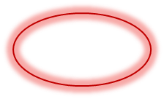
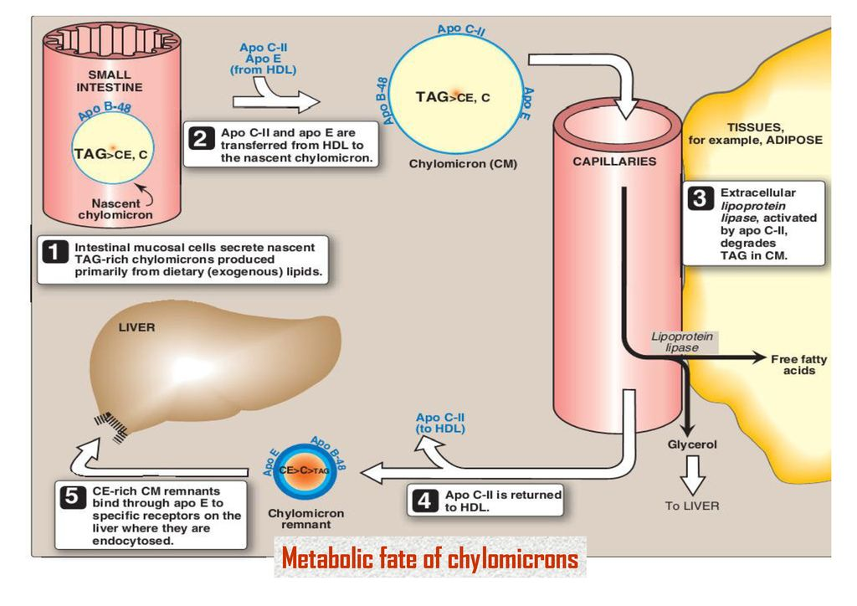
Core Knowledge

Slide 14
Core Knowledge
Chylomicron metabolism
Chylomicrons are assembled in intestinal mucosal cells and carry dietary (exogenous) TAG, cholesterol, fat-soluble vitamins, and cholesteryl esters to the peripheral tissues (Note: TAGs account for close to 90% of the lipids in a chylomicron.)
Apolipoprotein synthesis: Apo B-48 is unique to chylomicrons. Its synthesis begins on the rough ER (RER), and it is glycosylated as it moves through the RER and Golgi. (Note: Apo B-48 is so named because it constitutes the N-terminal 48% of the protein encoded by the gene for apo B.
Apo B-100, which is synthesized by the liver and found in VLDL and LDL, represents the entire protein encoded by this gene. Posttranscriptional editing of a cytosine to a uracil in intestinal apo B-100 messenger RNA [mRNA] creates a nonsense [stop] codon, allowing translation of only 48% of the mRNA)
Chylomicron assembly: Many enzymes involved in TAG, cholesterol, and phospholipid synthesis are located in the SER. Assembly of the apolipoprotein and lipid into chylomicrons requires microsomal triglyceride transfer protein (MTP), which loads apo B-48 with lipid. This occurs before transition from the ER to the Golgi, where the particles are packaged in secretory vesicles. These fuse with the plasma membrane releasing the lipoproteins, which then enter the lymphatic system and, ultimately, the blood. (Note: Chylomicrons leave the lymphatic system via the thoracic duct that empties into the left subclavian vein)

Slide 15
Core Knowledge
Metabolism of very-low-density lipoproteins
VLDLs are produced in the liver. They are composed predominantly of endogenous TAG (approximately 60%), and their function is to carry this lipid from the liver (site of synthesis) to the peripheral tissues
There, the TAG is degraded by LPL, as discussed for chylomicrons
[Note: Non-alcoholic “fatty liver” (hepatic steatosis) occurs in conditions in which there is an imbalance between hepatic TAG synthesis and the secretion of VLDL Such conditions include obesity and type 2 diabetes mellitus]

Slide 16
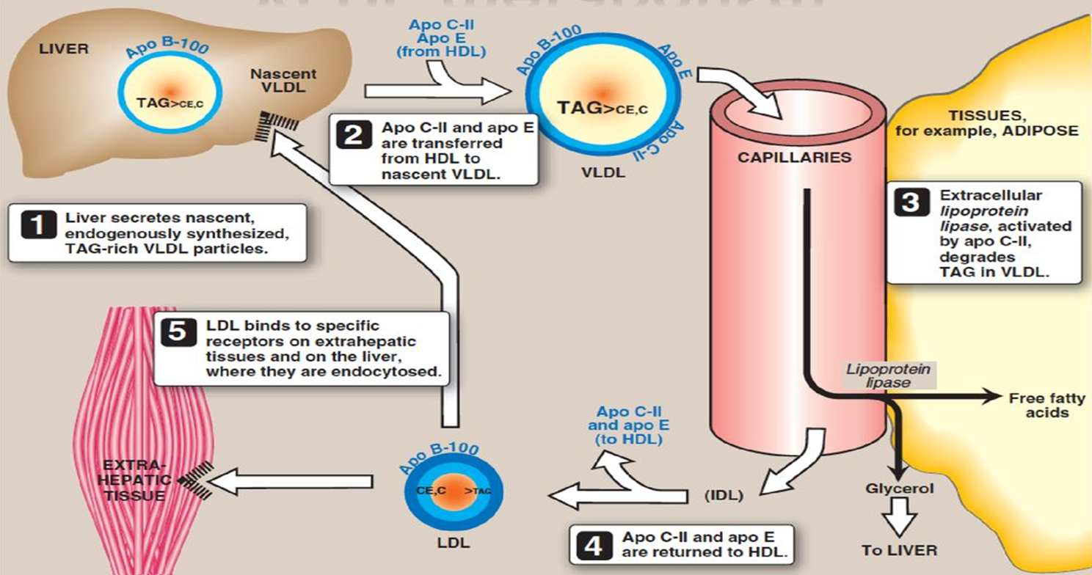
Core Knowledge
Metabolism of very-low-density lipoprotein (VLDL)

Slide 17
Transfer of cholesteryl ester (CE) from HDL to VLDL in exchange for triacylglycerol (TAG)
Core Knowledge
CETP

Slide 18
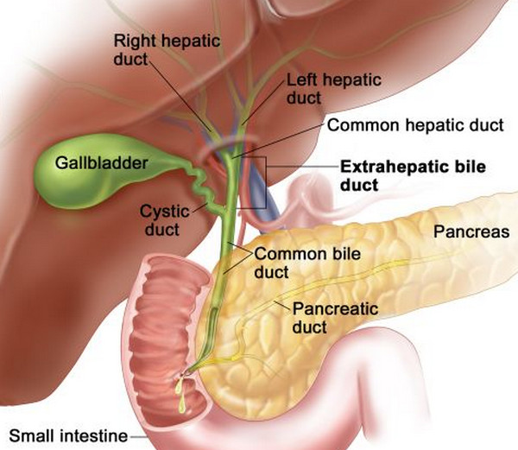
Horizontal Integration
Physiological and
anatomical aspect

Slide 19
Horizontal Integration
Physiological and anatomical aspect
Functions of bile salts

Slide 20
Cholelithiasis
Vertical Integration
The movement of cholesterol from the liver into the bile must be accompanied by the simultaneous secretion of phospholipid and bile salts
If this dual process is disrupted and more cholesterol is present than can be solubilized by the bile salts and PC present, the cholesterol may precipitate in the gallbladder, leading to cholesterol gallstone disease or cholelithiasis

Slide 21
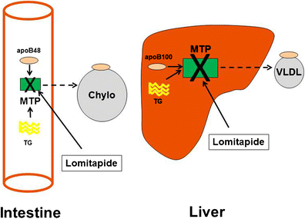
Core Knowledge
Disorders of Plasma Lipoproteins
Abetalipoproteinemia
(Rare hypolipoproteinaemia) Assembly of the apolipoprotein and lipid into chylomicrons requires (MTP), which loads apo B-48, apo B-100 with lipid

Slide 22
Core Knowledge
Cont:
(Note: Abetalipoproteinemia is a rare hypolipoproteinemia caused by a defect in MTP, leading to an inability to load apo B with lipid consequently,
Few VLDLs or chylomicrons are formed
TAG accumulates in the liver and intestine
Absorption of fat-soluble vitamins is decreased

Slide 23
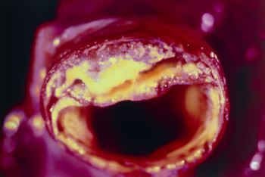
Core Knowledge
Familial dysbetalipoproteinemia or broad beta disease
Apo E-2 binds poorly to receptors, and patients who are homozygotic for apo E-2 are deficient in the clearance of IDL and chylomicron remnants. These individuals have familial type III hyperlipoproteinemia, with hypercholesterolemia and atherosclerosis

Slide 24
Type I hyperlipoproteinemia
Core Knowledge
Patients with a deficiency of LPL or apo C-II show a dramatic accumulation [≥1,000 mg/dl] of chylomicron-TAG in the plasma even in the fasted state. They are at increased risk for acute pancreatitis. Treatment is the
reduction of dietary fat
Large TG-rich lipoprotein particles, primarily chylomicrons, impede capillary circulation and cause ischemic damage to pancreatic acinar cells

Slide 25
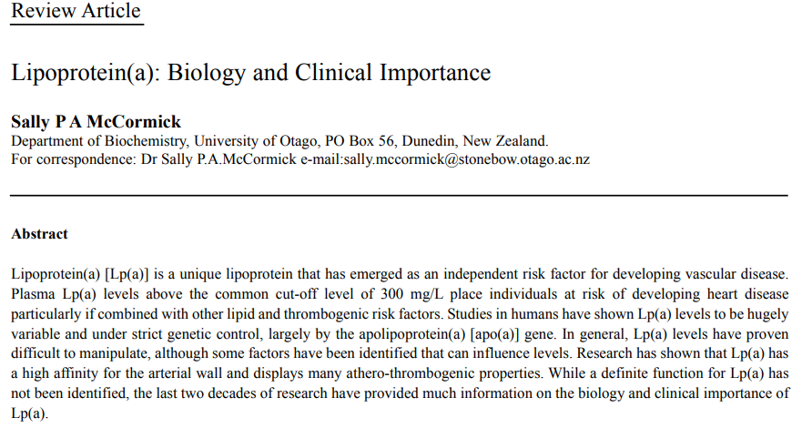
Suggested research articles
Spiral Integration
https://www.ncbi.nlm.nih.gov/pmc/articles/PMC1853362/

Slide 26
How To Access Digital Library
Steps to Access HEC Digital Library
Go to the website of HEC National Digital Library
On Home Page, click on the INSTITUTES
A page will appear showing the universities from Public and Private Sector and other Institutes which have access to HEC National Digital Library HNDL
Select your desired Institute
A page will appear showing the resources of the institution
Journals and Researches will appear
You can find a Journal by clicking on JOURNALS AND DATABASE and enter a keyword to search for your desired journal

Slide 27
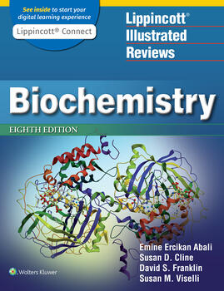
Learning resources
Lippincott Illustrated Review,
Biochemistry, (Eighth edition,
chapter 18, Pages 224-231)
Related articles
Google images

Slide 28
Family Medicine
Spiral Integration
Diagnosis
Family Medicine plays important role in following manner:
Education & Counselling
Dietary Guidance
Monitoring
Refer to Specialists

Slide 29
How To Access Digital Library
Steps to Access HEC Digital Library
Go to the website of HEC National Digital Library
On Home Page, click on the INSTITUTES
A page will appear showing the universities from Public and Private Sector and other Institutes which have access to HEC National Digital Library HNDL
Select your desired Institute
A page will appear showing the resources of the institution
Journals and Researches will appear
You can find a Journal by clicking on JOURNALS AND DATABASE and enter a keyword to search for your desired journal

Slide 30
Learning resources
Lippincott Illustrated Review,
Biochemistry, (Eighth edition,
chapter 18, Pages 224-231)
Related articles
Google images

Slide 31
How To Access Digital Library
Steps to Access HEC Digital Library
Go to the website of HEC National Digital Library
On Home Page, click on the INSTITUTES
A page will appear showing the universities from Public and Private Sector and other Institutes which have access to HEC National Digital Library HNDL
Select your desired Institute
A page will appear showing the resources of the institution
Journals and Researches will appear
You can find a Journal by clicking on JOURNALS AND DATABASE and enter a keyword to search for your desired journal

Slide 32
Learning resources
Lippincott Illustrated Review,
Biochemistry, (Eighth edition,
chapter 18, Pages 224-231)
Related articles
Google images

Slide 33
Spiral Integration
Bioethics
Ethical Considerations
From an ethical standpoint, the scenario raises considerations regarding patient autonomy, informed consent, and confidentiality
The physician must ensure that patient fully understands her diagnosis, treatment options, and potential implications
Discuss the necessity of a healthy lifestyle & treatment plan. This requires clear communication and understanding of risks and benefits.
Additionally, the physician must respect patient’s privacy and confidentiality throughout the diagnostic and treatment process

Slide 34
Spiral Integration
Artificial Intelligence
Role of AI in (The Disease) Management
AI can potentially aid in enhancing diagnostic accuracy and efficiency.
AI-powered decision support systems can also help clinicians in selecting appropriate treatment modalities
AI-driven predictive models may help anticipate the risk of complications of the Disease in susceptible populations

Slide 35
Liver cirrhosis: An Overview (Make Changes)
Spiral Integration
Research Article
Nadia Moustafa, Manal Abdul-Hamid Mohamed, Rasha Rashad Ahmed, Rehab Nady
July 2016 Merit Research Journal of Medicine and Medical Sciences 4(7):329-343
Identification and characterization of cell populations contributing to the myofibroblastic pool and production of extracellular matrix (ECM) in liver fibrosis, as well as the increasing knowledge about natural course, many of the intricate cellular and molecular mechanisms underlying liver fibrogenesis and its progression, and contributions of the genetic regulation, inflammatory and immuno-mediators, neuroendocrine factors, and oxidative stress, have provided important data upon which the design of effective and targeted antifibrotic pharmacological strategies, aiming at halting the progression to decompensated cirrhosis or even reversing the liver fibrogenesis, can be based.

Slide 36
How To Access Digital Library
Steps to Access HEC Digital Library
Go to the website of HEC National Digital Library
On Home Page, click on the INSTITUTES
A page will appear showing the universities from Public and Private Sector and other Institutes which have access to HEC National Digital Library HNDL
Select your desired Institute
A page will appear showing the resources of the institution
Journals and Researches will appear
You can find a Journal by clicking on JOURNALS AND DATABASE and enter a keyword to search for your desired journal

Slide 37
Learning Resources
Lippincott Illustrated Reviews 8th Edition, Chap , pages -
Harper’s Illustrated Biochemistry 32nd Edition, Chap , pages –
Google images

Slide 38
THANK YOU

