Slide 2
CNS Module 2nd Year MBBS(LGIS) Beta Oxidation of Fatty Acids)
Presenter: Dr Uzma Zafar Date: 01-02-25
Deptt of Biochemistry
RMU

Slide 3
Motto, Vision, Dream
To impart evidence based research oriented medical education
To provide best possible patient care
To inculcate the values of mutual respect and ethical practice of medicine
Wisdom
Truth
Service

Slide 4
Professor Umar Model of Integrated Lecture

Slide 5
Learning Objectives
At the end of this session students should be able to
Describe the steps of beta oxidation of fatty acids
Discuss different enzymes/coenzymes involved in oxidation
Explain carnitine shuttle
Understand energy yield
Vertically integrate related disorder

Slide 6
Beta Oxidation of Fatty Acids
Core Knowledge
Fatty acid oxidation
It is an aerobic process
Occurs in the mitochondria
Requires NAD & FAD as coenzymes
Generates ATP

Slide 7
Beta Oxidation of Fatty Acids
Core Knowledge
Steps of fatty acid oxidation
Activation of fatty acid to its CoA from
Transport of fatty acyl CoA into mitochondria
Reactions of β-oxidation

Slide 8
Beta Oxidation of Fatty Acids
Core Knowledge
I. Activation of Long chain fatty acids
Carnitine shuttle. The net effect is that a long-chain (LC) fatty acyl coenzyme A(CoA) is transported from the outside to the inside of mitochondria. AMP = adenosine monophosphate; PPi = pyrophosphate.

Slide 9
Beta Oxidation of Fatty Acids
Core Knowledge
a. Translocation steps:
First, the acyl group is transferred from CoA to carnitine by carnitine palmitoyltransferase I (CPT-I), an enzyme of the outer mitochondrial membrane.
This reaction forms an acylcarnitine and regenerates free CoA. Second, the acylcarnitine is transported into the mitochondrial matrix in exchange for free carnitine by carnitine–acylcarnitine translocase.
Carnitine palmitoyltransferase 2 (CPT-II, or CAT-II), an enzyme of the inner mitochondrial membrane, catalyzes the transfer of the acyl group from carnitine to CoA in the mitochondrial matrix, thus regenerating free carnitine.

Slide 10
Beta Oxidation of Fatty Acids
Core Knowledge
b. Carnitine shuttle inhibitor:
Malonyl CoA inhibits CPT-I, thus preventing the entry of long-chain acyl groups into the mitochondrial matrix
C. Carnitine sources:
Carnitine can be obtained from the diet, where it is found primarily in meat products.
It can also be synthesized from the amino acids lysine and methionine by an enzymatic pathway found in the liver and kidneys but not in skeletal or cardiac muscle

Slide 11
Beta Oxidation of Fatty Acids
Core Knowledge
d. Carnitine deficiencies:
Primary carnitine deficiency is caused by defects in a membrane transporter that prevent uptake of carnitine by cardiac and skeletal muscle and the kidneys, causing carnitine to be excreted. Treatment includes carnitine supplementation.
CPT-I deficiency affects the liver, where an inability to use LCFA for fuel greatly impairs that tissue’s ability to synthesize glucose [an endergonic process] during a fast. This can lead to severe hypoglycemia, coma, and death.

Slide 12
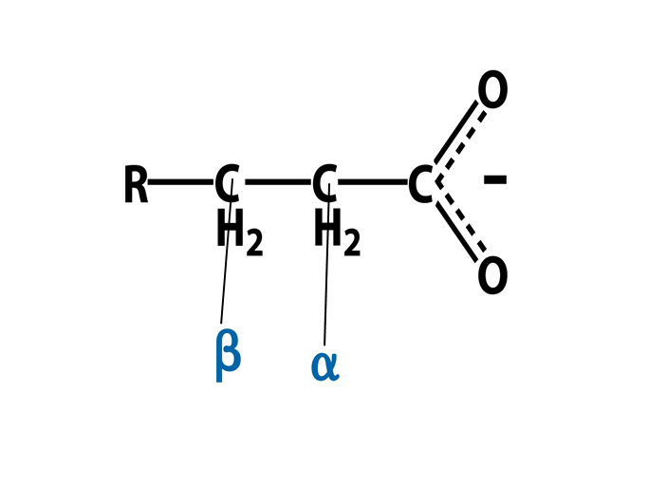
Beta Oxidation of Fatty Acids
Core Knowledge
III. Reactions of β-oxidation
Oxidation
Hydration
Oxidation
Thiolytic cleavage

Slide 13
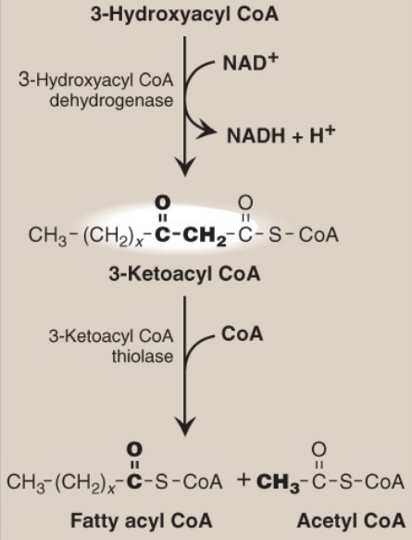
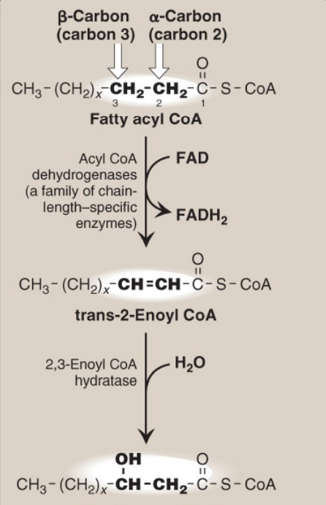
Beta Oxidation of Fatty Acids
Core Knowledge
Enzymes involved in the β-oxidation of fatty acyl coenzyme A(CoA)

Slide 14
Beta Oxidation of Fatty Acids
Core Knowledge
Each cycle produces
one acetyl CoA
one NADH and
one FADH₂
The final thiolytic cleavage produces two acetyl groups
Acetyl CoA is oxidized in TCA cycle

Slide 15
Beta Oxidation of Fatty Acids
Core Knowledge
ATP Yield
Summary of the energy yield from the oxidation of palmitoyl coenzyme A(CoA) (16 carbons). (Note: *Activation of palmitate to palmitoyl CoA requires the equivalent of 2 ATP [ATP → AMP + PPi ].) FADH2 = flavin adenine dinucleotide; NADH = nicotinamide adenine dinucleotide; TCA= tricarboxylic acid; CoQ = coenzyme Q; CO2 = carbon dioxide.

Slide 16
Horizontal Integration

Slide 17
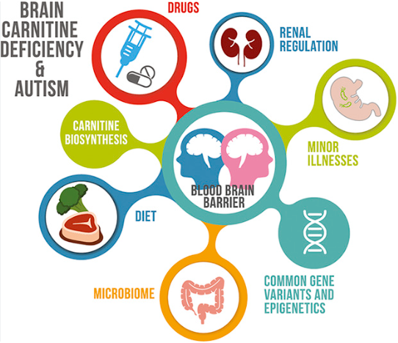
Vertical Integration
Clinical Correlates
Deficiency of Carnitine
CPT-I deficiency
CPT-I deficiency

Slide 18
Spiral Integration
Family Medicine
Family Medicine
Family Medicine plays important role in following manner:
Diagnosis
Education & Counselling
Dietary Guidance
Monitoring
Refer to Specialists

Slide 19
Spiral Integration
Bioethics
Ethical Considerations
From an ethical standpoint, the scenario raises considerations regarding patient autonomy, informed consent, and confidentiality
The physician must ensure that patient fully understands her diagnosis, treatment options, and potential implications
Discuss the necessity of a healthy lifestyle & treatment plan. This requires clear communication and understanding of risks and benefits.
Additionally, the physician must respect patient’s privacy and confidentiality throughout the diagnostic and treatment process

Slide 20
Spiral Integration
Artificial Intelligence
Role of AI in Management
Artificial Intelligence plays role in following aspects:
Personalized Nutrition
Diagnostic Tools
Food Recommendations
Drug Development

Slide 21
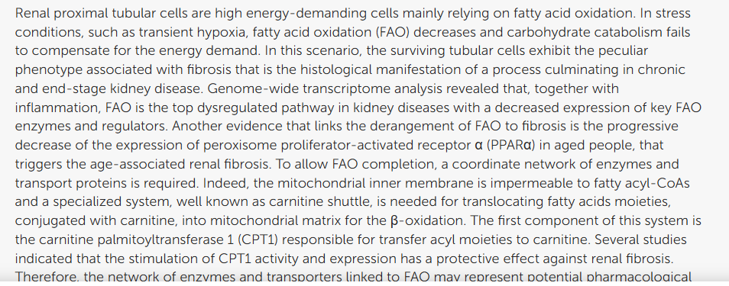
https://www.frontiersin.org/articles/10.3389/fphys.2020.00794/full
Spiral Integration
Research Article
The Link Between the Mitochondrial Fatty Acid Oxidation Derangement and Kidney Injury

Slide 22
How To Access Digital Library
Steps to Access HEC Digital Library
Go to the website of HEC National Digital Library
On Home Page, click on the INSTITUTES
A page will appear showing the universities from Public and Private Sector and other Institutes which have access to HEC National Digital Library HNDL
Select your desired Institute
A page will appear showing the resources of the institution
Journals and Researches will appear
You can find a Journal by clicking on JOURNALS AND DATABASE and enter a keyword to search for your desired journal

Slide 23
Learning Resources
Lippincott Illustrated Reviews Biochemistry, 8th Edition, Chapter 16 , page no. 210-14
Google scholar
Google images

Slide 24
THANK YOU

