Slide 2
CNS Module 2nd Year MBBS(LGIS) 2nd Messenger System & signaling pathways
Presenter: Dr Uzma Zafar Date: 01-02-25
Deptt of Biochemistry
RMU

Slide 3
Motto, Vision, Dream
To impart evidence based research oriented medical education
To provide best possible patient care
To inculcate the values of mutual respect and ethical practice of medicine
Wisdom
Truth
Service

Slide 4
Professor Umar Model of Integrated Lecture

Slide 5
Learning Objectives
At the end of the lecture, students will be able to
Explain 2nd messenger system
Discuss signalling pathways
Integrate anatomical and physiological aspects
Associate clinicopathological conditions
Appreciate four principles of biomedical ethics
Correlate and build core knowledge on the basis of latest research
Understand class ethics
Understand communication skill
Understand professionalism

Slide 6
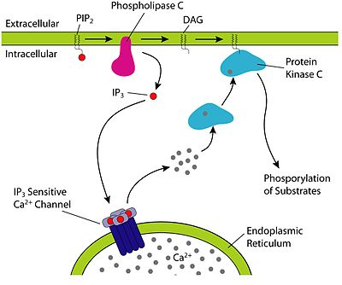
Core Knowledge
Second messengers
They are intracellular signaling molecules released by the cell in response to exposure to extracellular signaling molecules

Slide 7
Core Knowledge
Second messengers
These are the molecules that relay signals from cell surface receptors to the effector proteins inside the cell
Four classes of second messengers:
cAMP, cGMP
IP3
DAG
Ca⁺⁺

Slide 8
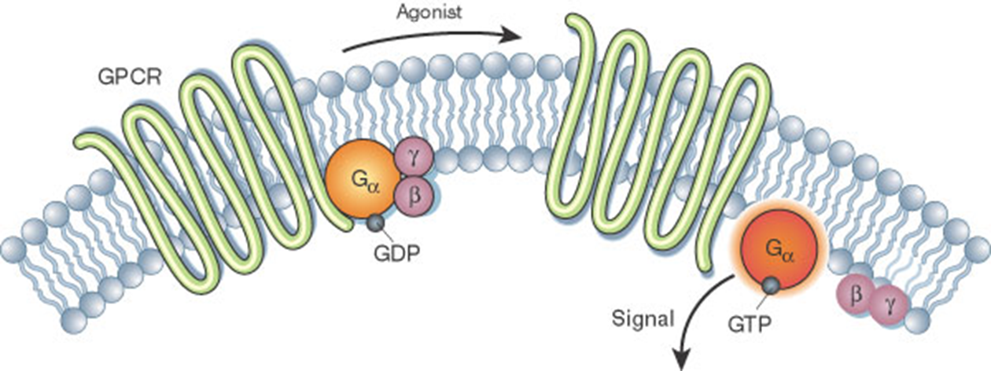
GPCR linked signalling pathways
Core Knowledge
When a ligand binds to the GPCR it causes a conformational change in the GPCR, which then activate G protein by exchanging the GDP bound to the G protein for a GTP
The G protein's α subunit, together with the bound GTP, can then dissociate from the β and γ subunits to further affect intracellular signaling proteins

Slide 9
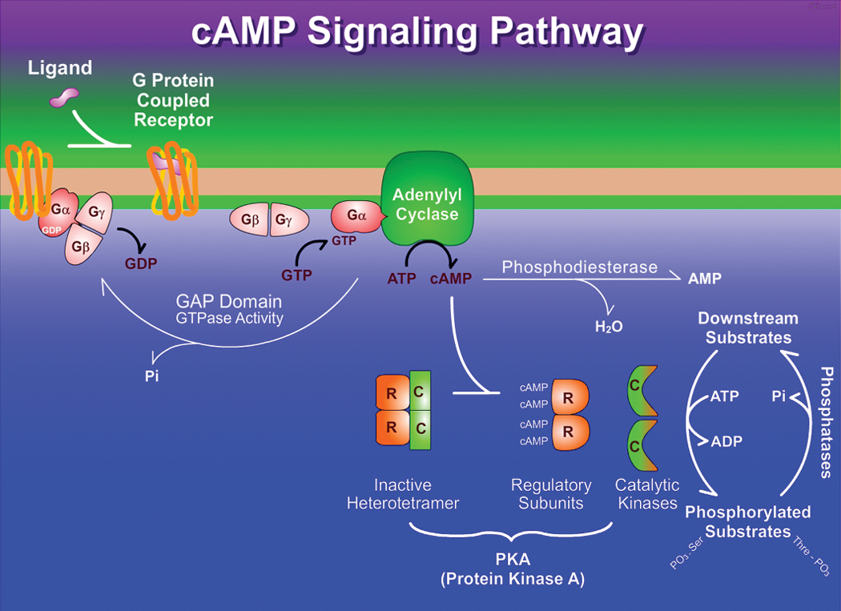
Core Knowledge
Role of cAMP in 2nd messenger system

Slide 10
Core Knowledge
Role of cAMP in 2nd messenger system
cAMP is synthesized from ATP by the action of the enzyme adenylyl cyclase
Binding of group II hormone to its receptor activates G-protein, which then activates adenylyl cyclase
cAMP mediates its actions via
Protein kinase A- phosphorylates serine, threonine residues in proteins
cAMP response element binding protein (CREB)- regulates gene transcription

Slide 11
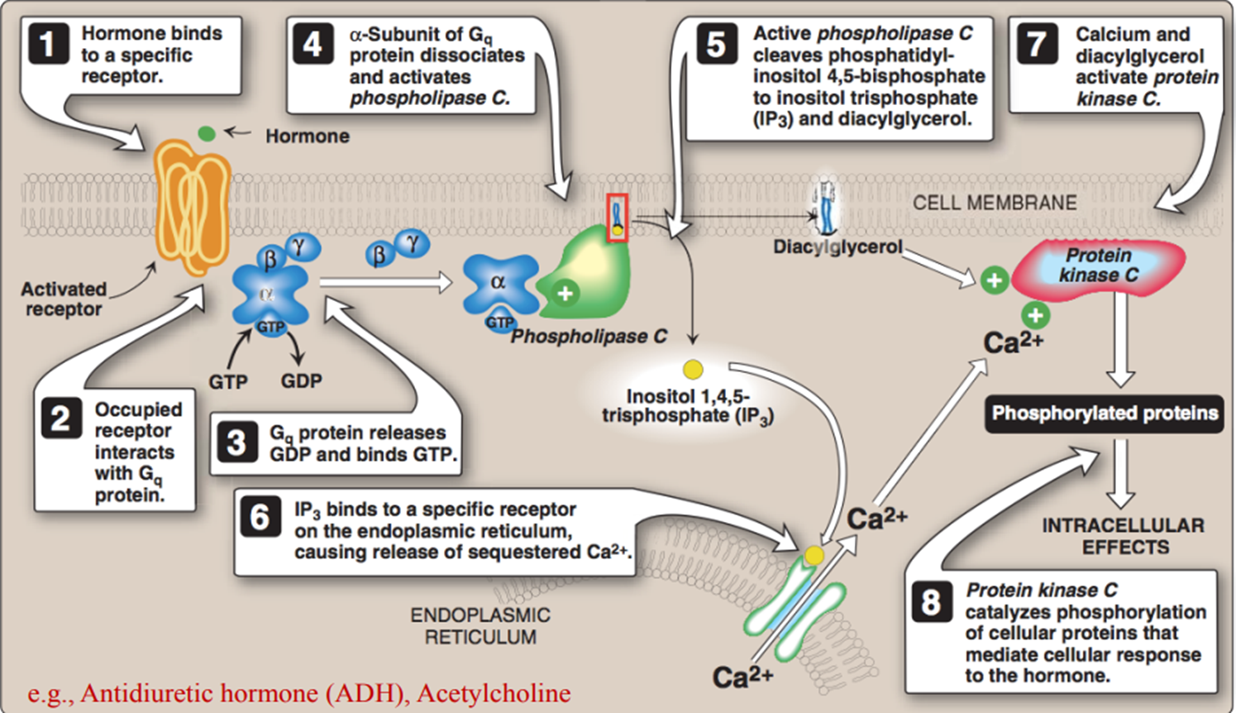
Core Knowledge
Role of (IP3) in 2nd messenger system

Slide 12
Core Knowledge
Role of calcium in 2nd messenger system
Many cells respond to extracellular stimuli by altering their intracellular calcium ion concentration
Ca⁺⁺ acts as a second messenger in two ways
Binding to an effector molecule e.g. an enzyme, thus activating it
Binding to an intermediary cytosolic calcium binding protein- calmodulin and increasing its affinity for effector molecules
E.g., calmodulin, when activated, causes smooth muscle contraction

Slide 13
Core Knowledge
Role of calcium in 2nd messenger system
Binding to an effector molecule e.g. an enzyme, thus activating it

Slide 14
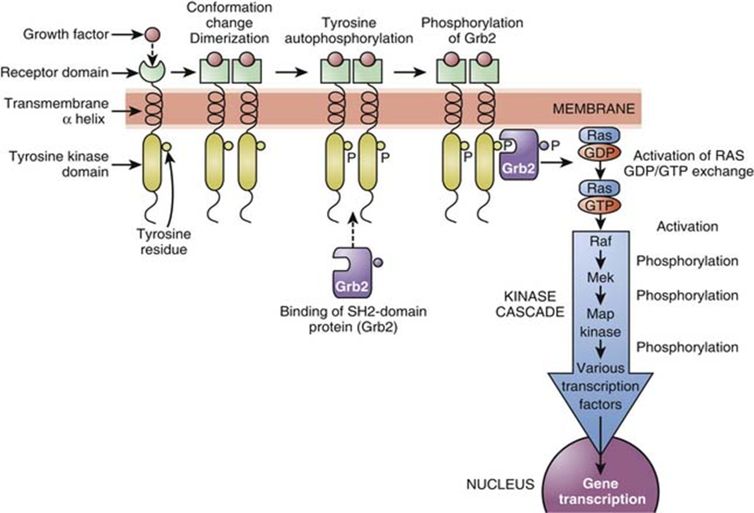
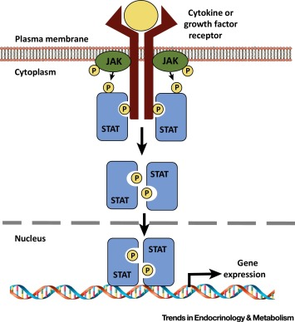
Core Knowledge
Types of Enzyme-linked receptors signaling pathways

Slide 15
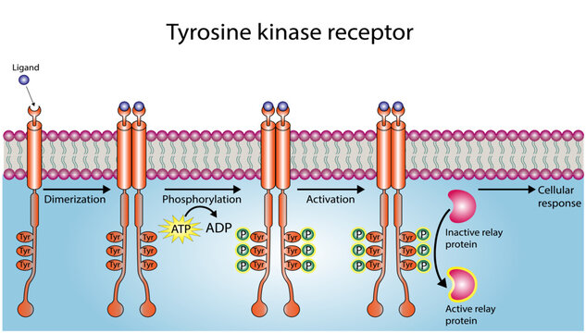
Core
Knowledge
Tyrosine kinase
signaling pathway

Slide 16
Core
Knowledge
JAK STAT receptor
Ligand binding domain
Transmembrane domain
Cytosolic domain

Slide 17
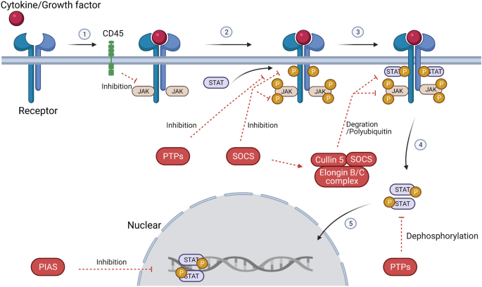
Core Knowledge
JAK STAT
signaling
pathway

Slide 18
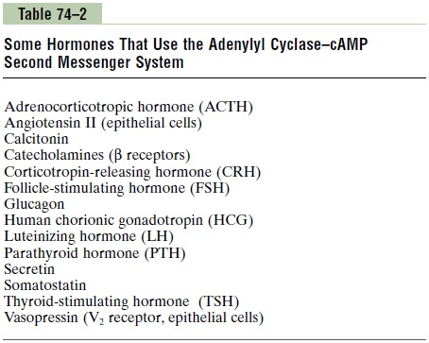
Horizontal Integration
Hormones that response via activation of cAMP

Slide 19
Hormones which cause rise in cAMP
Horizontal Integration
Epinephrine
Norepinephrine
Glucagon
ACTH
TSH
Parathyroid hormone

Slide 20
Horizontal Integration
Examples and action of tyrosine kinase
Epidermal growth factor (EGF)
Insulin and insulin-like growth factor 1 (IGF-1)
Bind to receptors with intrinsic tyrosine kinase activity
Tyrosine phosphorylation event initiates a cascade that involves several protein kinases, phosphatases and other regulatory protein
Response will be,
Growth control
Differentiation
Inflammatory response

Slide 21
Vertical Integration
Clinical integration
JAK STAT receptor pathway
Defective JAK STAT signaling pathway
Hepatitis
Myeloproliferative disorders
Multiple myeloma

Slide 22
Clinical integration
Vertical Integration
Cholera toxin – increase cAMP
Caffeine- Decrease cAMP
Pertussis toxin- increase cAMP
Adenomas- G Proteins loose ability to hydrolyze GTP
Cancer – Mutation in Growth surface receptors

Slide 23
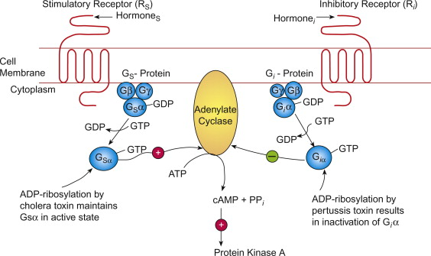
Cholera & pertussis
Vertical Integration
In cholera, the intrinsic GTPase activity of Gsα is disrupted, thus it cannot reassociate with βγ and is therefore irreversibly activated
In pertussis, Giα cannot dissociate from βγ, thus it is not free to act, and Gsα remains unopposed

Slide 24
Insulin resistance
Vertical Integration
In skeletal muscles elevated levels of free fatty acids (FFA) result in the formation of diacylglycerol (DAG)
DAG activates protein kinase Cε (PKCε)
PKCε phosphorylates the insulin receptor substrate (IRS)
This prevents from the carrying out the actions of insulin, resulting in insulin resistance in liver and skeletal muscles and hyperglycemia

Slide 25
Spiral Integration
Bioethics
Ethical Considerations
From an ethical standpoint, the scenario raises considerations regarding patient autonomy, informed consent, and confidentiality
The physician must ensure that patient fully understands her diagnosis, treatment options, and potential implications
Discuss the necessity of a healthy lifestyle & treatment plan. This requires clear communication and understanding of risks and benefits.
Additionally, the physician must respect patient’s privacy and confidentiality throughout the diagnostic and treatment process

Slide 26
Spiral Integration
Artificial Intelligence
Role of AI in Management
AI can potentially aid in enhancing diagnostic accuracy and efficiency.
AI-powered decision support systems can also help clinicians in selecting appropriate treatment modalities
AI-driven predictive models may help anticipate the risk of complications of the Disease in susceptible populations

Slide 27
Second Messengers
Spiral Integration
Research Article
Alexandra C Newton ¹, Martin D Bootman ², John D Scott ³
PMCID: PMC4968160 PMID: 27481708
Abstract
Second messengers are small molecules and ions that relay signals received by cell-surface receptors to effector proteins. They include a wide variety of chemical species and have diverse properties that allow them to signal within membranes (e.g., hydrophobic molecules such as lipids and lipid derivatives), within the cytosol (e.g., polar molecules such as nucleotides and ions), or between the two (e.g., gases and free radicals). Second messengers are typically present at low concentrations in resting cells and can be rapidly produced or released when cells are stimulated. The levels of second messengers are exquisitely controlled temporally and spatially, and, during signaling, enzymatic reactions or opening of ion channels ensure that they are highly amplified. These messengers then diffuse rapidly from the source and bind to target proteins to alter their properties (activity, localization, stability, etc.) to propagate signaling.
https://pmc.ncbi.nlm.nih.gov/articles/PMC4968160/

Slide 28
How To Access Digital Library
Steps to Access HEC Digital Library
Go to the website of HEC National Digital Library
On Home Page, click on the INSTITUTES
A page will appear showing the universities from Public and Private Sector and other Institutes which have access to HEC National Digital Library HNDL
Select your desired Institute
A page will appear showing the resources of the institution
Journals and Researches will appear
You can find a Journal by clicking on JOURNALS AND DATABASE and enter a keyword to search for your desired journal

Slide 29
Learning Resources
HARPERS Illustrated Biochemistry,
(31th edition, chapter 42, Pages 501-510)
Related articles
Google images

Slide 30
Assesment
1. Which of the following is NOT a second messenger?
A. Cyclic AMP (cAMP)
B. Cyclic GMP (cGMP)
C. Calcium ions (Ca²⁺)
D. Insulin
E. None of them

Slide 31
2. Which enzyme is directly activated by cAMP in the signaling pathway?
A. Adenylyl cyclase
B. Protein kinase A (PKA)
C. Phospholipase C (PLC)
D. Guanylyl cyclase
E. None of them

Slide 32
3. In the phosphoinositide signaling pathway, which molecule acts as a second messenger to release calcium from intracellular stores?
A. Diacylglycerol (DAG)
B. Inositol trisphosphate (IP₃)
C. Cyclic AMP (cAMP)
D. cGMP
E. None of them
4. Which of the following receptors is associated with the G-protein-coupled receptor (GPCR) signaling pathway?
A. Insulin receptor
B. Nicotinic acetylcholine receptor
C. Beta-adrenergic receptor
D. Steroid hormone receptor
E. None of them

Slide 33
5. Which of the following is NOT involved in the MAPK (mitogen-activated protein kinase) signaling pathway?
A. Ras protein
B. RAF kinase
C. MEK kinase
D. Adenylyl cyclase
E. None of them

Slide 34
MCQS KEY
1. d
2. b
3. b
4. c
5. d

Slide 35
THANK YOU

