Slide 1
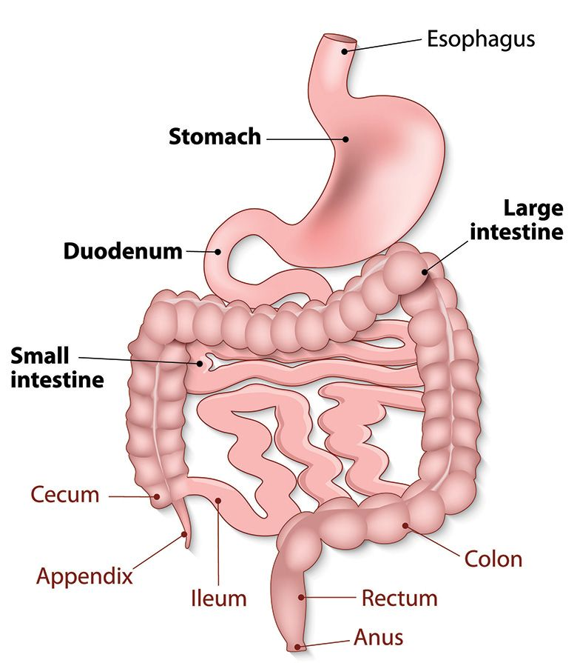
CLINICAL APPROACH TO ASSESS GI SYMPTOMS
Dr. Sadia Ahmed
MBBS, FCPS (GASTROENTEROLOGY)
ASSISTANT PROFESSOR
Holy Family Hospital RWP

Slide 3
Learning Outcomes
Discuss different symptoms of Gastrointestinal diseases and their differential diagnosis.
Discuss relevant questions in history of common presentations in gastroenterology.
Describe important investigations in gastroenterology and their interpretation of results.

Slide 5
SYMPTOMS
CORE SUBJECT
Dysphagia
Dyspepsia, Heartburn and regurgitation
Gastrointestinal bleeding ( upper & lower GI )
Diarrhea
Abdominal pain
Jaundice

Slide 6
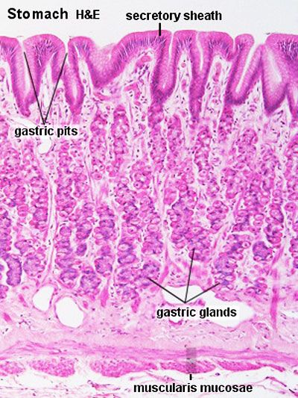
ANATOMY OF UPPER GI TRACT
SPIRAL INTEGRATION

Slide 7
DYSPHAGIA
CORE SUBJECT
Defined as difficulty in swallowing
Affecting any part of the swallowing pathway from the mouth to stomach
(Odynophagia is pain during swallowing)
TYPES :
Oropharyngeal dysphagia : Difficulty initiating swallowing. (Coughing, chocking)
Esophageal dysphagia : Food sticking few seconds after swallowing.
Causes ; NEUROLOGICAL or OBSTRUCTIVE

Slide 8
CORE SUBJECT

Slide 9
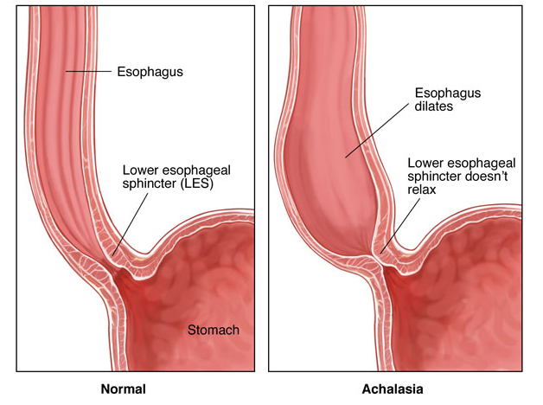
PATHOPHYSIOLOGY OF ACHALASIA CARDIA
HORIZONTAL INTEGRATION

Slide 10
VERTICAL INTEGRATION

Slide 11
DYSPHAGIA – HISTORY QUESTIONS
CORE SUBJECT
1. Do you have trouble swallowing solids or liquids, or both?
2. Does the problem occurs during initiation of a swallow or a few seconds afterwards?
3. Is the trouble swallowing intermittent or persistent?
4. Has the problem been getting progressively worse?
5. Do you cough or choke on starting to swallow?
6. Is it painful to swallow (odynophagia)?
7. Do you have any heartburn or acid regurgitation?
8. Have you been losing weight?

Slide 12
RESEARCH

Slide 13
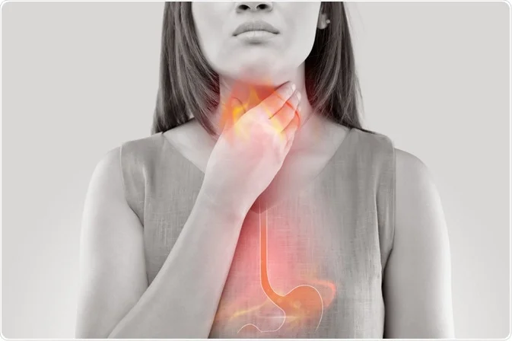

Slide 14
HEARTBURN AND REGURGITATION
CORE SUBJECT
Heartburn is retrosternal, burning discomfort, sometimes accompanied by regurgitation of acidic or bitter fluid into the throat.
These symptoms often occur after meals, on lying down or with bending, straining or heavy lifting.
They are classical symptoms of gastro-esophageal reflux

Slide 15
CORE SUBJECT

Slide 16
CORE SUBJECT

Slide 17
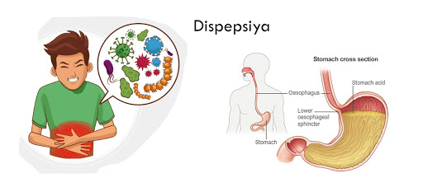
DYSPEPSIA
CORE SUBJECT
A condition characterized by upper abdominal pain or discomfort, feeling of unusual fullness following meals, nausea, heartburn, regurgitation of food or acid, and belching.
The term dyspepsia is general ,often used when the cause is not clear.

Slide 19
DIFFERENTIALS
CORE SUBJECT
Functional dyspepsia ( without any organic cause)
Peptic ulcer
GERD
Biliary tract disorders
Gastric malignancy
Drugs
Food intolerances ( spicy or fatty foods )

Slide 20
RESEARCH

Slide 21
VOMITTING
CORE SUBJECT
Forcible ejection of gastric contents.
Synchronous contraction of the diaphragm,intercostal muscles and abdominal muscles raises intra-abdominal pressure, combined with relaxation of the lower esophageal sphincter.

Slide 22
CORE SUBJECT

Slide 23
History questions
CORE SUBJECT
1. For how long have you been having attacks of vomiting (distinguish acute from chronic)?
Is the vomiting usually immediately after a meal or hours after a meal?
Do you have vomiting early in the morning or late in the evening?
4. Color and contents ? Is it bloodstained, bile-stained or feculent?
Is there any headache, abdominal pain, weight loss or fever?
What medications are you taking?

Slide 26
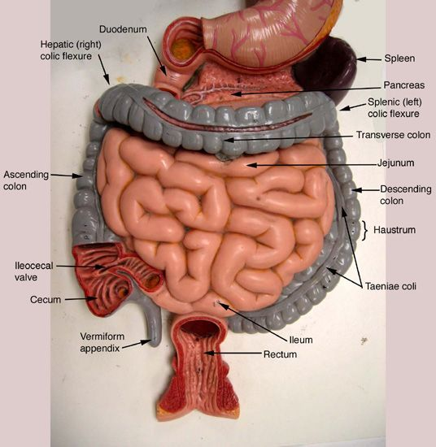
ANATOMY OF LOWER GI TRACT
SPIRAL INTEGRATION

Slide 27
TYPES
upper
Lower

Slide 28
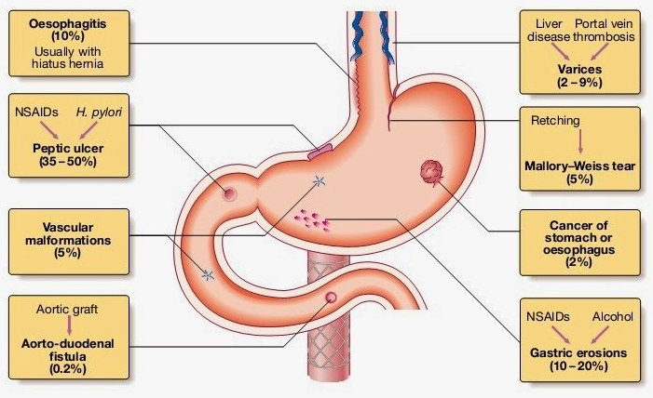
PATHOPHYSIOLOGY OF UPPER GI BLEED
HORIZONTAL INTEGRATION

Slide 29
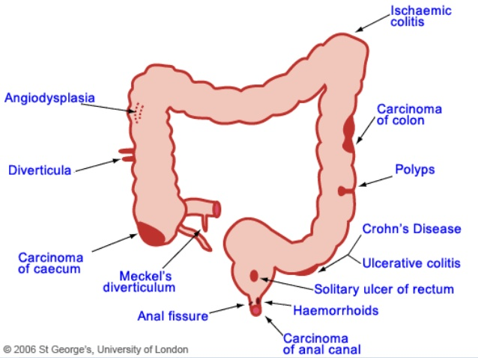
PATHOPHYSIOLOGY OF LOWER GI BLEED
HORIZONTAL INTEGRATION

Slide 31
UPPER GI HEMORRHAGE
CORE SUBJECT
Defined as blood loss originating proximal to the ligament of Treitz (duodenojejunal flexure), in the esophagus stomach or duodenum.
HEMATEMESIS: Vomiting of blood.
MELENA : Dark black, tarry stools associated with upper GI bleeding. the black color and characteristic odor are caused by hemoglobin in the blood altered by digestive enzymes and intestinal bacteria.

Slide 32
LOWER GI HEMORRHAGE
CORE SUBJECT
This may be caused by hemorrhage from the colon, anal canal or small bowel distal to ligament of treitz.

Slide 33
HISTORY QUESTIONS
CORE SUBJECT
1. Was there fresh blood or coffee ground vomitus?
2. Have you passed any black or bloody stools?
3. Intense retching or vomiting before bloody vomitus?
4. Have you been taking any drugs like aspirin, nonsteroidal anti-inflammatory drugs or steroids?
5. Do you drink alcohol? Do you have liver disease?
6. Have you ever had a peptic ulcer?
7. Have you lost weight?
8. Family history of GI malignancy?

Slide 34
RESEARCH

Slide 35
DIARRHEA
CORE SUBJECT
Passage of more than 200 g of stool daily or more than 3 bowel movements
Acute diarrhea is no longer than 14 days ;
chronic or persistent diarrhea lasts longer than 14 days.

Slide 37
HISTORY QUESTIONS
CORE SUBJECT
Number of stools per day?
Stool form (e.g loose, watery , greasy )?
Volume of stool (small or large)?
woken from sleep during the night by diarrhea?
Food allergies?
recent fever, rigors or chills?
any recent travel?
treatment with antibiotics or any drugs recently?
Personal or family history of celiac disease or IBD?
stress

Slide 38
RESEARCH

Slide 39
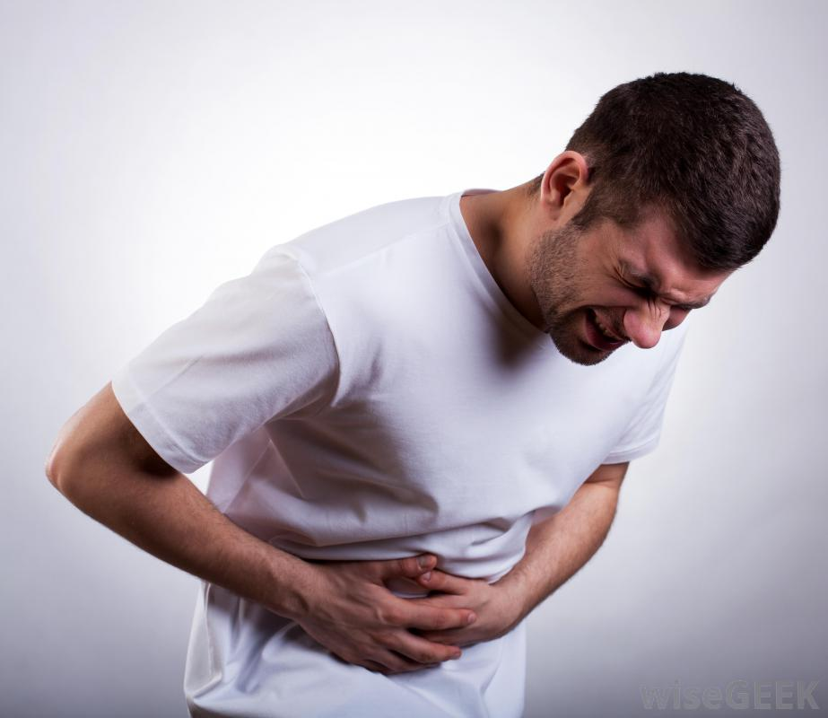

Slide 40
ABDOMINAL PAIN
CORE SUBJECT

Slide 42
CORE SUBJECT
MNEMONIC

Slide 44
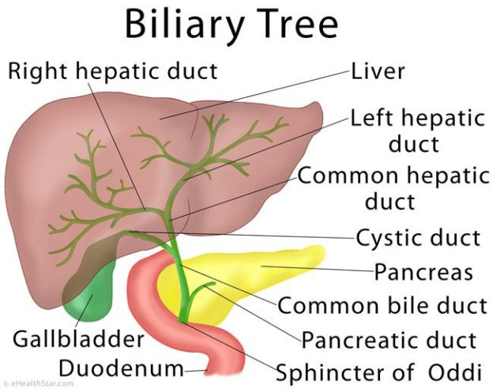
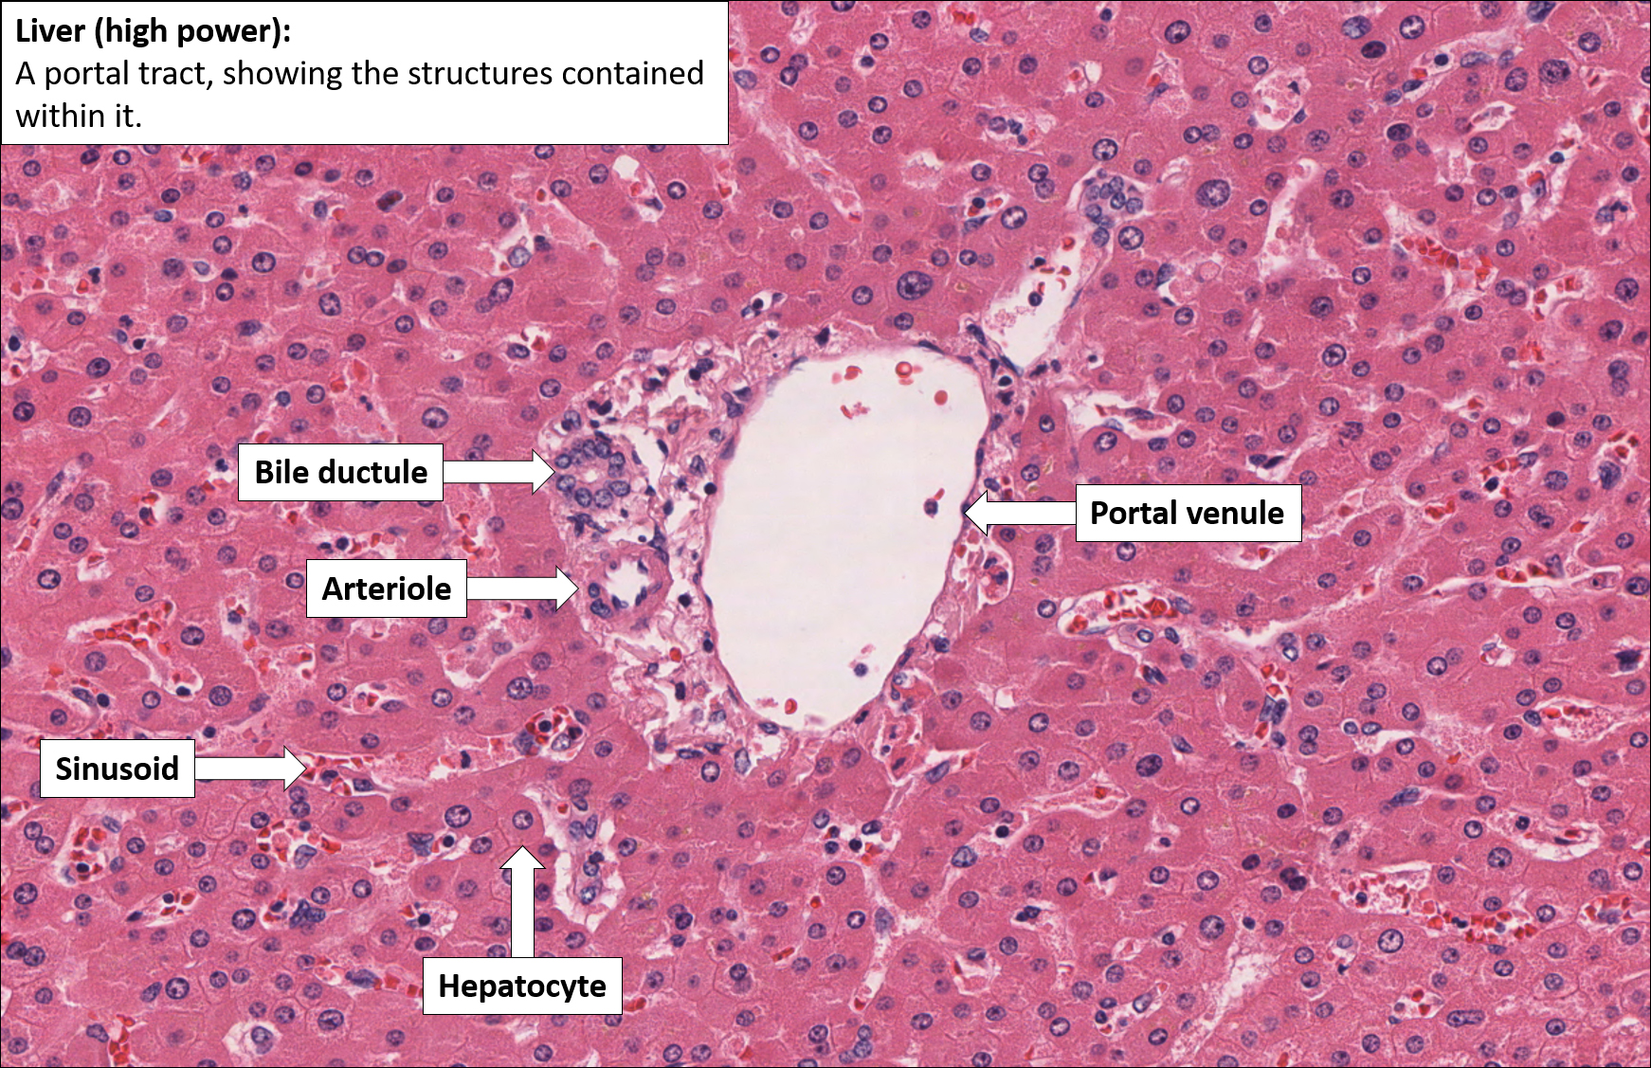
ANATOMY OF LIVER AND BILIARY TRACT
SPIRAL INTEGRATION

Slide 45
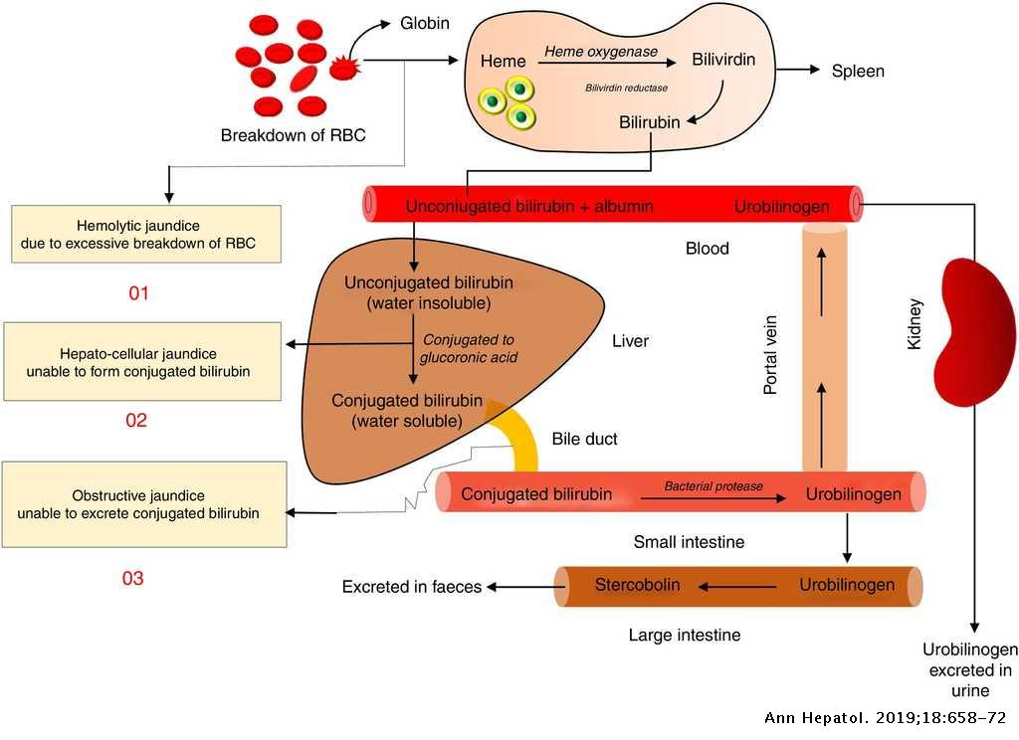
JAUNDICE PATHOPHYSIOLOGY
HORIZONTAL INTEGRATION

Slide 46
JAUNDICE
CORE SUBJECT
Yellow staining of the skin and sclerae (the whites of the eyes) by abnormally high blood levels of the bile pigment, bilirubin.

Slide 48
HISTORY QUESTIONS - JAUNDICE
CORE SUBJECT
Duration of jaundice
Associated pain
Previous history of jaundice, liver disease or blood transfusions
Chills, fever , systemic symptoms, weight loss
Itching, urine and stool color
Drugs, biliary surgery, gallstones
Contact with jaundice patient
Water source and hygiene status

Slide 49
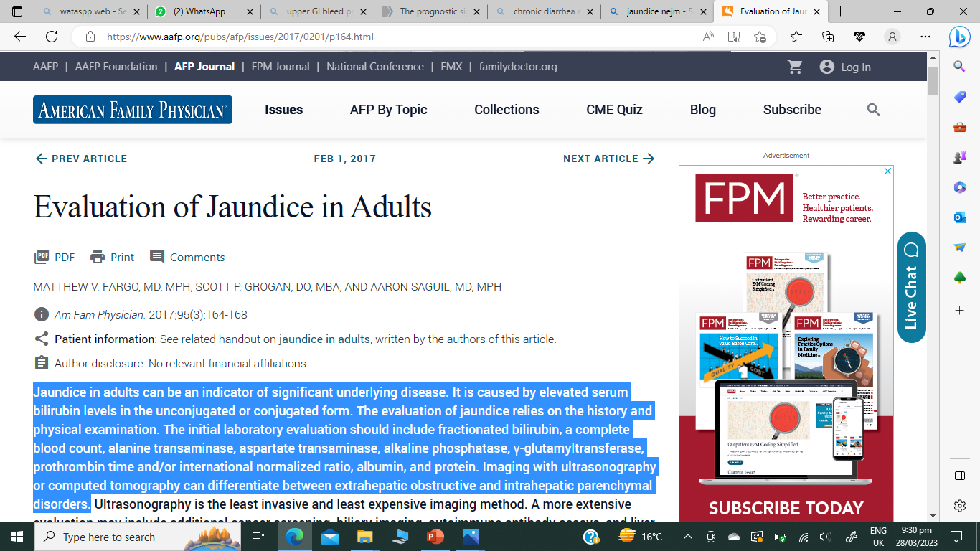
RESEARCH

Slide 50
Lets recall the gastrointestinal symptoms that we have just studied

Slide 51
INVESTIGATION OF GASTROINTESTINAL DISEASE
VERTICAL INTEGRATION

Slide 52
BLOOD TESTS
VERTICAL INTEGRATION
Blood complete picture
Liver function test
Viral serologies
Iron studies
ESR, CRP

Slide 53
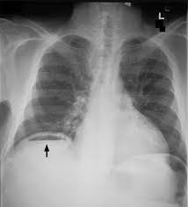
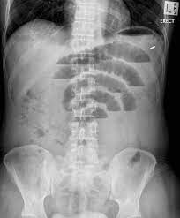
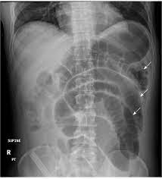
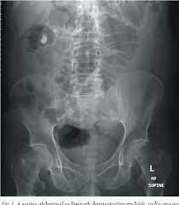
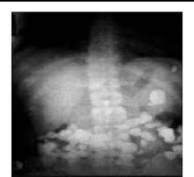
Plain x-ray
VERTICAL INTEGRATION
Plain X-rays of the abdomen are useful in the diagnosis of
intestinal obstruction or paralytic ileus
Calcified lymph nodes,
gallstones and renal stones
Chest X-ray subdiaphragmatic free air

Slide 54
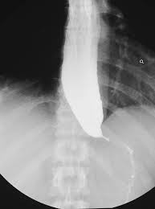
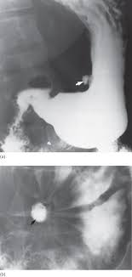
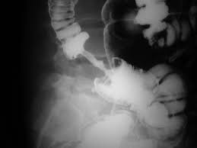
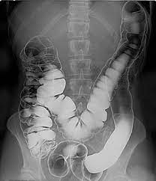
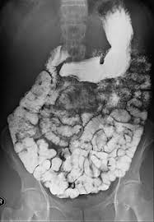
Contrast studies
VERTICAL INTEGRATION
X-rays with contrast medium( barium sulphate) are useful for detecting filling defects, such as tumors, strictures, ulcers and motility disorders

Slide 55
ULTRASOUND CT SCAN MRI
VERTICAL INTEGRATION
Assessment of pancreatic disease
Tumor deposits and staging
CT colonography(virtual colonoscopy)
Assessment of lesion vascularity
Abscesses and collections
Hepatic tumor staging
MRCP
Pelvic/perianal disease
Crohn’s fistulae
Small bowel visualization
Abdominal masses
Organomegaly
Ascites
Biliary tract dilatation
Gallstones
Guided biopsy of lesions
Small bowel imaging

Slide 56
ENDOSCOPY
VERTICAL INTEGRATION
DIAGNOSTIC
Dyspepsia in patients > 55 years
of age or with alarm symptoms
Atypical chest pain
Dysphagia
Vomiting
Weight loss
Acute or chronic gastrointestinal bleeding
Screening for esophageal varices in chronic liver disease
Duodenal biopsies in the investigation of malabsorption
THERAPEUTIC
Treatment of bleeding lesions
Banding/injection of varices
Dilatation of strictures
Insertion of stents
Placement of percutaneous gastrostomies
Ablation of Barrett’s esophagus
Resection of high-grade dysplastic lesions and early neoplasia

Slide 57
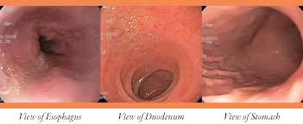
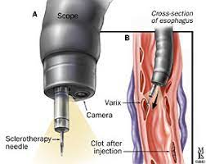
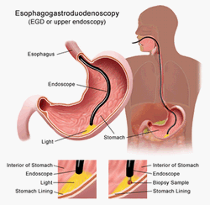

Slide 58
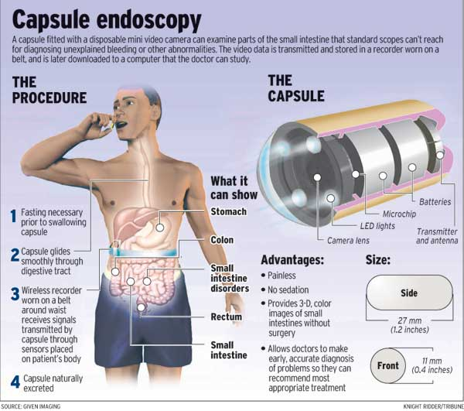
WIRELESS CAPSULE ENDOSCOPY
VERTICAL INTEGRATION
• Obscure gastrointestinal bleeding
• Small bowel Crohn’s disease
• Assessment of coeliac disease and
its complications
• Screening and surveillance in
familial polyposis syndromes

Slide 59
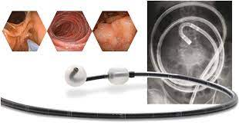
DOUBLE BALLOON ENTEROSCOPY
VERTICAL INTEGRATION
For detailed evaluation of small gut loops not approachable by upper GI endoscopy or colonoscopy. Therapy can also be done.

Slide 60
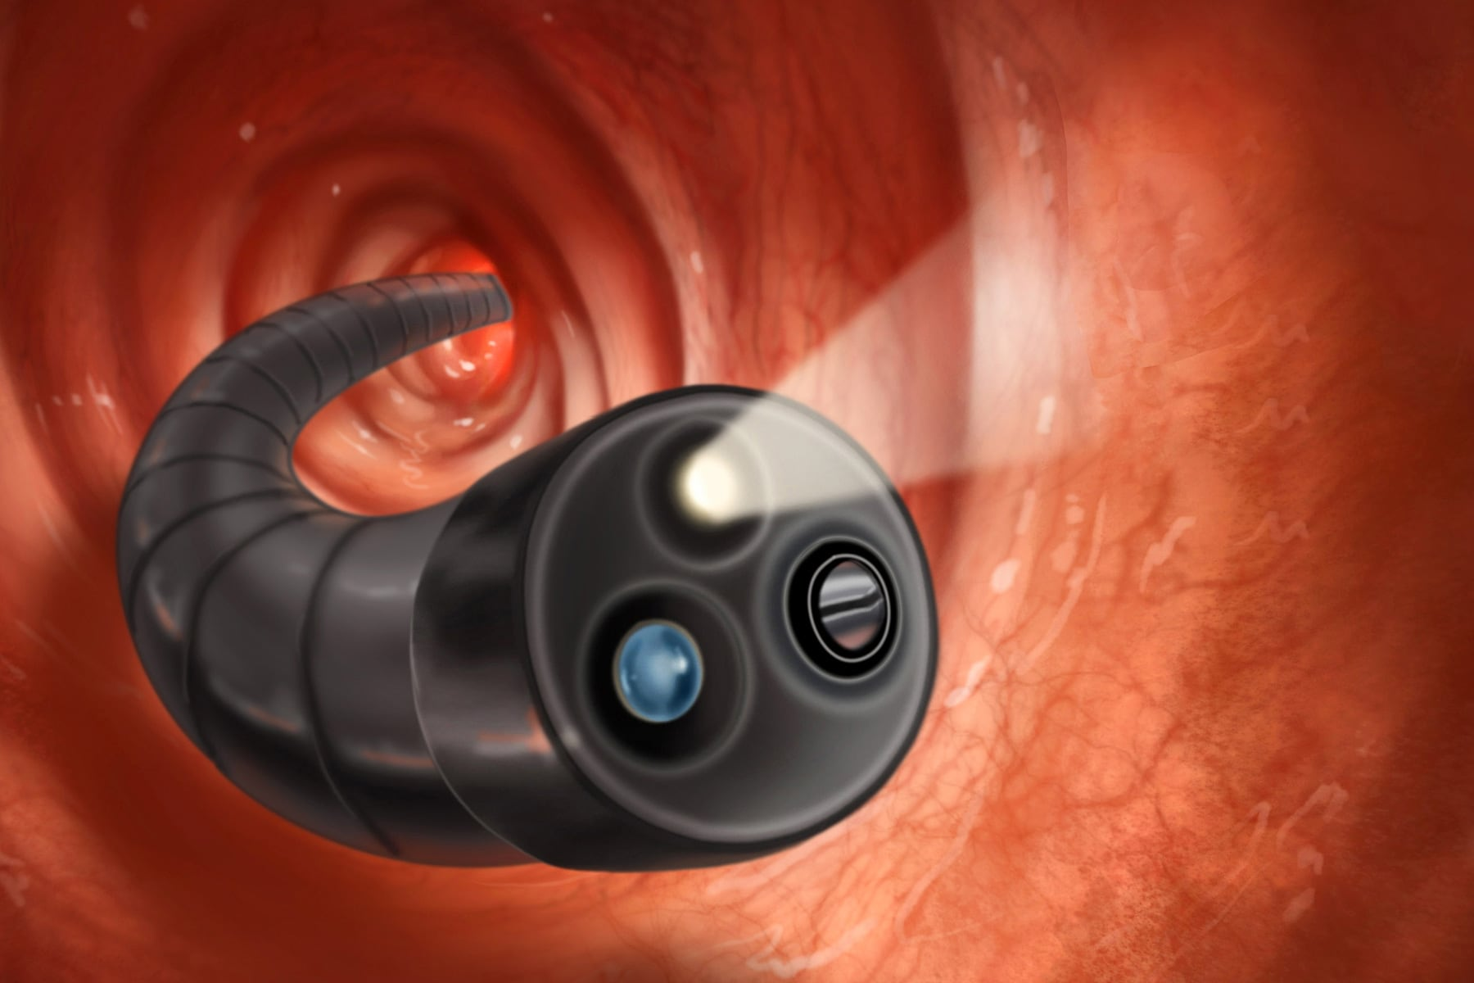
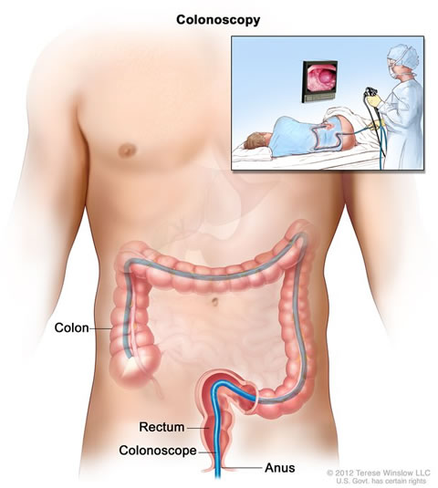
COLONOSCOPY
VERTICAL INTEGRATION
Suspected inflammatory bowel disease
Chronic diarrhoea
Altered bowel habit
Rectal bleeding or iron deficiency anaemia
Assessment of abnormal CT colonogram or barium enema
Colorectal cancer screening
Colorectal adenoma and carcinoma follow-up
Therapeutic procedures, including endoscopic resection, dilatation of strictures, laser, stent insertion and argon plasma Coagulation.

Slide 61
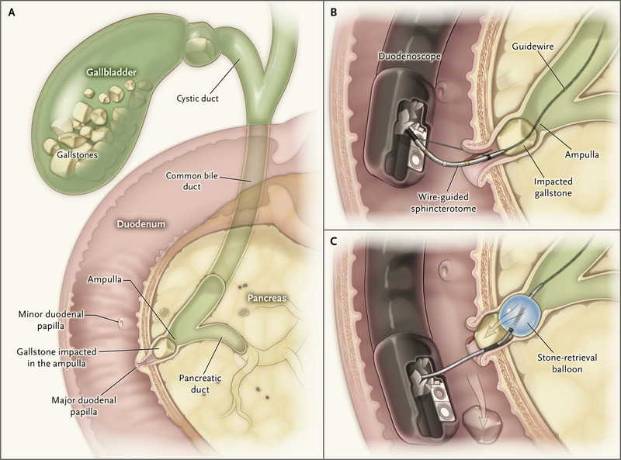
ERCP
VERTICAL INTEGRATION
Endoscopic retrograde cholangiopancreatography is a technique that combines the use of endoscopy and fluoroscopy to diagnose and treat certain problems of the biliary or pancreatic ductal systems. It is primarily performed by highly skilled and specialty trained gastroenterologists.

Slide 62
TESTS OF INFECTION
VERTICAL INTEGRATION
Bacterial cultures
Stool cultures are essential in the investigation of diarrhea ,especially when it is acute or bloody, in order to identify pathogenic organisms
Serology
Detection of antibodies plays a limited role in the diagnosis of gastrointestinal infection caused by organisms such as Helicobacter pylori, Salmonella species and Entamoeba histolytica.
Breath tests
Non-invasive breath tests for H. pylori infection and suspected small intestinal bacterial overgrowth

Slide 64
TESTS OF MOTILITY
VERTICAL INTEGRATION
Esophageal motility testing
Gastric emptying
Anorectal manometry

Slide 65
MCQ 1
Dysphagia is;
Difficulty in swallowing.
Painful difficulty in swallowing.
Chocking sensation in throat.
Inability to produce voice.
Difficulty in chewing.

Slide 66
ANSWER:
a ) Dysphagia is difficulty in swallowing

Slide 67
MCQ 2
A 16 years old boy presented with RIGHT ILIAC FOSSA pain of gradual onset which later increased in intensity and became constant. He also had a few episodes of vomiting. Lab work up showed high leucocyte count. Ultrasound abdomen was unremarkable. Surgery was planned. What could be the likely cause of his pain?
Acute pancreatitis
Renal colic
Acute appendicitis.
Peptic ulcer
Acute cholecystitis.

Slide 68
ANSWER:
C ) Acute Appendicitis.

Slide 69
MCQ 3
Melena is due to ?
Upper GI bleed
Lower GI bleed.
Hemorrhoids
Ulcerative colitis
Carcinoma Colon

Slide 70
ANSWER
a) Upper GI bleed.

Slide 71
MCQ 4
A patient presented in opd with complaints of loose motions for 18 days. This is categorized as;
1. Acute Diarrhea.
2. Chronic Diarrhea.
3. Idiopathic Diarrhea.
4. Nocturnal Diarrhea.
5. Acute Gastritis.

Slide 72
Answer
2. Chronic Diarrhea.

Slide 73
MCQ 5
ERCP is a technique for diagnosing and treating disorders of;
Biliary system
Pancreatic system
Both biliary and pancreatic systems.
Small intestine.
Large intestine.

Slide 74
ANSWER
3. Both biliary and pancreatic systems.

Slide 75
SEQ
A 23 years old female obese patient presented in gastro opd with Fever, right hypochondriac pain, jaundice, pruritis, clay coloured stools and dark urine. She said she had gall stones but no previous documents are available. Answer the following questions regarding this scenario.
What blood tests are you going to order?
Name some imaging studies that will help in establishing the diagnosis?
Name a technique that will help in confirming the diagnosis as well as treating the condition.
Can you tell what is diagnosis?

Slide 76
ANSWERS
Blood CP, LFTs.
Ultrasound abdomen.
ERCP
Choledocholithiasis.

Slide 77
THANKYOU

