Slide 1


Slide 2



Foundation Module
Case Based Learning (CBL)
First Year MBBS
Genetics – Polymerase Chain Reaction
Presenter: Dr Sana Latif Date: 07-02-25
(Senior Demonstrator)

Slide 3
Motto Vision; The Dream/Tomorrow
To impart evidence based research oriented medical education
To provide best possible patient care
To inculcate the values of mutual respect and ethical practice of medicine
Wisdom
Truth
Service

Slide 4
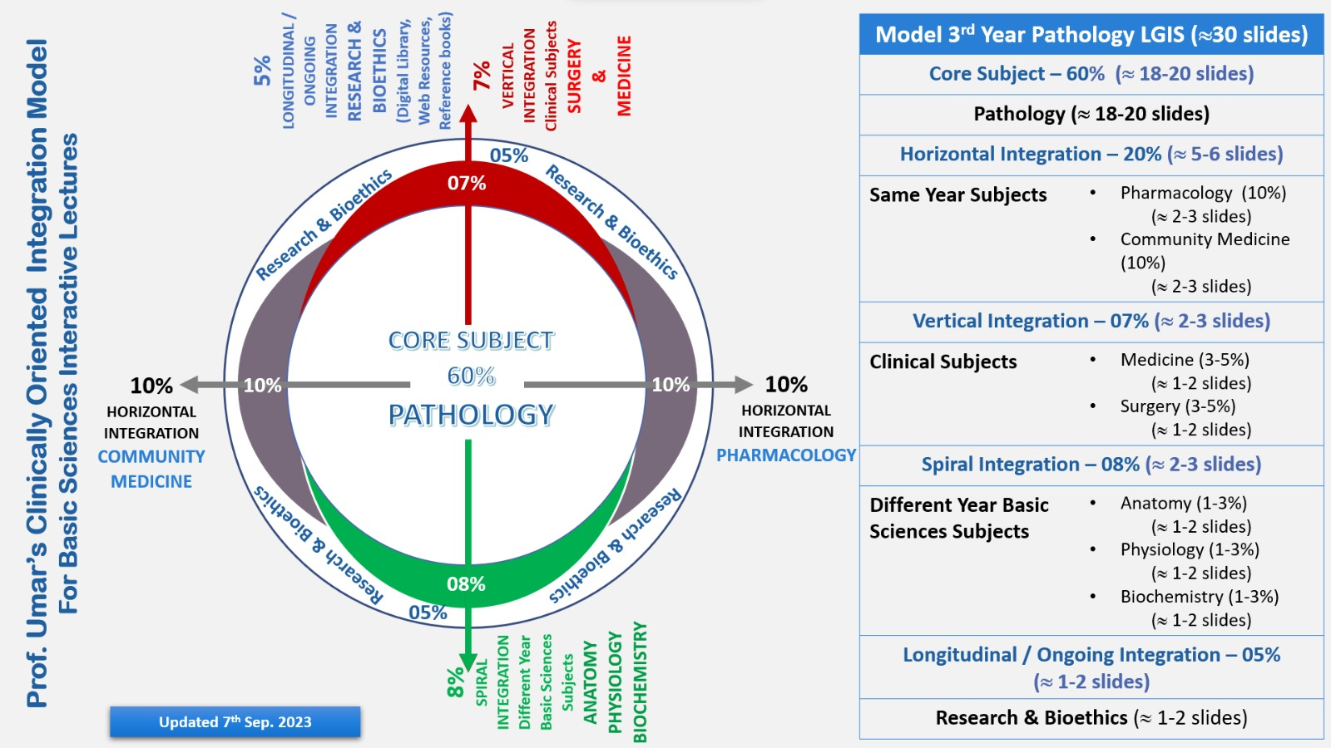
Professor Umar Model of Integrated Lecture

Slide 5
Learning Objectives
At the end of this session student should be
able to:
Define polymerase chain reaction technique, describe it’s steps & explain the clinical applications
Integrate Physiological, Biochemical and Clinical aspects
Correlate and build core knowledge on the basis of latest Research, Family Medicine, Artificial Intelligence & Bioethics.

Slide 6
Interactive Session
A male of age 47 years, presented in Holy Family Hospital Rawalpindi with distended abdomen and yellow discoloration of skin and sclerae. He was diagnosed as a case of HCV infection 5years ago. There was no history of interferon therapy.
On examination
His sclerae were yellow with multiple bruises on his body.
Liver was enlarged 3cm below right costal margin.
Investigations
Bilirubin, ALT & AST levels were found to be raised.
Advice
He was advised Quantitative PCR to determine his viral load.

Slide 7

PCR
Core Knowledge
PCR – Stands for Polymerase Chain Reaction.
It is a test to detect genetic material from a specific cell or organism.

Slide 8
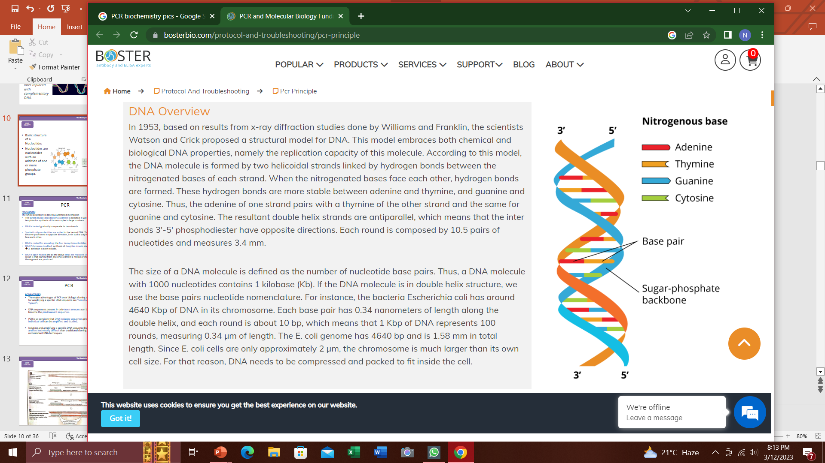
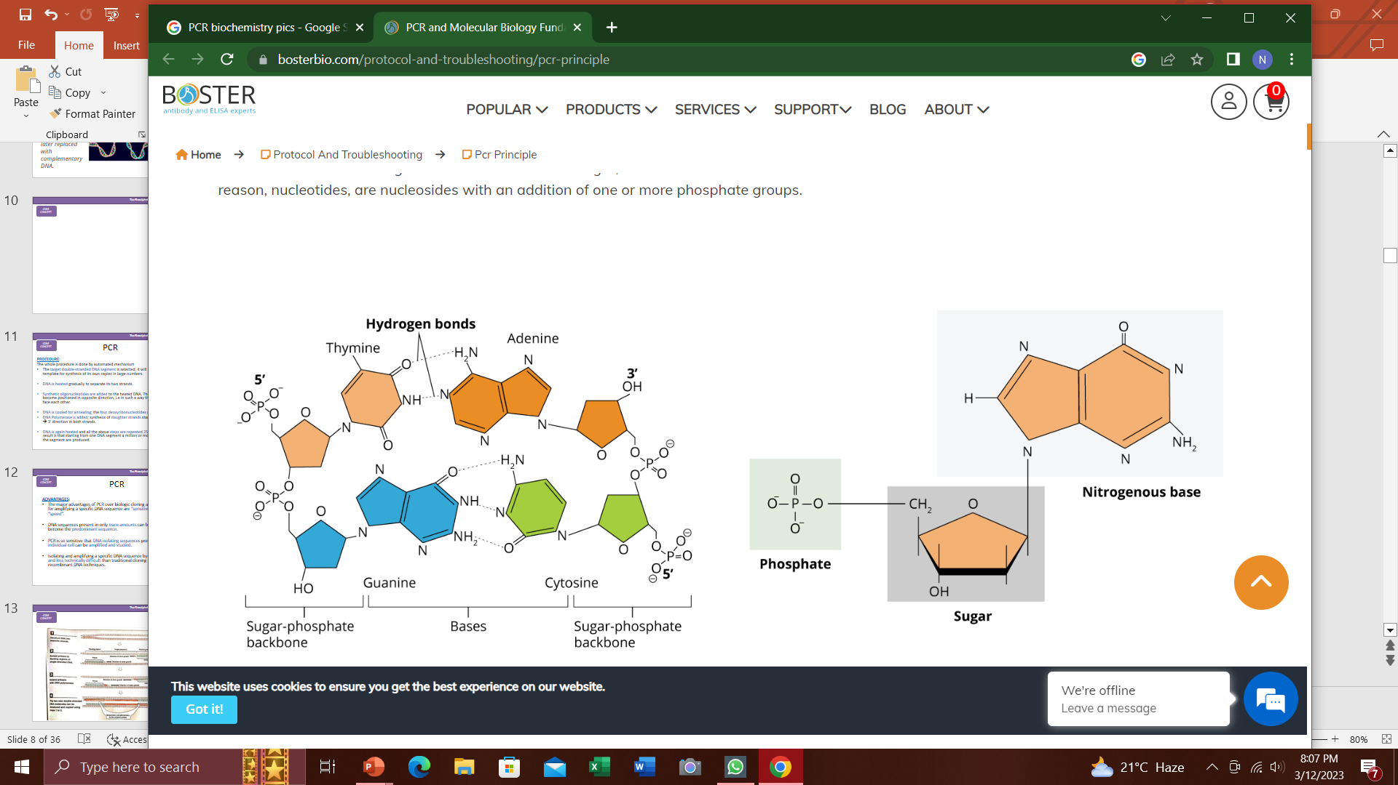
Basic Structure of DNA & RNA
Core Knowledge
Both DNA and RNA are formed by joining together of a large number of Nucleotide units or mononucleotides
Nucleotides are nucleosides with an addition of one or more phosphate groups.
DNA has Double Helix Strands which are antiparallel, i.e inter bonds 3′-5′ phosphodiester have opposite directions.

Slide 9
PCR
Core Knowledge
Each time a cell divides, it must first copy its DNA—a process called DNA Replication. PCR depends on this natural process.
In a cell, many proteins function together to replicate DNA. One key enzyme is called DNA Polymerase—the same enzyme that is used in PCR.
DNA Polymerase cannot start building from scratch. It can only attach new nucleotides to an existing string of nucleotides.
A cell and PCR have different ways of getting started. In a cell, an enzyme called Primase builds a Primer out of RNA. DNA Polymerase then extends the primer, adding complementary nucleotides as it goes.
In PCR, human-engineered primers steer DNA polymerase to the desired target sequence.

Slide 10
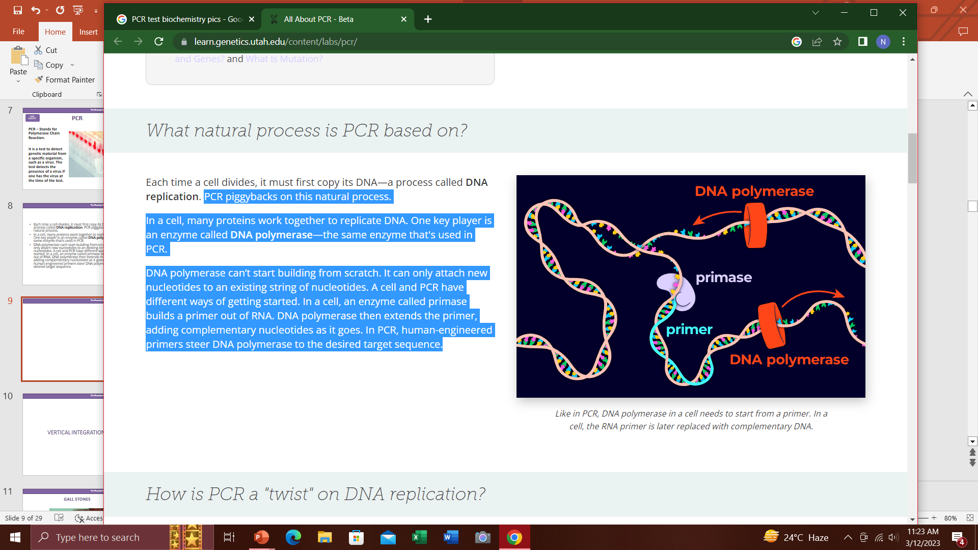
DNA Polymerase
Core Knowledge
Like in PCR, DNA polymerase in a cell needs to start from a primer.
In a cell, the RNA primer is later replaced with complementary DNA.

Slide 11
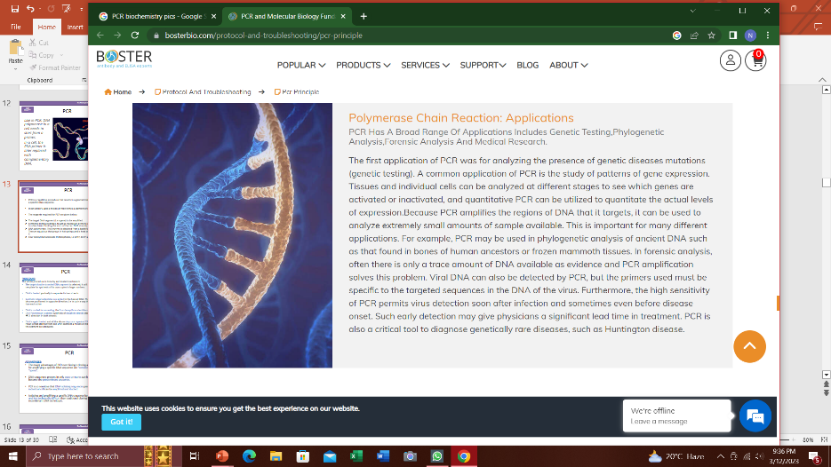
PCR - Amplification
Core Knowledge
PCR is a repetitive procedure that results in a Geometrical Amplification of a specific DNA sequence.
It can amplify upto a million or more times a segment of DNA.

Slide 12
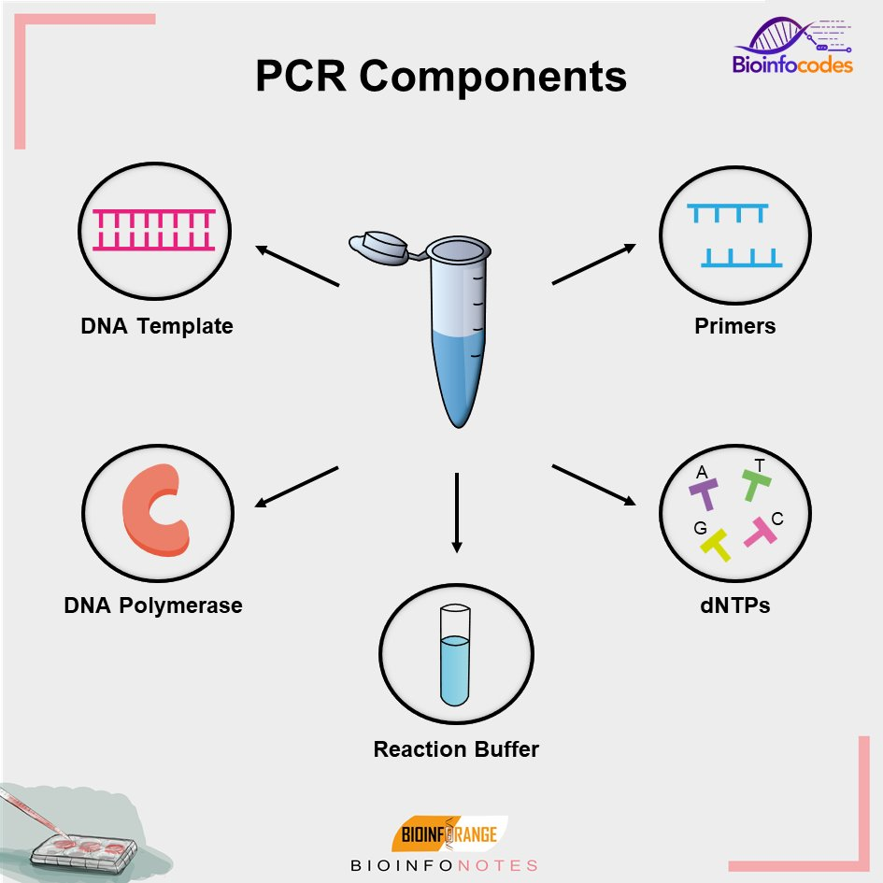
PCR Reagents
Core Knowledge
The Reagents required for PCR are given below:
The Target DNA Segment (i.e a gene) to be amplified.
Synthetic Oligonucleotides, to act as Replication Primers (complementary to a few bases flanking the ends of the two DNA strands)
DNA Polymerase. This enzyme is obtained from a bacterium named Therum Aquaticus that grows in hot springs and is heat stable.
Four Deoxyribonucleoside Triphosphates, i.e dATP, dCTP and dTTP

Slide 13
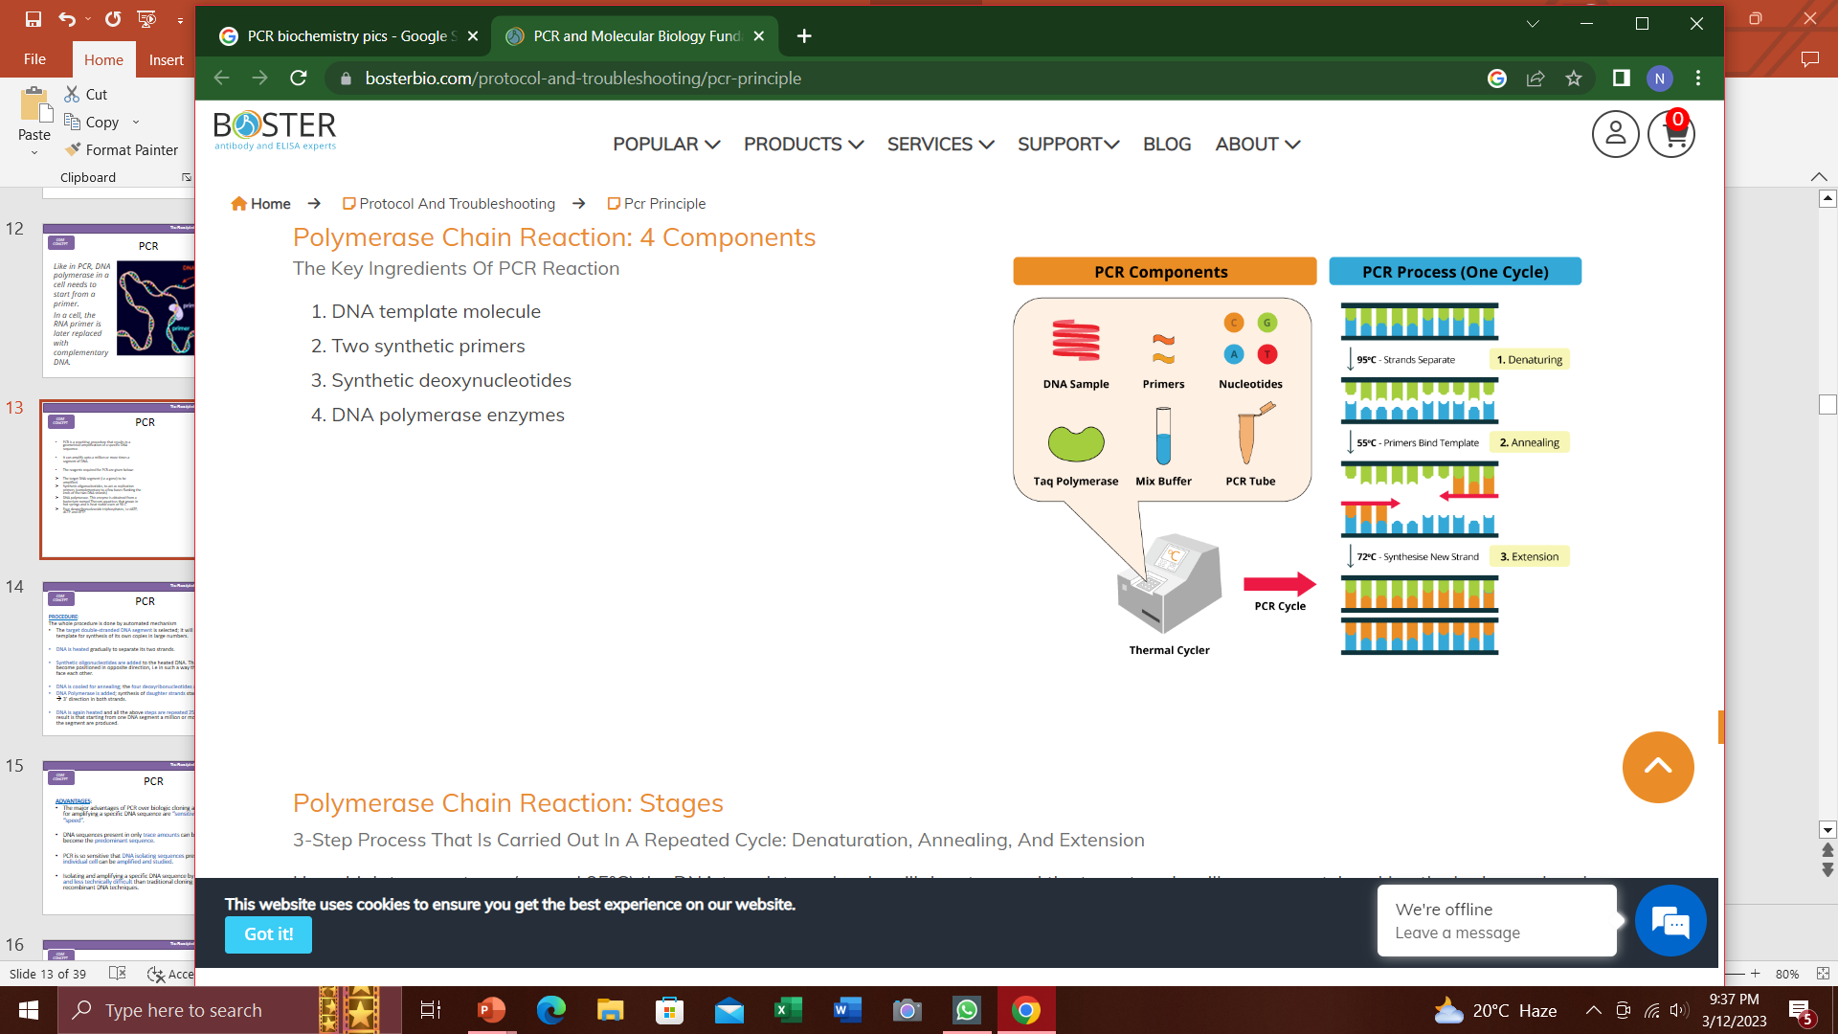
PCR Process
Core Knowledge

Slide 14
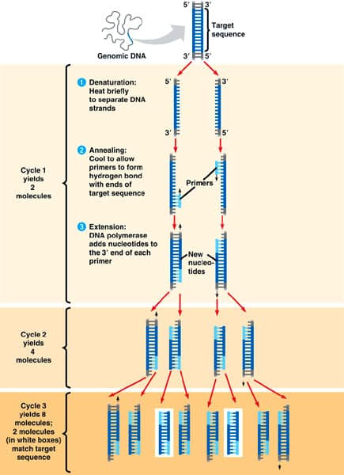
PCR- Procedure
Core Knowledge
Entire Procedure is done by Automated Mechanism
The target double-stranded DNA segment is selected; it will act as the template for synthesis of its own copies in large numbers.
DNA is heated gradually to separate its two strands.
Synthetic oligonucleotides are added to it. These probes become positioned in opposite direction, i.e in such a way that their 3’ ends face each other.

Slide 15
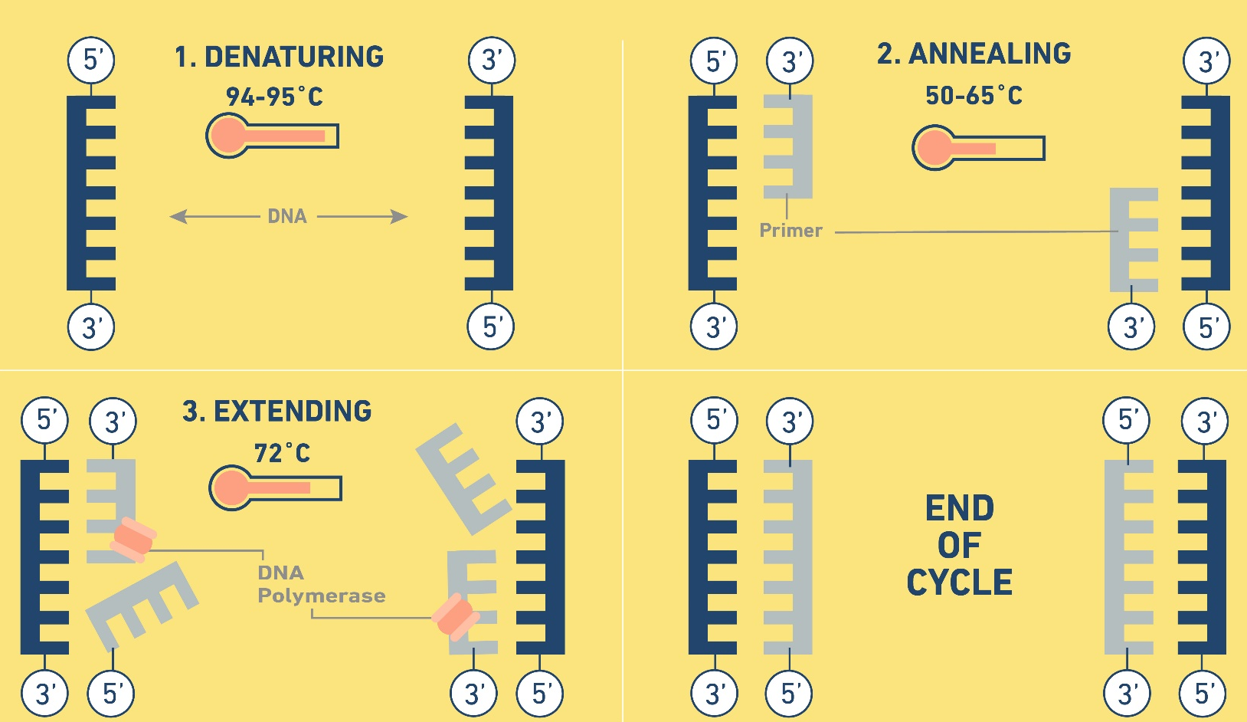
PCR- Procedure
Core Knowledge
DNA is cooled for Annealing; the four deoxyribonucleotides are added.
DNA Polymerase is added; synthesis of daughter strands starts occurring in 5’ → 3’ direction in both strands.

Slide 16
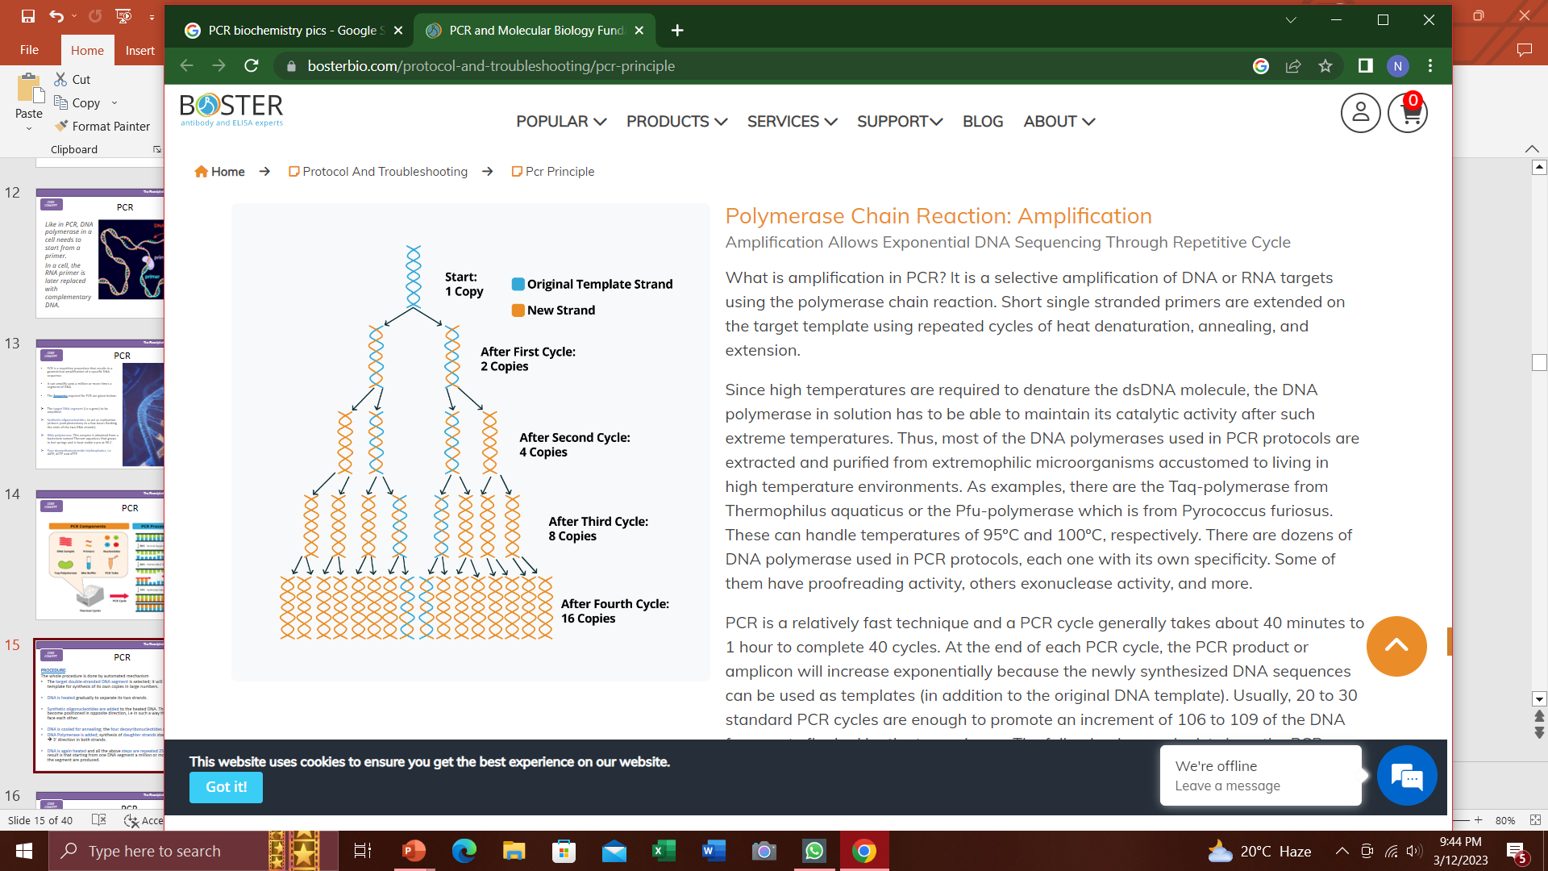
PCR - Procedure
Core Knowledge
DNA is again heated and all the above steps are repeated 25 to 30 times. The result is that starting from one DNA segment a million or more DNA copies of the segment are produced.

Slide 17
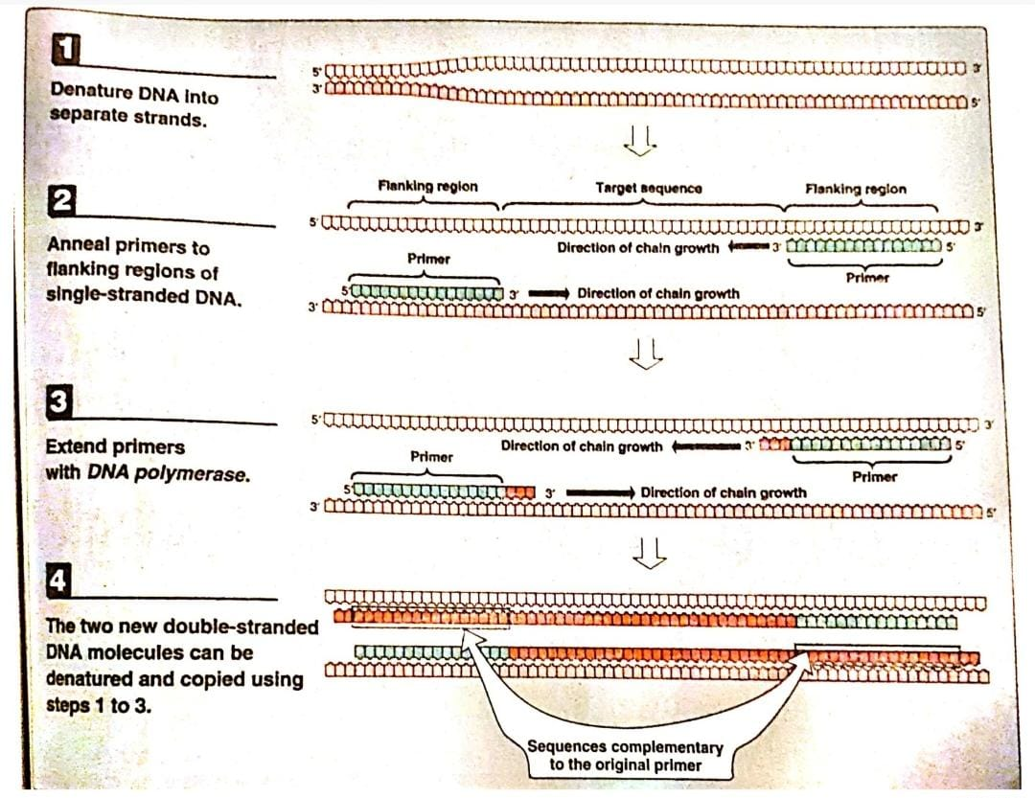
Core Knowledge

Slide 18
Advantages of PCR
Core Knowledge
The major advantages of PCR over biologic cloning as a mechanism for amplifying a specific DNA sequence are “Sensitivity” and “Speed”.
DNA sequences present in only trace amounts can be amplified to become the predominant sequence.
PCR is so sensitive that DNA isolating sequences present in an individual cell can be amplified and studied.
Isolating and amplifying a specific DNA sequence by PCR is faster and less technically difficult than traditional cloning methods using recombinant DNA techniques.

Slide 19
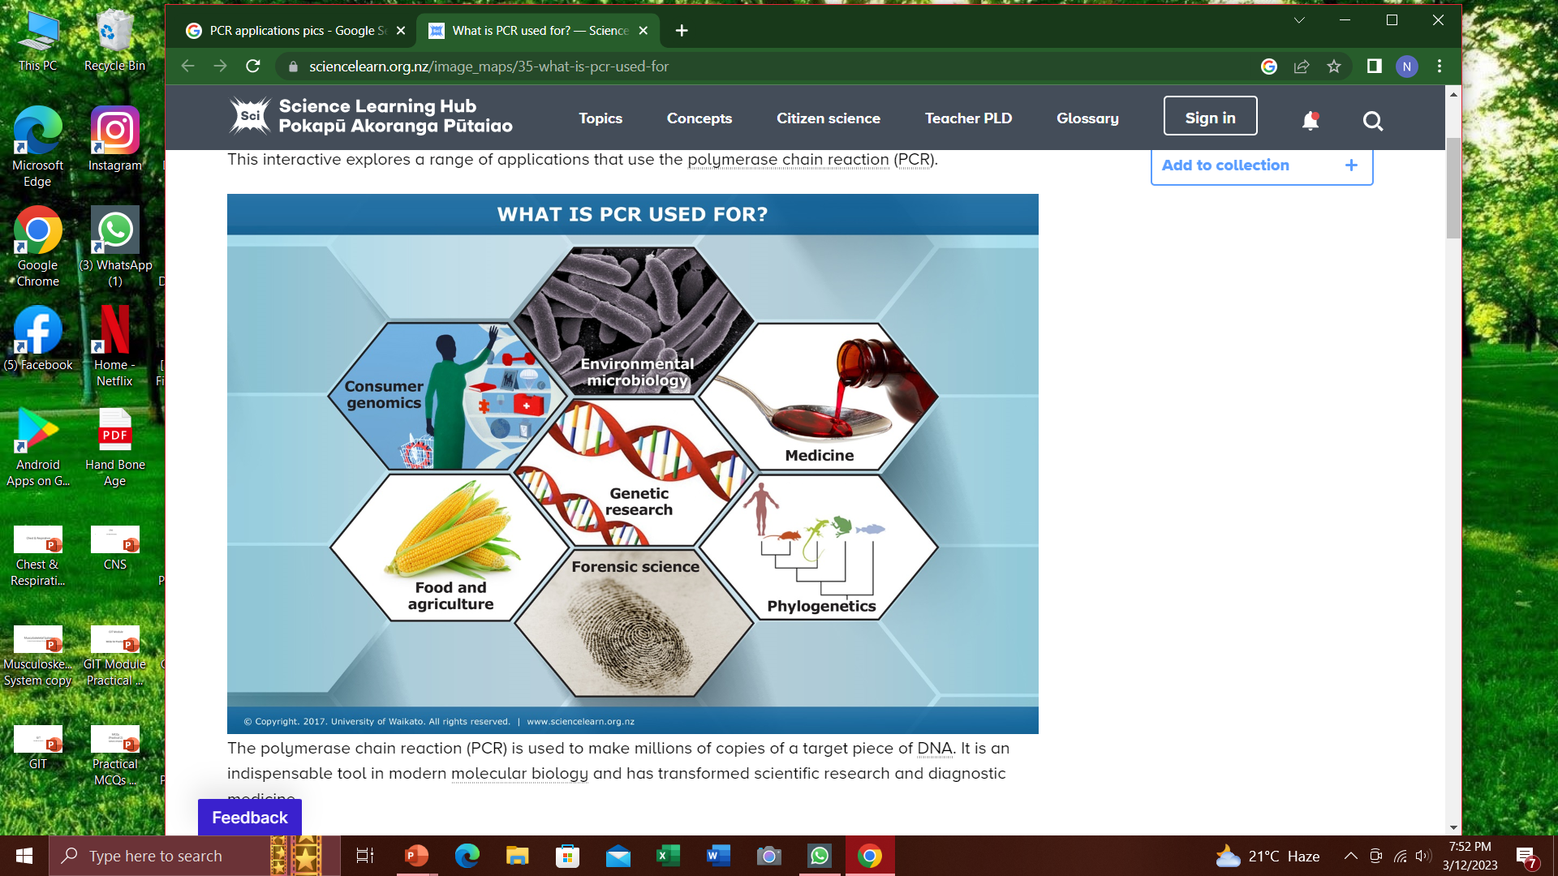
Vertical Integration

Slide 20
PCR- Applications
Vertical Integration
PCR has become a very common tool in Research, Forensics and Clinical Diagnostics:
1. Comparison of a normal gene to its mutant form
2. Forensic analysis of DNA samples
3. Detection of low-abundance nucleic acid sequences
4. Prenatal Diagnosis and carrier detection of cystic fibrosis

Slide 21
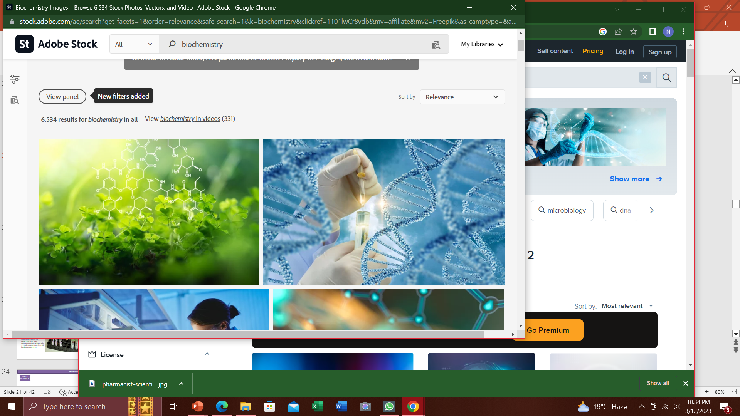
PCR- Applications
Vertical Integration
1. Comparison of a normal gene to its mutant form:
PCR allows the synthesis of mutant DNA in sufficient quantities for a sequencing protocol without laborious biologic cloning of the DNA.

Slide 22
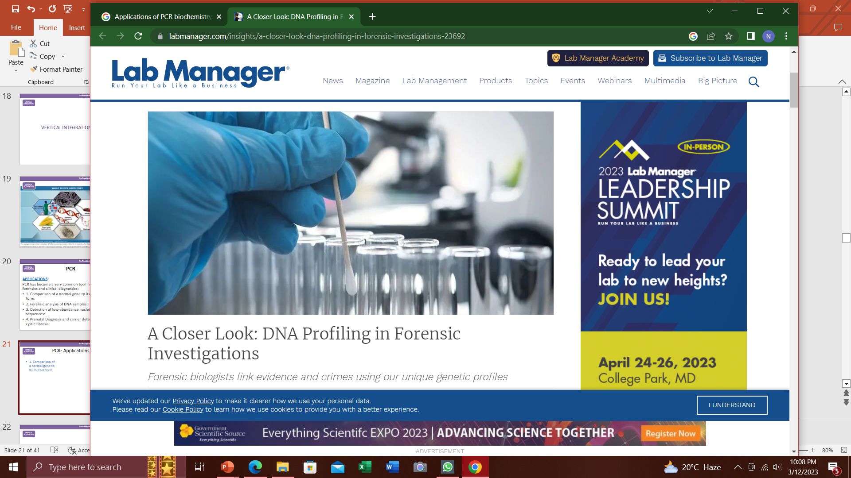
PCR- Applications
Vertical Integration
2.Forensic Analysis of DNA samples:
E.g
DNA fingerprinting
DNA isolation from samples of blood, semen, human hair.

Slide 23
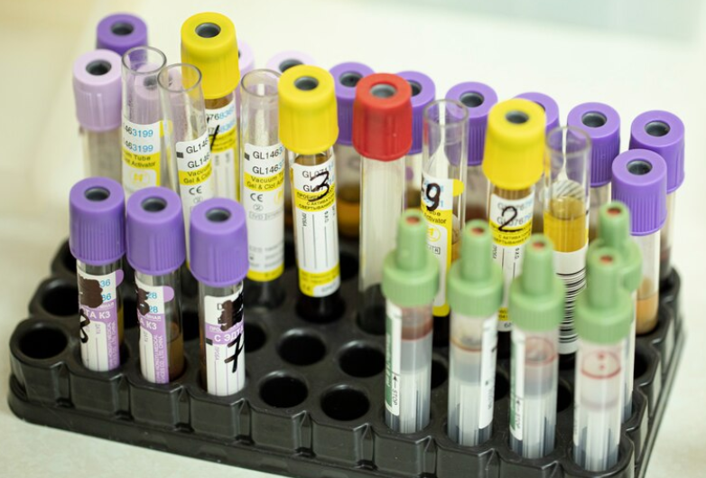
PCR- Applications
Vertical Integration
3. Detection of low-abundance nucleic acid sequences:
E.g HIV
Viruses having long latency period like HIV are difficult to detect at early stage of infection using conventional DNA techniques
PCR offers a rapid and sensitive method for detecting viral DNA sequences even when only a small proportion of a cell harbours the virus

Slide 24
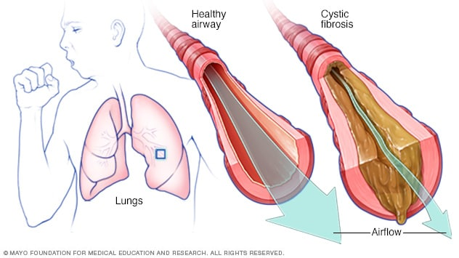
PCR- Applications
Vertical Integration
4. Prenatal Diagnosis and Carrier Detection of Cystic Fibrosis:

Slide 25
Management Of Viral Illnesses
Spiral Integration
Family Medicine
Diagnosis
Education
Dietary Guidelines
Anti-HCV antibody test is recommended to screen for HCV infection
Quantitative HCV RNA testing is recommended before initiating therapy to determine the baseline viral load, and testing for HCV genotype is recommended to help guide treatment decisions.
Monitoring of treatment effectiveness is assessed by repeated measurement of HCV RNA on PCR
Referral

Slide 26
Role of AI in Management
Spiral Integration
Artificial Intelligence
Artificial Intelligence plays role in HCV patients in following aspects:
Different machine learning algorithms are being applied for predicting advanced liver fibrosis in Chronic Hepatitis C patients. The individual model is capable of providing the accuracy up to 94.67%.
In designing healthcare systems, innovative techniques that carefully balance public health initiatives with limited resources.
Increase in access to healthcare, community outreach, and the growth of telemedicine, including safe laboratory testing,
Diagnostic Tools- Improvement in Genetic based Diagnosis.
Drug Development- New Drug Trials

Slide 27
Ethical Consideration
Spiral Integration
Bioethics
Patient Involvement in treatment decisions of HCV & Safeguarding patients privacy (Autonomy)
Keeping knowledge & skills regarding diagnosis & treatment of HCV current (Non-Maleficence)
Competent & timely delivery of healthcare to patients infected with HCV (Beneficence)
Delivering healthcare without prejudice- not to provide treatment to an individual infected with HCV solely on that fact is unethical (Justice)
Spiral Integration

Slide 28
Assessing the feasibility of free DNA for Disaster Victim Identification and Forensic Applications
Spiral Integration
Research Article
Wikanda Worrapitirungsi, Tikumphorn Sathirapatya, Poonyapat Sukawutthiya, Kornkiat Vongpaisarnsin & Pagparpat Varrathyarom
Scientific Reports Article number: 5411 (2024) https://rdcu.be/dAEH5
In tropical disaster victim identification (DVI) scenarios, challenging environmental conditions lead to accelerated DNA degradation in remains. To further enhance the utilization of leached DNA from tissue in the preservative solution (termed “free DNA”) as an alternative source, we incorporated new results by assessing its integrity in postmortem and decomposing cadavers preserved in DNA/RNA Shield™ and modified TENT, with silica-based purification (QIAquick®) for faster processing. The psoas muscle tissues of one decomposed and ten cadavers were preserved in each solution at 25 °C and 35 °C for 3 months. Free DNA efficiency was compared with individual reference samples for reliable results in quantity, quality, and STR profiles. The findings revealed that DNA/RNA Shield™ effectively preserves free DNA integrity for extended storage, while modified TENT is more suitable for short-term storage due to higher degradation levels. Moreover, the use of free DNA samples with massive parallel sequencing displays potential for forensic DNA analysis. Successful amplification of the mtDNA control region enables variant calling and heteroplasmy analysis while also serving as quality control using ACTB and enabling differentiation within the 16S rRNA region for microbiome analysis. The simplicity of handling free DNA for PCR-based forensic analysis adds to its potential for various applications, including DVI and field-based analysis of biological evidence.

Slide 29
CBL- Assessment
Which enzyme is used for DNA amplification in PCR?
What is the first step of a PCR cycle?
Which molecule serves as a starting point for DNA synthesis in PCR?
What is the optimal temperature range for primer annealing in PCR?
Which type of nucleic acid is amplified in conventional PCR?

Slide 30
How to use HEC Digital Library
Spiral Integration
Steps to Access HEC Digital Library
Go to the website of HEC National Digital Library
http://www.digitallibrary.edu.pk
2. On Home Page, click on the INSTITUTES.
3. A page will appear showing the universities from Public and Private Sector and other Institutes which have access to HEC National Digital Library (HNDL).
4. Select your desired Institute.
5. A page will appear showing the resources of the institution
6. Journals and Researches will appear
7. You can find a Journal by clicking on JOURNALS AND DATABASE and enter a keyword to search for your desired journal.

Slide 31
Learning Resources
Essentials of Biochemistry Vol 1 – Mushtaq Ahmad. 9th edition. Page no 462
Lippincott illustrated reviews. Biochemistry. 8th edition. Pages 534, 547, 550, 551.
Google Images

Slide 32


