Slide 2
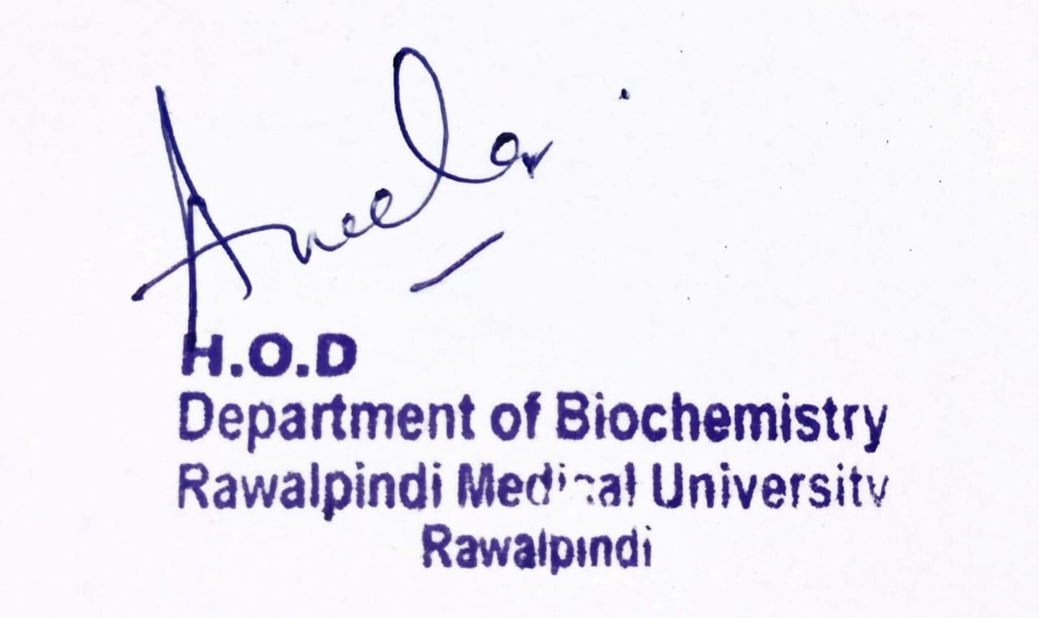
Blood and Immunity Module Case Based Learning 1st Year MBBS Thalassemia
Presenter: Dr Sana Latif Date: 24-01-25
(Senior Demonstrator)

Slide 3
Motto, Vision, Dream
To impart evidence based research oriented medical education
To provide best possible patient care
To inculcate the values of mutual respect and ethical practice of medicine
Wisdom
Truth
Service

Slide 4
Professor Umar Model of Integrated Lecture

Slide 5
Learning Objectives
At the end of this session students will be able to:
Discuss the structure of haemoglobin
Explain the types of haemoglobin
Tell the normal range of haemoglobin in children and adults
Classify haemoglobinopathies.
Describe the biochemical basis of thalassemia
Explain the clinical manifestations of thalassemia
Discuss briefly about the treatment of thalassemia
Explain & correlate the clinical aspects of core concept
Correlate and build core knowledge on the basis of latest research

Slide 6
Interactive Session
An 8 years old boy was brought to hospital for blood transfusion. A diagnosed case of beta Thalassemia Major since he was one and a half year old, for which he had been undergoing blood transfusions since then.
On general examination he was malnourished with a short stature, had yellow tinged fingernails, frontal bossing and maxillary expansion.
His peripheral blood smear examination and hemoglobin electrophoresis reports showed beta thalassemia major.

Slide 7
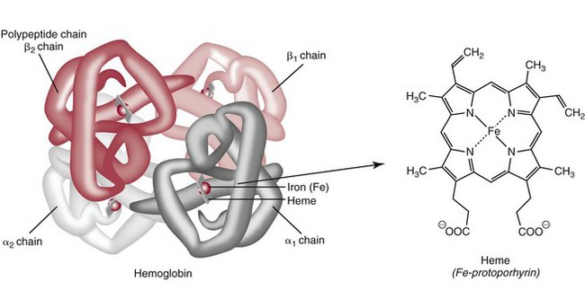
Haemoglobin
Core Knowledge

Slide 8
Types Of Haemoglobin
Core Knowledge

Slide 9
Haemoglobinopathies
Core Knowledge
A group of inherited disorders characterized by structural variations of the Hb molecule.
They are Disorders of Globin synthesis rather than heme synthesis.
These may result from :
Synthesis of Abnormal Hb
Reduced rate of synthesis of NORMAL α or β globin chains
Patients only have these disorders if they inherit two unusual hemoglobin genes – one each from both the parents.
People who inherit just one unusual gene are known as ‘carriers’ i.e have a ‘trait’.
Carriers are healthy and do not have the disorders.

Slide 10
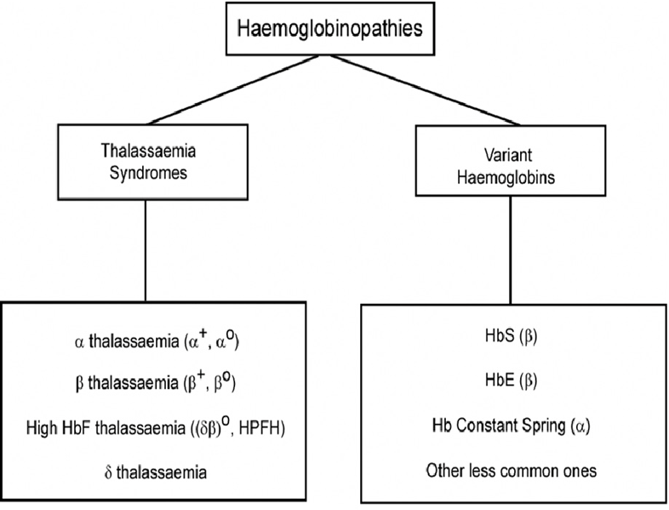
Types Of Haemoglobinopathies
Core Knowledge

Slide 11
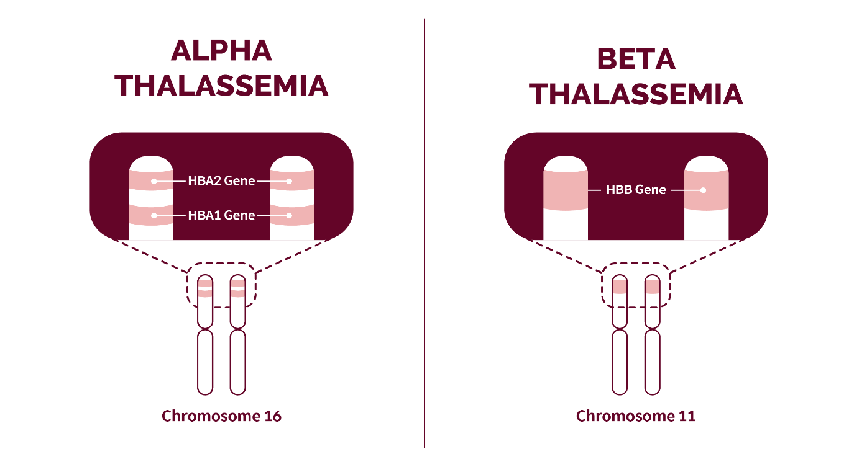
Thalassemia
Core Knowledge

Slide 12
Biochemical Basis Of Thalassemia
Core Knowledge

Slide 13
Alpha Thalassemia
Core Knowledge
A group of genetic disorders with defective α-chain synthesis.
Chromosome 16 carries 2 α genes, the total number of α-genes is 4.
Severity depends upon the patient’s affected number of genes.
Decrease in the synthesis of HbA, HbF, and HbA2.
5. The net result is an excess of β-chains and γ-chains which may polymerize into tetrameric forms γ4 called Hb Bart’s and β4 called HbH.
These abnormal Hb Bart’s and HbH are the characteristics of α-thalassemia.
Usually manifested immediately after birth or even in utero because the α-gene is activated early in fetal life.

Slide 14
Alpha Thalassemia
Core Knowledge

Slide 15
Beta Thalassemia
Core Knowledge

Slide 16
Beta-thalassemia Major
Core Knowledge
Also known as Cooley’s Anaemia:
The homozygous state of β-thalassemia (β⁰β⁰).
A globin gene mutation causes partial β-gene or total β-gene chain loss.
Increase in the production of γ-chains and δ-chains
The β chain when replaced by the 2-γ chain forms Hb F; when replaced by δ-chains, will form Hb A2.
Only HbF (>90%) and HbA2 (3% to 8%) on Electrophoresis.
Marked microcytosis and hypochromia.
MCV is <70 fl, and Hb is 2 to 3 g/dL
Hepatosplenomegaly, bony deformities, and failure to thrive as an infant.
patients are dependent upon blood transfusion.

Slide 17
Beta Thalassemia
Core Knowledge
Beta – Thalassemia Intermedia:
partial deletion of β⁰ of both beta genes.
These are homozygous (β⁺β+) genes.
A wide spectrum of the disease with moderate to severe anemia, and Hb between 6 to 10 g/dL.
There are growth retardation and bony abnormalities.
This usually occurs later than the major thalassemia type.
Electrophoresis shows Hb F 20% to 40% and increased Hb A2, 3% to 8%.
Beta – Thalassemia Minor:
where a single β-gene is affected (β⁰/β).
There is mild anemia Hb 9 to 11 g/dL or no anemia.
Normal to increased RBC count.
RBCs are microcytes, MCV 60 to 70 fl.
Electrophoresis shows a mild increase in Hb F and Hb A2 (3% to 8%).

Slide 18
A Brief Overview: Thalassemia
Core Knowledge

Slide 19
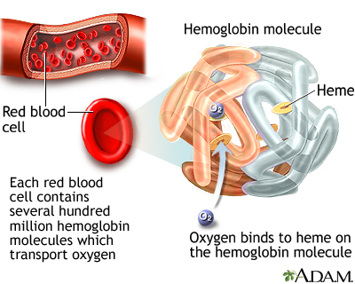
Anatomy Of The Blood
Horizontal Integration

Slide 20
Normal Range of Hb
Horizontal Integration

Slide 21
Physiology Of the Blood
Horizontal Integration
Each red blood cell (RBC) comprises approximately 280 million molecules of Haemoglobin.
There are more than 350 types of abnormal hemoglobin
An average adult is said to have close to 1.74 pounds or 790 grams of Hb.
Our red blood cells are red due to the heme groups in haemoglobin. Heme contains iron imparting a red colour to the molecule.
Haemoglobin forms an unstable and reversible bond with oxygen. It is referred to as oxyhaemoglobin in the oxygenated state and is bright red in colour and is purplish blue in shade in the reduced state.

Slide 22
Clinical Manifestations Of Thalassemia
Vertical Integration
Thalassemia signs and symptoms can include:
Fatigue
Weakness
Pale or yellowish skin
Facial bone deformities
Slow growth
Abdominal swelling
Dark urine

Slide 23
Vertical Integration

Slide 24
Management of Thalassemia
Spiral Integration
Family Medicine
Family Medicine plays important role in following manner:
Diagnosis
Education
Dietary Guidance
Monitoring
Refer to Specialists

Slide 25
Role of Artificial Intelligence in Managing
Spiral Integration
Artificial Intelligence
Artificial Intelligence plays role in following aspects:
Personalized Nutrition
Diagnostic Tools
Food Recommendations
Drug Development

Slide 26
Ethical Consideration
Spiral Integration
Bioethics
Informed Consent
Resource Allocation
Ethical Consideration
Access to Healthcare

Slide 27
Unveiling Extramedullary Hematopoiesis: A Case Report Highlighting the Causes, Symptoms, and Management Strategies
Spiral Integration
Research Article
Abstract
Extramedullary hematopoiesis (EMH) serves as a compensatory mechanism in chronic hemolytic anemias, such as thalassemia, and can result in spinal cord compression. This case report highlights a 36-year-old woman with transfusion-dependent β-thalassemia (TDT) who presented with lower extremity motor deficiency, pelvic paresthesia, and bladder dysfunction. The patient had a history of lower back pain, bilateral lower limb weakness, and demonstrated poor compliance with iron chelation therapy. MRI findings indicated spinal cord compression attributable to extramedullary hematopoiesis. Due to the infeasibility of surgical intervention, the patient underwent hypertransfusion and iron chelation therapy. While neurological symptoms improved, urinary retention persisted. The patient continues to receive iron chelation treatment and undergo transfusions. Managing extramedullary hematopoiesis in thalassemia necessitates an individualized treatment approach.
Link:
https://www.mdpi.com/2039-4365/14/2/4
Journal Name:
Thalass. Rep., Volume 14, Issue 2 (June 2024)
Author Name:
Konstantinos Manganas, Aikaterini Xydaki ,Angeliki Kotsiafti ,Olympia Papakonstantinou and Sophia Delicou

Slide 28
CBL- Assessment
1. Which globin chain is defective in β-thalassemia?
2. What mutation causes α-thalassemia?
3. Which hemoglobin type increases in β-thalassemia?
4. What biochemical test diagnoses thalassemia?
5. How does thalassemia affect RBC lifespan?

Slide 29
CBL- MCQ Assessment
1. Which protein in red blood cells carries oxygen? A) Hemoglobin B) Albumin C) Myoglobin D) Fibrinogen E) Ferritin
2. Which metal ion is essential for hemoglobin function? A) Zinc B) Iron C) Copper D) Calcium E) Magnesium
3. Which enzyme is required for heme biosynthesis? A) Catalase B) Hexokinase C) Transaminase D) Pyruvate kinase E) ALA Synthase
4. Which type of hemoglobin is increased in β-thalassemia? A) HbA2 B) HbA C) HbF D) HbS E) HbC

Slide 30
CBL- MCQ Assessment
5. Which biochemical test is used for thalassemia diagnosis? A) Electrophoresis B) PCR C) Western blot D) ELISA E) Spectrophotometry
6. Which globin chain is absent in α-thalassemia? A) Alpha B) Beta C) Gamma D) Delta E) Epsilon
7. Which genetic mutation causes β-thalassemia? A) Deletion B) Frameshift C) Point D) Insertion E) Duplication
8. Which organ is responsible for iron storage? A) Brain B) Kidney C) Heart D) Liver E) Pancreas

Slide 31
CBL- MCQ Assessment
9. Which vitamin enhances iron absorption? A) Vitamin B12 B) Vitamin D C) Vitamin K D) Vitamin A E) Vitamin C
10. What is the most common inheritance pattern of thalassemia? A) Autosomal recessive B) Autosomal dominant C) X-linked recessive D) X-linked dominant E) Mitochondrial
Answers
A
B
E
C
A
A
C
D
E
A

Slide 32
How to use HEC Digital Library
Steps to Access HEC Digital Library
Go to the website of HEC National Digital Library
http://www.digitallibrary.edu.pk
2. On Home Page, click on the INSTITUTES.
3. A page will appear showing the universities from Public and Private Sector and other Institutes which have access to HEC National Digital Library (HNDL).
4. Select your desired Institute.
5. A page will appear showing the resources of the institution
6. Journals and Researches will appear
7. You can find a Journal by clicking on JOURNALS AND DATABASE and enter a keyword to search for your desired journal.

Slide 33
Learning Resources
Lippincott Illustrated Reviews - BIOCHEMISTRY, Eighth Edition, Chapter 3, Page # 36 - 43.
Google images
Google scholar

