Slide 1
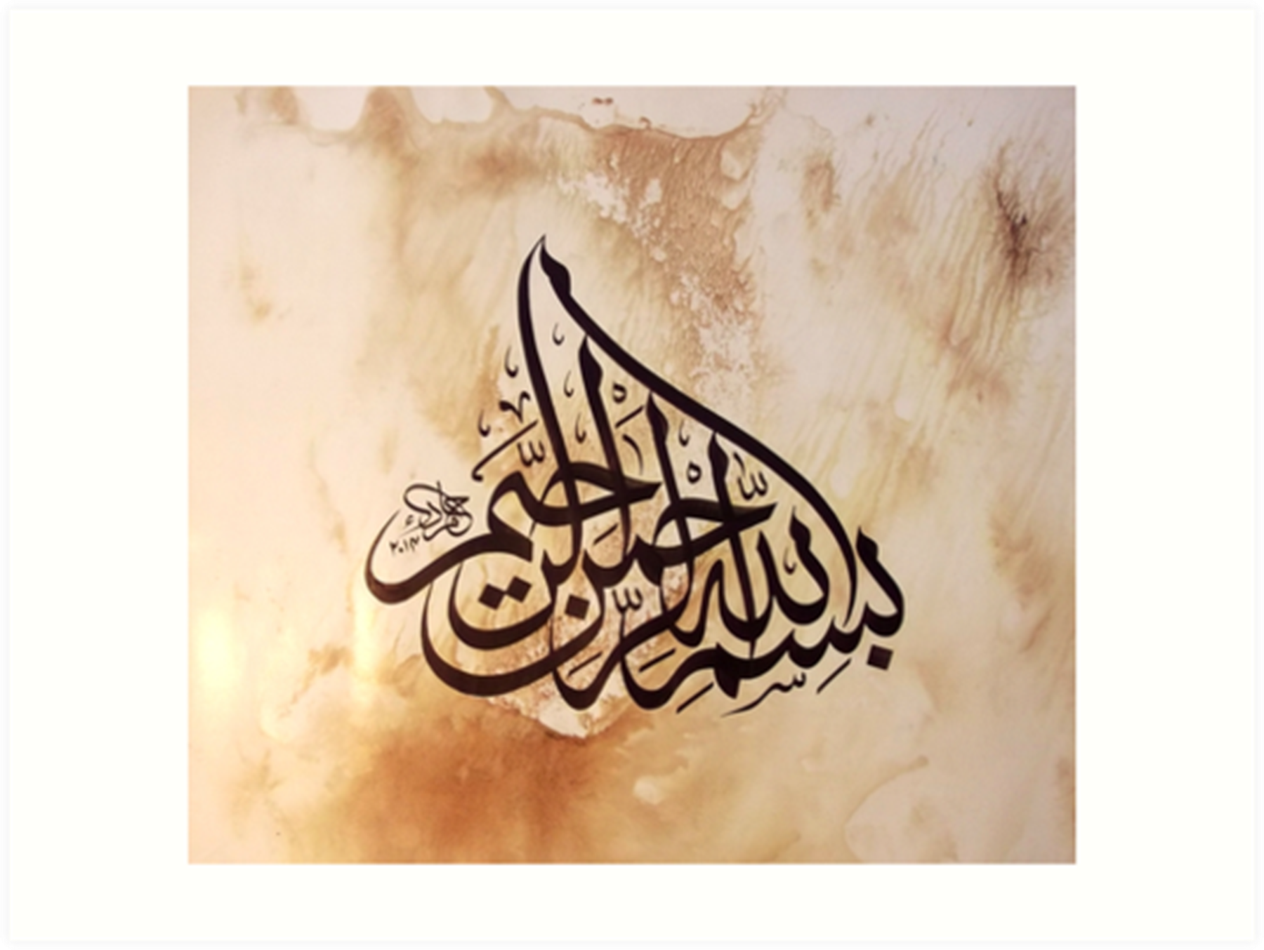

Slide 2
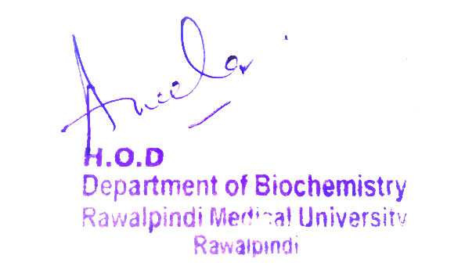
Blood & Immunity Module First Year MBBS(CBL) Jaundice
Presenter: Dr. Romessa Naeem Date: 24-02-25
(Demonstrator)

Slide 3
Motto, Vision, Dream
To impart evidence based research oriented medical education
To provide best possible patient care
To inculcate the values of mutual respect and ethical practice of medicine
Wisdom
Truth
Service

Slide 4
Professor Umar Model of Integrated Lecture

Slide 5
Learning Objectives
At the end of this session students should be able to
Describe the pathway of heme degradation
Describe causes and biochemical parameters of different types of Jaundice.

Slide 6
Interactive Session
A 39 years obese lady presented in ER with complains of nausea, vomiting and severe pain in the right upper quadrant. She had history of intolerance to fatty food. She had pale skin and sclerae. Her labs showed conjugated hyperbilirubinemia with absent urinary urobilinogen. Ultrasound abdomen was done that showed multiple stones in the gall bladder. Her endoscopy showed a stone impacted in the common bile duct. She was diagnosed to have Obstructive Jaundice.

Slide 7
Heme Degradation
Core Knowledge

Slide 8
Jaundice
Core Knowledge

Slide 9
Core Knowledge

Slide 10
Core Knowledge

Slide 11
Core Knowledge

Slide 12
Summary
Core Knowledge

Slide 13
Neonatal Jaundice
Core Knowledge

Slide 14
Treatment : Phototherapy
Core Knowledge

Slide 15
Anatomy of Hepatobiliary System

Slide 16
Physiological Role of Bilirubin
In Antioxidant
Waste product removal
Indicator of Liver Function

Slide 17
Viral Hepatitis

Slide 18
Management of Obstructive Jaundice
Spiral Integration
Family physician helps the patient in following way:
Diagnosis of the patient based on history ,examination and laboratory investigation
Manage the complications(Ascites , hepatic encephalopathy and variceal bleeding)
Educates and counsel the patient and his family
Life style modification(regular exercise , healthy diet ,avoid certain medication and abstain from alcohol )
Refer to Specialists.

Slide 19
Ethical Consideration
Spiral Integration
Informed Consent
Equity in Access to care
Family and Care giver Support
Resource Allocation

Slide 20
Role of AI in Managing Obstructive Jaundice
Spiral Integration
Diagnosis and Prediction
Personalized treatment
Disease Management
Healthcare Operations
Counselling through AI Chatbots
Remote Monitoring

Slide 21
Suggested Research Article
Link:
https://www.ncbi.nlm.nih.gov/pmc/articles/PMC5088
Journal:
Semin Intervent Radiol
Title:
A Systematic Approach to Patients with Jaundice
Author:
Bilal Gondal, MD, MRCSI¹ and Andrew Aronsohn,
Abstract
Jaundice is a clinical manifestation of disorders of underlying bilirubin metabolism, hepatocellular dysfunction, or biliary obstruction. As clinical presentations of yellowing of eyes or skin can be somewhat nonspecific for the underlying etiology of disease, a stepwise approach to evaluation is necessary for accurate diagnosis and effective treatment plan. In this review, we discuss underlying mechanisms of cholestasis and jaundice as well as laboratory and imaging modalities needed to evaluate a patient presenting with hyperbilirubinemia. Jaundice occurs in settings of cholestasis or inability to effectively secrete bile as well as disorders of bilirubin metabolism and hepatocellular dysfunction. Clinical signs of jaundice occur when the serum bilirubin level exceeds 2.5 to 3 mg/dL. In all cases, evaluation begins with liver chemistry tests which include bilirubin (conjugated and unconjugated), alkaline phosphatase, alanine aminotransferase, aspartate aminotransferase, and total protein.

Slide 22
How To Access Digital Library
Steps to Access HEC Digital Library
Go to the website of HEC National Digital Library.
On Home Page, click on the INSTITUTES.
A page will appear showing the universities from Public and Private Sector and other Institutes which have access to HEC National Digital Library HNDL.
Select your desired Institute.
A page will appear showing the resources of the institution
6. Journals and Researches will appear
7. You can find a Journal by clicking on JOURNALS AND DATABASE and enter a keyword to search for your desired journal.

Slide 23
Assessment
What is the normal level of bilirubin?
Which liver function enzyme is raised in post-hepatic jaundice?
Enlist causes of pre-hepatic jaundice.
What happens to urine urobilinogen in post-hepatic jaundice?
Why bilirubin is transported in plasma bound to albumin?

Slide 24
Learning Resources
Lippincott Illustrated Reviews Biochemistry, 8th Edition, Chapter 21 Page #316-317 Google scholar
Text book of Harpers Biochemistry 32nd edition chapter 48 page#566
Google images

Slide 25
THANK YOU

