Slide 1
Brucellosis & amoebiasis
Dr. Muhammad Mujeeb Khan
FCPS (Medicine)
Dip. DM (UK), Dip. Nutrition (Pak),
MSc. Infectious Diseases (UK)
Associate Professor
Rawalpindi Medical University, Rawalpindi

Slide 2
University Motto, Vision, Values & Goals
Mission Statement
To impart evidence-based research-oriented health professional education
Best possible patient care
Mutual respect, ethical practice of healthcare and social accountability.
Vision and Values
Highly recognized and accredited center of excellence in medical education, using evidence-based training techniques for development of highly competent health professionals, who are lifelong experiential learner and are socially accountable.
Goals
The Undergraduate Integrated Learning Program is geared to provide you with quality medical education in an environment designed.

Slide 3
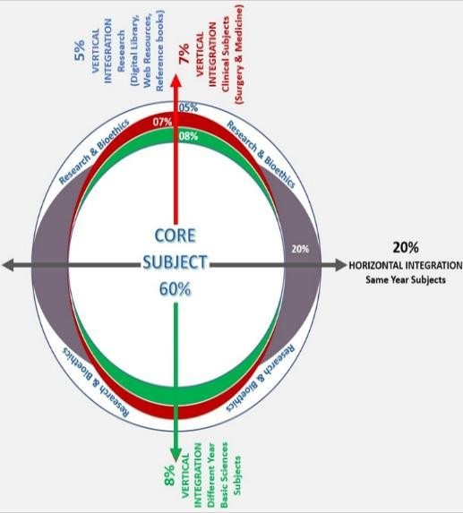
PROF UMER MODEL OF INTEGRATED LECTURE

Slide 4
SEQUENCE OF LGIS
Learning objectives
What is Brucellosis and Amoebiasis and how to diagnose it?(core concept = 70%)
Related pathology and pharmacology (horizontal integration 15%)
Recent advances and developments. (vertical integration – 10%)
Research article related to topic (3%) Ethics (2%)

Slide 5
LEARNING OBJECTIVES
At the end of the lecture, students will have learnt about
➢ What is Brucellosis and Amoebiasis?
➢ Transmission and risk factors
➢ Pathophysiology
➢ Approach and management
➢ Complications and prevention
➢ Recent advances

Slide 6
Brucellosis - Introduction
Brucellosis id caused by enzootic infection (endemic in animals)
Gram negative Bacilli
Caused by Brucella species:
B. melitensis (Goats, sheep and camels) It causes most severe disease
B. abortus (cattle)
B. suis (Pigs)
B. canis (dogs)

Slide 7
Introduction
Most common in regions with poor veterinary control and unpasteurized dairy consumption
Global burden: Estimated 500,000 cases annually

Slide 8
Transmission and risk factors
Transmission:
Direct contact with infected animals (farmers, veterinarians).
Consumption of unpasteurized milk or dairy products.
Inhalation of contaminated aerosols (laboratory workers)
Risk factors
Occupational exposure (farmers, slaughterhouse workers).
Consumption of unpasteurized dairy products.
Travel to endemic regions (Mediterranean, Middle East, South America).

Slide 9
Enters through ingestion, broken mucous membrane or skin
Phagocytosed by macrophages but evade immune destruction
PATHOPHYSIOLOGY OF BRUCELLOSIS
Spreads to reticuloendothelial system
Chronic infection leads to granuloma formation and systemic inflammation
Cytokine release (TNF-α, IL-1, IL-6) causes fever, fatigue, and systemic symptoms.

Slide 10
Clinial Features
Fever : High swinging temperature, rigors
Night sweats.
Fatigue.
Arthralgia (joint pain).
Weight loss.
Hepatosplenomegaly
Patient may present with complications

Slide 11
Complications
Osteoarthritic
Sacroiliitis
Spondylitis
Arthritis
Cardiovascular : Endocarditis
Neurobrucellosis
Respiratory:
Pneumonia, pleural effusion
Gastrointestinal
Hepatitis
Splenomegaly, Splenic abscess
Reproductive
Orchitis/epididmitis
Infertility in chronic cases
Hematological
Anemia, leukopenia, Thrombocytopenia

Slide 12
Diagnosis of Brucellosis
Cultures :
Blood culture (gold standard). Positive in 75-80%
Bone marrow culture in case of prior antibiotic use
Alert the Laboratory about suspected brucellosis as organism may infect laboratory workers
Serology:
Antibody titre of more than 1/320 in endemic area
Four fold rise in titre
PCR for Brucella DNA

Slide 13
TREATMENT
 | Treatment
Brucelosis with no complications | Doxycyline + rifampicin (6 wweks)
Bone disease: | Doxycycline + rifampicin (6 weeks) + gentamicin (7 days)
Neurobrucellosis: | Doxycycline + rifampicin (6 weeks) + ceftriaxone
Endocarditis: | Doxycyline + Rifampicin (6 weeks) + Gentamicin Almost always need surgical intervention

Slide 14
Prevention
Avoid consumption of unpasteurized dairy products.
Use protective gear when handling animals or animal products.
Vaccination of livestock (not available for humans).
Public health measures: Control of animal brucellosis, education on safe food practices

Slide 15
Recent Advances
Vaccine Development: Research on human vaccines is ongoing, but no approved vaccine is available yet.
New Diagnostic Tools: Rapid PCR tests for early detection.
Nanotechnology: Nanoparticles for targeted drug delivery to infected cells

Slide 16
References
World Health Organization. Brucellosis in humans and animals. Geneva: WHO; 2006.
Pappas G, Akritidis N, Bosilkovski M, Tsianos E. Brucellosis. N Engl J Med. 2005;352(22):2325-36.
Centers for Disease Control and Prevention. Brucellosis: Diagnosis and treatment. CDC; 2023.
Franco MP, Mulder M, Gilman RH, Smits HL. Human brucellosis. Lancet Infect Dis. 2007;7(12):775-86

Slide 17
amoebiasis
Dr. Muhammad Mujeeb Khan
FCPS (Medicine)
Dip. DM (UK), Dip. Nutrition (Pak),
MSc. Infectious Diseases (UK)
Associate Professor
Rawalpindi Medical University, Rawalpindi

Slide 18
Amoebiais
Caused by the protozoan parasite Entamoeba histolytica.
Most common in tropical and subtropical regions with poor sanitation.
Global burden: Estimated 50 million cases annually, with 100,000 deaths

Slide 19
Transmission and Risk Factors
Transmission:
Fecooral route: Ingestion of food or water contaminated with E. histolytica cysts.
Direct person-to-person contact (poor hygiene).
Risk Factors:
Living in or traveling to endemic areas (tropical and subtropical regions).
Poor sanitation and hygiene practices.
Consumption of contaminated food or water.
Immunocompromised individuals (e.g., HIV/AIDS).

Slide 20
E. histolytica cysts are ingested and excyst in the small intestine, releasing trophozoites.
Trophozoites colonize the large intestine, causing tissue invasion and ulceration
PATHOPHYSIOLOGY
OF AMOEBIASIS
Trophozoites can spread to the liver via the portal vein, leading to liver abscess formation

Slide 21
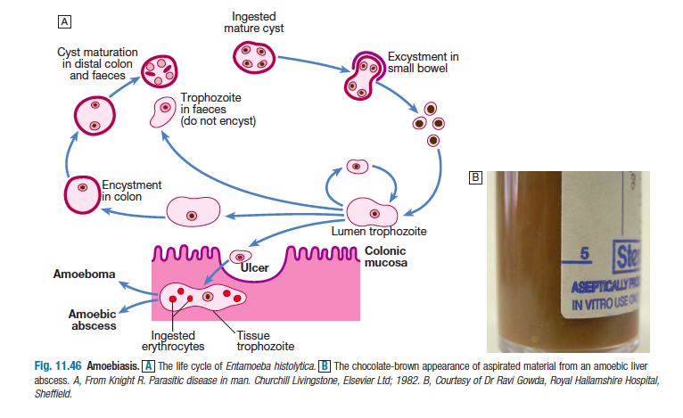

Slide 22
CLINICAL FEATURES
Intestinal
Extra intestinal
Asymptomatic carriers
Amoebic colitis
Fulminant colitis
Ameboma
Liver: Amoebic liver abscess
Lung: Pleuropulmonary Amoebiasis due to direct spread of liver abscess in pleural cavity
Heart: Pericardial amoebiasis. Spread of left lobe liver abscess into pericardium
Cerebral amoebiasis: Due to hematogenous spread

Slide 23
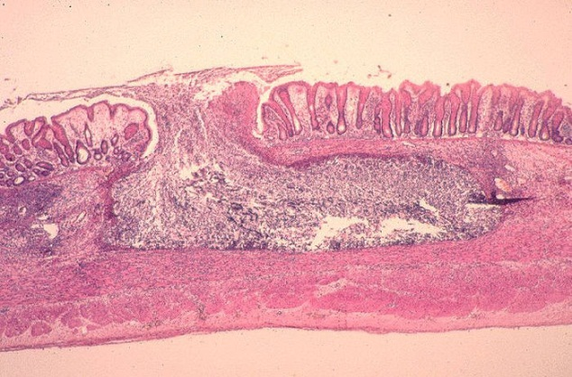
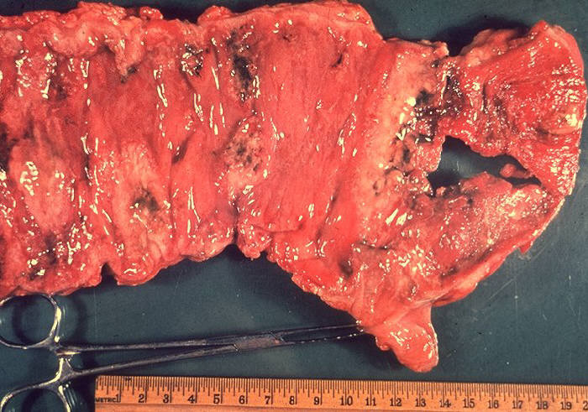
AMOEBIC ULCERS
Amoebic colitis
- flask shaped ulcers (Narrow neck & wide base)
- Abdominal pain, diarrhea (bloody), fever
- tenesmus, peri-anal ulcers
Fulminant colitis - <0.5%
- severely ill with high fever
- intestinal bleeding
- perforation
- paralytic ileus

Slide 24
AMOEBIC VS BACILLARY DYSENTRY
Symptom | Bacillary dysentery | Amoebic dysentery
Onset | Acute | Gradual
General Condition | Poor | Normal
Fever | High grade | Low grade (adult)
Tenesmus | Severe | Moderate
Dehydration | Frequent | Mild dehydration (adult)
Faeces | No trophozoites | Trophozoites present
Culture | Positive | Negative

Slide 25
Diagnosis
Stool microscopy (cysts and trophozoites).
Serology (ELISA for anti-E. histolytica antibodies).
Imaging (ultrasound or CT for liver abscess)
Sigmoidoscopy: Typical flask shaped ulcers may be seen

Slide 26
TREATMENT
Symptomatic cases
Asymptomatic in non-endemic areas
Asymptomatic if food handlers
 | Drug
 | Metronidazole | Tinidazole | To eradicate Luminal cysts | Diloxanide furoate/paromomycin
Acts on | Kills trophozoites in intestine & tissue | Kills trophozoites in intestine & tissue | Luminal- Eradicate cysts | Luminal- Eradicate cysts
Dose | 800 mg PO tid x 5-10 days | 600 mg bd PO x 5 days | 650 mg PO tid x10days | 500 mg PO tid x10days

Slide 27
AMOEBIC LIVER ABSCESS
Medical Therapy:
Metronidazole or tinidazole for 7-10 days. Followed by Paromomycin or Diloxanide furoate to eliminate intestinal cysts.
Drainage:
Metronidazole or tinidazole for 7-10 days. Followed by Paromomycin or Diloxanide furoate to eliminate intestinal cysts
Percutaneous needle aspiration or catheter drainage for large abscesses (>5 cm) or if there is no response to medical therapy.

Slide 28
COMPLICATIONS OF AMOEBIC LIVER ABSCESS
Rupture of the abscess into:
Peritoneal cavity (peritonitis).
Pleural cavity (empyema).
Pericardium (cardiac tamponade).
Secondary bacterial infection of the abscess.
Sepsis and multiorgan failure

Slide 29
Prevention
Improve sanitation and access to clean water.
Proper handwashing and hygiene practices.
Avoid consumption of raw or undercooked food in endemic areas.
Health education on safe food and water practices

Slide 30
References
World Health Organization. Amoebiasis: Diagnosis and treatment. Geneva: WHO; 2021.
Stanley SL. Amoebiasis. Lancet. 2003;361(9362):1025-34.
Centers for Disease Control and Prevention. Amoebiasis: Epidemiology and risk factors. CDC; 2023.
Haque R, Huston CD, Hughes M, Houpt E, Petri WA. Amoebiasis. N Engl J Med. 2003;348(16):1565-73.

Slide 31
THANK YOU

