Slide 2
Bone Tumors –Bone Forming
CNS & Psychiatry II 4th year MBBS
Dr Mudassira Zahid
Department of Pathology
Rawalpindi Medical University

Slide 4
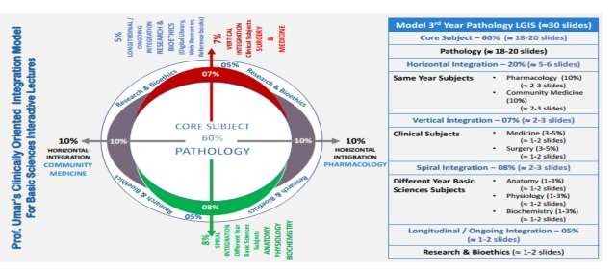

Slide 5
Learning Objectives
Classification of Bone Tumors
Correlation of Bone Tumors with Age and Site of Origin
Morphology of Benign Bone Tumors
Morphology of Osteosarcoma
Morphology of Ewing Sarcoma
Morphology of Giant Cell Tumor (GCT) of Bone
Correlation of Morphology of Tumor Metastasis to Bone with Clinical Presentation
Learning Resources: Robbins & Cotran Pathologic Basis Of Disease 10th Edition

Slide 6
Bone Tumors
CORE PATHOLOGY
Bone tumors are classified into:
Most are classified according to the normal cell of origin and apparent pattern of differentiation
Primary bone tumors
Secondary bone tumors (Metastasis)

Slide 7
CORE PATHOLOGY
Bone-forming tumors
Cartilage-forming tumors
Primary bone tumors
Miscellaneous tumors
Fibrous tumors
Hematopoietic tumors

Slide 8
CORE PATHOLOGY
Osteoma
Osteoid osteoma
Bone-Forming tumors
Osteoblastoma
Osteosarcoma

Slide 9
CORE PATHOLOGY
Ewing’s sarcoma
Miscellaneous tumors
Giant cell tumor of bone

Slide 10
Presentation of Bone Tumors
VERTICAL INTEGRATION
SURGERY
Incidentally detected
Swelling and pain
Pathological fracture?
Interpretation of Bone Tumors
Clinical Picture
Radiology and Imaging
Pathological Findings

Slide 11
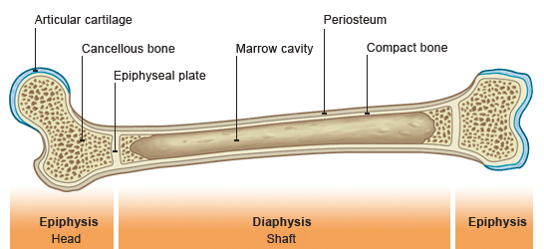
Tumors and Tumor-Like Conditions of Bone
VERTICAL INTEGRATION
ANATOMY
Benign tumors outnumber malignancies and are more common in young individuals.
Specific tumor types have preferential age and sex distribution.
Specific tumor types preferentially involve specific bones and specific regions within a bone.

Slide 12
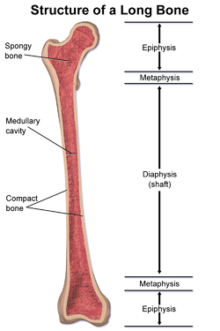
VERTICAL INTEGRATION
ANATOMY

Slide 13
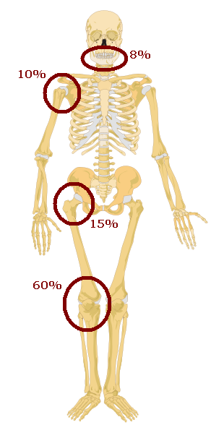
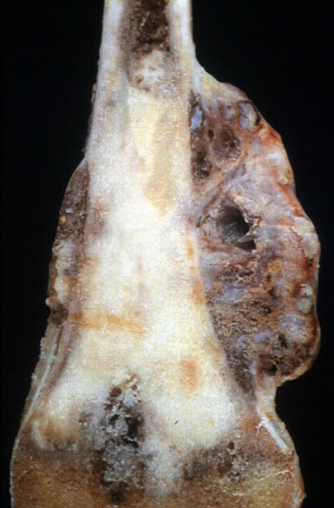
Osteosarcoma
HORIZONTAL INTEGRATION
COMMUNITY MEDICINE
VERTICAL INTEGRATION
ANATOMY
Bimodal Age Distribution
Metaphysis
Long Bones
Around Knee Joint
10 20 30 40 50 60 70 yrs

Slide 14
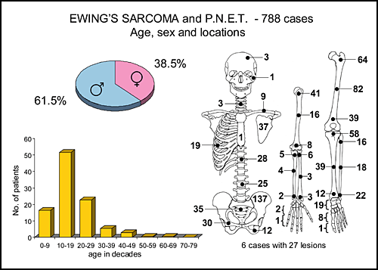
HORIZONTAL INTEGRATION
COMMUNITY MEDICINE
VERTICAL INTEGRATION
ANATOMY

Slide 15
Osteoma
CORE PATHOLOGY
Type: Benign lesions of bone that often represent developmental aberrations or reactive growths rather than true neoplasms.
Site: Head and neck.
Age: Typically seen in middle age.
Gross: Solitary, exophytic, and slow-growing.
Histology: Composed of normal bone.

Slide 16
Osteoid Osteomas
CORE PATHOLOGY
Bone tumors less than 2 cm in greatest dimension.
Usually occur in patients in their teens and twenties.
Predilection for the appendicular skeleton.
50% of cases involve the femur or tibia, commonly arising in the cortex.
Painful lesions: The pain is caused by excess prostaglandin E2, produced by proliferating osteoblasts.
The pain characteristically occurs at night and is relieved by aspirin.

Slide 17
Osteoid Osteomas
CORE PATHOLOGY
Specimen Radiograph of Intracortical Osteoid Osteoma
The round radiolucency with central mineralization represents the lesion.
The lesion is surrounded by abundant reactive bone that has massively thickened the cortex.

Slide 18
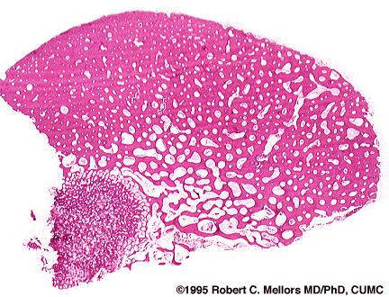
Osteoid Osteomas
CORE PATHOLOGY
Osteoid osteomas, especially those that arise beneath the periosteum, usually elicit a tremendous amount of reactive bone formation that encircles the lesion.
The actual tumor, known as the nidus, manifests radiographically as a small round lucency that is variably mineralized.

Slide 19
Osteoblastoma
CORE PATHOLOGY
Larger than 2 cm.
Commonly found in the spine.
Pain is not relieved by aspirin.
Bone reaction is less compared to osteoid osteomas.
The nidus is large.

Slide 20
Osteosarcoma
CORE PATHOLOGY
Bone-producing malignant mesenchymal tumor of bone.
Malignant bone matrix (osteoid) is produced by malignant cells.
Metaphysis involvement.
Commonly affects the tibia and femur (around the knee).
Primarily affects young age individuals, typically less than 20 years old.
In older age patients, secondary osteosarcoma can develop, often due to Paget's disease or radiation exposure.

Slide 21
Osteosarcoma - Sub Categorization
CORE PATHOLOGY
Based on | Subtypes
Location | Intramedullary / intracortical / periosteal
Differentiation | Well differentiated; moderately differentiated; poorly differentiated
Histology | Osteoblastic / chondroblastic / fibroblastic, telangiectatic / giant cell / small cell
Others | Solitary / multicentric Primary / secondary

Slide 22
Osteosarcoma
CORE PATHOLOGY
Gross Features
Osteosarcoma of the Upper End of the Tibia
A tan-white tumor present in the metaphysis.
The tumor has infiltrated through the cortex, lifted the periosteum, and formed soft tissue masses on both sides of the bone.
The tumor is bulky, gritty, hemorrhagic, and necrotic.
Bone destructive and spreading in different directions.

Slide 23
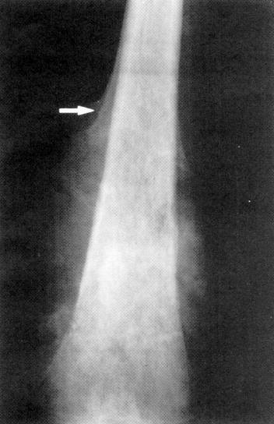
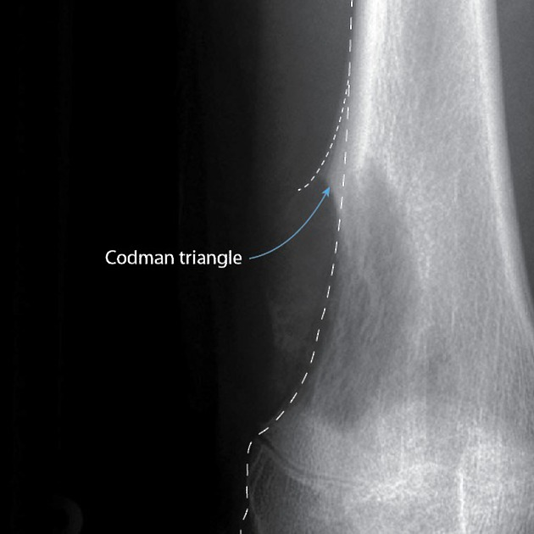
Osteosarcoma Radiographic Features
CORE PATHOLOGY
A large, destructive, mixed lytic and blastic mass.
The tumor frequently breaks through the cortex and lifts the periosteum, resulting in reactive periosteal bone formation.
The triangular shadow between the cortex and raised ends of the periosteum is known radiographically as Codman’s triangle, which is characteristic, but not diagnostic of this tumor.

Slide 24
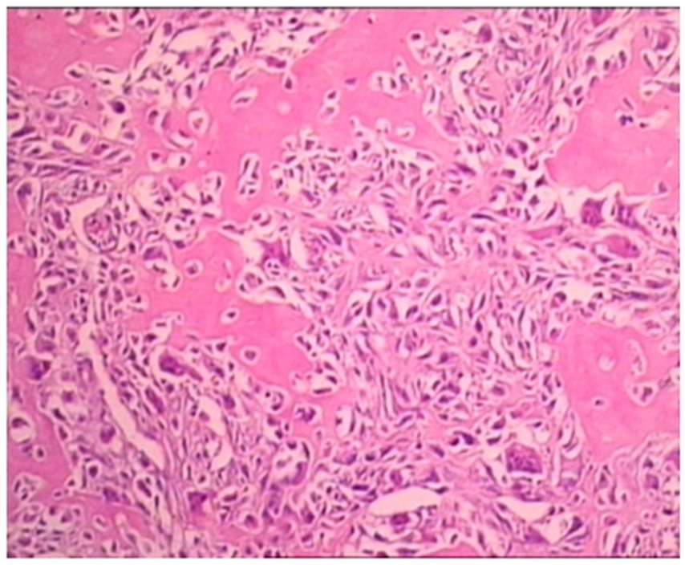
Osteosarcoma
CORE PATHOLOGY
Microscopy of Osteosarcoma
Bizarre tumor cells with pleomorphic, hyperchromatic nuclei.
Presence of atypical mitosis.
Formation of "lacy osteoid": Formation of bone by tumor cells.
Conspicuous vascular invasion, leading to metastasis to the lungs and brain.

Slide 25
Bone-Forming Tumors
 | Tumor Type | Locations | Age | Morphology
BENIGN | Osteoma | Facial bones, skull | 40-50 | Exophytic growths attached to bone surface; histologically resemble normal bone
 | Osteoid osteoma | Metaphysis of femur and tibia | 10-20 | Cortex, <2cm sever nocturnal pain; histologically interlacing trabeculae of woven bone
 | Osteoblastoma | Vertebral column | 10-20 | >2cm Histologically similar to osteoid osteoma
MALIGNANT | Primary osteosarcoma | Metaphysis of distal femur, proximal tibia, and humerus | 10-20 | Grow outward, lifting periosteum, and inward to the medullary cavity; microscopically malignant cells form osteoid.
 | Secondary osteosarcoma | Femur, humerus, pelvis, jaw | >40 | Complications of polyostotic Paget disease; radiation, bone infarction. histologically similar to primary osteosarcoma
CORE PATHOLOGY

Slide 26
Giant Cell Tumor Of Bone
CORE PATHOLOGY
Osteoclastoma
Mononuclear cells and osteoclast-type giant cells.
Benign but locally aggressive.
Common in individuals 20-40 years.
RANK ligand expression stimulates the development of osteoclast-like giant cells.
Arise in the epiphysis and involve the metaphysis around the knee.
Pain and pathological fractures are common symptoms.
These tumors are slightly more common in females.

Slide 27
Giant Cell Tumor - Gross
Large, red-brown tumor.
Typically located in the epiphysis.
CORE PATHOLOGY

Slide 28
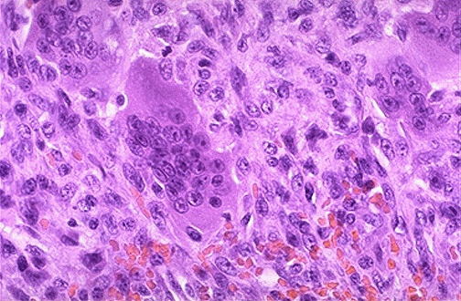
Giant Cell Tumor Microscopy
CORE PATHOLOGY
Composed of uniform oval mononuclear cells. Scattered within are osteoclast-type giant cells. Nuclei of giant cells resemble those of mononuclear cell nuclei. Features include necrosis, hemorrhage, and hemosiderin deposition.

Slide 29
Ewing Sarcoma / PNET
CORE PATHOLOGY
Malignant small round cell tumor of bone
PNET – clear neural differentiation.
Ewing sarcoma – undifferentiated.
Presenting age: 10-15 years, with 80% of cases occurring in those less than 20 years.
Males are affected more than females.
Location: Diaphysis of long bones, arises in the medullary cavity.
Combination chemotherapy has improved the 5-year survival rate to 75%.

Slide 30
Ewing Sarcoma / PNET
CORE PATHOLOGY
Tumors arise from the medullary cavity, invade the cortex, and spread to soft tissue.
Composed of small round cells, slightly larger than lymphocytes.
Cells are rich in glycogen.
May show Homer-Wright rosettes.
Necrosis is commonly seen.
X-ray shows typical layers of reactive bone, often described as the "Onion-skin" pattern.

Slide 31
Genetics
CORE PATHOLOGY
Chromosomal translocation resulting in fusion of:
EWS (chromosome 22) with
FLI1 (chromosome 11)
This fusion leads to the production of a chimeric protein that acts as a transcription factor.
Diagnostic importance: FISH (Fluorescence In Situ Hybridization) is used to detect this translocation.

Slide 32
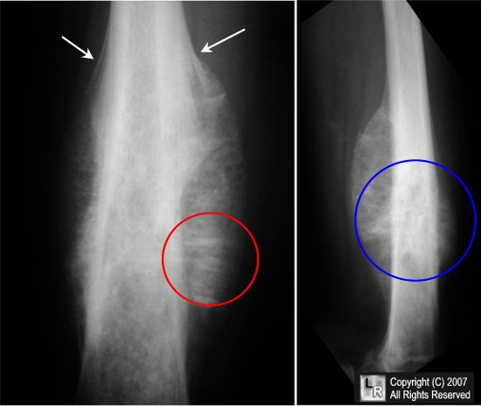
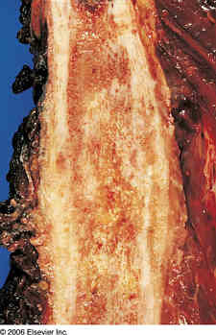
Gross
CORE PATHOLOGY
Arise in the medullary cavity (diaphysis).
Invade the cortex and periosteum.
Tan-white color with hemorrhage and necrosis.
Spread to soft tissue.

Slide 33
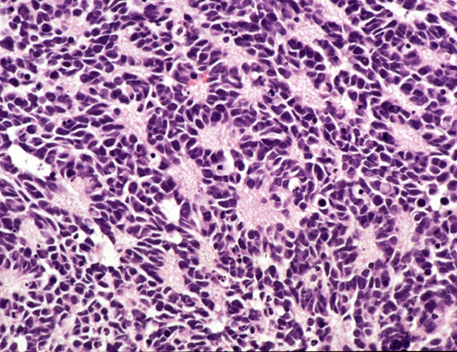
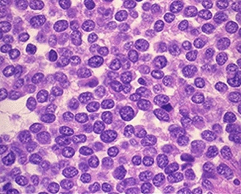
Microscopy
CORE PATHOLOGY
Sheets of uniform small cells.
Presence of rosettes (Homer-Wright).
Few mitotic figures.

Slide 34
Chemotherapy Regimens
HORIZONTAL INTEGRATION
For first-line osteosarcoma therapy (primary, neoadjuvant, adjuvant therapy, or for metastatic disease), the following regimens are used:
Cisplatin and doxorubicin
MAP (high-dose methotrexate, cisplatin, and doxorubicin)
Doxorubicin, cisplatin, high-dose methotrexate, and ifosfamide have antitumor activity in osteosarcoma.
In patients older than 40 years, preferred regimens often combine doxorubicin, cisplatin, and ifosfamide without high-dose methotrexate

Slide 35
Multidisciplinary Approach to Bone Tumor Management
SPIRAL INTEGRATION
PROFESSIONALISM
Pathology & Imaging Teams: Radiologists and pathologists ensure accurate diagnosis through imaging, biopsies, and molecular studies.
Oncology & Surgery Collaboration: Orthopedic oncologists and surgical teams plan tumor resection and limb-salvage procedures.
Medical & Radiation Oncology: Use of chemotherapy and radiotherapy for malignant tumors to improve survival and reduce recurrence.
Rehabilitation & Supportive Care: Physiotherapists, prosthetists, and psychologists aid in post-surgical recovery, mobility, and mental well-being.

Slide 36
Research
2022 Feb 21;23(4):2348. doi: 10.3390/ijms23042348.

