Slide 1
BLAST INJURIES
Dr Filza ali & Dr Shahida Forensic Medicine & Toxicology

Slide 3
Motto of RMU

Slide 4
Vision of RMU
The Dream/ Tomorrow
To impart evidence based research oriented medical education
To provide best possible patient care
To inculcate the values of mutual respect and ethical practice of medicine

Slide 5
Prof Umar’s LGIS model

Slide 6
SEQUENCE OF LGIS
Learning Objectives
Core concept 70 %
Horizontal integration related to Pathology and Pharmacology 15 %
Relevant clinical concepts and medico legal application of core knowledge / Vertical integration 10%
Research article relevant to the topic 3%
Ethics and family medicine 2%

Slide 7
LEARNING OBJECTIVES
By the end of lesson students will be able to:
Define blast injuries , Dynamite & explosives.
Enlist the elements of a bomb & products of blast.
Briefly explain the effect of blast on victim
State the cause of injury and death due to blast.
Briefly State the medicolegal importance of blast injuries

Slide 8
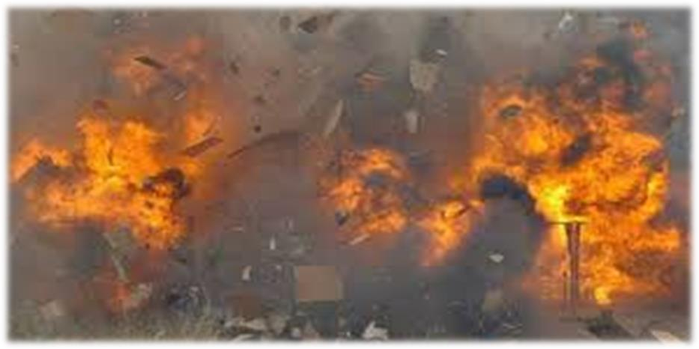
Blasts/ Explosion Injuries
Core Concept

Slide 9
Blast
Core Concept
Sudden release of large amount of energy, heat and blast waves.
Dynamite
Nitroglycerine, ammonium nitrate, saltpeter, aromatic nitro compounds
Explosives
Substances having shattering effect

Slide 10
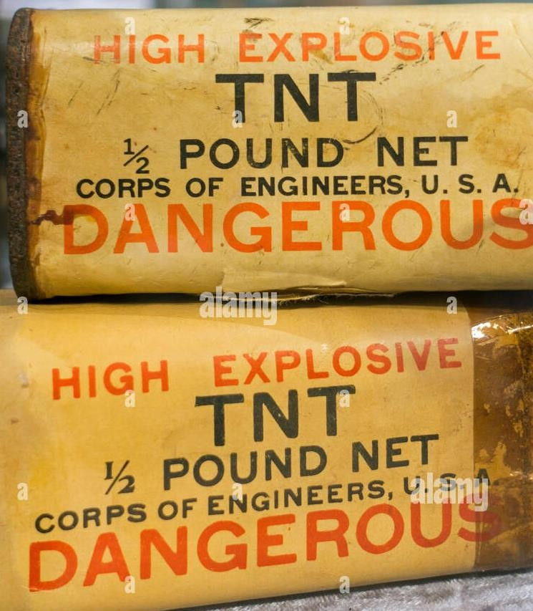
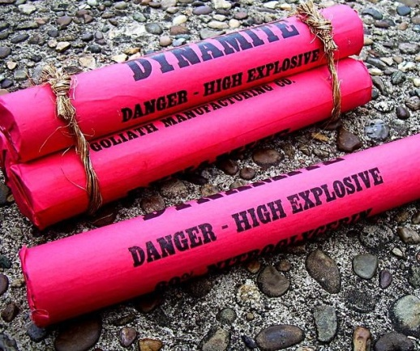
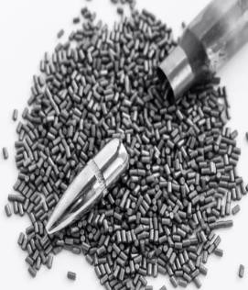
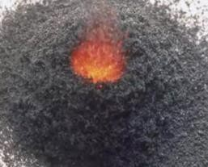
Classification of Explosives
Core Concept
High order Explosives
Instantaneous blast waves – TNT dynamite & C-4 plastic
Low order Explosives underdoes deflagration not detonation – composed of propellants like fire works, oil or petroleum or in missiles

Slide 11
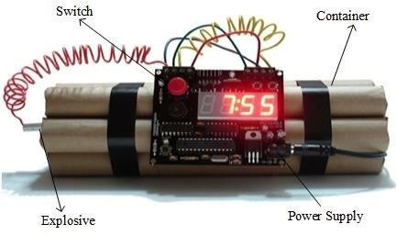
Elements of a Bomb
Core Concept
Explosive material:
Container:
Detonation device:
Product Of Blast
Gelignite, sugar-sodium mixture Plastic, glass & metal.
Time-delayed, remote controlled
Blast Waves
Flame
Solid Fragments
Pressure Waves
Explosion……. Increase in atmospheric pressure……..pressure waves
………speed 21,000km/hr………concentrically / flow around barriers.

Slide 12
Peak Over Pressure(lbs/sq inch)
Core Concept
Maximum difference b/w pressure in region of explosion & normal
atmospheric pressure.
Blast or shock wave is followed by negative pressure(vaccum) which
sucks items back to center.
Positive Pressure Duration:
Time duration for atmospheric pressure to become normal.
Blast /Shock Waves In Water:
Water is 800 times denser
1000 times less compressible
Injuries more serious
Air over pressure of more than 100 lbs/sq inch, endangers human
life.

Slide 13
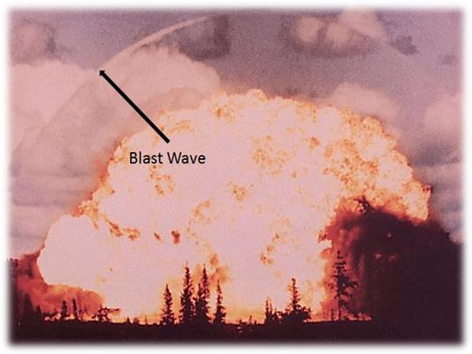
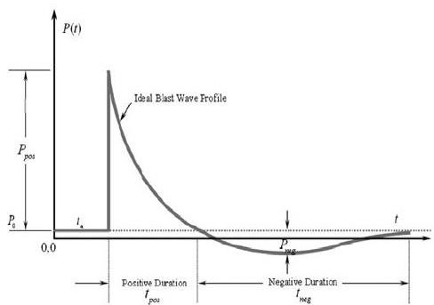
Core Concept

Slide 14
Effect Of Blast On Victim
Core Concept
Primary Effect: Direct Impact
Person thrown in the air. Flash, heat, fragments of metal, nails. Organs containing air like lungs, middle ear are more affected
Secondary Effects: Indirect Impact
Primary missiles…………. components of bomb Secondary missiles………….nearby things
Tertiary Effect: Indirect Impact
Striking against a wall.
Other Effects:
Burning, inhalation of gases.

Slide 15
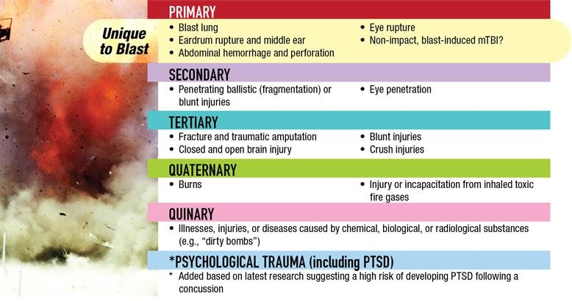
Core Concept

Slide 16
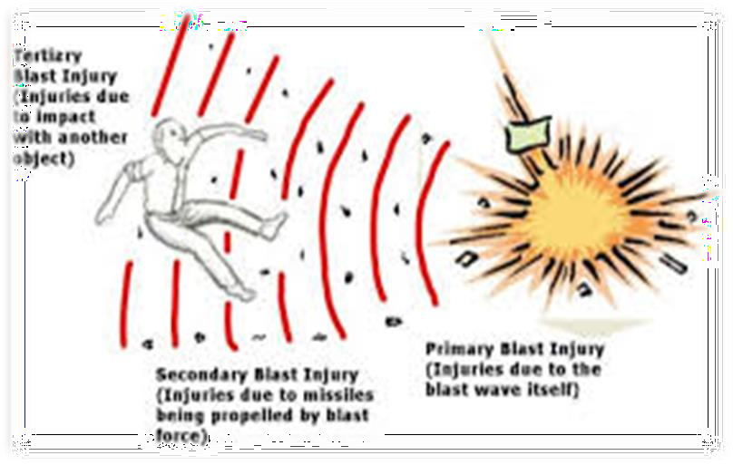
Effect Of Blast On Victim
Core Concept

Slide 17
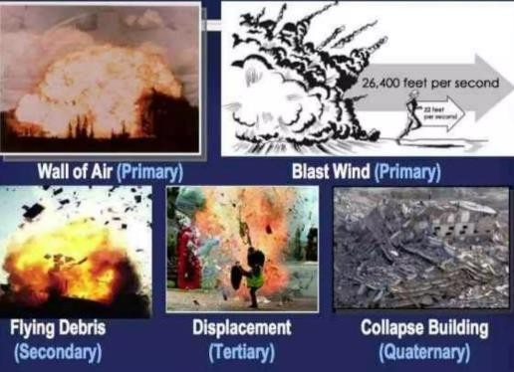
Core Concept

Slide 18
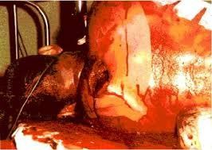
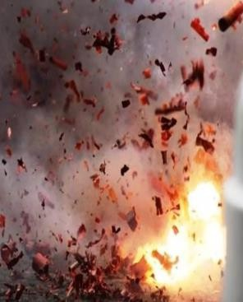
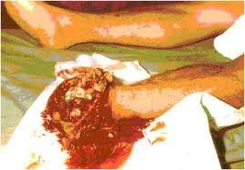
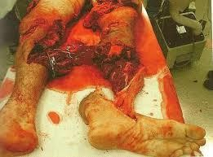
Core Concept

Slide 19
Causes Of Injuries By Blast
Core Concept
Flash:
Blast waves/ sound effect:
Pressure:
Wave of compression
Refraction
Heat:
Sharpnels /flying missiles:
Gas effect/ smoke:
Debris:
Temperature of gases is 200oC Rupture of tympanic membrane
Burns Bruise/Abrasion Asphyxia
Mechanical injury by debris.

Slide 20
Cause Of Death in Blast
Vertical Integration
Multiple injuries:
Traumatic asphyxia:
Inhalation of gases:
amputation, bruises, laceration
CO, H2S, HCN, SO2, Nitrous/Nitric gases.
Postmortem Examination
Identification
Injuries
Cause of death

Slide 21
Medicolegal Importance
Vertical Integration
Whether a bomb has caused the explosion or not
Number of dead persons
Identification of dead persons
Enlisting the injuries whether external or Internal
Cause of death
Circumstances of death

Slide 22
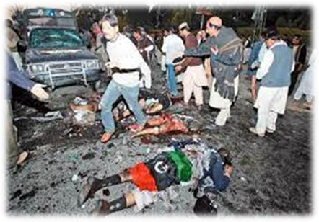
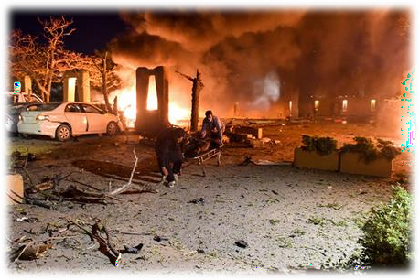
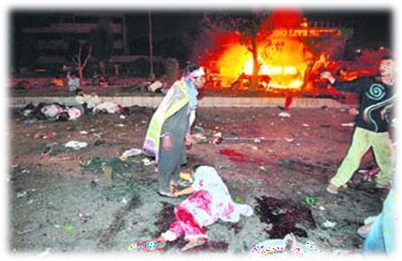
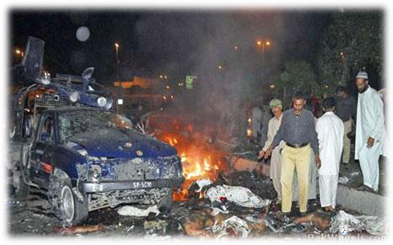
Core Concept

Slide 23
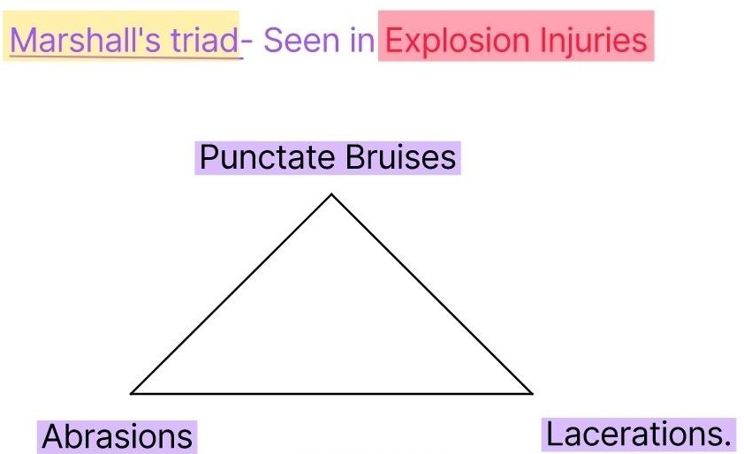
Marshall’s Triad
Core Concept
Marshall's triad of bruises, abrasions and punctate lacerations with tattooing of the body indicates bomb explosion.
Injuries may be seen due to fallen rubble.
Burns (flash burns and singed hair seen on victims in immediate vicinity).

Slide 24
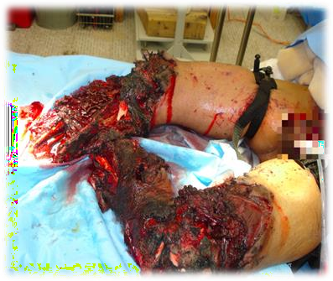
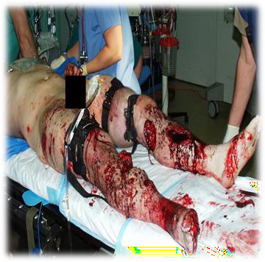
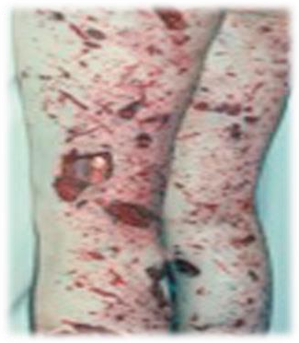
Core Concept

Slide 25
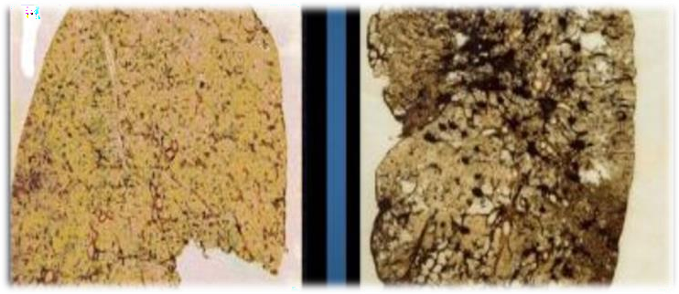
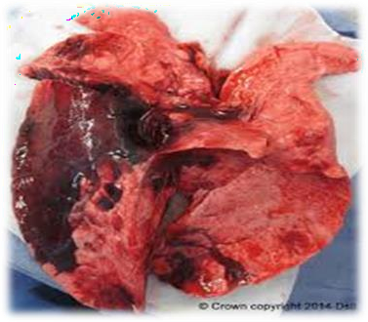
Blast Lung
Core Concept
Blast lung is caused by blast waves.
Bursting of alveoli due to pressure of blast waves.
Tearing of lungs, hemorrhages, contusions etc.
Which leads to rapid deterioration of respiratory system,
apnea and death.

Slide 26
Research
Research
https://www.ncbi.nlm.nih.gov/books/NBK430914/
https://pubmed.ncbi.nlm.nih.gov/26692453/
https://www.pafmj.org/index.php/PAFMJ/article/view/6203
https://gjms.com.pk/index.php/journal/article/download/180/178
https://jmedsci.com/index.php/Jmedsci/article/view/21
https://fcd.mcw.edu/?search/showPublication/id/1142834

Slide 27
Ethical Concerns in Blast injury care
Ethics
Amputation and rehabilitation: Blast injuries often result in amputations, raising
questions about prosthetic care, rehabilitation, and reintegration into society
Traumatic brain injury: Blast-induced traumatic brain injuries pose unique ethical concerns, such as decision-making capacity and long-term care.
Pediatric and geriatric considerations: Blast injuries affecting children or older
adults require special psychological support due to their unique vulnerabilities.
Disaster response and emergency preparedness: Ethical planning for blast injury response involves balancing individual needs with community-wide disaster response efforts

Slide 28
Family Medicine
Family Medicine
The treatment protocols are based on:
Mechanical ventilation,
Intensive therapy
Supportive care.
Secondary and tertiary blast structural injuries to the thorax require damage control surgery, dominated by pleural space management (drainage) and haemorrhage control (thoracotomy if needed)
People are given oxygen and fluids and are monitored for complications, such as:
Air embolism
Acute crush syndrome
Compartment syndrome.
It occurs when injured muscles swell so much that they cut off their blood supply.

Slide 29
How To Access Digital Library
1. Go to the website of HEC National Digital Library.
2. On Home Page, click on the INSTITUTES.
3. A page will appear showing the universities from Public and Private Sector and other Institutes which have access to HEC National Digital Library HNDL.
4. Select your desired Institute.
5. A page will appear showing the resources of the institution
6. Journals and Researches will appear
7. You can find a Journal by clicking on JOURNALS AND DATABASE and enter a keyword to search for your desired journal.

Slide 30
Conclusion
Core Concept
Blast injuries are not confined to battle field but are pandemic
Consider exposure to carbon monoxide & Cyanide in terrorist explosion
Penetrating/Blunt trauma is the most common injury seen among survivors
Patients should need 4-6 hours rigorous observation in blast incidents
Radiological imaging of head , chest and abdomen will help in early diagnosis of Blast Lung,head injury, abdominal injury as well as any penetrating foreign bodies
Isolated tympanic membrane rupture is not a reliable marker of morbidity
Always give Tetanus toxoid and & Anti Tetanus serum
Delay the primary closure in case of contaminated wound

Slide 31
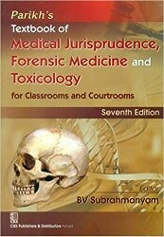
TEXT BOOKS & PRACTICAL NOTEBOOK:
Principles & Practice of Forensic Medicine.
by Nasib R. Awan
Parikh’s Textbook of Medical Jurisprudence,
Forensic Medicine & Toxicology.
Practical Manual Of Forensic Medicine
& Toxicology

Slide 32
THANK YOU

