Slide 2
Benign Prostatic Hyperplasia
Dr Zeeshan Qadeer
Associate Professor Urology, RMU

Slide 3
University Motto, Vision, Values & Goals
Mission Statement
To impart evidence-based research-oriented health professional education
Best possible patient care
Mutual respect, ethical practice of healthcare and social accountability.
Vision and Values
Highly recognized and accredited centre of excellence in
Medical Education, using evidence-based training techniques for development of highly competent health
professionals, who are lifelong experiential learner and are socially accountable.
Goals
The Undergraduate Integrated Learning Program is geared to provide you with quality medical education in an environment designed to:

Slide 4
SEQUENCE OF LGIS
Learning objectives
Core Subject (70%)
Vertical Integration (10%)
Horizontal Integration (15%)
Research (3%)
Biomedical Ethics (2%)

Slide 5
PROF UMER MODEL OF INTEGRATED LECTURE

Slide 6
Learning objectives
Understand the pathophysiology of benign prostatic hyperplasia (BPH), including the role of dihydrotestosterone and nodular hyperplasia.
Recognize the clinical presentation of BPH, focusing on lower urinary tract symptoms (LUTS) categorized into voiding and storage symptoms.
Identify complications associated with BPH, such as urinary retention, bladder calculi, hematuria, recurrent UTIs, and renal insufficiency.
Describe the diagnostic approach to BPH, including history-taking, digital rectal examination (DRE), PSA levels, ultrasound, and cystoscopy.
Differentiate between medical and surgical treatment options, including alpha-blockers, 5-alpha reductase inhibitors, TURP, and minimally invasive procedures.
Determine the indications for surgical intervention, such as failure of medical therapy, recurrent urinary retention, bladder stones, or renal impairment.

Slide 7
CORE SUBJECT

Slide 8
Benign prostatic hyperplasia (BPH) is a histologic diagnosis characterized by proliferation of cellular elements of prostate, leading to enlarged prostate gland
Notes:
formerly known as benign prostatic hypertrophy,

Slide 9
VERTICAL INTEGRATION WITIH ANATOMY

Slide 10
Anatomy of Prostate
Prostate weighs 20g
Apex = inferior portion of prostate, continuous with striated sphincter
Base = superior portion and continuous with bladder neck

Slide 11
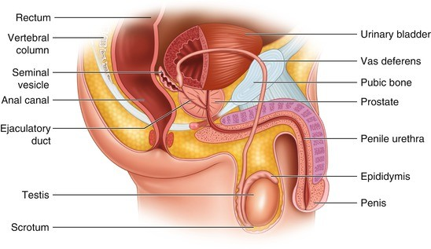

Slide 12
Zones
Central zone – surrounds the ejaculatory ducts, comprising 25% of prostate
Transitional zone – located centrally and surrounds the urethra, 5-10% of normal prostate volume. typically undergo benign hyperplasia (BPH)
Peripheral zone – makes the main body of gland (65%) located posteriorly. Prostate carcinoma develops in this zone.
Anterior Fibromuscular

Slide 14
HORIZONTAL INTEGRATION WITH PATHOLOGY

Slide 15
Pathology (nodular hyperplasia)
Proliferation of both stromal & epithelial components of the prostate gland, an age related change
There is a major role of ­dihydrotestosterone ( potent form of testosterone hormone) in enlargement of prostate gland.
5 Alpha reductase inhibitor is enzyme which converts testosterone into dihydrotestosterone

Slide 16
Epidemiology
50% prevalence in men between 50 - 60 years
Affects quality of life in 1/3 of men above 50 years of age
90% men have BPH by the age of 85 years
Worldwide, approximately 30 million men have symptoms related to BPH

Slide 17
Presentation
Lower urinary tract symptoms (LUTS):
Voiding: hesitancy, intermittency, weak stream,
straining, dribbling, incomplete bladder emptying
Storage: frequency, nocturia, urgency and
urge incontinence

Slide 18
Complications
Chronic bladder outlet obstruction (BOO) secondary to BPH may lead to
urinary retention
impaired kidney function
recurrent urinary tract infections
gross hematuria
bladder calculi

Slide 19
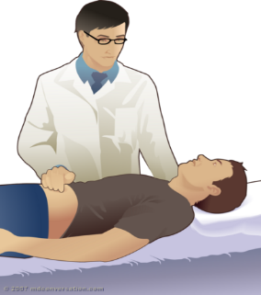
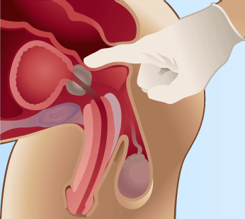
Evaluation:
Physical Examination
Abdomen (assess bladder)
External genitalia
Focused neurological exam
Digital Rectal Examination (DRE)

Slide 20
Investigations
Ultrasound Prostate gland with Pre & Post void Urine
RFTS
Urinalysis
PSA

Slide 21
Cystoscopy

Slide 22
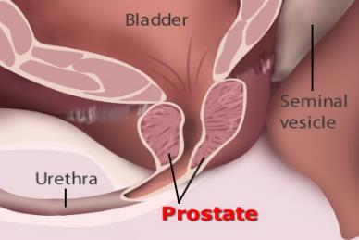
Management
Watchful waiting
for patients with mild symptoms
Medical treatment
alpha blockers
5-alpha-reductase inhibitors
Anti muscarinic for storage symptoms
Notes:
Permanent catheter for pts unfit for surgery. Treat symptoms not size of prostate

Slide 23
Surgery
Indications
Failure of medical treatment
Renal failure
Recurrent UTI’s
Recurrent retention of urine
Bladder stones
Haematuria

Slide 24
TURP

Slide 25
Other surgical options
Endoscopic Laser Resection/vaporization/enucleation
Open prostatectomy

Slide 26
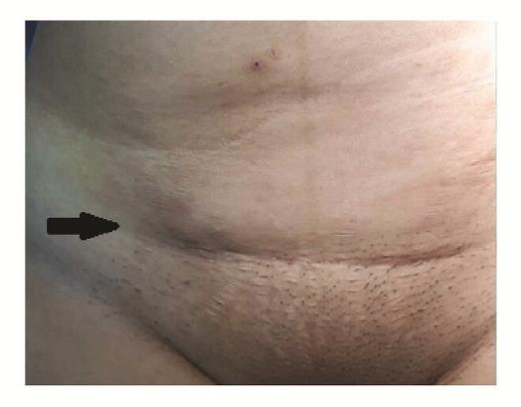
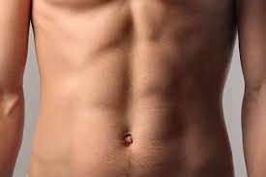
Conventional prostate surgery Recent prostate surgeries

Slide 27
Spiral Integration with Family Medicine
Early screening for LUTS in aging men and lifestyle modifications to prevent BPH progression.
Medical management of mild-to-moderate BPH in primary care, including pharmacotherapy and watchful waiting.

Slide 28
Biomedical Ethics
Informed consent for TURP and other surgical options, ensuring patients understand potential risks like retrograde ejaculation.
Shared decision-making for medical vs. surgical treatment, considering patient quality of life and comorbidities

Slide 29
Research
Advancements in minimally invasive BPH procedures, such as laser enucleation and UroLift.
Ongoing studies on novel pharmacological therapies, including selective androgen receptor inhibitors for BPH treatment.
https://pmc.ncbi.nlm.nih.gov/articles/PMC4754003/

Slide 30
REFERENCES
Campbells urology 12th edition
Smith and Tanaghos urology 9th edition
EAU 2024 guidelines

Slide 31
THANK YOU ☺

Slide 32
Which of the following is most common symptom associated with benign prostatic hyperplasia (BPH)
1- Hematuria
2- Flank pain
3- Acute urinary retention
4- Baldder stone formation
5- Nocturia

Slide 33
65 years old man is presented with frequency, nocturia and weak stream, on digital rectal examination (DRE) his prostate is enlarged
Which diagnostic test is most appropriate to confirm etiology of these symptoms
1- Urine routine examination
2- Serum PSA
3- Ultrasound abdomen and pelvis
4- Cystoscopy
5- Renal function tests

Slide 34
For a patient with severe prostate symptoms, not adequately controlled by medications alone which of following surgical method is most commonly recommended
1- Radical prostatectomy
2- Laser prostatectomy
3- Transurethral resection of prostate (TURP)
4- Open prostatectomy
5- Transurethral incision of prostate (TIP)

