Slide 1
BENIGN AND MALIGNANT CONDITIONS OF VULVA AND VAGINA
PROF. HUMERA NOREEN
HOD OBS/GYNAE UNIT 2 HFH

Slide 2
Prof. Umar’s Model of Teaching Strategy
Self Directed Learning Assessment Program
First Ten Minutes
Objectives :
To cultivate critical thinking, analytical reasoning, and problem-
solving competencies.
To instill a culture of self-directed learning, fostering lifelong
learning habits and autonomy.
How to Assess?
➢
Ten randomly selected students will be evaluated within the first 10 minutes of the lecture through 10 multiple-choice questions (MCQs) based on the PowerPoint presentation shared on Students Official WhatsApp group, one day before the teaching session.
➢
The number of MCQs from the components of the lecture will follow
the guidelines outlined in the Prof. Umar model of Integrated Lecture.
Component of LGIS
Core Know ledge
Horizontal Integration
Vertical Integration
Spiral Integration
No of MCQs
6-7
1-2
1
1

Slide 3
Professor Umar Model of Integrated Lecture
3

Slide 4
SEQUENCE OF LGIS
Learning objectives
Benign and Malignant Conditions of Vulva & Vagina
(core concept = 70%)
Related pathophysiology (horizontal integration 15%)
Related clinical findings (vertical integration – 10%)
Research article related to topic (3%)
Ethics (2%)

Slide 5
Vulvar Anatomy
The vulva (external genitalia ) includes:
Mons pubis
Clitoris
Labia majora and minora
Perineum: a less hairy skin & subcutaneous tissue area lying between the vaginal orifice & the anus & covering the perineal body.
Its length is 2-5 cm
Vestibule: It is the area of smooth skin lying within the labia minora & in front of the vaginal orifice.
Hymen

Slide 6
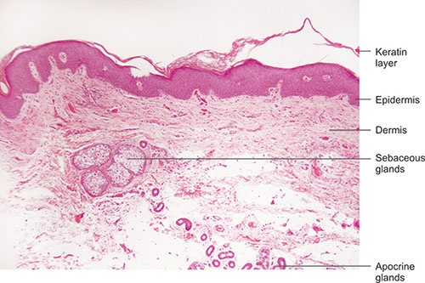
Vulvar Histology
The vulva has both keratinized and nonkeratinized epithelium. On the labia majora, mons pubis and perineal region, the epithelium is keratinized and is similar to skin at other body sites. The epithelium that covers the hymen, vestibule and inner surfaces of the labia minora is a non-keratinized mucosal type

Slide 7
Non-neoplastic epithelial disorders
Lichen sclerosis
Other dermatoses
lichen planus.
psoriasis.
Seborrheic dermatitis
inflammatory dermatoses
ulcerative dermatoses
Squamous cell hyperplasia
.

Slide 8
Lichen sclerosis
70% of benign epithelial disorders
Epithelial thinning, inflammation
Histological changes in the dermis.
Etiology: unknown
Symptoms:
Itching (commonest), vaginal soreness + Dyspareunia
Burning and pain are uncommon.
Signs: wrinkled skin,
Labia minora atrophy
Constriction of Vulval orifice, adhesions, ecchymoses & fissures.

Slide 9
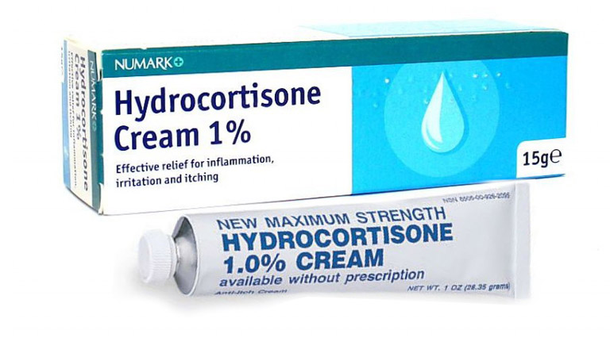
Lichen sclerosis
Diagnosis:
Biopsy in resistant cases
Treatment
Emollients
Topical steroids (clobetasol propionate 0.05% ointment)
Testosterone: not effective than petroleum jelly can cause pruritus, pain & virilization.
Surgery: avoided unless malignant changes

Slide 10
Lichen Planus
General Appearance:
Erosive lesions at vestibule w/without adhesions
resulting in stenosis
May have associated oral mucocutaneous lesions & desquamative vaginitis
Symptoms:
Irritating vaginal , vulvar soreness, intense burning, pruritus, dyspareunia, post-coital bleeding
Types:
Papulosquamous (classic)
Hypertrophic
Erosive

Slide 11
Treatment of Lichen Planus
Intravaginal hydrocortisone suppositories
Steroid creams (medium-high potency)
Vaginal estrogen cream if atrophic epithelium present
Vaginal dilators for stenosis
Surgery for severe vaginal synechiae
Vulvar hygiene
Emotional support

Slide 12
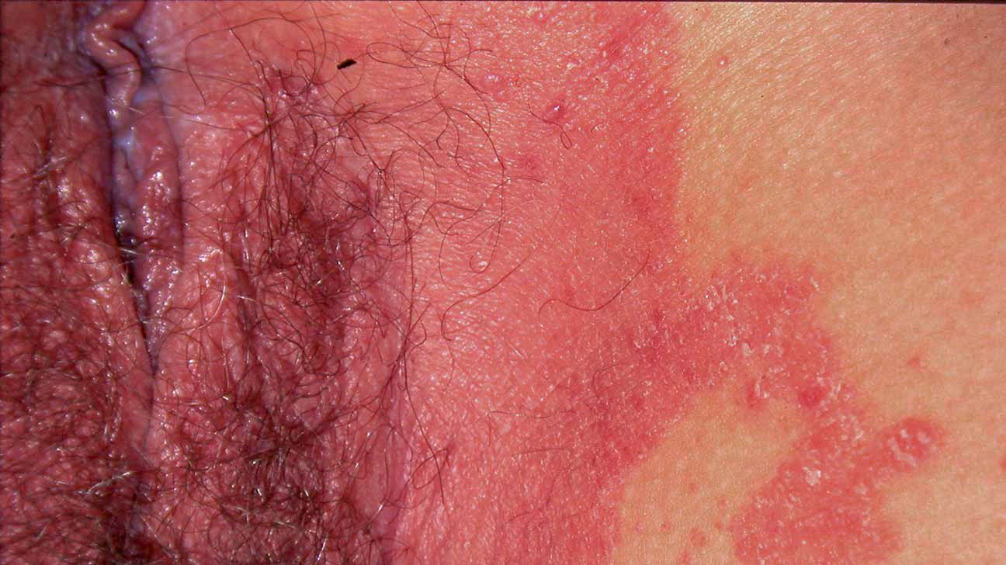
Vulvar Psoriasis
Physical Appearance
Red moist lesions w/without scales
Well demarcated erythema
(salmon pink patches)
Treatment
Topical corticosteroids
Oral therapy with methotrexate, cyclosporin and acetretin

Slide 13
Lichen Simplex Chronicus
Physical Appearance
Thickened white epithelium on vulva
Generally unilateral and localized
Treatment: Medium potency steroid twice daily

Slide 14
Bartholin glands
Two in number.
Lie posterior-laterally to the vaginal orifice, one on either side
Normally not seen nor felt.
If enlarged, can be a painless cyst or painful abscess

Slide 15
Bartholin Duct Cyst
Most common vulval cyst.
Usually unilateral, on the posterior-lateral side of the introitus.
Usually about 2 cm & contains sterile mucus.
Usually asymptomatic.
Secondary infections → Bartholin’s abscess.
Treatment: Excision or Marsupialization.

Slide 16
Vulval intraepithelial neoplasia (VIN)
Classification
VIN I : mild dysplasia with hyperplastic vulvar dystrophy with mild atypia
VIN II: Moderate dysplasia, hyperplastic vulvar dystrophy with moderate atypia
VIN III: Severe dysplasia; hyperplastic vulvar dystrophy with severe atypia (it replaces the term Carcinoma in situ carcinoma in situ, Bowen’s disease).
Diagnosis : colposcopy + biopsies
Treatment:
Low grade VIN: Observation.
VIN 3: Local excision or laser vaporization
Topical immunomodulator: imiquimod

Slide 17
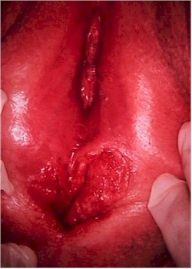
Vulval cancer
Incidence:
Uncommon (20th )
Life time risk (1in 275)
Median age 68 years
Strong association with social deprivation

Slide 18
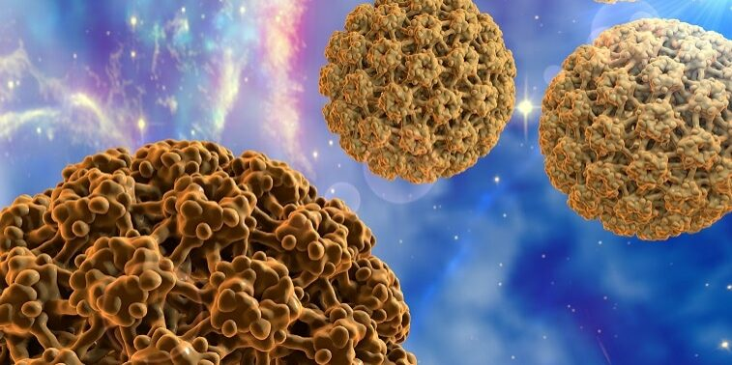
Aetiology
Two independent pathways of vulval carcinogenesis
Mucosal HPV (Human Papilloma Virus) infection
Lichen sclerosus OR autoimmune processes

Slide 19
Clinical presentation
Symptoms:
Lump or ulcer
Associated with bleeding or discharge or itching
May be painful or painless
Signs:
Well demarcated raised or ulcerated lesion
Hard , craggy
Bleeds on touch
Changes in the vulvar skin: such as color changes or growths that look like a wart or ulcer.
Tenderness in the vulvar area.

Slide 20
Factors increasing the risk of vulvar cancer
Advanced age
Precancerous untreated high grade VIN
Lichen sclerosis, Human papillomavirus (HPV) infection
Cancer of the vagina or cervix
Heavy cigarette smoking
Paget’s disease
Family history

Slide 21
Pathology/ Histology types
Squamous: >90%
Melanoma: 5-10%
Basal Cell: 2%
Sarcoma: 1-2%
Paget: <1%
CA of Bartholin gland :rare

Slide 22
SQUAMOUS CELL CARCINOMA
Are usually seen in the anterior part of the vulva.
2/3 of cases in the labia majora.
1/3 of cases in the clitoris ,labia minora, fourchette, and perineum.
Spread:
LYMPHATIC > 50%
Direct spread occurs in 25% to the urethra, vagina and rectum
Hematogenous spread to bone or lung is rare
The lymph nodes are arranged in 5 groups in each groin:

Slide 23
Site
The labia majora are the most common site of vulvar carcinoma - 50% of cases.
The labia minora - 15% to 20% of vulvar carcinoma cases.
The clitoris and Bartholin glands are less frequently involved.
Lesions are multifocal in about 5% of cases.

Slide 24
New FIGO Staging (2021)
Stage I: Tumor confined to vulva
1A: Tumor size ≤ 2 cm and stromal invasion ≤ 1 mm
1B: Tumor size > 2 cm & stromal invasion >1mm, no inguinal lymph nodes affection.
Stage II:
Tumor of any size with extension to lower 1/3 of urethra, lower 1/3 of vagina , lower 1/3 of anus with negative nodes .

Slide 25
Stage III: Tumor of any size with extension to upper part of adjacent perineal structures, or any no of non fixed, non ulcerated lymph nodes
III A: tumor of any size with extension to upper 2/3 of urethra, upper 2/3 of vagina, bladder mucosa, rectal mucosa, or regional lymph node metastasis ≤ 5 mm.
IIIB: Regional lymph node metastases >5 mm
III C: Regional lymph node metastases with extracapsular spread
Stage IV: Tumor of any size fixed to bone, fixed, ulcerated lymph nodes metastases or distant metastases
VI A: Disease fixed to pelvic bone, fixed or ulcerated lymph node metastasis
VI B: Distant metastasis.

Slide 26
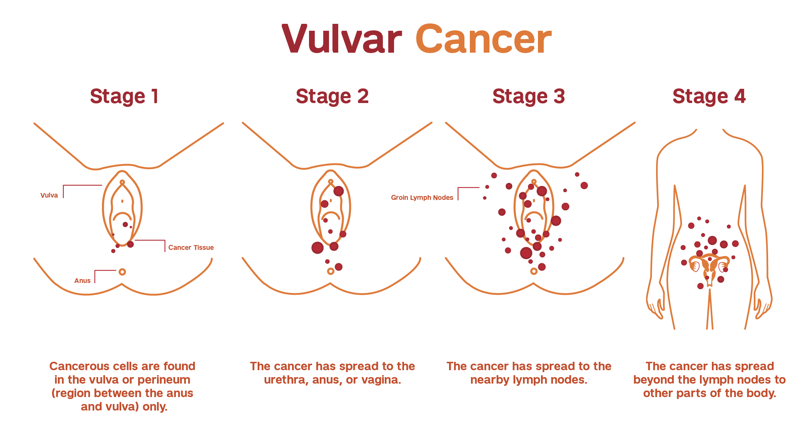

Slide 27
Treatment of vulval carcinoma
Stage I & II :
Wide local excision with 1-10 mm depth
Stage III & IV : According to the general health.
Chemotherapy & radiotherapy to shrink the tumor to permit surgery which may preserve the urethral & anal sphincter function.
Radical vulvectomy + inguinal L. nodes dissection.
Reconstructive surgery with skin grafts or mucocutaneous flaps for healing.

Slide 28
Prognosis and Survival rates
5 Year Stage Survival:
I 79%
II 59%
III 43%
IV 13%
Survival depends on:
Pathologic status of the inguinal nodes
Whether spread to adjacent structures has occurred

Slide 29
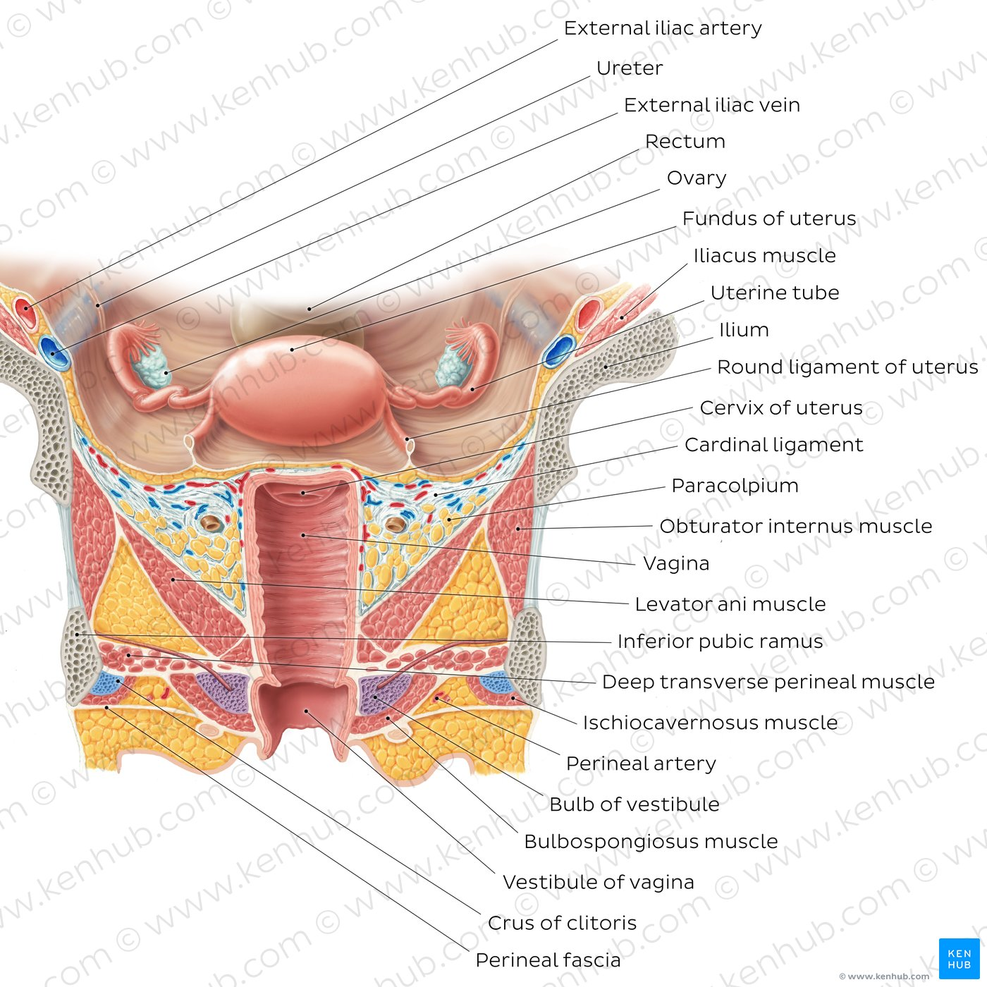
VAGINA
Lowest part of internal genital tract
Histology ; non keratinized squamous epithelium
connective tissue
circular and longitudinal muscle coats

Slide 30
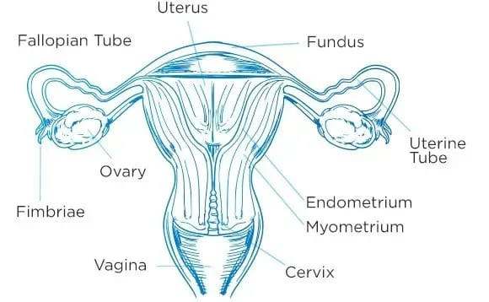
BENIGN DISEASES OF VAGINA
Vaginal Infections
Toxic Shock Syndrome
Vaginal Trauma
Endometriosis
Benign Vaginal Tumors
Fistula

Slide 31
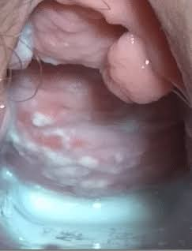
Vaginal Infections
Normal pH of Vagina in reproductive age is 3.8 to 4.2 due to the presence of lactobacilli, it protects from infections
Candidiasis
Caused by
Caused by candida albicans
Risk factors
More common in pregnancy, Diabetics and immunosuppressed.
Symptoms
Vaginal itching or soreness, White Discharge, painful urination

Slide 32
Candidiasis
Examination
Speculum examination reveals thick curdy white discharge
Investigations
Culture
Treatment
oral and topical antifungals

Slide 33
Bacterial Vaginosis
Caused by
Corynebacterium, Haemophilus species, Gardnerella vaginalis
Symptoms
Milky white discharge
Strong fishy odour
Nearly half will have no symptoms

Slide 34
Bacterial Vaginosis
Examination
a thin grey white discharge and a vaginal pH increased to greater than 5
investigations
Gram stain shows clue cells.
10 % KOH reveals Fishy amine smell
Treatment
Metronidazole
Clindamycin

Slide 35
Trichomonas Vaginalis
Sexual Transmission
Caused By:
Trichomonas vaginalis
Symptoms:
Offensive purulent yellow green discharge
Dysuria
Vulval irritation

Slide 36
Trichomonas Vaginalis
Examination:
Strawberry cervix
Foul smelling, frothy and mucopurulent Green/Grey discharge
investigations
Diagnosed by identifying Flagellate on a wet film
Treatment
Metronidazole

Slide 37
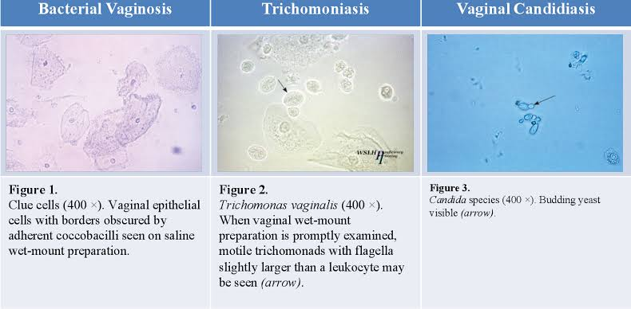

Slide 38
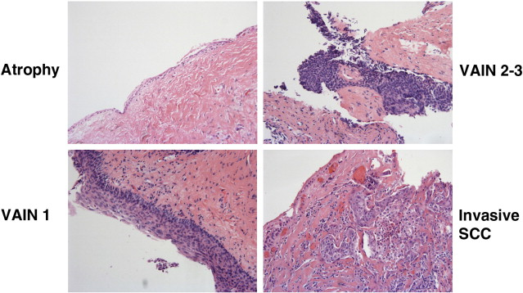
Vaginal intraepithelial neoplasia (VAIN)
1-6 %
Almost always in upper vagina
Mean age is 52 years
ETIOLOGY
Human Papilloma Virus ( HPV) 98%
Weakened immune system patients(chemotherapy, radiotherapy , immunosuppressive therapy)
CLASSIFICATION
VAIN 1 mild dysplasia
VAIN 2 moderate dysplasia
VAIN 3 severe dysplasia /carcinoma in situ

Slide 39
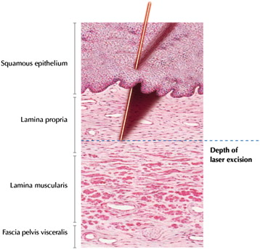
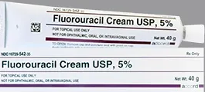
Vaginal intraepithelial neoplasia
DIAGNOSIS
abnormal cytology seen in vaginal vault specimen
TREATMENT
Excision biopsy
5-fluorouracil cream
Laser evaporation
Surgery

Slide 40
Vaginal carcinoma

Slide 41
Vaginal carcinoma
Background
Rare,1-2% of all Gynecological malignancies
Mostly occurs in women >60 years of age
Etiology
The Cause in unknown
Predisposing/ associated factors are.
HPV infection
Prior lower genital tract intraepithelial neoplasia and
neoplasia (mainly CIN and/or cervical carcinoma)

Slide 42
Vaginal carcinoma
Pathology
Squamous cell
80-90%
Adenocarcinoma
Adenosquamous
Clear Cell
Primary Vaginal cancers

Slide 43
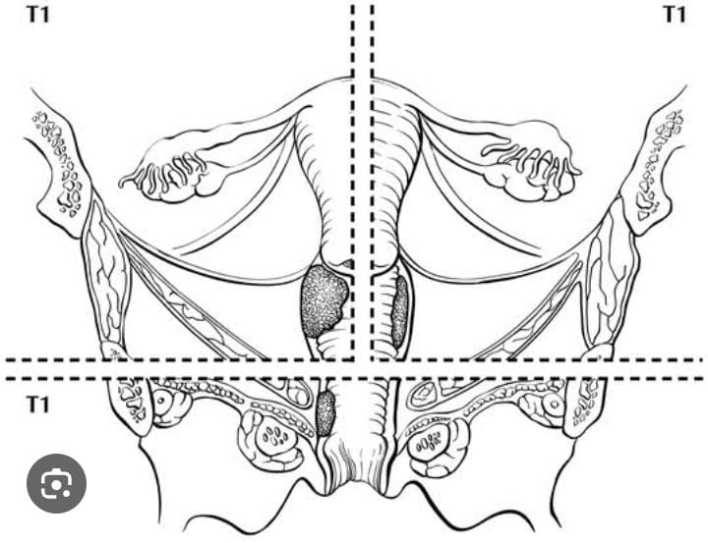
Vaginal carcinoma
Presentation:
Depends on stage
Most common features are
Vaginal Bleeding > 50%
Discharge
Urinary symptoms
Abdominal pain/ Mass
Asymptomatic 10%
Sites
Can occur at any site
Most common is upper 3rd of vagina
size
Range from small ulcer of <1cm in diameter to large pelvic masses
Majority are of 2 to 4cm in diameter

Slide 44
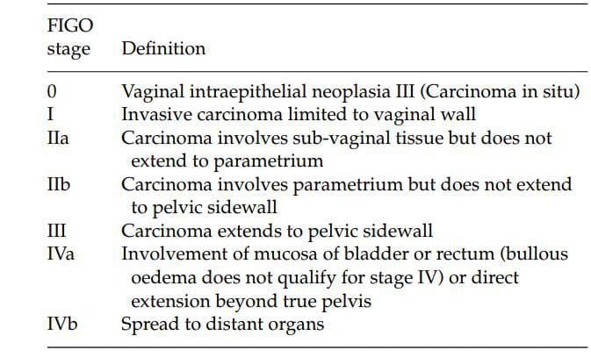
FIGO Classification

Slide 45
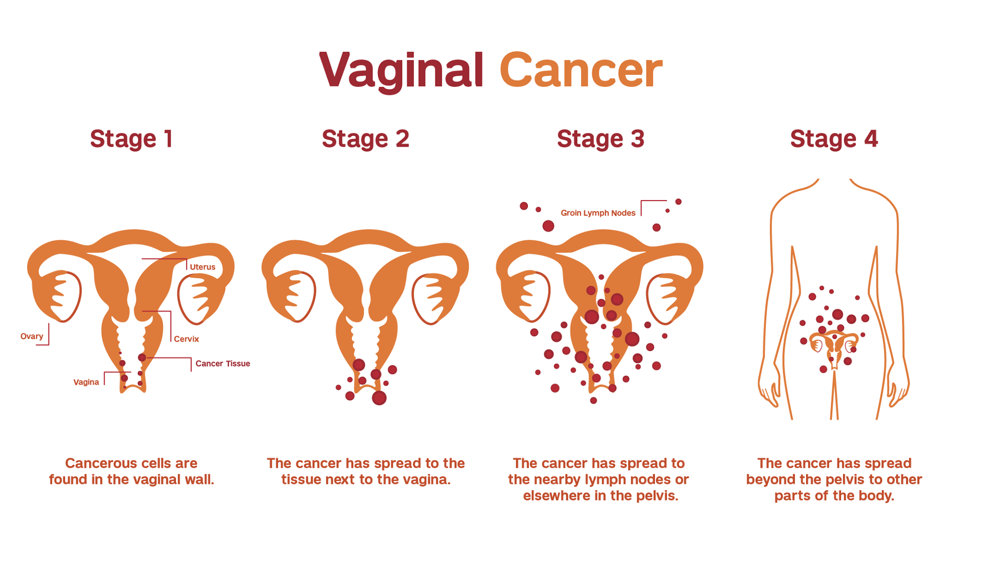

Slide 46
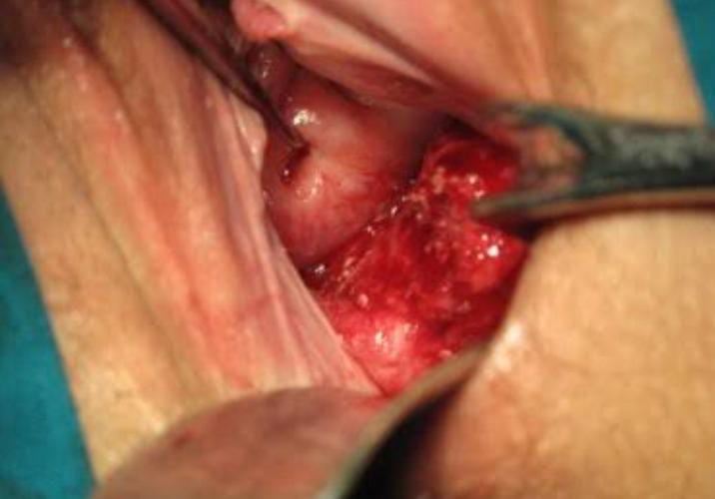
Assessment
Performed under General anesthesia
Full thickness Biopsy for Histology
Combined rectal and vaginal examination
Cystoscopy and sigmoidoscopy
Chest Xray
Intravenous Urogram
Rectal USG/MRI

Slide 47
Treatment
Radiotherapy
Mid tumor dose should be 75Gy
Techniques
Teletherapy
Brachytherapy
Combination of two
Complications
10 to 20%
Acute
Proctitis
Cystitis
Vulvar excoriation
Ulceration
Vaginal necrosis
Chronic
Vesicovaginal or rectovaginal fistula
Renal stricture
Vaginal stenosis

Slide 48
Radiotherapy

Slide 49
Surgery
Indications
Stage 1 tumor in upper one 1/3 of vagina
Small mobile stage 1 tumor in lower segment of vagina
Bulky lesions that are less likely to be cured by Radiotherapy
Complications of Surgery
Urinary problems(Stress/ Urge incontinence)
Fistula
Sexual Dysfunction

Slide 50
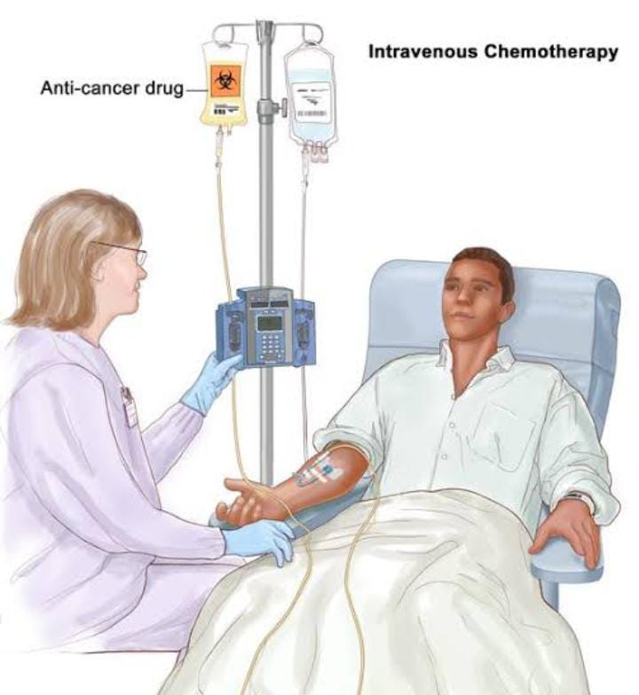
Chemotherapy
Limited published research on chemotherapy.
Chemotherapy mainly for advanced cases.
Squamous cancer: chemotherapy still experimental
Side Effects
Fatigue
Mouth ulcers
Hair loss
constipation

Slide 51
Survival rates
5 years survival rates 39-66%
Prognostic factors
Stage
Recurrence
Median time of relapse is 0.7 year
For Stage 1 disease 70 to 80%
Site
Size
Histological grade
Occurs locally or within pelvis
In most cases with about 20% relapcing with distant metastasis

Slide 54
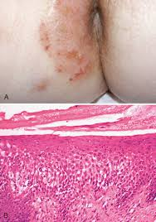
Squamous Cell Hyperplasia (Atopic Eczema/Neurodermatitis)
Physical Appearance
Benign epithelial thickening and hyperkeratosis
Acute phase with red/moist lesions
Causing pruritus leading to rubbing & scratching
Circumscribed, single or unifocal
Raised white lesions on vulva or labia majora and clitoris

Slide 55
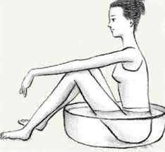
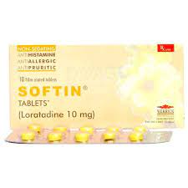
Squamous Cell Hyperplasia (Atopic Eczema/Neurodermatitis)
Treatment
Sitz bath
Oral antihistamines
topical steroid

Slide 56
Benign Vulvar lumps
Bartholin’s cyst.
Epidermal inclusion cyst.
Skene’s duct cyst.
Congenital mucous cysts: arise from mesonephric ducts remnants.
Cyst of the canal of Nuck: can give rise to hydrocele in labia majora.
Sebaceous cyst.
Papillomatosis (solid).
Fibroma (solid).
Lipoma (solid).
Condylomata (solid).
Cysts are either congenital or arise from obstructed glands.
Manifestations arise from the cysts or from infection.

Slide 57
Skene’s Gland
Found on each side of urethra
Normally neither seen nor felt
Skenitis
May become swollen and tender
particularly with GC or chlamydia
Treatment: Drainage.
Culture: For Gonnococcus, Chlamydia

Slide 58
Inclusion Cysts of the Vulva
Contain creamy, yellow debris & lined with stratified epithelium.
Found in the perineum, posterior vaginal wall & other parts of the vulva.
Arise from perineal skin buried at obstetrical injuries.
Usually symptomless.
Treatment: excision.

Slide 59
Toxic Shock Syndrome
Risk Factors
Vaginal tampons
Caused By:
Staph. Aureus
Symptoms:
Abrupt onset of pyrexia >38.9C
Diffuse skin rash with oedema
Blanching Erythema
Investigations:
Blood cultures are usually negative
Staph. Aureus is usually isolated from vagina.
Treatment:
Iv Fluids
Antibiotics
Symptomatic support

Slide 60
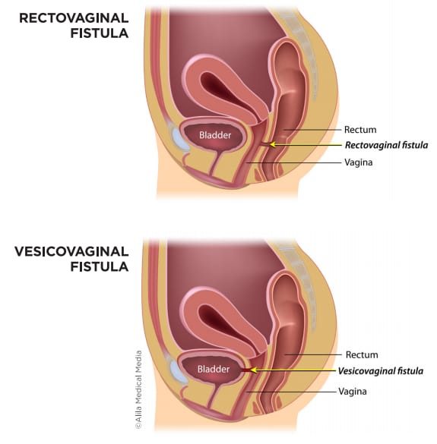
Vaginal Fistula
An abnormal opening between vagina and other near by organs in pelvis
Caused by
Trauma (tears, poorly repaired episiotomies)
Medical conditions (Crohn's disease, carcinoma)
Gynecological surgeries (ureter, bladder, rectum)
Anterior wall fistulas (rare in childbirth)
Rectovaginal fistulas (possible after childbirth
Treatment
Surgical repair

Slide 61
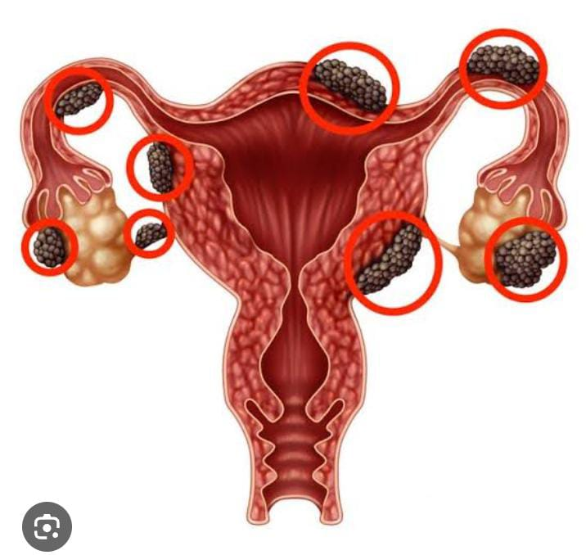
Endometriosis
It is a condition in which the type of tissue that forms the lining of the uterus (endometrium) is found out the uterus
Risk Factors:
Surgery
Episiotomy
Sites
Peritoneum
Ovaries and fallopian tubes
Bladder, ureter, rectum
Cul-de-Sac
Symptoms:
Chronic pelvic pain
Dysmenorrhea, HMB
Dyspareunia
Bladder and bowel symptoms
Diagnosis
Pelvic examination (initial)
Laparoscopy is diagnostic
Biopsy
Treatment:
NSAIDS
Hormonal medications
Surgery

Slide 62
Benign Vaginal Tumors
These are uncommon but occur within the vaginal wall and include
Myoma
Fibromyoma
Neurofibroma
Papilloma
Adenomyoma
Myxoma

Slide 63
Bioethics
Patient informed consent: Ensuring patients fully understand their diagnosis, treatment options (including conservative management), and potential risks and benefits before proceeding with any intervention
Privacy and confidentiality: Respecting patient privacy by discussing sensitive issues in a supportive and confidential environment

Slide 64
Future Research
Stein R, Ganeshan D, Gopireddy DR, Chaudhry A, Kumar S, Bande K, et al. Current update on vaginal malignancies. Abdom Radiol (NY) 2021; 46: 5353–68. doi: 10.1007/s00261-021- 03228-z
Dasgupta S, Ewing-Graham PC, Swagemakers SMA, van der Spek PJ, van Doorn HC, Noordhoek Hegt V, Koljenović S, van Kemenade FJ. Precursor lesions of vulvar squamous cell carcinoma - histology and biomarkers: A systematic review. Crit Rev Oncol Hematol. 2020 Mar;147:102866.

Slide 65
Physician should know the difference between benign and malignant conditions, their prevention and timings of vaccination
Timely referral to tertiary care hospital.

Slide 66
Thank You

