Slide 2
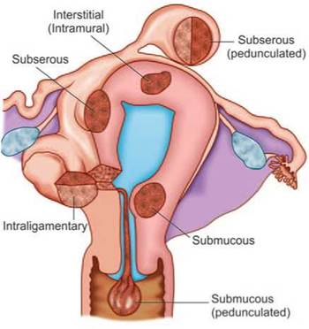
BENIGN DISEASES OF UTERUS
Dr. Farah Deeba
Assistant professor OBS & GYNAE
Holy family hospital Rawalpindi

Slide 3
Prof. Umar’s Model of Teaching Strategy
Self Directed Learning Assessment Program
First Ten Minutes
Objectives :
To cultivate critical thinking, analytical reasoning, and problem-
solving competencies.
To instill a culture of self-directed learning, fostering lifelong
learning habits and autonomy.
How to Assess?
➢
Ten randomly selected students will be evaluated within the first 10 minutes of the lecture through 10 multiple-choice questions (MCQs) based on the PowerPoint presentation shared on Students Official WhatsApp group, one day before the teaching session.
➢
The number of MCQs from the components of the lecture will follow
the guidelines outlined in the Prof. Umar model of Integrated Lecture.
Component of LGIS
Core Know ledge
Horizontal Integration
Vertical Integration
Spiral Integration
No of MCQs
6-7
1-2
1
1

Slide 4
Professor Umar Model of Integrated Lecture
3

Slide 5
University Motto, Vision, Values & Goals
Mission Statement
To impart evidence-based research-oriented health professional education
Best possible patient care
Mutual respect, ethical practice of healthcare and social accountability.
Vision and Values
Highly recognized and accredited center of excellence in Medical Education, using evidence-based training techniques for development of highly competent health professionals, who are lifelong experiential learner and are socially accountable.
Goals
The Undergraduate Integrated Learning Program is geared to provide you with quality medical education in an environment designed to.

Slide 6
SEQUENCE OF LGIS
Learning objectives
Benign Diseases of Uterus
(core concept = 70%)
Related pathophysiology (horizontal integration 15%)
Related clinical findings (vertical integration – 10%)
Research article related to topic (3%)
Ethics (2%)

Slide 7
Learning Objectives: Able to
Describe the common benign conditions that affect the uterus according to their tissue of origin
Understand the presenting symptoms and examination findings associated with benign uterine pathology.
Describe the common tests used to evaluate the uterus and endometrial cavity
Explain the available treatment options for uterine fibroids and adenomyosis and the rationale for selection.

Slide 8
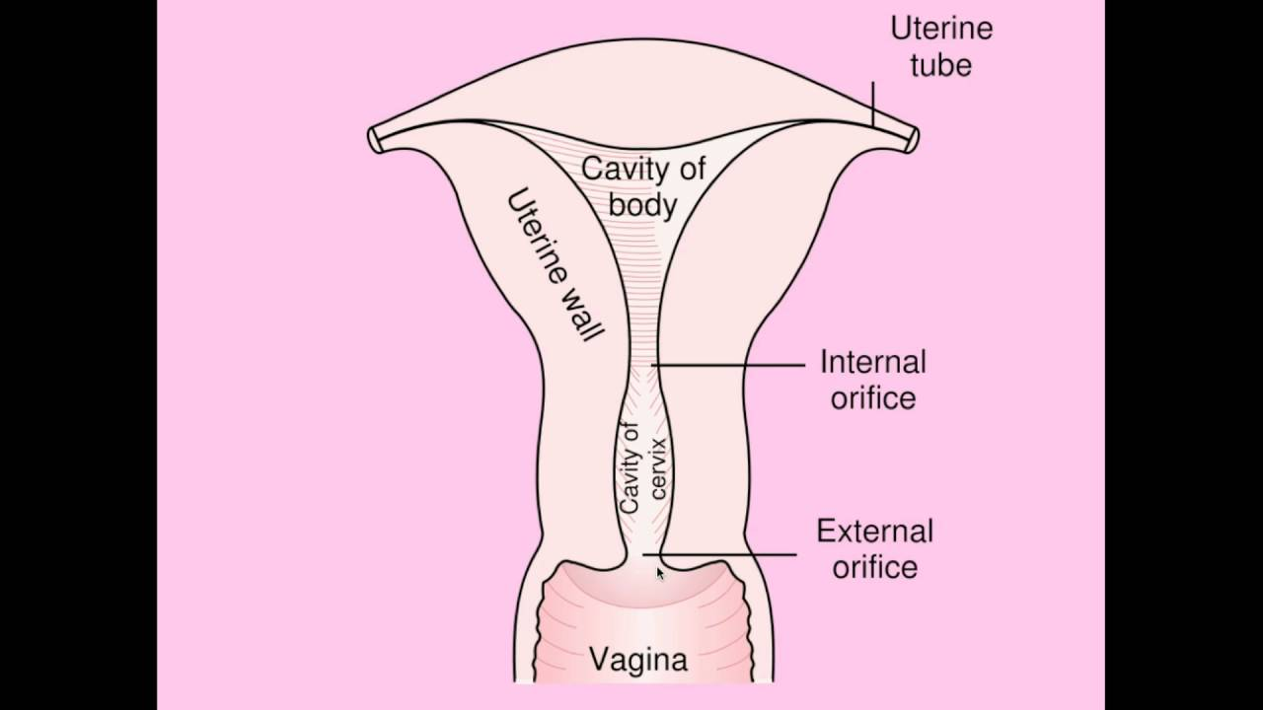
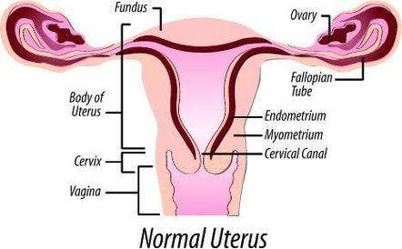
BENIGN DISEASES OF UTERUS
ANATOMY OF UTERUS

Slide 9
Benign Conditions of Endometrial Origin
Inflammation(Endometritis):
Endometrial Polyps:
Endometrial hyperplasia
Asherman syndrome

Slide 10
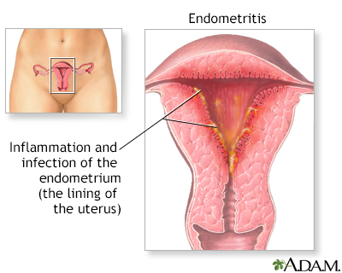
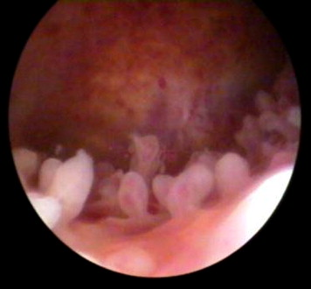
Endometritis
Can be acute or chronic.
Mostly polymicrobial.
Acute:
Mostly associated with childbirth or abortion.
Chronic:
PID, IUCD, Cancer, TB, Chlamydia, Gonorrhea etc.
Symptoms:
Pain in lower abdomen
Fever
Abnormal vaginal bleeding/discharge
General malaise.

Slide 11
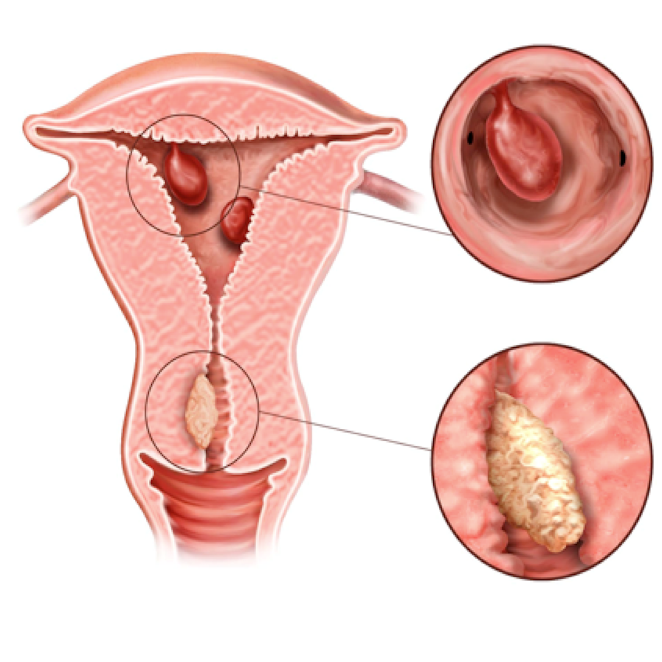
Endometrial Polyps
Localized growths of endometrial tissue covered by epithelium and containing a variable amount of glands, stroma and blood vessels.
Presentations:
Can be asymptomatic.
Intermenstrual bleeding
Postmenopausal bleeding.
Miscarriage.
Can be cancerous.

Slide 12
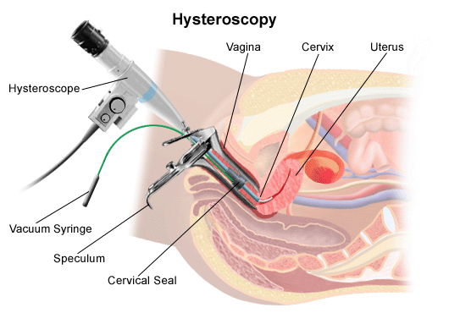
Endometrial Polyps
Diagnosis:
Hysteroscopy.
Hysterosalpingography.
Saline infusion sonography
Treatment:
Polypectomy

Slide 13
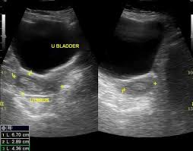
ENDOMETRIAL HYPERPLASIA
Proliferation of endometrial glands into irregular size and shape with increase in gland/stroma ratio compared with proliferative endometrium.
Classification:
Simple hyperplasia with or without atypia.
Complex hyperplasia with or without atypia.
Risk Factors:
Unopposed estrogen exposure.
PCO and anovulation.
Estrogen producing tumor.
Obesity, DM.

Slide 14
BENIGN DISEASES OF UTERUS

Slide 15
BENIGN DISEASES OF UTERUS

Slide 16
Asherman syndrome
Irreversible damage of basal endometrium does not allow normal regeneration of the endometrium.
The endometrial cavity undergoes fibrosis and adhesion formation, termed ‘Asherman syndrome’.
The result is reduced, or absent, menstrual shedding and subfertility.
This usually occurs after pregnancy where there has been endometritis or following overzealous curettage of the uterine cavity during surgical management of miscarriage or following secondary postpartum haemorrhage.

Slide 17
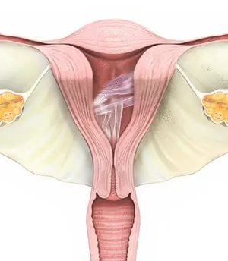
Asherman syndrome
Prevention of uterine scarring
Conservative or less traumatic surgical approaches to managing RPOC
Prevent endometritis
Diagnosis : Hysteroscopy,HSG
Treatment: Hysteroscopic adhesiolysis.
However, treatment can be difficult and risks further uterine trauma

Slide 18
BENIGN DISEASES OF UTERUS
Benign Conditions Of Myometrial Origin:
Leiomyoma (Fibroid).
Adenomyosis.

Slide 19
Leiomyoma /Fibroid
These are clonal tumors that arise from myometrium.
Well demarcated firm, whorled tumor.
Highly prevalent, in 40% of women overall, more common in nulliparous and obese.
Estrogen dependent tumors ,so can enlarge during pregnancy.
Malignant prevalence is 0.5%.
Red degeneration of fibroid is a known complication.
SYMPTOMS:
AUB (usually HMB,IMB)
Subfertility
Recurrent pregnancy loss
Pressure effects
Abdominal distention.

Slide 20
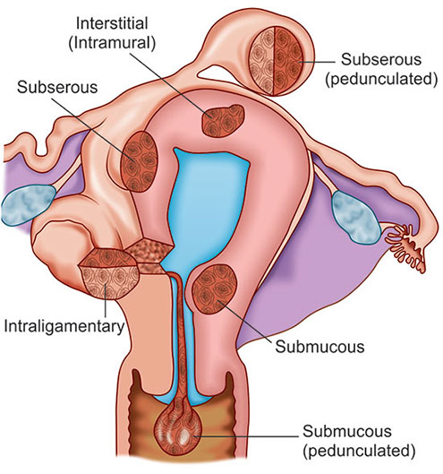
Leiomyoma /Fibroid
Location of Fibroids:

Slide 21
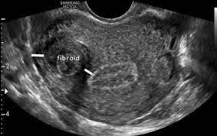
Leiomyoma /Fibroid
Diagnosis:
Abdominopelvic USG.
SIS.
Hysteroscopy.
MRI.
Treatment:
If asymptomatic no treatment required.
Medical:
COCPs, Mefenamic acid, Tranexamic acid, LNG-IUS.
GnRH agonists.
Ineffective in cases of submucosal fibroids or large fibroids>12 weeks size.

Slide 22
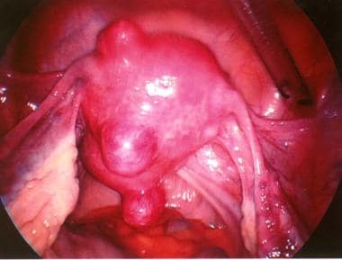
Leiomyoma /Fibroid
Surgical:
Myomectomy
Hysterectomy
Radiological: Uterine artery embolization.
Thermal ablation of myoma.

Slide 23
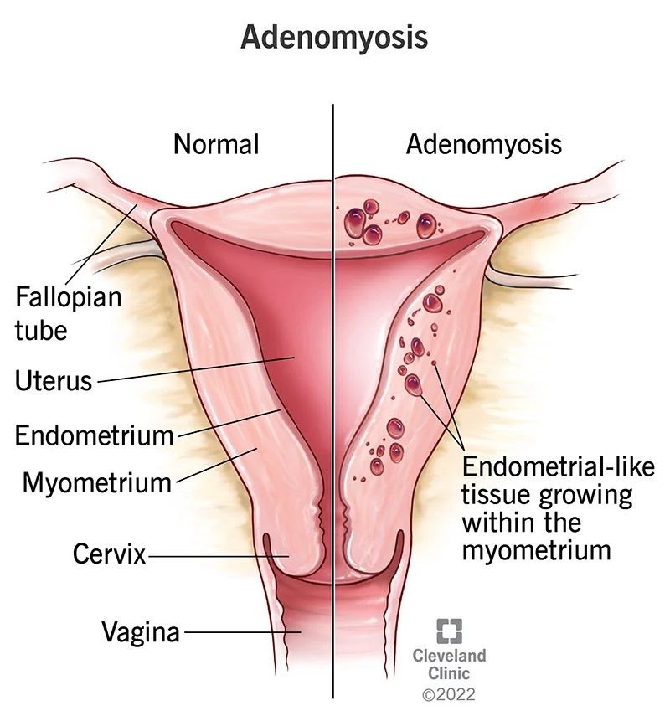
Adenomyosis
Endometrial glands and stroma develop deep within the myometrium (Ectopic Endometrium).
Usually in multiparas in their late 30 or early 40s.
Symptoms:
HMB
Increasingly severe secondary dysmenorrhea.

Slide 24
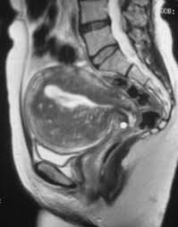
Adenomyosis
DIAGNOSIS
USG
MRI
Histopathological examination after hysterectomy.
Treatment:
Contraceptives (LARCs, LNG-IUS, Depot Provera) only temporary treatments
Hysterectomy remains only definitive treatment.

Slide 25
BENIGN DISEASES OF UTERUS
Questions
&
Answers

Slide 26
MCQ
A pregnant woman with fibroid uterus develops acute pain in abdomen with low grade fever & mild leucocytosis at 28 week. The most likely diagnosis is
Preterm labor.
Torsion of fibroid.
Red degeneration of fibroid.
Infection in fibroid.

Slide 27
MCQ
A pregnant woman with fibroid uterus develops acute pain in abdomen with low grade fever & mild leucocytosis at 28 week. The most likely diagnosis is
Preterm labor.
Torsion of fibroid.
Red degeneration of fibroid.
Infection in fibroid.

Slide 28
BENIGN DISEASES OF UTERUS
Least common complication in fibroid is
Menstrual disorder
Urinary retention
Malignancy
Degeneration

Slide 29
BENIGN DISEASES OF UTERUS
Least common complication in fibroid is
Menstrual disorder
Urinary retention
Malignancy
Degeneration

Slide 30
RESEARCH
Addley, H., Fennessy, F. (2023). Benign Disease of the Uterus. In: Hodler, J., Kubik-Huch, R.A., Roos, J.E., von Schulthess, G.K. (eds) Diseases of the Abdomen and Pelvis 2023-2026. IDKD Springer Series. Springer, Cham. https://doi.org/10.1007/978-3-031-27355-1_13
Johnatty SE, et al. Co-existence of leiomyomas, adenomyosis and endometriosis in women with endometrial cancer. Sci Rep. 2020;10:3621

Slide 31
BIOMEDICAL ETHICS
Take detailed history of pattern of menstrual irregularity before starting treatment.
Hysterectomy should be avoided in young girls who are willing to conserve their fertility.
Before embarking on surgery for fibroid and adenomyosis ,conservative options should be offered.
Treatment should not be delayed in patients with menstrual irregularity.
Haemetenics should be advised to those with excessive bleeding.

Slide 32
FAMILY MEDICINE
Family physicians should take detailed history and do an examination of all patients with menstrual irregularity.
Hormonal treatment should be explained and make sure patient has understood.
Any patient with risk factors for malignancy should be referred without any delay.

Slide 33
BENIGN DISEASES OF UTERUS
Thank you

