Slide 4
Learning objectives

Slide 5
Case scenario
30-year-old unmarried woman, presents to breast clinic with complaint of lump in her left breast.
She first noticed the lump while showering a week ago.
She has no family history of breast cancer.

Slide 6
Physical examination reveals a 2-cm, firm,mobile mass in the upper outer quadrant of the left breast. The mass is non tender and has a well-defined border.
There are no nipple discharge, skin changes, or axillary lymphadenopathy

Slide 7
Ultrasound breast: A 2-cm, hypoechoic mass with a smooth border and no posterior shadowing.
Fine-needle aspiration biopsy (FNAB): C2 Benign breast tissue with no atypia
Core needle biops (CNB): Fibroadenoma

Slide 8
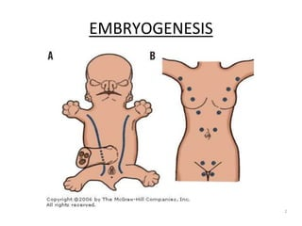

Slide 9
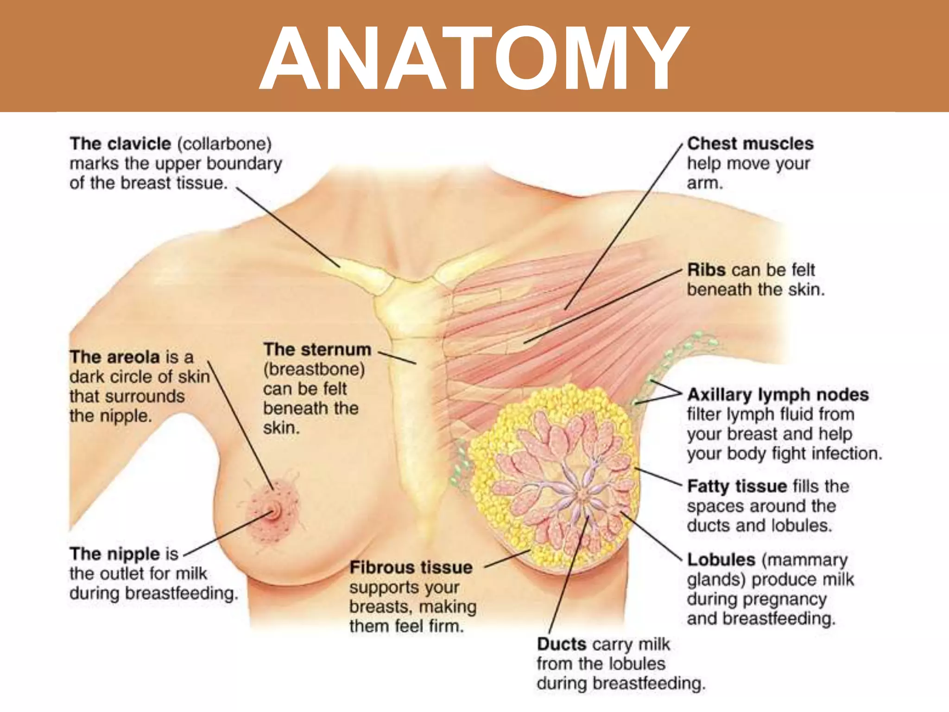

Slide 11
introduction
Non-cancerous conditions that affect the breast tissue
10 times more frequent than carcinoma,
70% lumps are benign
30 % can have malignancy or malignant potential
Mostly requires reassurance
Important to differentiate from malignant breast diseases

Slide 12
Benign
Breast disease
Congenital disorders
Inflammatory conditions (e.g. Mastitis, Abscess)
tumors (e.g. Fibroadenoma, Phyllodes tumor)
Cysts and fibrocystic changes

Slide 13
Congenital anomalies
Polymastia
Polythelia
Amastia
Poland syndrome
Symmastia.

Slide 14
Congenital anomalies polymastia polythelia

Slide 15
amastia Poland syndrome

Slide 16
Benign breast cyst

Slide 17
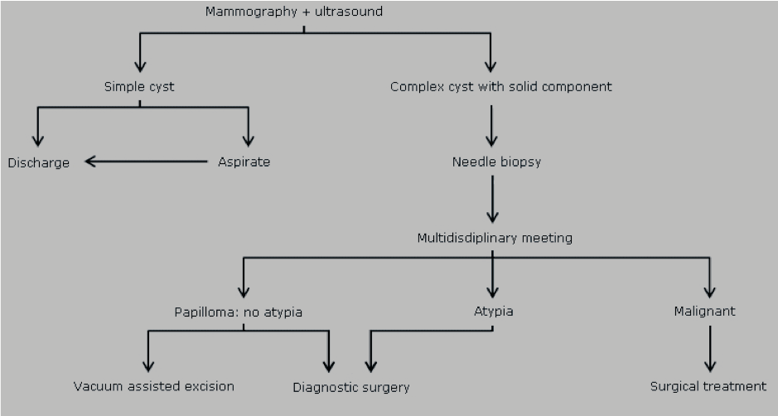
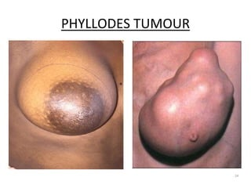

Slide 18
FibroadenomA
Benign tumor of glandular and fibrous tissue
Most common benign breast tumor in young women
Clinical features: Painless, firm, mobile lump
Diagnosis: Ultrasound, mammography, and biopsy -
Management: Reassurance, follow-up, or surgical excision-

Slide 20
Fibrocystic Changes
Spectrum of changes including fibrosis, cyst formation, and epithelial proliferation
Clinical features: Cyclical breast pain, tenderness, and nodularity - Diagnosis: Mammography, ultrasound, and biopsy
Management: Reassurance, pain management, and hormonal therapy-

Slide 21
Mastitis
Infection of breast tissue
Presents with pain, redness, swelling, and fever
Treatment: Antibiotics, drainage (if abscess)

Slide 22
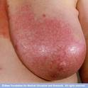
Cellulitis, mastitis
Breast cellulitis is a clinical diagnosis classically characterized by swelling, erythema, warmth, and tenderness often from S aureus.
Mastitis is defined as inflammation of the breast tissue parenchyma and presents similar to that of breast cellulitis with tenderness and swelling.

Slide 23
Breast Abscess
Collection of pus in breast tissue
Often caused by Staphylococcus aureus and Streptococcal species.
Common in lactating women
Clinical features: Painful, fluctuant breast mass
Diagnosis: Clinical examination, ultrasound, and culture
Management: Antibiotics, drainage, and supportive care-

Slide 28
Fat necrosis
Duct ectasia-
Intraductal papilloma
Clinical Evaluation- History and physical examination- Imaging (Ultrasound, Mammography)- Biopsy (if necessary)
Management- Reassurance and supportive care- Pain management- Antibiotics (if infected)- Surgery

Slide 29
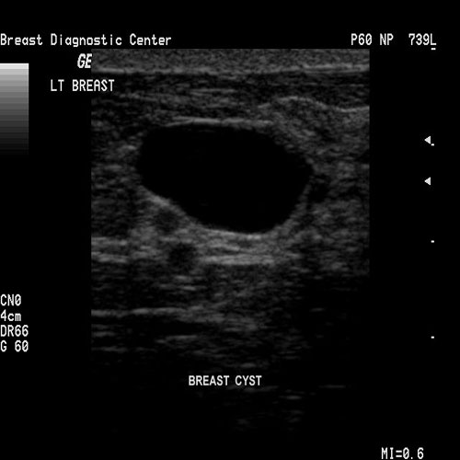
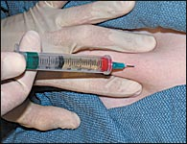
Simple Cyst

Slide 30
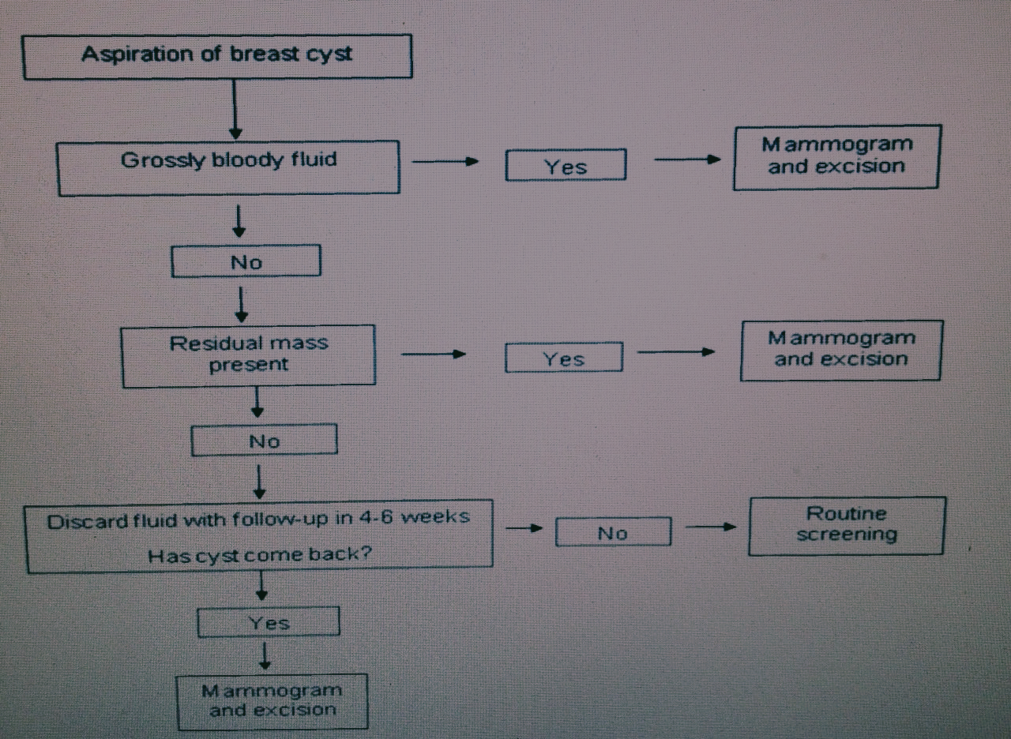

Slide 31
Conclusion- Benign breast diseases are common and important to diagnose and manage appropriately- A thorough clinical approach and understanding of each condition are essential for providing optimal care diseases:

Slide 32
Triple Assessment for Benign Breast Diseases
comprehensive approach to evaluate breast lesions-

Slide 33
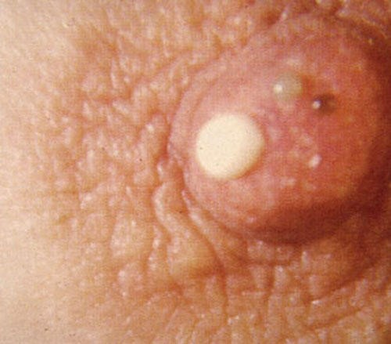
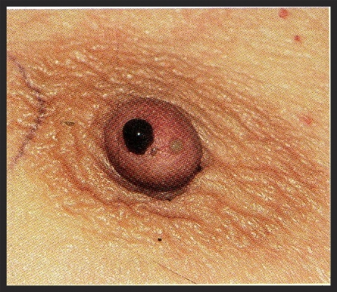
Nipple discharge

Slide 37
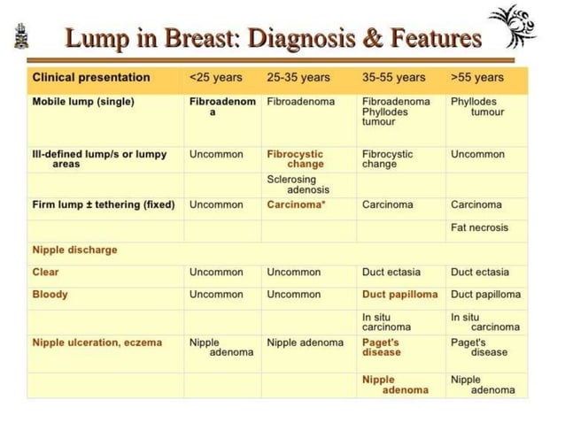

Slide 38
THANKYOU

Slide 39
