Slide 1
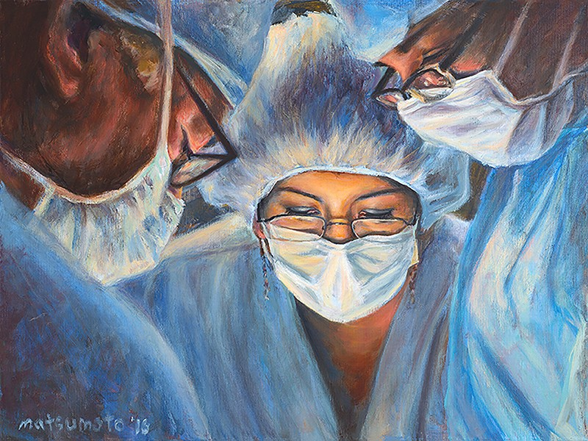
Basics of Anesthesia And its Types
Dr. Ayesha Nazir
Assistant Professor
Rawalpindi Medical University

Slide 2
University motto, mission statement , vision and goals
Mission Statement :
To impart evidence-based research-oriented health professional education Best possible patient care Mutual respect, ethical practice of healthcare and social accountability.
Vision and Values
Highly recognized and accredited center of excellence in Medical Education, using evidence-based training techniques for development of highly competent health professionals, who are lifelong experiential learner and are socially accountable.

Slide 3
Sequence of LGIS
Learning objectives
Basics of Anesthesia and its types (core concept 70%)
Related basic sciences ( horizontal integration 15%)
Related clinical sciences (vertical integration 10%)
Research article related to topic 3%
Ethics 2%

Slide 4
Learning objectives
By the end of this lecture students will be able to
Define Anesthesia
Enumerate components of Anesthesia
Understand different modalities of anesthesia
Briefly explain pros and cons of general anesthesia and regional anesthesia

Slide 5
Prof Umar's model of integrated lecture

Slide 6
DEFINITION
Absence of sensation with or with out loss of consciousness.
TYPES OF ANESTHESIA
1.General Anesthesia
2.Regional Anesthesia
3.Monitored Anesthesia Care

Slide 7
General Anesthesia
Altered physiological state of
Reversible loss of consciousness
Analgesia
Amnesia
Muscle relaxation (some degree)

Slide 8
How does it work ?
The mode of action of each class of anesthetics varies depending upon the target of the anesthetic compounds. The target mainly comprises of:
Potentiation of inhibitory chloride channels by GABA, glycine etc.
Inhibition of excitatory receptors by glutamate, NMDA.

Slide 9
Horizontal integration

Slide 10
Stages of Anesthesia
Anesthesia is attained through 4 stages, namely:
Stage I: Analgesia/Disorientation
Stage II: Delirium/Excitement
Stage III: Surgical Anesthesia
Stage IV: Respiratory Arrest
All the stages are categorized according to the physiological changes resulting from different degrees of unconsciousness.

Slide 11
Conduct of General Anesthesia
Induction:
Pre-op review.
Intravenous line.
Pre-medication.
ASA standard monitoring.
Drugs for hypnosis/sedation: Propofol Midazolam Etomidate etamine Thiopentol.
Drugs for muscle relaxation : Succinylcholine , Atracurium , Cisatracurium , Rocuronium.
Airway maintenance.
Analgesia.
Amnesia.

Slide 12
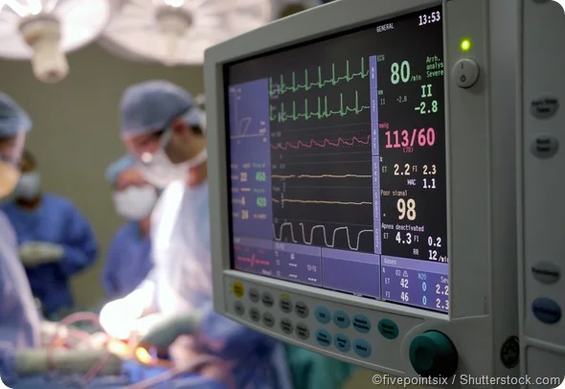
Maintenance
Inhalational agents : isoflurane , sevoflurane , halothane , desflurane.
Maintenance of muscle relaxation.
Ongoing Analgesia And amnesia.
Monitoring.

Slide 13
Emergence
Hypnotics –off
Wait for muscle relaxants effect to wear off
Reversal agent- Neostigmine and Glycopyrrolate.
Suctioning
Extubation
Post extubation observation
PACU

Slide 14
Regional Anesthesia
Regional anesthesia is the use of local anesthetics to block sensations of pain from a large area of the body, such as an arm or leg or the abdomen.
Regional anesthesia allows a procedure to be done on a region of the body without inducing unconsciousness.

Slide 15
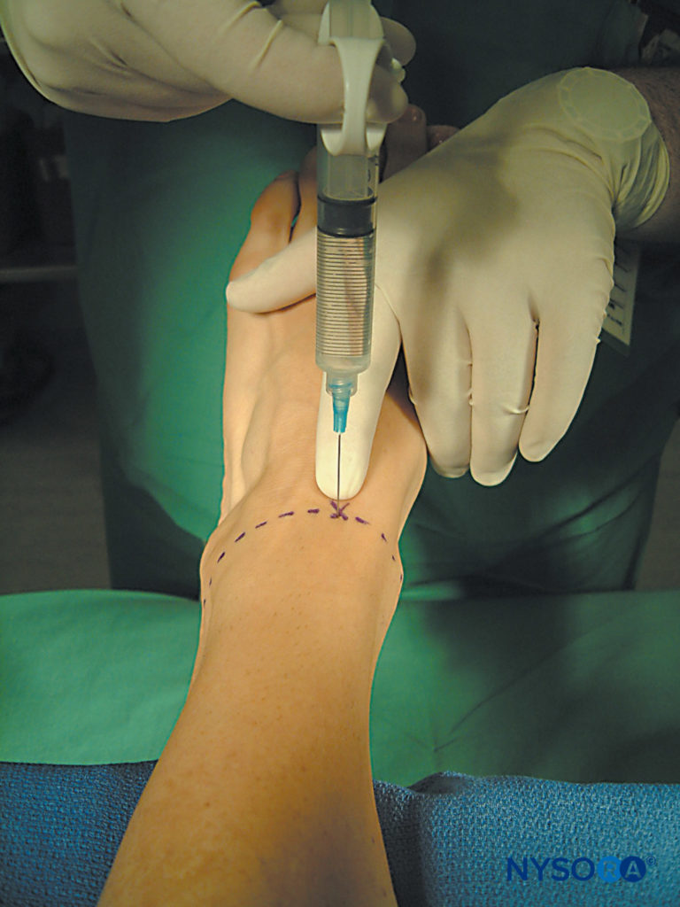
Types of Regional Anesthesia
Topical Anesthesia
Intravenous Regional Anesthesia
Peripheral nerve blocks
Neuraxial block

Slide 16
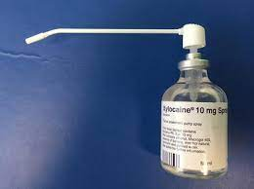
Topical
Topical sprays
EMLA (0.5% Prilocaine + 0.5% Lignocaine)
LMX cream (plain lidocaine cream 4% and 5%)
2% lidocaine jelly

Slide 17
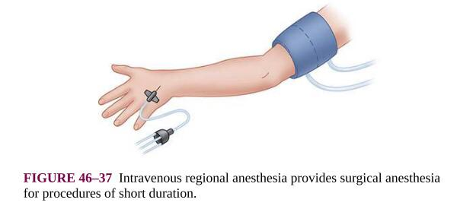
Intravenous Regional Anesthesia
Bier`s block
Surgical anaesthesia for extremities(45-60min)
Intravenous catheter (hand/foot)
Double pneumatic torniquet
Esmarch bandage on elevated limb
Proximal torniquet inflated
Bandage removed

Slide 18
0.5% lidocaine (25ml for forearm, 50ml for arm/below knee and 100ml for thigh) injected over 2-3min.
Remove iv cannula
Torniquet pain 20-30mins
Distal torniquet is inflated, proximal deflated
Torniquet must be left inflated for a min of 15-20min.

Slide 19
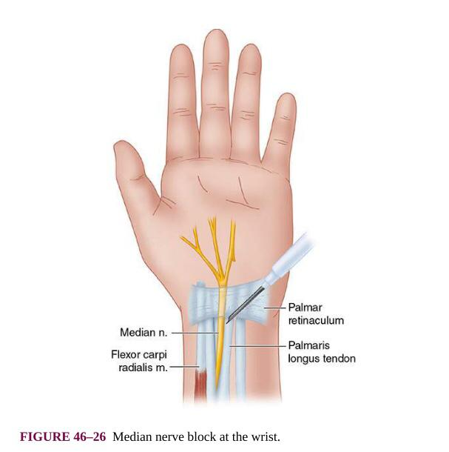
Peripheral Nerve blocks
Upper Limb : Brachial plexus block Radial nerve block Ulnar nerve block Median nerve block Musculocutaneous nerve block.

Slide 20
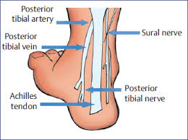
Peripheral Nerve blocks
Lower Limb : Lumbar and sacral Plexus block Sciatic nerve block Saphenous nerve block Femoral Nerve Block Ankle block

Slide 21
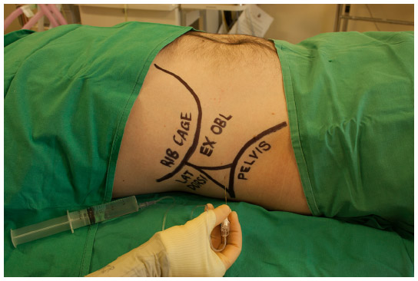
Peripheral Nerve blocks
Truncal blocks: Intercostal nerve block Paravertebral Pecs block Transversus abdominus plane block (TAP)

Slide 22
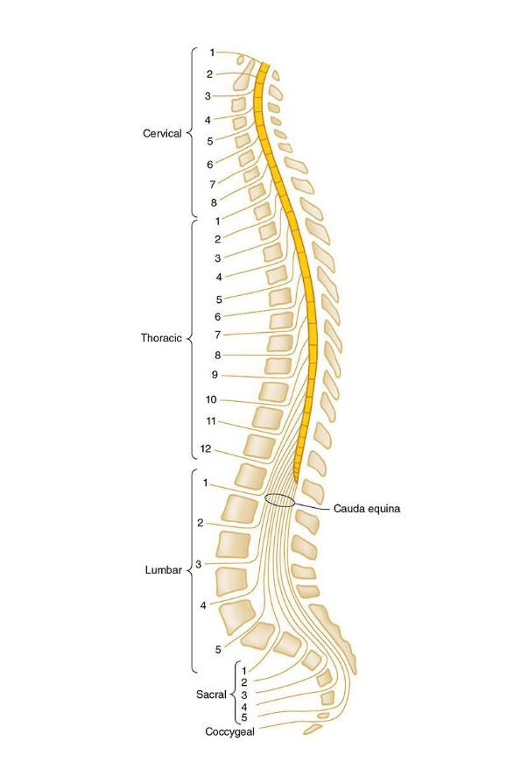
Neuraxial Block
Spinal block
Epidural block
Caudal block

Slide 23
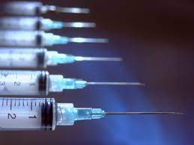
Indications
Spinal Anesthesia: Below the umbilicus surgeries ( Gynaecological, Obstetrical, Orthopedic, Plastic/Reconstructive, Urological surgeries)
Epidural Anaesthesia/Analgesia : Labour analgesia, for intra-op/post-op analgesia, below the umbilicus surgeries of longer duration

Slide 24
Absolute Contraindications
Patient’s refusal
Coagulopathy
Skin infection at site of insertion
Increased ICP
Severe Hypovolemia
Severe Aortic stenosis
Severe Mitral stenosis

Slide 25
Relative Contraindications
Sepsis
Uncooperative patient.
Pre-existing neurological disorder.
Demyelinating lesions
Stenotic valvular heart lesions
Severe spinal deformity

Slide 26
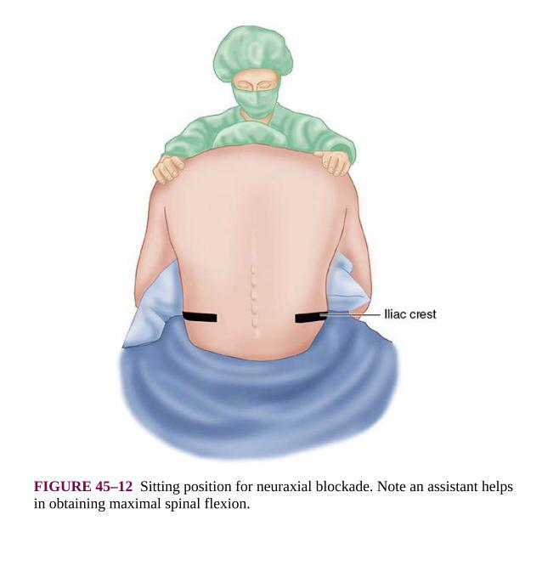
Spinal & Epidural Anaesthesia
Local anesthetic injected into the subarachnoid or epidural space.
Patient’s position: Sitting, Lateral.
Approach: Midline, Para-median
Bupivacaine 0.75% 0.5%

Slide 27
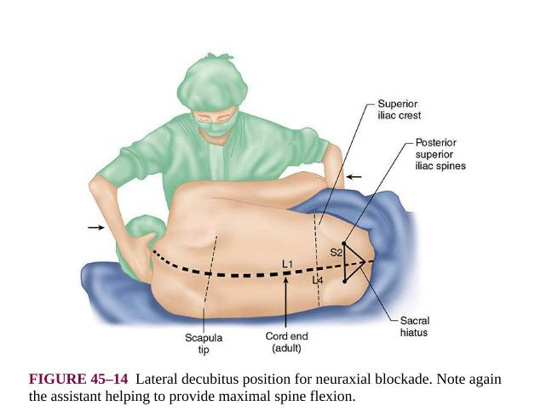
Pre-Procedure Preparation
Patient’s assessment
Explain the procedure & Obtain consent
Patient should be fasting
Equipments for resuscitation & GA
IV line insertion & start fluid load
Ensure asepsis.

Slide 30
Recent Advances
Target-Controlled Infusion (TCI): allows for the precise administration of intravenous anesthesia by calculating drug dosage based on patient-specific factors such as age, weight, and medical condition.
Ultrasound-Guided Regional Anesthesia: Ultrasound technology has revolutionized the administration of regional anesthesia, such as nerve blocks.
Automation in the delivery of anesthetics.
Monitoring inside the operating rooms: advances in non-invasive monitoring.
Monitoring beyond the operating room: telemedicine and wearable health-care technologies.

Slide 31
What is the most important skill for anesthetist?
Critical thinking
Ability to Work under pressure
Medical knowledge
Attention to detail

