Slide 1
Bacterial growth , nutrition and metabolism
Microbe Module
3rd Year MBBS
Dr Kiran Fatima
Pathology Department
Rawalpindi Medical University

Slide 2


Slide 3
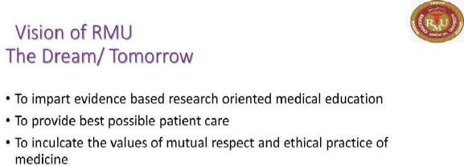

Slide 4
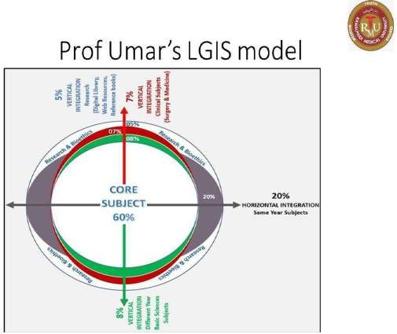

Slide 5
Learning outcomes
Explain the growth curve, calculate generation time, and analyze factors (temperature, pH, etc.) influencing growth.
Factor effecting the growth of bacteria.
Bacterial metabolism: Define catabolism/anabolism, explain central metabolic pathways (glycolysis, Krebs cycle), and ATP generation.
Compare Respiration and Fermentation: Differentiate aerobic/anaerobic respiration and fermentation, including products and energy yields.
Apply Metabolic Principles: Explain bacterial roles in biogeochemical cycles and apply knowledge to control bacterial growth.
Connect Growth, Nutrition, Metabolism: Understand the interrelationships of these processes and their importance in diverse fields.

Slide 6
Levinson, W. Review of Medical Microbiology and Immunology. 15th ed. McGraw-Hill Education / Medical; 2020
Learning resources

Slide 7
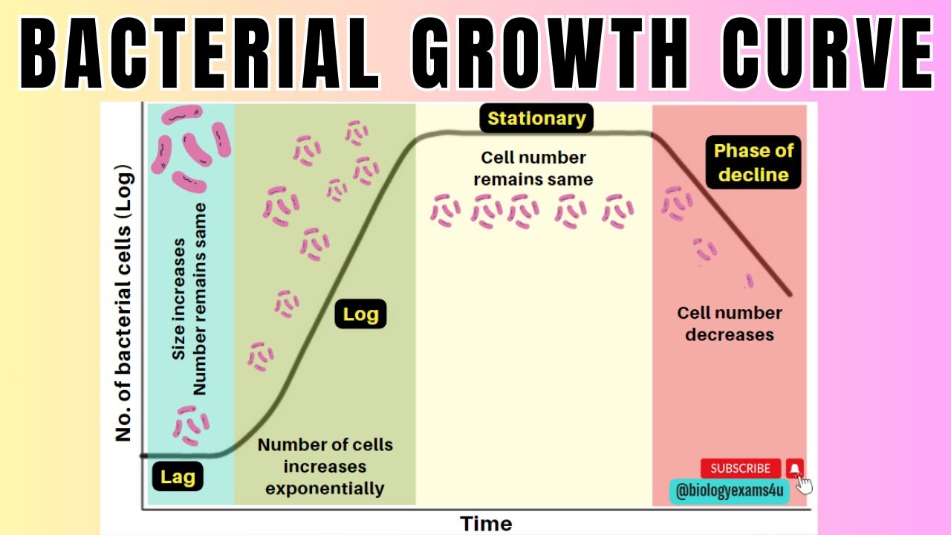
spiral

Slide 8
⦁ Bacterial growth is the division of one bacterium into two daughter cells in a process called binary fission.
⦁ Providing no mutational event occurs the resulting daughter cells are genetically identical to the original cell.
Pathology
core
Bacterial growth
⦁ One cell give rise to two progeny cells , bacteria undergo exponential growth . The concept of exponential growth can be illustrated by
NUMBER OF CELLS 1 2 4 8 16
EXPONENTIAL 2⁰ 2¹ 2² 2³2⁴

Slide 9
⦁ One bacterium will produce 16 bacteria after four generations .Doubling time ranges from as little 20 min for E.coli to more than 24 hr for M.tuberculosis.
⦁ Time varies not only with species but also with the amount of nutrition ,temp ,pH and other envoirmental factors.
Pathology
core

Slide 10
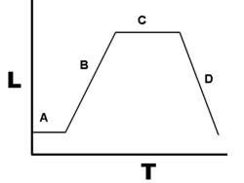
Pathology
core
Growth cycle
⦁ The growth cycle of bacteria has four major phases: lag phase (A), exponential or log phase (B), stationary phase (C), and death phase (D).
mhtml:fil e:// C:\User s\ Hi na \ Documen ts\Bact er ia l% 20g rowt h%20-% 20 Wi ki p ed ia ,% 20t he% 20 fr ee% 20 en cyclopedi a. mht ! htt p://upl oa d.w ik imedi a.or g/w ik ip edi a/commons/t humb/5/53/Ba ct eri al _g row th .png /250px-Bacteri al _g r ow th .p ng

Slide 11
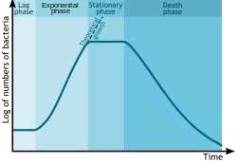
Pathology
spiral
Growth cycle
mhtml:fil e:// C:\User s\ Hi na \ Documen ts\Bact er ia l% 20g rowt h%20-% 20 Wi ki p ed ia ,% 20t he% 20 fr ee% 20 en cyclopedi a. mht ! htt p://upl oa d.w ik imedi a.or g/w ik ip edi a/commons/t humb/c/c0/Ba ct er i al _g row th_en. sv g /250px-Ba ct er ia l _g rowt h_en. sv g.png

Slide 12
Pathology
core
⦁ The first lag phase ,during which vigrous metabolic activity occurs but cells do not divide.It last for a few min to many hours.
⦁ The log phase(Exponential phase )when rapid cell divison occurs.Beta lactum drugs act during this phase when cells are making peptidoglycan (dividing).
⦁ The stationary phase when nutrients depletes or
toxic products cause growth to slow until the number of cell produce balance the number of cell die(steady state).Cell grown in special appratus called chemostat in which fresh nutrients are added and waste products are removed.
⦁ The death phase bacteria run out of nutrients and die.

Slide 13
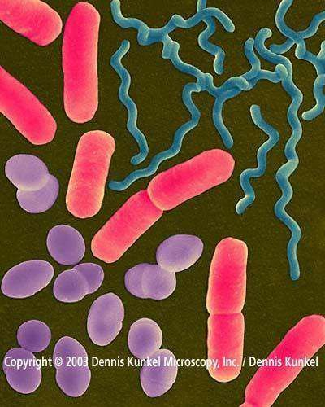
Physical Envoirment
⦁ oxygen
Pathology
core
Factor influencing bacterial growth
⦁ Temprature
⦁ pH
⦁ Osmosis
Nutritional Envoirment

Slide 14
Pathology
core
Aerobic and anerobic bacterial growth
⦁ For most organism adequate supply of oxygen enhances their gowth and metabolism.
⦁ Oxygen act as the hydrogen acceptor in the final step of energy production catalyzed by proteins and cytochromes.
⦁ Use of oxygen generates toxic molecules hydrogen peroxide and superoxide.Bacteria require two molecules to utilize oxygen superoxide dimutase and catalase.

Slide 15
⦁ Obligate aerobes require O₂ for growth; they use O₂ as a final electron acceptor in aerobic respiration M.tuberculosis.
⦁ Obligate anaerobes Clostridium tetani do not need O₂ as a nutrient.It can not grow in presence of oxygen it lacks superoxide dimutase or catalase or both.
Pathology
core
Aerobic and anerobic bacterial growth
⦁ Facultative anaerobes (or facultative aerobes)E.coli are organisms that can switch between aerobic and anaerobic types of metabolism. Under anaerobic conditions they grow by fermentation, but in the presence of O₂ they switch to aerobic respiration.

Slide 16
Pathology
core
⦁ Microaerophilic are organisms that require a low concentration of oxygen (2% to 10%) for growth.
⦁ Aerotolerant anaerobes like obligate anaerobes, cannot use oxygen to transform energy but can grow in its presence.
They obtain energy only by fermentation and are known as obligate fermenters.

Slide 17
Pathology
core
Temperature
⦁ Psychrophiles are cold-loving bacteria temp require(5-15c)
⦁ Mesophiles are bacteria that grow best at moderate temperatures (25-25c)
⦁ Thermophiles are heat-loving bacteria (45- 70c)
⦁ Hyperthermophiles are bacteria that grow at very high temperatures(70-110)

Slide 18
1.Neutrophiles
Pathology
core
pH
grow best at a pH range of 5 to 8.
2. Acidophiles
grow best at a pH below 5.5
3. Alkaliphiles
grow best at a pH above 8.5.

Slide 19
Pathology
core
Osmosis
⦁ Most bacteria require an isotonic environment or a hypotonic environment for optimum growth.
⦁ Organisms that can grow at relatively high salt concentration (up to 10%) are said to be osmotolerant.

Slide 20
⦁ The chemicals and elements of the environment that are utilized for bacterial growth are referred to as nutrients or nutritional requirements.
Pathology
core
Bacterial nutrition
⦁ Many bacteria can be grown in the laboratory in culture media which are designed to provide all the essential nutrients in solution for bacterial growth.

Slide 21
⦁ Combining their nutritional patterns, all organisms in nature can be placed into one of four separate groups
Pathology
core
⦁ Photoautotrophs, Photoheterotrophs, Chemoautotrophs, and Chemoheterotrophs
⦁ Microorganisms are often grouped according to their energy source and their source of carbon.

Slide 22
Phototrophs use radiant energy (light) as their primary energy source.
Pathology
core
Energy source
Chemotrophs use the oxidation and reduction of chemical compounds as their primary energy source.

Slide 23
Autotrophs: require only carbon dioxide as a carbon source. An autotroph can synthesize organic molecules from inorganic nutrients.
Pathology
core
Carbon source
Heterotrophs: require organic forms of carbon. A Heterotroph cannot synthesize organic molecules from inorganic nutrients.

Slide 24
Pathology
core
Nitrogen source
Nitrogen is needed for the synthesis of such molecules as amino acids, DNA, RNA and ATP. Depending on the organism, nitrogen, nitrates, ammonia, or organic nitrogen compounds may be used as a nitrogen source.

Slide 25
Pathology
core
Minerals
⦁ Sulphur
Sulphur is needed to synthesize sulfur- containing amino acids and certain vitamins. Depending on the organism, sulfates, hydrogen sulfide, or sulfur-containing amino
acids may be used as a sulfur source.
⦁ Phosphorus
Phosphorus is needed to synthesize phospholipids DNA, RNA, and ATP.
Phosphate ions are the primary source of phosphorus.
⦁ Potassium magnesium, and calcium

Slide 26
Pathology
core
⦁ Iron
Iron is a part of certain enzymes.
⦁ Trace elements
Minute amounts are required some function as cofactors like Na,Zn,copper,manganese, and cobalt ions.
Cofactors function as electron
donors or electron acceptors during enzyme reaction.

Slide 27
Pathology
core
Water
⦁ Availability of water a critical factor that affects the growth of all cells.
⦁ The availability of water for a cell depends upon its presence in the atmosphere (relative humidity) or its presence in solution or a substance (water activity).
⦁ The water activity (A_{w}) of pure H₂O is 1.0 (100% water). Microorganisms live over a range of A_{w} from 1.0 to 0.7.

Slide 28
⦁ Growth factors are organic compounds such as amino acids purines, pyrimidines , and vitamins that a cell must have for growth but cannot synthesize itself.
⦁ Organisms having complex nutritional requirements and needing many growth factors are said to be fastidious.
Pathology
core
Growth factors

Slide 29
⦁ Microbial metabolism is the means by which a microbe obtains the energy and nutrients (e.g. carbon) it needs to live and reproduce.
Pathology
core
Bacterial metabolism
⦁ Microbes use many different types of metabolic strategies and species can often be differentiated from each other based on metabolic characteristics.

Slide 30
Pathology
core
Heterotrophic metabolism
⦁ Heterotrophic metabolism is the biologic oxidation of organic compounds, such as glucose, to yield ATP and simpler organic (or inorganic) compounds, which are needed by the bacterial cell for biosynthetic and chemical reactions
⦁ All heterotrophic bacteria require preformed organic compounds.

Slide 31
Pathology
core
⦁ These carbon- and nitrogen-containing compounds are growth substrates, which are used aerobically or anaerobically to generate reducing equivalents (e.g., NADH + H⁺).
⦁ These reducing equivalents in turn are chemical energy sources for all biologic oxidative and fermentative systems.

Slide 32
⦁ Respiration is a type of heterotrophic metabolism that uses oxygen and in which 38 moles of ATP are derived from the oxidation of 1 mole of glucose.
Pathology
core
Respiration
⦁ Glucose is the most common substrate used for heterotrophic metabolism. Most aerobic organisms oxidize glucose completely.
⦁ Respiration takes place when any organic compound (usually carbohydrate) is oxidized completely to CO₂ and H₂O
C₆H₁₂O₆+6O₂→6CO₂+6H₂O+Energy

Slide 33
⦁ The complete oxidation of glucose may involve three fundamental biochemical pathways.
Pathology
core
⦁ The glycolytic , Krebs cycle, and the third is the series of membrane-bound electron transport oxidations coupled to oxidative phosphorylation.

Slide 34
⦁ In aerobic respiration, molecular O₂serves as the terminal acceptor of electrons.
Pathology
core
⦁ For anaerobic respiration, NO₃–, SO₄^{2–}, CO₂, or fumarate can serve as terminal electron acceptors.
⦁ Ammonia is formed when protein or amino acids are present.

Slide 35
⦁ Fermentation is the process of extracting energy from the oxidation of organic compounds, such as carbohydrates, using an endogenous electron acceptor.
Pathology
core
Fermentation
It is the breakdown of monosaccharide such as glucose to pyruvic acid and than to lactic acid turn medium acidic which can be detected by pH indicator.
⦁

Slide 36
⦁ It is also called glycolytic cycle as facultative bacteria generate ATP in the absence of oxygen.
Pathology
core
If oxygen present pyruvate produce by fermentation enter the kreb cycle which generates more ATP .
Facultative and anaerobes fermentates.
Presence of abundant oxygen, yeast cells fermentation to oxidative phosphorylation, as long as sugars are readily available for consumption.

Slide 37
Pathology
core
⦁ Lactose must be broken down in E.coli before fermentation occurs.
⦁ Fermentation of sugars are also use to differentiate microorganism.

Slide 38
Pathology
core
⦁ During fermentation, pyruvate is metabolised to various compounds.
⦁ Homolactic fermentation is the production of lactic acid from pyruvate.
⦁ Alcoholic fermentation is the conversion of pyruvate into ethanol and carbon dioxide.
⦁ Heterolactic fermentation is the production of lactic acid as well as other acids and alcohols.

Slide 39
⦁ Embden -Meyerhof Pathway
It is homolactic fermentation breaks down both molecules of pyruvate into lactate.
Pathology
core
Pathway of fermentation

Slide 40
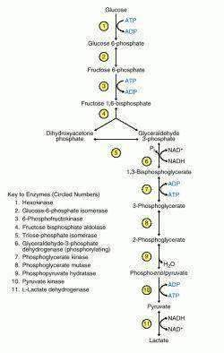
Pathology
spiral

Slide 41
⦁ In heterolactic acid fermentation, one molecule of pyruvate is converted to lactate; the other is converted to ethanol and carbon dioxide
Pathology
core
Heterotactic pathway

Slide 42

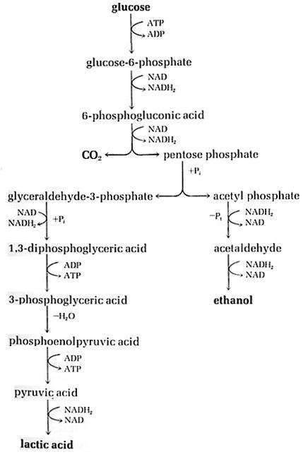
Pathology
core

Slide 43
Alcoholic fermentation is the conversion of pyruvate into ethanol and carbon dioxide.
Pathology
core
Enter-doudoroff pathway

Slide 44
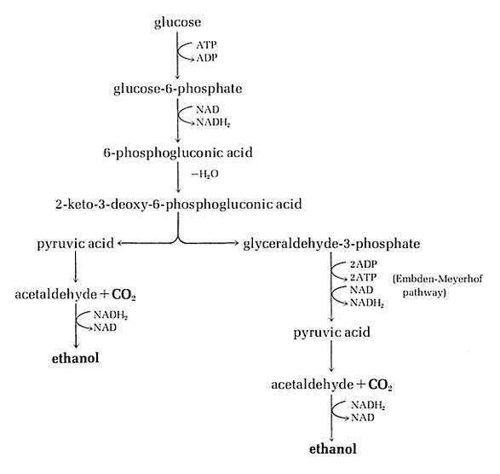
Pathology
core
Enter-doudoroff pathway

Slide 45
Krebs cycle is the oxidative process in respiration by which pyruvate (via acetyl coenzyme A) is completely decarboxylated to CO₂. The pathway yields 15 moles of ATP.
Pathology
core
Kreb cycle
⦁
⦁ In bacteria, this reaction occurs through acetyl ~ SCoA, which is the first product in the oxidative decarboxylation of pyruvate by pyruvate dehydrogenase.
⦁ 2 pyruvate molecules are obtained from the dissimilation of 1 glucose molecule, then 30 ATP molecules are generated in total.

Slide 46
⦁ Chemical energy conserved by the Krebs cycle is contained in the reduced compounds generated .
Pathology
core
⦁ The potential energy inherent in these reduced compounds is not available as ATP until the final step of respiration (electron transport and oxidative phosphorylation) occurs.

Slide 47

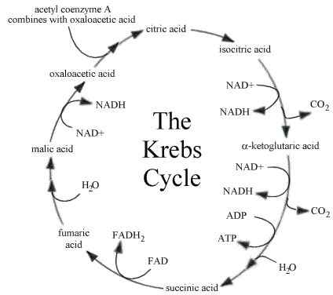
Pathology
core

Slide 48
⦁ The glyoxylate cycle, which occurs in some bacteria, is a modification of the Krebs cycle.
Pathology
core
Glyoxylate cycle
⦁ Acetyl coenzyme A is generated directly from oxidation of fatty acids or other lipid compounds.
⦁ It functions similarly to the Krebs cycle but lacks many of the Krebs cycle enzyme reactions.

Slide 49
⦁ In the final stage of respiration, ATP is formed through a series of electron transfer reactions within the cytoplasmic membrane that drive the oxidative phosphorylation of ADP to ATP.
Pathology
core
Electron transport chain aand oxidative phosphorylation
⦁ Bacteria use various flavins, cytochrome, and non-heme iron components as well as multiple cytochrome oxidases for this process.
⦁ Energy generated is conserved within the membrane and then transferred in coupled manner to drive the formation of ATP.

Slide 50
Pathology
core
Mitchell or proton extrusion hypothesis
⦁ The Mitchell hypothesis explains the energy conservation in all cells on the basis of the selective extrusion of H⁺ ions across a proton-impermeable membrane, which generates a proton motive force.
⦁ This energy allows for ATP synthesis both in respiration and photosynthesis.

Slide 51
Pathology
core
Bacterial photosynthesis
⦁ Bacterial photosynthesis is a light-dependent, anaerobic mode of metabolism.
⦁ Carbon dioxide is reduced to glucose, which is used for both biosynthesis and energy production.

Slide 52
Pathology
core
Autotrophy
⦁ Autotrophy is a unique form of metabolism found only in bacteria.
⦁ Inorganic compounds are oxidized directly (without using sunlig h t) to yield energy (e.g., NH₃, NO₂ –, S₂, and Fe² ⁺).
⦁ This metabolic mode also requires energy for CO₂ reduction, like photosynthesis.
⦁ This metabolic mode has also been called chemotrophy, chemoautotrophy, or chemolithotrophy

Slide 53
⦁ Anaerobic respiration is another heterotrophic mode of metabolism in which a specific compound other than O₂ serves as a terminal electron acceptor.
Pathology
core
Anaerobic respiration
⦁ Such acceptor compounds include NO₃–, SO₄^{2–}, fumarate, and even CO₂ for bacteria.

Slide 54
⦁ The nitrogen cycle consists of a recycling process by which organic and inorganic nitrogen compounds are used metabolically and recycled among bacteria, plants, and animals.
Pathology
core
The nitrogen cycle
⦁ Important processes, including
ammonification, mineralization, nitrification, denitrification, and nitrogen fixation, are carried out primarily by bacteria.

Slide 55
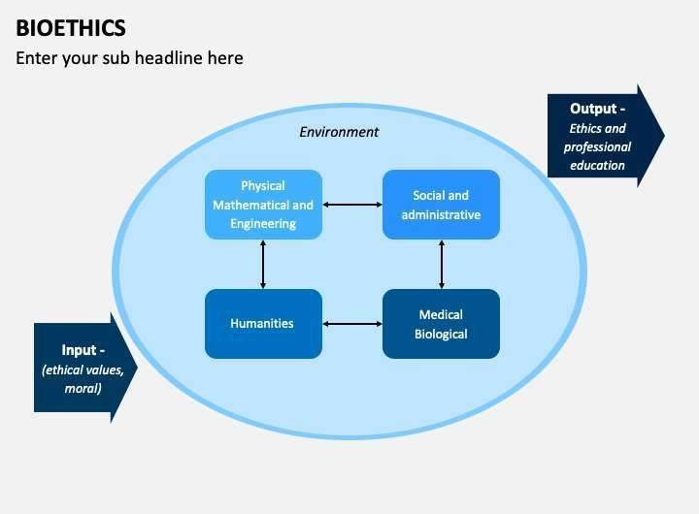

Longitudinal

Slide 56
https://www.mdpi.com/2076-2607/10/7/1386
Longitudinal
Research
This study demonstrate the ability of new strains PA12 (P. alvei), SC5 (B. cereus), 328EF (Codinaeopsis sp.) and SC15 (P. sheari) to perform better in terms of chlorophyll index, (A), dry mass, and concentration of important nutrients such as N, P, and Mg, in plants of G. max. The activity of these strains was compatible with the growth promotion pattern presented by a commercial product available on the market. Thus, we recommend the use of these isolates in field tests to validate these strains for the production of biological inoculants that will comprise the portfolio of bioinputs available for sustainable agricultural practices.

Slide 57
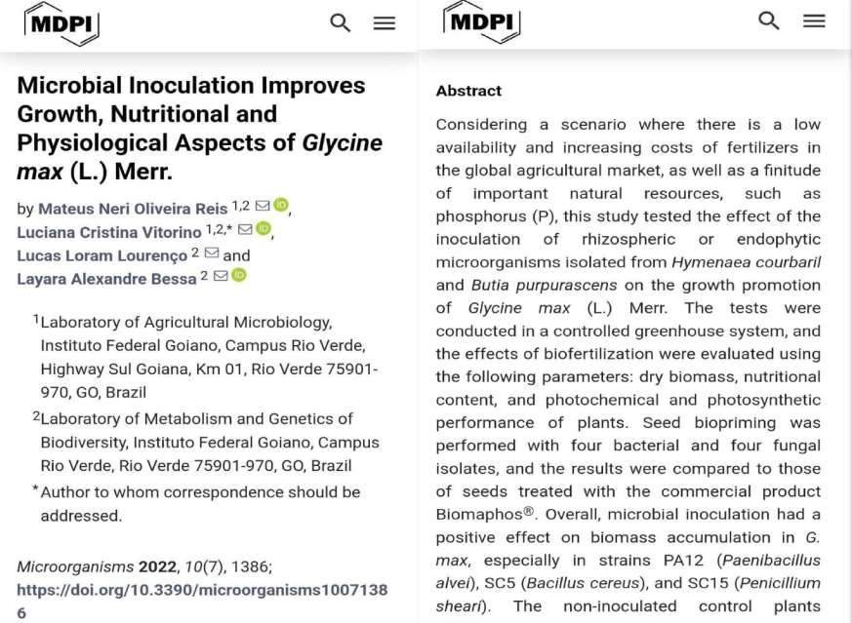

Slide 58

Longitudinal

Slide 59
Family medicine
⦁ A 35-year-old woman with a weakened immune system develops a fever and cough after traveling to South America. She is suspected of having a bacterial lung infection. In the lab, you isolate a fast-growing, rod- shaped bacteria from a sputum sample. You are tasked with culturing the bacteria to identify it and determine the best course of antibiotic treatment.
⦁ Question: Which of the following cultural conditions would likely be MOST appropriate for initial growth of this unknown bacteria?
⦁ a) Blood agar plate incubated at 37°C in an anaerobic chamber
⦁ b) MacConkey agar plate incubated at room temperature
⦁ c)
Chocolate agar plate incubated at 37°C with 5% CO2
d) Sabouraud dextrose agar plate incubated at 25°Cpen_spark

Slide 60


