Slide 1
Bacterial Genetics
Microbe Module
3rd year MBBS
BY
Dr. Kiran Fatima
Pathology Department
Rawalpindi Medical University

Slide 2


Slide 3
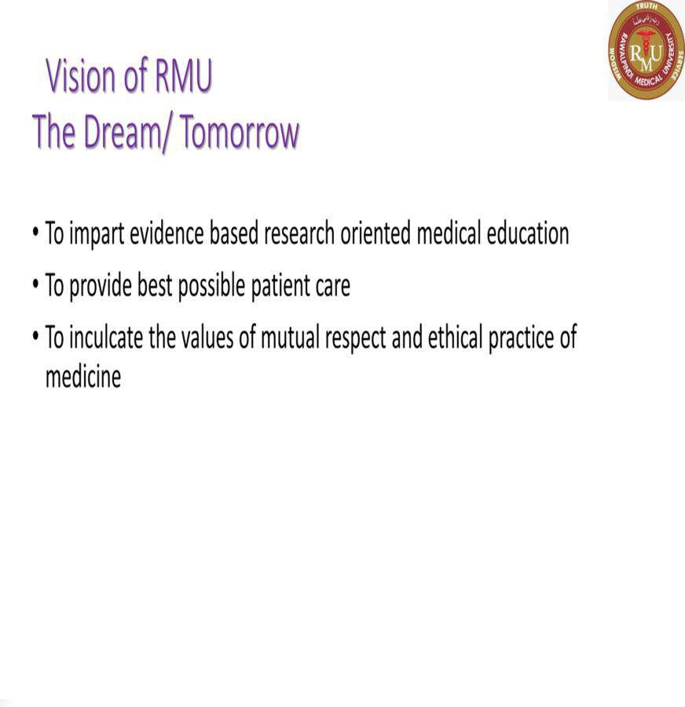

Slide 4
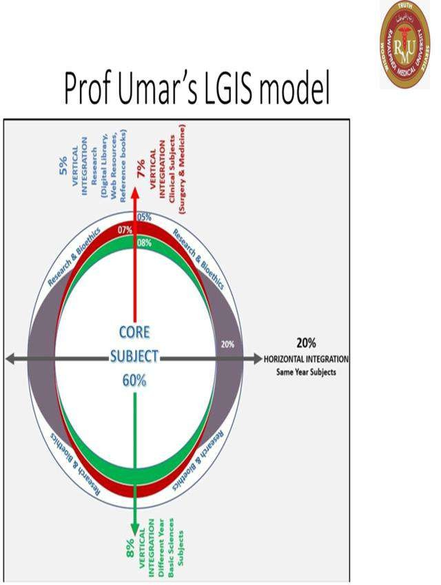

Slide 5
Learning outcomes
After this lecture students will be able to understand;
What is meant by gene transfer.
Methods of gene transfer in bacteria
What is the difference between conjugation, transformation and transduction.

Slide 6
Learning resources
Levinson, W. Review of Medical Microbiology and Immunology. 15th ed. McGraw-
Hill Education / Medical; 2020

Slide 7
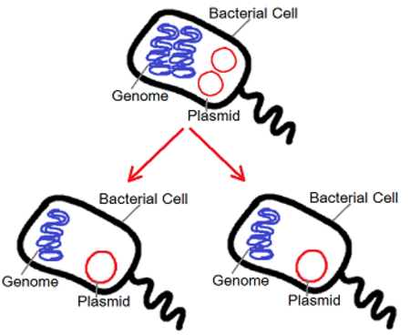
spiral

Slide 8
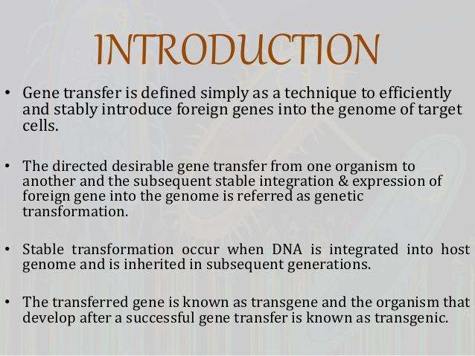
Pathology
core

Slide 9
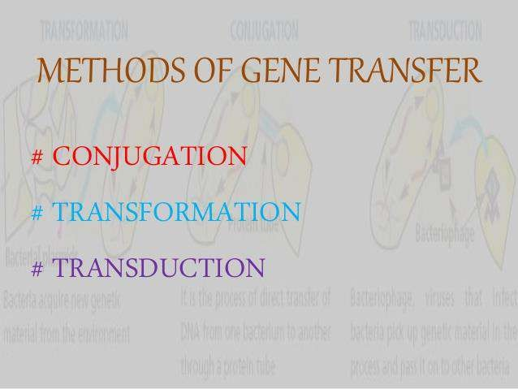
Pathology
core

Slide 10
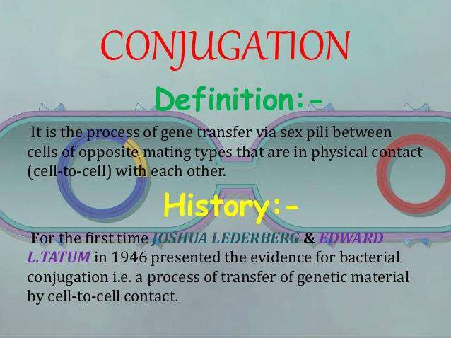
Pathology
core

Slide 11
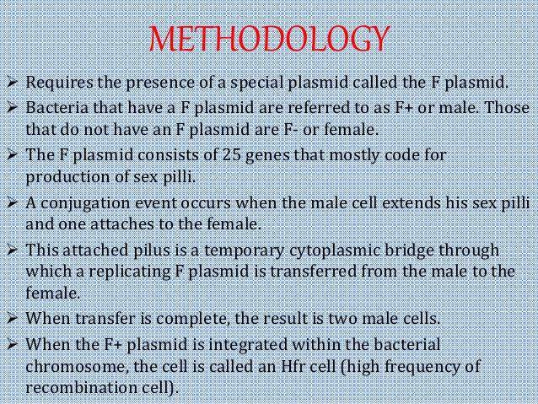
Pathology
core

Slide 12
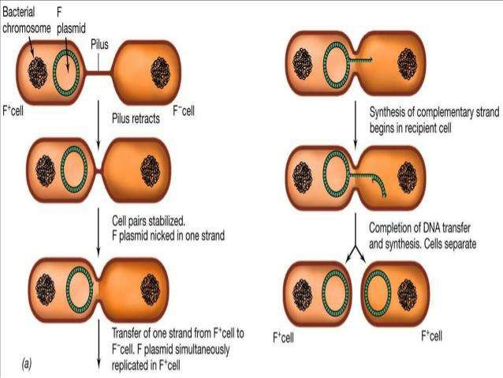
Pathology
spiral

Slide 13
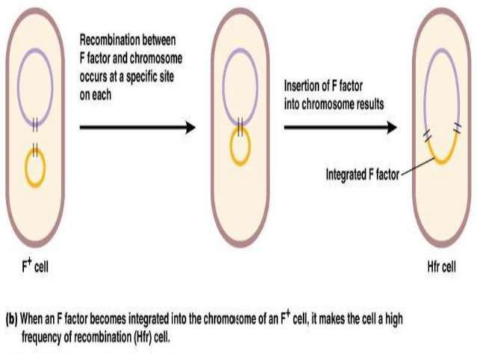
Pathology
spiral

Slide 14
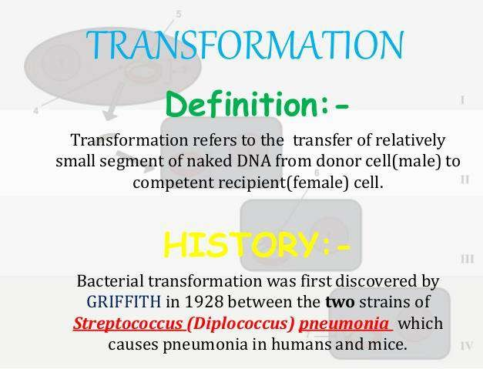
Pathology
core

Slide 15
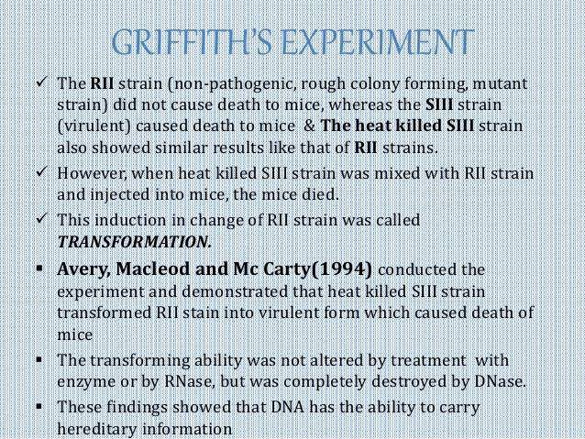
Pathology
core

Slide 16
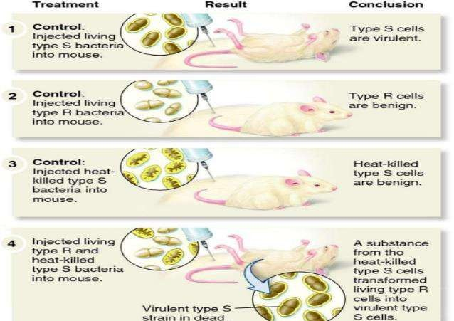
Pathology
core

Slide 17
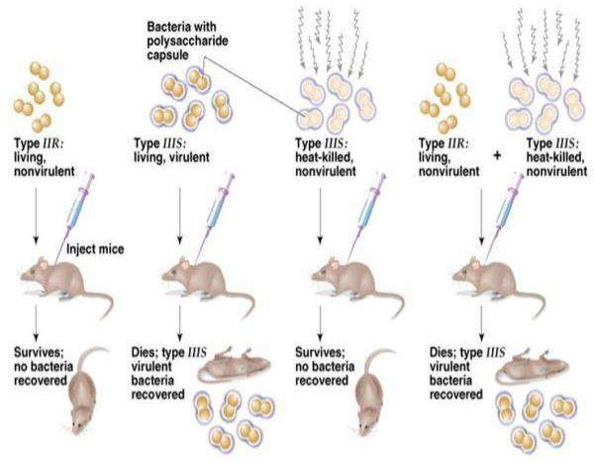
Pathology
core

Slide 18
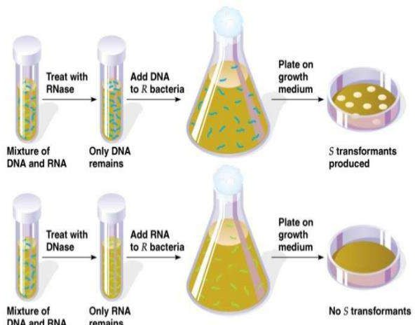
Pathology
spiral

Slide 19
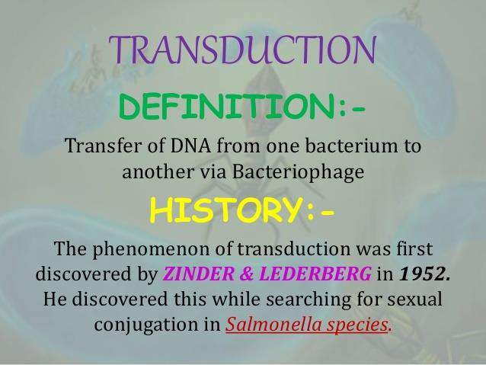
Pathology
core

Slide 20
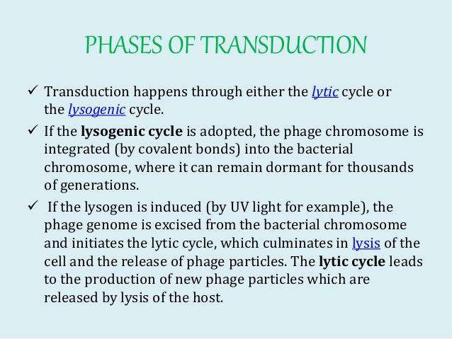
Pathology
core

Slide 21
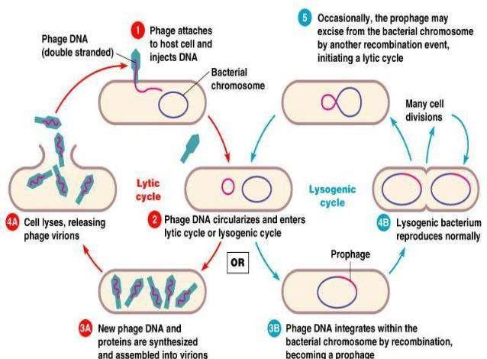
Pathology
core

Slide 22
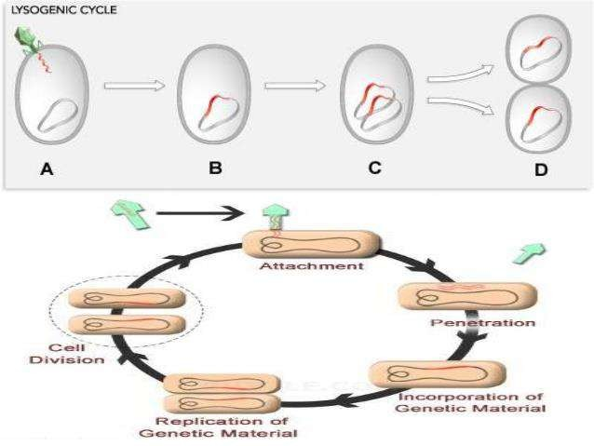
Pathology
spiral

Slide 23
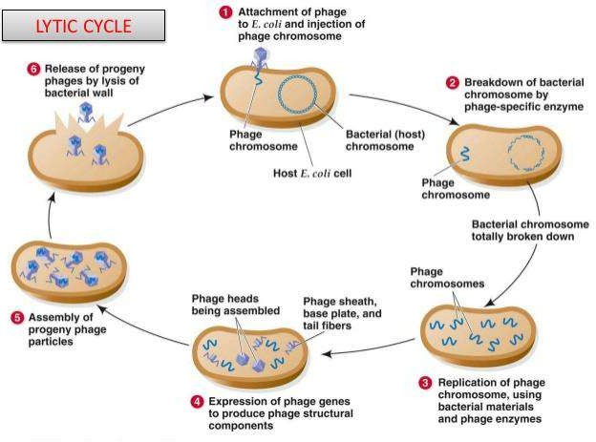
Pathology
core

Slide 24
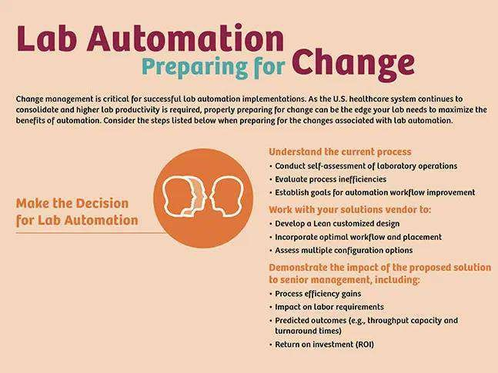
Ai and automation in lab
Longitudinal

Slide 25
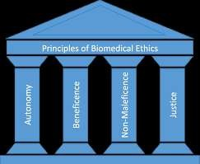
Bioethics
Longitudinal

Slide 26
Research
Longitudinal
https://www.ncbi.nlm.nih.gov/books/NBK7908/
General Concepts
Genetic Information in Microbes
Genetic information in bacteria and many viruses is encoded in DNA, but some viruses use RNA. Replication of the genome is essential for inheritance of genetically determined traits. Gene expression usually involves transcription of DNA into messenger RNA and translation of mRNA into protein

Slide 27
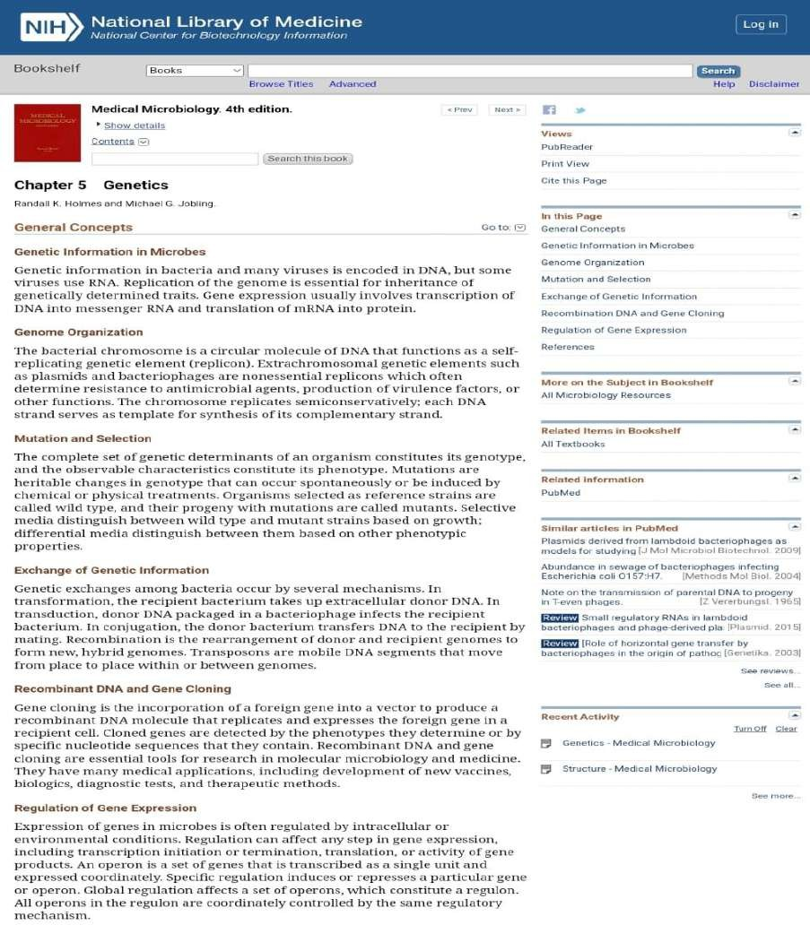

Slide 28
Family medicine
Longitudinal
Scenario:
A hospital is experiencing an outbreak of antibiotic-resistant E. coli infections. Doctors suspect the bacteria may be acquiring resistance genes from other gut bacteria in patients.
Question: Which type of genetic transfer in bacteria is most likely responsible for the spread of antibiotic resistance genes in this scenario?
Answer: Conjugation

Slide 29


