Slide 1
AUTOPSY-II
Dr. Filza
Dr Shahrukh
Forensic Medicine &Toxicology

Slide 4
To impart evidence based research oriented medical education
To provide best possible patient care
To inculcate the values of mutual respect and
ethical practice of medicine
VISION OF RMU
THE DREAM/ TOMORROW

Slide 5
SEQUENCE OF LGIS
Learning Objectives
Core concept 70 %
Horizontal integration related to Pathology and Pharmacology 15 %
Relevant clinical concepts and medico legal application of core knowledge / Vertical integration 10%
Research article relevant to the topic 3%
Ethics and family medicine 2%

Slide 6
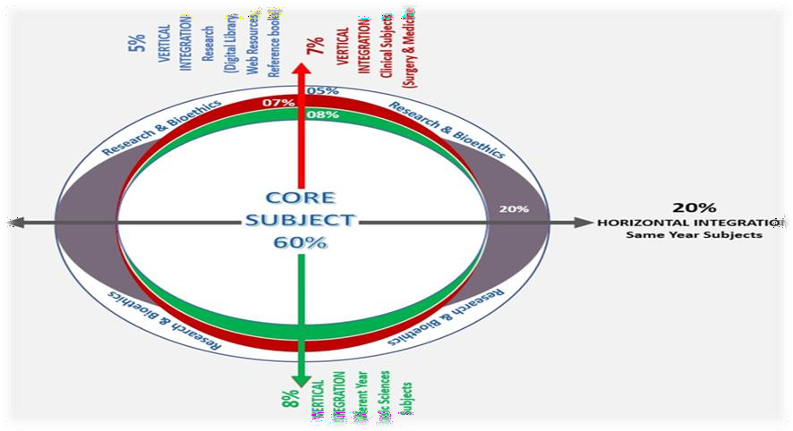
Prof Umar’s LGIS model

Slide 7
Core Subject
Spiral Integration
Horizontal Integration
Vertical integration
EOLA(End of lecture assessment)
Digital Library References
Research, Bioethics, Artificial Intelligence
Sequence of lecture

Slide 8
Define Negative Autopsy & Enlist its causes.
Describe the procedure of exhumation and its Forensic Importance.
Briefly explain examination of mutilated and decomposed bodies
Define Postmortem artifacts and its type w.r.t their medico-legal importance.
Risks and Hazards of autopsy.
Relevant Laws
Learning objectives:

Slide 9
Negative Autopsy:
Core Concept
In about 2–5% of all postmortem examination cases, the cause of death remains unknown, even after all laboratory examinations including biochemical, microbiological, virological, microscopic and toxicological examination.
Negative Autopsy

Slide 10
Negative Autopsy:
Core Concept
Inadequate history.eg epilepsy, vagal inhibition
Inadequate external examination and internal examination.
Insufficient laboratory examinations.
Lack of toxicological analysis.
Lack of training of the doctor.
Corruption
Causes Of Negative Autopsy

Slide 11
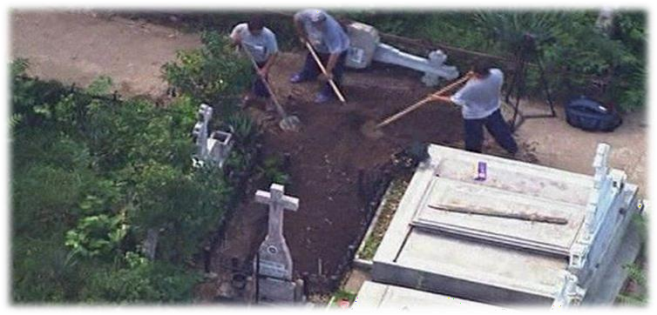
Core Concept
EXHUMATION

Slide 12
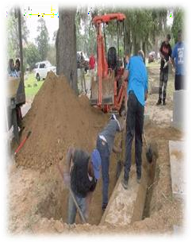
DEFINITION:
Core Concept
“Lawfull disinternment or digging out of a buried body from the grave for postmortem examination or re-examination” Three parties required:
Judicial party--------- Magistrate
Police------------------ arrangement for exhumation
Medical board------ 3 Doctors
EXHUMATION

Slide 13
1. Medical board proceeds to the burial place with area magistrate.Exumation is conducted in early hours of morning , police will cordon the area , with shamiana and qanat.
Core Concept
2 Magistrate gets the:
Grave identified
Dead body exhumed
Dead body identified
Hands over the body to medical board in writing.
Medical board conduct Post mortem examination by the side of the grave, shielded from the on lookers.
Samples must be taken including soil samples from above, below, sides of coffin and a control sample of earth is taken.
After completion of Postmortem examination, dead body is handed back to the Magistrate in writing.
Magistrate is responsible for Re-burial of the dead body
PROCEDURE OF EXHUMATION

Slide 14
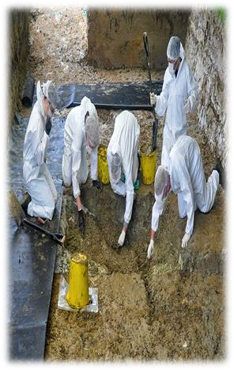
Core Concept
Should be performed during daylight
Ventilation should be adequate
Person should stand against wind side
Face mask preferably impregnated in KMnO4
Gloves should be intact
Disinfectant is sprinkled on sides of the body, not on the body.
PRECAUTIONS OF EXHUMATION

Slide 15
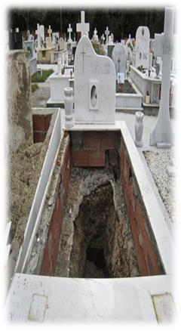
Core Concept
Time lapse between death and exhumation.
Soft tissue findings may be obscured.
Environmental condition of soil, water level
and rains.
Post-Mortem Artifacts
Decomposition causes loss of all cell details -- Histopathological limitation
Toxicological analysis------- disappear soon
after death e.g vegetable poisons, volatile
poisons, synthetic poisons.
Inexperienced and untrained staff.
L IMITATIONS OF EXHUMATION

Slide 16
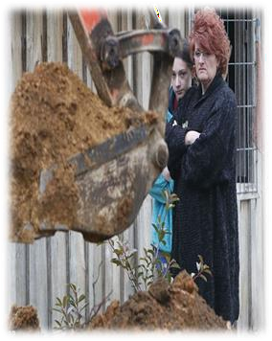
Core Concept
When suspicion of foul play has been raised after burial.
When identity of the dead body is to be
established.
When cause of death is disputed and
further medical evidence is required.
For permanent burial(ammanat)
MEDICOLEGAL ASPECTS OF EXHUMATION

Slide 17
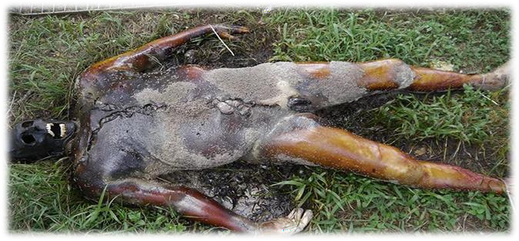
We can perform autopsy on:
Core Concept
Decomposed bodies
Mutilated bodies
Fragmentary remains
Bones
Examination of mutilated and decomposed bodies

Slide 18
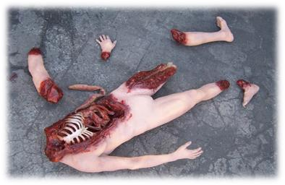
Core Concept
Decomposed body:
Shows putrefactive changes
depending upon the time elapsed
since death
Mutilated body:
Is disfigured,deprived of a limb or part of the body. Soft tissues,
muscles, skin still attached to the
bones.
Fragmentary remains: Only fragments of the body e.g head, trunk or limb.
Examination of mutilated and
decomposed bodies

Slide 19
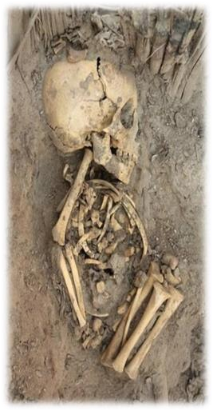
Core Concept
The following information is specially looked for while doing autopsy on the Decomposed
bodies , Mutilated bodies , Fragmentary remains and Bones.
Source of Specimen
( human or animal)……Precipitin Test
If human, do the part belongs to
same individual……….DNA Profiling
Age
Sex
Stature
Race
Identity
Special features
Cause of death
Time since death

Slide 20
Post mortem Artifact: An artifact that is added to the dead body during post mortem period is known as post mortem artifact
Post mortem artifacts lacks vital reactions of the living tissues
Core Concept
Artifact: An artifact is an artificial product or feature which appears by processing or handling.
POSTMORTEM ARTIFACTS

Slide 21
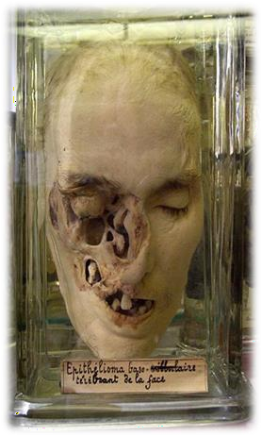
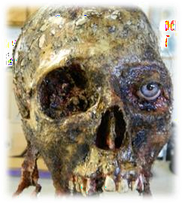
Causes of Post mortem Artifacts
Core Concept
Physical handling
Interference by the scavengers, insects
and animals
POSTMORTEM ARTIFACTS

Slide 22
Core Concept
Causes | Postmortem Artifacts | Misinterpretations
Introduced during systemic death Agonal Resuscitation | Regurgitation and aspiration of gastric contents into the air passages | Chocking
 | Injection marks on the limbs, neck and chest | Addiction or violence
 | Bruising of the skin of chest | Violence
 | Fracture of ribs and sternum | Violence
 | Bruising of the heart | Violence
CLASSIFICATION

Slide 23
Core Concept
Causes | Postmortem Artefacts | Misinterpretations
Introduced during postmortem period 1. Situational handling | Pseudo groove on the neck by tight collar | Ligature mark
 | Dislocation of shoulder and hip joints | Violence
2. Decomposition | Bloatment | Obesity
 | Rupture of stomach wall due to acid digestion | Corrosive Poisoning
 | Separation of skull sutures in infants | Violence
3. Animal | Nibbling by rats and rodents | Incised wounds
 | Ravage by fish and crabs | Incised wounds
 | Ripping apart by vultures | Lacerated wounds
CLASSIFICATION

Slide 24
Core Concept
Causes | Postmortem Artefacts | Misinterpretations
4. Postmortem Burning | Heat ruptures of skin and scalp | Open wounds
Introduced during Autopsy Faulty technique | Pseudo bruising in the subcutaneous tissue of the neck | Throttling
CLASSIFICATION

Slide 25
2.Biological Hazards ; Bacterial, Viral, Fungal infections
Core Concept
1.Mechanical Hazards ; Injuries to limbs,hands,back,eyes.
Chemical Hazards ; Antiseptics, Preservatives
Electrical Hazards ; Electric burns ……faulty appliances
Radiation Hazards ; Electromagnetic radiation
AUTOPSY HAZARDS/RISKS

Slide 26
Core Concept
Between the doctor and dead body.
The body and its surroundings tell nothing but truth.
What dialogues?
Who are you?
Identity
How you died?
Cause of death
When you died which system failed first?
Mode of death
Your death was suicidal, accidental or homicidal? Manner of death
When you died?
Time since death
What was position of body?
Lividity
AUTOPSY IS A DIALOGUE

Slide 27
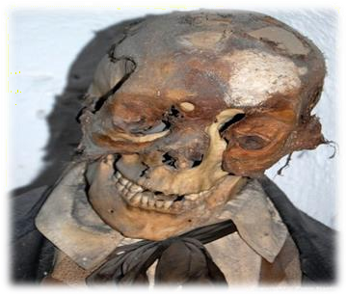
1. Cr. PC Section 174
Core Concept
Criminal procedure code
2. Cr. PC Section 176
LAWS RELATED TO MEDICAL EXAMINATIONS

Slide 28
i) Cr.PC Section 174
Core Concept
The officer in-charge of a police station or some other police officer specially empowered by the provincial Government in that behalf, on receiving information that a person:
Has committed suicide, or
Has been killed by another, or by animal, or by machinery, or by an accident or
c. Has
died under circumstances raising a reasonable
suspicion---some of the person has committed an offence.
LAWS RELATED TO MEDICAL EXAMINATIONS

Slide 29
ii) Cr.PC Section 176
Core Concept
Inquiry by Magistrate into cause of death
When any person dies while in the custody of
police, the
nearest Magistrate empowered to hold inquests shall, and in any other case mentioned in section 174, clauses (a), (b) (c) of subsection (1) any Magistrate so empowered may hold any inquiry into the cause to death either instead of, or in addition to, the investigation held by the police officer, and if he does so, he shall have all the powers in conducting it which he would.
LAWS RELATED TO MEDICAL
EXAMINATIONS

Slide 30
Core Concept
have in holding an inquiry shall record the evidence taken by him in connection therewith in any of the manners hereinafter prescribed according to the circumstances of the case
Power to disinter corpses:
Whenever such Magistrate considers it expedient to make an examination of the dead body of any person who has been already interred, in order to discover the cause of his death , the Magistrate may, cause the body to be disinterred and examined.
LAWS RELATED TO MEDICAL EXAMINATIONS

Slide 31
https://pubmed.ncbi.nlm.nih.gov/22250143/
Research
This study reveals the correspondence rate between the clinical and the postmortem diagnosis, as well as between macroscopic and histopathological diagnosis.
The importance of post-mortem investigations for the documentation of cause of death will be discussed in this Special Issue, including the expanding roles of molecular autopsy
https://www.mdpi.com/journal/diagnostics/special_issues/Autopsy
This article summarises current and future areas of paediatric autopsy research, including postmortem imaging, molecular biology and discovery-based laboratory approaches
https://ep.bmj.com/content/101/1/54
Research

Slide 32
Recommendations For Autopsy
Ethics
Before conducting Autopsies in cases of sudden death in the young, a multidisciplinary team of medical examiners , clinical geneticists, genetic counselors, and cardiologists should be established who consult other specialized medical professionals, bioethicists, and lawyers when appropriate. Following Ethical Points must be considered before conducting the autopsies:
Confidentiality:
Confidentiality should be maintained but the public release of post-mortem report should generally be treated as an “unwarranted invasion of personal privacy” and exempted from disclosure under state and federal Freedom of Information Acts.
Analysis:
Validation of the finding by an independent method, multidisciplinary collaboration, and other useful methods.
Disclosure:
Positive results that are confirmed and determined to be causative or likely causative should be disclosed to the next-of-kin and first-degree biological relatives
Biomedical Ethics

Slide 33
How to Approach a dead body
Family Medicine
While approaching a dead body received at your set up following points should be kept in mind as a GP
Confirm all signs of death and inform all the relatives with empathy
If any foul play is suspected, must inform the relevant authorities .
In case of an unknown or unidentified body . It is important to notify police and body should be handed over to them after proper documentation
Family Medicine

Slide 34
How To Access Digital Library
1. Go to the website of HEC National Digital Library.
2. On Home Page, click on the INSTITUTES.
3. A page will appear showing the universities from Public and Private Sector and other Institutes which have access to HEC National Digital Library HNDL.
4. Select your desired Institute.
5. A page will appear showing the resources of the institution
6. Journals and Researches will appear
7. You can find a Journal by clicking on JOURNALS AND DATABASE and enter a keyword to search for your desired journal.

Slide 35
Learning Resources
Principles & Practice of Forensic Medicine.
by Nasib R. Awan
Parikh’s Textbook of Medical Jurisprudence,
Forensic Medicine & Toxicology.

Slide 36
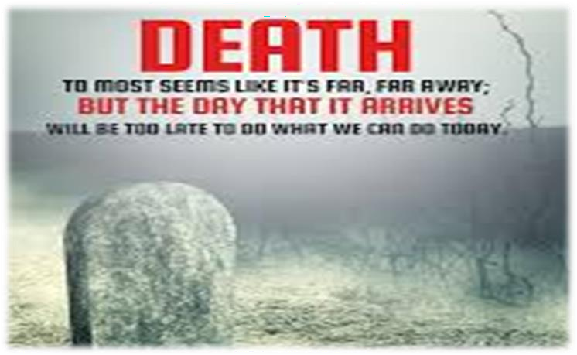
THANK YOU

