Slide 1
GIT Module
AUTOPSY-I
Dr Filza Ali
Dr Gulzaib Pervaiz

Slide 3
To impart evidence based research oriented medical education
To provide best possible patient care
To inculcate the values of mutual respect and
ethical practice of medicine
VISION OF RMU
THE DREAM/ TOMORROW

Slide 4
Prof Umar’s LGIS Model

Slide 5
SEQUENCE OF LGIS
Learning Objectives
Core concept 70 %
Horizontal integration related to Pathology and Pharmacology 15 % ( If Applicable )
Relevant clinical concepts and medico legal application of core knowledge / Vertical integration 10%
Research article relevant to the topic 3%
Ethics and family medicine 2%

Slide 6
Learning Objectives:
Define medicolegal autopsy
Classify autopsy and narrate the objectives of medicolegal autopsy.
Briefly state the autopsy protocol and its requirements.
Describe the stages of a medico-legal autopsy.
Describe autopsy procedure.

Slide 7
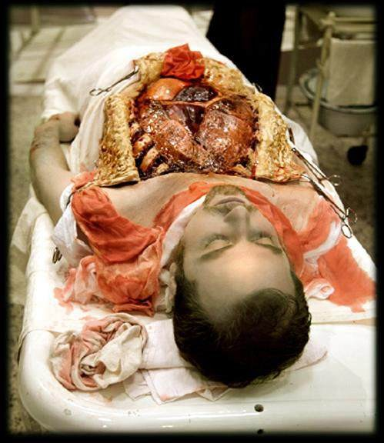
Autopsy “ A medical examination of dead body conducted in accordance with the laws of the state.”
Core Concept
Also known as
Necropsy Necros: Dead Opis: View | or | Post-Mortem Post: After Mortem: Death

Slide 8
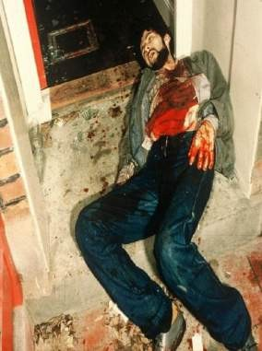
TYPES OF AUTOPSY:
Core Concept
Clinical /medical or Pathological Autopsy
Psychological Autopsy
Medicolegal or Forensic Autopsy
Exhumation
Mini Autopsy
Sonopsy
Needle Autopsy
PMCT..post mortem computerized tomography
Virtopsy…3D computerized tomography
CLINICAL or PATHOLOGICAL AUTOPSY:
Performed for diagnosis of disease, to see effects of disease on different organs of the body.
Done by HISTOPATHOLOGISTS.
Core Subject

Slide 9
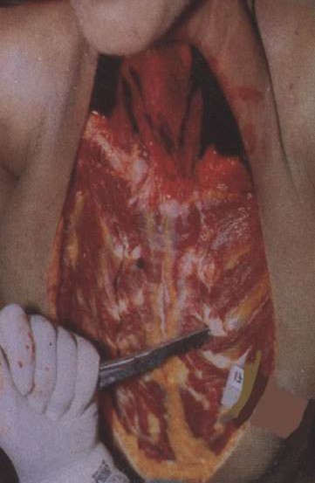
2. FORENSIC OR MEDICOLEGAL AUTOPSY:
Core Concept
These are for unnatural ,sudden and suspicious deaths.
Done under the law of state.
Performed by:
Causality Medical officer
CMO ……DHQ/THQ
Forensic demonstrators……teaching
hospitals
EXUMATION
Digging out a dead body after burial
Core Subject

Slide 10
4. PSYCHOLOGICAL AUTOPSY:
Core Concept
It is performed when a person commits suicide. It is only the collection of information from the friends, relatives to find out reason of suicide.
Not performed on the dead body. No doctor is needed.
Performed by Social workers, Psychologists

Slide 11
Objectives of Postmortem Examination
Core Concept
 | Forensic | Clinical
Identification | Yes | No
Cause of death | Yes | Yes
Time since death | Yes | No
Manner of death | Yes | No
Core Subject

Slide 12
PROTOCOL OF MEDICO-LEGAL AUTOPSY:
Core Concept
It is a signed document containing a written record,which serves as a proof of autopsy.
TYPES:
Narrative autopsy protocol
Numerical autopsy protocol
NARRATIVE AUTOPSY PROTOCOL:
It is written in a story form
Advantage:
Best for people who are able to tell a story
Immediate storage of facts
Forensic expert can tell difference between normal and abnormal
Disadvantage:
Narration may be sketching only
Subjective and personal
Core Subject

Slide 13
2. Numerical Autopsy Protocol:
It is systemic report , Listing various systems and brief description. In PAKISTAN MIXED autopsy protocal is used
Core Concept
Advantages:
Minor details are mentioned and report is comprehensive
Provides a unifrom detail of all information in all cases
It is objective and impersonal
Facilitates immediate inspection of any particular heading, feature or lesion found at autopsy
Disadvantages:
Requires more time for completion
Requires more pages
Core Subject

Slide 14
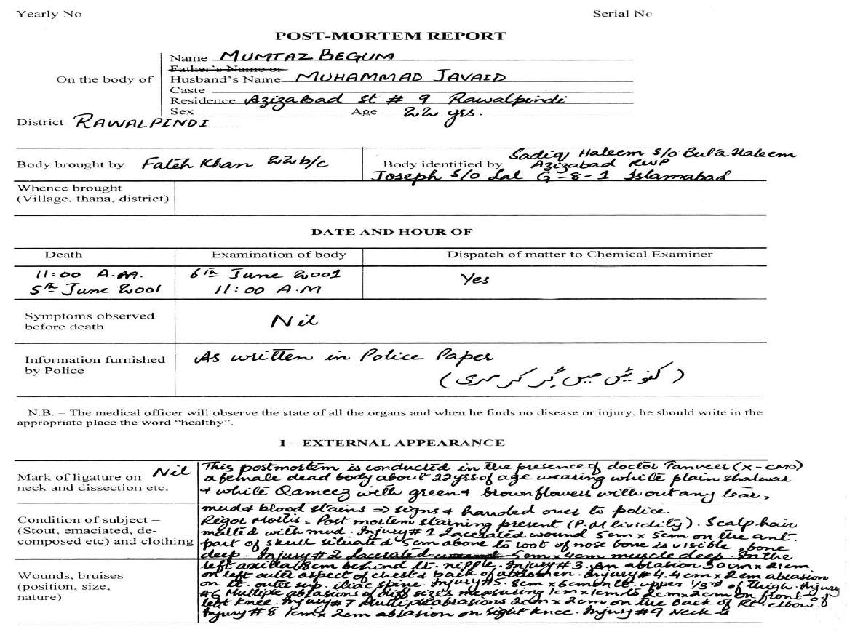
Core Concept
Post-mortem Protocol: Descriptive protocol Used in Pakistan (page 1)

Slide 15
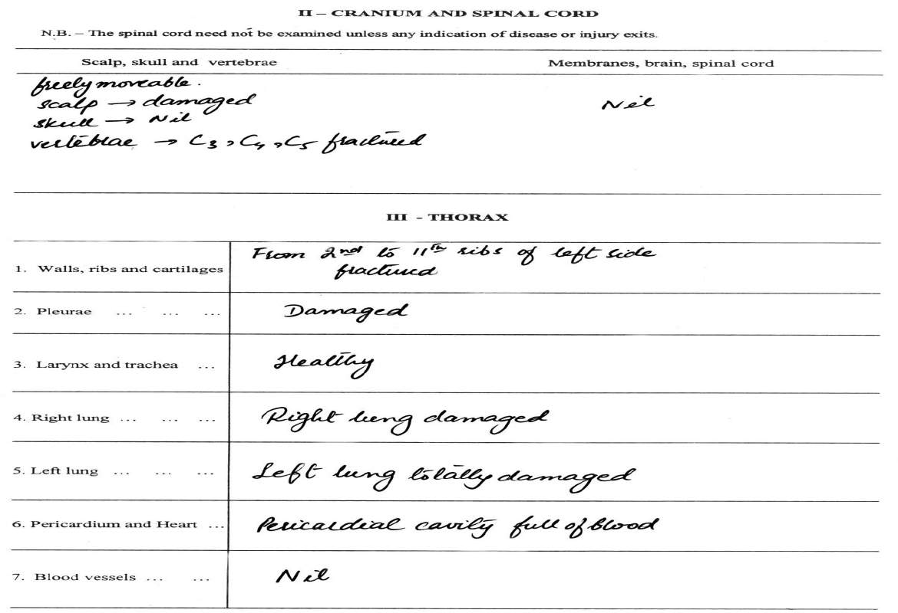
Core Concept
Post-mortem Protocol: Descriptive Protocol Used in Pakistan (pg 2)

Slide 16
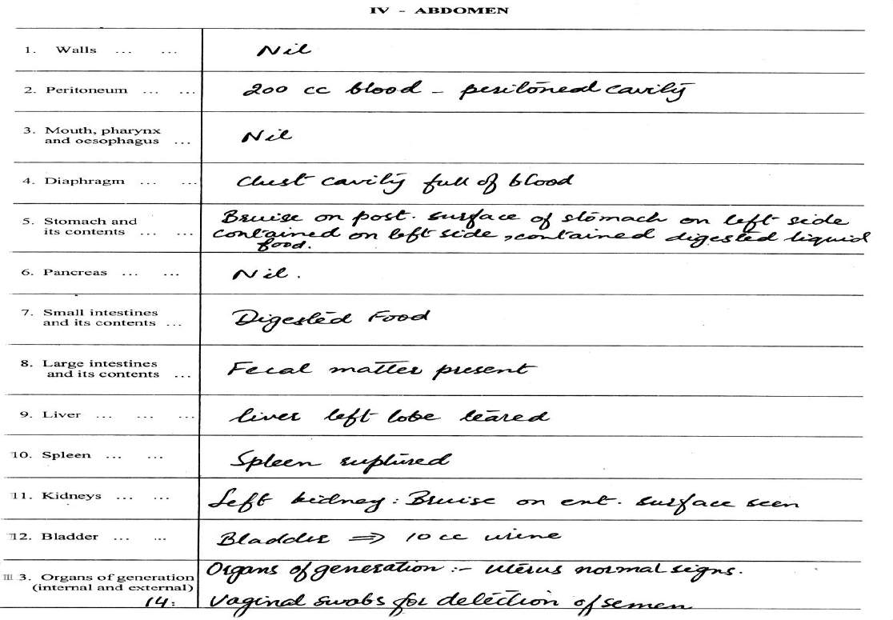
Core Concept
Post-mortem Protocol: Descriptive Protocol Used in Pakistan (pg 3)

Slide 17
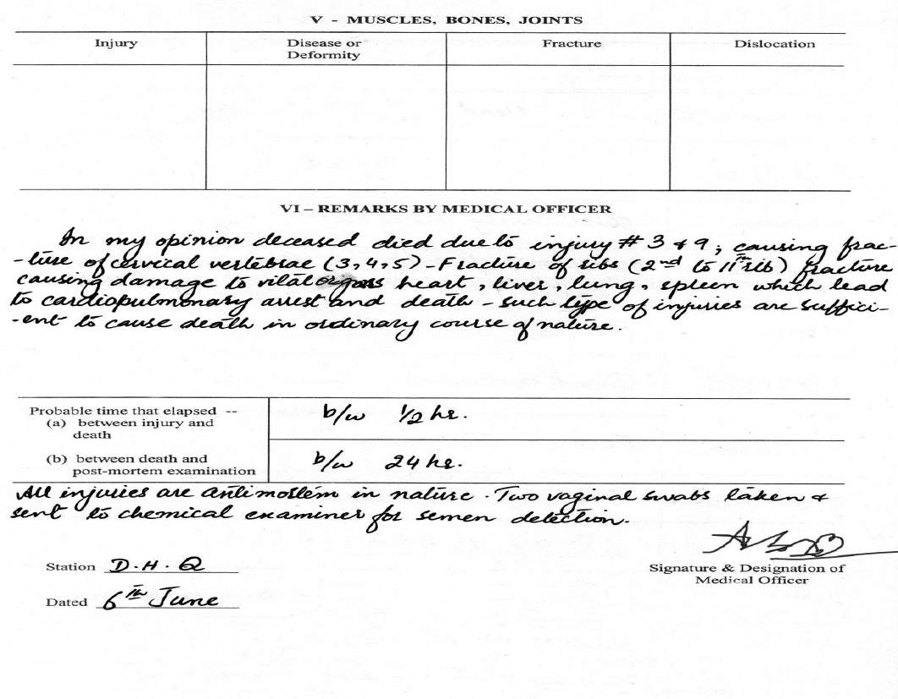
Core Concept
Post-mortem Protocol : Descriptive protocol Used in Pakistan
(page 4)

Slide 18
REQUIREMENTS OF MEDICOLEGAL AUTOPSY:
Core Concept
Authorization:
CMO is given authority to examine cadaver by Health Department of Government of Punjab
Complete police papers:
Docket (from Competent authority)
Police Docket
Police will decide whether Postmortem is required or not.
IF required, a written authority by name and designation to the CMO for PME.
Judicial Orders/ magistrate
Police papers
FIR
Police inquest (inquiry)
Core Subject

Slide 19
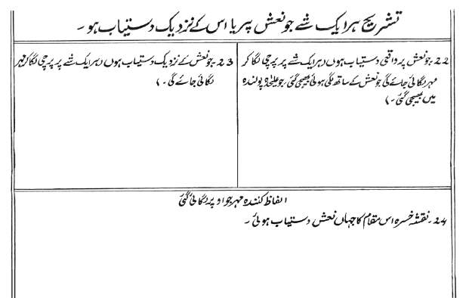
iii) Dead body challan
Core Concept
Age,sex,date,time of death etc
iv) Death Certificate/ treatment record
In case of hospital death
Core Subject

Slide 20
3. Complete & Meticulous:
Core Concept
Post Mortem should be complete and meticulous
All cavities should be opened properly, even if the cause of death is present in one cavity.
Preservation of evidence:
All evidences should be preserved carefully
Proper Handing over a Dead body:
Handing over a dead body to the police and receive a receipt and signature of police officer
Handover the belongings and preserved evidences, sealed to the Police (constable).
Core Subject

Slide 21
Entry in the registers
Core Concept
A. General Register
biodata of deceased
date and time of receipt of corpse
name, no, police station of constable
date and time of return of corpse back to police.
B. Autopsy Register
biodata of deseased
autopsy no allocated to deceased
date and time of autopsy
name and no of specimens collected
date and time of dispatch of specimens and name of lab
provisional/final conclusion of cause of death
Core Subject

Slide 22
STAGES OF A FORENSIC POST-MORTEM EXAMINATION:
Core Concept
PHYSICAL EXAMINATION OF CLOTHES:
Examined by i) Naked eyes
ii) Magnified Lens
EXTERNAL POST-MORTEM EXAMINATION:
Examine body from head to toe by
inspection
palpation
INTERNAL POST-MORTEM EXAMINATION:
Open all body cavities.
Spinal cord and extremities are opened, if required
Fetus……..abdoman opened first to see diaphragm
Core Subject

Slide 23
4. CAREFUL & COMPLETE EXAMINATION OF ALL VISCERA & BODY CAVITIES:
Core Concept
COLLECTION OF SPECIMENS:
Specimens of visera and fluid are collected and sent to
Chemical examiner……………. Poison, Drug.
Histopathologists……………….. Disease
6. CLOSURE OF BODY:
Body is closed by continuous sutures
Core Subject

Slide 24
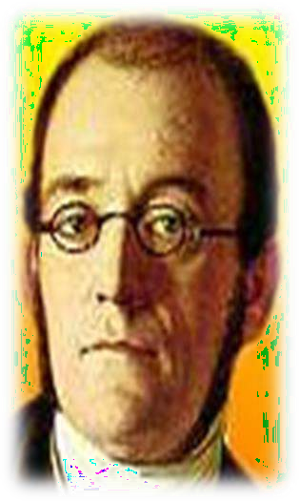
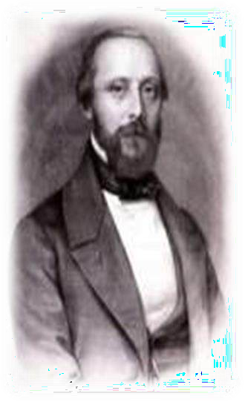
Techniques of post-mortem examination
Core Concept
1 Rokitansky’s – 1804-1878 examination and dissection in situ 2 Gohn’s - 1890
en bloc removal and examination outside the body
3 Virchow’s – 1821-1902 organ by organ on the body
4 Le Tulle’s – 1856-1929
en masse removal of organs for later detailed examination
Core Subject

Slide 25
TYPES OF POST MORTEM INCISIONS:
Core Concept
Primary Incision:
to open trunk and head
to open the cavities of the body
Secondary Incisions:
for removal of organs from the body
Tertiary Incisions:
to dissect the organ e.g stomach is opened to
examine food content or any injury
4. Quaternary Incisions:
Any additional incision
e.g removal of bullet
Core Subject

Slide 26
TYPES OF PRIMARY INCISIONS:
Core Concept
. I shaped/ straight Incision:
in the midline avoiding the umbilicus, which extends from
chin to pubic symphsis
Y-shaped incision:
extending obliquely down from the point just in front of the base of each ear to meet at suprasternal notch
Further following course taken by straight incision
Advantage of better exposure
Modified Y-shaped Incision:
Incision for scalp:
from mastoid to mastoid
Core Subject

Slide 27
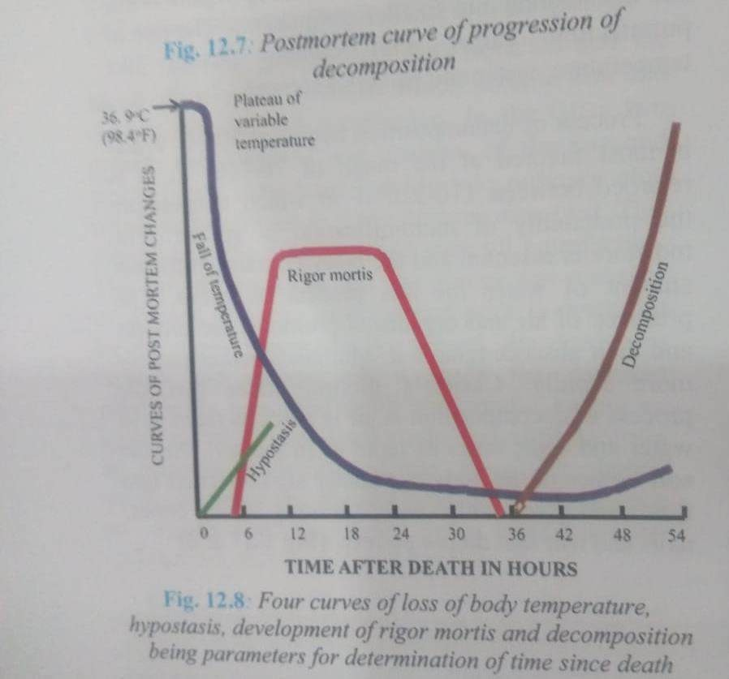
Postmortem Interval:
Time between death and autopsy .
Core Concept
Core Subject

Slide 28
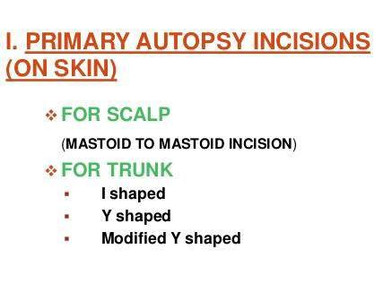
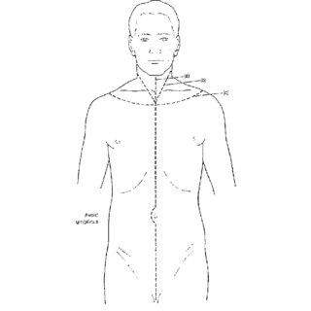
Core Concept
Core Subject

Slide 29
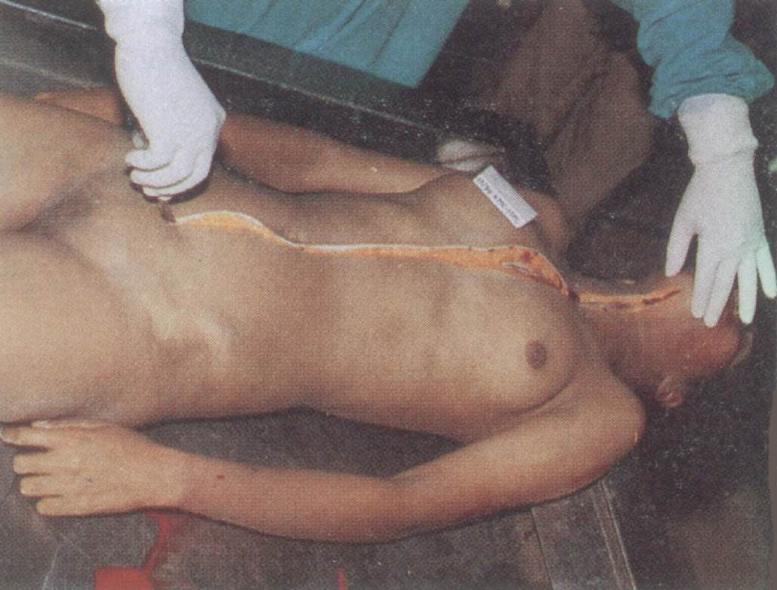
I-shaped Incision:
Core Concept

Slide 30
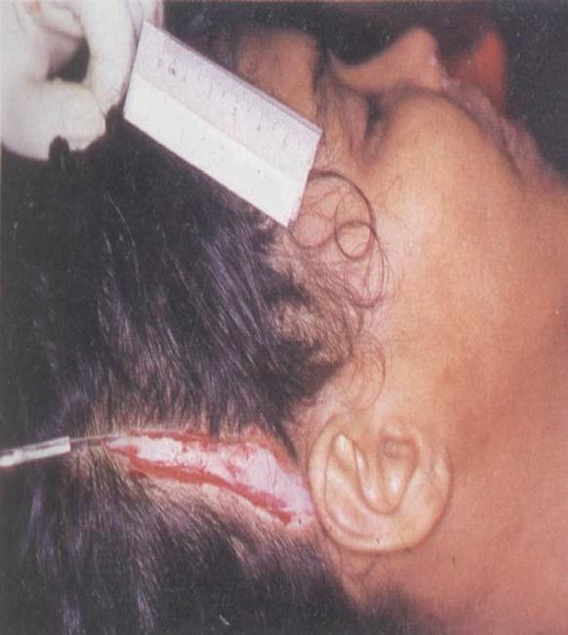
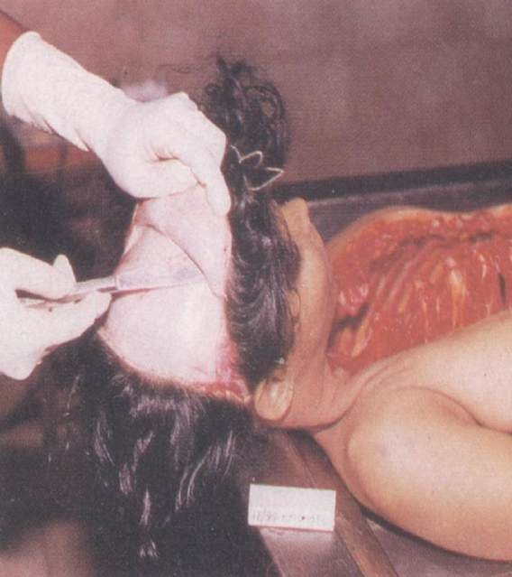
Incision for Scalp
Core Concept

Slide 31
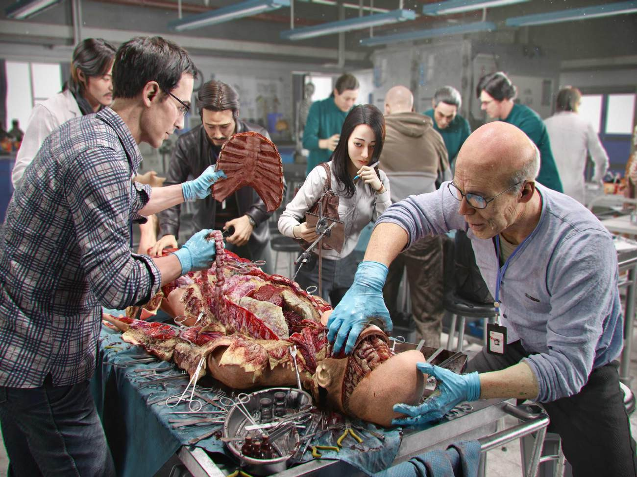
Core Concept

Slide 32
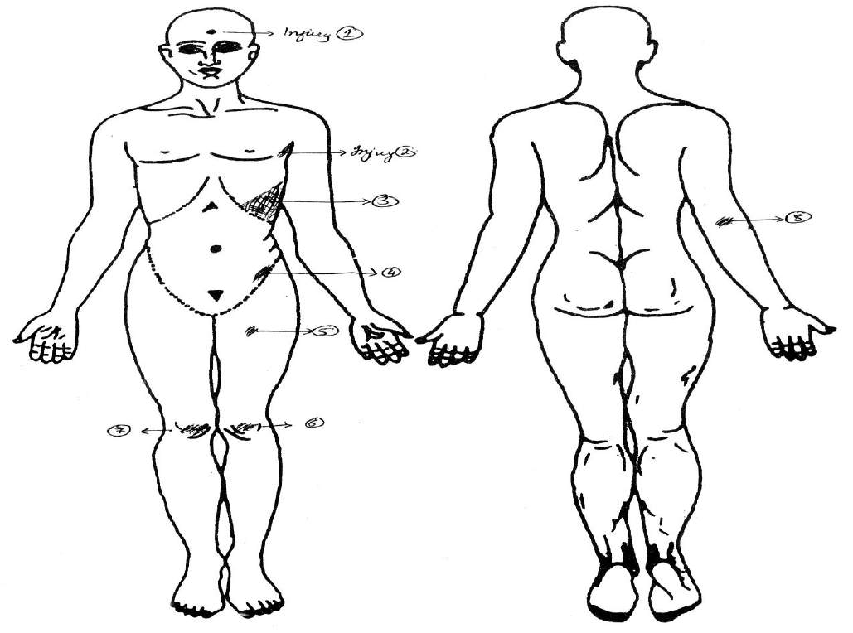
Vertical Integration
Post-mortem Protocol: Descriptive Protocol Used in Pakistan
(page 5)

Slide 33
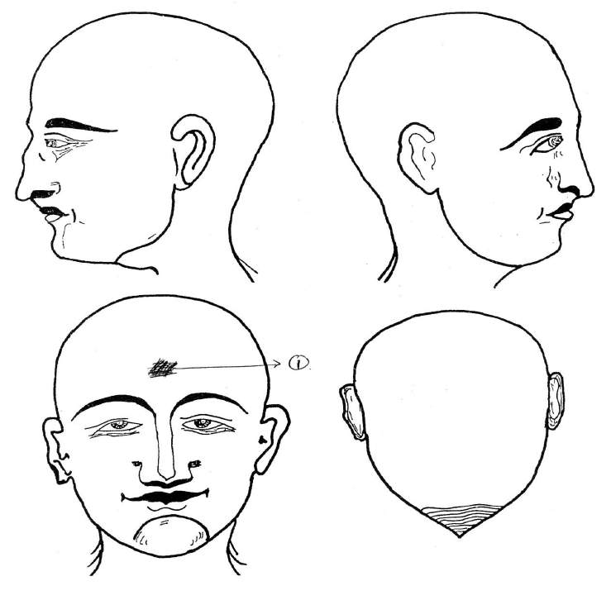
Vertical Integration
Post-mortem Protocol: Descriptive Protocol Used in Pakistan
(page 6)

Slide 34
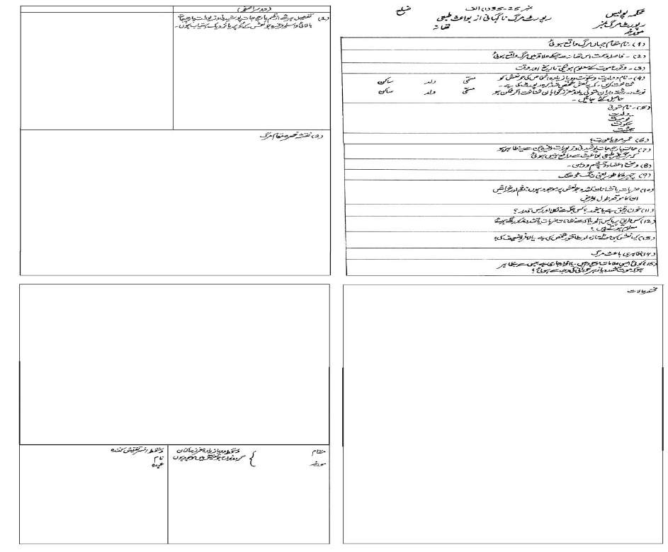
Death Report: Form A
Core Concept
For unexpected deaths due to natural causes : Ref Police Rules 25.35(1)
2 1
4 3

Slide 35
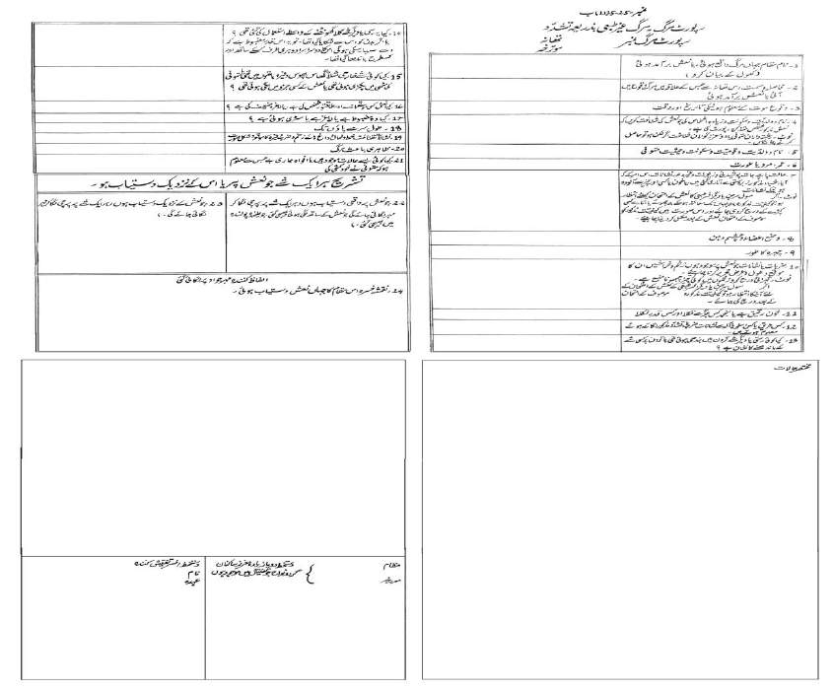
Core Concept
Death Report Form B
For unnatural deaths due to violence
Ref Police Rules 25.35(1)
1
3
2
4

Slide 36
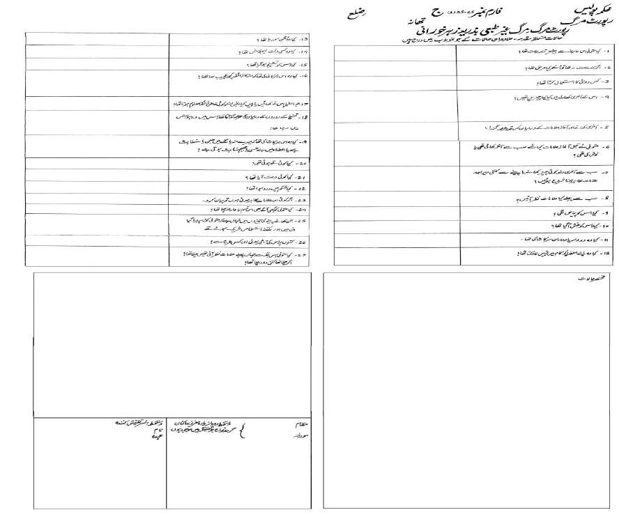
Core Concept
Death Report : Form C
For unnatural deaths due to poisoning
Ref Police Rules 25.35(1)
2 1
4 3

Slide 37
EOLA
END OF LECTURE ASSESMENT
Core Concept
Case Scenario: A dead body of a middle aged man was brought for autopsy. After checking the police docket the medicolegal officer performs autopsy:
Questions:
Enlist the types of autopsies
State different objectives of autopsy.
Name incisions given for autopsy.
Core Subject

Slide 38
Research
Research
https://www.intechopen.com/chapters/72207#:~:text=The%20most%20c ommonly%20employed%20skin,and%20the%20I%2Dshaped%20incision.
https://www.prepladder.com/neet-pg-study-material/forensic- medicine/forensic-autopsy-types-incisions-techniques
https://www.ncbi.nlm.nih.gov/books/NBK539901/

Slide 39
Recommendations For Autopsy
Ethics
Before conducting Autopsies in cases of sudden death in the young, a multidisciplinary team of medical examiners , clinical geneticists, genetic counselors, and cardiologists should be established who consult other specialized medical professionals, bioethicists, and lawyers when appropriate. Following Ethical Points must be considered before conducting the autopsies:
Confidentiality:
Confidentiality should be maintained but the public release of post-mortem report should generally be treated as an “unwarranted invasion of personal privacy” and exempted from disclosure under state and federal Freedom of Information Acts.
Analysis:
Validation of the finding by an independent method, multidisciplinary collaboration, and other useful methods.
Disclosure:
Positive results that are confirmed and determined to be causative or likely causative should be disclosed to the next-of-kin and first-degree biological relatives
Biomedical Ethics

Slide 40
How to Approach a dead body
Family Medicine
While approaching a dead body received at your set up following points should be kept in mind as a GP
Confirm all signs of death and inform all the relatives with empathy
If any foul play is suspected, must inform the relevant authorities .
In case of an unknown or unidentified body . It is important to notify police and body should be handed over to them after proper documentation
Family Medicine

Slide 41
How To Access Digital Library
1. Go to the website of HEC National Digital Library.
2. On Home Page, click on the INSTITUTES.
3. A page will appear showing the universities from Public and Private Sector and other Institutes which have access to HEC National Digital Library HNDL.
4. Select your desired Institute.
5. A page will appear showing the resources of the institution
6. Journals and Researches will appear
7. You can find a Journal by clicking on JOURNALS AND DATABASE and enter a keyword to search for your desired journal.

Slide 42
Learning Resources
Principles & Practice of Forensic Medicine by Nasib R. Awan
Parikh’s Textbook of Medical Jurisprudence, Forensic Medicine & Toxicology.

Slide 43
FAILURE IS NOT THE OPPOSITE OF SUCCESS, RATHER IT IS A PART OF SUCCESS.
THANK YOU.

