Slide 1
Autonomy (Nature, value & dimensions)
بسم الله الرحمن الرحيم
Prof. Dr. Mohammad Akram Randhawa
MBBS (KE), MPhil (Pb), PhD (QU)
Fellowship Clinical Pharmacology (UK)
Postgraduate Department
Rawalpindi Medical University

Slide 2
Autonomy
Origin from Greek ‘autonomos’
Autos ‘self’ + nomos ‘law’, i.e. ‘having its own laws’,
Right or condition of self-government.
e.g. “Between the First and Second World Wars, Canada gained greater autonomy from Britain"
Freedom from external control or influence, i.e. independence.
e.g. “ courts enjoy a considerable degree of autonomy”
Synonyms or similar words:
Self-government , independence, self-rule, sovereignty, self-determination, freedom, autarchy, self-sufficiency

Slide 3
Autonomy in medical ethics (Overview)
Autonomy may be defined as “the right of competent adults to make informed decisions about their own medical care”.
i.e. competency to make decision regarding a specific medical intervention or treatment (decision-making or decisional autonomy).
The principle is to seek consent or informed agreement of patient before any investigation or treatment takes place.
An important example of the practice of autonomy in full strength is when patients exercise their autonomy by refusing life-sustaining treatment.
Therefore, in certain situations, a doctor may have to decide in best interest of patient and help patient (or his relatives, in case of minors, too old or psychiatric patients) to understand the problem.
Thus, “autonomy has its value, but within its limits or dimensions”.

Slide 4
Patient Autonomy (Cont.)
Earlier, autonomy has been described as:
An adult patient who suffers from no mental incapacity has an absolute right to choose whether to consent to medical treatment.
This right of choice is not limited to decisions which others might regard as sensible.
It exists whether reasons for making choice are rational, irrational, unknown or even non-existent. [Lord Donaldson, 1992].
Currently, most theories of autonomy agree that:
Two conditions are essential for autonomy: ‘liberty ’(independence for controlling influences) and ‘agency’ (‘capacity’ or capability for intentional action).

Slide 5
Patient Autonomy (Cont.)
Earlier concept mainly highlighted first element (‘liberty’ that allows patients to freely choose and act) and neglected second (‘capacity’ to implement the options they freely choose).
Now, it is emphasized that there is need to expand concept of patient autonomy beyond liberty to make decisions regarding a specific medical intervention or treatment, i.e. must include capability to choose appropriate decision/action.
Thus, in medical context, autonomy or autonomous decision is:
A decision is ordinarily regarded as autonomous when individual has the capacity to make relevant decision, has sufficient information to make the decision and does so voluntarily.

Slide 6
Patient Autonomy (Cont.)
Decisions where autonomy is lacking:
When someone is being compelled to make a decision then it cannot be said to be theirs and should not be respected.
However, compulsion is not always easy to detect.
For example, a young woman who visits a GP with her husband for a termination of pregnancy might be under pressure to proceed.
If a doctor had concern about compulsion/coercion, he should find an opportunity to talk to the lady alone in order to confirm that the decision is genuinely hers.

Slide 7
Patient Autonomy (Cont.)
When patients lack the capacity to make a decision.
Then decisions must be made on their behalf, e.g.
a. In case of very young children, decisions are made by parents.
b. Provision of compulsory treatment for mentally ill persons.
c. Where adults lack capacity, health care decisions are ordinarily made by the health professional, overall in charge of their care.
d. Adults can also appoint someone to make decisions on their behalf.
e. Force feeding suffering to patients suffering from severe anorexia. Justification is that anorexia undermines ability to make an autonomous decision, similar to mentally ill persons.
f. When immediate decisions are medically required, the doctrine of presumed consent applies. In other circumstances, consent must be obtained.

Slide 8
Consent and Surrogate Decision Making
Respect for Autonomy
It emphasizes the importance of informed written consent, ensuring that patients have access to all relevant information about their illness.
Consent and Surrogate Decision Making
If patient is unable to make decisions about personal health care, some other person or people must be provided with sufficient information or direction in decision making on his/her behalf.
General term for such person is surrogate decision maker.
A. Children
Children require a decision maker in medical situations.
For most non-emergency medical decisions affecting children and minors, medical care cannot be given without a parent’s or guardian’s consent. T
Parent’s or guardian’s decision can be overridden only if a court determines that the decision constitutes neglect or abuse of the child.

Slide 9
Consent and Surrogate Decision Making (Cont.)
B. Adults
When adult patients lack capacity to consent to or refuse medical treatment, health care practitioners must rely on an authorized surrogate for consent and decision making.
All surrogates—whether appointed by the patient, or by the court—have an obligation to follow the expressed wishes of patient, taking into account the patient’s personal values and goals of care.
If adult patients already have a court-appointed guardian with authority to make health care decisions, the guardian is the authorized surrogate.
A guardian, besides an overall judgment of the situation, should include the patient (Patient’s desires) in decision-making as much as possible.

Slide 10
Consent and Surrogate Decision Making (Cont.)
Consent and Surrogate Decision Making [Cont.]
If patients have no authorized surrogate, health care practitioners usually rely on the next of kin or even a close friend.
Typical order of priority is a spouse, an adult child, a parent, and then possibly other relative or a close friend.
If more than one person has the same priority (eg, several adult children), consensus is preferred.
If agreement on an ethically and legally sound resolution cannot be reached, health care practitioners may consult hospital/institution ethics committee.

Slide 11
Competence to refuse medical treatment: Autonomy vs paternalism
Right to refuse medical treatment is universally recognized as a fundamental principle of liberty.
Right is often infringed upon by physicians who misunderstand or ignore the patient's liberty or and give more weightage to patients competency/ incompetency to decide about coerced medical intervention.
Patients capacity to decide depends upon his/her ability to understand the information provided during obtaining consent to treatment.
If a patient has this capacity, both his consent and refusal must be honored.
If patient lacks the capacity to decide than arrangements could be made to designate another person to help decision making.

Slide 12
Advanced directives and proxies
Advance Directives are documents created to describe, the extent of medical treatment to be given, when patient is likely to become unconscious or too ill to communicate.
They are called "advance directives," because are give in advance of the time when someone would need to follow and health care team is then unable to express them.
Patient should be encouraged to discuss in advance with his/her spouse, other family members, physicians, nurses, while he/she is feeling well and thinking clearly.

Slide 13
Advanced directives and proxies [Cont.]
Advanced directives include:
a. A health care proxy, which gives the person chosen as authority to make all health care decisions for patient when he is unable to do so.
b. Decisions to remove or provide life-sustaining treatment.
c. A living will, which gives specific information about the procedures patient would like, or would not like, to be performed when patient will become terminally ill.
d. A power of attorney or durable power of attorney, which authorizes the person designated by patient to make financial decisions for him/her. .
Anatomical gift, which a patient can specify that his/her organ &/or tissue be used for transplantation, research or educational purposes.

Slide 14
Dimensions of Patient Autonomy
In recent years, it has been proposed that the concept of patient autonomy need to be expanded beyond making decisions regarding a specific medical intervention or treatment the(decisional autonomy).
To meet the requirements or fil the gaps, a multidimensional concept of patient autonomy has been proposed as under:
Decisional autonomy
Executive autonomy
Functional autonomy
Informative autonomy
Narrative autonomy

Slide 15
Dimensions of Patient Autonomy (Cont.)
Why multidimensional concept is needed:
In acute care situations, it is usually appropriate to view autonomy almost exclusively in decisional terms, for the purpose of accepting or rejecting a specific therapeutic decision.
In chronic cases, such as chronic fatal illness or degenerative diseases, capability of decision making is diminished or compromised.
Because autonomy can only be respected if the patient is capable of that.
Therefore, viewing decision-making capacity as the only feature of autonomy means ignoring many of its other manifestations.
For this reason, it is necessary to “decentralize autonomy”.

Slide 16
Five Dimensions of Patient Autonomy
A. Decisional autonomy
Refers to patients’ freedom of choice, in other words, their capacity to deliberate and decide on a course of action from among a suitable range of useful options.
This autonomy is subject essentially to three requirements:
Patients must act voluntarily, i.e., with no external duress.
(2) Have sufficient information regarding the decision they are going to make (i.e., aim of the decision, any risks and benefits and possible alternatives).
(3) Have the capacity, i.e., possess a series of psychological (cognitive, volitional, and affective) capabilities, to be able to know, appraise, and manage this information properly, to make a decision and to express it.

Slide 17
Dimensions of Patient Autonomy (Cont.)
B. Functional autonomy
It addresses patients perspective of physiological and psychological circumstances more appropriately in chronic illnesses, where there is disability and dependence.
A number of different measures or indicators of an individual’s functional capacity are considered. Which can be grouped as :
Mental (Cognitive, psychological, emotional, and awareness, etc.).
(2) Physical (Motor functions, anatomical functions and structures, e.g. related to voice, speech and general physiological functions of the body).
(3). Sensory functions (Visual, auditory, olfactory, gustatory, tactile & pain.
Lack of functional autonomy derives from disabilities people have and can be judged from ability to perform a task (e.g., getting dressed without help).

Slide 18
Dimensions of Patient Autonomy (Cont.)
C. Executive autonomy
In simple terms, executive autonomy may be defined as the capacity to implement the decision.
It involves patient’s capacity to plan, sequence and perform tasks related to management of their chronic illness.
Especially those related to planning and execution of treatment.
Patient’s executive autonomy may be essential for effectively supervising and executing the treatment plan.
Consequences of ignoring executive autonomy can be non-adherence to treatment, poorer health outcomes and repeated hospitalizations.

Slide 19
Dimensions of Patient Autonomy (Cont.)
D. Narrative autonomy
Narrative autonomy addresses communication between doctor & patient, which is key to implementing a more humane model in medicine.
Main objectives are to provide patients with better care, gain a deeper knowledge of their problem, understand them and be closer to them.
This cooperative model requires a certain “narrative competence” on the part of physician, i.e., ability to acknowledge, absorb, interpret and act on plights of others”.
Having narrative autonomy means patient is capable of interaction and communication with others, including physician.
It helps in developing a suitable line of treatment.

Slide 20
Dimensions of Patient Autonomy (Cont.)
E. Informative autonomy
Finally, informative autonomy involves patients’ ability to access and control their personal, intimate, private and public information.
Informative autonomy covers the personal management of clinical information and right to communicate or protect such information.
Also includes, doctor’s duty of confidentiality and skills required to communicate with others about patient’s illness.
In informative autonomy the information has an intrinsic value and enables patients to decide for themselves when and under what conditions they disclose situations referring to their own life and health.
Whereas in the decisional autonomy, the information has an instrumental value and refers to all medical aspects (details about treatment, i.e. benefits & side effects, etc.).

Slide 21
Dimensions of autonomies in interaction
Different dimensions of patient autonomy should not be viewed as isolated realities.
Autonomy entails considerably more than just decision-making by the patient.
Respecting autonomy involves much more than simply obtaining signatures on an informed consent form.
Different dimensions of autonomy possess considerable integration and continuum (Figure. 1).

Slide 22
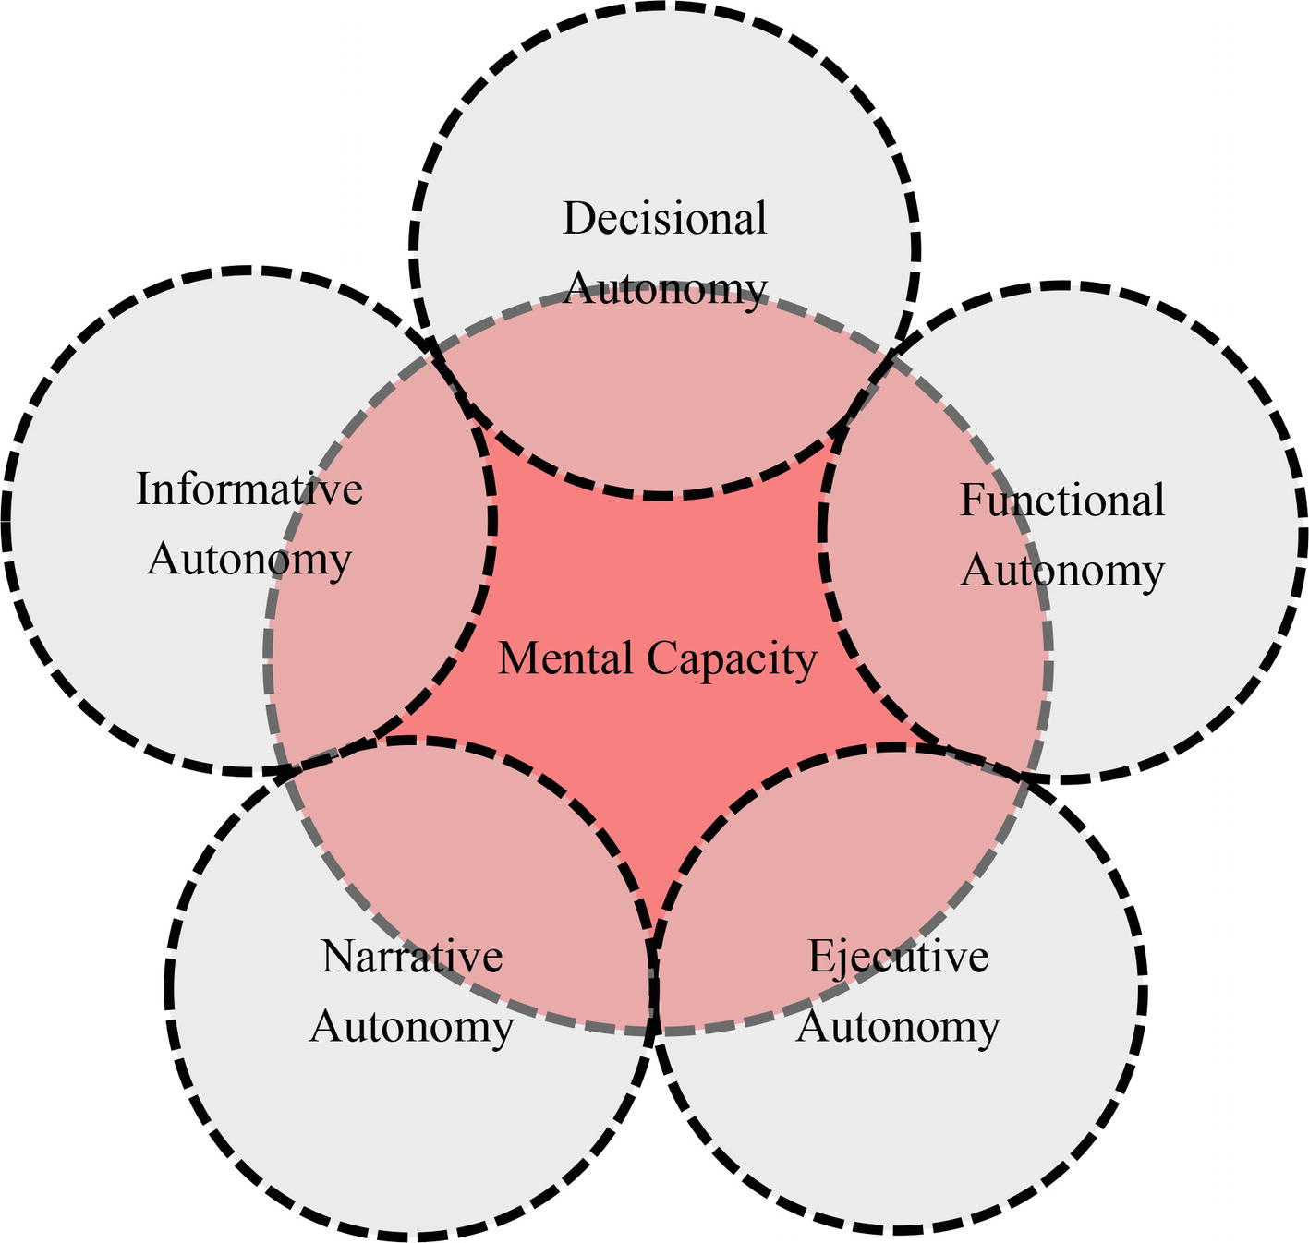
Figure 1. Mental capacity is fundamental element of patient’s autonomy and is influenced by various dimensions autonomy.

Slide 23
References (Patient Autonomy)
https://www.bma.org.uk/advice-and-support/ethics/medical-students
Gerald Dworkin – Theory and practice of autonomy
GMC – Consent: patients and doctors making decisions together
Ion Arrieta Valero. Autonomies in Interaction: Dimensions of Patient Autonomy and Non-adherence to Treatment. Front. Psychol., 14 August 2019. Sec. In Theoretical and Philosophical Psychology. Volume 10 - 2019 | https://doi.org/10.3389/fpsyg.2019.01857

