Slide 1


Slide 2
Assessment of fetal well being
Dr.Humera Noreen
Associate Professor
Gynae Unit 1
Holy Family Hospital

Slide 3


Prof. Umar’s Model of Teaching Strategy
Self Directed Learning Assessment Program
First Ten Minutes
Objectives :
To cultivate critical thinking, analytical reasoning, and problem-
solving competencies.
To instill a culture of self-directed learning, fostering lifelong
learning habits and autonomy.
How to Assess?
➢
Ten randomly selected students will be evaluated within the first 10 minutes of the lecture through 10 multiple-choice questions (MCQs) based on the PowerPoint presentation shared on Students Official WhatsApp group, one day before the teaching session.
➢
The number of MCQs from the components of the lecture will follow
the guidelines outlined in the Prof. Umar model of Integrated Lecture.
Component of LGIS
Core Know ledge
Horizontal Integration
Vertical Integration
Spiral Integration
No of MCQs
6-7
1-2
1
1

Slide 4
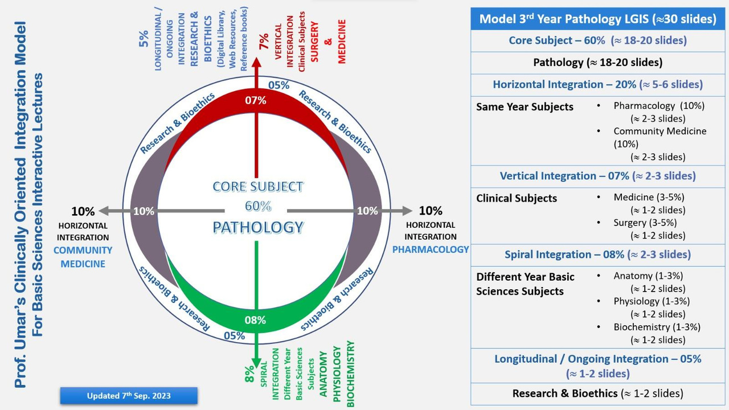
Professor Umar Model of Integrated Lecture
3

Slide 5
Learning objectives
At the end of this lecture the student will be able to
Understand the importance of assessment of fetal wellbeing
Discuss the various modalities used for assessment
Outline the uses of ultrasound in fetal wellbeing
Recognize value of CTG and its features
Aware of role of Doppler USG in management of high risk pregnancies
Importance of Bioethics in fetal assessment
Implication of research

Slide 6
Core subject 60%

Slide 7
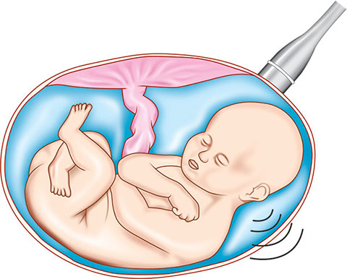
Why assessment of fetal well being is important?
To ensure optimal neonatal outcomes from both pregnancy and labor
Identify the compromised fetus at a stage at which intervention will improve outcome

Slide 8
Test for assessment of fetal well being
Early in pregnancy
Chorionic villus sampling
Amniocentesis
Cordocentesis
Later in pregnancy
Ultrasound/ Biophysical profile
CTG
Doppler ultrasound
MRI

Slide 9
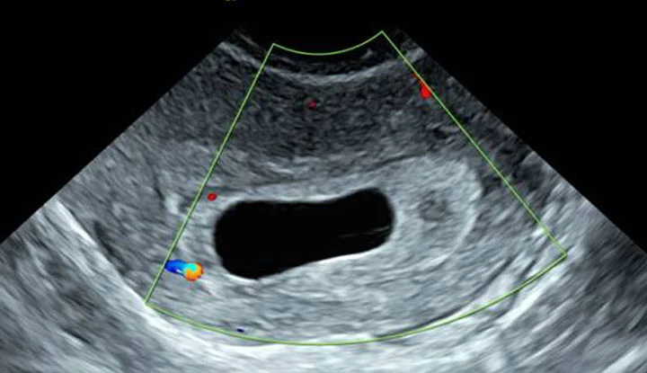
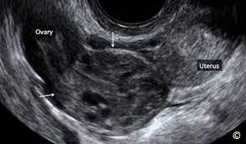
1. Ultrasound
1:Diagnosis and confirmation of viability in early pregnancy
Also detects disorders of early pregnancy like
Incomplete miscarriage
Blighted ovum
Ectopic pregnancy
Blighted ovum
Ectopic pregnancy

Slide 10
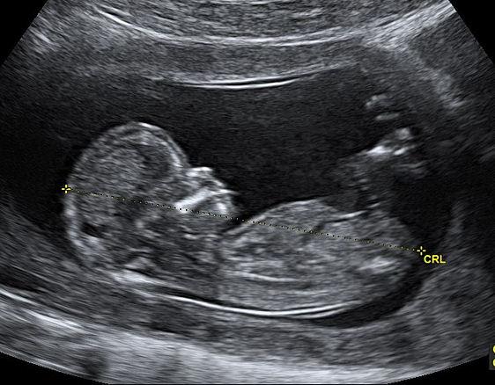
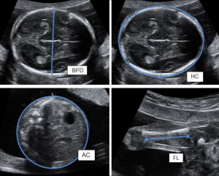
1. Ultrasound
2:Determination of gestational age and assessment of fetal size and growth
In early pregnancy
Crown rump length…..13+6 weeks
Head circumference …..14 to 20 weeks
In later pregnancy
Head circumference(HC)
Abdominal circumference(AC)
Biparietal diameter(BPD)
Femur length(FL)

Slide 11
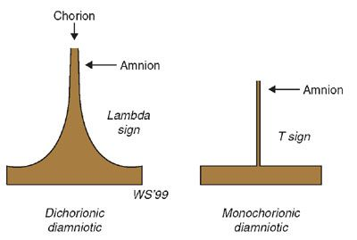
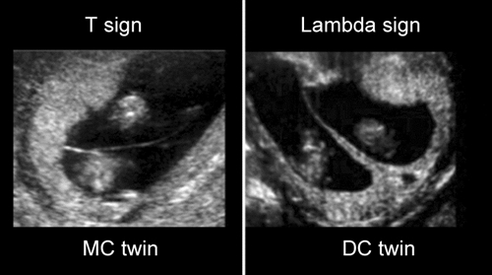
1.Ultrasound
3:Multiple pregnancy
Determine chorionicity
Dichorionic twin pregnancies have a thick inter-twin separating membrane (septum)
Monochorionic twin pregnancy has a very thin inter-twin septum.

Slide 12
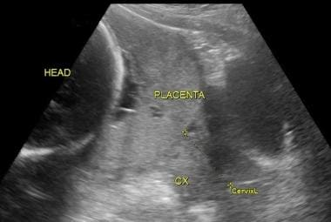
1. Ultrasound
4: Placental localization
Identification of the lower edge of the placenta to exclude or confirm placenta previa as a cause for antepartum haemorrhage

Slide 13
1.Ultrasound
5:Amniotic fluid assessment
The amniotic fluid index (AFI) is measured by dividing the uterus into four ‘ultrasound’ quadrants (10-25 cm)
Reduced volume (< 10 cm)
Oligohydramnios (<5 cm)
Polyhydramnios (>25 cm)

Slide 14
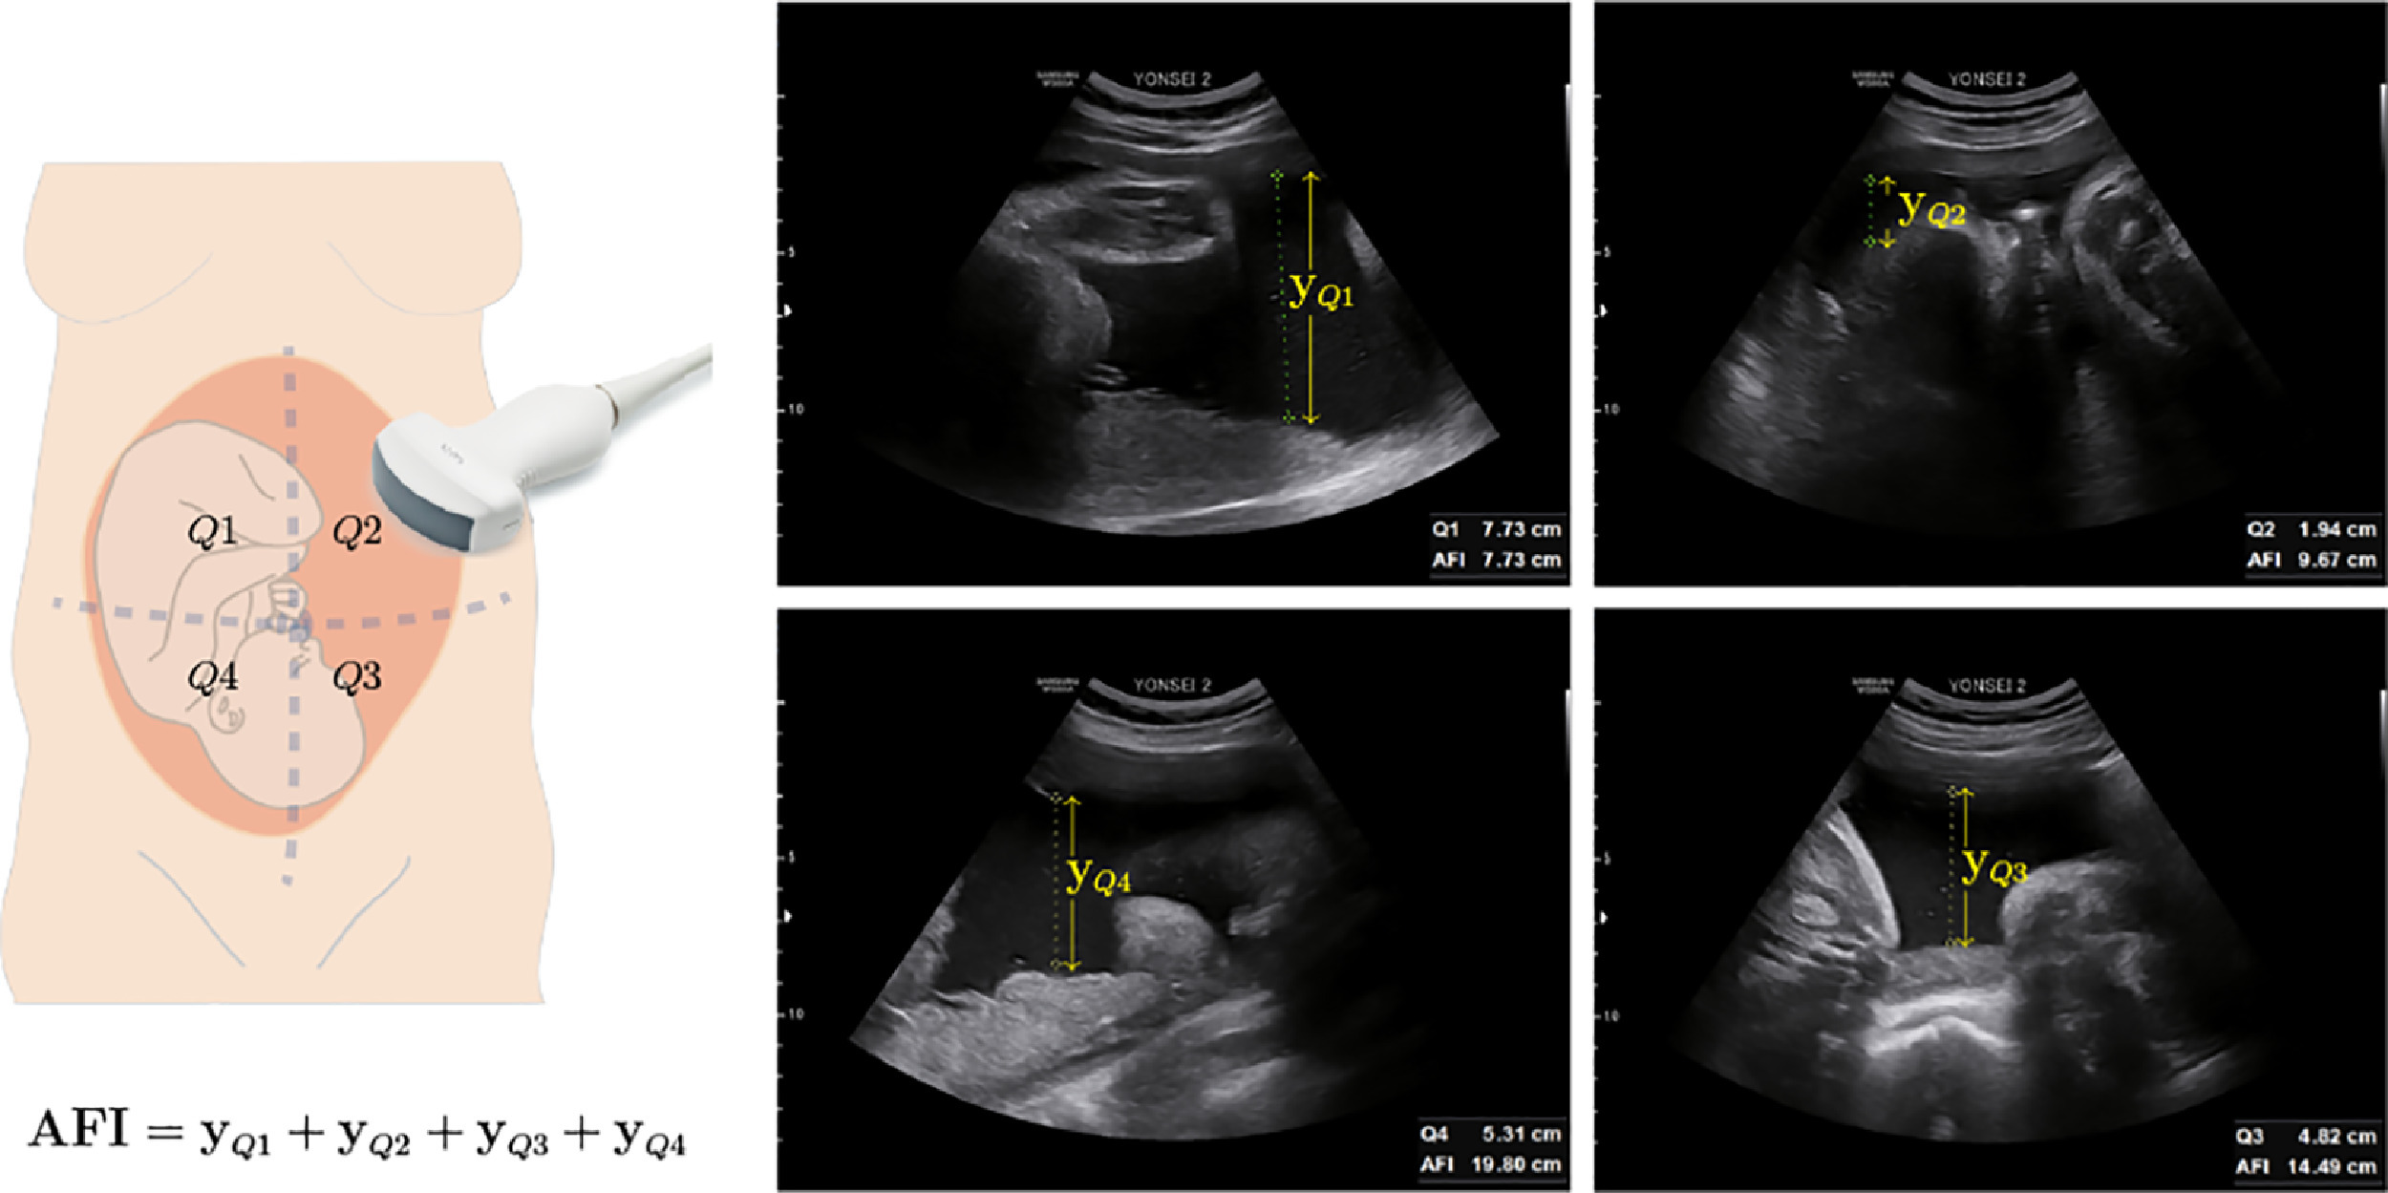
Amniotic fluid index (AFI)

Slide 15
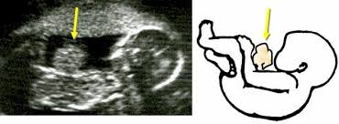
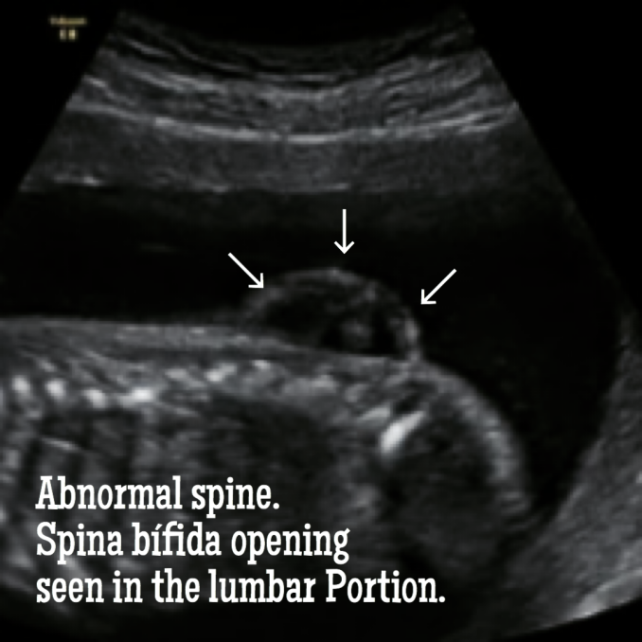
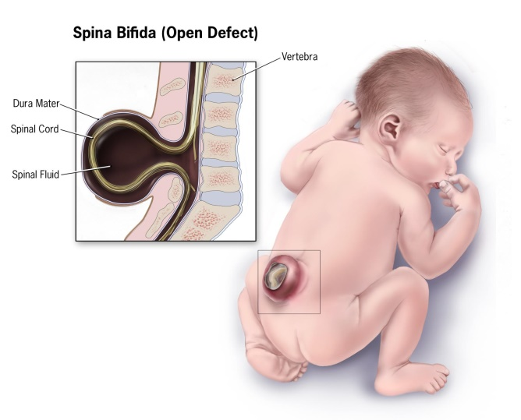
1.Ultrasound
6: Diagnosis of fetal abnormality
Major fetal structural abnormalities 2–3% of pregnancies
Diagnosis at around or before 20 weeks’ gestation.
e.g spina bifida and hydrocephalus, exomphalos and gastroschisis, anencephaly

Slide 16
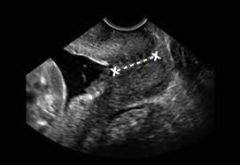
1.Ultrasound
7: Measurement of cervical length

Slide 17
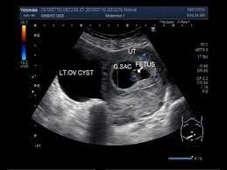
1.Ultrasound
8:Confirmation of intrauterine death. Confirmation of fetal presentation in uncertain cases.
9: Diagnosis of uterine and pelvic abnormalities
for example fibromyomata and ovarian cysts

Slide 18
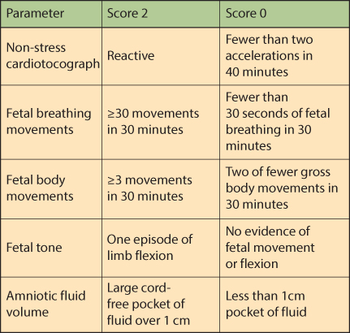
Biophysical profile
Score of 0, 2 or 4
Score of 6
Score of 8 ,10
Abnormal
Equivocal
Normal

Slide 19
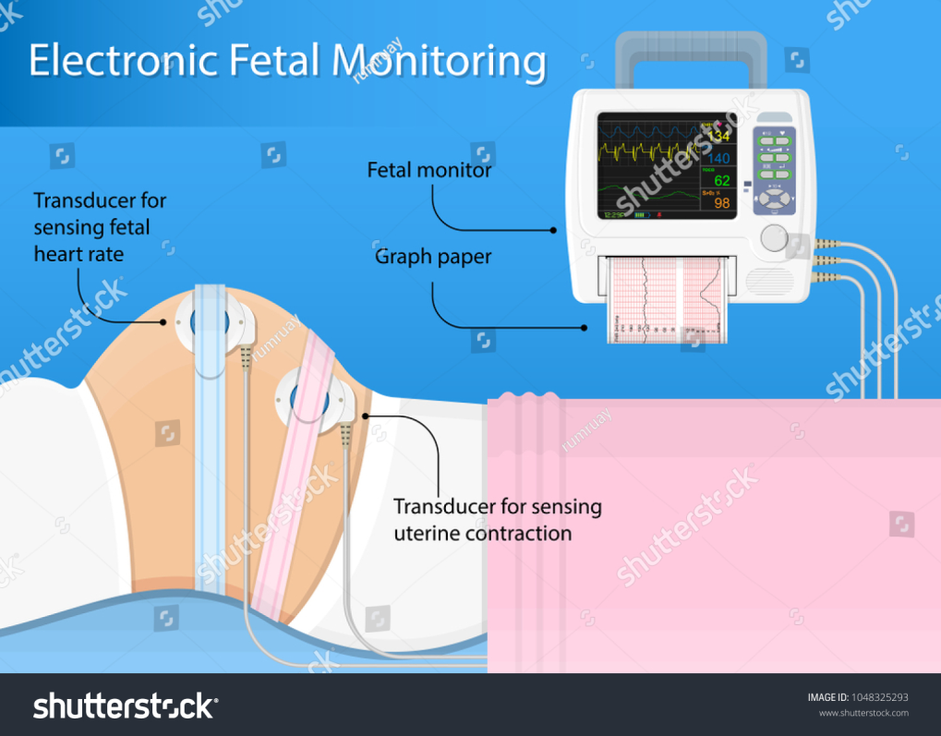
2.Cardiotocography (CTG)
Definition
It is a continuous tracing of the fetal heart rate used to assess fetal wellbeing, together with an assessment of uterine activity.

Slide 20
Cardiotocography (CTG)
Important CTG features
Baseline rate.
Baseline variability.
Accelerations.
Decelerations

Slide 21
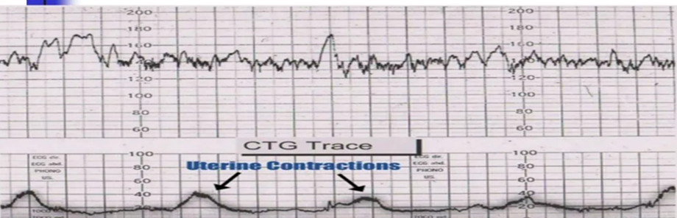
Cardiotocography (CTG)
Acceleration
Baseline variability
Baseline HR

Slide 22
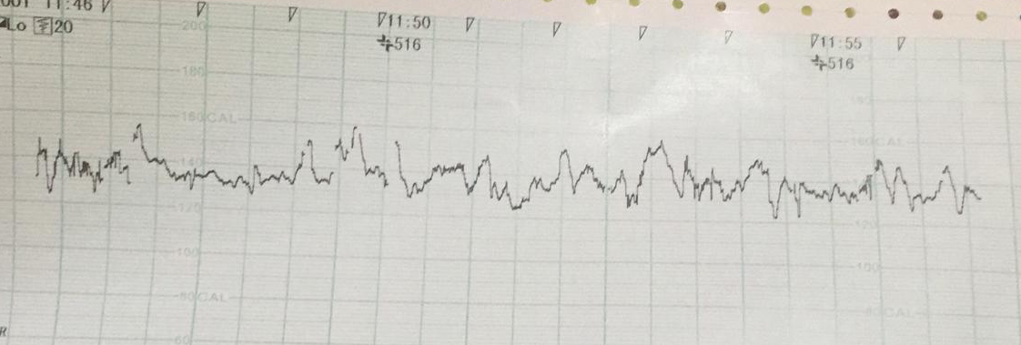
Cardiotocography (CTG)
1.Baseline fetal heart rate
Normal fetal heart rate 110–160 (bpm)
Fetal tachycardia >160 bpm
Fetal bradycardia <110 bpm
Baseline HR

Slide 23
Baseline FHR
Fetal tachycardia
Maternal or fetal infections
Acute fetal hypoxia
Fetal anemia
Drugs e.g Ritodrine
Fetal bradycardia
Hypoglycemia
Hypotension
Hypothermia
Drugs e.g beta blockers

Slide 24
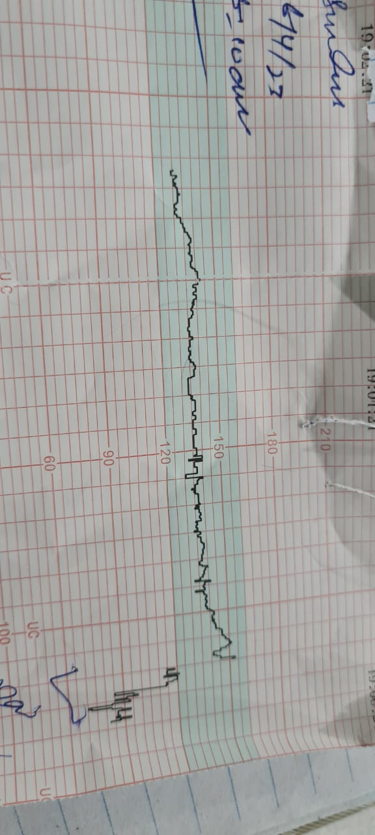
Cardiotocography (CTG)
2.Baseline variability
fluctuations in heart rate occurring between two and six times per minute.
Minimal variability

Slide 25
Cardiotocography (CTG)
Factors reduce baseline variability:
Hypoxia
Fetal Infection
Drugs suppressing the fetal central nervous system, such as opioids, and hypnotics

Slide 26
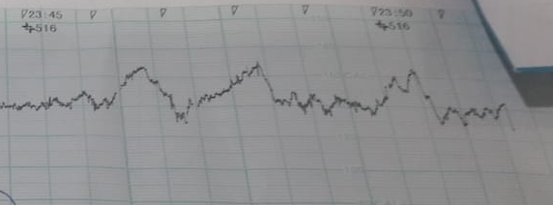
Cardiotocography (CTG)
3.Fetal heart rate acceleration
“Increase in the baseline fetal heart rate of at least 15 bpm, lasting for at least 15 seconds”
Two or more accelerations on a 20–30-minute CTG defines a reactive trace and is indicative of a non-hypoxic fetus
Accelerations

Slide 27
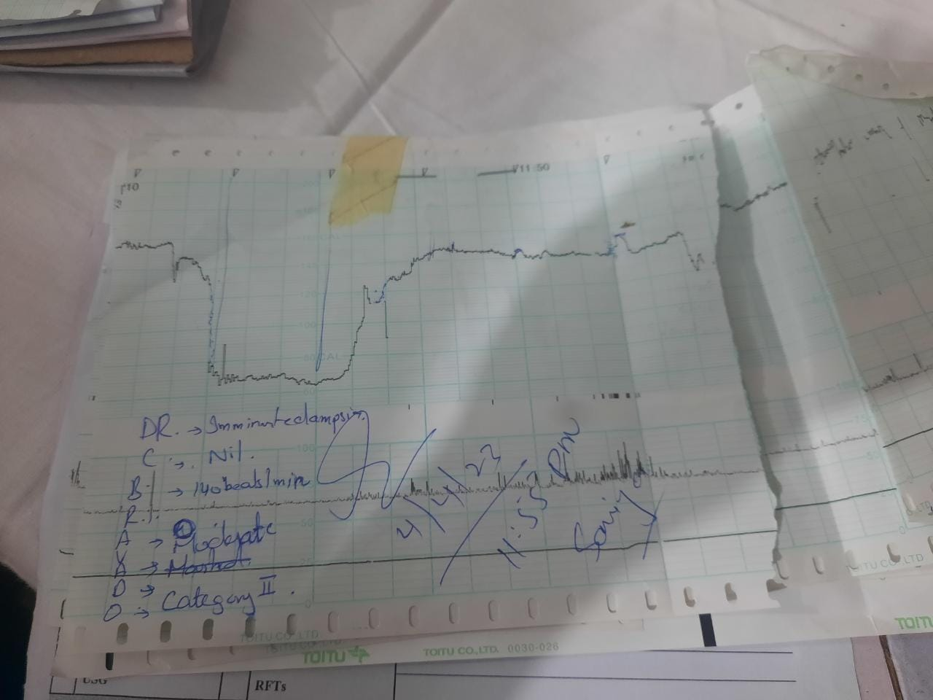
Cardiotocography (CTG)
4.Fetal heart rate decelerations
“ Transient reductions in fetal heart rate of 15 bpm or more, lasting for more than 15 seconds”
Indicative of fetal hypoxia or umbilical cord compression
FHR Deceleration

Slide 28
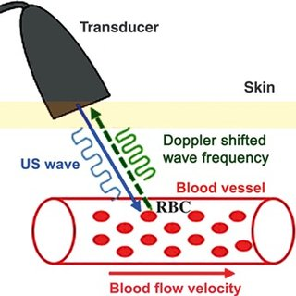
3. Doppler Ultrasound
Measure sound waves that are reflected from moving objects such as red blood cells
Umbilical artery
Fetal vessels
Maternal uterine artery

Slide 29
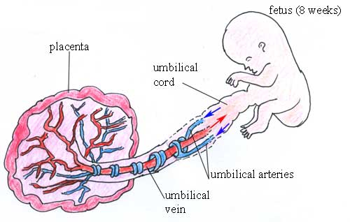
a. Umbilical artery (Anatomy)

Slide 30
a. Umbilical artery (Physiology)
Provide information on placental resistance to blood flow ……placental health
In the normal pregnancy the normal constant forward flow of blood in diastole will be seen
In the diseased placenta flow during diastole may be reduced, absent or even reversed
Strong correlation with fetal hypoxia and intrauterine death.

Slide 31
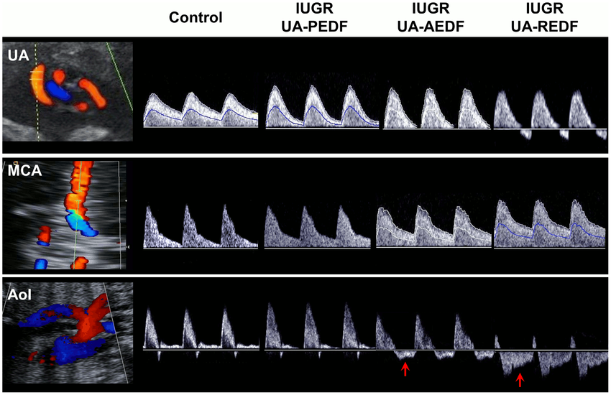
a. Umbilical artery Doppler
Peak end diastolic flow
Reverse end diastolic flow
Normal
Absent end diastolic flow
Abnormal

Slide 32
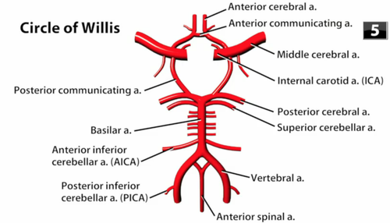
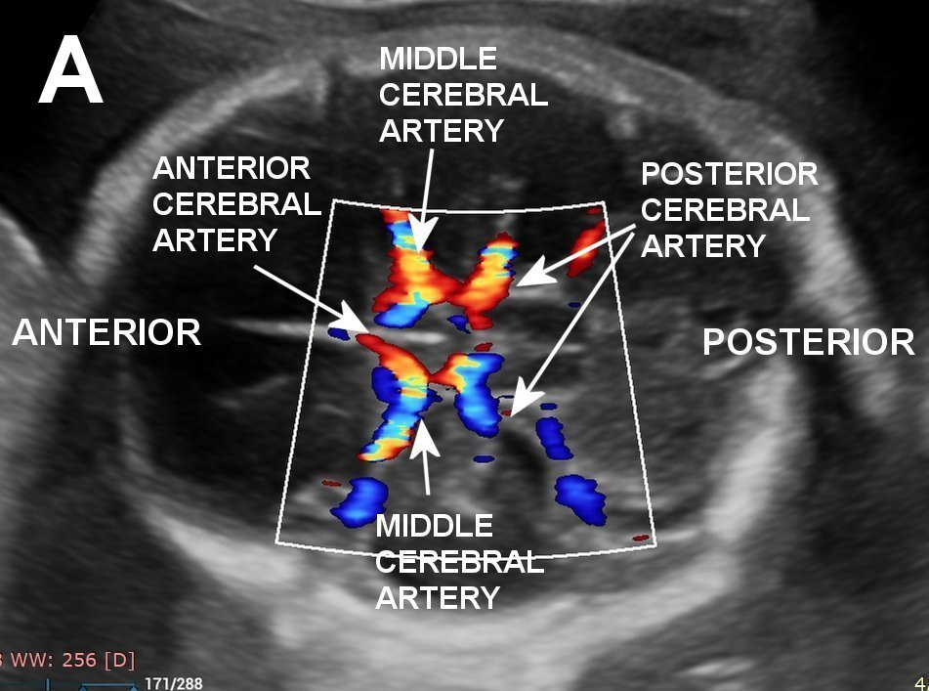
b. Middle cerebral artery

Slide 33
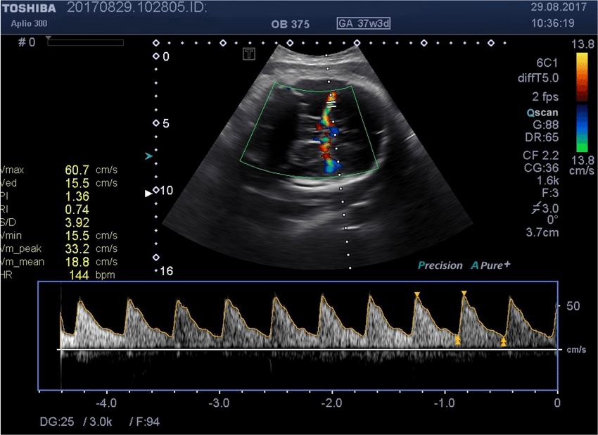
b. Middle cerebral artery
Indicator of fetal anaemia e.g Rhesus isoimmunization

Slide 34
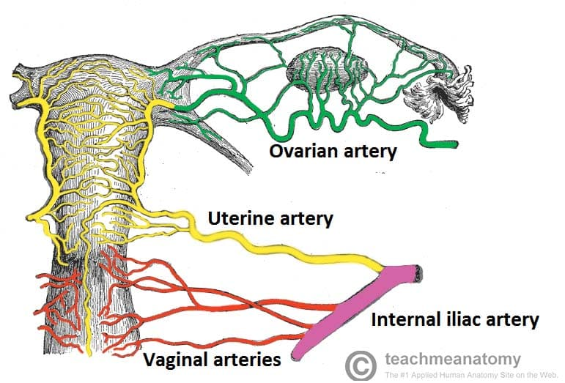
c. Uterine artery

Slide 35
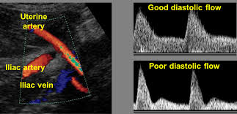
c. Uterine artery
To predict pregnancies at risk of adverse outcome during the first and early second trimester
Including pre-eclampsia, FGR and placental abruption
Evaluation at 20–24 weeks’ gestation

Slide 36
3D and 4D ultrasound
Used as an adjunct to 2D ultrasound
Interrogate fetal structures that may be difficult to visualize, such as the corpus callosum or fetal spine
To demonstrate fetal structural abnormalities to the parents, for example cleft lip and palate

Slide 37
4. Magnetic resonance imaging
(MRI)
Limited role
Better characterization of anatomic details of, for example, the fetal brain

Slide 38
Bioethics
Healthy mother and healthy baby must be our aim
Every patient with small for gestational age fetus must be evaluated fully with justified investigations
There must not be cesarean section for early onset IUGR

Slide 39
Family Medicine
A comprehensive history must be taken to find the risk factors for FGR
Detailed examination with special emphasis on symphysio- fundal height ( SFH) to suspect FGR
If there are risk factors for FGR then timely referral to tertiary care hospital must be done

Slide 40
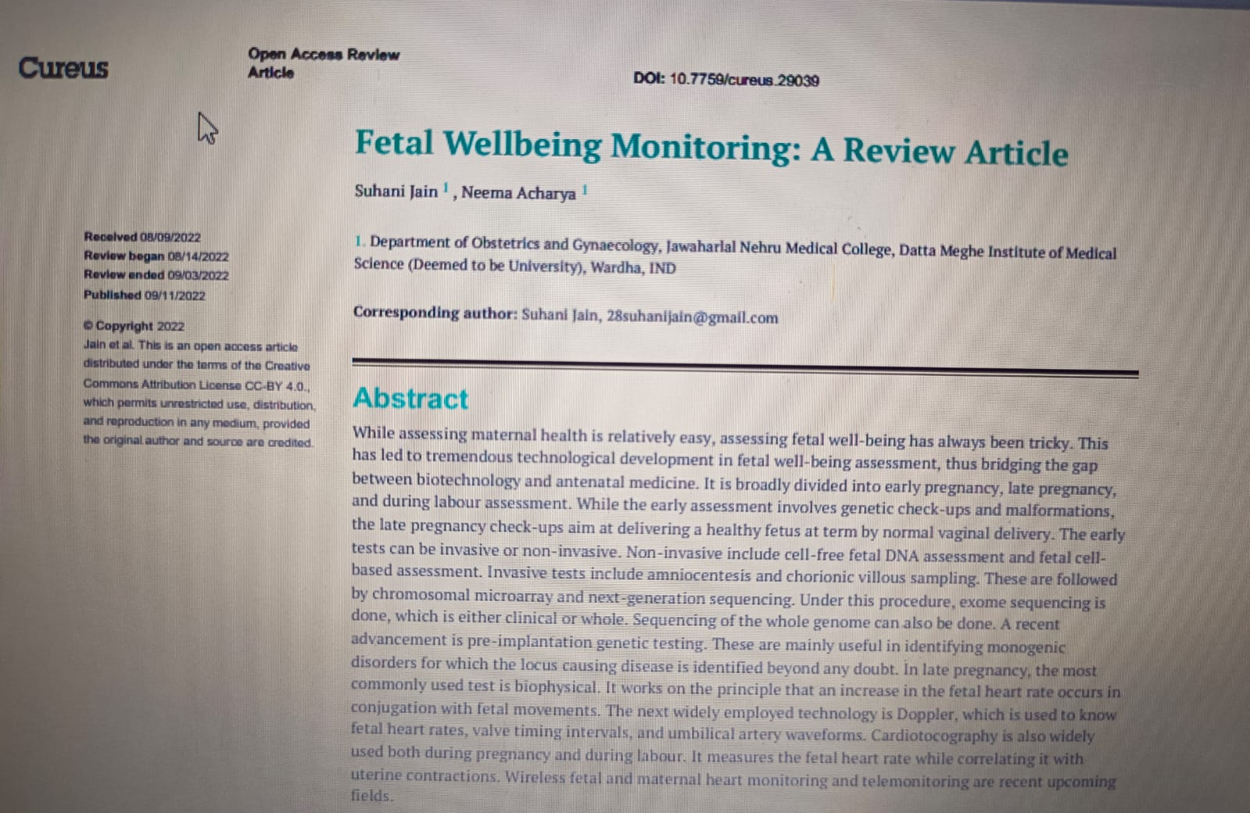
Research
https://www.ncbi.nlm.nih.gov/pmc/articles/PMC9550204/

Slide 41
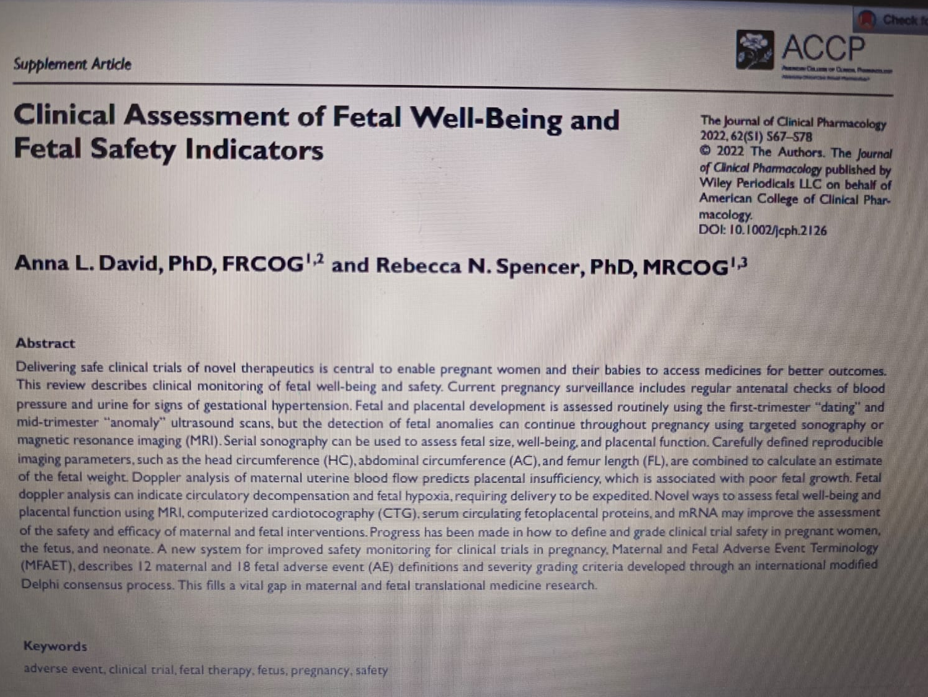
Research
https://accp1.onlinelibrary.wiley.com/doi/full/10.1002/jcph.2126

Slide 42


