Slide 1
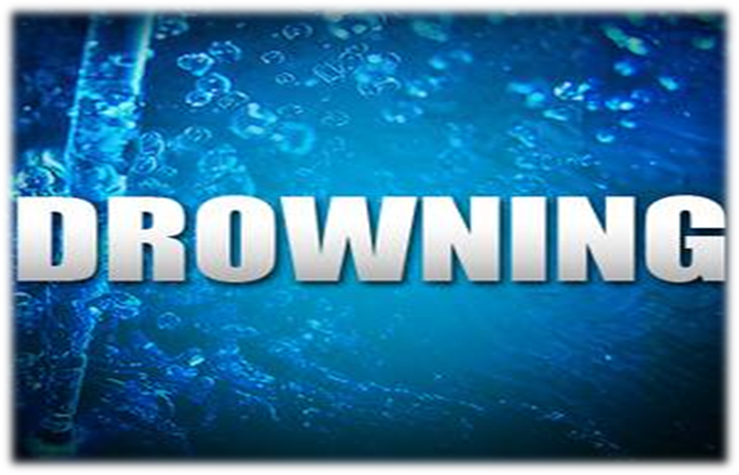
ASPHXIA IV
Dr . Filza Ali & Dr Sharukh

Slide 3
Motto of RMU
Wisdom
Truth
Service

Slide 4
Vision of RMU The Dream/ Tomorrow
To impart evidence based research oriented medical education
To provide best possible patient care
To inculcate the values of mutual respect and ethical practice of medicine

Slide 5
Prof Umar’s LGIS Model

Slide 6
Learning Objectives
Students will be able to
Define drowning and Classify drowning.
State the cause of death in different types of drowning
Briefly explain the patho-pysiology of wet drowning both in sea and fresh water.
Describe the postmortem findings and their medico-legal importance.
Differentiate between antemortem and postmortem drowning.

Slide 7
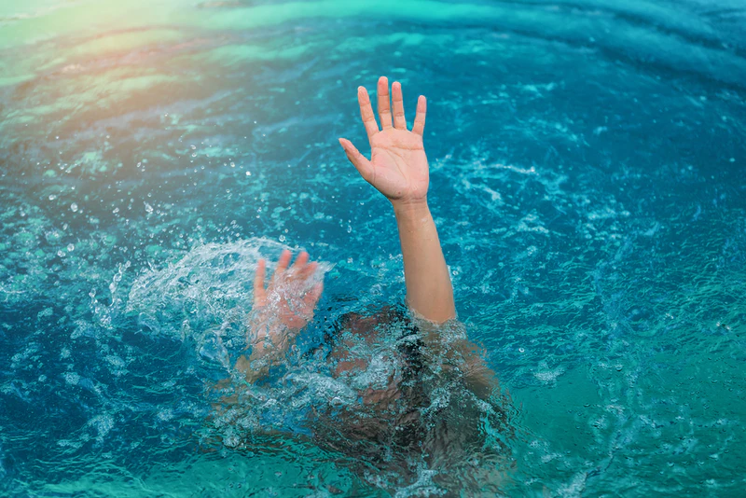
Definition:-
Core Concept
Literally means,
“To suffer death by submersion in water or any other liquid because of being unable to breath”
While submersion or immersion means “Putting or plunging the person under water”

Slide 8
Drowning or (immersion)
Core Concept
Drowning may be defined as
“A form of death in which there is defective oxygenation of the blood in the lungs due to the presence of fluid in the respiratory tract the which is entering the air passages through the nose & mouth.”

Slide 9
Core Concept

Slide 10
Types of Drowning:
Core Concept
Drowning
Primary/ Typical/ Wet Drowing
Fresh/Brackish water drowning
Sea/Salt water drowning
Atypical Drowning
Dry drowning
Secondary
drowning
Immersion syndrome/ Hydrcution/Submersion inhibition
Shallow water drowning

Slide 11
Types of Drowning
Core Concept
TYPICAL DRWONING
This is the typical type in which the water is swallowed and inhaled in the respiratory passages causing asphyxia and death.
ATYPICAL DROWNING
This term includes the death from submersion due to following reasons:
Vagal inhibition(Immersion Syndrome)
Laryngeal spasm
Submersion of the unconscious

Slide 12
Atypical Drowning
Core Concept
DRY DROWNING:
No inhalation or very little. Death is sudden & practically no water enters the lungs/stomach thus giving no finding of Drowning.
This situation is called Dry Drowning. Inhalation of fluid in air passage. It triggers the laryngeal spasm and leading to death.
SHALLOW WATER DROWNING:
Submersion of unconscious

Slide 13
Core Concept
IMMERSION SYNDROME:
Vaso-vagal inhibition Water rushes into the nose & mouth producing an impact against the naso- pharynx or larynx which produces laryngeal spasm, shock & stimulation of vagus nerve. It is also called Submersion inhibition / Hydrocution
SECONDARY DROWNING SYNDROME OR NEAR DROWNING :
Infection from contaminated inhaled water leading to heavy, fibrosed and stiff lungs

Slide 14
Cause of death
Core Concept
Dry Drowning:
Reflex neurogenic cardiac failure
(sudden cardiac arrest)
Pre- disposing factors .
Person in high emotional state.
Sudden immersion in a position where feet enters the water first.

Slide 15
Cause of death
Core Concept
Near drowning / Secondary drowning.
Survival beyond 24 hours after the victim is removed from the aqueous environment has been considered as, ‘near-drowning’
Hypothermia and decreased oxygen supply to brain and the vital tissues, determine the morbidity and mortality.The person may survive or die later.
It is also called Post immersion syndrome

Slide 16
Typical Drowning
Core Concept
WET DROWNING is the obstruction of air passages & lungs by inhalation of fluid.
Types of Wet Drowning :-
Fresh / Brackish water Drowning
Salt / Sea water Drowning

Slide 17
Mechanism of death in wet drowning
Core Concept

Slide 18
Fresh /Brackish water drowning
Core Concept
Inhaled water spread through enormous lung field (alveolar space area)
Water is rapidly absorbed & water enters the blood stream leading to haemodilution .
There is haemolysis of RBC & fall in mineral salts thus we have initially anoxia in lung added with circulatory anoxia.
This condition leads to collapse ,hypotension & causes ventricular fibrillation & cardiac failure .

Slide 19
Fresh /Brackish water drowning
Core Concept

Slide 20
Core Concept
Sea /Salt water drowning
Salt water contains excess of salts.
Salt water when spreads through the lung field excess salt diffuses into the blood stream producing increased in plasma chloride & haemo concentration.
Fluid from blood gains entrance into the lungs and totally replacing the air in lungs,
So we have pure anoxic anoxia & Asphyxia.

Slide 21
Sea /Salt water drowning
Core Concept

Slide 22
Patho-physiology of Drowning
Horizontal Integration
In fresh water drowning, death takes 4-5 minutes because :
the absorbed water causes hemodilution → massive increase in blood volume →bursting of RBCs → release of potassium→ ventricular fibrillation → cardiac failure → DEATH

Slide 23
Patho-physiology of Drowning
Horizontal Integration
Core Concept
In sea water drowning, death occurs usually in 8-10 minutes
Due to salt water→higher concentration of saline draws water into pulmonary spaces →hemoconcentration → pulmonary edema → hypovolemia, circulatory shock, Asystole and cardiac arrest due to, myocardial anoxia → DEATH

Slide 24
Cause of death
Core Concept
In fresh water drowning:
Death occurs because of Ventricular fibrillation.
In sea water drowning:
Death occurs because of cardiac arrest.

Slide 25
Postmortem findings
Vertical Integration
External findings:
Clothes are wet.
Fine, frothy , copious froth at mouth and nostril.
Face is bloated with protruded tongue and half open eyes.
Person may make a last attempt such as holding gravel, weed, grass & the muscles which are in action are contracted & leads to instant rigor mortis known as Cadaveric spasm.

Slide 26
Vertical Integration
Postmortem findings
Sodden or wrinkled hand & feet known as Washer woman or washer man feet.
The cold water causes contraction of erector pillories muscles producing goose flesh appearance called Cutis anserina.
Facial pallor due to contraction of blood vessels.
Postmortem lividity is of light pink color, present over face, neck , front of upper part of chest,upper and lower limbs.

Slide 27
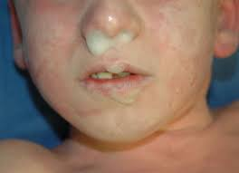
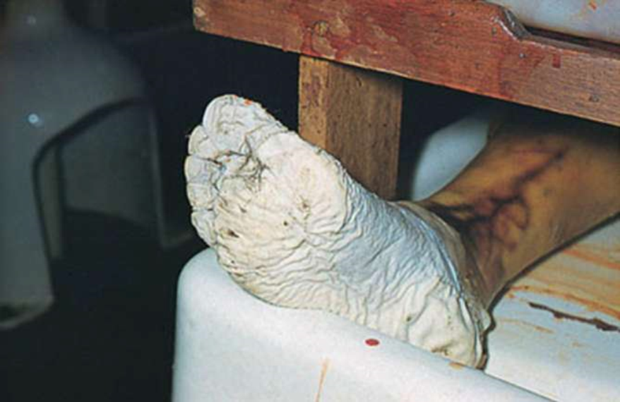
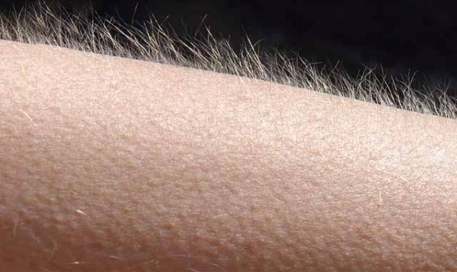
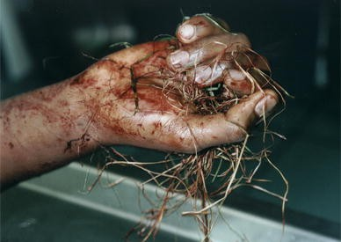
Postmortem findings(External)
Vertical Integration

Slide 28
Postmortem findings
Vertical Integration
Internal findings:
Respiratory Tract & Lungs
Frothy fluid tinged with blood is observed in the bronchi, trachea & Larynx & may appear at mouth & nose.
Petechial hemorrhage may be found in the pleura
Lung are usually voluminous. Edematous lungs are called edema aquosum.
Lungs are congested fine bubbles may be found around the nose & mouth. fine froth at the level of nose and mouth is called champignon de mouse.

Slide 29
Postmortem findings
Vertical Integration
There is hemorrhage in lungs known as paultafs hemorrhage
The trachea & bronchi & alveoli of the lungs contain substances such as sand or shell particles which are found in the medium in which person has drowned
Stomach & Intestines
Stomach & intestines fluid characterized of medium in which the drowning has taken place may be found in the stomach & intestine.
Heart
Chloride contents in case of sea water 25 mg more in Lt. ventricle.

Slide 30
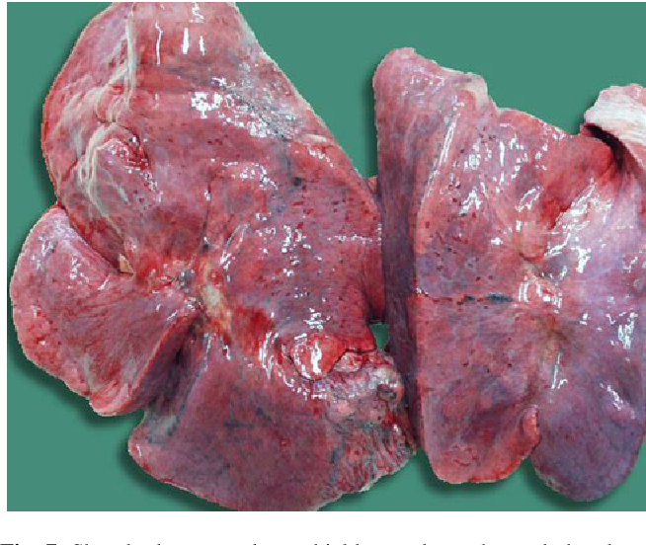
Postmortem findings(Internal)
Vertical Integration
Paultafs hemorrhage

Slide 31
Gettler’s test
Core Concept
Normally Chlorine content of left & right side of heart is same and that is about 600 mg/100ml
Difference is not more than 5mg/100ml
If difference is 25mg % between 2 chambers it is suggestive of Antemortem drowning.
ln fresh water drowning Chlorine content of left heart will be lower than that of right heart because of dilution by water
In salt water drowning Chlorine content of left heart will be higher than that of right heart because of mixing with salt water and hemoconcentration.

Slide 32
DIATOMS: single-celled organisms that secrete intricate skeletons
Core Concept

Slide 33
Medico legal importance of diatoms
Vertical Integration
Medico legal Aspect of diatoms is that diatoms are present in bone marrow in ante mortem drowning only .
Diatoms are unicellular microscopic algae of different shapes like diamond ,rod ,circular shape ,they live in colony in water.

Slide 34
Core Concept
ANTE-MORTEM DROWNING | POST-MORTEM DROWNING
Presence of fine, frothy and copious froth/foam at nostrils or mouth or both | Absent
Cadaveric spasm | Absent
Lungs voluminous and bulky [emphysema aquosum] | Passive collection of water may be seen [edema aquosum]
Foreign material esp. mud, weeds, debris in bronchi and bronchioles | Very little such evidence
Stomach may contain weeds, mud or any foreign material swallowed | Possible but not always present
Presence of DIATOMS in distant body tissues is confirmatory sign | Diatoms may be passively inhaled in lungs but never in distant body tissues

Slide 35
Medico-legal importance:
Vertical Integration
Accidental:-
Commonest form & seen in the drowning of fishermen, dock workers & intoxicated & epileptics.
Suicidal
This type of drowning fairly common
Homicidal
It is rare.

Slide 36
Research
Research
https://pubmed.ncbi.nlm.nih.gov/16738432/#:~:text=Males%20constitute%2079.8%25%20of%20all,of%20all%20asphyxial%20deaths%2C%20respectively.
https://pjmhsonline.com/2021/august/2148.pdf
https://apims.net/index.php/apims/article/view/276
https://www.duhs.edu.pk/download/jduhs-vol.6-issue-3/rp3.pdf
https://emedicine.medscape.com/article/1988699-overview

Slide 37
Biomedical Ethics
Ethics
The determination of a patient's death is of considerable medical and ethical significance.
Death is a biological concept with social implications.
Acting with honesty, transparency, respect, and integrity is critical to trust in the patient-physician relationship, and the profession, in life and in death.

Slide 38
Family Medicine
Family Medicine
Some treatments for asphyxiation include:
Cardiopulmonary resuscitation (CPR)
Oxygen therapy.
Heimlich maneuver is a first aid technique for choking. It uses abdominal thrusts below the diaphragm to remove a foreign object from a person’s airways.
Medication can help to ease the effects of severe asthma attack.

Slide 39
How to use HEC Digital Library
Go to the website of HEC National Digital Library
http://www.digitallibrary.edu.pk
On Home Page, click on the INSTITUTES.
A page will appear showing the universities from Public and Private Sector and other Institutes which have access to HEC National Digital Library (HNDL).
Select your desired Institute.
A page will appear showing the resources of the institution
Journals and Researches will appear
You can find a Journal by clicking on JOURNALS AND DATABASE and enter a keyword to search for your desired journal

Slide 40
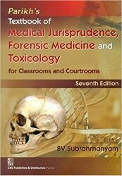
TEXT BOOKS & PRACTICAL NOTEBOOK:
Principles & Practice of Forensic Medicine.
by Nasib R. Awan
Parikh’s Textbook of Medical Jurisprudence,
Forensic Medicine & Toxicology.
Practical Manual Of Forensic Medicine
& Toxicology

Slide 41
Thank You

