Slide 1
ASPHYXIA III
Dr Filza ali & Dr Gulzaib

Slide 3
Motto of RMU

Slide 4
To impart evidence based research oriented medical education
To provide best possible patient care
To inculcate the values of mutual respect and ethical practice of medicine
Vision of RMU
The Dream/ Tomorrow

Slide 5
Prof Umar’s LGIS Model

Slide 6
By the end of lecture students will be able to :
Define suffocation.
Enlist different types of suffocation.
Briefly explain the postmortem findings in death due to suffocation
State the medico-legal importance of death from different types of suffocation.
Learning objectives:

Slide 7
SEQUENCE OF LGIS
Learning Objectives
Core concept 70 %
Horizontal integration related to Pathology and Pharmacology 15 %
Relevant clinical concepts and medico legal application of core knowledge / Vertical integration 10%
Research article relevant to the topic 3%
Ethics and family medicine 2%

Slide 8
“ It is a form of asphyxia caused by mechanical obstruction to the passage of air into the respiratory tract by means other than constriction of neck or drowning. ”
SUFFOCATION

Slide 9
Suffocation
Core Concept
“ To die as a result of being not able to breathe or to have difficulty in breathing. ”
examples:
Toxic gases in air e.g. CO, Cyanide etc.
Decompression- fall of air cabin pressure
Heaters in rooms eating up all the oxygen
Children smothered at night accidentally

Slide 10
Gagging
Core Concept
Smothering
Choking
Traumatic asphyxia
Overlaying
Burking
Types of Suffocation

Slide 11
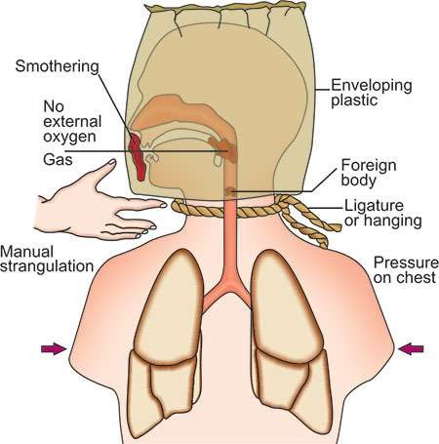
Core Concept
Types of Suffocation

Slide 12
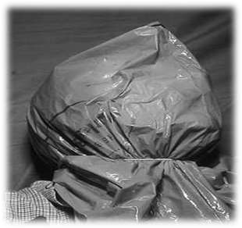
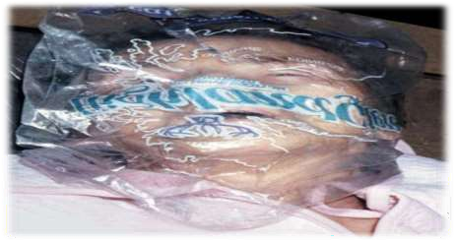
“ It is a form of asphyxia caused by mechanical occlusion of external air passages, i.e. the nose and mouth by hand, cloth, plastic bag or other material. ”
Core Concept
Smothering

Slide 13
Vertical Integeration
Postmortem findings:
Abrasions and bruises around the mouth and nostrils. These may not be seen, if soft materials, like cloth or pillow has been used.
Injuries on the inside of the lips from pressure of teeth are seen.
Bruising of gums or sometimes tears of delicate tissues are seen.
Smothering

Slide 14
Vertical Integration
Medico-legal importance:„Accidental
smothering is common
Alcoholics or epileptics who may fall or roll over in a heap of mud or such other material.
After birth, an infant may die from smothering, if he is born with membranes covering the nose and mouth.(cul de sac)
Children may get smothered while playing with plastic bags over the face or head.
Smothering

Slide 15
In an epileptic attack, tongue may fall back on to posterior
Core Concept
“It is a form of asphyxia caused by an obstruction within the air-passages by a foreign object, like coins, fruit seeds , toffees , candies fish etc.”
pharyngeal wall causing choking.
Phases of acute fatal airway obstruction :
Penetration of the object into the airway.
Obstruction of the airway.
Failure to expel once the obstruction has occurred.
Choking

Slide 16
Mechanism :
Core Concept
Initially , stridor, respiratory distress, coughing and the inability of the victim to speak
Followed by a rapid, deep inhalation, which causes the foreign object to pass further down the airway
Laryngospasm occurs, followed by vagal stimulation, leading to arrhythmia, apnea and death
Choking

Slide 17
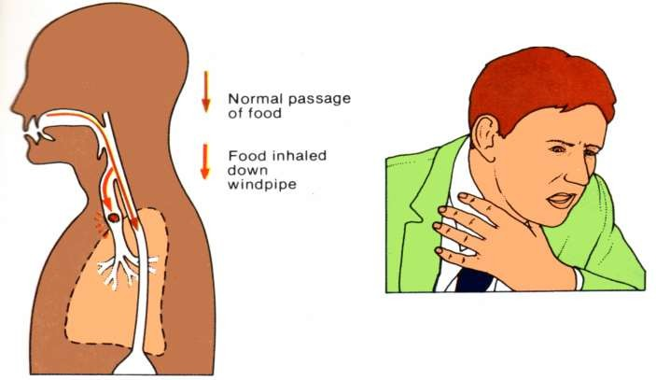
Core Concept
Choking

Slide 18
Vertical Integration
Core Concept
Cause of death:
Asphyxia.
Vagal inhibition.
Laryngeal spasm.
Delayed death from pneumonia, lung abscess or bronchiectasis.
Postmortem findings:
Signs of asphyxial death. Sub-conjunctival hemorrhages
without cutaneous petechiae may be seen.
Presence of food items / foreign body in respiratory tract which are round and firm yet pliable to allow molding in the airway.
In an epileptic, tongue may show bite marks or bruising.
Choking

Slide 19
Vertical Integration
Core Concept
Medico-legal importance:
Most choking deaths are accidental; suicide and homicide are rare.
„Accidental: Choking deaths are common in children < 1 year of age. 90% of choking deaths happen before the age of 5 years.
„Homicidal: When objects are forced into the mouth, signs of a struggle, if the individual was conscious, may be noted along with perioral, teeth, tongue and other intraoral injuries. „
Suicidal: Choking is uncommon, and may occur in psychiatric patients and prisoners.
Choking

Slide 20
Café-coronary:
Core Concept
This is a condition of accidental choking wherein a bolus of food produces complete obstruction of the larynx.
I„t is called so, because it mimics a heart attack and is usually seen in an
intoxicated restaurant patron.
Causes:
Predisposing factors include:
Decreased protective airway reflex.
Tendency to swallow food whole.
Alcohol consumption.„
Ingestion of large dose of tranquilizers.
Reflex cardiac arrest from ‘vagal inhibition’ as a consequence of stimulation of laryngeal nerve endings.
Choking

Slide 21
Core Concept
Clinical findings:
Victim who was apparently healthy,
collapses suddenly turning blue while eating at a dining table.
Treatment:(for choking)
If there is difficulty in breathing & cyanosis, give first aid by application of pressure on abdomen (Heimlich maneuver) till the patient recovers or loses consciousness.
A blow on the back or on the sternum may cause coughing and
expel the foreign body.
The victim is placed in a supine position and the mouth is opened to perform finger sweep.
If the object cannot be removed, the person may need a tracheotomy/cricothyrotomy.
Choking

Slide 22
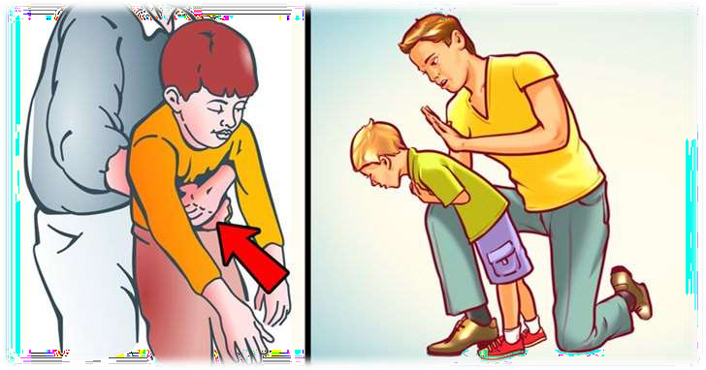
Choking

Slide 23
Core Concept
“Gagging is a form of asphyxia which results from pushing a gag (rolled up cloth or paper balls) into the mouth, sufficiently deep to block the pharynx.”
It combines the features of smothering and choking.
Initially, the airway may be patent through nose, but collections of saliva, excessive mucus with edema of pharynx and nasal mucosa causes complete obstruction.
Gagging

Slide 24
Vertical Integration
Core Concept
Postmortem findings:
Same as choking. Injuries to nose and mouth with seepage of blood into the back of throat.
Medico-le„gal importance:
Almost always homicidal, and the victim is usually an infant or an elderly person.
„Gagging is usually resorted to prevent the victim from shouting for help; death is usually unintended.
„Gags have been used to suppress screams by victims using a painful method of suicide (self- immolation)
Gagging

Slide 25
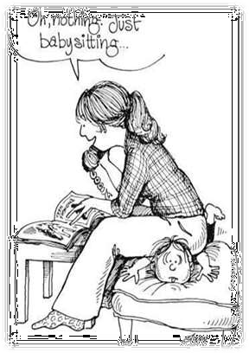
Vertical Integration
Core Concept
“ Overlaying or compression suffocation results from compression of the chest, nose and mouth, so as to prevent breathing.”
It is a form of accidental smothering of an infant by a nursing mother, sharing a bed with her child who may roll over during sleep and occlude the air passages. „
Ethanol intoxication or a medical condition
Overlaying

Slide 26
Vertical Integration
Core Concept
Postmortem findings:
o Face, nose and chest of victim child may appear compressed and pale.
Pressure marks from bedding or clothing.
Signs of asphyxia will be seen along with intr-athoracic petechiae.
Medico-legal importance:„
o Purely accidental in nature.
„It may also be a case of infanticide.
„These cases are likely to be victims of sudden infant death syndrome (SIDS).
Overlaying

Slide 27
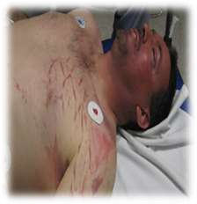
Core Concept
“Asphyxia resulting from respiratory arrest due to mechanical fixation of chest, so that the normal movements of chest wall are prevented.”
It is also called Crush Asphyxia / Perthes
Syndrome
Traumatic Asphyxia

Slide 28
Core Concept
Causes:
Due to house collapse, accidentally or in wars/ earthquake.
Stampede by crowd, running in panic, e.g. due to outbreak of fire in a public gathering.
Run over by a vehicle or overturned vehicle (especially tractors).
Collapse of wall inside a mine or trenches (cave-in), in bunkers of sand or grain.
When held between the buffers of two bogies of a train.
iii.
Traumatic Asphyxia

Slide 29
Vertical Integration
Core Concept
Postmortem findings:
External findings
Florid red or blue congestion and deep cyanosis of face
and neck
Numerous petechial hemorrhages or ecchymosis.
Level of compression is indicated by well defined demarcating line between the discolored upper portion of body and the lower normal part.
External blunt trauma injuries can be seen on the head, neck and chest along with mud or other foreign material.
Traumatic Asphyxia

Slide 30
Internal findings:
Vertical Integration
Eyes: Retinal hemorrhages).
Face: Nose, ear or pharyngeal petechiae/ ecchymosis that
mimic a basal skull fracture.
Bones: Rib and clavicle fractures are common; extremity and pelvic fractures.
Upper Respiratory tract: Edema, epiglottic and laryngeal
petechiae.
Lungs: Congested, heavy, sub-pleural petechiae, contusions/lacerations and hemo/pneumothorax may be present.
Traumatic Asphyxia

Slide 31
Vertical Integration
Heart: Right heart and veins above aorta may be distended, injuries are rare.
Abdomen : Hepatic and splenic lacerations may be found.
CNS: Edema and petechiae can be seen.
Medico-legal importance:„
o Mostly accidental,
Fallen appliances or furniture particularly over children has been described as a means of homicide.
Traumatic Asphyxia

Slide 32
Core Concept
“ It is a combination of homicidal smothering and traumatic asphyxia.”
William Burke and William Hare killed 16 persons during 1927–28 in Scotland and sold their bodies to Dr Robert Knox for use as specimens in his anatomy classes in Edinburgh Medical School.
Burking

Slide 33
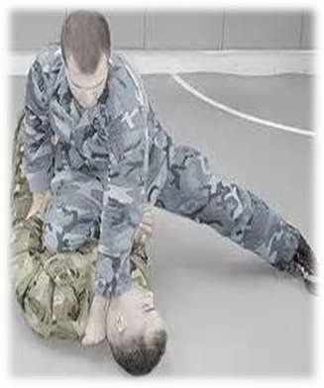
Core Concept
Mechanism:
A victim was invited to their house and given alcohol. When drunk, he was thrown on the ground. Burke would kneel or sit on the chest and close the nose and mouth with his hands, and Hare used to pull him around the room by the feet till he is dead
Burking

Slide 34
Research
https://pubmed.ncbi.nlm.nih.gov/16738432/#:~:text=Mal es%20constitute%2079.8%25%20of%20all,of%20all%20 asphyxial%20deaths%2C%20respectively.
https://pjmhsonline.com/2021/august/2148.pdf
https://apims.net/index.php/apims/article/view/276
https://www.duhs.edu.pk/download/jduhs-vol.6-issue- 3/rp3.pdf
https://emedicine.medscape.com/article/1988699-
overview
Research

Slide 35
Ethics
The determination of a patient's death is of considerable medical and ethical significance.
Death is a biological concept with social implications.
Acting with honesty, transparency, respect, and integrity is critical to trust in the patient-physician relationship, and the profession, in life and in death.
Biomedical Ethics

Slide 36
Family Medicine
Some treatments for asphyxiation include:
Cardiopulmonary resuscitation (CPR)
Oxygen therapy.
Heimlich maneuver is a first aid technique for choking. It uses abdominal thrusts below the diaphragm to remove a foreign object from a person’s airways.
Medication can help to ease the effects of severe asthma attack.
Family Medicine

Slide 37
How to use HEC Digital Library
Go to the website of HEC National Digital Library
http://www.digitallibrary.edu.pk
On Home Page, click on the INSTITUTES.
A page will appear showing the universities from Public and Private Sector and other Institutes which have access to HEC National Digital Library (HNDL).
Select your desired Institute.
A page will appear showing the resources of the institution
Journals and Researches will appear
You can find a Journal by clicking on JOURNALS AND DATABASE and enter a keyword to search for your desired journal

Slide 38
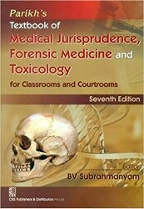
TEXT BOOKS & PRACTICAL NOTEBOOK:
Principles & Practice of Forensic Medicine.
by Nasib R. Awan
Parikh’s Textbook of Medical Jurisprudence,
Forensic Medicine & Toxicology.
Practical Manual Of Forensic Medicine
& Toxicology

Slide 39
Thank you

