Slide 1
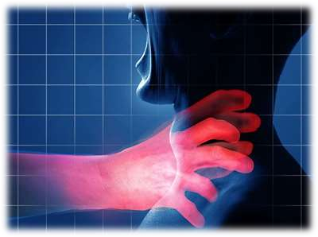
ASPHYXIA – II
HANGING & STRANGULATION
Dr Filza ali & Dr Shahida

Slide 2
MOTTO OF RMU

Slide 3
VISION OF RMU
THE DREAM/ TOMORROW
To impart evidence based research oriented medical education
To provide best possible patient care
To inculcate the values of mutual respect and ethical practice of medicine

Slide 4
PROF UMAR’S LGIS MODEL

Slide 5
LEARNING OBJECTIVES :
Students will be able to
Define Hanging and Strangulation.
Enlist various types of hanging and strangulation.
Briefly explain their pathophysiology and postmortem
findings.
State their medico-legal importance.
Differentiate between hanging and strangulation?

Slide 6
SEQUENCE OF LGIS
Learning Objectives
Core concept 70 %
Horizontal integration related to Pathology and Pharmacology 15 %
Relevant clinical concepts and medico legal application of core knowledge / Vertical integration 10%
Research article relevant to the topic 3%
Ethics and family medicine 2%

Slide 7
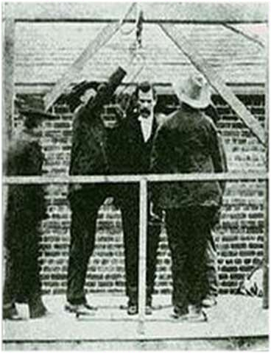
HANGING
Core Concept
Form of death produced by suspending the body
with a ligature round the
neck and the constricting
force is weight of the body.
Commonly used ligatures
are rope, turban, dhoti, dupatta, belt, or anything that is available at the scene.

Slide 8
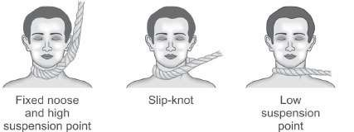
TYPES OF HANGING
Core Concept
On the basis of KNOT
Typical hanging
Atypical hanging
On the basis of SUSPENSION
Complete hanging
Partial or incomplete hanging
Other Types
Judicial hanging
Lynching
Accidental hanging

Slide 9
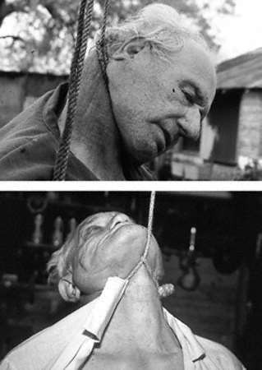
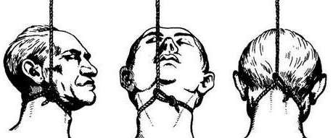
ON THE BASIS OF SUSPENSION:
Core Concept
Typical hanging…...Knot is at the nape of neck.
Atypical hanging……Knot is at
point other than nape of neck. The most common point of suspension is the side of the neck followed by the back and the front.
At the time of suspension, the noose typically slips above the larynx, catching under the chin.

Slide 10
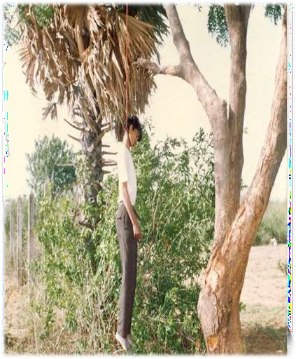
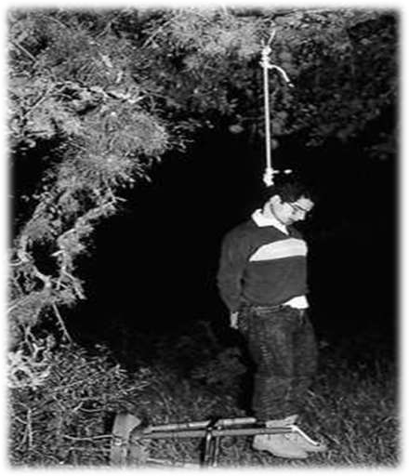
COMPLETE HANGING
Core Concept

Slide 11
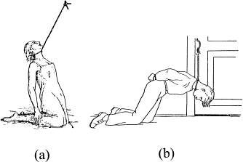
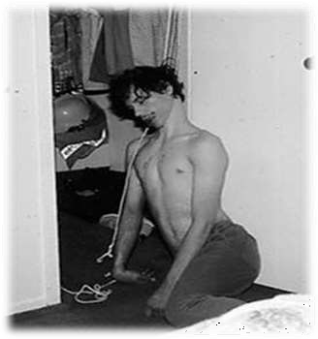
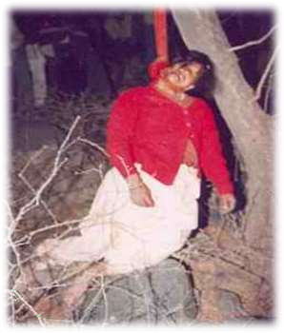
PARTIAL HANGING
Core Concept

Slide 12
LYNCHING:
Core Concept
Lynching is a condition in which several persons acting jointly and illegally overpower an individual and hang him by means of a rope to a tree or some similar object.

Slide 13
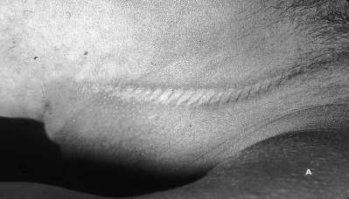
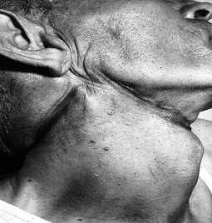
THE FURROW
Core Concept
Mark of ligature present on the neck is a furrow.
This furrow generally does not completely encircle the neck, but rather slants upward toward the knot, fading out at the point of suspension (the knot).
To clarify of the furrow, depend on the material used.

Slide 14
Core Concept
If the ligature is a hard material
i.e. rope, it will give deep, well- demarcated, distinct furrow, often
with a mirror-image impression of the twist of the rope on the skin.
If the ligature is a soft material, the groove might be poorly defined, pale, and devoid of bruises and abrasions.

Slide 15
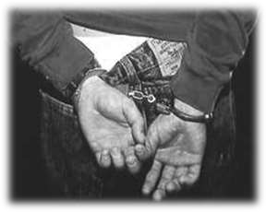
MATERIAL USED AS LIGATURE:
Core Concept
Most common are Ropes, Electrical cords Belts.
In jails and prisons, convicts typically tear sheets into strips as well as using T-shirts, undershorts, trousers, or even socks.
Usually, to prevent a change of mind, the victim ties his hands together.

Slide 16
CAUSE OF DEATH IN HANGING
Core Concept
Injury to spinal cord.
Sudden stoppage of heartbeat due to vasovagal inhibition.
Occlusion of the airways.
Occlusion of jugular veins.
Occlusion of carotid arteries.
Fracture or dislocation of cervical vertebrae

Slide 17
POSTMORTEM FINDINGS IN HANGING
Vertical Integeration
Ligature marks on the neck dried.
Dribbling of saliva at angle of mouth.
Hyoid bone fracture.
Swollen face with protruded eyes and tongue
Passage of urine, feaces or seminal fluid.

Slide 18
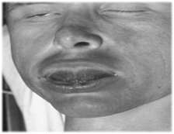
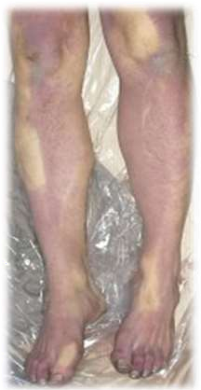
Vertical Integeration
Core Concept
Absence of petechiae in most hangings is because there is complete obstruction of the arterial system, so there is no pooling of blood in the head, no increased pressure, and, therefore, no petechial hemorrhages.
In hanging, blood will pool in the dependent areas of the body, usually the forearms, hands, and lower legs, secondary to gravity because of hydrostatic rupture of vessels

Slide 19
MEDICOLEGAL IMPORTANCE OF HANGING
Vertical Integeration
Core Concept
Hanging is mostly of Suicidal nature.
Cases of Homicidal hanging are less frequently found because it is impossible to control a person while he is alive.
In case of homicidal hanging we find traces of drugs, injury on the body which is firstly used to incapacitate the person.
Accidental hanging cases are also frequent.

Slide 20
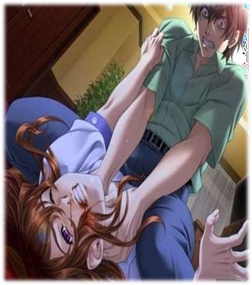
STRANGULATION
Core Concept
Strangulation is a form of asphyxia
It is a violent form of death, which results from constricting the neck by means of a ligature or any other means without suspending the body.

Slide 21
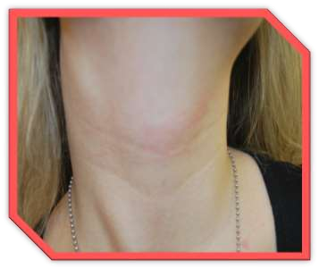
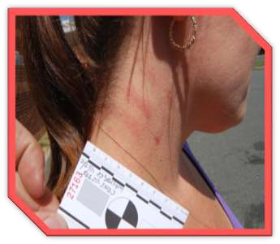
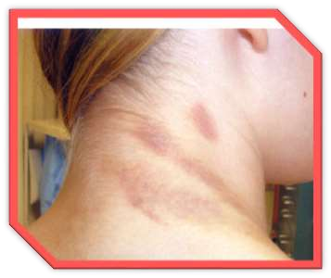
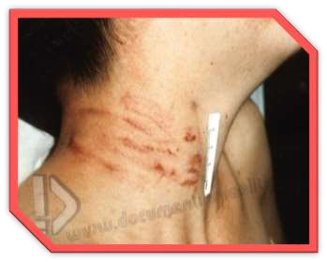
STRANGULATION MARKS
Core Concept

Slide 22
TYPES OF STRANGULATION
Core Concept
THROTTLING:
when constriction is produced by
the pressure of the fingers and the palms.
GARROTING:
Loop of thin string thrown from back and tightened.
BANSDOLA:
Neck compressed between two bamboo sticks.
MUGGING:
Pressure upon neck by arm around
the throat.

Slide 23
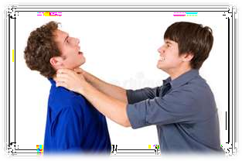
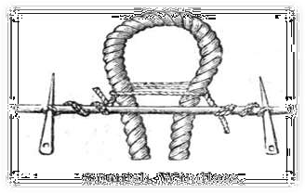
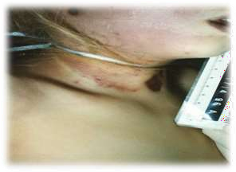
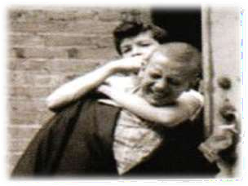
TYPES OF STRANGULATION
Core Concept
Throttling
Bansdola
Garroting
Mugging

Slide 24
LIGATURE STRANGULATION
Core Concept
The pressure upon the neck may be affected by compressing whole or a part of the circumference of neck by a ligature.
CAUSE OF DEATH
Vagal inhibition
Venous constriction
Airway obstruction

Slide 25
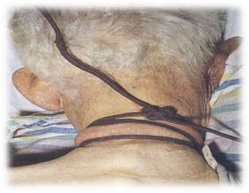
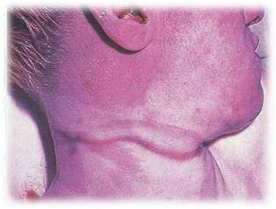
LIGATURE MARK
Core Concept
Appearance: depends mainly upon the nature of the ligature material.
Ligature marks are most distinct in cases where the ligature used is made of hard material such as a rope or wire.
Ligature mark may be indefinite where the ligature used is made of soft material.

Slide 26
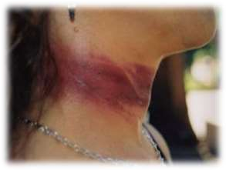
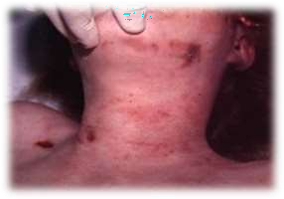
Core Concept
Color : Ligature marks are brown & dry at the time of examination.
Injuries : Abrasions & bruises of the surrounding skin are commonly found around them caused by the victims finger nails to release the ligature.
Number: A single external ligature mark is usually present on the neck, but more than one mark may be found.
Shape: These marks take the form of linear depression in the skin.

Slide 27
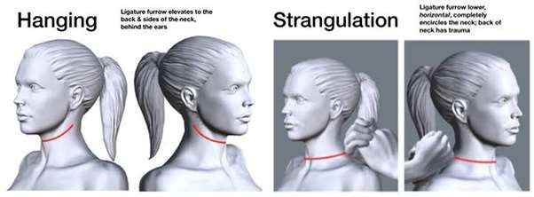
Core Concept
Situation : They are situated in any region of neck but usually found over the lower point of the larynx & upper part of the trachea i.e. below thyroid cartilage.
Direction : These marks are directed transversally across the neck.

Slide 28
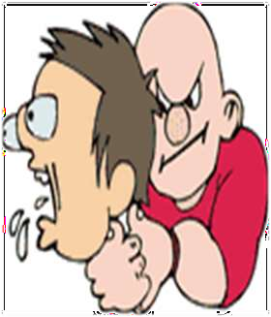
MANNUAL STRANGULATION
Core Concept
THROTTLING
Throttling or manual strangulation is the application of force to the neck of a person by pressure from the hands or forearm of another person.
Catching or grasping of neck at the location of carotid sinus by the hand. This cause sudden cardiac arrest due to vaso vagal inhibition the death is sudden in this case

Slide 29
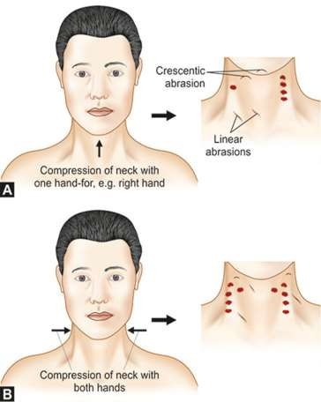
GENERAL FINDINGS
Core Concept
Cutaneous abrasions
Cutaneous bruising
Bruising into large structures of neck
Injuries to hyoid bone and larynx

Slide 30
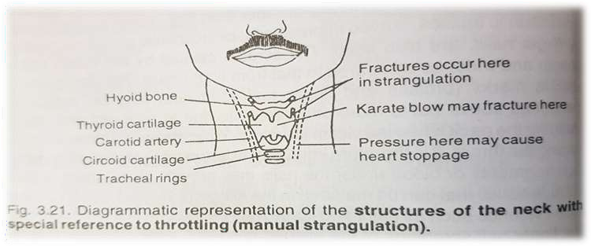
INJURIES TO THE TISSUES OF NECK
Core Concept
Dissection of the neck reveals bruising of the connective & muscular tissues,
Injuries to the hyoid bone & the laryngeal cartilages.
Fracture of the hyoid bone occur.

Slide 31
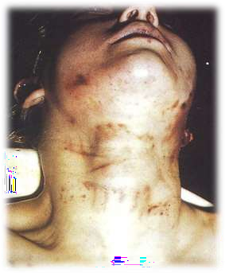
DEFENSIVE INJURIES ON VICTIM
Core Concept
Offender may be injured as the victim tries to defend himself.
Scratch marks on face, hands and/or arms with frontal strangulation
Bite marks on hands when mouth is covered or attempted to cover during chokehold
Bite marks/scratches to chest/arms when victim tries to escape being held down.

Slide 32
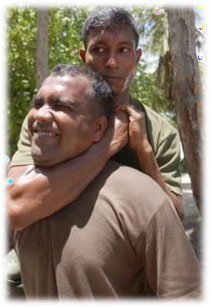
MUGGING
Core Concept
Caused by pressure upon the neck by the arm held around the throat
Attack is usually made from behind, the neck being trapped in the crook of the elbow and pressure exerted when the front and sides of the larynx get squeezed

Slide 33
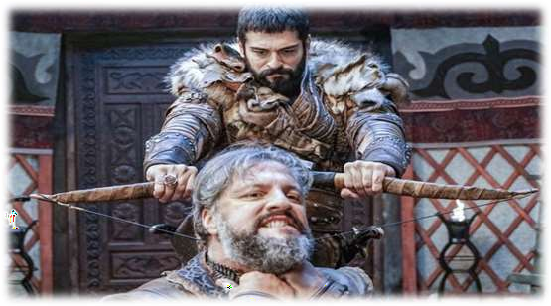
GARROTING
Core Concept
In this, a loop of thin string is thrown around the the victim, who is attacked from his back
neck of
This ligature is then rapidly tightened with the help of two sticks tied at the free ends of the string so as to constrict the neck strongly

Slide 34
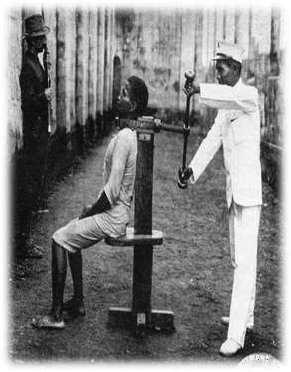
BANSDOLA
Core Concept
In this the neck is
compressed in
between two bamboos
or other
the other
sticks, one in front and
behind the neck.
The ends of the sticks are tied with a rope through which the victim is squeezed to death
Sometimes only foot can be used while the victim is thrown on the ground

Slide 35
CAUSE OF DEATH IN STRANGULATION
Core Concept
Death is usually caused by Hypoxic anoxia by applying pressure on the sides of neck which may constrict the larynx & prevent the free passage of air down the respiratory tract this results in hypoxic hypoxia which can lead to rapid death.
Reflex cardiac arrest which is induced by compression of the carotid sinuses during manual strangulation. .

Slide 36
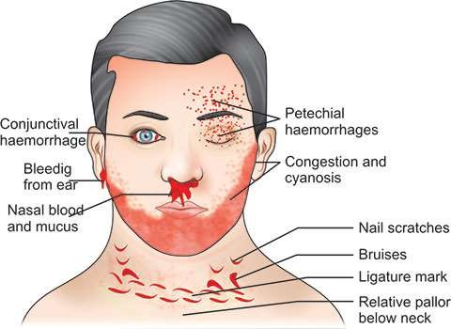
POSTMORTEM FINDINGS IN STRANGULATION
Vertical Integeration
General findings
External
Internal
The ligature mark
Non specific pathological findings

Slide 37
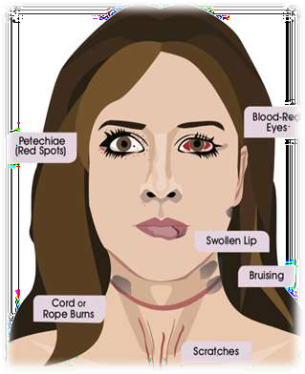
GENERAL FINDINGS
Core Concept
Vertical Integeration
External Findings
Face is swollen and blotchy.
Eyes usually suffused and bulging.
Tongue is swollen, protruding and caught between teeth.
Ligature mark which commonly depends upon the size, type, form, etc. of the ligature.
The thinner the ligature more deep will be the mark.

Slide 38
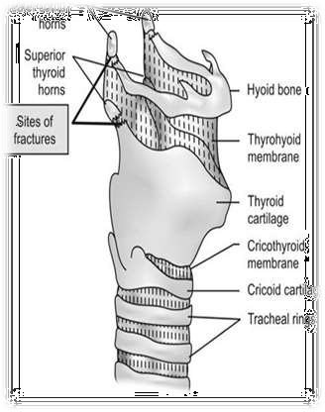
Internal Findings
Vertical Integeration
Bruising of the soft tissue of neck and muscles specially underneath the ligature mark.
Injuries to blood vessels are rare in this situation.
Injuries to hyoid bone are not commonly seen.
Thyroid cartilages are fractured.

Slide 39
NON-SPECIFIC PATHOLOGICAL FINDINGS
Horizontal Integration
CCFPP
Congestion
Cyanosis of lips and face
Fluidity of blood
Petechial hemorrhages in conjunctivae and in
skin of face and neck
Pulmonary edema

Slide 40
Vertical Integeration

Slide 41
MEDICOLEGAL IMPORTANCE OF STRANGULATION
Vertical Integeration
Death from throttling is almost Homicidal. It occurs in the course of assaults, robbery & rape.
Cause of Accidental have been recorded where firm pressure has been suddenly applied to the neck of a person causing deaths by a reflex cardiac arrest. i.e.
In case of infants at time of birth.
Children may strangled while playing.
While working near a machine one can strangled.
Suicidal throttling is not possible.

Slide 42
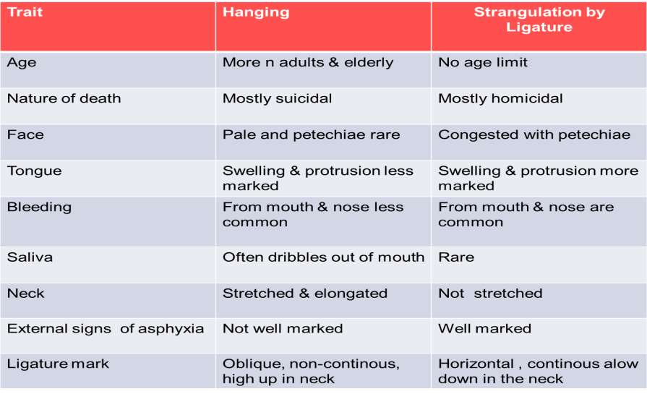
DIFFERENCE B/W HANGING & STRANGULATION
Core Concept

Slide 43
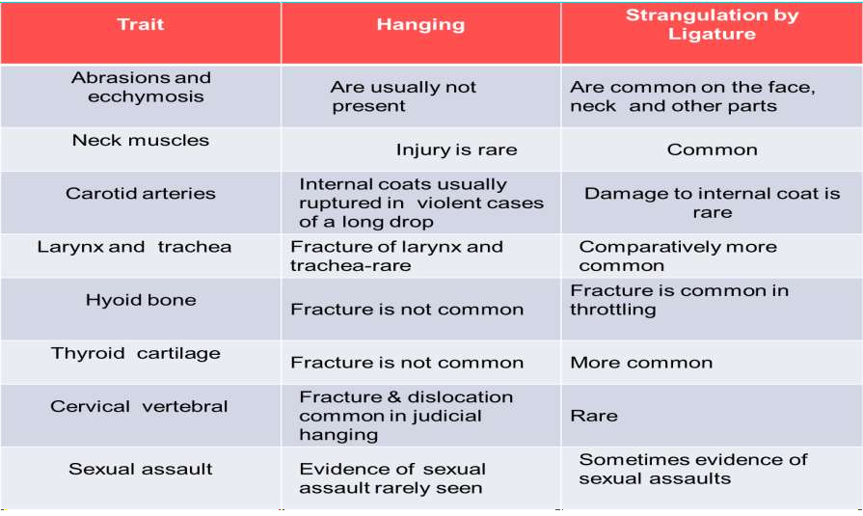
DIFFERENCE B/W HANGING & STRANGULATION
Core Concept

Slide 44
RESEARCH
RESEARCH
https://pubmed.ncbi.nlm.nih.gov/16738432/#:~:text
=Males%20constitute%2079.8%25%20of%20all,of% 20all%20asphyxial%20deaths%2C%20respectively.
https://pjmhsonline.com/2021/august/2148.pdf
https://apims.net/index.php/apims/article/view/276
https://www.duhs.edu.pk/download/jduhs-vol.6-issue- 3/rp3.pdf
https://emedicine.medscape.com/article/1988699- overview

Slide 45
BIOMEDICAL ETHICS
ETHICS
The determination of a patient's death is of considerable medical and ethical significance.
Death is a biological concept with social implications.
Acting with honesty, transparency, respect, and integrity is critical to trust in the patient- physician relationship, and the profession, in life and in death.

Slide 46
FAMILY MEDICINE
FAMILY MEDICINE
Some treatments for asphyxiation include:
Cardiopulmonary resuscitation (CPR)
Oxygen therapy.
Heimlich maneuver is a first aid technique for choking. It uses abdominal thrusts below the diaphragm to remove a foreign object from a person’s airways.
iv. Medication can help to ease the effects of severe asthma attack.
iii.

Slide 47
How to use HEC Digital Library
Go to the website of HEC National Digital Library
http://www.digitallibrary.edu.pk
On Home Page, click on the INSTITUTES.
A page will appear showing the universities from Public and Private Sector and other Institutes which have access to HEC National Digital Library (HNDL).
Select your desired Institute.
A page will appear showing the resources of the institution
Journals and Researches will appear
You can find a Journal by clicking on JOURNALS AND DATABASE and enter a keyword to search for your desired journal

Slide 48
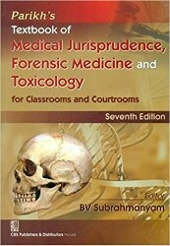
TEXT BOOKS & PRACTICAL NOTEBOOK:
Principles & Practice of Forensic Medicine.
by Nasib R. Awan
Parikh’s Textbook of Medical Jurisprudence,
Forensic Medicine & Toxicology.
Practical Manual Of Forensic Medicine
& Toxicology

Slide 49
THANK YOU

