Slide 1

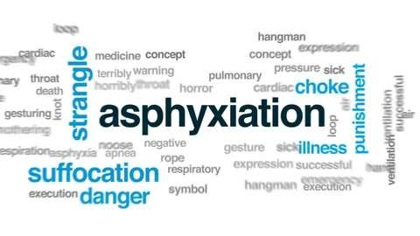
ASPHYXIA – I
Dr. Filza Ali Dr.Urooj
Forensic medicine and toxicology

Slide 2



Slide 3



Motto of RMU

Slide 4



Vision of RMU
The Dream/ Tomorrow
To impart evidence based research oriented medical education
To provide best possible patient care
To inculcate the values of mutual respect and ethical practice of medicine

Slide 5
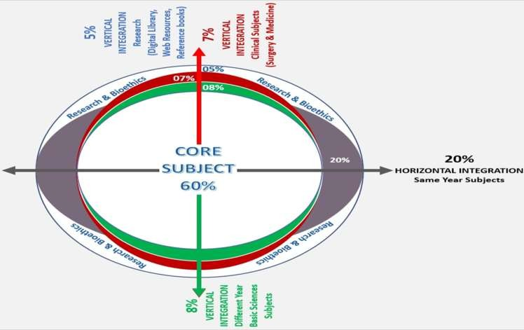
Prof Umar’s LGIS Model

Slide 6
Learning Objectives:
By the end of class students will be able to:
Define Asphyxia and anoxia.
Classify different types of asphyxia.
Describe the patho-physiology and biochemistry of asphyxia.
Briefly explain the clinical effects of asphyxia.

Slide 7
SEQUENCE OF LGIS
Learning Objectives
Core concept 70 %
Horizontal integration related to Pathology and Pharmacology 15 %
Relevant clinical concepts and medico legal application of core knowledge / Vertical integration 10%
Research article relevant to the topic 3%
Ethics and family medicine 2%

Slide 8
Definition:
Core Concept
“Asphyxia is defined as the result of interference with the process of transfer of O₂ to the lungs.”
“A condition arising when the body is deprived of oxygen, causing unconsciousness or death; suffocation.”
Hypoxia is a condition in which the body or a region of the body is deprived of adequate oxygen supply at the tissue level

Slide 9





Classification of Asphyxia:
Core Concept
Iatrogenic Asphyxia
Toxic Asphyxia
Mechanical Asphyxia
Pathological Asphyxia
Environmental Asphyxia

Slide 10
Classification of Asphyxia:-
Core Concept
Mechanical Asphyxia:-
Airway is blocked both within & without in an unnatural way.
Pathological Asphyxia:-
Transfer of O₂ to lungs is prevented by the disease of upper respiratory passage.

Slide 11
Classification of Asphyxia:-
Core Concept
Toxic Asphyxia:-
Poisonous substances prevent uptake of O₂.
Iatrogenic:-
Doctor’s negligence.
Environmental Asphyxia:-
Insufficient O₂ in inspired air as in deep well
exposure to methane gas.

Slide 12
Mechanical asphyxia:-
Core Concept
Obstruction of the air passages in an unnatural way either from within or by exerting pressure from outside
It is the most important type of asphyxia from medico legal point of view
It can further be divided into different types according to the five levels of obstruction

Slide 13
Classification of Mechanical Asphyxia
Core Concept
Level of Obstruction | Type of Mechanical Asphyxia
Nose & Mouth | Suffocation (Smothering/Gagging)
Glottis | Hanging
Larynx & upper trachea | Strangulation, Throttling
Trachea or main bronchus | Choking
Muscles of respiration | Traumatic asphyxia

Slide 14
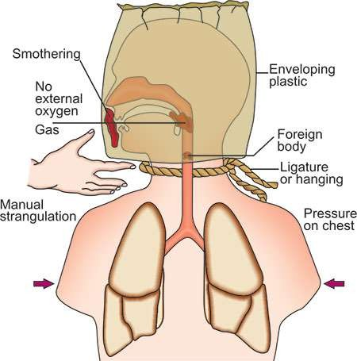
Types of Mechanical Asphyxia:
Core Concept

Slide 15
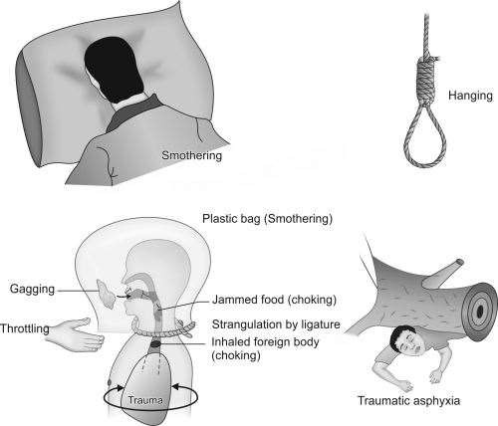
Types of Mechanical Asphyxia:
Core Concept

Slide 16
Anoxia
Core Concept
This term may be defined as the result interference with oxygenation of tissue. While Asphyxia is interference with the process of transfer of O₂ to the lungs.
An absence or deficiency of oxygen reaching the tissues; severe hypoxia.

Slide 17
Types of Anoxia
Core Concept
O₂ can not gain excess to blood stream e.g. all mechanical Asphyxias, breathing inert gases (Nitrogen, Helium)
Anoxic Anoxia
Reduced O₂ carrying capacity of the blood (CO poisoning)
Anaemic Anoxia
Impaired circulation resulting in reduction of O₂ delivery (Shock)
Stagnant Anoxia
Body cells are unable to use O₂ which is available to them (Cyanide
poisoning)
Histotoxic Anoxia

Slide 18







Biochemistry of Asphyxia
Core Concept
Replacement of Na, K in the tissue.
Reduction in O₂ conc
Increase in Blood sugar
Increase in Co₂ conc
Increase In cortisol
Ph to acid side – lactic acid increased
Hypoxanthine level is increased

Slide 19
Physiology Of Asphyxia:-
Stage 1:-
Core Concept
Obstruction leading to hypoxia accumulation of CO₂ cyanosis.
Stimulation of respiratory center
Respiratory movements quickens both in rate & amplitude.
Blood pressure & pulse rate unchanged.

Slide 20
Stage 2:-
Core Concept
Struggle to breath expiratory type of breathing.
Deep cyanosis.
Veins of neck get swollen.
Congestion of face and other organ
Unconsciousness
Breathing more laboured.
Convulsion.

Slide 21
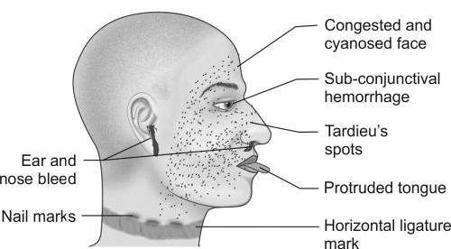
Stage 3:-
Core Concept
Unconsciousness deepens
Breathing slow.
Pupils dilated.

Slide 22
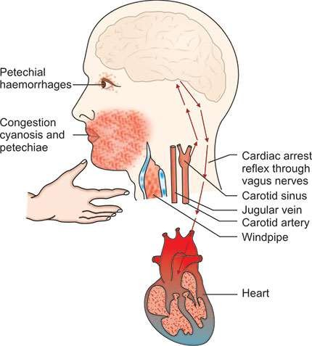
Pathology of Asphyxia:-
Core Concept
CCFPP
Congestion
Cyanosis
Fluidity of blood
Petechial haemorrhage
Pulmonary oedema
s

Slide 23
Clinical Effects Of Asphyxia:
Core Concept
Cyanosis
due to formation of reduced-Hb)
Patechiae (Tardieu spots
due to increased intravenous pressure
Oedema and stasis
due to increased capillary permeability
Pressure upon the chest
Leading to mismatch between right & left
ventricular working
Pressure around the neck
Causing obstructed venous return from the
head and neck
Obstruction in the respiratory passage
due to any indirect rise in intra thoracic
pressure.

Slide 24
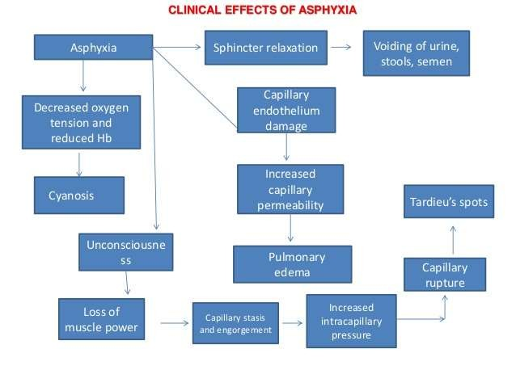
Clinical Effects Of Asphyxia:
Core Concept

Slide 25
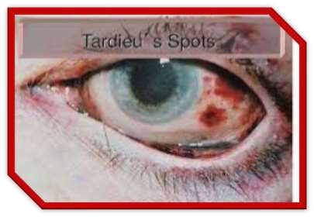
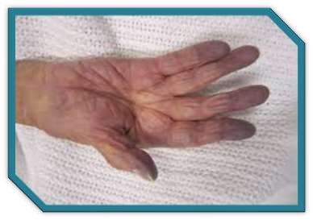
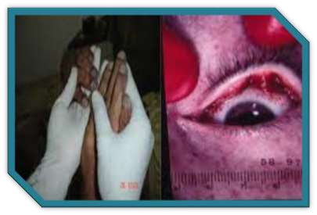
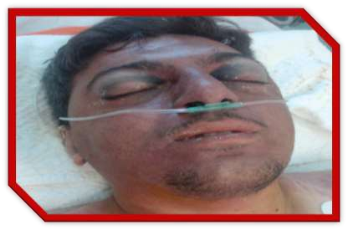
Clinical Effects Of Asphyxia:
Core Concept

Slide 26
Fatal period:-
Core Concept
03 to 4 minutes
Anoxic Anoxia:-
O₂ can not gain excess to blood stream.
Anemic Anoxia:-
Blood is incapable of carrying sufficient quantity of oxy- hemoglobin to the tissue or Blood is either deficient in Hb Stagnant Anoxia:-
Circulatory failure Hemorrhage.
Histotoxic Anoxia:-
Body cells are unable to use O₂ which is available to them

Slide 27

Research
RESEARCH
https://pubmed.ncbi.nlm.nih.gov/16738432/#:~:text= Males%20constitute%2079.8%25%20of%20all,of%2 0all%20asphyxial%20deaths%2C%20respectively.
https://pjmhsonline.com/2021/august/2148.pdf
https://apims.net/index.php/apims/article/view/276
https://www.duhs.edu.pk/download/jduhs-vol.6-issue- 3/rp3.pdf
https://emedicine.medscape.com/article/1988699- overview

Slide 28
Biomedical Ethics
ETHICS
The determination of a patient's death is of considerable medical and ethical significance.
Death is a biological concept with social implications.
Acting with honesty, transparency, respect, and integrity is critical to trust in the patient-physician relationship, and the profession, in life and in death.

Slide 29
Family Medicine
Family Medicine
Some treatments for asphyxiation include:
Cardiopulmonary resuscitation (CPR)
Oxygen therapy.
Heimlich maneuver is a first aid technique for choking. It uses abdominal thrusts below the diaphragm to remove a foreign object from a person’s airways.
iv. Medication can help to ease the effects of severe asthma attack.
iii.

Slide 30
How to use HEC Digital Library
Go to the website of HEC National Digital Library
http://www.digitallibrary.edu.pk
On Home Page, click on the INSTITUTES.
A page will appear showing the universities from Public and Private Sector and other Institutes which have access to HEC National Digital Library (HNDL).
Select your desired Institute.
A page will appear showing the resources of the institution
Journals and Researches will appear
You can find a Journal by clicking on JOURNALS AND DATABASE and enter a keyword to search for your desired journal

Slide 31
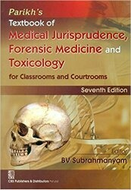
TEXT BOOKS & PRACTICAL NOTEBOOK:
Principles & Practice of Forensic Medicine.
by Nasib R. Awan
Parikh’s Textbook of Medical Jurisprudence,
Forensic Medicine & Toxicology.
Practical Manual Of Forensic Medicine
& Toxicology

Slide 32
THANK YOU

