Slide 1
Approach to A patient with Dyspepsia
Dr. Tayyab Saeed Akhter
MBBS; FCPS
Consultant Medical Specialist
Gastroenterologist and Hepatologist.
Senior Registrar
Center for Liver & Digestive Diseases;
Holy family Hospital Rawalpindi.
Chief Medical Officer
Shifa4u: American Telephysician Project.
Faculty Learna University of South wales UK

Slide 2
What Does This Picture Depicts?
Notes:
Gagné’s event 1: Gain attention of the students

Slide 3
Learning Objectives
At the end of one- hour lecture session by using the power point presentation, 3rd year medical students should be able to
define Dyspepsia
discuss the pathophysiology of dyspepsia
define Functional Dyspepsia
illustrate an approach towards dyspeptic patients
discuss the therapeutic options for dyspeptic patients
Notes:
Gagné’s event 2: Inform students of the objectives

Slide 4
How many of you have experienced pain or discomfort in their epigastrium in the last one month?
Kindly raise your hand to share the experience….
Notes:
Gagné’s event 3: Stimulate recall of prior learning

Slide 5
Dyspepsia
CORE CONCEPT
The term dyspepsia comes from the Greek words dys (poor) and pepsis (digestion).
Dyspepsia (DP) refers to chronic or recurrent pain or discomfort located in the central part of the upper abdomen (epigastrium).
It is often replaced incorrectly by the terms “chronic gastritis” or “acid-peptic disease.”
Notes:
Gagné’s event 4: Present the content

Slide 6
Dyspepsia
CORE CONCEPT
Approximately 15% to 40% of the population have chronic or recurrent symptoms of dyspepsia which have gone uninvestigated.
In some countries it has been found that the annual incidence is about 1%, and it is estimated that one in two people will consult with a physician at some point in their life about dyspeptic symptoms.
Dyspepsia accounts for 5% of general practice consultation and about 20% to 30% of gastroenterology consultations.
Halder SLS, Talley NJ. Functional Dyspepsia: A New Rome III Paradigm. Curr Treat Options Gastroenterol. 2007;10(4):259-72.
Graham DY, Rugge M. Clinical practice: diagnosis and evaluation of dyspepsia. J Clin Gastroenterol. 2010;44(3):167- 72.
Talley NJ, Vakil NB, Moayyedi P. American gastroenterological association technical review on the evaluation of dyspepsia. Gastroenterology. 2005;129(5):1756-80.
Talley NJ, Vakil N, Practice Parameters Committee of the American College of Gastroenterology. Guidelines for the management of dyspepsia. Am J Gastroenterol. 2005;100(10):2324-37.
Notes:
Gagné’s event 4: Present the content

Slide 7
Digestion involves multilevel coordination
SPIRAL INTEGRATION
Notes:
Gagné’s event 5: Provide learning guidance - concept mapping and visualizing

Slide 8
Physiology Of Gastric Acid Secretion & Digestion
SPIRAL INTEGRATION
3 phases
Sight, smell, taste or thought of food activate enteric neurons via vagus.
Food stretches stomach walls activating neural reflex to stimulate acid secretion. Peptides & amino acids stimulate G cells to release Gastrin*.
Food acts as a buffer, raising pH & thus removing the stimulus for somatostatin secretion.
Cephalic Phase
Intestinal phase
Gastric Phase
Once Chyme enters the duodenum, it activates negative feedback mechanisms to reduce acid secretion
*Note:
The major effect of Gastrin is indirect via histamine from ECL cells not through direct parietal cell stimulation.
Notes:
Gagné’s event 4: Present the content

Slide 9
Physiology Of Gastric Acid Secretion & Digestion
SPIRAL INTEGRATION
Notes:
Gagné’s event 5: Provide learning guidance – provide analogies for knowledge construction and visual images to make visual associations

Slide 10
Physiology Of Gastric Acid Secretion from Parietal Cell
SPIRAL INTEGRATION
Notes:
Gagné’s event 5: Provide learning guidance – provide analogies for knowledge construction and visual images to make visual associations
Gagné’s event 6: Elicit performance (practice) - Elicit recall strategies – ask students to revisit information they have learned

Slide 11
Dyspepsia is imbalance between Protective & Aggressive Factors
CORE CONCEPT
Let us have an imaginary Tug of war between the students on the right(Aggressive factors) and students on the left(Protective factors).
Protective factors
Aggressive factors
Gastric mucus
Bicarbonates
Prostaglandins
Blood Supply
Acid & pepsin
H. Pylori
Irritation
NSAIDS
Notes:
Gagné’s event 6: Elicit performance (practice) - Elicit student activities – ask deep-learning questions, make reference to what students already know or have students collaborate with their peers Gagné’s event 5: Provide learning guidance - as scaffolds (cues, hints, prompts) which will be removed after the student learns the task or content

Slide 12
Pathophysiology Of Dyspepsia/FD
SPIRAL/HORIZONTAL INTEGRATION
Notes:
Gagné’s event 4: Present the content

Slide 13
Functional Dyspepsia
CORE CONCEPT
When gastrointestinal endoscopy and hepatobiliary ultrasound (when indicated) reveal no organic pathologies, the diagnosis is FD.
Since the Rome III consensus, FD has been divided into two categories:
FD with pain
FD with postprandial distress
Notes:
Gagné’s event 4: Present the content

Slide 14
A Real Life Situation
VERTICAL INTEGRATION
One of your aunt recently visited your house and started discussing her health-related issues. She is 45 years old and over the past 2 years she often had epigastric pain with burning sensation. Her abdomen is always bloated and distended. She denies any weight loss, fevers, nausea, vomiting or fecal incontinence, but does complain of inability to complete her meals because of early satiety. In the past she had tried a lactose free diet but had no improvement in symptoms. Previous evaluation as included normal stool testing for H. Pylori.
How will you guide your Aunt for her chronic symptoms?
Notes:
Gagné’s event 6: Elicit performance (practice) - Help students integrate new knowledge – provide content in a context-rich way (use real-world examples)
Gagné’s event 7: Provide feedback - Remedial feedback – Directs students in the right direction to find the correct answer but does not provide the correct answer

Slide 15
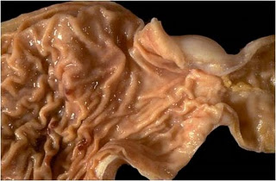
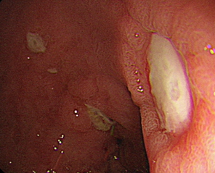
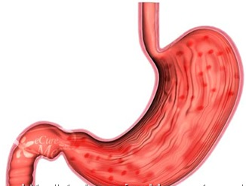
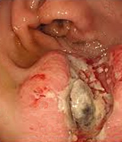
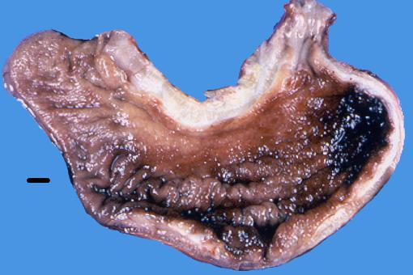
Spectrum Of Dyspepsia
HORIZONTAL INTEGRATION
Idiopathic or functional dyspepsia (70%)
Acute Gastritis / Erosions/ Ulcers
Chronic Gastritis(Type A or B) / Ulcers
Gastric Carcinoma
Notes:
Gagné’s event 5: Provide learning guidance - concept mapping and visualizing

Slide 16
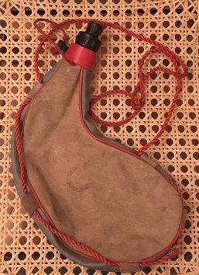
A Leather Botte Stomach – “Linitis Plastica”
HORIZONTAL INTEGRATION
A Dyspeptic patient can have an underlying Carcinoma of Stomach
Notes:
Gagné’s event 6: Elicit performance — Facilitate student elaborations – ask students to elaborate or explain details and provide more complexity to their responses

Slide 17
Approach to Dyspepsia
VERTICAL INTEGRATION
Alarm Features or Red Flag Signs
Gastrointestinal bleeding
Unexplained anemia
Early fullness
Unexplained weight loss (more than 10% of normal weight)
Progressive dysphagia (choking) or odynophagia (painful swallowing)
Repeated vomiting
Lymphadenopathy
Gastrointestinal cancer in first-degree relatives
Palpable abdominal mass
Notes:
Gagné’s event 4: Present the content
Gagné’s event 5: Provide learning guidance -- Use examples and non-examples – in addition to providing examples, use non-examples to help students see what not to do or the opposite of examples

Slide 18
Quiz
A 58-year-old man presented with recent onset of epigastric burning that was precipitated by hunger or after heavy meal. His appetite was unchanged and his weight was stable. He was a non-smoker and did not consume alcohol. The patient took paracetamol only for a painful left hip. Investigations are shown below:
Hb 11g/dl, MCV 70fl, Ferritin 20iu/l
What is the next best management step in this case?
Notes:
Gagné’s event 8: Assess performance – Embedded quiz.

Slide 19
Quiz -- Answer
Upper GI Endoscopy as Age is >55 and patient is Anemic.
Notes:
Gagné’s event 7: Confirmatory feedback – Informs the student they did what he or she were supposed to do or Corrective and remedial feedback – informs the student the accuracy of their performance or response

Slide 20
Treatment Modalities
VERTICAL INTEGRATION
Life style Modification
Acid Suppression
Prokinetics
Anti depressants
Eradicate if positive for H. Pylori and not already treated
Notes:
Gagné’s event 4: Present the content

Slide 21
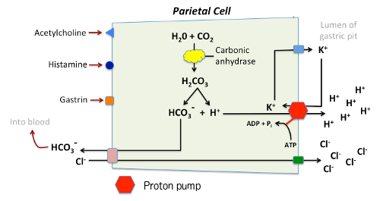
Acid Suppression
VERTICAL INTEGRATION
H₂ Receptor Blockers
PPIs
Notes:
Gagné’s event 6: Elicit recall strategies – ask students to revisit, or reiterate information they have learned , Help students integrate new knowledge – provide content in a context-rich way
Gagné’s event 5: Provide learning guidance – provide analogies for knowledge construction and visual images to make visual associations

Slide 22
Acid Suppression
VERTICAL INTEGRATION
H₂ Receptor Blockers
PPIs
Cannot provides 24 Hours pH control with once daily dose.
Delayed onset of action. (As long as 3 Hours)
Cimetidine, Ranitidine, Famotidine
Temoprazole 1970
Omeprazole 1980
Lansoprazole 1984
Pantoprazole 1988
Rabeprazole 1989
Esomeprazole 1999
Dexlensoprazole 2009
Notes:
Gagné’s event 4: Present the content -- Provide examples

Slide 23
Acid Suppression
VERTICAL INTEGRATION
PPIs
P-CAB
Notes:
Gagné’s event 6: Elicit recall strategies – ask students to revisit, or reiterate information they have learned , Help students integrate new knowledge – provide content in a context-rich way
Gagné’s event 5: Provide learning guidance – provide analogies for knowledge construction and visual images to make visual associations

Slide 24
Acid Suppression
VERTICAL INTEGRATION
PPIs
P-CAB
Potent potassium competitive acid blocker
Binds & inhibits H+,K+-ATPase at the final step in the acid secretory pathway in gastric parietal cells.
Vonoprazan 2015 (Japan)
Temoprazole 1970
Omeprazole 1980
Lansoprazole 1984
Pantoprazole 1988
Rabeprazole 1989
Esomeprazole 1999
Dexlensoprazole 2009
Notes:
Gagné’s event 4: Present the content -- Provide examples

Slide 25
RESEARCH
CONCLUSION: Efficacy of vonoprazan-based triple therapy is superior to that of PPI-based triple therapy
for first-line H. pylori eradication

Slide 26
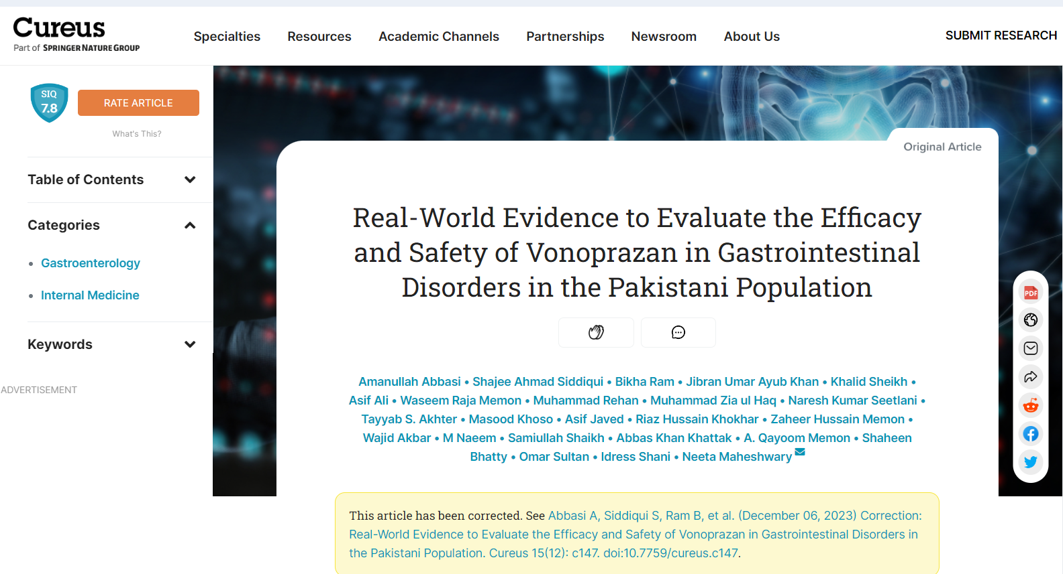
RESEARCH
First-ever National study on Vonoprazan
Real wOrld evideNce to evaluatE the effiCacy & safeTy of VonoPrazaN in Gastrointestinal disorders in Pakistani population
Submitted for Publication

Slide 27
RESEARCH
Key Findings:
n= 1642
Gerd Q Score at Baseline
Gerd Q Score at 4th week
20.37±15.87
3.70±6.31
H. Pylori positive at Baseline
H. Pylori Negative at 4th week After Therapy
735
667
H. Pylori eradication achieved
Patient’s condition improved
Acid regurgitation and heartburn-free days
Treatment compliance
90.74%
96.9%
>70%
78.13%

Slide 28
Treatment Strategy For Functional Dyspepsia
VERTICAL INTEGRATION
Eradicate if positive for H. Pylori and not already treated
FD with pain
FD with postprandial distress
Acid Suppressive Therapy
Prokinetic Agents
Acotiamide
5-HT1A agonists
Prokinetic Agents
Acotiamide
5-HT1A agonists
Acid Suppressive Therapy
Antidepressant if symptoms refractory
Notes:
Gagné’s event 4: Present the content – use flow sheet

Slide 29
Now back to the Real Life Situation
VERTICAL INTEGRATION
One of your aunt recently visited your house and started discussing her health-related issues. She is 45 years of age and over the past 2 year she often had epigastric pain with burning sensation. Her abdomen is always bloated and distended. She denies any weight loss, fevers, nausea, vomiting or fecal incontinence, but does complain of inability to complete her meals because of early satiety. In the past she has tried a lactose free diet but had no improvement in symptoms. Previous evaluation included normal stool testing for H. Pylori.
How will you guide you Aunt now for her chronic symptoms? Chart out a therapeutic strategy for her & Write down a prescription for your Aunt?
Notes:
Gagné’s event 9: Enhance retention and transfer to the job
Gagné’s event 8: Assess performance - Include criterion-referenced performances which measure how well a student has learned a topic

Slide 30
Your Aunt is suffering from FD with postprandial distress
VERTICAL INTEGRATION
Eradicate if positive for H. Pylori and not already treated
FD with postprandial distress
Life style Modification
Prokinetic Agents
Acotiamide
5-HT1A agonists
Acid Suppressive Therapy
Antidepressant if symptoms refractory
Notes:
Gagné’s event 7: Provide feedback -- Confirmatory feedback – Informs the student they did what he or she were supposed to do , Corrective and remedial feedback – informs the student the accuracy of their performance or response—

Slide 31
THANKS
For Correspondence:
tsaofpk@hotmail.com
tayyab.akhtar@shifa4u.com
03445220322
Department of Gastroenterology
Holy Family Hospital Rawalpindi

