Slide 1
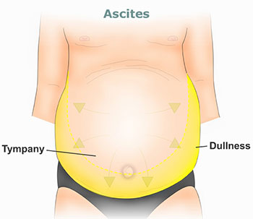
Approach To A Patient with Ascites
Dr.Sadia Ahmad
Assistant Professor Gastroenterology
RMU and Allied Hospitals

Slide 2
Ascites

Slide 3
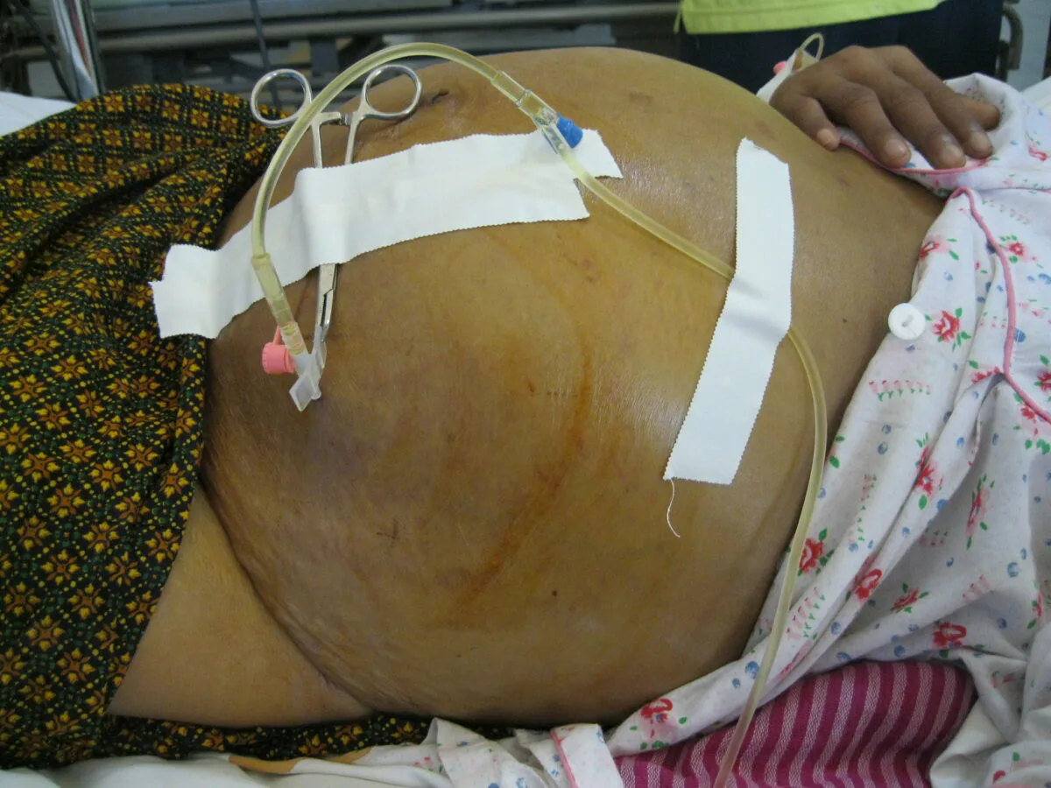
Learning Objectives:
At the end of this lecture students of 3rd year should know the
Definition
Pathophysiology
Etiology
Classification
Workup
Treatment
Complications
Prognosis of ascites

Slide 4
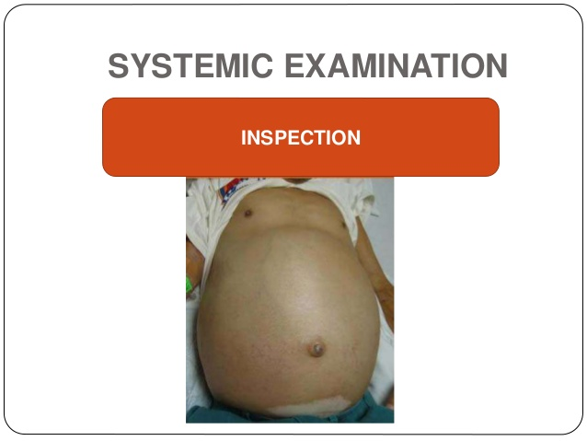
What is Ascites CORE CONCEPT
Accumulation of free fluid in the peritoneal cavity.
Abdominal distension
fullness in the flanks,
shifting dullness on percussion
fluid thrill/fluid wave.

Slide 5
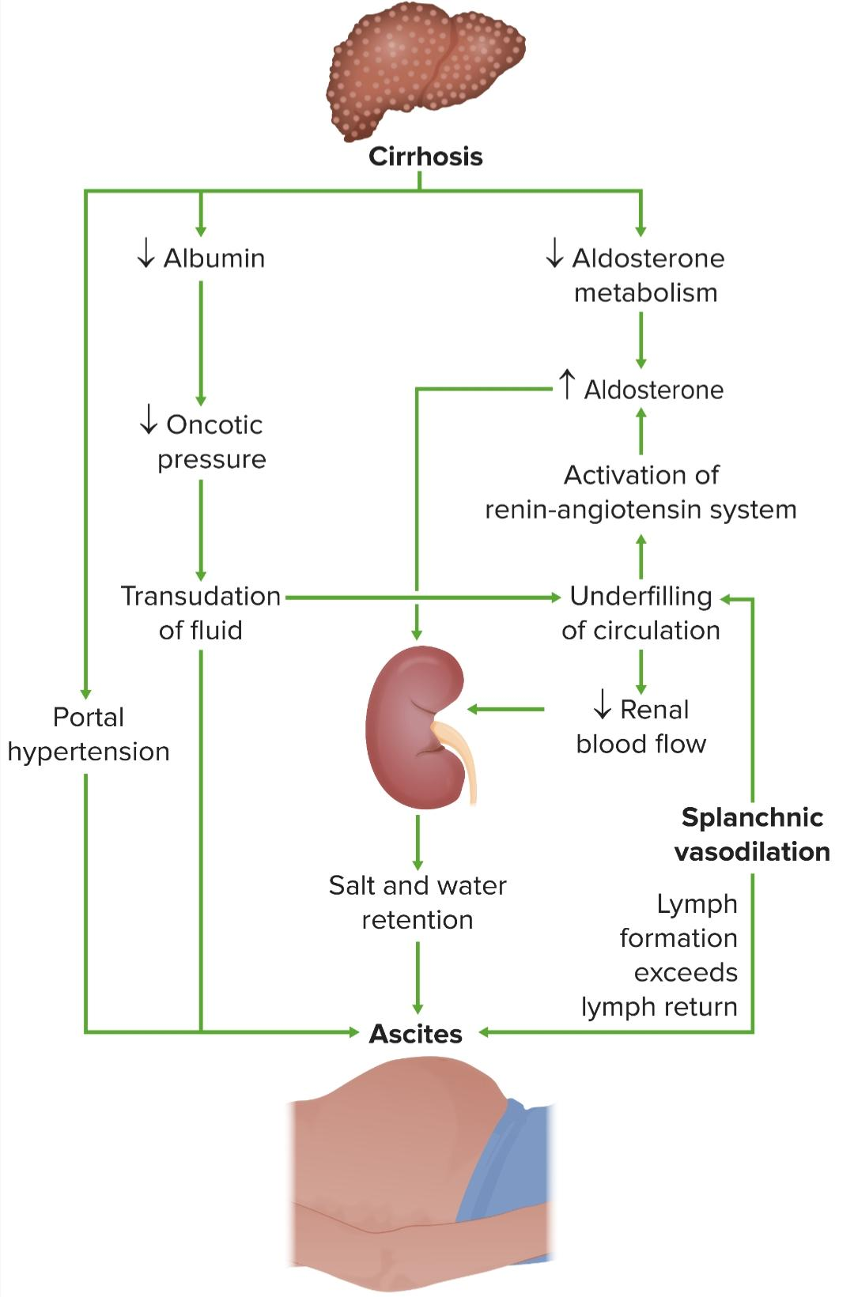
Pathogenesis

Slide 6
Grading of ascites CORE CONCEPT

Slide 7
Etiology CORE CONCEPT

Slide 8
Causes of Ascites: CORE CONCEPT

Slide 9
WORKUP
HISTORY:
AGE:
CHILD: TUBERCULOUS ASCITES AND NEPHROTIC SYNDROME
MIDDLE AGE: LIVER CIRRHOSIS
OLD AGE: MALIGNANCY
GENDER:
MALE: ALCOHOL ABUSE, DRUG ABUSE
FEMALE: MEIG SYNDROME, PELVIC TUMORS, INFECTION, OVARIAN TUMORS
CARDIAC CAUSES: LEG EDEMA PRECEDES ASCITES
RENAL CAUSES: FACIAL PUFFINESS PRECEDES ASCITES

Slide 10
Physical examination

Slide 11
CONGESTIVE CARDIAC FAILURE

Slide 12
NEPHROTIC SYNDROME

Slide 13
Diagnostic workup: VERTICAL INTEGRATION
Imaging: Ultrasound is highly sensitive can detect as little as 100 ml
CT scan: can differentiate benign from malignant ascites
Ascitic fluid Analysis:
After the diagnosis of ascites is made, its cause should be determined by laboratory analysis.
10-20 ml of ascitic fluid for routine analysis
Most common site---left lower quadrant
Other sites: in the midline between symphysis pubic and umbilicus and right iliac fossa
For cytology at least 50 ml of fluid required

Slide 14
Ascitic fluid analysis VERTICAL INTEGRATION

Slide 15
VERTICAL INTEGRATION

Slide 16
VERTICAL INTEGRATION

Slide 17
Treatment: VERTICAL INTEGRATION
High SAAG ( Transudate ) ascites:
Sodium and Water restriction:
Restriction of sodium intake to 100 mmol/24 hrs, (‘no added salt diet’) is usually adequate.
Restriction of water intake to 1.0–1.5 L/24 hrs is necessary only if the plasma sodium falls below 125 mmol/L .
2. Diuretics:
Spironolactone (100–400 mg/day) is the first-line Loop diuretics Furosemide (40-160mg)

Slide 18
VERTICAL INTEGRATION
Diuretic Refractory/Resistant ascites:
Patients who do not respond to doses of 400 mg spironolactone and 160 mg furosemide, or who are unable to tolerate these doses due to hyponatremia or renal impairment, are considered to have refractory or diuretic-resistant ascites and should be treated by other measures.

Slide 19
VERTICAL INTEGRATION
3. Large Volume Paracentesis
:First-line treatment of refractory ascites is large-volume paracentesis.
intravenous colloid such as human albumin (6–8 g per litre of ascites removed, usually as 100 mL of 20% or 25% human albumin solution (HAS).

Slide 20
VERTICAL INTEGRATION

Slide 21
VERTICAL INTEGRATION

Slide 23
Management of High SAAG ascites:

Slide 24
VERTICAL INTEGRATION Treatment of low SAAG ascites
Peritoneal carcinomatosis : therapeutic paracentesis
Tuberculous ascites: ATT
Ovarian tumors: surgery + chemotherapy
Nephrotic syndrome: steroids
Pancreatic ascites: endoscopic stenting, surgery, somatostatin
Malignancy: chemotherapy

Slide 25
Complications : VERTICAL INTEGRATION
Spontaneous bacterial peritonitis (SBP)
Hydrothorax
Hepatorenal syndrome
Inguinal/ umbilical hernia
Scrotal edema
Prognosis:
Only 10–20% of patients survive for 5 years from the first appearance of ascites due to cirrhosis.
The mortality at 1 year is 50% following the first episode of bacterial peritonitis

Slide 26
VERTICAL INTEGRATION Spontaneous Bacterial Peritonitis
Abdominal pain, rebound tenderness, absent bowel sounds and fever in a patient with obvious features of cirrhosis and ascites.
Diagnostic paracentesis: cloudy fluid, and an ascites neutrophil count of >250×106/L
Most common organism is E.coli.
Treatment should be started immediately with broad-spectrum antibiotics, such as cefotaxime or piperacillin/tazobactam).
Prophylaxis: quinolones, such as norfloxacin or ciprofloxacin.

Slide 27
LONGITUDINAL INTEGRATION

Slide 28
LONGITUDINAL INTEGRATION

Slide 29
Multiple Choice Questions
Question No.1 :
First line treatment of refractory ascites is?
Salt restriction
Diuretics
Water restriction
Large volume paracentesis
TIPSS

Slide 30
Question No.2
All of the following are causes of low SAAG (exudative) ascites except?
Cirrhosis
Tuberculosis
Pancreatitis
Malignancy
Nephrotic syndrome

Slide 31
Question No.3
A 45 years male recently diagnosed as cirrhosis secondary to HCV infection presented with abdominal distension. On examination he has shifting dullness positive. He has been advised salt and water restriction, how much salt restriction should be advised?
50 mmol/24 hours
20 mmol/24 hours
100 mmol/24 hours
60 mmol/24 hours
10 mmol/ 24 hours

Slide 32
Question No. 4
A 50 Years old female presented with abdominal distension. Examination revealed fluid thrill positive, prominent abdominal veins, clubbing and palmer erythema. Ascitic fluid examination revealed protein 2g/dl, straw colored and SAAG 1.6. What is most likely cause of ascites?
Cardiac failure
Liver cirrhosis
Nephrotic syndrome
Pancreatitis
Tuberculosis

Slide 33
Question No. 5
The first line diuretics for treatment of ascites in addition to salt restriction are?
Amiloride
Mannitol
Spironolactone
Bumetanide
Hydrochlorothiazide

