Slide 5
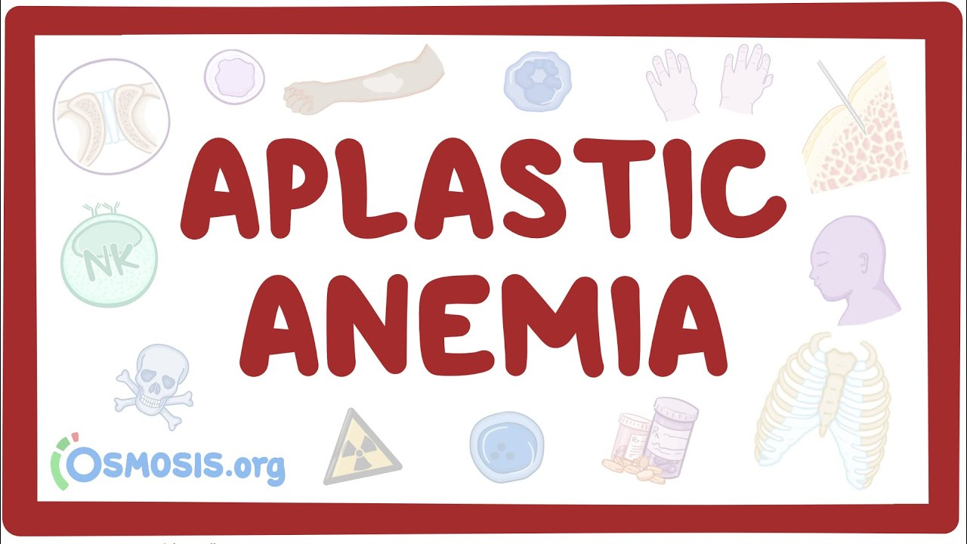
Aplastic Anemia
Dr Aqeela Ayub
Associate Professor Pediatrics

Slide 6
Learning Objectives:
By the end of this lecture:
Define Aplastic anemia
Types
Causes
Signs and symptoms
Diagnosis
Treatment
Complications
Prognosis.

Slide 7
core subject – 60% (15-20 )
Horizontal integration – 20% 5- 6 slides
Same year subjects surgery gynaecology
Vertical integration- 7% 2-3 slides
Physiology Anatomy Pathology
Spiral integration – 8 % Research / bioethics- 5%

Slide 8
Prof. Umar’s Model of Teaching Strategy Self Directed Learning Assessment Program
Objectives:
To cultivate critical thinking, analytical reasoning, and problem solving competencies.
To instill a culture of self-directed learning, fostering lifelong learning habits and autonomy.
HowtoAssess?
➢Ten randomly selected students will be evaluated within the first 10 minutes of the lecture through 10 multiple-choice questions (MCQs) based on the PowerPoint presentation shared on Students Official WhatsApp group, one day before the teaching session.
➢The number of MCQs from the components of the lecture will follow the guidelines outlined in the Prof. Umar model of Integrated Lecture.
Component of LGIS | Core knowledge | Horizontal integration | Vertical integration | spiral integration
No of MCQs | 6-7 | 1-2 | 1 | 1

Slide 9
Aplastic Anemia
Vertical Integration:
Review Anatomy
Review Physiology
Review Pathophysiology
Revise Embryology.

Slide 10
Anatomy Hematopoietic stem cells
Erythroid line
Myeloid line
Megakaryocyte line

Slide 11
Physiology

Slide 13
Aplastic Anemia - Definition
Aplastic anemia is a syndrome of bone marrow failure characterized by peripheral pancytopenia and marrow hypoplasia.
Decreased RBC production– Anemia
Decreased WBCs ------------- frequent infections
Decreased Platelets--------- Bleeds (bruises/ mucosa)

Slide 14
What is Marrow and its Failure:
Bone Marrow Failure is characterized by inadequate production of formed elements of blood.
Bone Marrow Failure may affect production of RBCs, WBCs, platelets separately or all three elements together.
Bone Marrow Failure results from failure to produce blood cells at different levels of maturation.
Bone Marrow Failure- may or may not be associated with hypoplasia of Bone Marrow.

Slide 15
Epidemiology:
Less common cause of anemia in children
Incidence- 1-5 children per million population per year.
Male: Female ratio = 1:1

Slide 16
Pathogenesis:
Hematopoietic stem cells may be deficient due to:
Acquired injury from viruses, toxins, chemicals
Immunological suppression (mediated by Ab, cytotoxic T cells)
Mutation in genes controlling hematopoiesis.

Slide 17
Types:
Congenital – 20%
Fanconi anemia
Dyskeratosis congenita
Shwachman – Diamond syndrome
Amegakaryocytic thrombocytopenia
Acquired – 80%
Idiopathic
Radiation
Drugs/ chemicals
infections

Slide 18
Radiation:
Marrow failure can be an acute sequale to radiations.
Nuclear accidents
Power plant workers
Employees of hospitals (food sterilization, metal radiography)

Slide 19
Drugs:
Agents producing marrow suppression in commonly employed doses:
Cytotoxic drugs
Alkylating agents
Antimetabolites
Antimitotics.
Some antibiotics
Chloramphenicol
Sulphonamides (idiosyncratic reaction)
Insecticides.
Agents that frequently produce marrow aplasia:
Benzene.

Slide 20
Infections:
Hepatitis virus
Non A
Non B
Non C
Hepatitis B and C.
Infectious mononucleosis
Parvovirus B 19
Human immune deficiency virus -HIV

Slide 21
Idiopathic:
Immune mediated.
Auto immune cytotoxicity.
T- lymphocytes cytokines suppress hematopoiesis.

Slide 22
Classification
Severe Aplastic anemia
Moderate Aplastic Anemia
Absolute neutrophil count less than 500/mm3
Platelet count less than 20,000/mm3
Reticulocyte count less than 1 %
Absolute neutrophil count between 500 and 1500/mm3
Platelet count between 20,000 to 1 lac/mm3
Reticulocyte count less than 1 %

Slide 23
Fanconi Anemia:
Genetic, autosomal recessive disorder.
Etiology– abnormal chromosomal fragility and breaks.
Clinical presentation–
Phenotypic abnormalities.
Dysmorphic features.
Absent hypoplastic/ bifid thumb.
Short stature.
Dark skin colour.
Developmental delay.
Bone marrow failure by 5-10 years age.
Anemia and purpura on skin are presenting symptoms.

Slide 24
Fanconi Anemia:
Lab Diagnosis—
Pancytopenia (anemia, neutropenia, thrombocytopenia).
Low Reticulocyte count.
Hypo-plastic Bone Marrow on BM Biopsy.
Chromosomal breaks on chromosomal breakage study.

Slide 25
Case scenario:
A 7 year old girl is brought to emergency room with H/O
Fever off and on for last 2 months
Body aches and pains for the last one month
Bruises on body for last 2 weeks
Bleeding from gums last 3 days
On examination
Pale looking
Febrile
Purpuric spots on face and legs
Lymph nodes/ liver/ spleen not palpable.
What initial investigations will help you to reach a diagnosis?

Slide 26
CBC
Hb- 6.3 gm/dl
MCV- 75
MCH- 33
MCHC- 35
WBC- 2500/ul
Polys 20%
Lymphos- 70%
Platelets- 30,000
Reticulocytes – 0.2%
What is the interpretation ?
Which further investigation is needed at present?

Slide 27
Interpretation of results:
Pancytopenia
Hemoglobin low
Leukopenia- WBC count low- TLC <4000
Neutrophil count very low- ANC <1500
Platelet count – decreased.
Reticulocyte count low - < 0.5 %
ANC < 1500.
Bone marrow - hypocellular marrow with excess fats.

Slide 28
Clinical Features:
RBC deficiency:
Pallor and anemia
Restless behaviour/ irritability
Fatigue
Poor appetite
Dyspnea
Nausea.
WBC deficiency:
Infections
Pneumonia
Sepsis
Platelet deficiency
Purpura
Epistaxis
Gum bleeding
Malena

Slide 31
Differential Diagnosis: Anemia, Leukopenia, Thrombocytopenia.
Aplastic anemia.
Acute leukemia.
Megaloblastic anemia
Dengue fever.
Hypersplenism.
Systemic lupus erythematosis (SLE).
Myelodysplastic syndrome.

Slide 32
Diagnosis:
Clinical diagnosis:
Anemia, purpura, fever
No lymphadenopathy
No hepatosplenomegaly.
Lab Diagnosis:
pancytopenia
Bone marrow aspiration / biopsy
Hypoplasia
Hypocellular marrow.
[[ little materials/ dry tab/ only fat cells/ fibrous stroma/scattered lymphocytes and plasma cells]]

Slide 33
Sites of hematopoiesis:

Slide 36
Complications:
Low physical performance and debility.
Frequent infections and febrile episodes.
Bleeding and hemorrhage.
Iron overload (blood transfusions)

Slide 37
Treatment:
Supportive:
Anemia—
Hemorrhage—
Infections—
Colony stimulating factors ?

Slide 38
Treatment:
Specific:
Immunosuppressive treatment.
Cyclosporin– immunomodulator.
Corticosteroids– methylprednisolone.
Specific antibodies– ATG (anti-thymocyte globulin)
-- ALG (anti-lymphocyte globulin)
Bone Marrow Transplant. (BMT)
Androgens

Slide 39
Prognosis:
Idiopathic:
Depends upon severity of disease.
Medical treatment: 50% cure rate.
BMT: 80% cure.
Congenital:
Fanconi Anemia: shortened life span.
complications (AML, SCC)

Slide 40
Bio ethical aspects:
Diagnosis
Treatment options
Quality of life considerations
Informed consent for BMA
Arranging Blood products
Arranging medications
End of life care.

Slide 41
Refrences
Nelson textbook of pediatrics
Robbins Basic pathology
Recent advances in the diagnosis and treatment of pediatric acquired aplastic anemia. Progress in Hematology, Aplastic anemia. Published: 03 March 2023 Volume 119, pages 240–247, (2024)

