Slide 1




Slide 2


Foundation Module
SGD/Dissection
Anterior Axio-appendicular Muscles
Date: 03/03/25
Dr Sajjad Hussain
Senior Demonstrator

Slide 3
MISSION- VISION- VALUES
To impart evidence based research oriented medical education
To provide best possible patient care
To inculcate the values of mutual respect and ethical practice of medicine
Wisdom
Truth
Service

Slide 4

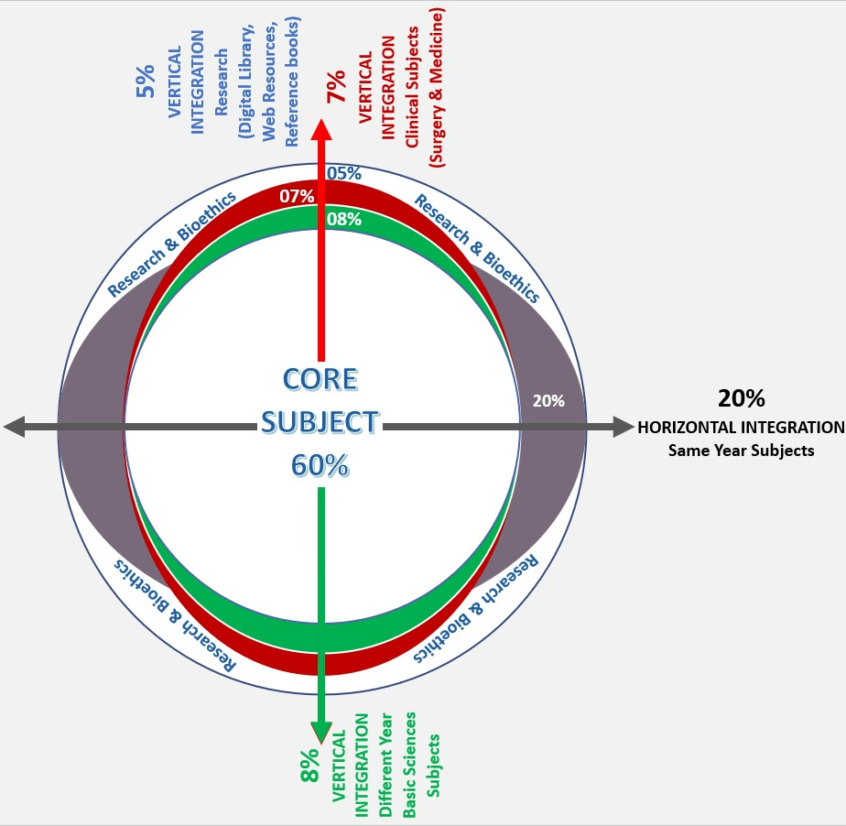
Professor Umar Model of Integrated Lecture
60%
CORE SUBJECT
20%
HORIZONTAL
INTEGRATION
Physiology
biochemistry
8%
VERTICAL INTEGRATION
Pathology
pharmacology
7%
VERTICAL INTEGRATION
Clinical integration
5%
VERTICAL INTEGRATION
Research, professionalism
Ethics
Digital library
Notes:
4

Slide 5
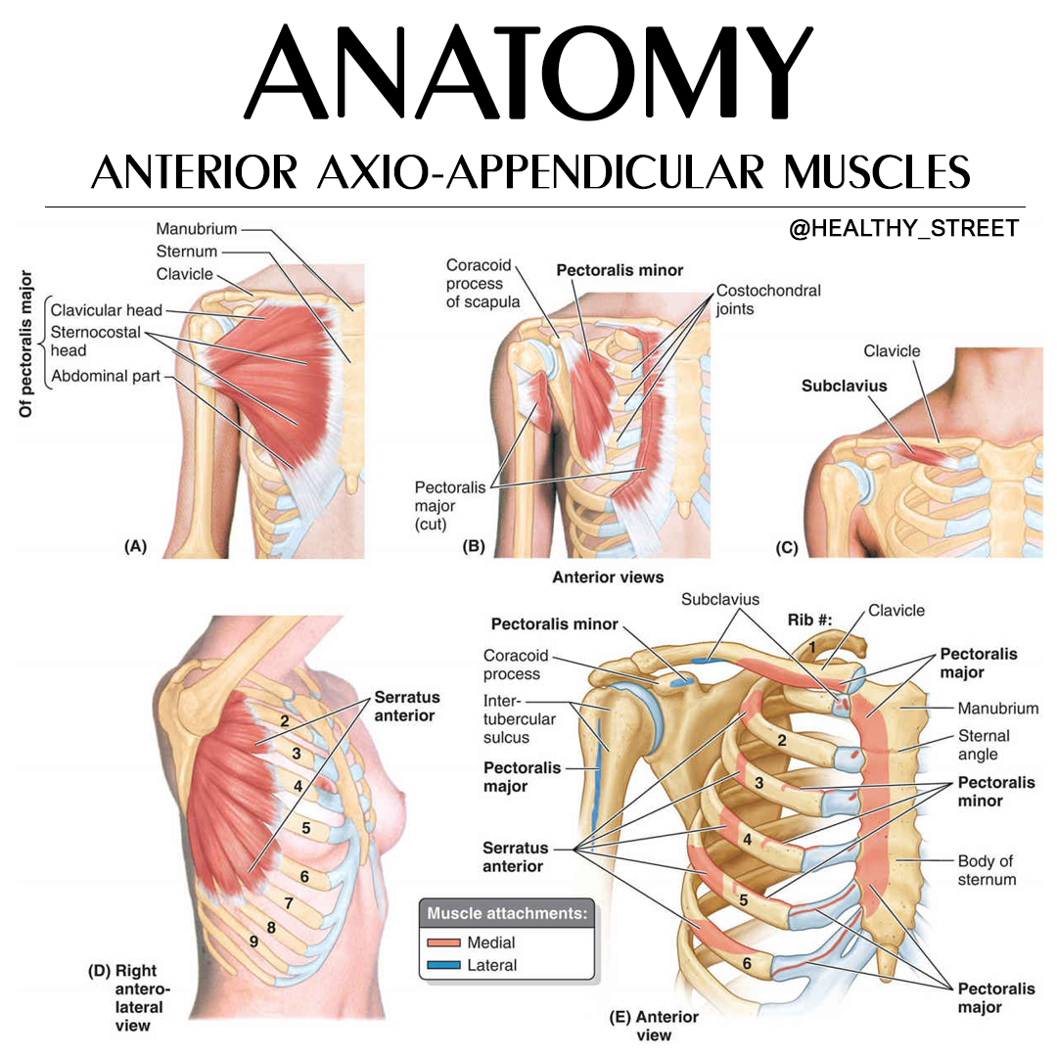

Slide 6
Assessment
Which of the following is intrinsic muslce of pectoral region
Serratus Anterior
Pectoralis major
Trapezius
Subclavius
2. Which of the following muscle is also known as Boxer’s muscle?
Serratus anterior
Deltoid
Latissimus Dorsi
Trapezius
3. Damage to which nerve causes winging of scapula ?
Axillary nerve
Median Nerve
Long thoracic Nerve
Radial Nerve
4. Which muscle among the following serves as an important anatomical landmark?
Pectoralis major
Latissimus Dorsi
Trapezius
Pectoralis minor
5. The suspensory ligament is the continuation of
Pectoral fascia
Superficial fascia of thorax
Deep thoracic fascia
Clavipectoral fascia

Slide 7
Key
A
A
C
D
D

Slide 8
Learning Objectives
At the end of the Demonstration Student should be able to
Describe Superficial fascia with cutaneous nerve and vessels of anterior axio-appendicular region and tabulate muscles of the anterior axio-appendicular region.
Understand the bio-physiological aspects of anterior axio-appendicular region.
Practice principles of bioethics
Understand the curative and preventive health care measures.
Read a relevant research article
Apply strategic use of artificial intelligence in healthcare
Use HEC digital library

Slide 9
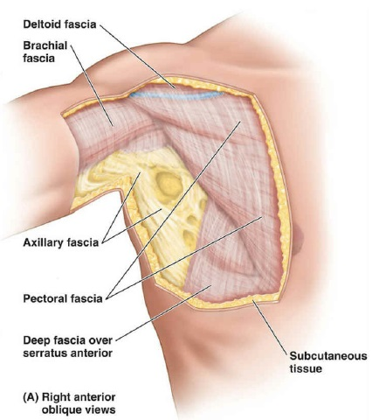
Core Concept
Superficial and Deep Fascia, superficial nerve and vascular supply & Muscles
Subcutaneous tissue (superficial fascia)
containing fat
Deep fascia compartmentalizing
and investing the muscles
Pectoral fascia
Clavipectoral fascia

Slide 10
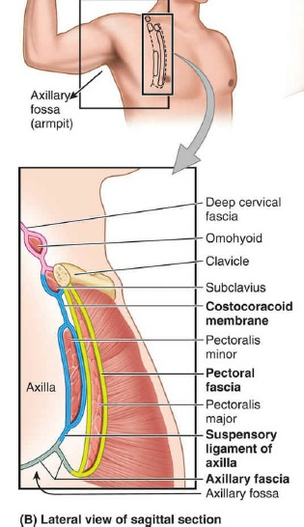
Pectoral Fascia
Core Concept
Superiorly, it is attached to the clavicle
Inferiorly, it is continuous with the fascia of anterior abdominal wall

Slide 11
Pectoral Fascia
Core Concept
Superolaterally, it passes over the deltopectoral groove to become continuous with the fascia covering the deltoid muscle.
Inferolaterally, it curves round the inferolateral border of the pectoralis major to become continuous with the axillary fascia.

Slide 12
Clavipectoral fascia
Core Concept
It is a strong fascial sheet deep to the clavicular head of the pectoralis major muscle, filling the space between the clavicle and
the pectoralis minor muscle.
Suspensory ligament of Axilla

Slide 13
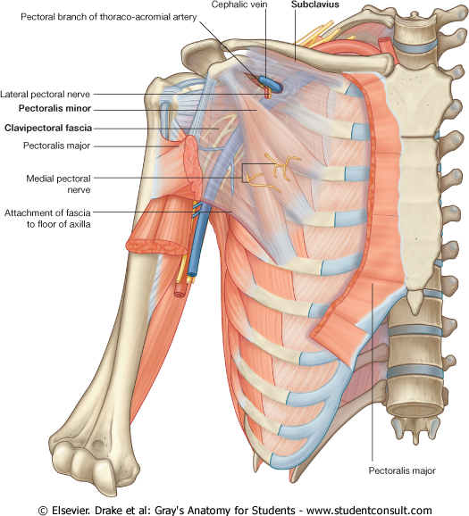
Clavipectoral fascia
Core Concept
Medially, it is attached to the first rib and costoclavicular ligament and blends with external intercostal membrane of the upper two intercostal spaces.
Laterally, costocoracoid ligament/membrane.

Slide 14
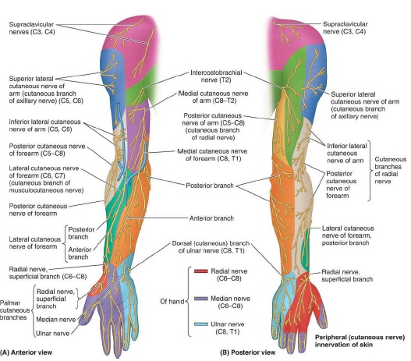
Cutaneous Innervation
Core Concept
The skin above the
horizontal line drawn at
the level of sternal angle is
supplied by supraclavicular
nerves (C3 and C4).
The skin below the
horizontal line is supplied by
anterior and lateral cutaneous
branches of the 2nd–6th
intercostal nerves (T2–T6).

Slide 15
Cutaneous Innervation
Core Concept
The upper lateral cutaneous nerve of the arm supplies the skin over the inferolateral part of the shoulder.

Slide 16
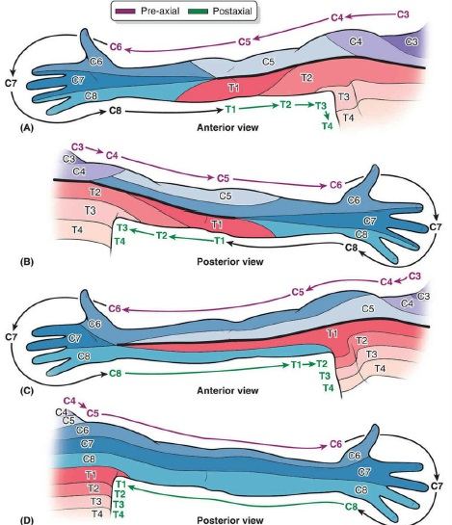
Dermatomes
Core Concept
(A and B) The pattern of segmental (dermatomal) innervation of the upper limb proposed by Foerster (1933) depicts innervation of the medial aspect of the limb by upper thoracic (T1–T3) spinal cord segments, consistent with the experience of heart
pain (angina pectoris) referred to that area
(C and D) The pattern of segmental innervation proposed by Keegan and Garrett (1948)

Slide 17
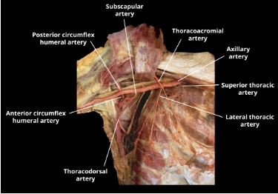
Cutaneous Vascular Supply
Core Concept
The area over the lateral end of the clavicle is supplied by the supraclavicular artery
The area over the deltoid is supplied by the anterior and posterior circumflex humeral arteries

Slide 18
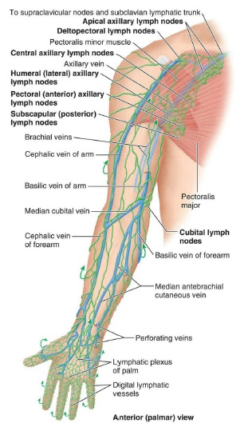
Cutaneous Vascular Supply
Core Concept
Superficial veins: The cephalic vein
courses along the cranial (cephalic)
margin of the limb, while the basilic
vein courses along the caudal (basic)
margin of the limb. Both veins come from
the dorsal venous network on the dorsum
of the hand and terminate by draining into
the beginning (basilic vein) and end
(cephalic vein) of the axillary vein.
Deep veins: Deep veins in the limbs
usually take the form of paired
accompanying veins, bearing the
same name as the artery they accompany.

Slide 19
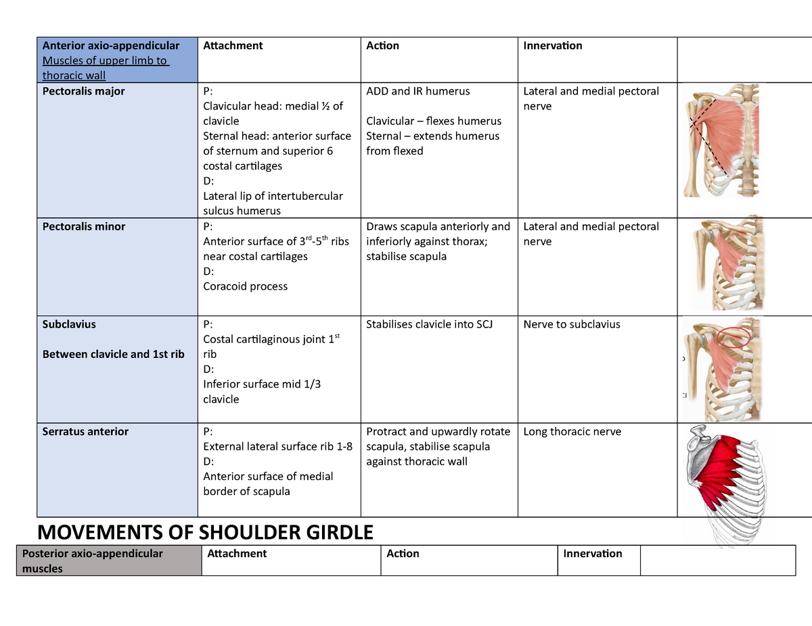

Slide 20
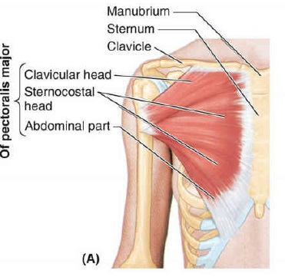
Pectoralis Major
Core Concept
It is the largest muscle of
the pectoral region.
Origin
Clavicular head
Sternocostal head
Insertion
Lateral lip of the bicipital
groove

Slide 21
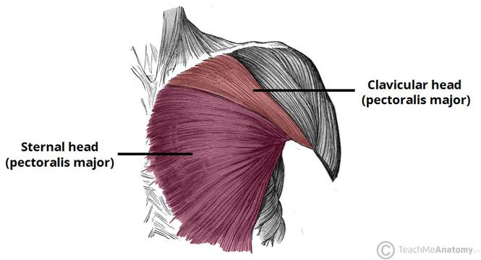
Pectoralis Major
Core Concept
Nerve Supply
Lateral (C5 to C7) and medial
pectoral (C8 and T1) nerves.
Actions
clavicular head flexes the arm
sternocostal head adducts and medially rotates the
arm.

Slide 22
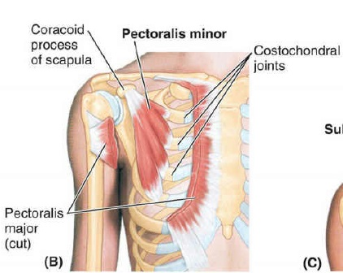
Pectoralis Minor
Core Concept
Origin
It arises from 3rd, 4th, and
5th ribs near their costal
cartilages.
Insertion
It is inserted by a short
thick tendon into the
medial border and upper
surface of the coracoid
process of the scapula.

Slide 23
Pectoralis Minor
Core Concept
Nerve Supply
Medial and Lateral
pectoral nerves.
Actions
It stabilizes the scapula
It also assists in elevating the ribs
It is a useful anatomical and surgical landmark

Slide 24
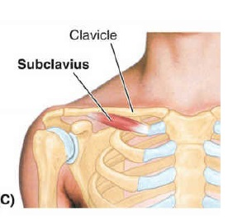
Subclavius
Core Concept
.
Origin
It arises from 1st rib at the
costochondral junction.
Insertion
It is inserted into the subclavian
groove on the inferior surface of
clavicle.
Nerve Supply
Nerve to subclavius, which arises
from the upper trunk of brachial
plexus
Action
Stabilizes clavicle by pulling it
inferiorly and medially during
movement at the shoulder joint

Slide 25
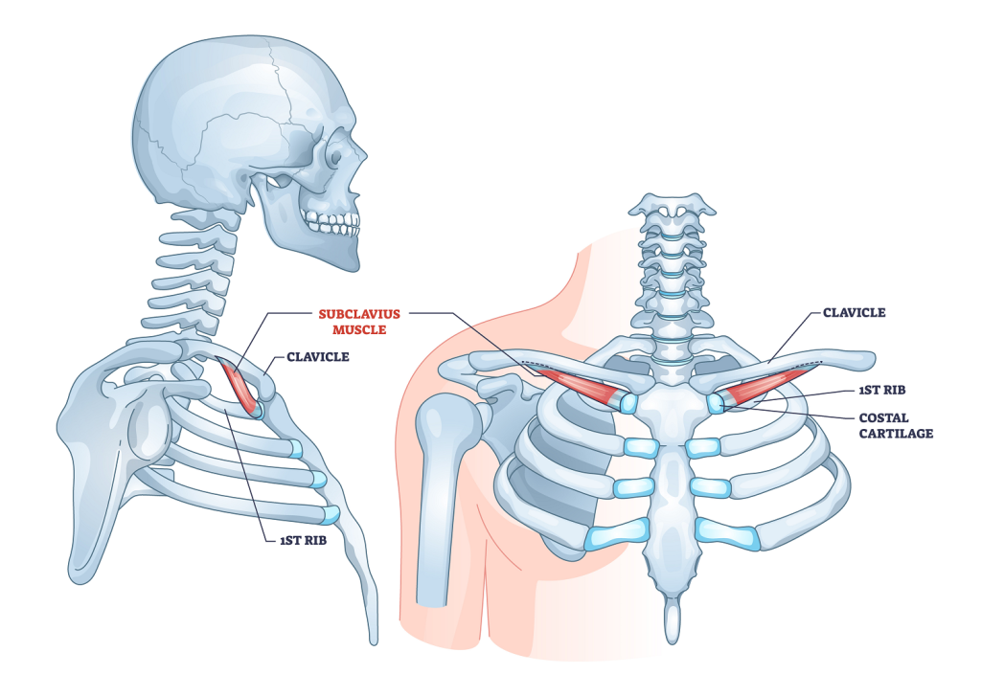

Slide 26
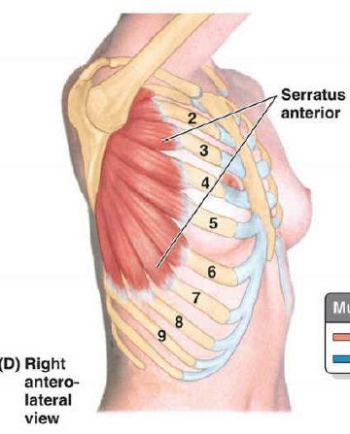
Serratus Anterior
Core Concept
Origin
It arises by a series of 8
digitations from upper
eight ribs.
The first digitation arises
from the 1st and 2nd ribs,
whereas all other
digitations arise from their
corresponding ribs.

Slide 27
Serratus Anterior
Core Concept
Insertion
It is inserted into the costal
surface of the scapula
along its medial border.
Nerve Supply
Long thoracic nerve/nerve
to serratus anterior (C5, C6,
and C7).

Slide 28
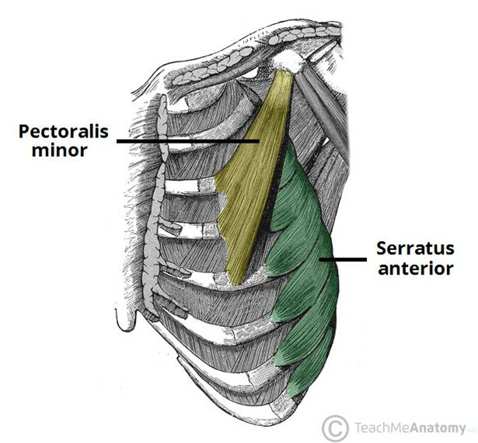
Serratus Anterior
Core Concept
Actions
It is a powerful protractor of the scapula, i.e., it pulls the scapula forward around the chest wall for pushing and punching movements- Boxer’s muscle.
It keeps the medial/vertebral border of scapula in firm contact with the chest wall.
Its lower 4 or 5 digitations along with lower part of the trapezius rotate the scapula laterally and upwards during overhead abduction of the arm.

Slide 29
Vertical Integration
Congenital anomaly of Pectoralis Major
Occasionally, a part of the pectoralis major, usually the
sternocostal part, is absent at birth. This causes weakness in
adduction and medial rotation of the arm.

Slide 30
Vertical Integration
Paralysis of Serratus Anterior
The paralysis of serratus anterior muscle following an
injury to long thoracic nerve by stab injury or during
removal of the breast tumor leads to the following
effects:
(a) Protraction of scapula is weakened.
(b) Inferior angle and medial border of scapula become
unduly prominent particularly when patient pushes his
hands against the wall, producing a clinical condition
called winging of the scapula.

Slide 31
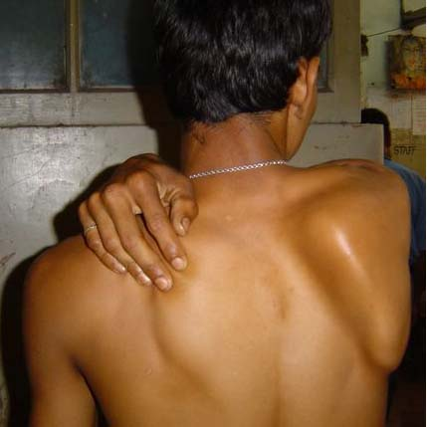

Slide 32
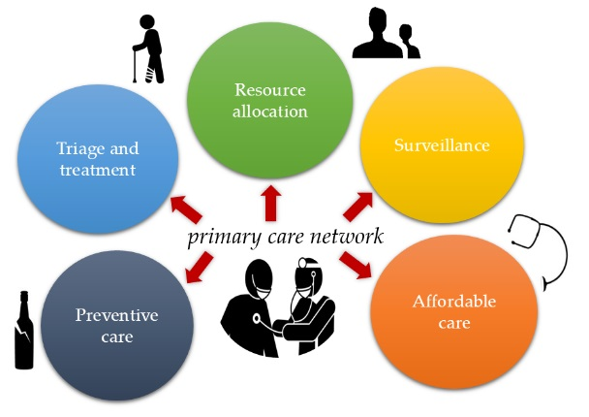
Family Medicine
Spiral Integration

Slide 33
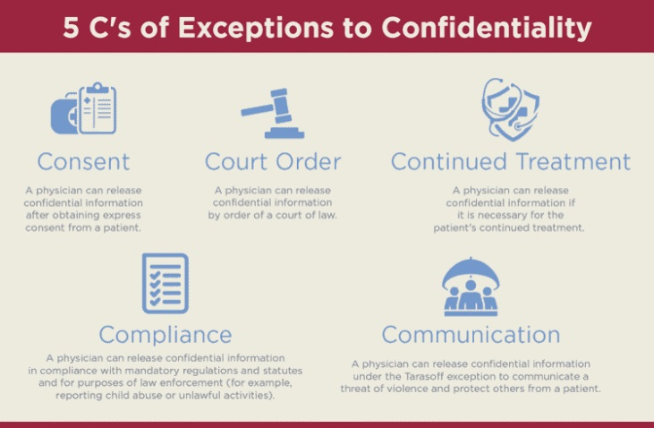
Bioethics
Spiral Integration

Slide 34
Artificial Intelligence
Spiral Integration
Diagnosis Assistance: AI algorithms can analyze medical
imaging scans to aid in the accurate and efficient detection of
humerus fractures, assisting radiologists and clinicians in
interpretation.
2. Treatment Planning: AI can help clinicians determine the optimal treatment approach for humerus fractures by analyzing patient data, such as fracture characteristics, medical history, and outcomes from similar cases.
3. Outcome Prediction: AI models can predict patient outcomes following humerus fracture treatment, providing valuable insights for clinicians in patient management and decision-making.

Slide 35
Contributions of the individual muscles of the shoulder to glenohumeral joint stability during abduction https://europepmc.org/article/MED/18412511
Spiral Integration
The aim of this study was to determine the relative contributions of the deltoid
and rotator cuff muscles to glenohumeral joint stability during arm abduction.
A three-dimensional model of the upper limb was used to calculate the muscle
and joint-contact forces at the shoulder for abduction in the scapular plane. The
joints of the shoulder girdle-sternoclavicular joint, acromioclavicular joint, and
glenohumeral joint-were each represented as an ideal three degree-of-freedom
ball-and-socket joint. The articulation between the scapula and thorax was
modeled using two kinematic constraints. Eighteen muscle bundles were used
to represent the lines of action of 11 muscle groups spanning the glenohumeral
joint. The three-dimensional positions of the clavicle, scapula, and humerus
during abduction were measured using intracortical bone pins implanted into
one subject. The measured bone positions were inputted into the model, and an
optimization problem was solved to calculate the forces developed by the
shoulder muscles for abduction in the scapular plane.

Slide 36
How To Access Digital Library
Go to the website of HEC National Digital Library.
On Home Page, click on the INSTITUTES.
A page will appear showing the universities from Public and Private Sector and other Institutes which have access to HEC National Digital Library HNDL.
Select your desired Institute.
A page will appear showing the resources of the institution
Journals and Researches will appear
You can find a Journal by clicking on JOURNALS AND DATABASE and enter a keyword to search for your desired journal.

Slide 37
Learning Resources
Clinically Oriented Anatomy 7th Edition
by Keith L. Moore (Author), Anne M. R.
Agur (Author), Arthur F. Dalley (Author)
Gray's Anatomy: The Anatomical Basis of Clinical Practice 42nd Edition
www.google.com for pictures

Slide 38
Thank you

