Slide 1


Slide 2



Renal Module
2nd Year MBBS(CBL)
Ammonia Toxicity
Presenter: Dr. Romessa Naeem Date: 27-01-25
(Demonstrator)

Slide 3
Motto, Vision, Dream
To impart evidence based research oriented medical education
To provide best possible patient care
To inculcate the values of mutual respect and ethical practice of medicine
Wisdom
Truth
Service

Slide 4
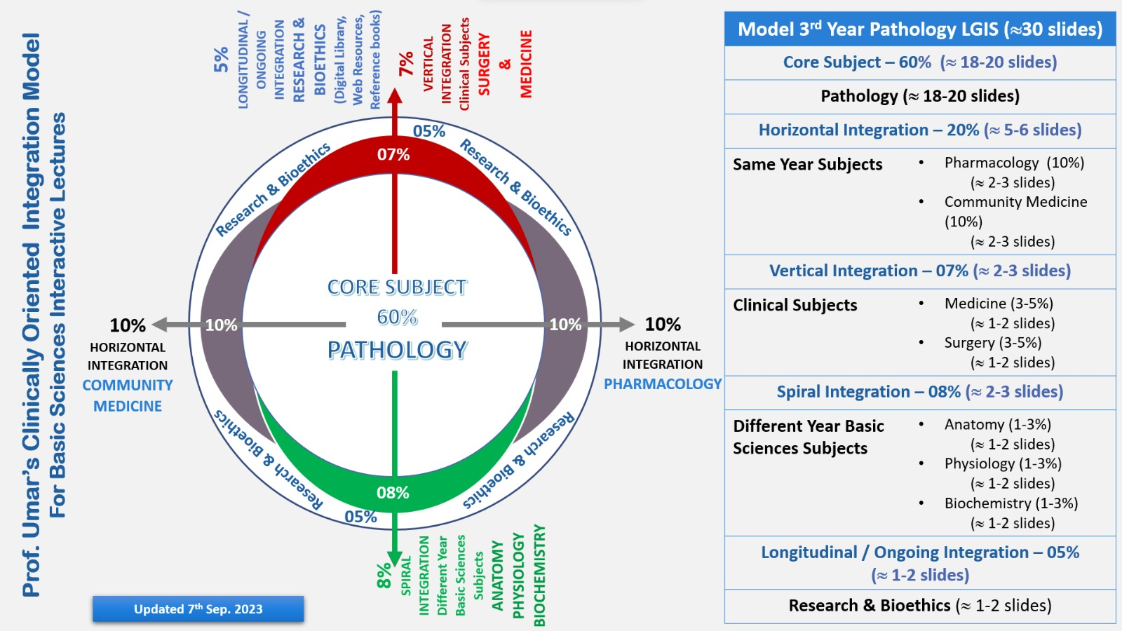
Professor Umar Model of Integrated Lecture

Slide 5
Learning Objectives
At the end of this session students should be able to
Discuss sources and transport of ammonia in body
Describe steps and regulation of urea cycle
Discuss ammonia toxicity
Explain types and clinical features of Hyperammonemia

Slide 6
Interactive Session
A 57 years female was brought to ER BBH hospital with history of hematemesis confusion/irritability delirium and altered mental . Upon history taking by ER resident ,it was found that the patient was diagnosed with hepatitis C a few years back .She had received partial treatment (interferon therapy)for the disease initially .The patient had taken protein rich diet for last several days. Lab investigation showed raised serum ammonia level.

Slide 7
Introduction
Core Knowledge
The capacity of hepatic urea exceeds the normal rates of ammonia generation.
The levels of blood ammonia are normally low (5-35umol/l).
When liver function is compromised ,blood levels can be greater then 1,000umol/l.
Such hyperammonemia is a medical emergency.

Slide 8
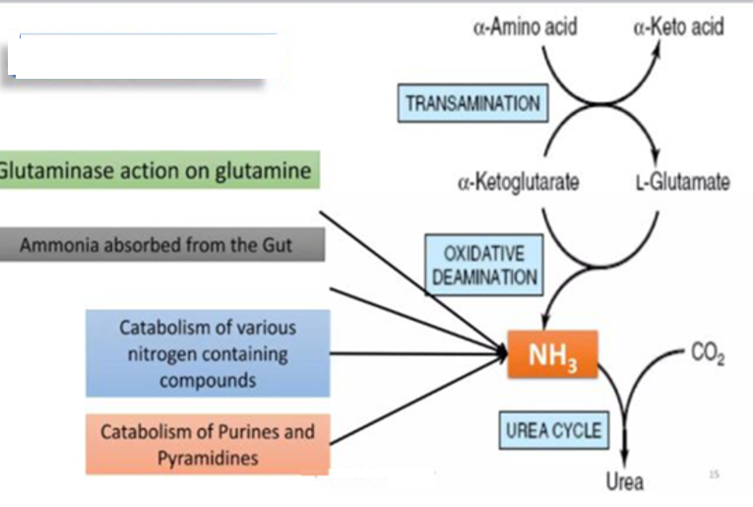
Sources of Ammonia
Core Knowledge
Sources of Ammonia

Slide 9
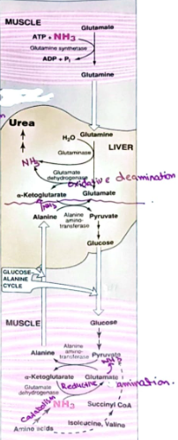
Transport of Ammonia To Liver
Core Knowledge

Slide 10
Types of Hyperammonemia
Core Knowledge
Acquired Hyperammonemia (Hepatic Coma):
Liver disease is a common cause in adults for example
Viral hepatitis
Hepatotoxins such as alcohol
Congenital Hyperammonemia:
Genetic Deficiency of enzymes of urea cycle

Slide 11
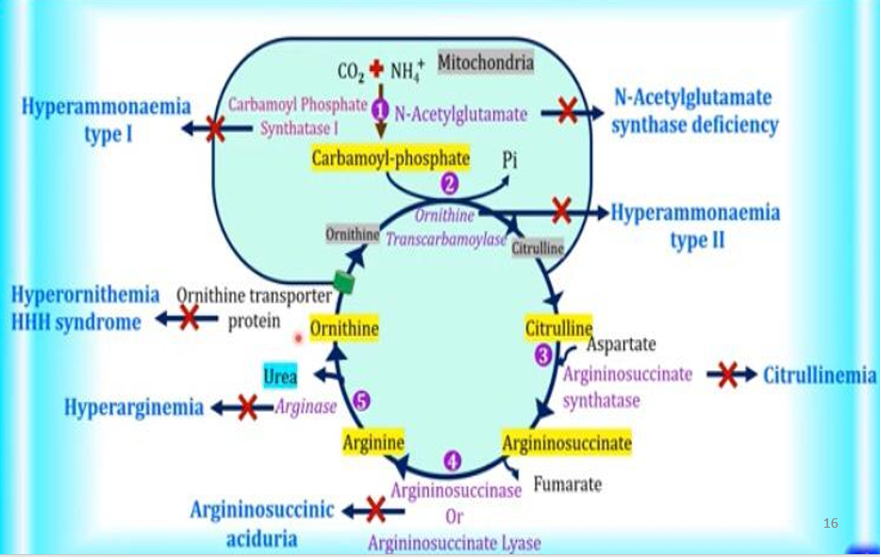
Urea Cycle with Disorders
Core Knowledge

Slide 12
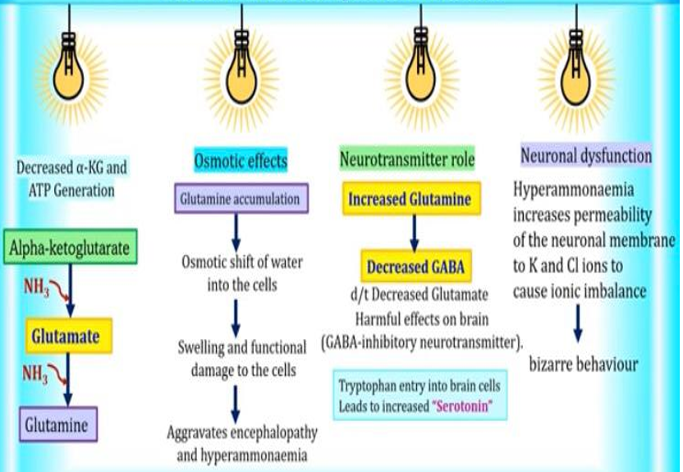
Ammonia Toxicity-Mechanism
Core Knowledge

Slide 13
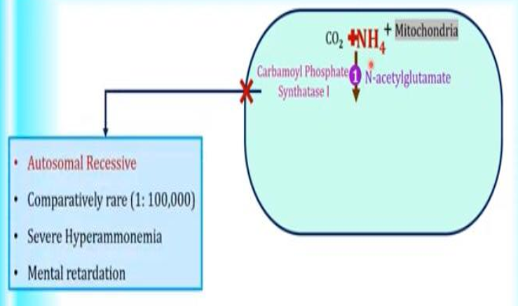
Hyperammonemia Type I
Core Knowledge

Slide 14
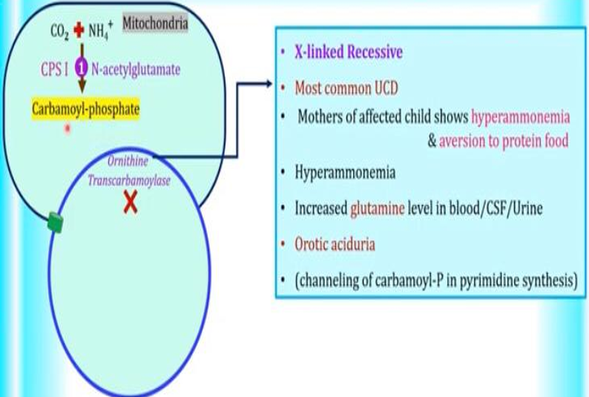
Hyperammonemia Type II
Core Knowledge

Slide 15
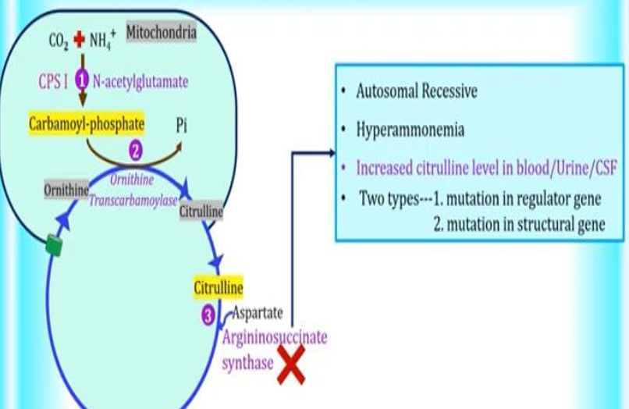
Citrullinemia
Core Knowledge

Slide 16
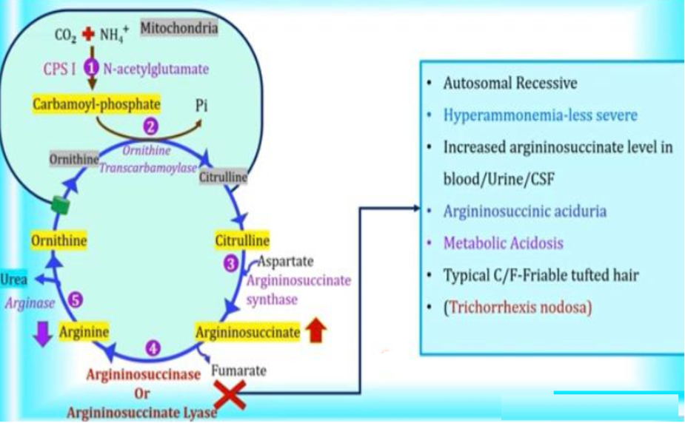
Argininosuccinic Aciduria
Core Knowledge

Slide 17
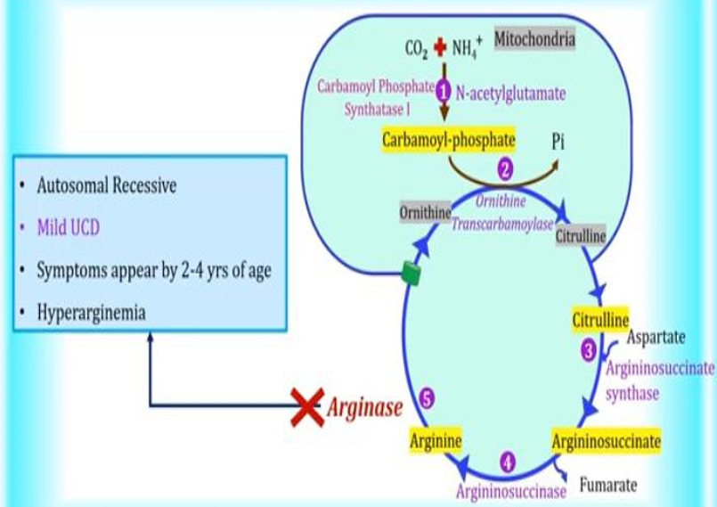
Hyperargininemia
Core Knowledge

Slide 18
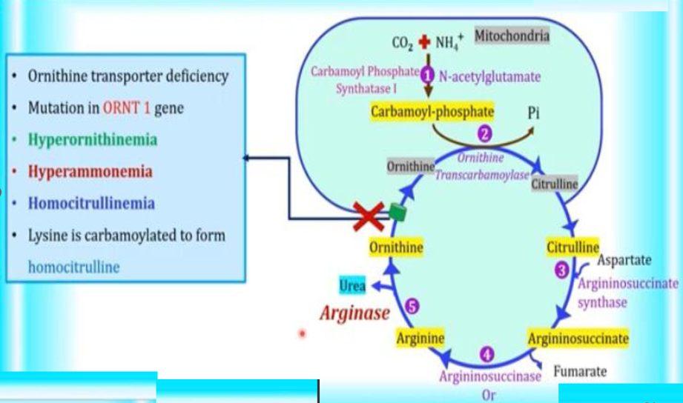
Hyperornithinemia
Core Knowledge

Slide 19
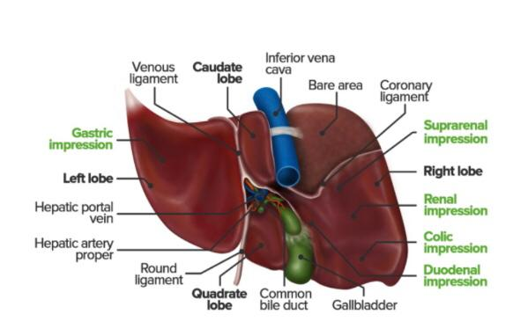
Anatomy of Liver

Slide 20
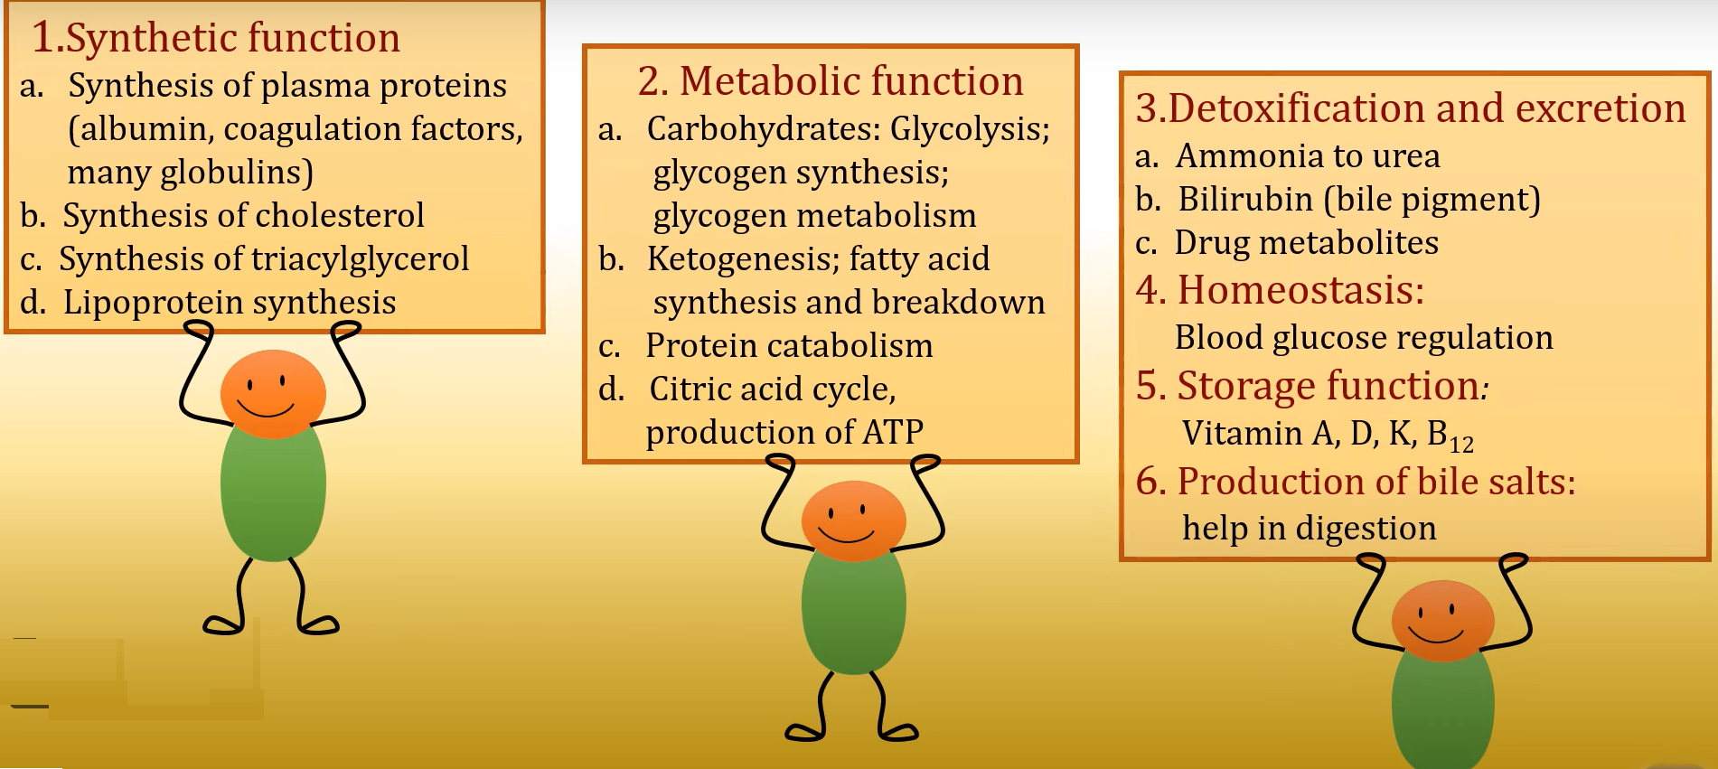
Physiology of Liver

Slide 21
Management of Hyperammonemia
Spiral Integration
1️⃣ Preventive Care: Educate patients on dietary modifications, including controlled protein intake, and avoid triggers of hepatic encephalopathy.
2️⃣ Regular Monitoring: Schedule frequent follow-ups for liver function tests, ammonia levels, and cognitive assessments.
3️⃣ Early Intervention: Identify and treat early signs of hepatic encephalopathy in outpatient settings to prevent hospitalizations.
4️⃣ Family Screening: Encourage screening for hepatitis C in high-risk family members and ensure proper vaccination.
5️⃣ Multidisciplinary Approach: Coordinate care with hepatologists, nutritionists, and mental health professionals for comprehensive management.

Slide 22
Ethical Consideration
Spiral Integration
1️⃣ Informed Consent: The patient’s altered mental status necessitates decision-making through legal surrogates or advance directives.
2️⃣ Autonomy vs. Beneficence: Physicians must balance respecting patient/family wishes with providing medically appropriate care.
3️⃣ Non-Maleficence: Avoid potential harm by ensuring timely treatment and preventing further complications.
4️⃣ Family’s Role in Decision-Making: Engage the family in shared decision-making while explaining the risks and benefits of treatment.
5️⃣ Cultural and Ethical Sensitivity: Address concerns related to alternative medicine, treatment refusal, and end-of-life care with empathy.

Slide 23
Role of AI in Managing Hyperammonemia
Spiral Integration
1️⃣ AI for Early Diagnosis: Machine learning algorithms can predict hepatic encephalopathy risk using patient data trends.
2️⃣ Telemonitoring Tools: AI-based apps help track ammonia levels, cognitive status, and dietary habits remotely.
3️⃣ Decision Support Systems (CDSS): AI-driven tools assist physicians in treatment planning and medication adjustments.
4️⃣ Predictive Analytics: AI models can forecast disease progression and hospital readmission risks, enabling proactive care.
5️⃣ Ethical AI Integration: Ensure data privacy, algorithm transparency, and bias mitigation in AI-driven healthcare applications.

Slide 24
Suggested Research Article
Link: https://www.ncbi.nlm.nih.gov/
Journal Name:
Bookshelf
Title:
Hyperammonemia
Author Name:
Rimsha Ali,Shivaraj Nagalli.
Objectives:
Identify the etiology of hyperammonemia.
Describe the presentation of a patient with hyperammonemia.
Outline the management options available for hyperammonemia.
Introduction : Hyperammonemia is a metabolic condition characterized by the raised levels of ammonia, a nitrogen-containing compound. Normal levels of ammonia in the body vary according to age. Hyperammonemia can result from various congenital and acquired conditions in which it may be the principal toxin. Hyperammonemia may also occur as a part of other disorders that involve various other metabolic abnormalities. Normally, ammonia is produced in the colon and small intestine from where it is transported to the liver to be converted to urea via the urea cycle. Urea, a water-soluble compound, can then be excreted via the kidneys

Slide 25
How To Access Digital Library
Steps to Access HEC Digital Library
Go to the website of HEC National Digital Library.
On Home Page, click on the INSTITUTES.
A page will appear showing the universities from Public and Private Sector and other Institutes which have access to HEC National Digital Library HNDL.
Select your desired Institute.
A page will appear showing the resources of the institution
6. Journals and Researches will appear
7. You can find a Journal by clicking on JOURNALS AND DATABASE and enter a keyword to search for your desired journal.

Slide 26
CBL Assessment
Q1-Why ammonia is toxic?
Q2-What are the congenital causes of Hyperammonemia?
Q3-What is urea?
Q4-How ammonia is transported from muscle to liver?
Q5-What is the site of urea cycle in the body?

Slide 27
Learning Resources
Lippincott Illustrated Reviews Biochemistry, 8th Edition, 19 page no. 282-286
Google scholar
Google images

Slide 28
THANK YOU

