Slide 2
DR. TANVEER HUSSAIN
MBBS.FCPS (Med), FRCP ( Glasg),
FCPS (Gastroenterology), CHPE
Associate Professor & HOD
Gastroenterology, RMU

Slide 3

University Motto, Vision, Values & Goals
Mission Statement To impart evidence-based research-oriented health professional education Best possible patient care Mutual respect, ethical practice of healthcare and social accountability. Vision and Values Highly recognized and accredited center of excellence in Medical Education, using evidence-based training techniques for development of highly competent health professionals, who are lifelong experiential learner and are socially accountable. Goals The Undergraduate Integrated Learning Program is geared to provide you with quality medical education in an environment designed to:

Slide 4
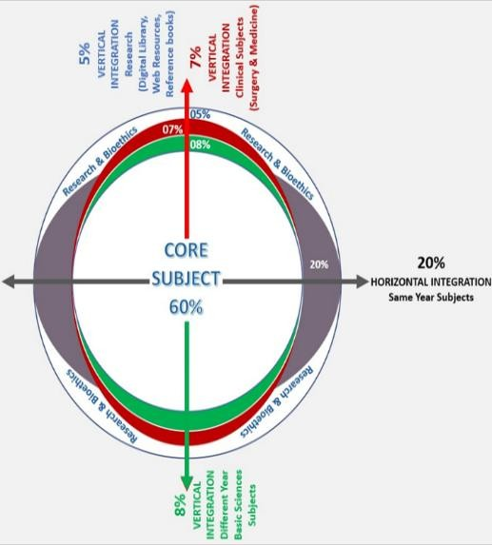
RMU Integrated Lecture Model

Slide 5
LOs
At the end of lecture, students will be able to understand
Etiopathogenesis & clinical features of the disease
Specific investigations of the disease
Treatment plan of the disease
Complication of the disease

Slide 6
CASE SCENARIO
A 25 years old shopkeeper presented A&E with restless, irritability and drowsiness for one day.
His wife informed that he has jaundice since last 01 wk.
On exam
Jaundice, bruise on forearm and respond to stimulus.
BP 140/90 mmHg, Pulse 110/min R/R 16/min
GCS 12/15 ALT 830 IU
INR 2.5, Bilirubin 14.5mg/dl HEV Ig M +ve.
Q.1 What is diagnosis?
Q.2 What further investigations need?
Q.3 How will you manage
.

Slide 7
Acute Liver Failure

Slide 8
Sub-classifications of ALF
Weeks from development of jaundice to development of HE
>28 weeks = chronic liver disease
0
1
4
12
Hyperacute¹
Acute¹
Subacute¹
+++ | ++ | + | Severity of coagulopathy²
+ | ++ | +++ | Severity of jaundice²
++ | ++ | +/- | Degree of intracranial hypertension²
Good | Moderate | Poor | Chance of spontaneous recovery²
Paracetamol HAV, HEV | HBV | Non-paracetamol drug-induced | Typical cause²
+++ High severity; ++ Medium severity; + Low severity; +/- Present or absent
1. O'Grady JG, et al. Lancet 1993;342:273−5; 2. Bernal W, et al. Lancet 2010;376:190−201;
EASL CPG ALF. J Hepatol 2017;66:1047–81
Notes:
O'Grady JG, Schalm SW, Williams R. Acute liver failure: redefining the syndromes. Lancet. 1993 Jul 31;342(8866):273-5.
Bernal W, Auzinger G, Dhawan A, Wendon J. Acute liver failure. Lancet. 2010 Jul 17;376(9736):190-201.

Slide 9
Aetiology of ALF
Viral
Hepatitis B, A, E
(less frequent CMV,
HSV, VZV, Dengue)
Drugs
Paracetamol, anti-tuberculous, chemotherapy, statins, NSAIDs, phenytoin, carbamazepine, ecstasy, flucloxacillin
Toxins
Amanita phalloides, phosphorus
ALF
Vascular
Budd–Chiari syndrome
Hypoxic hepatitis
Other
Wilson disease, autoimmune, lymphoma, malignancy, HLH
Pregnancy
Pre-eclamptic liver rupture, HELLP, fatty liver of pregnancy
EASL CPG ALF. J Hepatol 2017;66:1047–81

Slide 10







Aetiology of ALF varies with geography
Top three causes of ALF in selected countries
Bangladesh
HEV 75%
HBV 13%
Unknown 6%
Germany
Other causes* 28%
Unknown 21%
HBV 18%
India
HEV 44%
Unknown 31%
HBV 15%
Japan
HBV 42%
Unknown 34%
Other drugs 9%
Sudan
Unknown 38%
Other causes* 27%
HBV 22%
UK
Paracetamol 57%
Unknown 17%
Other drugs 11%
USA
Paracetamol 39%
Other causes* 19%
Unknown 18%
*’Other causes’ refers to identified causes that are not: HAV, HBV, HEV, paracetamol or other drugs
Bernal W, Wendon J. New Eng J Med 2013;369:2525−34
Notes:
Bernal W, Wendon J. Acute liver failure. N Engl J Med. 2013 Dec 26;369(26):2525-34.

Slide 11
Diagnosis of ALF
An increase in PT by 4-6 seconds (INR>1.5)
Development of hepatic encephalopathy (HE).
In a patient without pre-existing cirrhosis and with an illness of less than six months duration.

Slide 12
Diagnosis
History
Family members with liver disease?
Recent cold sores
Onset of jaundice
Work environment- toxic agents
Hobbies/travel
Herbal products/dietary supplements

Slide 13
Investigations
Prothrombin time/INR
Chemistries
Liver enzymes
Arterial blood gas
Toxicology screen
Viral hepatitis serologies (anti-HAV IgM, HBsAg,
anti-HBc IgM, anti-HEV, anti-HCV, HCV RNA ,
HSV1 IgM, VZ/HS, EB, CMV)

Slide 14
Ceruloplasmin level
Pregnancy test (females)
Ammonia (arterial if possible)
Autoimmune Markers (ANA, ASMA,
immunoglobulin levels )

Slide 15
Liver biopsy for diagnostic dilemma
Importance of early biopsy- severity and aetiology
Particularly useful in HBV, AIH and Alcoholic hepatitis, differentiate between ALF and ACLF
Trans jugular route

Slide 16
Differential diagnosis
Aetiology | Clinical features
Paracetamol | Very high levels of aminotransferases and low level of bilirubin. Rapidly progressive disease, acidosis and renal impairment. Low phosphate may be seen as a good prognostic marker but replacement is required
Non-paracetamol | Subacute clinical course can mimic cirrhosis, clinically and radiographically
Acute Budd–Chiari syndrome | Abdominal pain, ascites and hepatomegaly; loss of hepatic venous signal and reverse flow in portal vein on ultrasound
Wilson disease | Young patient with Coombs (DAT)-negative haemolytic anaemia with a high bilirubin to ALP ratio; Kayser–Fleischer ring; low serum uric acid level; markedly increased urinary copper
Mushroom poisoning | Severe gastrointestinal symptoms after ingestion; development of early AKI
Autoimmune | Usually subacute presentation – may have positive autoantibodies, elevated globulin and characteristic lymphocyte pattern when compared to viral and seronegative aetiologies
Malignant infiltration | History of cancer, massive hepatomegaly; elevated ALP or other tumour markers
Acute ischaemic injury | Marked elevation of aminotransferases, increased lactic dehydrogenase and creatinine, which normalize soon after stabilization of haemodynamic instability. Patients with severe congestive heart disease or respiratory disease
Possible indication for emergency LTx
No indication for emergency LTx
CPG ALF. J Hepatol 2017;66:1047–81

Slide 17
  Outcome
Recovery because of successful intervention
  NAC for paracetamol toxicity
  Antivirals for acute hepatitis B
Spontaneous recovery with supportive care
Death
Rescue by liver transplant (OLT)

Slide 18
Etiology of ALF outcome
Transplant free survival >50%
Hepatitis A, paracetamol
Transplant free survival <25%
Autoimmune, HBV, Wilsons, mushroom, idiosyncratic drug

Slide 19
Role of NAC
Efficacy of NAC is well established in paracetamol induced ALF
Non PCM ALF – role of NAC is controversial
  However most recent studies has improved outcome

Slide 20
Treatment
Assessment and management at presentation
Organ-specific management
  Cardiovascular
  Respiratory
  Gastrointestinal
  Metabolic
  Acute kidney injury and renal replacement therapy
  Coagulopathy
  Sepsis
  Neurological
Artificial and bioartificial liver devices
Liver transplantation
EASL CPG ALF. J Hepatol 2017;66:1047–81

Slide 21
Assessment and management at presentation
Immediate measures
  Determine aetiology to guide treatment, especially LTx
Primary or secondary causes of ALF and need for transplantation
Disease group | Hepatic/primary ALF | Extrahepatic/secondary liver failure and ACLF
Acute liver failure | Drug related Acute viral hepatitis Toxin-induced ALF Budd–Chiari syndrome Autoimmune Pregnancy related | Hypoxic hepatitis Systemic diseases: Haemophagocytic syndromes Metabolic disease Infiltrative disease Lymphoma Infections (e.g. malaria)
CLD presenting with a phenotype of ALF | Fulminant presentation of Wilson disease Autoimmune liver disease Budd–Chiari HBV reactivation | Liver resection for either secondary deposits or primary liver cancer Alcoholic hepatitis
Possible indication for emergency LTx
No indication for emergency LTx
EASL CPG ALF. J Hepatol 2017;66:1047–81

Slide 22
General support outside ICU
Laboratory analyses at admission
Assess disease severity
PT, INR or factor V and full coagulation screen
Liver blood tests*
Renal function
Urine output: hourly
Urea†
Creatinine
Arterial blood gas and lactate
Arterial ammonia
Check aetiology
Toxicology screen in urine and paracetamol serum level
Viral serological screen
HBsAg, anti-HBc IgM (HBV DNA), HDV if positive for HBV
anti HAV IgM
anti-HEV IgM
anti-HSV IgM, anti-VZV IgM, CMV, HSV, EBV, parvovirus and VZV PCR
Autoimmune markers‡
Test for complications
Lipase or amylase
EASL CPG ALF. J Hepatol 2017;66:1047–81

Slide 23
General support outside ICU
Diagnosis, monitoring and care at admission
Diagnostic tests
Cultures (respiratory, blood, urine)
Chest X-ray/ECG/liver echography: axial imaging of the abdomen and chest may also be required
ECG
Routine monitoring
Oxygen saturation, blood pressure, heart rate, respiratory rate, hourly urine output
Clinical neurological status
Standard care
Glucose infusions
(10–20%)*
Stress ulcer prophylaxis
Restrict clotting factors unless active bleeding
NAC in early stage, even in non-paracetamol cases
Preventative measures
Avoid sedatives
Avoid hepatotoxic and nephrotoxic drugs
In case of HE
Transfer to an appropriate level of care (ideally critical care) at the first symptoms of mental alterations
Quiet surrounding, head of bed >30°C, head in neutral position and intubate, ventilate, and sedate if progression to >3 coma
Low threshold for empirical start of antibiotics if haemodynamic deterioration and/or increasing encephalopathy with inflammatory phenotype
In case of evolving HE, intubation and sedation prior to the transfer
Ensure volume replete and normalize biochemical variables (Na, Mg, PO₄, K)
*Glycaemic target ± 140 mg/dl, Na 135–145 mmol/l;
EASL CPG ALF. J Hepatol 2017;66:1047–81

Slide 24
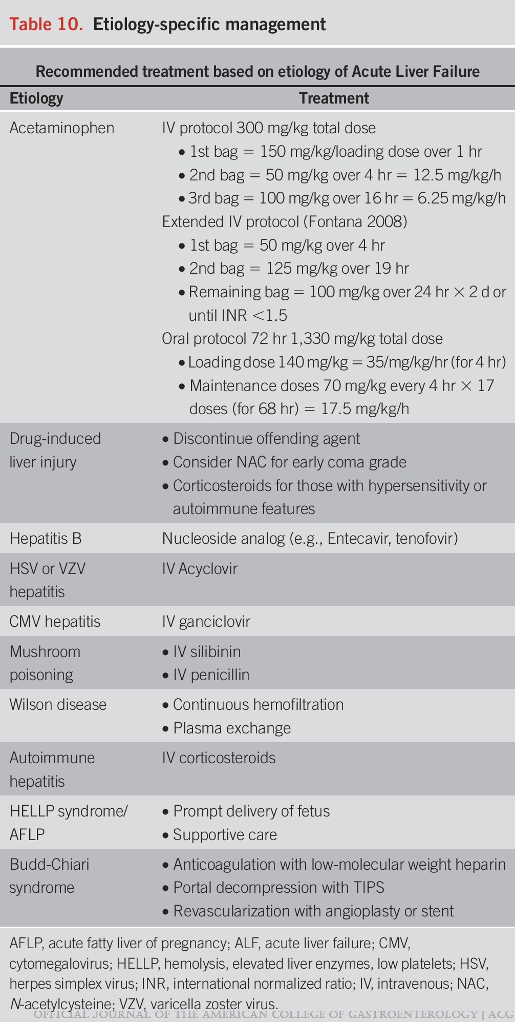
ACG118(7) 1128-1153, July 2023.
:

Slide 25
Organ-specific management
Main organ-specific complications in ALF
Coagulation/haemostasis
Neurological = cerebral oedema
Cranial hypertension
Unbalanced haemostasis
Thrombocytopenia
Brain death
Infection
Acute liver failure
Metabolic
Bacterial, fungal
Pneumopathy
Septicaemia
Urinary infection
Hypoglycaemia
Hyponatraemia
Hypophosphotaemia
Hypokalaemia
Haemodynamic
Pulmonary
Renal
Hyperkinetic syndrome
Arrhythmia
Pneumopathy
Acute respiratory distress syndrome
Pulmonary overload
Toxic
Functional
EASL CPG ALF. J Hepatol 2017;66:1047–81

Slide 26
Artificial and bioartificial liver devices
Liver-assist devices are intended to provide a ‘bridge’ to LTx or recovery of liver function, reducing the need for transplant
  Experience with “liver support devices” to date has been disappointing
  High-volume plasma exchange improved outcome in an RCT in ALF*
100
HVP (n=92)
SMT (n=90)
80
60
Cumulative proportion
surviving (%)
40
20
0
0
7
14
21
28
35
42
49
56
63
70
77
84
91
Time (days)
*HVP defined as exchange of 8–12 or 15% of ideal body weight with fresh frozen plasma, for 3 days was superior to SMT regarding transplant-free and overall hospital survival
Larsen FS, et al. J Hepatol. 2016;64:69–78; EASL CPG ALF. J Hepatol 2017;66:1047–81

Slide 27
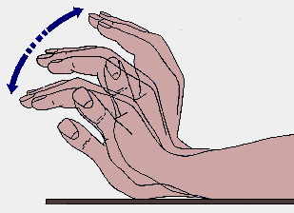
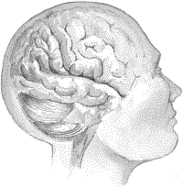

Slide 29
Acute and Chronic Pancreatitis

Slide 30
Acute pancreatitis
Interstitial pancreatitis
Necrotizing pancreatitis

Slide 31
Etiology
Common Causes:
  Gallstones
  Alcohol
  Hypertriglyceridemia
  ERCP
  Trauma
  Postoperative
  Drugs (azathioprine, 6-mercaptopurine, sulfonamides, estrogens, tetracycline, valproic acid, anti-HIV medications).
  Sphincter of Oddi dysfunction

Slide 32
Etiology
Uncommon Causes:
  Vascular causes and vasculitis (ischemic-hypo perfusion states after cardiac surgery)
  Connective tissue disorders
  TTP
  Cancer of the pancreas
  Hypercalcemia
  Periampullary diverticulum
  Pancreas divisum
  Hereditary pancreatitis
  Cystic fibrosis
  Renal failure

Slide 33
Etiology
Rare Causes:
  Infections (mumps, coxsackievirus, cytomegalovirus, echovirus, parasites)
  Autoimmune (Sjögren's syndrome)
Causes to Consider in Patients with Recurrent Acute Pancreatitis without an Obvious Etiology
  Occult disease of the biliary tree or pancreatic ducts, especially microlithiasis, sludge
  Drugs
  Hypertriglyceridemia
  Pancreas divisum
  Pancreatic cancer
  Sphincter of Oddi dysfunction
  Cystic fibrosis
  Idiopathic

Slide 34
Pathophysiology
Proteolytic enzymes activated
In pancreatic parenchyma
endotoxins, exotoxins, viral infections, ischemia, anoxia, lysosomal calcium, and direct trauma
Auto
digestion
Activated proteolytic enzymes digest pancreatic and peri pancreatic tissues
also activate elastase and phospholipase A₂

Slide 35
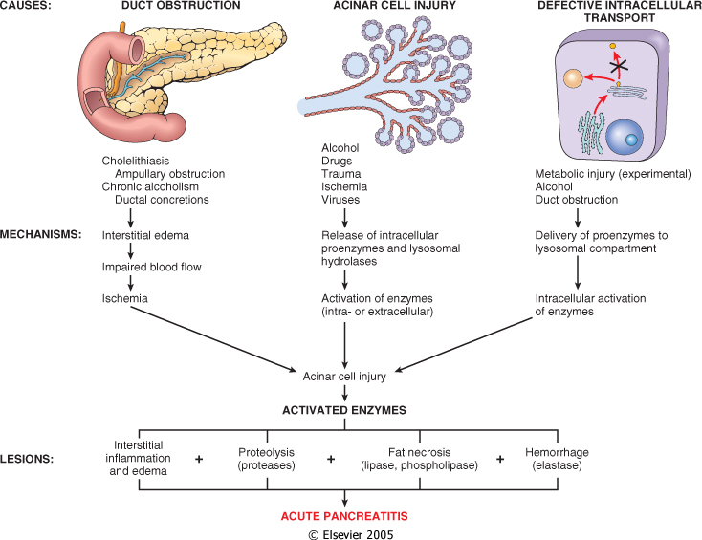

Slide 36
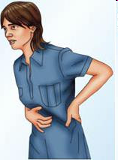
Clinical features
Abdominal pain
Nausea, vomiting, and abdominal distention
Low-grade fever
Tachycardia
Hypotension
Jaundice
Erythematous skin nodules
Atelectasis, pleural effusion

Slide 37
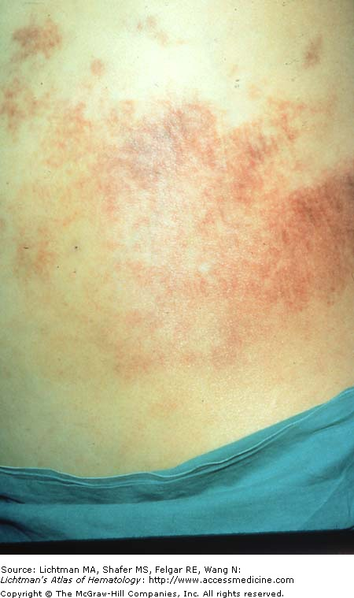
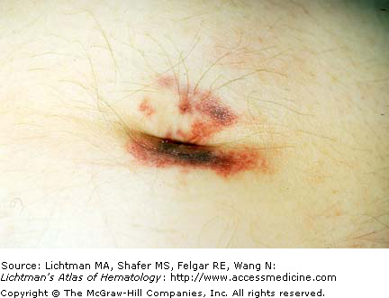
Clinical features
Abdominal tenderness and muscle rigidity
Diminished bowel sounds
A faint blue discoloration around the umbilicus (Cullen's sign) may occur as result of hemoperitoneum.
Blue-red-purple or green-brown discoloration of the flanks (Turner's sign) reflects tissue catabolism of hemoglobin

Slide 38
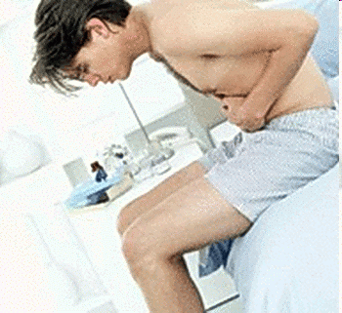
Diagnosis
Requires two of the following:
  Typical history.
  Elevated serum amylase or lipase (>3 ULN).
  Imaging( Ultrasound, CT or MRI)
  consistent with acute pancreatitis.

Slide 39
Differential diagnosis
Perforated viscus.
Acute cholecystitis
Acute intestinal obstruction
Mesenteric vascular occlusion
Myocardial infarction
Dissecting aortic aneurysm
Connective tissue disorders with vasculitis
Pneumonia
Diabetic ketoacidosis

Slide 40
Severity
Risk Factors
  Age > 60 years
  Obesity, BMI > 30
  Comorbid disease
Markers during Hospitalization
  Persistent organ failure
  Pancreatic necrosis
  Hospital-acquired infection

Slide 41
Markers of Severity within 24 Hours
SIRS [temperature >38° or < 36°C, Pulse > 90, Tachypnea > 24, WBC > 12,000]
Hemoconcentration (Hct >44%)
BISAP (bedside index of severity in acute pancreatitis)
  (B) Blood urea nitrogen (BUN) >22 mg%
  (I) Impaired mental status
  (S) SIRS: 2/4 present
  (A) Age >60 years
  (P) Pleural effusion
Organ Failure
  Cardiovascular: systolic BP <90 mmHg, heartrate >130
  Pulmonary: Pao₂ <60 mmHg
  Renal: serum creatinine >2.0 mg%
  Gastrointestinal: bleeding >500 mL/24 hours

Slide 42
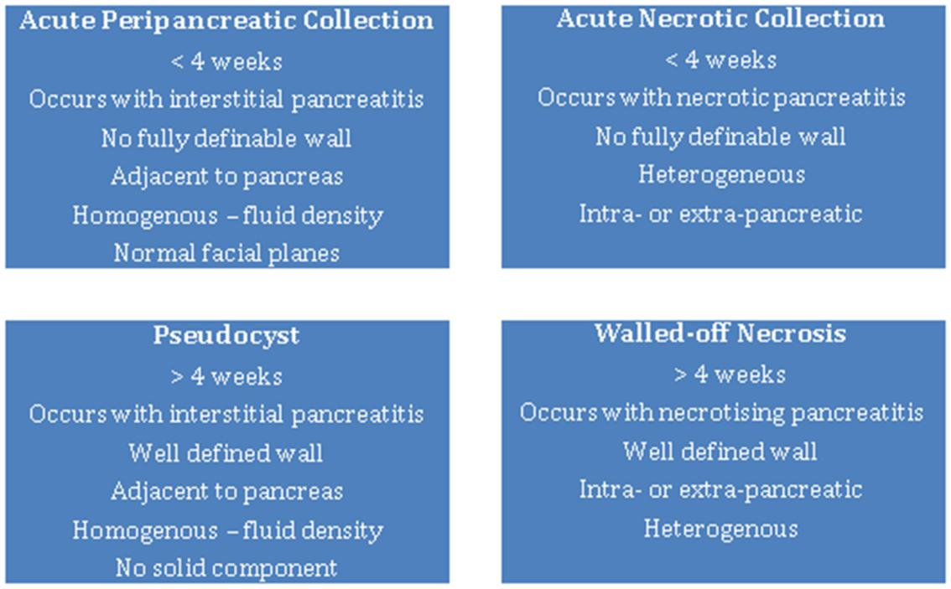
Complications

Slide 43
Local complications
Necrosis
  Sterile
  Infected
  Walled-off necrosis
Pancreatic fluid collections
  Pancreatic abscess
  Pancreatic pseudocyst

Slide 44
Local complications
Obstruction of gastrointestinal tract (stomach, duodenum, colon)
Pancreatic ascites
  Disruption of main pancreatic duct
  Leaking pseudocyst
Involvement of contiguous organs by necrotizing pancreatitis
  Massive intraperitoneal hemorrhage
  Thrombosis of blood vessels (splenic vein, portal vein)
  Bowel infarction
Obstructive jaundice

Slide 45
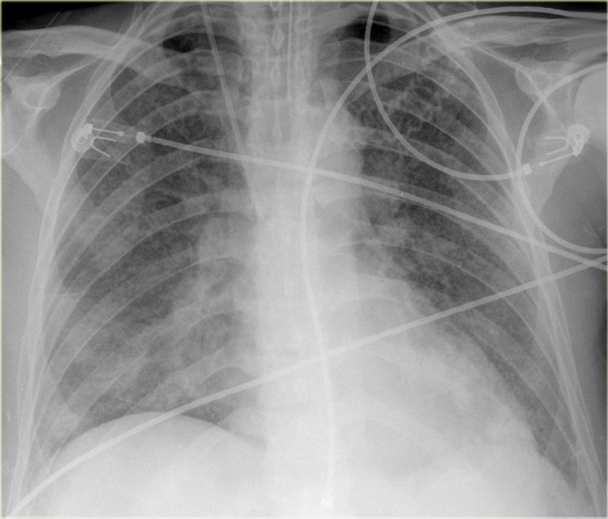
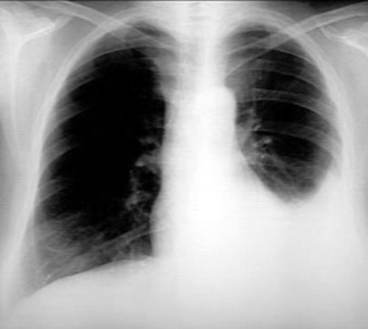
Systemic complications
Pulmonary
  Pleural effusion
  Atelectasis
  Mediastinal abscess
  Pneumonitis
  Acute respiratory distress syndrome
Cardiovascular
  Hypotension
  Hypovolemia
  Sudden death
  Nonspecific ST-T changes in electrocardiogram simulating myocardial infarction

Slide 46
Systemic complications
Hematologic
  Disseminated intravascular coagulation
Gastrointestinal hemorrhage
  Peptic ulcer disease
  Erosive gastritis
  Hemorrhagic pancreatic necrosis with erosion into major blood vessels
  Portal vein thrombosis, variceal hemorrhage
Renal
  Oliguria
  Azotemia
  Renal artery and/or renal vein thrombosis
  Acute tubular necrosis

Slide 47
Systemic complications
Metabolic
  Hyperglycemia
  Hypertriglyceridemia
  Hypocalcemia
Encephalopathy
  Sudden blindness (Purtscher's retinopathy)
  Central nervous system
  Psychosis
Fat emboli
  Fat necrosis
  Subcutaneous tissues (erythematous nodules)
  Bone
  Miscellaneous (mediastinum, pleura, nervous system)

Slide 48
Prognosis
80% Will recover without any complications
20% Will develop severe cardio-pulmonary complications or septic complications
Prognostic assessment :
  Ranson
  Imrie
  APACHE 2
  CRP

Slide 49
ATLANTA classification
Severity Assessment, Assess at admission, 24 hours and 48hours.
Severe: Persistent (>48 hrs) organ failure.
local complications ( necrosis, peripancreatic fluid collections, pseudocyst, splenic & portal vein thrombosis) or Exacerbation of coexistent disease.
Moderately severe: As above but transient only (<48 hours).
Mild: No organ failure, local complications or exacerbation of coexistent disease

Slide 50
Treatment
The main aim of initial treatment is to alleviate symptoms and prevent complications by reducing pancreatic secretory stimuli and correction of fluid and electrolyte abnormalities.
Initially, patients should be fluid resuscitated and kept nil by mouth with bowel rest when nausea, vomiting or abdominal pain are present.
Supportive care continues until pain is resolved and diet restarted.
The majority of patients will improve within 3–7 days of conservative management.
Patients with organ failure or poor prognostic signs should be assessed for admission to a high dependency unit.

Slide 51
Initial management
Aggressive hydration(defined as 250-500 ml per hour of isotonic crystalloid solution) should be given to all patients, unless cardiovascular or renal co morbidities exist.
Early aggressive intravenous hydration is most important in first 12–24 h and may have little benefit beyond.
In patients with severe volume depletion (hypotension and tachycardia), more rapid repletion (bolus) may be needed.
Ringer Lactate solution can be preferred over isotonic crystalloid fluid.
Fluid requirements should be assessed at frequent intervals within 6 h of admission and for the next 24–48 h.
The goal of aggressive hydration should be decrease blood urea nitrogen.

Slide 52
Management
Consideration of HDU involvement
Persistent SIRS >48h
Elderly (aged >70yr
Obese (BMI>35)
Moderately severe pancreatitis
Presence of SIRS on admission is a predictor of Severe pancreatitis.

Slide 53
Role of surgery in Acute Pancreatitis
In mild AP, due to gallstones, cholecystectomy should be performed before discharge to prevent a recurrence of AP.
In necrotizing biliary AP, to prevent infection, cholecystectomy is to be deferred until active inflammation subsides and fluid collections resolve or stabilize.
Asymptomatic pseudocysts and pancreatic or extra pancreatic necrosis do not warrant intervention, regardless of size, location or extension.
In stable patients with infected necrosis, surgical, radiologic or endoscopic drainage can be delayed preferably for more than 4 weeks to allow liquefaction of the contents and development of fibrous wall around the necrosis (walled-off necrosis).
In symptomatic patients with infected necrosis, minimally invasive methods of necrosectomy are preferred to open necrosectomy.

Slide 54
ERCP in Acute Pancreatitis
Patients with AP and concurrent acute cholangitis should undergo ERCP within 24 h of admission.
ERCP is not needed in patients with gallstone pancreatitis who lack laboratory or clinical evidence of ongoing biliary obstruction.
In absence of cholangitis or jaundice, MRCP should be used to screen for choledocholithiasis if highly suspected.
Antibiotics
Antibiotics can be given for extra pancreatic infection, such as cholangitis, catheter acquired infections, bacteremia, urinary tract infections or pneumonia

Slide 55
Chronic Pancreatitis

Slide 56
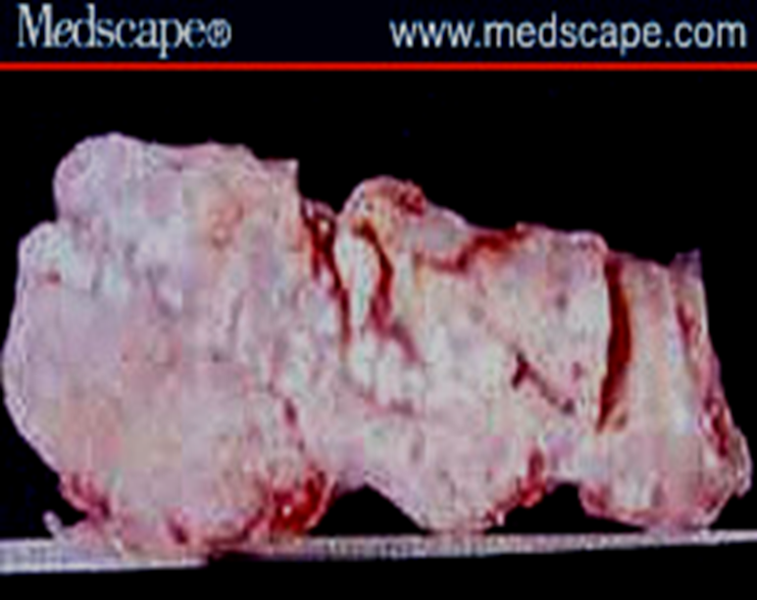
Defined as chronic inflammatory condition that causes irreversible damage to pancreatic structure and function.
Incurable
5 -27 / 100,000

Slide 57
Etiology
Alcohol, 70%
Idiopathic (including tropical), 20%
Other, 10%
  Hereditary
  Hyperparathyroidism
  Hypertriglyceridemia
  Autoimmune pancreatitis
  Obstruction
  Trauma
  Pancreas divisum

Slide 58
Signs and Symptoms
Steady and Boring Pain
Not Colicky
Nausea /Vomiting
Anorexia- Most Common
Malabsorption And Weight Loss
Diabetes Mellitus

Slide 59
Classic triad “ pancreatic calcification , steatorrhea , and diabetes mellitus”
Found in <1/3
secretin stimulation test (abnormal when 60% or more of pancreatic exocrine function has been lost)
decreased serum trypsinogen (<20ng/ml) or a fecal elastase level of <100ug/mg of stool strongly suggests severe pancreatic insufficiency

Slide 60
Imaging techniques
Plain film radiography of abdomen
Ultrasonography
Computed tomography
ERCP
MRCP
EUS

Slide 61
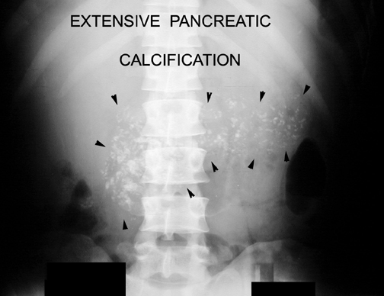
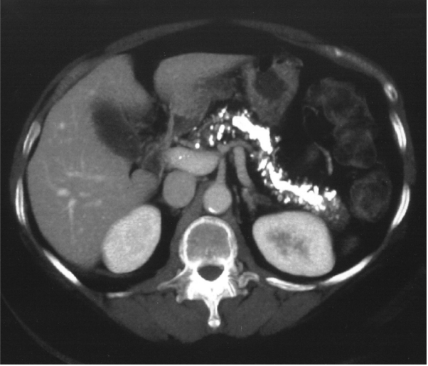
Plain films :
  Pancreatic calcifications : 30%
  most common with alcoholic pancreatitis
Pancreatic calcifications. CT scan showing multiple, calcified, intra ductal stones

Slide 62
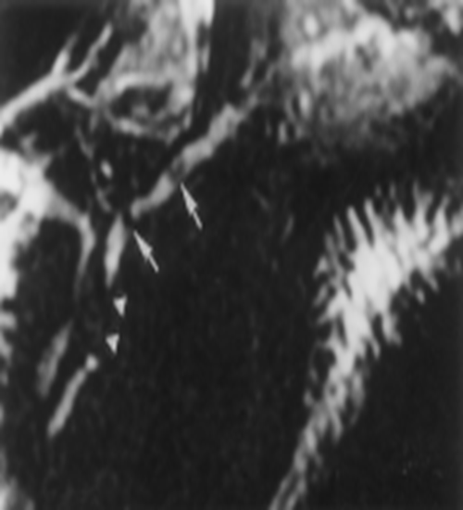
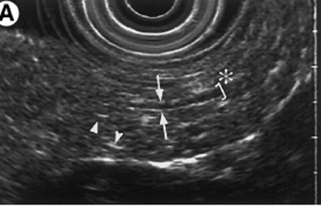
MRCP
MRCP allows a noninvasive alternative to
ERCP for imaging the pancreatic duct.
EUS
is a minimally invasive test that
allows simultaneous assessment
of ductal and parenchymal structure

Slide 63
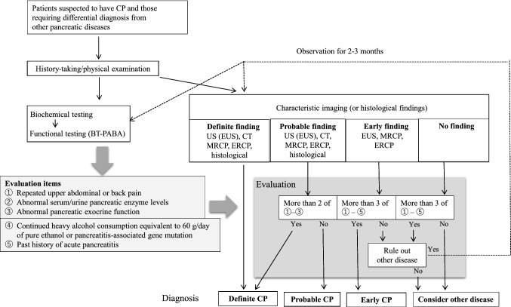

Slide 64
Treatment
Analgesia
Enzyme Therapy
Antisecretory Therapy
Neurolytic Therapy
Endoscopic Management
Surgical Therapy

Slide 65
Complications
Pseudocyst
Pancreatic Ascites
Pancreatic-Enteric Fistula
Pancreatic Mass
Splenic and Portal Vein Thrombosis

Slide 66
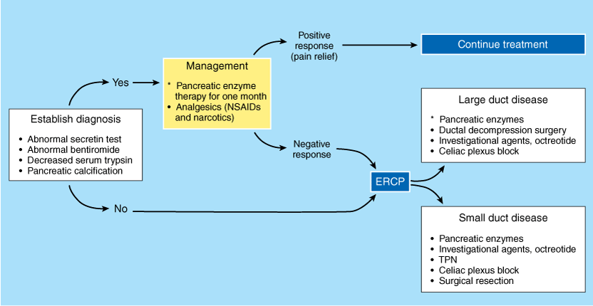
Management Algorithm

Slide 67

The principles in Medical Ethics

Slide 68
The Principle of Autonomy:
An informed, competent adult patient can refuse or accept treatments, drugs, and surgeries according to their wishes.
People have the right to control what happens to their bodies because they are free and rational.
These decisions must be respected by everyone, even if those decisions aren’t in the best interest of the patient.

Slide 69
The Principle of Veracity:
Truth telling
Obligation to full and honest disclosure

Slide 70
THANK YOU

