Slide 1
Acute Limb Ischemia
Prof. M Waqas Raza
FCPS FRCS MHPE
General/Vascular surgeon
Dean of Surgery RMU

Slide 2
At the end of interactive Integrated Lecture
The students should be able to
1. Describe the clinical feature of Acute limb ischemia
2.Outline the important steps in diagnosis and Investigations of acute limb ischemia
3. Chalk out a management Plan
4. Recall basic steps of surgical embolectomy
5 . Appreciate the importance of timely intervention and consequences of late intervention.

Slide 3
Prof. Umer model of LGIS

Slide 4
Arteries of limbs

Slide 5
Definition
A sudden decrease in limb perfusion that threatens limb viability defines acute limb ischemia and represents a major vascular emergency.
The clinical presentation is considered to be acute if it occurs within 14 days after symptom onset

Slide 6
Limb ischemia etiology

Slide 8
Chronic limb ischemia
In contrast to critical limb ischemia, also called chronic limb-threatening ischemia, in which collateral blood supply is often present, ALI threatens limb viability in a very short interval, because there is insufficient time for new blood vessel growth to compensate for the loss of perfusion.
Acute on chronic limb ischemia ?????

Slide 9
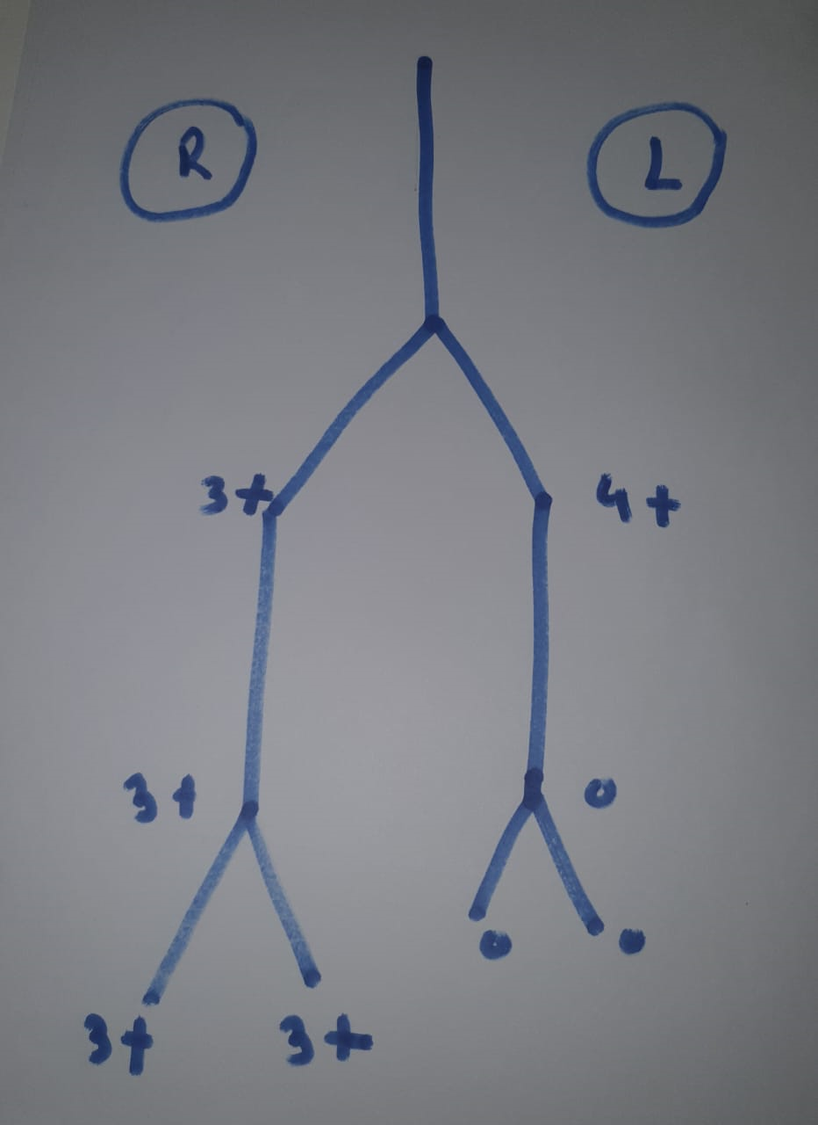

Slide 10
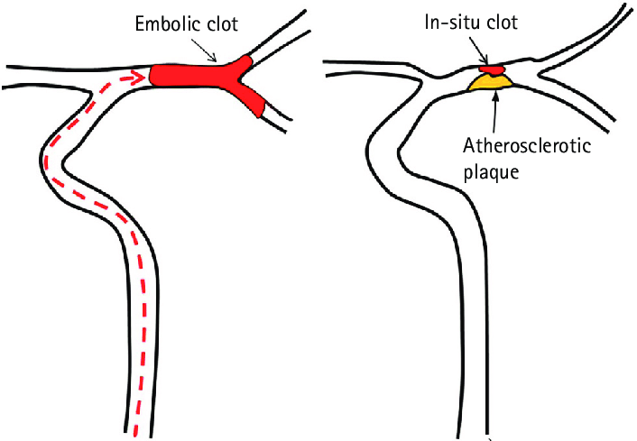
Extent of damage
Level of occlusion/collateral circulation
Etiology
Embolic vs thrombotic
Trauma

Slide 13
Prevalence
The incidence of ALI is approximately 1.5 cases out of 10,000 people per year.
Complications among ALI patients are high and despite early revascularization, 30-day mortality and amputation rates are between 10 and 15%.
ALI patients experience increased in-hospital major adverse events including myocardial infarction, congestive heart failure exacerbation, deterioration in renal function and respiratory complications

Slide 14
Etiology
There are different causes which can lead to ALI
Arterial embolism (30%)
Cardiac embolization
Aortic embolization (eventually from a thrombosed aneurysm)
Thrombosed graft,
Hypercoagulable states
Paradoxical venous-to-arterial embolism
Iatrogenic complications related to endovascular procedures
Arterial thrombosis due to plaque progression and complication (40%)
Thrombosis of a popliteal aneurysm (5%)
Trauma (5%)
Graft thrombosis (20%)

Slide 15
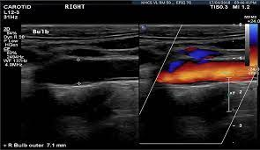
Investigations
Duplex ultrasound (DUS)
First imaging choice to assess ALI.
It is widely available,
Low cost
Non-invasive
Non-irradiant
Relative short time to perform.

Slide 16
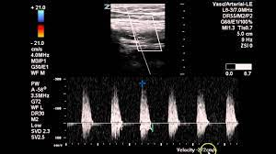
DUS is useful to
Assess the anatomic location
Degree of obstruction (complete vs. incomplete).
DUS provides important information on hemodynamics (proximal and distal to the obstruction)
Highly useful for the follow up of revascularization procedures .

Slide 17
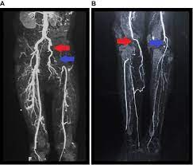
Computed Tomography Angiography/Magnetic Resonance Angiography
Multi-detector computed tomography (MDCT) angiography has a sensitivity and specificity of 96 and 98%, respectively in detecting significant (>50%) aortoiliac stenoses
The biggest advantage of CTA is the visualization of calcifications, stents and bypasses.

Slide 18
Iodinated contrast agents can worsen renal failure and are generally not indicated in patients with a glomerular filtration rate lower than 60 mL/min.
Patients with ALI may, however, have a limited ability to attend long imaging sessions associated with non-invasive angiography.
CTA and MRA are reserved for patients with a non-immediately threatened limb.
The use of CTA and MRA for ALI remain very limited.

Slide 19
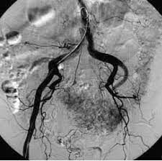
Conventional Invasive Angiogram
DSA was considered for many years the “gold standard” for diagnosis.
Invasive procedure, with a potential risk of complications
Cath Labs not readily available
DSA should not be used as a first diagnostic tool and should not replace DUS for positive diagnosis of ALI
DSA is complementary to DUS and plays an essential role in the therapeutic strategy.

Slide 20
Management
Evaluation of Limb viability
Urgent anticoagulation with unfractionated heparin (UFH) prevents thrombus propagation and preserves microcirculation
Analgesic treatment is often necessary
Routine blood and coagulation tests should be performed.
.

Slide 21
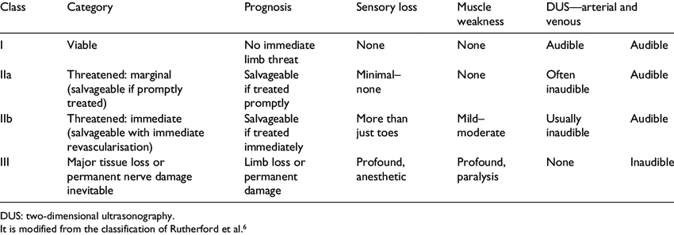
Modified Rutherford Classification

Slide 22
Auscultation of the heart, chest X-ray and electrocardiography are mandatory in every patient
Cardiac embolism is of particular concern in patients with atrial fibrillation, myocardial infarction, impaired left ventricular function or mechanical heart valves.

Slide 23
Treatment
One Liner
If Ankle/Wrist is fixed, its probably too late for intervention
The therapeutic strategy will depend on
Type of occlusion
Location
Type of conduit (artery of graft)
Rutherford class
Duration of ischemia
Co-morbidities
Therapy-related risks and outcomes.

Slide 24
Different revascularization strategies can be applied, either
Endovascular
Surgical

Slide 25
EndovascularTechniques
Percutaneous catheter-directed thrombolysis (CDT),
Percutaneous thromboaspiration (PAT), with or without thrombolytic therapy
Percutaneous Mechanical thrombectomy (PMT).

Slide 26
Catheter-Directed Thrombolysis
Clinical outcomes are similar to surgert and amputation-free survival rates at 6 months and one year are not significantly different.
Patients with symptoms of longer duration (>14 days) has better outcomes after surgery
CDT has lower rates of procedure-related morbidity and mortality compared to the surgery group, at a cost of higher bleeding complications.
Using CDT, complete or partial thrombus resolution, with a satisfactory clinical result, occurs in 75–92% of ALI patients with occluded native vessel, stent or graft.

Slide 27
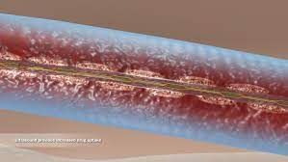
Because of the long time to reperfusion, CDT it is generally not indicated in Rutherford stage IIb.
Patients with suspected graft infection, symptom duration >14 days, contraindications to thrombolysis
Failure to position the catheter across the thrombus should not undergo CDT.
Up to 20% of patients can have a contraindication to thrombolytic therapy
Another new technique is ultrasound-accelerated thrombolysis (USAT) which uses sound waves to accelerate thrombolysis. Low-frequency sounds mechanically fragment clots and augment enzymatic fibrinolysis

Slide 28
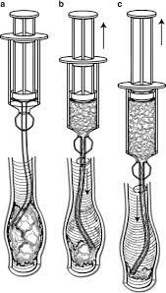
Percutaneous Thromboaspiration
It is a low-cost, rapid technique which uses large lumen catheters (6–8F) connected to a syringe.
It is used in combination with thrombolysis to reduce procedural time in advanced ischemia.
Thromboaspiration alone has been reported to have modest procedural success rates of approximately
30%, but combined with thrombolysis, the primary success rate reached 90%, with a limb salvage rate of 86% [35].
Thromboaspiration is highly effective in treating acute iatrogenic distal embolization during endovascular procedures.

Slide 29
Percutaneous Mechanical Thrombectomy
The percutaneous removal of a thrombus is often used as first-line therapy for ALI patients.
PMT is defined as endovascular thrombus maceration and removal with the use of dedicated percutaneous thrombectomy devices (PTDs).
In patients at high risk of bleeding, PMT can be used to debulk the thrombus mass before local lysis to shorten the treatment period, thereby limiting the dose of thrombolytic agent needed.
A number of studies mention very high technical success rates (over 90%) for primary re-opening of infra-aortic vessels with PMT
Usually, there is a need to perform balloon angioplasty or stent implantation after successful removal of the thrombotic material.

Slide 30
Open Surgery
Surgical procedures in ALI include
Thrombectomy with a balloon catheter (Fogarty)
Bypass surgery
Adjuncts such as
Endarterectomy
Patch angioplasty
Intra-operative thrombolysis.

Slide 31
Reperfusion Injury
Reperfusion injury may result after target vessel re-opening, especially in advanced stages of ischemia.
Profound limb swelling, with a dramatic increase in compartmental pressures, is the trademark of this phenomenon
Patients experience severe pain and hyperesthesia of the affected limb.
The diagnosis is based on clinical findings but can be confirmed if the compartment pressure is over 30 mmHg .

Slide 32
Systemic Manifestations of reperfusion
Cardiac
Respiratory
Renal

Slide 37
Upper limb embolectomy

Slide 39
Exposure of Popliteal artery in Leg

Slide 40
Distal embolectomy

Slide 41
Proximal embolectomy

Slide 42
Proximal embolectomy

Slide 43
Final Pass

Slide 44
The Cameraman

Slide 46
Vascular surgery---A speciality
The increase in the volume and complexity of vascular conditions and the development of new minimally invasive techniques has led to the need for vascular surgery to become a separate specialty.

Slide 47
The eye can’t see ……
Failure to palpate the pulses
Misdiagnosis as sciatica or stroke
Refer to vascular surgeon once the gangrene has set in
THANX

