Slide 1
Abnormal Uterine Bleeding
Dr Hina gul
Assist. Prof. Gynae & Obs
BBH, Rwp

Slide 2



To impart evidence based research oriented medical education.
To provide best possible patient care.
To inculcate the values of mutual respect and ethical practice of medicine
VISION,THE DREAM TOMORROW

Slide 3
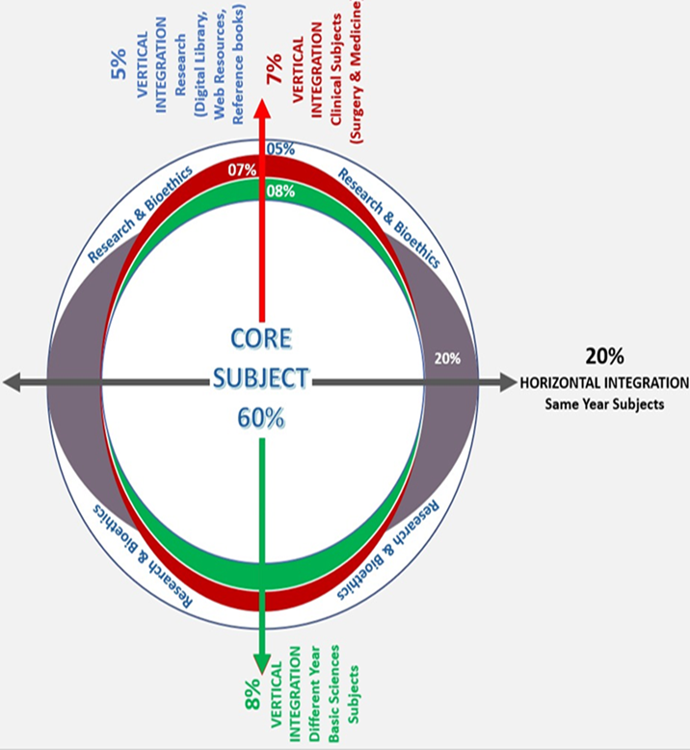
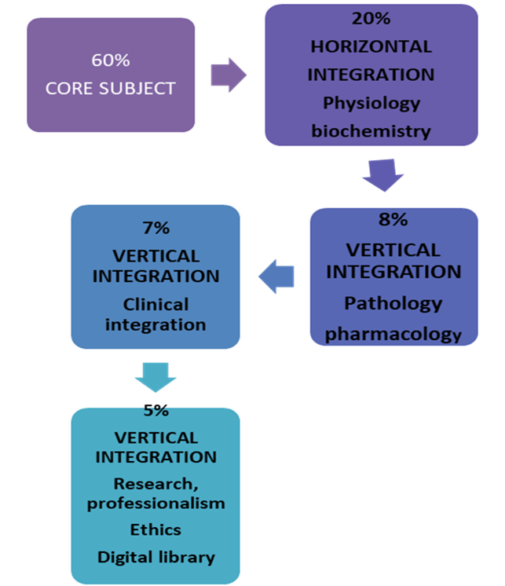


Slide 4
Learning Objectives
Define abnormal uterine bleeding (AUB) and describe its types and prevalence
Classify AUB and recognize key history and examination findings
Identify investigations to diagnose AUB
Discuss management options

Slide 5
Question 1
What is the amount of blood loss in HMB as per definition?
60 mL
70 mL
80 mL
90 mL
100 mL
✓

Slide 6
Question 2
The term dysfunctional uterine bleeding as been replaced by which of the following?
Heavy menstrual bleeding
Inter-menstrual bleeding
Post coital bleeding
Bleeding of endometrial origin
Abnormal uterine bleeding
✓

Slide 7
Question 3
Which of the following is an indication for endometrial biopsy in HMB?
Age over 40 years
Endometrial thickness < 4mm
Treatment failure
Obesity with hypertension
No prior ablative techniques
✓

Slide 8
Question 4
Which is the most common cause of AUB?
Adenomyosis
Fibroid
Endometrial polyp
Bleeding of endometrial Origin
Coagulation disorders
✓

Slide 9
Question 5
A 32-year-old woman present with heavy menstrual bleeding she has two children and doesn’t want to concieve at present. O/E she has normal size uterus that’s non-tender
What is the first line treatment for her HMB according to NICE?
Endometrial abalation
Oral contraceptive pills
Oral contraceptive pills used back to back
Northisterone
LNG-IUS
✓

Slide 10
Definition
Abnormal uterine bleeding is defined as bleeding that is abnormal in volume, timing, regularity and negatively impacts patient’s life

Slide 11
Types of AUB
Heavy menstrual Bleeding ( HMB)
Intermenstrual bleeding (IMB)
Post coital bleeding (PCB)
Bleeding of endometrial origin (BEO)

Slide 12
Prevalance and impact
Menstrual irregularities account for up to 25-35% of women attending gynecological outpatient departments.
More commonly experienced by women of 35-45 years of age group.
Commonly seen in young girls (55.7%) soon after attaining menarche

Slide 13
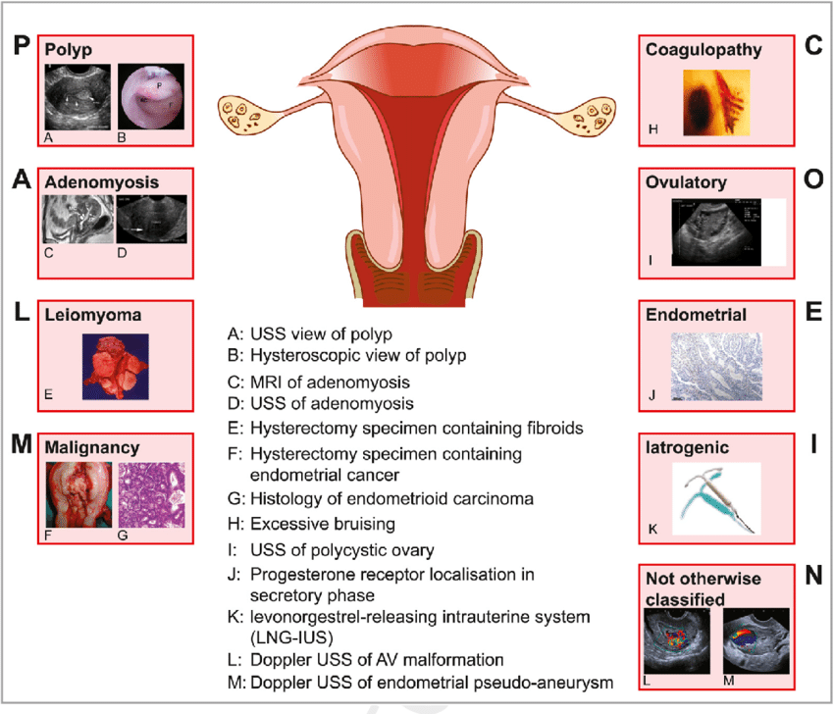
FIGO has developed a classification system recognized as PALM COEIN

Slide 14
Clinical Evaluation

Slide 15
History
Cycle length, Flow, Flooding and clots
Intermenstrual and post-coital bleeding
Effect on Quality of life
Discharge: type, colour, timing
Dysmenorrhea
Dysparunia
History of contraception use
Pap-smear history

Slide 16
History
A coagulation disorder:
  Excessive bleeding since menarche
  history easy bruising, bleeding after dental tooth extraction
Fibroid: Pressure symptoms urinary symptoms, abdominal mass.
Thyroid disease: Weight changes, skin changes and fatigue

Slide 17
Examination
General physical examination:
  Signs of anemia
  Systemic coagulopathy (bruising, petechia)
  Thyroid disease ( goiter)
Abdominal examination:
  To reveal pelvic mass (fibroid)
Speculum examination:
  To assess the vulva, vagina and cervix
  To assess the source of bleeding such as tumor or discharge .

Slide 18
Investigations
Full blood count | All women with HMB
Coagulation screen | If history suggestive of a coagulation disorder
Thyroid function tests | If symptoms of thyroid disease
Endocervical/high vaginalswabs | If history suggestive of risk of infection
Papsmear examination | Suspicion of cervical pathology
Evaluation of the uterine cavity (pelvic ultrasound, MRI, and outpatient hysteroscopy) | Intermenstrual or post‐coital bleeding, irregular HMB, suspected structural pathology, or when medical managemen thas failed
Histological assessment of the endometrium | Symptomatic women ≥45 years old, younger women medical treatment has failed, younger women with risk factor (e.g. PCOS, obesity) and all women prior to surgical intervention

Slide 19
Management
It is important to consider and discuss:
• The patient’s preference of treatment.
• Risks/benefits of each option.
• Contraceptive requirements
Past medical history
Previous surgical history on uterus

Slide 20
Medical treatment
NON HORMONAL TREATMENTS
Antifibrinolytics (Tranexamic acid): Inhibit endometrial fibrinolysis, reduce blood loss by 50%
Prostaglandin synthetase inhibitors (NSAIDs- Mefenamic Acid) : inhibit endometrial prostaglandin production, and reduce blood loss by 25%

Slide 21
Medical treatment
HORMONAL TREATMENTS
Levonorgestrel Intrauterine system (Mirena ): reduces blood loss by 95% after 6 months- 1 year.
Progestogens (Norethisterone): taken 15mg daily in a cyclical pattern from day 6 to day 26 of the menstrual cycle.

Slide 22
Medical treatment
Combined oral contraceptive pill (COCP): effective and reduce blood loss by 50% .
Gonadotrophin-releasing hormone agonists (GnRH): act on the pituitary to stop production of estrogen which results in amenorrhea

Slide 23
Surgical treatment
Endometrial Abalation
Uterine artery Embolization
Myomectomy
Transcervical resection of fibroid
Hysterectomy

Slide 24
Endometrial Ablation
Endometrial ablation is the targeted destruction of the endometrium, prevents regeneration of endometrium
Suitable for women with a uterus no bigger than 10 weeks size and fibroid <3cm
After treatment, 40% will become amenorrhoeic, 40% will have markedly reduced blood loss and 20% will have no difference.
Microwave ablation (Microsulis™).

Slide 25
Uterine artery embolization
A well-established technique for the treatment of fibroids.
The femoral artery is canalized on one or both sides and fed into the iliac and then into uterine artery.
After treatment, 30-46% reduction in fibroid volume as benn reported and symptomatic improvement upto 85%

Slide 26
Polypectomy
Endocervical polyps can be avulsed in the outpatient setting.
Endometrial polyps can be removed under general anesthesia or by hysteroscopic resection.
Myomectomy
It is the surgical removal of fibroid from the uterine wall with conservation of the uterus.

Slide 27
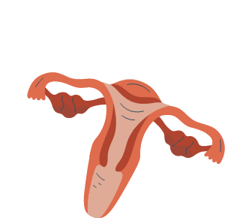
Hysterectomy
It is the surgical removal of the uterus.
Considered in women who have completed family and when medical and less invasive treatment has failed.
Can be performed abdominally and vaginally.

Slide 28
Research
Lebduska E, Beshear D, Spataro BM. Abnormal uterine bleeding. Medical Clinics. 2023 Mar 1;107(2):235-46.
Achanna KS, Nanda J. Evaluation and management of abnormal uterine bleeding. Med J Malaysia. 2022 May 1;77(3):374-83.

Slide 29
Beneficence
The principle of beneficence is the obligation of physician.
To act for the benefit of the patient.
Support a number of moral rules to protect and defend the right of others.
Prevent harm, remove conditions that will cause harm.
Help persons with disabilities, and rescue persons in danger

Slide 30
Biomedical ethics
All the treatment options should be approachable to patients.
Availability of blood products in primary and secondary health care units.
Timely decision to refer the patient if needed.

Slide 31
Learning Resources
GNAECOLOGY by Ten Teachers, 20th EDITION
Dewhurst’s Textbook Of Obstetrics & Gynaecology, 9th EDITION
Google scholar
Google images

Slide 32
How To Access Digital Library
Go to the website of HEC National Digital Library.
On Home Page, click on the INSTITUTES.
A page will appear showing the universities from Public and Private Sector and other Institutes which have access to HEC National Digital Library HNDL.
Select your desired Institute.
A page will appear showing the resources of the institution
Journals and Researches will appear
You can find a Journal by clicking on JOURNALS AND DATABASE and enter a keyword to search for your desired journal.

Slide 33


