Slide 2
ASTHMA IN PREGNANCY
D R F A R A N M A Q B O O L
A S S I S T A N T P R O F E S S O R
RAWALPINDI TEACHING
H O S P I T A L

Slide 3
UMER INTEGRATION MODEL

Slide 4
Mission, Vision ,Goals
MISSION To impart evidence-based research-oriented health professional education Best possible patient care Mutual respect, ethical practice of healthcare and social accountability. Vision and Values Highly recognized and accredited centre of excellence in Medical Education, using evidence-based training techniques for development of highly competent health professionals, who are lifelong experiential learner and are socially accountable. Goals The Undergraduate Integrated Learning Program is geared to provide you with quality medical education in an environment designed to learn and grow.

Slide 5
Core concept (Learning Objectives)
What is asthma
Effects of pregnancy on lungs
Effects of pregnancy on asthma
Effects of asthma on pregnancy
Labor and Puerperium
Clinical features and diagnosis
Management of asthma in pregnancy
Asthma action plan

Slide 6
Core Concept Asthma
Definition: Chronic inflamatory disease characterized by brochial hyper reactivity leading to variable degree of airflow obctruction.
This airflow obstruction during pregnancy can cause maternal hypxia and can effect the outcome of pregnancy

Slide 7
CORE CONCEPT
Effects of Pregnancy on lungs
Anatomical changes:
Upper respiratory mucosal edema and mucous gland hyperplasis leading to increased secretion
Enlarging uterus causing widened AP and transverse diameter
and elevating the diagphram upto 4 cm.

Slide 8
CORE CONCEPT
Changes in lung fuctions:
Increase in R/R upto 10% and increase in Tidal Volume= increase in minute venilation
Increased inspiratory capacity and deceased Functional residual capacity and Residual volume
Total lung capacity remain same

Slide 9
CORE CONCEPT
Hormonal changes:
Estrogen: upper airway hyperemia and inc mucous production
Progesteron: bronchodilation
Maternal cortisol: brochodilation
Prostaglandins: brochodilation and brochoconstriction
Result of these changes:
Increase oxygen delivery + consumption
Increase risk of URTI
Slight increase risk of asthma exacerbation

Slide 10
CORE CONCEPT
EFFECT OF PREGNANCY ON ASTHMA
Asthma symptoms flare up in 1/3 of pregnant women, remain same in 1/3 and decrease in other 1/3.
Overall incidence of asthma occuring in pregnancy is 8 percent
Symptoms are more likely to worsen in second and third trimester of pregnancy
Halting or reducing medication intake for asthma may result in asthma exacerbations
Exacerbation mostly occur in second trimester

Slide 11
Complications that can occur in a pregnant female with asthma
(effects of asthma on pregnancy)

Slide 12
Classification of Asthma Severity and its management
According to severity asthma can be classified into 4 types
1. Mild intermittent
Management: Step 1
2. Mild persistent
Management: Step 2
3. Moderate persistent
Management: Step 3
4. Severe persistent
Management: Step 4 or 5

Slide 13
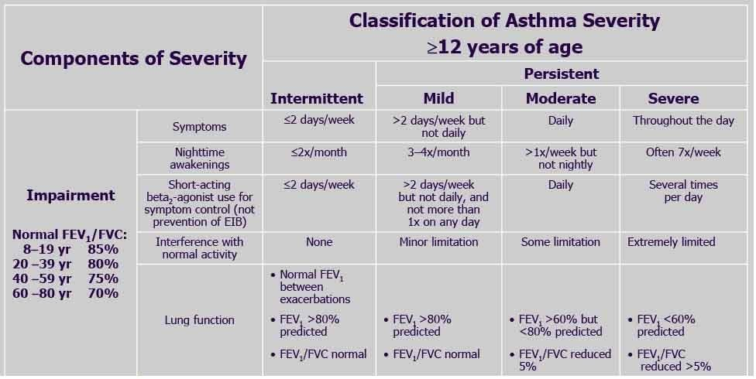

Slide 14
Complications
Pre-Eclampsia
Preterm labour
Low birthweight
Congenital anomalies
Spontaneous abortions
Increased fetal and maternal mortality
Note: all above complication are associated with poor asthma control and asthma exacerbation(chronic and acute hypoxia), and these can be avoided

Slide 15
VERTICAL INTEGRATION
clinical features of asthma in pregnancy
More than one type of respiratory symptoms as wheeze, shortness of breath, cough that vary in intensity over time.
GPE reveals tachypnea, retraction of sternomastoid and abdominal pectoralis muscles, agitation due to hypoxia and pulsus paradoxus (>20 mmHg)
Diffuse wheezes , long high pitched sound on expiration and occasionally on inspiration

Slide 16
VERTICAL INTEGRATION PRE-ECLAMPSIA
Pre-eclampsia is known to occur in 5-8 percent of all pregnancies with asthma.
Women may present with elevated blood pressure, swelling, protein in urine, headaches, abdominal pain, visual changes and associated vomiting

Slide 17
HORIZONTAL INTEGRATION
labour and puerperium
There is less chances of Asthma exacerbations during labor due to excess stress hormone like cortisol
Some drugs used to induce labor can cause airway narrowing like PGF-2 etc and shoul not be used
Oxytocin is a safe and better alternative
If exacerbation occurs it can cause:
uterine hemorrhage
neonatal hypoxia, distress, hypoglycemia and neonatal
seizures etc

Slide 18
VERTICAL INTEGRATION
SIGNS AND SYMPTOMS OF SEVERE ASTHMA
Difficulty completing short sentences
Severe apprehension, feeling of doom
Pulse>110, R/R> 30, cyanosis,
Reduced breath sounds, silent chest
Distension of jugular venous pressure
Drowsy
Unconciousness
Low O2 sats

Slide 19
VERTICAL INTEGRATION
DIAGNOSTICS FOR ASTHMA IN PREGNANCY
Diagnosis id usually made clinicaly and
SPIROMETRY can be used to diagnose asthma in pregnancy.
Positive bronchodilator reversibility test
Decreased peak expiratory flow(PEF) rate and FEV in one second.. Mild reduction in FVC . Increased Residual Volume
FeNO , fraction of exhaled nitric oxide and blood eosinophil counts, are significant tools for asthma assessment.

Slide 20
VERTICAL INTEGRATION
CO-MORBIDS ASSOCIATED WITH ASTHMA
These co morbids increase risk of asthma attack
Allergic rhinitis
GERD
Sinusitis
Bronchiectasis
Obesity

Slide 21
VERTICAL INTEGRATION
Asthma Monitoring
Clinical Assesment
Day time, night time symptoms, activity limitation as mentioned above
Spirometery
monthly
PEF metery
twice daily
⯍After waking in morning then 12 hours after

Slide 22
HORIZONTAL INTEGRATION
Risk factors associated with Asthma attacks
Cold air
Allergens
Exercise
Smoking
URTIs etc

Slide 24
VERTICAL INTEGRATION
Management of asthma in pregnancy
GOALS
Complete asthma control with optimum medications
Prevent exacerbation
Avoidance of exacerbating factors like smoking
Treat any co morboities which can cause difficulty in controlling asthma

Slide 25
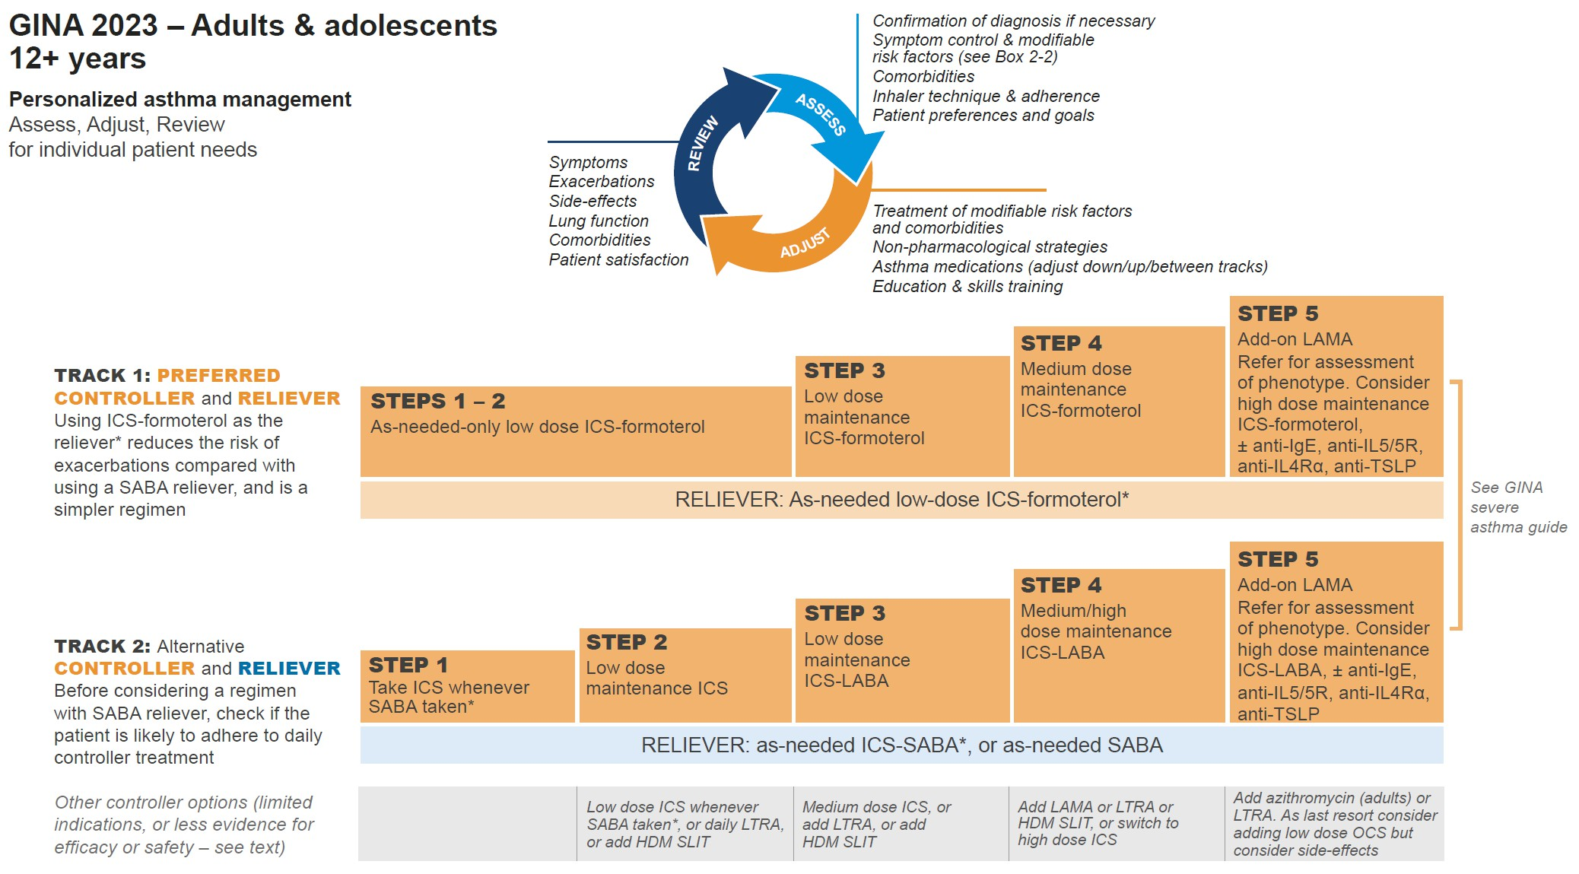
Steps Of management according to GINA 2023
*Anti-inflammatory reliever (AIR)
Box 3-12
© Global Initiative for Asthma, www.ginasthma.org

Slide 26
HORIZONTAL INTEGRATION DIFFERENTIALS OF ASTHMA IN PREGNANCY
AIRWAY OBSTRUCTION
AMNIOTIC FLUID EMBOLISM
ACUTE CHF secondary to peripartal cardiomyopathy
Physiologic dyspnea of pregnancy

Slide 27
VERTICAL INTEGRATION
Medicine used to treat asthma
1. Bronchodilators
Beta 2 Agonists
⯍SABA e.g Salbutamol, terbutaline
⯍LABA e.g formoterol, salmeterol, bambuterol
Muscrinic antagonists
⯍SAMA e.g ipratropium
⯍LAMA e.g Tiotropium, glycopyronium
Leukotriene antagonists
⯍Montelukast, zafirlukast

Slide 28
VERTICAL INTEGRATION MANAGEMENT
Xanthine derivatives
⯍ Theophylline, aminophyline, doxyphylline
Other bronchodilators
⯍Epinephrine, MgSO4
2. Anti-inflamatory drugs
Corticosteroids
⯍ Inhaled corticosteroids(ICS): budesunide, beclomethasone, fluticasone
⯍ Oral corticosteroids(OCS): prednisolone, dexa and
betamethasone
⯍Intra venous corticosteroids: hydrocortisone and methyl-prednisolone

Slide 29
Drugs that must be used cautiously in asthma in (HORIZONTAL)pregnancy
3. Others anti-inflamatory
sodium cromoglicate, nedocromil
4. Antibodies
Anti IgE antibodies, omalizumab
Anti IL-5 antibodies, reslizumab, mepolizumab

Slide 30
CORE CONCEPT
Note: Treatment of pregnant asthmatic patients is exactly same as in non pregnant asthmatic patients.
All the asthma medicine are safe and any small rsik or side effect outweighs risk to mother and fetus due to exacerbation and poor control of asthma

Slide 31
Assessment of Asthma control

Slide 32
CORE CONCEPT
Summary
Asthma is one of the common condition which may complicate Pregnancy
Asthma may remain same improve or worsen during pregnancy which may alter out come of pregnancy
That’s why Asthma should be vigorously managed
and monitored
And the goals of management are asthma control, prevention and treatment of exacerbation and co- morbidities

Slide 33
Thank you

