Slide 1


Slide 2

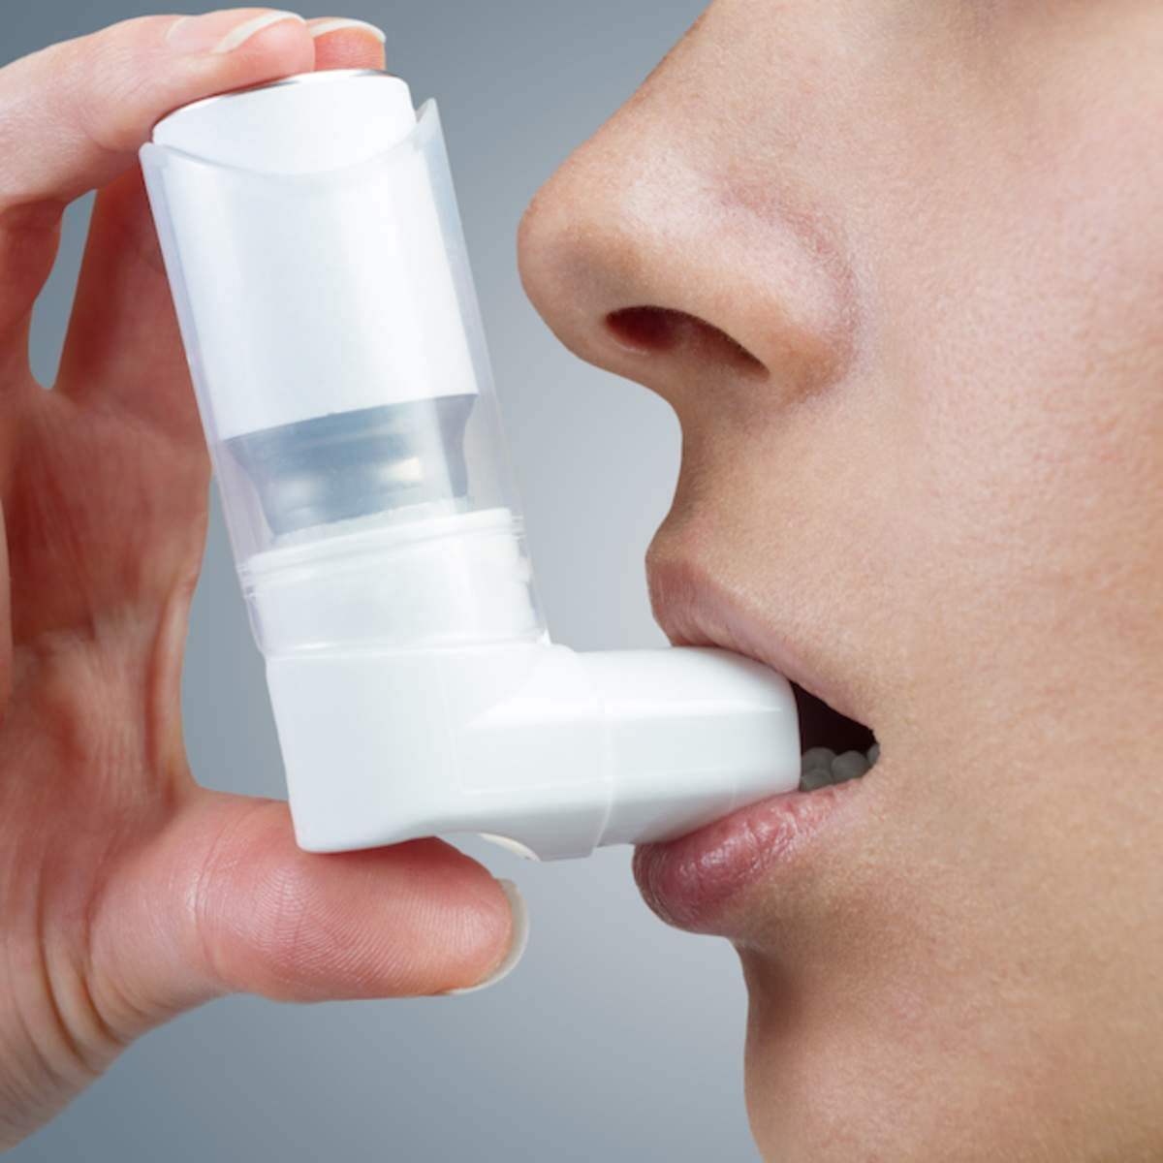
ASTHMA IN PREGNANCY
DR MUHAMMAD ARIF
ASSOCIATE PROFESSOR
MEDICINE DEPARTMENT
HOLY FAMILY HOSPITAL

Slide 3
University Motto, Vision, Values & Goals
Mission Statement
To impart evidence-based research-oriented health professional education Best possible patient care Mutual respect, ethical practice of healthcare and social accountability.
Vision and Values
Highly recognized and accredited centre of excellence in Medical Education, using evidence-based training techniques for development of highly competent health professionals, who are lifelong experiential learner and are socially accountable.
Goals
The Undergraduate Integrated Learning Program is geared to provide you with quality medical education in an environment designed to:

Slide 4
(Learning Objectives)
CORE CONCEPT
What is asthma
Effects of pregnancy on lungs
Effects of pregnancy on asthma
Effects of asthma on pregnancy
Labor and Puerperium
Clinical features and Diagnosis
Management of asthma in pregnancy
Asthma action plan

Slide 5


Slide 6
CORE CONCEPT
Definition: Chronic inflammatory disease characterized by bronchial hyper reactivity leading to variable degree of airflow obstruction.
This airflow obstruction during pregnancy can cause maternal hypoxia and can effect the outcome of pregnancy

Slide 7
Effects of Pregnancy on lungs
CORE CONCEPT
Anatomical changes;
  Upper respiratory mucosal edema and mucous gland hyperplasia leading to increased secretion
  Enlarging uterus causing widened AP and transverse diameter and elevating the diaphragm up-to 4 cm.

Slide 8
CORE CONCEPT
Changes in lung fuctions:
  Increase in R/R upto 10% and increase in Tidal Volume= increase in minute venilation
  Increased inspiratory capacity and deceased Functional residual capacity and Residual volume
  Total lung capacity remain same

Slide 9
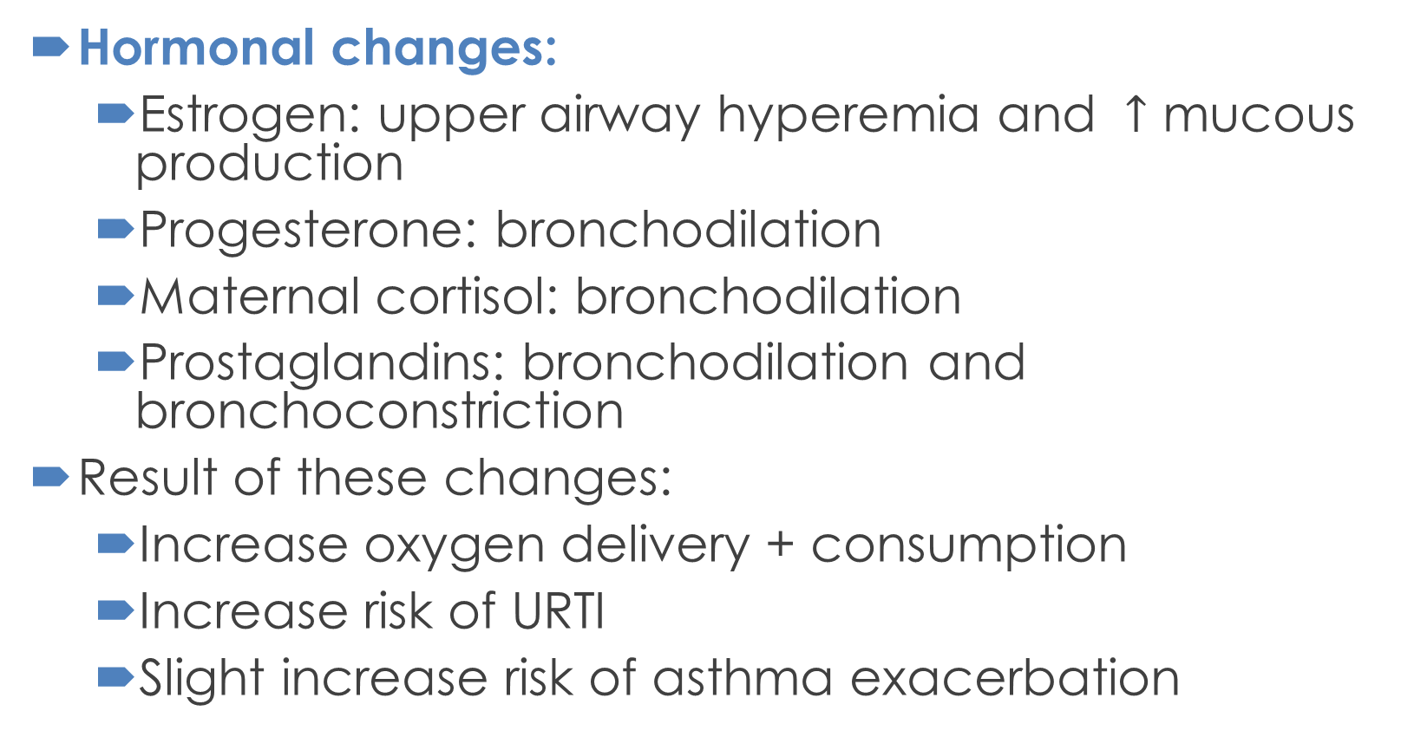
CORE CONCEPT
Hormonal changes:
  Estrogen: upper airway hyperemia and $↑$ mucous production
  Progesterone: bronchodilation
  Maternal cortisol: bronchodilation
  Prostaglandins: bronchodilation and bronchoconstriction
Result of these changes:
  Increase oxygen delivery + consumption
  Increase risk of URTI
  Slight increase risk of asthma exacerbation

Slide 10
EFFECT OF PREGNANCY ON ASTHMA
CORE CONCEPT
Asthma symptoms flare up in 1/3 of pregnant women, remain same in 1/3 and decrease in other 1/3.
Overall incidence of asthma in pregnancy is 8 %.
Symptoms are more likely to worsen in second and third trimester of pregnancy
Halting or reducing medication intake for asthma may result in asthma exacerbations
Exacerbation mostly occur in second trimester

Slide 11
Classification of Asthma Severity and its management
VERTICAL INTEGRATION
According to severity asthma can be classified into 4 types
1. Mild intermittent
Management: Step 1
2. Mild persistent
Management: Step 2
3. Moderate persistent
Management: Step 3
4. Severe persistent
Management: Step 4 or 5

Slide 12
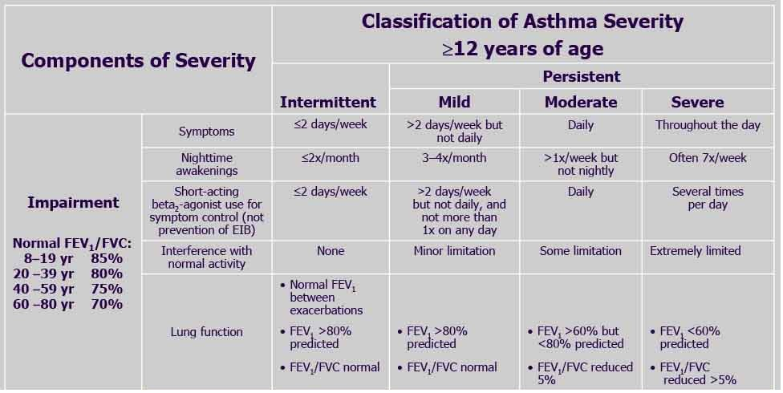

Slide 13
Complications
VERTICAL INTEGRATION
Pre-Eclampsia
Preterm labour
Low birthweight
Congenital anomalies
Spontaneous abortions
Increased fetal and maternal mortality
Note: all above complication are associated with poor asthma control and asthma exacerbation(chronic and acute hypoxia), and these can be avoided

Slide 14
Clinical Features Of Asthma In Pregnancy
VERTICAL INTEGRATION
More than one type of respiratory symptoms as wheeze, shortness of breath, cough that vary in intensity over time.
GPE reveals tachypnea, retraction of sternomastoid and abdominal pectoralis muscles, agitation due to hypoxia and pulsus paradoxus (>20 mmHg)
Diffuse wheezes , long high pitched sound on expiration and occasionally on inspiration

Slide 15
PRE-ECLAMPSIA
VERTICAL INTEGRATION
Pre-eclampsia is known to occur in 5-8 percent of all pregnancies with asthma.
Women may present with elevated blood pressure, swelling, protein in urine, headaches, abdominal pain, visual changes and associated vomiting

Slide 16
Labour And Puerperium
VERTICAL INTEGRATION
There is less chances of Asthma exacerbations during labor due to excess stress hormone like cortisol
Some drugs used to induce labor can cause airway narrowing like PGF-2 etc and should not be used.
Oxytocin is a safe and better alternative
If exacerbation occurs it can cause:
  uterine hemorrhage
  neonatal hypoxia, distress, hypoglycemia and neonatal seizures etc

Slide 17
SIGNS AND SYMPTOMS OF SEVERE ASTHMA
VERTICAL INTEGRATION
Difficulty completing short sentences
Severe apprehension, feeling of doom
Pulse>110, R/R> 30, cyanosis,
Reduced breath sounds, silent chest
Distension of jugular venous pressure
Drowsy
Unconciousness
Low O2 sats

Slide 18
DIAGNOSTICS OF ASTHMA IN PREGNANCY
VERTICAL INTEGRATION
Diagnosis is usually made clinically and
SPIROMETRY can be used to diagnose asthma in pregnancy.
Positive bronchodilator reversibility test
Decreased peak expiratory flow(PEF) rate and FEV1 in one second. Mild reduction in FVC . Increased Residual Volume
FeNO , fraction of exhaled nitric oxide and blood eosinophil counts, are significant tools for asthma assessment.

Slide 19
CO-MORBIDS ASSOCIATED WITH ASTHMA
VERTICAL INTEGRATION
These co-morbids increase risk of asthma attack
Allergic rhinitis
GERD
Sinusitis
Bronchiectasis
Obesity

Slide 20
Asthma Monitoring
VERTICAL INTEGRATION
Clinical Assesment
  Day time, night time symptoms, activity limitation as mentioned above
Spirometery
  monthly
PEF metery
  twice daily
    After waking in morning then 12 hours after

Slide 21
Risk factors associated with Asthma attacks
HORIZONTAL INTEGRATION
Cold air
Allergens
Exercise
Smoking
URTIs

Slide 22
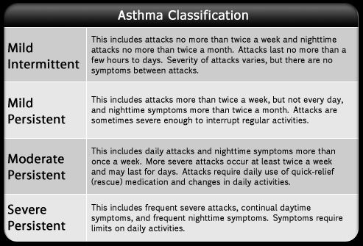

Slide 23
Management of Asthma in pregnancy
VERTICAL INTEGRATION
GOALS
  Complete asthma control with optimum medications
  Prevent exacerbation
  Avoidance of exacerbating factors like smoking
  Treat any co morbidities which can cause difficulty in controlling asthma

Slide 24
Steps Of management according to GINA 2023

Slide 25
DIFFERENTIALS OF ASTHMA IN PREGNANCY
HORIZONTAL INTEGRATION
AIRWAY OBSTRUCTION
AMNIOTIC FLUID EMBOLISM
ACUTE CHF SECONDARY TO PERI-PARTAL CARDIOMYOPATHY
PHYSIOLOGIC DYSPNEA OF PREGNANCY

Slide 26
Medicine Used To Treat Asthma
VERTICAL INTEGRATION
1. Bronchodilators
  Beta 2 Agonists
    SABA e.g Salbutamol, terbutaline
    LABA e.g formoterol, salmeterol, bambuterol
  Muscrinic antagonists
    SAMA e.g ipratropium
    LAMA e.g Tiotropium, glycopyronium
  Leukotriene antagonists
    Montelukast, zafirlukast

Slide 27
VERTICAL INTEGRATION
  Xanthine derivatives
    Theophylline, aminophyline, doxyphylline
  Other bronchodilators
    Epinephrine, MgSO4
2. Anti-inflamatory drugs
  Corticosteroids
    Inhaled corticosteroids(ICS): budesunide, beclomethasone, fluticasone
    Oral corticosteroids(OCS): prednisolone, dexa and betamethasone
    Intra venous corticosteroids: hydrocortisone and methyl-prednisolone

Slide 28
Drugs that must be used cautiously in asthma in pregnancy
HORIZONTAL INTEGRATION
3. Others anti-inflamatory
  sodium cromoglicate, nedocromil
4. Antibodies
  Anti IgE antibodies, omalizumab
  Anti IL-5 antibodies, reslizumab, mepolizumab

Slide 29
CORE CONCEPT
Note:
Treatment of pregnant asthmatic patients is exactly same as in non pregnant asthmatic patients.
All the asthma medicine are safe and any small risk or side effect outweighs risk to mother and fetus due to exacerbation and poor control of asthma

Slide 30
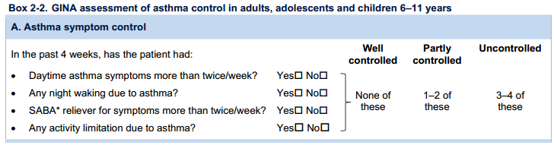
Assessment of Asthma control
VERTICAL INTEGRATION

Slide 31
Summary
CORE CONCEPT
Asthma is one of the common condition which may complicate Pregnancy
Asthma may remain same improve or worsen during pregnancy which may alter out come of pregnancy
That’s why Asthma should be vigorously managed and monitored
And the goals of management are asthma control, prevention and treatment of exacerbation and co-morbidities

Slide 32
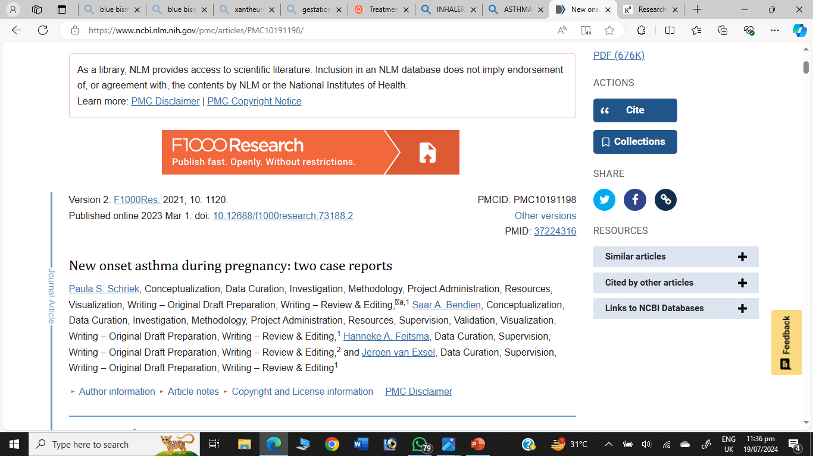

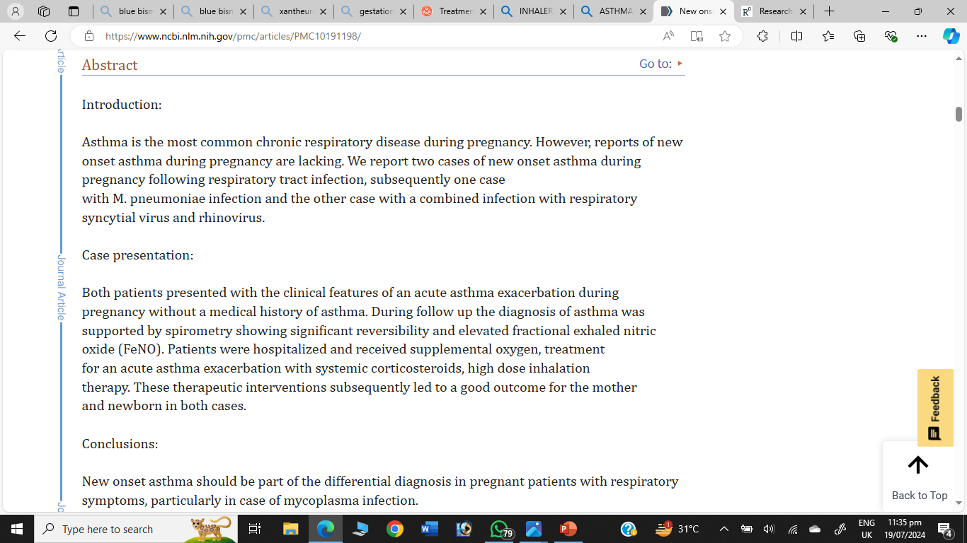
LONGITUDINAL INTEGRATION

Slide 33
Thank you

