Slide 1
AN APPROACH TO A PATIENT WITH GASTROINTESTINAL MALIGNANCY
DR QASIM ALI

Slide 2
INTRODUCTION
Gastrointestinal CA refer to malignant conditions of Gastrointestinal tract ( this include cancers of esophagus, stomach, gallbladder, liver , pancreas , bowel )
GI cancers do not discriminate between men and women
The symptoms relate to the organ affected and can include obstruction
The underlying causes for different types of gastrointestinal cancers vary, but some of the key risk factors include smoking, excessive alcohol consumption, increasing age, viral and bacterial infections, chronic pancreatitis, and obesity.
Can be divided into Upper GI and Lower GI carcinomas

Slide 4
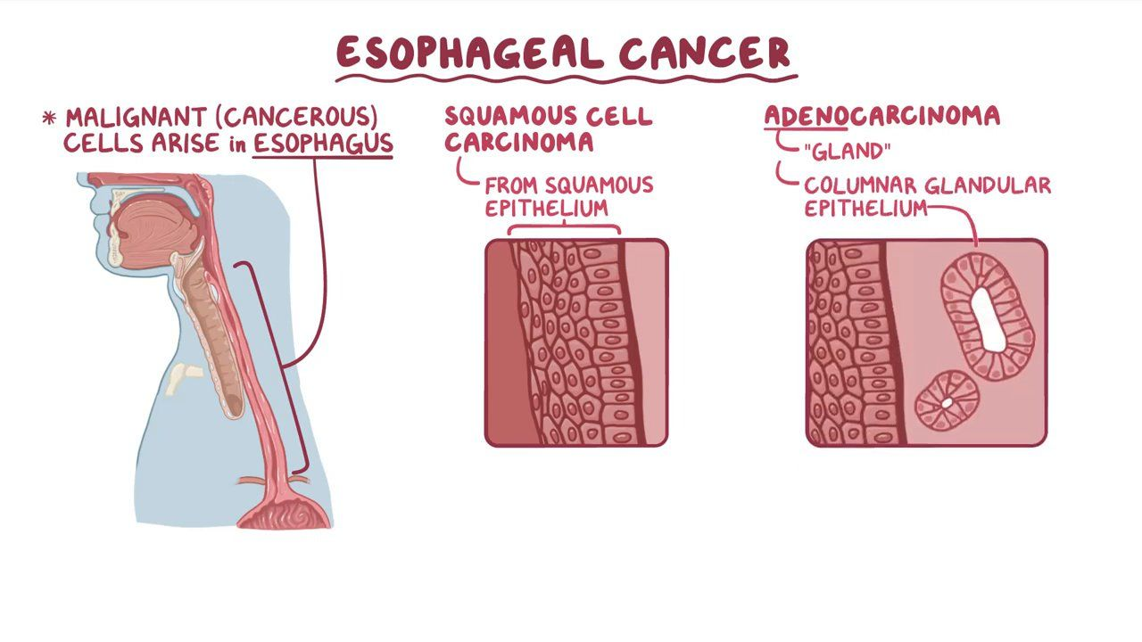
ESOPHAGEAL CANCER

Slide 6
HOW TO APPROACH ????
HISTORY
CLINICAL EXAMINATION
GENERAL ASSESMENT
INVESTIGATIONS
FOLLOW UP
COUNSELLING AT EVERY STEP

Slide 7
UPPER GI MALIGNANCIES
 | ESOPHAGEAL CARCINOMA | STOMACH CARCINOMA | SMALL INTESTINE CA
RISK FACTORS | Smoking , Achalasia , GERD , Obesity Barret esophagus Alcohol Men >>( 4:1) Age >70 Hereditary HPV | Smoked food Diet nitrites ( carcinogenic) Chronic gastritis ( H.pylori ) Pernicious anemia Previous gastric surgery like gastroenterostomy E cadherin mutation | Familial adenomatous polyposis Crohns disease Mutations Peptic ulcer disease
TYPES | 2 Histopathological subtypes Squamous cell carcinoma Adenocarcinoma | Adenocarcinoma 95% ( diffuse & intestinal type ) Lymphoma 4% Malignant GIST | Adenocarcinoma ( most commonly in duodenum and proximal jejunum) Ampullary Carcinoma Lymphoma Carcinoid tumors
CLINICAL FEATURES / PRESENTATION | Dysphagia (difficult swallowing ) Odynophagia ( painful swallowing) Heart burn / discomfort behind sternum Extension of tumor into tracheobronchial tree : stridor , coughing , choking | Early : asymptomatic Advanced : Bloating Distention Vomiting Dyspepsia | Generally asymptomatic WHEN GROW Obstruction Pain Bloody stool Jaundice

Slide 8
 | Hoarseness of voice ( paralysis of left recurrent laryngeal nerve by direct invasion of tumor into vocal cords ) Regurgitation of food Aspiration pneumonia Weight loss Hematemesis Anemia Cervical lymphadenopathy | Anemia Tumor may perforate leading to peritonitis Obstruction leading to dysphagia and persistent vomiting ( GASTRIC OUTLET OBSTRUCTION ) GI bleeding
PHYSICAL SIGNS | IF METASTASIS Ascites Jaundice | Palpable abdominal mass Palpable supraclavicular lymph nodes ( Virchow’s nodes) Palpable periumbilical lymph nodes ( Sister Marry Joseph nodules ) Palpable ovarian mass (Krukenberg) Palpable mass on DRE ( Blumer shelf )

Slide 9
INVESTIGATIONS | ENDOSCOPY (biopsy ) CT CHEST , ABDOMEN AND PELVIS BARIUM SWALLOW ENDOSCOPIC USG BRONCHOSCOPY LAPROSCOPY | GASTROSCOPY ( biopsy ) ENDOSCOPIC USG BARRIUM SWALLOW ( if endoscopy not available ) CT SCAN PET SCAN LAPROSCOPY | ENDOSCOPY (biopsy ) CT CHEST , ABDOMEN AND PELVIS LAPROSCOPY
STAGING | TNM STAGING | TNM
TREATMENT | ESOPHAGECTOMY Ivor lewis Transhiatal esophagectomy McKeown Three stage esophagectomy Salvage esophagectomy RADIOTHERAPY CHEMOTHERAPY PALLIATIVE TREATMENT | SUBTOTAL GASTRECTOMY TOTAL GASTRECTOMY CHEMOTHERAPY RADIOTHERAPY PALLIATIVE TREATMENT | EXCISION OF TUMOR WITH STOMA FORMATION CHEMOTHERAPY RADIOTHERAPY

