Slide 1
A 57 year old female with hard lump in parotid region
Prof .M Waqas Raza
FCPS FRCS MHPE
General /Vascular surgeon
HOD RTH Surgery Rawalpindi

Slide 2
Case scenario
A 57 year old lady presents with a recurrent lump in her right parotid region which has now developed ulceration of overlying skin .
He also complaints of weakness of facial movements
History of surgery for a long standing swelling in the same area 2 years back
Multiple interventions by Quacks and Hakeems

Slide 4
What is the Differential diagnosis

Slide 5
Structures passing through parotid:

Slide 6
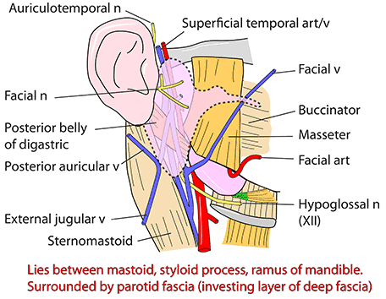

Slide 7
Parotid neoplasia:
Benign
Pleomorphic adenoma
Warthin’s tumor
Malignant
Mucoepidermoid carcinoma
Adenoid cystic carcinoma
Acinic cell carcinoma
Adenocarcinoma
Squamous cell carcinoma

Slide 9
Features of malignant change:
1.5% in 5 yrs. ; 9.5% in 15 yrs.
Recent increase in size
Pain
Nodularity
Involvement of skin, LN , Facial nerve, masseter
Restriction of jaw movements
Features of malignant change includes
Capsular distension
Nerve infiltration
Tumour necrosis

Slide 10
Diagnosis:
Fine needle aspiration
Core needle aspiration
USG
CT scan
MRI scan

Slide 11
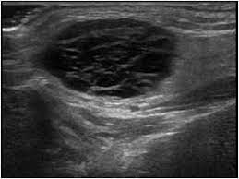
USG – Hypoechoic with lobulated and distinct borders

Slide 12
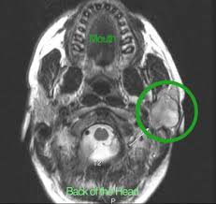
CT scan:
Smoothly margined or lobulated homogeneous small spherical mass
Small regions of calcification
When the tumour is small, the enhancement tends to be prominent

Slide 13
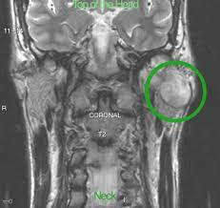
MRI:
Well-circumscribed and homogeneous
T1: Usually of low intensity
T2: Usually of very high intensity (especially myxoid type)
T1 C+ (Gd): Usually demonstrates homogeneous enhancement

Slide 14
Management:
Surgical excision of the tumour
Superficial(Patey's operation) parotidectomy
Total parotidectomy Treatment
Complications:
Recurrence of 5 to 50%
Facial nerve injury

Slide 15
Mucoepidermoid tumor
Commonest type of malignant salivary tumor in adults
Commonest malignant tumor of parotid in childhood
Common in middle age (35-65 years of age)
Female predilection

Slide 16
Parotid is the most common site of tumor
2nd common is palate minor salivary gland
Radiation – etiological factor
t(11;19)(q21;p13) chromosome translocation resulting in a MECT1-MAML2 fusion gene

Slide 17
Presents as painless, slow-growing mass that is firm or hard.
Grossly – Un encapsulated mass with cystic spaces
Facial nerve involvement in late stages

Slide 18
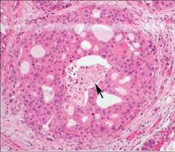
Histology:
The tumours are composed of a mixture of:
Mucus secreting cells (muco- )
Squamous cells (-epidermoid)
Lymphoid infiltrate often also present

Slide 19
Low grade:
Well-differentiated cells with little cellular atypia
High proportion of mucous cells
Prominent cyst formation
Intermediate grade: intermediate features
High grade:
Poorly differentiated with cellular pleomorphism
High proportion of squamous cells
Solid with few if any cysts Grade of tumor

Slide 20
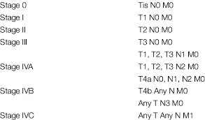
TNM staging:

Slide 21
Investigations:
USG :
well-circumscribed hypo echoic lesion, with a partial or completely cystic appearance
CT scan:
Low-grade tumors appear as well- circumscribed masses, usually with cystic components. Calcification may be present
High-grade tumors are poorly defined margins, infiltrate locally and appear solid.

Slide 22
Treatment
Low grade
wide local excision or superficial parotidectomy without any adjuvant radiotherapy
High grade
requires complete or radical parotidectomy, often with sacrifice of the facial nerve, neck dissection (as nodal metastases are common) and adjuvant radiotherapy

Slide 23
Adenoid cystic carcinoma:
It is also called as cylindromatous carcinoma
Low grade tumor
Wide distribution and mainly occur in relation to the airways, salivary glands, lacrimal glands and breast
Tendency for perineural extension is high

Slide 24
Common in females 3:1
Occurs in 5th & 6th decade of life
Slow growing tumor but highly malignant
High affinity for perineural transmission [Anterograde and retrograde]
Maxillary and mandibular branch of trigeminal nerve
Facial nerve
Reaches Gasserian trigeminal ganglion, pterygopalantine ganglion & cavernous sinus

Slide 25
Microscopy:
Cribriform – Swiss cheese pattern
Tubular
Solid
It involves periosteum and bony medulla

Slide 26
Treatment
Radical parotidectomy with adjuvant radiotherapy
Fast neutron therapy
Chemotherapy

Slide 27
Recurrence is common
5 years survival rate is 89 %
15 years survival rate is 40 %
Positive margin, perineural spread, solid type carry poor prognosis

Slide 29
Parotidectomy Indications:
Chronic parotitis
Salivary calculi
Parotid abscess
Parotid tumors
T1,T2,T3 – Total conservative parotidectomy
T4 – Radical parotidectomy

Slide 30
Types:
Superficial parotidectomy
Total conservative parotidectomy
Radical parotidectomy
Suprafascial parotidectomy

Slide 31
Incisions:

Slide 32
Identification of facial nerve
Facial nerve is 1cm deep and below the tip of inferior portion of cartilaginous canal – conley’s point
By nerve stimulator
It is inferomedial to the tragal point
Deep to digastric muscle
Nerve is just lateral to styloid process
Tracing branch from distal to proximal (Hamilton bailey technique)

Slide 33
Indication for nerve sacrifice:
Preoperative weakness / paralysis of nerve
Intraoperative evidence of gross invasion
Tumors transgressing through facial nerve from superficial to deep lobe
Nerve stump is checked for frozen section for negative margins, if positive, mastoidectomy & nerve dissection is required

Slide 34
Complications of parotidectomy
Facial nerve injury
Hemorrhage
Salivary fistula
Infection – flap necrosis is common
Frey’s syndrome
Sialocele
Injury to greater auricular nerve

Slide 35
TREATMENT PLAN
Wide excision of the mass with overlying skin
Cover the resulting cosmetic defect by a pedicle musculocutaneous flap

