Slide 2
Basic antenatal care, Obstetric history taking and examination
Dr. Humaira Bilqis
MBBS, MCPS, FCPS, chpe
Assistant professor (ob/gyn)
Rawalpindi medical university

Slide 3
Two different stories of life

Slide 5
What is the difference?
The start
The journey
The ending
The way ahead

Slide 6
PREGNANCY IS A JOURNEY
WHICH MUST BE SAFE FOR EVERY
MOTHER

Slide 7
LEARNING OBJECTIVES
Enlist the aims of antenatal care
Elaborate the recommended schedule of antenatal visits
Define the booking visit
Define EDD and its calculation
Elicit the booking history and examination

Slide 8
LEARNING OBJECTIVES
Order booking investigations and understand their importance
Categorize the obstetric patient into high risk and low risk groups

Slide 9
PROF UMER MODEL OF INTEGRATED LECTURE

Slide 10
AIMS OF ANTENATAL CARE
To optimize pregnancy outcomes for women and babies
To prevent, detect and manage high risk factors
To provide advice, reassurance, education and support to women and their families
To deal with the “minor” ailments of pregnancy
To provide general health screening

Slide 11
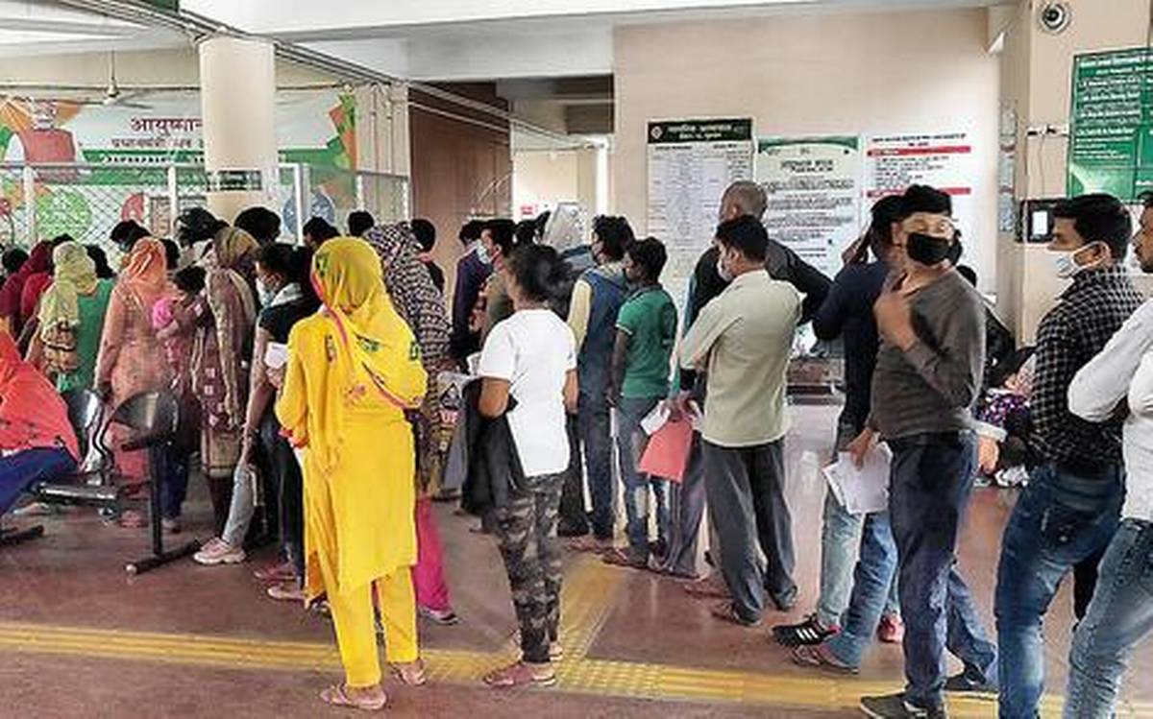
RECOMMENDED SCHEDULE OF ANTENATAL VISITS
4 visit model
8 visit model

Slide 12
RECOMMENDED SCHEDULE OF ANTENATAL VISITS
2016 WHO ANC model
First trimester Contact 1: up to 12 weeks
Second trimester Contact 2: 20 weeks
Contact 3: 26 weeks
Third trimester Contact 4: 30 weeks
Contact 5: 34 weeks
Contact 6: 36 weeks
Contact 7: 38 weeks
Contact 8: 40 weeks
Return for delivery at 41 weeks if not given birth

Slide 13
BOOKING VISIT (First contact with the doctor)
Thorough and meticulously recorded history
Thorough examination (BP, BMI, systemic, obstetrical)
General pregnancy dietry advice
General exercise advice
Breastfeeding education
Options for pregnancy care
Booking investigations
Dating ultrasound scan

Slide 14
DATING THE PREGNANCY
Traditional methods
1. Manual
2. Pregnancy-calculating wheel
Pregnancy calculator Apps on smart phones
Dating scan
1. Crown-rump length (CRL) at 10-14 wks
2. Head circumference (HC) at 14-20 wks

Slide 15
EXPECTED DATE OF DELIVERY
Naegle’s Rule (in 28 days cycle)
Add
9 months + 7 days
in LMP

Slide 16
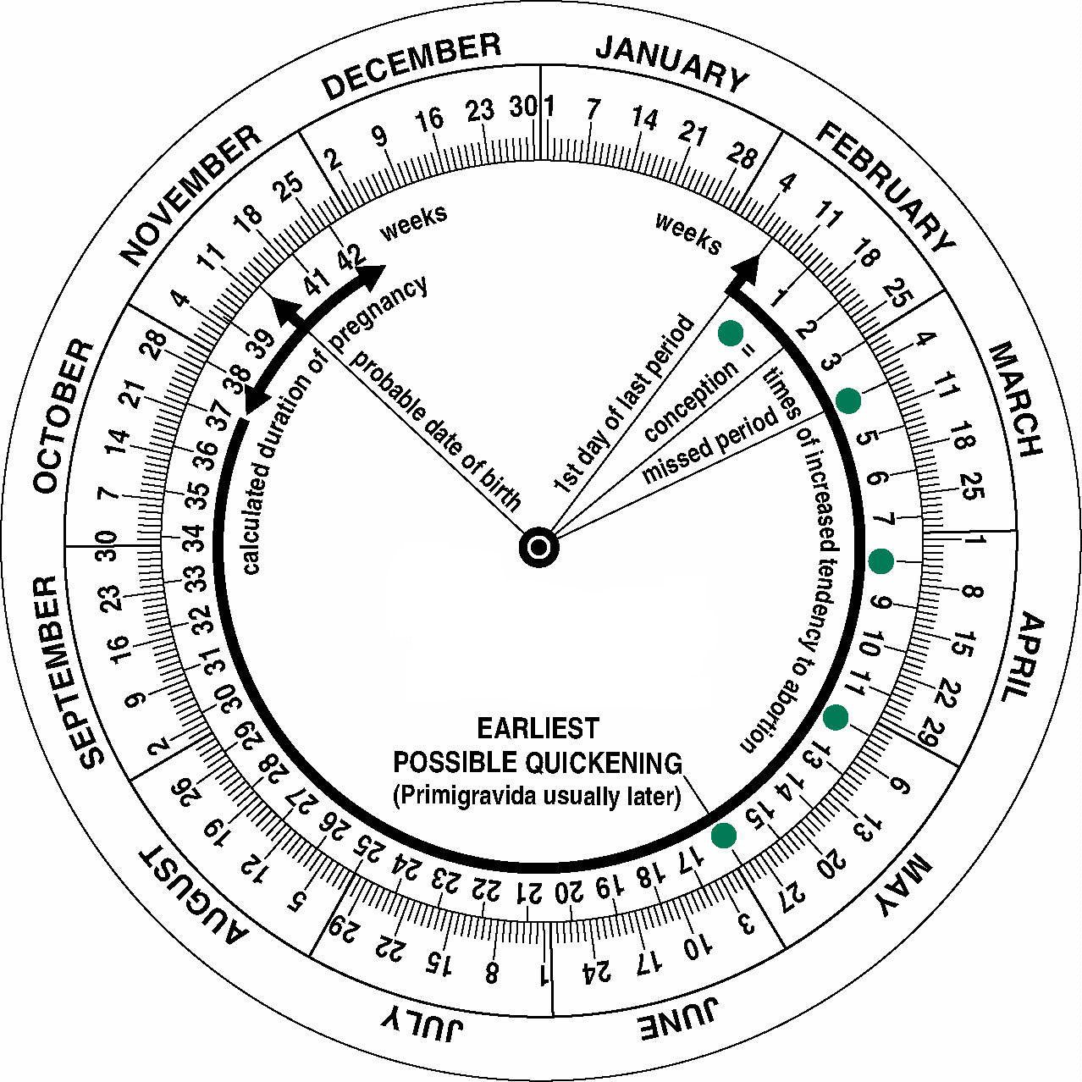
DATING THE PREGNANCY
Pregnancy-calculating wheel

Slide 17
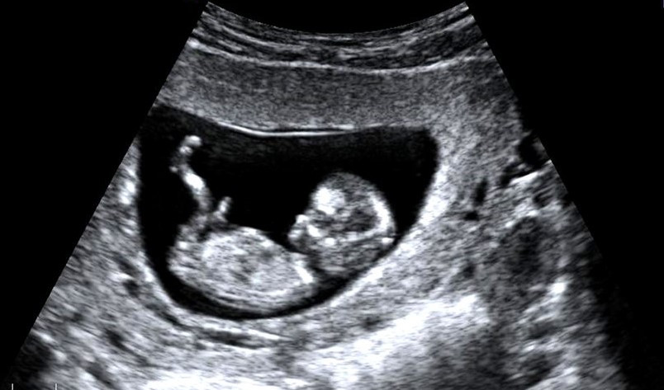
DATING THE PREGNANCY
Dating ultrasound scan (10-14 weeks)
Preferred method (NICE guidelines on ANC)

Slide 18
BOOKING HISTORY
Personal profile
Name, age, education, occupation, marital ststus, consanguinity, residence
Previous obstetric history
Gravidity, parity, record of all previous pregnancies in chronological order with outcomes, gestational ages, pre-partum, intra-partum & postpartum complications, birth weights and status of babies at birth & now, H/O breastfeeding & vaccination
Past gynaecological history
Menstrual cycle, contraceptive history, H/O PID, Pap smear, ectopic pregnancy, recurrent miscarriages, surgery on cervix or uterus, ovarian cysts, assisted conception

Slide 19
BOOKING HISTORY
Past medical and surgical history
All pre-existing medical conditions, psychiatric illnesses and all surgeries
Drug history
Any drug being taken
Family history
Diabetes, pre-eclampsia, thrombosis, serious psychiatric illness
Social history
Ethnicity, single/married, support at home, housing, stable income, domestic violence, smoking, alcohol/drug abuse, nature of work

Slide 20
EXAMINATION
Weight and height
Blood pressure measurement
General physical examination
Breast examination
Systemic examination (CVS, respiratory)
Obstetrical examination
Speculum examination

Slide 21
Blood pressure measurement

Slide 22
Obstetrical examination (Leopold’s maneuver)

Slide 23
Fundal height in weeks

Slide 24
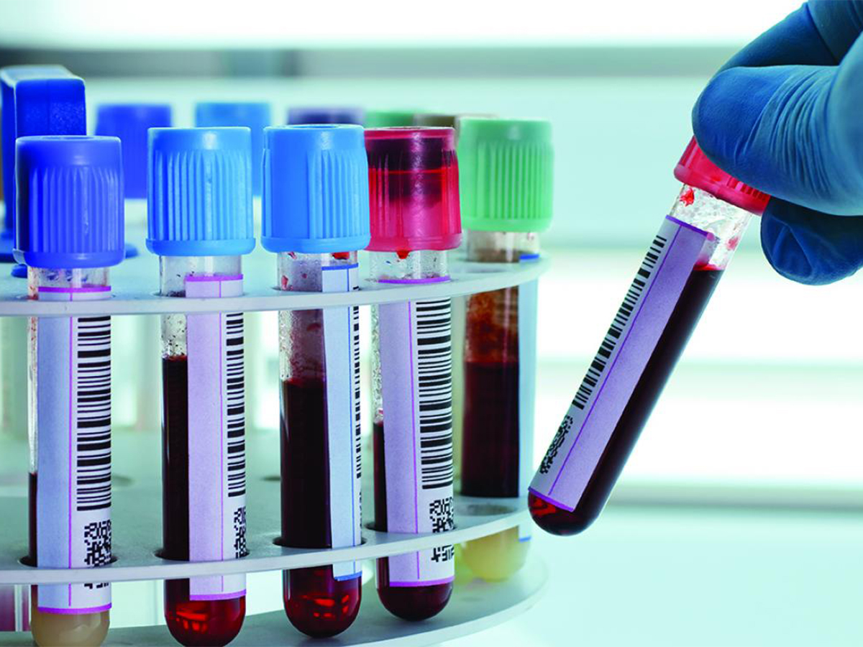
BOOKING INVESTIGATIONS
Blood grouping and antibody screening
Full blood count
Blood sugar levels
MSU examination
HBsAg / Anti HCV antibodies
Dating scan

Slide 25
SECOND TRIMESTER
Iron supplements
Calcium supplements
Anomaly scan
Screening for gestational diabetes
Tetanus prophylaxis

Slide 26
THIRD TRIMESTER
Iron supplements
Calcium supplements
Growth scans
Biophysical profile
Doppler studies of fetal vessels (if indicated)
Steroid cover

Slide 27
THIRD TRIMESTER
Plan of delivery to be discussed with the patient and family
Breastfeeding classes
Contraceptive counselling

Slide 28
RISK ASSESSMENT
HIGH RISK
or
LOW RISK
but
No “NO RISK” pregnancy

Slide 29
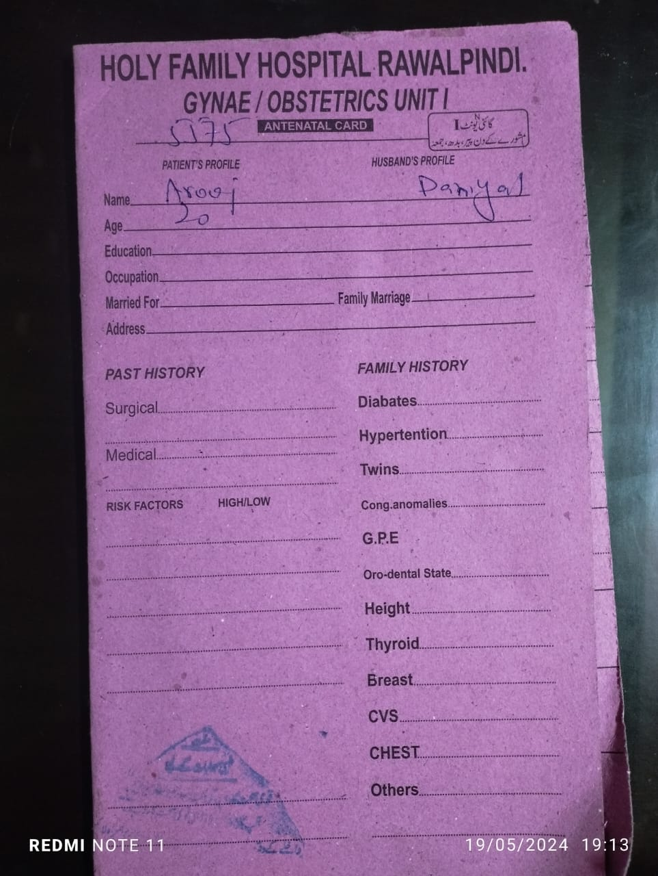
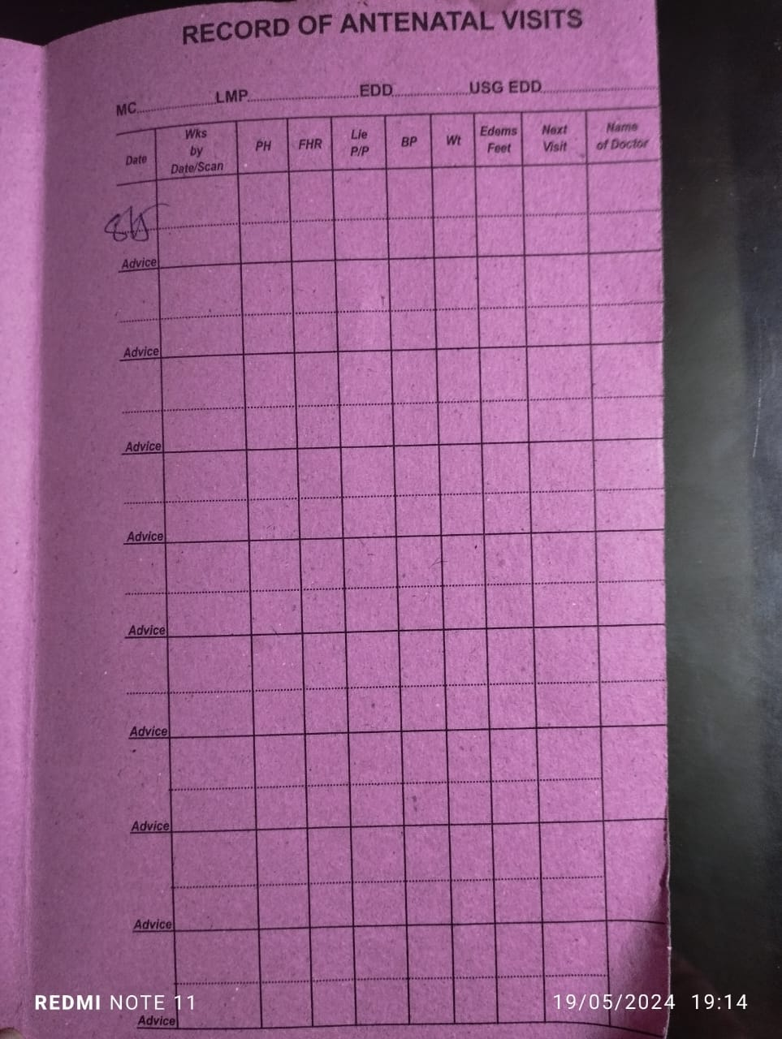
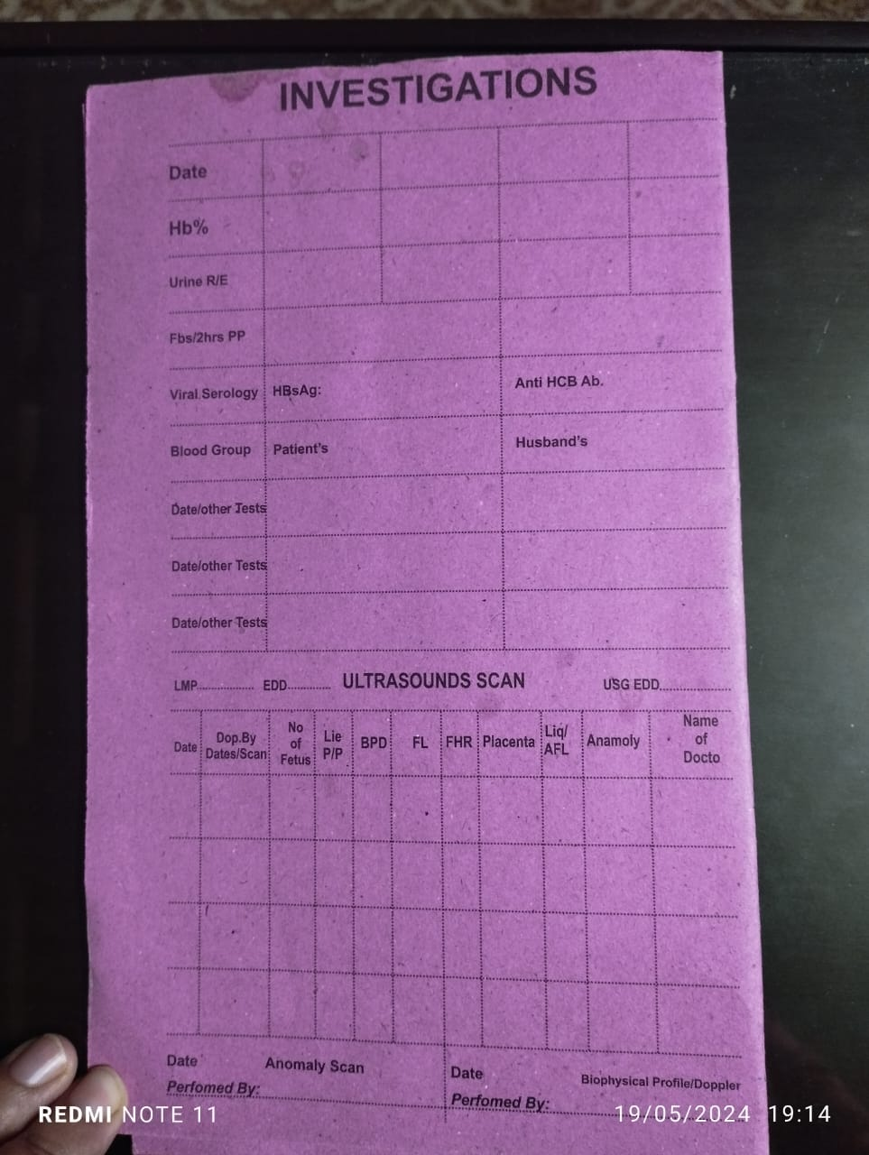
Antenatal record

Slide 30
Activity
1. Last menstrual period (LMP): 1st Nov, 2022
Expected date of delivery (EDD): ??
2. LMP: 29th March, 2023
EDD: ??

Slide 31
Two minutes activity
Last menstrual period (LMP): 1st Nov, 2022
Expected date of delivery (EDD): 8th August, 2023
2. LMP: 29th March, 2023
EDD: 5th January, 2024

Slide 32
BASIC TERMINOLOGIES USED IN OBSTETRICS
GRAVIDITY:
Total number of pregnancies regardless of how they ended (including current pregnancy)
PARITY:
Number of livebirths at any gestation or stillbirths after 24 weeks

Slide 33
BASIC TERMINOLOGIES USED IN OBSTETRICS
STILLBIRTH: Any fetus born with no signs of life
INTRAPARTUM STILLBIRTH: When fetus dies in utero during the process of labour
INTRAUTERINE DEATH (IUD): Death of the fetus in utero after 24 weeks but before the onset of labour
EARLY NEONATAL DEATH (ENND): Death within 7 days of life
PERINATAL DEATHS: IUDs + ENNDs

Slide 34
BASIC TERMINOLOGIES USED IN OBSTETRICS
Term (37-42 weeks)
Preterm (<37 weeks)
Post-date (40-42 weeks)
Post-term (>42 weeks)

Slide 35
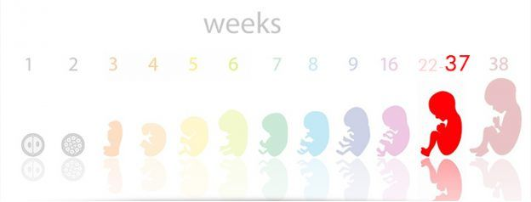
BASIC TERMINOLOGIES USED IN OBSTETRICS
Normal weight at term : 2.5 – 4 kg
Low birth weight (< 2.5 kg at term)
Macrosomic baby (>4 kg)

Slide 36
COMMON PROBLEMS OF PREGNANCY
Backache
Nausea
Vomiting
Constipation
Gastro-esophageal reflux
Symphysis pubis dusfunction

Slide 37
Any questions

Slide 38
RESEARCH
https://www.motherhoodindia.com/
(importance-of-antenatal-visits)
https://www.rcog.org.uk/for-the-public/browse-all-patient-information-leaflets/
(antenatal-care-for-uncomplicated-pregnancies)

Slide 39
BIOMEDICAL ETHICS
Fully inform and communicate with the woman and her family in decision making about care for herself and her baby, ensuring her the right to informed consent and refusal.
Ethical care should aim at ensuring that the woman remains responsible for herself and her fetus and that she retains her trust in the health professionals .

Slide 40
FAMILY MEDICINE
Pregnant women with red flag signs should be immediately referred to concerned specialty
Preconception counseling is highly important for successful antenatal period and pregnancy outcomes.

Slide 41
Thank you

