Slide 2
SUBFERTILITY
Prof Lubna Ejaz Kahloon
Edited by Dr Humaira BilqIs
19.04.22

Slide 3
Learning Objectives
By the end of this lecture, the participant will be able to:
1. Define subfertility
2. Enlist causes of male and female subfertility
3. Enlist laboratory tests for the diagnosis of
female & male infertility.
4. Outline the management of subfertility
according to the cause
.

Slide 4
Definition
Subfertility:
Failure of a couple to conceive after regular, unprotected sexual intercourse for one year
Primary subfertility:
Couples who have never conceived.
Secondary subfertility:
Couples who have previously conceived.

Slide 5
Conception or Fertilization

Slide 6
Factors affecting natural conception rate
1. Age: Decline in female after 35 years
2. Smoking: Reduces both females and male
fertility
3. Alcohol: Excessive alcohol is harmful to
the fetus, can also affect sperm
quality
4. Coital frequency: Adequate frequency is two
to three times per week.
Stress and anxiety may reduce libido and
coital frequency

Slide 7
5. Body mass index of <19 or >29 is unfavorable
6. Occupational hazards: Exposure to chemicals
& radiation
7. Drugs:
- Non-steroidal anti-inflammatory: Inhibit
ovulation.
- Chemotherapy: Destroys rapidly dividing cells
e.g. gametes.
- Cimetidine: Loss of libido, erectile dysfunction
- Sulphasalazine: Oligospermia
- Androgen injections: affects sperm quality
- Furantoins & calcium channel blockers also
reduce sperm quality and/or function.

Slide 8
Causes of infertility
Female: 40% of the cases
a. Ovulation problems (impaired
ovulation/anovulation), increased age ,
reduced ovarian reserve, HPO axis dysfunction
b. Tubal blockage
c. Uterine factors (fibroids, Endometrial
scarring/polyp, Cervical)
﻿ d. Medical disordres: diabetes, epilepsy, thyroid
and bowel diseases also contribute to
subfertility
Male: 25-40% of the cases.
Unknown cause/ idiopathic: 15-20%

Slide 9
Female: Impaired ovulation
BMI: If >29 or <19
Polycystic ovarian syndrome: commonest cause
Hyper- or hypothyroidism
Hyperprolactinemia
Premature ovarian failure

Slide 10
Polycystic ovarian syndrome (PCOS)
Characterized by:
-Menstrual irregularity (oligomenorrhea
or amenorrhea)
- Hyperandrogenemia: hirsutism /Acne/
↑testosterone
- Polycystic ovaries on USG
High risk to have :
- Diabetes (Type II)
- Cardiovascular disorders

Slide 11
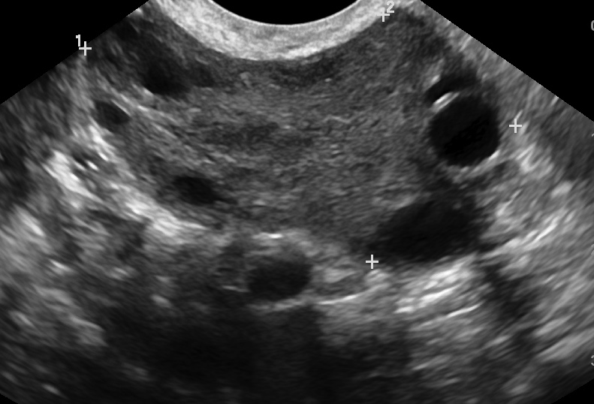
Normal ovary
Polycystic ovary

Slide 12
Diagnosis of PCOS is based on a score of two out of three features
1-Oligo or anovulation
2-Clinical and/ or biochemical signs of hyperandrogenism
3-Polycystic ovary on ultrasound
And exclusion of other etiologies: congenital
adrenal hyperplasia, androgen-secreting
tumors, Cushing syndrome

Slide 13
Female: Tubal blockage
Previous pelvic inflammatory disease, such as a chlamydia / gonorrhoea infection
Any inflammatory process within the
abdominal/pelvic cavity: Appendicitis

Slide 14
Female: Uterine factors
Abnormalities of endometrium may prevent the successful implantation of the embryo.
Presence of uterine fibroids ,adhesions and polyps, structural abnormalities
Cervical secretions unfavorable

Slide 15
Cervical factor

Slide 16
Causes of male subfertility
﻿Problems related to spermatogenesis
Genetic causes
Physiological causes
Mechanical causes
Obstructive causes
Coital problems
Erectile dysfunction
Retrograde ejaculation

Slide 17
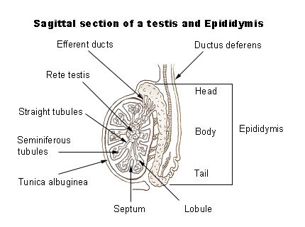

Slide 18
Spermatogenesis
The sperm are released into the lumen of the seminiferous tubule and leave the testes.
They then enter the epididymis where they undergo their final maturation and become capable of fertilizing a female gamete.
Sperm production begins at puberty and continues throughout the life of a male.
The entire process, beginning with a primary spermatocyte, takes about 74 days. After ejaculation, the sperm can live for about 48 - 72 hours in the female reproductive tract.

Slide 19
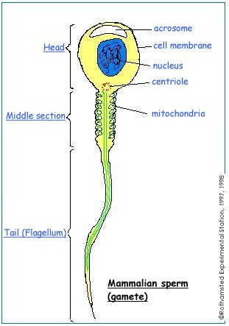
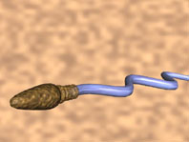

Slide 20
Key points in history and examination of infertile couple
le
Female
Length of time spent trying for pregnancy
Any previous pregnancies
Coital frequency
Occupation
Menstrual history
Previous history of pelvic inflammatory /
disease/ectopic pregnancy

Slide 21
Key points in history and examination of infertile couple (contd.)
Previous medical and surgical history
Previous fertility treatment
Cervical smear
History of thyroid disorders
n
GPE: BP, pulse, height and weight (BMI),
thyroid, breast
Pelvic examination: any uterine pathology
such as fibroids

Slide 22
Key points in history and examination of infertile couple (contd.)
Male
Length of time spent trying for pregnancy
Fathered any previous pregnancies
History of mumps or measles
History of testicular trauma, surgery to testis
Occupation
Medical and surgical history
Testicular examination : testicular volume, consistency, masses, absence of vas deferens, varicocele, evidence of surgical scars

Slide 23
Investigations for female
Hormonal profile
S. FSH D2-D3
S. LH D2-D3
S. Estradiol D2-D3
AMH (anti mullerian hormone) reflects the size of the primordial follicle pool. Best biochemical marker of ovarian function
In adult women, AMH levels gradually decline as the primordial follicle pool declines with age. AMH is undetectable at menopause

Slide 24
Investigations (contd.)
Progesterone level D21
Thyroid function tests
Prolactin
Testosterone
Ovulation detection:
LH urinary kit, D21 Progesterone, TVS serial tracking,
Pre menstrual endometrial biopsy

Slide 25
Investigations (contd.)
﻿Chlamydia testing / treatment offered prior to any uterine instrumentation. If ART is to be offered, HIV, hepatitis B and C should be tested.
TVUSS: Uterine and ovarian morphology, Antral follicular count (<4 predicting low response, >16 high response).

Slide 26
Investigations (contd.)
Tests for tubal patency
Hysterosalpingogram (HSG)-X RAY
Hysterocontrast sonography (HyCoSy) –USG
If these tests suggest potential blockage of the Fallopian tubes:
Diagnostic laparoscopy and dye test

Slide 27
Laparoscopy with chromotubation (dye instillation)
The gold standard test for the evaluation of the tubal factor, and when it is performed in conjunction with hysterscopy, information on uterine contour/cavity and endometrial biopsy, can be obtained simultaneously.

Slide 28
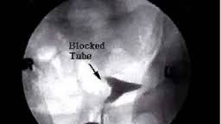

Slide 31
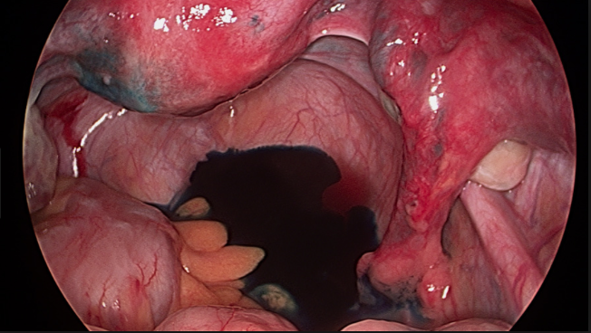

Slide 32
Investigations for male
Semen analysis (after 2-4 days abstinence)
Two to three abnormal test results are required to
diagnose male subfertility…..referral to urology.
Testicular USG (varicocele, testicular vol)
Endocrine evaluation:
Low FSH,LH, Testosterone -Hypothalamic-pituitary
failure
High FSH- Substantial parenchymal loss to testes
High Prolactin-Prolactinomas
High TSH- Hypothyroidism
Karyotyping can be done in severe cases.

Slide 33
Normal parameters for semen analysis (WHO criteria)
2 ml or more | Volume
> 7.2 | pH
15 million/ml or more | Sperm concentration (count)
> 39 million per ejaculate | Total sperm number
32 % | Progressive motility
4 % normal forms | Morphology
58 % | Vitality-live sperms

Slide 34
Management
Treatment is directed towards cause
Ensure adequate & timely intercourse. (D 12-16)
-Ovulation induction(OI): ( Anovulation, idiopathic)
-Intrauterine insemination (IUI) (Unresponsive to OI, mild to moderate male factor)
-In Vitro fertilization (IVF), Intracytoplasmic sperm injection (ICSI)
If no success in pregnancy from the previous modalities, tubal pathology, old age women, male factor.

Slide 35
Management
-ICSI For Sperm problems & fertilization problems
-Surgical sperm retrieval (male factor) Poor semen analysis and used in ICSI
- Cryopreservation of gametes
“preserving fertility in oncology patients”

Slide 36
Ovulation induction Drugs
Oral
-Clomiphene citrate (CC) anti-estrogen agent
-Aromatase inhibitor (Letrozole)
- Metformin
Injectable
Gonadotropins
Laparoscopic ovarian drilling by diathermy or laser is a surgical treatment to induce ovulation in anovulatory PCOS patients.

Slide 37
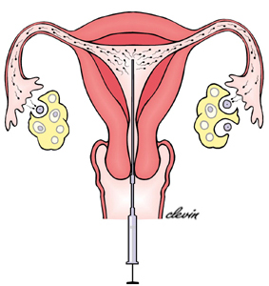
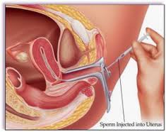
Intrauterine Insemination (IUI)
Stimulation with FSH to produce 2–3 mature follicles.
A small sample of prepared sperm is instilled into the uterine cavity with a fine uterine catheter.

Slide 38
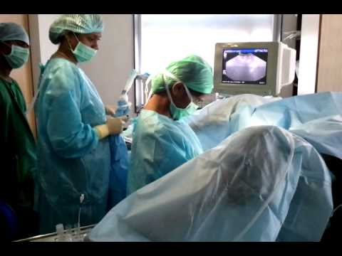
In Vitro Fertilization Egg are retrieved from hyper-stimulated ovaries by TVS probe in Operation theater

Slide 39
IVF
Eggs are incubated in lab with sperms to get fertilized
When fertilization occurs ➡ fertilized embryo(s) starts dividing ➡ It is then replaced into the uterine cavity.
Approximately 2 weeks after embryo transfer, a pregnancy test is performed to check for successful implantation.

Slide 40
Surgical Management of infertility
-Laparoscopic surgery for ovarian drilling
-Procedures for improving tubal patency
-Salpingectomy for hydrosalpinx before IVF
Surgical resection (e.g, endometriosis)
-Surgical correction should be considered when a submucous fibroid, endometrial polyp, septate uterus, or uterine synechiae are discovered in the setting of failure to conceive or recurrent pregnancy loss

