Slide 1
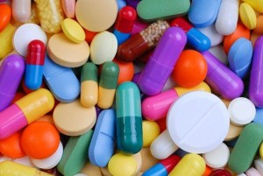
Sedatives and hypnotics Dr.Filza Ali & Dr Shahida

Slide 2
Vision of Rawalpindi Medical University The Dream/ Tomorrow
To impart evidence based research oriented medical education
To provide best possible patient care
To inculcate the values of mutual respect and ethical practice of medicine

Slide 3
Prof Umar’s LGIS Model

Slide 4
SEQUENCE OF LGIS
Learning Objectives
Core concept 70 %
Horizontal integration related to Pathology and Pharmacology 15 %
Relevant clinical concepts and medico legal application of core knowledge / Vertical integration 10%
Research article relevant to the topic 3%
Ethics and family medicine 2%

Slide 5
LEARNING OUT COMES
By the end of this session, students will be able to:
Identify a case of barbiturate poisoning
Explain briefly its mechanism of action
Write down its classification
Enumerate important signs and symptoms
Give important steps in its management
Mention fatal dose and fatal period
Write down its post mortem appearance
Give its medicolegal significance

Slide 6
BARBITURATES
Core Concept
In the past used as sedatives, hypnotics, anesthetics and anticonvulsants
They are now replaced by safer drugs like benzodiazepines
Nowadays, their use is limited to a few specific conditions, such as:
Insomnia(extreme cases)
Seizures(non responsive)
Induction of anesthesia
Tension headaches (in combination with acetaminophen and caffeine )
Notes:
Anti epileptics :Carbamazepines (Tegretol), Valproic acid, Phenytion sodium,

Slide 7
MECHANISM OF ACTION
Core Concept
BARBITURATES (derivatives of barbituric acid), stimulates, inhibitory GABA A receptors and inhibit, excitatory glutamate receptors (its subtypes AMPA and kainate receptors)
Bind to multiple sub unit interface at GABA A, the sites distinct from GABA A itself and distinct from benzodiazepine binding sites
Increase the duration of Chloride ions channel opening
(benzodiazepines increase the frequency of opening of chloride ion channel)
Notes:
GABA: Gamma amino butyric acid AMPA:α Amino 3 Hydroxy,5 Methyl,4 Isoxazole Propionic acid

Slide 8
Core Concept

Slide 9
MECHANISM OF ACTION
Core Concept
Depress the Nervous system
Cumulative
Synergistic effect, Alcohol dhatura, opiates, tranquilizers, sedatives, anticonvulsants, hypnotics, analgesics (P/C)

Slide 10
METABOLISM
Core Concept
Absorption is rapid and complete
Metabolized by the liver slowly, small amount excreted unchanged by kidneys

Slide 11
CLASSIFICATION
Core Concept
According to duration of action(colorful tab),4 groups
LONG ACTING: (duration: 8-24hrs , fatal dose 3-4gms)
Barbitones (Veronal white tab.)
Phenobarbitone or Phenobarbital (Luminal, white tab, also I/V or I/M)
2. INTERMIDIATE ACTING (4-8 hrs, fatal dose 2-3gms)
Allobarbitone (Dial, white tab)
Amylobarbitone/Amobarbital ( Amytal, capsules)
Butobarbitone(Soneryl, tab)
Pentobarbitone(Nembutal, oral capsules, I/M, rectal suppository)

Slide 12
CLASSIFICATION
Core Concept
3. SHORT ACTION: ( 2-4 hrs,fatal dose
1-2gms)
Cyclobarbitone (white tab)
Secobarbital /Quinalbarbitone(red velvet ,capsules)
4. ULTRA SHORT ACTION: ( 0.5-2 hrs..I/V, for duration of anaesthesia, fatal dose 1gm)
Thiopentone sodium(Thiopental or Pentothal, white powder or sol.)
Methohexo baritone( Brevital, white powder or sol.)

Slide 13
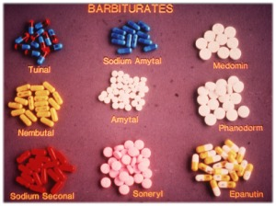
Core Concept
Luminal

Slide 14
SIGNS AND SYMPTOMS
Core Concept
Giddiness, ataxia, slurred speech, confusion, excitement and delirium followed by stupor and coma
(symptoms resembling alcohol poisoning)
Flaccid limbs, absent reflexes, pupils constricted (abnormal reaction of pupil to light, alternate contraction and dilatation)
Cyanosis, Hypotension (relative bradycardia) hypothermia
Notes:
The patient’s heart rate may be helpful in considering potentially involved medications. Hypotension resulting from vasodilatation (e.g., alpha-1 receptor antagonists, nitrites) or fluid loss (e.g., diarrhea or vomiting from colchicine, iron, certain species of mushrooms) is usually accompanied by compensatory tachycardia. In contrast, hypotension induced by sympatholytic agents (e.g., clonidine, opioids, sedative-hypnotic agents) or cardiac conduction delay (e.g., beta receptor antagonists, calcium channel antagonists, digoxin) is more likely to be accompanied by a relative bradycardia. Some drugs have multiple pharmacologic properties and produce unpredictable cardiovascular toxicity. For example, tricyclic antidepressants cause vasodilatation due to alpha antagonist effects, tachycardia due to antimuscarinic (anticholinergic) effects, and cardiac depressant effects owing to sodium channel blockade and norepinephrine depletion.
The patient’s heart rate may be helpful in considering potentially involved medications. Hypotension resulting from vasodilatation (e.g., alpha-1 receptor antagonists, nitrites) or fluid loss (e.g., diarrhea or vomiting from colchicine, iron, certain species of mushrooms) is usually accompanied by compensatory tachycardia. In contrast, hypotension induced by sympatholytic agents (e.g., clonidine, opioids, sedative-hypnotic agents) or cardiac conduction delay (e.g., beta receptor antagonists, calcium channel antagonists, digoxin) is more likely to be accompanied by a relative bradycardia. Some drugs have multiple pharmacologic properties and produce unpredictable cardiovascular toxicity. For example, tricyclic antidepressants cause vasodilatation due to alpha antagonist effects, tachycardia due to antimuscarinic (anticholinergic) effects, and cardiac depressant effects owing to sodium channel blockade and norepinephrine depletion.
The patient’s heart rate may be helpful in considering potentially involved medications. Hypotension resulting from vasodilatation (e.g., alpha-1 receptor antagonists, nitrites) or fluid loss (e.g., diarrhea or vomiting from colchicine, iron, certain species of mushrooms) is usually accompanied by compensatory tachycardia. In contrast, hypotension induced by sympatholytic agents (e.g., clonidine, opioids, sedative-hypnotic agents) or cardiac conduction delay (e.g., beta receptor antagonists, calcium channel antagonists, digoxin) is more likely to be accompanied by a relative bradycardia. Some drugs have multiple pharmacologic properties and produce unpredictable cardiovascular toxicity. For example, tricyclic antidepressants cause vasodilatation due to alpha antagonist effects, tachycardia due to antimuscarinic (anticholinergic) effects, and cardiac depressant effects owing to sodium channel blockade and norepinephrine depletion.
The patient’s heart rate may be helpful in considering potentially involved medications. Hypotension resulting from vasodilatation (e.g., alpha-1 receptor antagonists, nitrites) or fluid loss (e.g., diarrhea or vomiting from colchicine, iron, certain species of mushrooms) is usually accompanied by compensatory tachycardia. In contrast, hypotension induced by sympatholytic agents (e.g., clonidine, opioids, sedative-hypnotic agents) or cardiac conduction delay (e.g., beta receptor antagonists, calcium channel antagonists, digoxin) is more likely to be accompanied by a relative bradycardia. Some drugs have multiple pharmacologic properties and produce unpredictable cardiovascular toxicity. For example, tricyclic antidepressants cause vasodilatation due to alpha antagonist effects, tachycardia due to antimuscarinic (anticholinergic) effects, and cardiac depressant effects owing to sodium channel blockade and norepinephrine depletion.

Slide 15
SIGNS AND SYMPTOMS
Core Concept
Cheyne stokes breathing (slow, sighing, periodic respiration clinically)
Barbiturate blisters (skin rash usually at site of friction or pressure areas, clefts, axilla, inner aspects of knees and calves, sometimes on dorsum of hands) after 48-72 hrs

Slide 16
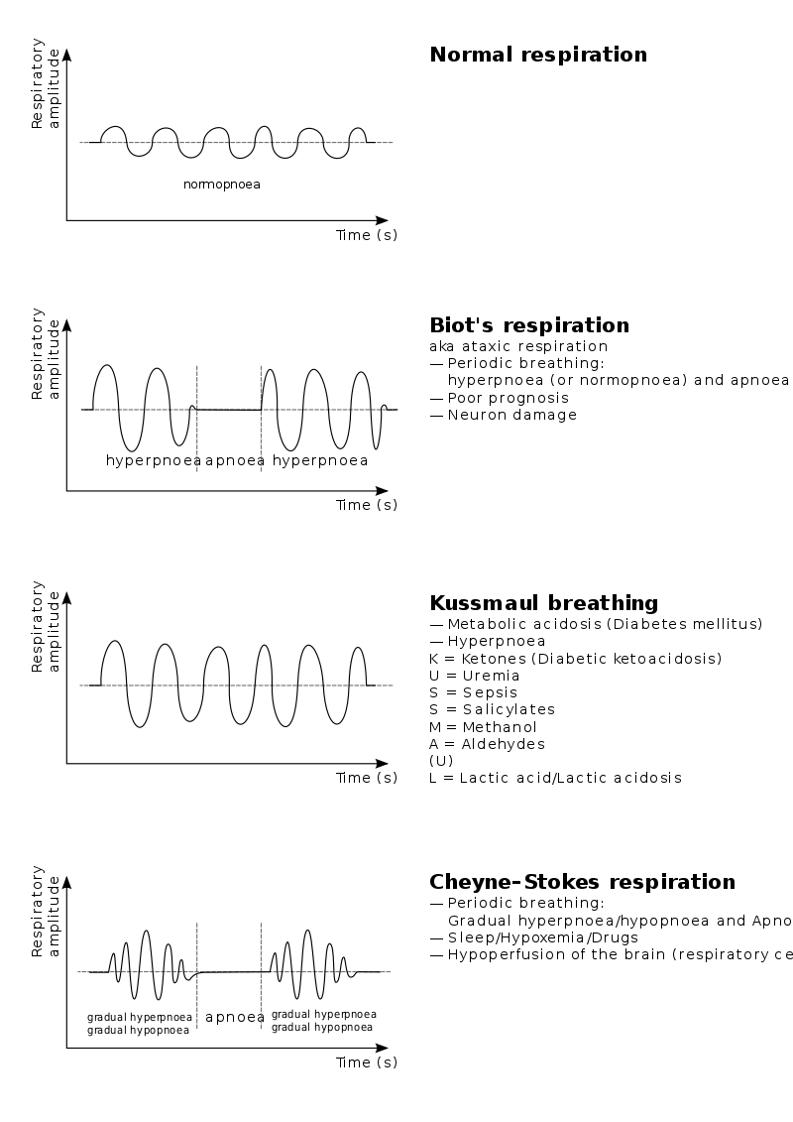
Core Concept

Slide 17
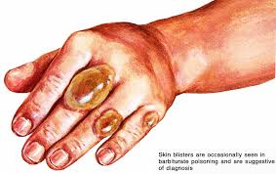
Core Concept
BARBITURATE BLISTERS

Slide 18
SIGNS AND SYMPTOMS
Core Concept
Paralytic ileus (absent bowel sounds)
Oliguria, albuminuria, glycosuria
Respiratory and cardiac failure (cause of death in early stage)
Bronchopneumonia, edema lungs(cause of death in late stage)

Slide 19
Core Concept
Cheyne stokes breathing
oliguria
o
o

Slide 20
FATAL DOSE AND PERIOD
Core Concept
FATAL DOSE :It is ten times the therapeutic dose
Long :3-4 gms (blood levels,10mg/100ml)
Inter:2-3 gms (7mg/100ml)
Short :1-2 gms (3mg/100ml)
Alcohol potentiates this effect
FATAL PERIOD:
24-48 hrs upto days

Slide 21
TREATMENT
Core Concept
SYMPTOMATIC TREATMENT
Keep him warm, Raise foot end, aspirate mucous,O2,artificial respiration
Maintain B.P , every hypotensive adult should therefore receive 2 liters of normal saline ( till obvious fluid overload.)
If no improvement , give dopamine (norepinephrine)
Analeptics, like Amphetamine sulphate 20mg I/V
Antibiotics Inj. CEFTRIAXONE (Rocefin) IV 1g every 24hrs to prevent bronchopneumonia
Endotracheal intubation ,later tracheostomy (after 3 days)

Slide 22
TREATMENT
Core Concept
GENERAL TREATMENT:( after maintaining ABC)
Gastric lavage with 100-150 ml of potassium permanganate sol.(1:1000,1 gm/L), activated charcoal(repeated charcoal lavages )
Lab investigations :
Gastric Lavage for analysis
Blood for analysis ..CBC, electrolytes, BUN , Creatinine , glucose ( to rule out metabolic derangements )and ABGs for respiratory depression
Urine for its metabolites and Phenobarbitone (also for proteins and casts , sugar) ,Alcohol and Acetaminophen levels for co ingestion

Slide 23
TREATMENT
Core Concept
Purgation by enema
Haemodialysis (>10mg/dl LA,>5mg/dl SA), lipid dialysis, exchange transfusions or whole bowel irrigation
Catheterization and forced alkaline diuresis with 2-3 ampoules of Sodium bicarbonate in 1litre of 5% dextrose or ½ litre of 20% Mannitol

Slide 24
POST MORTEM APPEARANCE
Core Concept
Is of aspyxia
External:
Congestion, cyanosis
Froth from mouth and nose
PML, prominent
Barbiturate blisters

Slide 25
POST MORTEM APPEARANCE
Core Concept
Internal:
Stomach Medicine in stomach contents , erosions
Lungs Edema, Congestion, petechial haemorrhages lungs or signs of bronchopneumonia
Brain congested, edematous, petecheal haemorrhages
focal necrotic areas
Heart petechial haemorrhages
Kidneys, degenerated convoluted tubules
Body fat (Chemical analysis for ultra short acting barbiturates)

Slide 27
MEDICOLEGAL ASPECTS
Vertical Integration
Suicidal
Accidental due to Barbiturate automatism( due to anterograde amnesia) or due to synergistic effect
Judicial execution and Euthanasia (I/V Thiopental)
As “ truth serum” (IV Thiopental)
Addiction both physical and psychological due to prolong therapeutic use and used as “Downers” in Cocaine and amphetamine addiction
Note: Warn the patient not to drive or operate the machinery if taken as medicines

Slide 28
CASE SCENARIO
A 48 years old epileptic man, disease well controlled on Phenobarbitone for years with history of treated HIV infection, and type II diabetes for last 5 years, was repeatedly admitted in hospital with altered mental status, arousable to voice and followed simple commands
His tone was flaccid and all reflexes diminished . He showed abnormal reaction of pupil to light.
His blood levels for Phenobarbitone used to be 53-65 mcg/ml during admissions (N 15-40 mcg/ml).
He and his family denied any intentional overdosage, addiction or suicidal tendency ,as he never ran out of his usual medicinal supply.
How ever after necessary investigations, he was treated and sent home on his regular medicines.
2weeks later he presented with cyanosis, coma, hypotension, hypothermia and decreased reflexes. He had slow sighing respiration with periods of complete cessation of breathing
Two days later he developed vesicles on finger knuckles and axilla.

Slide 29
Research
Research
https://www.healthinaging.org/tools-and-tips/ask-expert-sedative-hypnotic-drugs-and-related-medications
https://www.google.com/search?q=Sedatives+and+hypnotics+research&oq=Sedatives+and+hypnotics+research&gs_lcrp=EgZjaHJvbWUyBggAEEUYOTIHCAEQIRigATIHCAIQIRigATIHCAMQIRigAdIBCTcyMTRqMGoxNagCCLACAfEF_tbO-vbKMOLxBf7Wzvr2yjDi&sourceid=chrome&ie=UTF-8
https://www.britannica.com/science/sedative-hypnotic-drug

Slide 30
Biomedical Ethics
ETHICS
There is ri s k of addiction and dependence which raises the concern of prescribing it.
The determination of a patient's death is of considerable medical and ethical significance.
Death is a biological concept with social implications.
Acting with honesty, transparency, respect, and integrity is critical to trust in the patient-physician relationship, and the profession, in life and in death.

Slide 31
Family Medicine
FAMILY MEDICINE
Family medicine plays a vital role in barbiturate prescribing, and here are some key aspects
Primary Care Provision
Patient Education and Counseling
Diagnosis and Treatment
Medication Management medications, including barbiturates.
iii.

Slide 32
How to use HEC Digital Library
Go to the website of HEC National Digital Library
http://www.digitallibrary.edu.pk
On Home Page, click on the INSTITUTES.
A page will appear showing the universities from Public and Private Sector and other Institutes which have access to HEC National Digital Library (HNDL).
Select your desired Institute.
A page will appear showing the resources of the institution
Journals and Researches will appear
You can find a Journal by clicking on JOURNALS AND DATABASE and enter a keyword to search for your desired journal

Slide 33
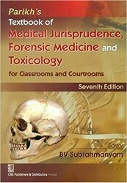
TEXT BOOKS & PRACTICAL NOTEBOOK:
Principles & Practice of Forensic Medicine.
by Nasib R. Awan
Parikh’s Textbook of Medical Jurisprudence,
Forensic Medicine & Toxicology.
Practical Manual Of Forensic Medicine
& Toxicology

Slide 34
Thank you

