Slide 2
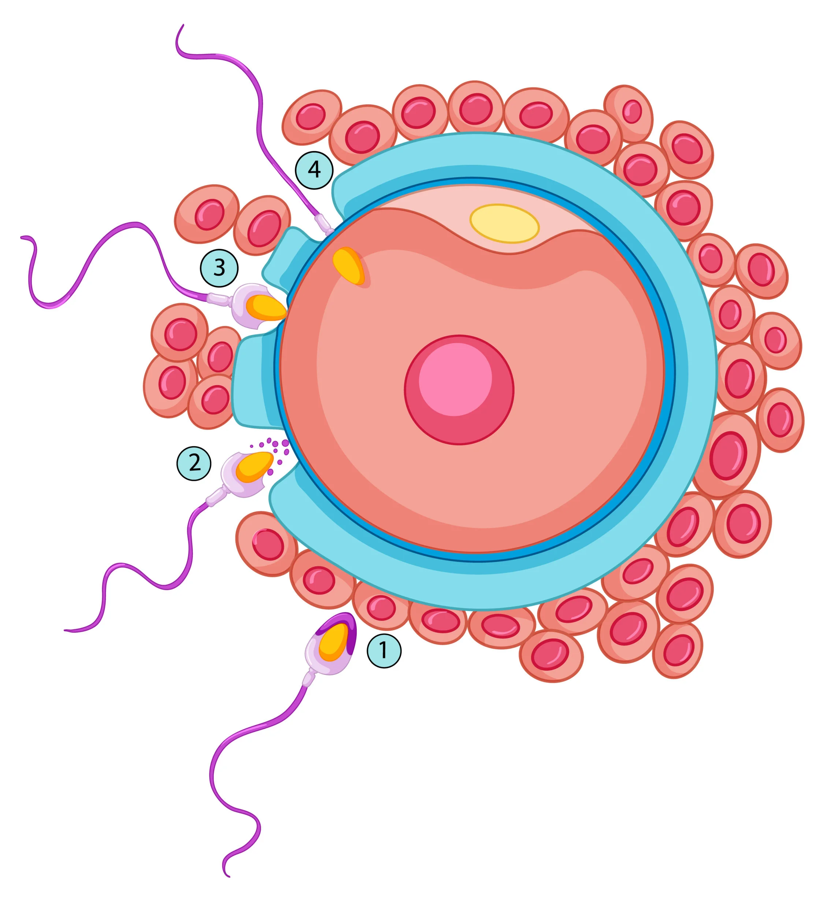
Foundation Module 1st Year MBBS(LGIS) First Week of Development (fertilization)
Presented by:
Prof. Dr. Ayesha Yousaf
Date:10-03-2023
Updated on 25.01.2025

Slide 5
Learning Objectives
At the end of the lecture, students will be able to
Discuss capacitation in female genital tract
Discuss different phases and results of fertilization
Enlist causes of infertility
Discuss the assisted reproductive technologies
Correlate and build core knowledge on the basis of latest research
Describe concept of justice in bioethics

Slide 6
Interactive Session
A 37 year old female with history of Pelvic Inflammatory Disease(PID) fails to conceive after years of marriage. Investigation reveals fallopian tube scarring, most probably due to previous infection. As the disease is too extensive to be corrected by tubal cannulation or surgery, what can be a suitable treatment option to help the patient conceive?
Notes:
IVF is recommended for women who wish to get pregnant but have damaged or blocked fallopian tubes that cannot be treated. Even in instances where a woman no longer has fallopian tubes, she may be able to get pregnant through IVF. This is because during an IVF procedure, a fertilized egg at the embryo stage is placed directly into a woman’s uterus, bypassing the need for the sperm and egg to travel to the fallopian tubes or of a resulting embryo to travel to the uterus.

Slide 7
Oocyte transport
Core Knowledge
Secondary oocyte is expelled at ovulation from the ovarian follicle
During ovulation, the fimbriated end of the uterine tube becomes closely applied to the ovary. Fimbriae move back and forth over the ovary.
Sweeping action of the fimbriae and fluid currents produced by the cilia of the mucosal cells "sweep" the secondary oocyte into the infundibulum.
Oocyte passes into the ampulla, mainly as the result of peristalsis-movements of the wall of the tube

Slide 8
Sperm transport
Core Knowledge
From epididymis sperms are rapidly transported to the urethra by peristaltic contractions of the thick muscular coat of the ductus deferens .
Seminal gland, prostate, and bulbourethral glands- produce secretions
200 to 600 million sperms are deposited and pass slowly through the cervical canal by movements of their tails.

Slide 9
Semen
Horizontal Integration
Vesiculase –coagulates some of semen –forms a vaginal plug
Prostaglandins stimulate uterine motility
Fructose secreted by seminal glands is energy source
Non motile in epididymis
Move slowly in acidic environment of vagina
Move rapidly in alkaline environment of uterus
Motile sperms reach ampulla in 5 min may take 45 min
Only 200 sperms reach fertilization site

Slide 10
Spermatozoa are not able to fertilize the oocyte immediately upon arrival in the female genital tract but must undergo
Core Core Knowledge
nowledge
Spermaozoa
1. Capacitation
2. Acrosome reaction

Slide 11
Capacitation: Period of conditioning in the female genital tract
Core Knowledge
It takes 5-7 hours and sperms become more active.
It occurs in the uterus and oviducts.
Epithelial interaction
Removal of glycoprotein and a seminal plasma protein from the plasma membrane that overlies acrosomal region of the spermatozoa
Acrosomal reaction cannot occur until capacitation has occurred.

Slide 12
Acrosome reaction
Horizontal Integration
Occurs after binding the zona pellucida
Induced by zona proteins
Multiple point fusions of sperm plasma membrane and external acrosomal membrane occurs-breakdown -apertures
release of enzymes needed to penetrate the zona pellucida
Enzymes :
Acrosine
Trypsin like substance

Slide 13
Fertilization
Core Knowledge
It is the process by which male and female gametes fuse, occurs in the ampullary region of the uterine tube.

Slide 14
Fertilization
Core Knowledge
Fertilization is a complex sequence of coordinated molecular events that begins with contact between a sperm and an oocyte and ends with the intermingling of maternal and paternal chromosomes at metaphase of the first mitotic division of the zygote, a unicellular embryo.

Slide 15
Phases of fertilization
Core Knowledge
Phase 1 Penetration of corona radiata
Phase 2 Penetration of zona pellucida
Phase 3 Fusion of oocyte and sperm cell membrane
Phase 4 Formation of male and female pronuclei
Phase 5 Membranes of the pronuclei break down

Slide 16
PHASE 1 - Penetration of Corona Radiata
Core Knowledge
Ejaculation contain 300 million sperm and only 300 to 500 reach fallopian tube and only one fertilizes the egg
Capacitated sperms can pass freely through corona cells by hyaluronidase from acrosome
Tubal mucosal enzymes assist in dispersal
Movement of tail of sperm
Other sperms aid in penetrating barrier

Slide 17
Phase 2 - Penetration of the Zona Pellucida
Core Knowledge
Acrosomal enzymes: esterases, acrosin, and neuraminidase cause lysis of the zona pellucida
Sperm penetrates zona pellucida, the Zona reaction
makes the zona pellucida impermeable to other sperms.
Composition of extracellular glycoprotein coat changes after fertilization
release of lysosomal enzymes from cortical granules near plasma membrane of oocyte
When more than one sperm manages to enter the ovum (dispermy = 2; triploidy = 3), the fetus nearly always aborts.

Slide 18
Phase 2 - Penetration of the Zona Pellucida
Core Knowledge

Slide 19
Phase 3 - Fusion of Oocyte and sperm cell membrane
Core Knowledge
Head and tail of a sperm enter the cytoplasm of the oocyte, sperm plasma membrane remains behind.
As soon as sperm entered the oocyte
2nd meiotic division of oocyte is completed mature oocyte and second polar body is formed
Metabolic activation of egg
De-condensation of maternal chromosomes-nucleus of mature oocyte becomes Female pronucleus

Slide 20
Phase 4 Formation of Male and Female Pronuclei
Core Knowledge
With in cytoplasm of oocyte nucleus of sperm enlarges to form Male pronuclei
At this stage, the male and female pronuclei are indistinguishable.
As they grow, the pronuclei replicate their DNA
Oocyte containing two haploid pronuclei is called an OOTID

Slide 21
Phase 5 Breakdown of pronuclei membranes
Core Knowledge
Membranes of the pronuclei break down, chromosomes condense and arrange themselves for mitotic cell division
Ootid becomes Zygote
On membrane dissolution, there is 1 cell with 46 chromosomes = diploid (2N)
The first cleavage follows shortly, leaving 2 cells, each with 46 chromosomes.
Mitosis in the new zygote uses centrioles derived from the sperm. The oocyte has no centrioles.

Slide 22
Results of fertilization
Core Knowledge
Stimulates the secondary oocyte to complete Meiosis.
Restores the normal diploid number of chromosomes (46).
Results in variation of human species as maternal and paternal chromosomes intermingle.
Embryo contains only maternal mitochondria because the sperm mitochondria are dispersed into the egg cytoplasm and discarded.
Determines the sex of the embryo .

Slide 23
Twins: still 1 sperm per egg
Vertical Integration
Monozygotic (mono-ovular):
A fertilized, single egg splits into two developing zygotes at a very early stage.
Identical twins; same sex.
Dizygotic (poly-ovular):
Result from the fertilization by two sperms of two separate ova that have reached maturation at the same time.
Not identical twins; can be different sexes

Slide 24
Triplody(KLM pg 25) (in vitro)
Vertical Integration
There are 3 pronuclei within this one zygote.
In the laboratory, such embryos are discarded.
In vivo, such embryos almost always abort spontaneously.

Slide 25
Contraceptive Methods(Langman pg 35,36)
Vertical Integration
Contraceptive pill:
Synthetic estrogen combined with synthetic progesterone pills are taken once each day for 3 weeks after the last day of menstruation.
Negative feedback inhibits ovulation.
Placebo pill taken the 4th week permits menstruation.
Rhythm method:
Women measure oral basal body temperature upon awakening daily.
On day of LH surge, there is a slight drop in basal body temperature.

Slide 26
Intrauterine Devices (IUDS)Langhman pg 36
Vertical Integration
Is a small T shaped unit and there are two types of IUDs
Hormonal IUD releases progestine- thickening of cervical mucus
- sperms less active make sperm and egg less viable
2. Copper IUD releases copper very slowly into the uterus which prevent fertilization and prevent implantation.
It also prevent sperm to enter into the uterine tubes

Slide 27
Primary Causes of Infertility
Vertical Integration

Slide 28
Assisted Reproductive Technology(KLM pg 29)
Vertical Integration
Some of the techniques are
In Vitro fertilization (IVF) and embryo transfer
STEPS
Ovarian follicles are stimulated to grow and mature by the administration of clomiphene citrate or gonadotrophins
Several mature oocytes are aspirated . Oocytes are retrieved in one of two ways:
Through a surgical procedure called laparoscopy or
Through transvaginal retrieval by ultrasound guidance.

Slide 29
Assisted Reproductive Technology(KLM pg 29)
Vertical Integration
During a transvaginal retrieval, a needle is inserted through the vagina under sonographic and into the follicle so the egg and follicular fluid may be aspirated.
A laparoscopic retrieval will permit the telescopic viewing of the follicles inserted through the abdomen.
A needle is introduced through a second incision and placed into the follicle. The egg and the follicular fluid can then be aspirated.

Slide 30
Assisted Reproductive Technology(KLM pg 29)
Vertical Integration
Oocytes are transferred to petri dish containing a special culture medium and capacitated sperms
Fertilization of the oocyte and cleavage of the zygote are monitored for 3-5 days
One or two of the resulting embryos four to eight cell stage or early blastocyst are transferred by introducing a catheter through vagina and cervical canal into the uterus
Remaining embryos are stored in liquid nitrogen
The patient lies supine for several hours

Slide 31
Assisted Reproductive Technology(KLM pg 29)
Vertical Integration
IVF is associated with a higher rate of chromosomal abnormalities.
leads to multiple pregnancies
It is associated with high rates of mortality and morbidity and the frequency of multiple births depend on maternal age (with a higher incidence in younger women).

Slide 32
Intracytoplasmic sperm injections
Vertical Integration
A sperm is obtained from male reproductive tract and is injected into the cytoplasm of the egg
There is an increased risk for fetuses to have Y chromosomes deletions

Slide 33
Surrogate mothers
Vertical Integration
Some women produce mature oocytes but are unable to become pregnant who has had her uterus removed .
IVF may be performed and the embryo transferred to another woman's uterus for development and delivery

Slide 34
Sterilization
Vertical Integration
Form of birth control
IN MEN = Vasectomy prevent release of sperm by blocking the ductus deferens
IN WOMEN = Tubal ligation in which uterine tubes are blocked or ligated

Slide 35
Management of IVF
Spiral Integration
Prioritize your health prior to starting IVF treatment.
Manage your stress levels (think: yoga, meditation, therapy)
Get enough sleep each night (8 hours is optimal)
Take your prenatal vitamins.
Be proactive and ask your Care Team questions.

Slide 36
Facts of subfertility cause, smoking and body weight on the success rate of IVF
Spiral Integration
Research Article
A.M.E. Lintsen, P.C.M. Pasker-de Jong, E.J. de Boer, C.W. Burger, C.A.M. Jansen, D.D.M. Braat, F.E. van Leeuwen, on behalf of the OMEGA project group, Effects of subfertility cause, smoking and body weight on the success rate of IVF, Human Reproduction, Volume 20, Issue 7, 1 July 2005, Pages 1867–1875, https://doi.org/10.1093/humrep/deh898
Male subfertility, advancing female age, smoking and obesity negatively impact live birth outcomes via IVF treatment.
Notes:
the live birth rate for male subfertility was significantly lower compared to unexplained subfertility and tubal pathology. Advancing female age had an unfavourable effect on the success rate of IVF for all subfertility causes. Smoking and overweight during IVF treatment had deteriorating effects on the live birth rates. Women who smoked had a significantly higher abortion rate than non-smoking women. Furthermore the effect of smoking was comparable to an increase in female age with 10 years, from age 20 to 30 years.

Slide 37
Learning Resources
Langman's Medical Embryology, 14th Edition
The Developing Human: Clinically Oriented Embryology KLM Embryology
Textbook of Clinical Embryology (Kevin Coward, Dagan Wells)
Google Scholar

Slide 38
Let’s Recap

