Slide 1
Prostatic Carcinoma
Dr. Faraz Basharat Khan
Senior Registrar Urology, RMU

Slide 2
University Mission and Vision
Mission Statement
Highly recognized and accredited center of excellence in Medical Education, using evidence-based training techniques for development of highly competent health professionals, who are lifelong experiential learner and are socially accountable.
Vision
To impart evidence-based research oriented health professional education in order to provide best possible patient care and inculcate the values of mutual respect, ethical practice of healthcare and social accountability.

Slide 3
Sequence of LGIS
Learning Objectives
Anatomy and Physiology of the prostate (Vertical Integration)
Pathology of Prostate cancer (Horizontal Integration)
The clinical aspects of prostate cancer (Core subject)
Research related to prostate cancer
Ethics

Slide 5
Learning Objectives
Recall the anatomy and pathophysiology of prostate cancer
Understand the epidemiology and risk factors for prostate cancer
Recognize the clinical presentation and diagnostic approaches to prostrate cancer
Staging and grading of prostate cancer
Outline the Management of prostate cancer
Understand the prognosis

Slide 7
Vertical Integration with Anatomy and Physiology

Slide 8
Anatomy & Physiology
Prostate is a walnut sized, male accessory gland, located below the bladder
The primary function of the prostate is to contribute prostatic fluid to semen about 20–30% to the total semen volume
Prostatic fluid contains components that make semen an ideal substance for sperm cells to live in, including enzymes, zinc, and citric acid.
One important enzyme is prostate-specific antigen (PSA)

Slide 12
Horizontal integration with Pathology

Slide 13
Epidemiology and Risk Prevention
Prostate cancer is the second most common cancer in males
There are three well-established risk factors for PCa:
Increasing age,
Ethnic origin(African origin)
Genetic predisposition.
There is currently no high-level evidence that preventative measures may reduce the risk of PCa

Slide 15
Core Subject

Slide 16
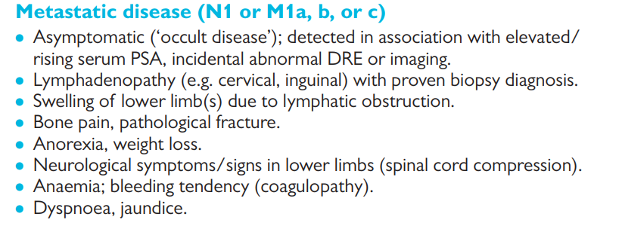
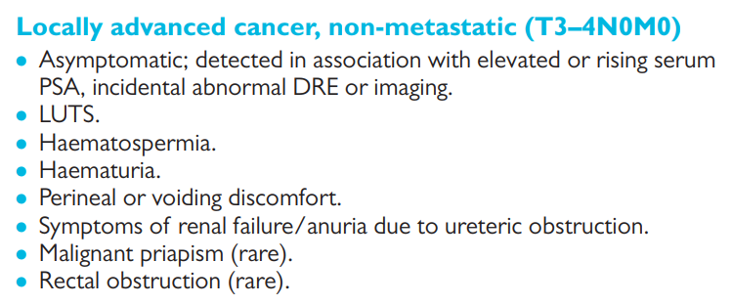
Clinical Manifestation

Slide 17
Diagnostic work up
History & Examination (clinical manifestations)
DRE(abnormal DRE raises suspicion)
PSA( raised PSA raises suspicion)
Prostate Biopsy
CECT TAP, MRI Prostate, Bone scan (Metastatic work up)

Slide 18
DRE
Anal tone ?
Prostatic size? enlarged
Consistency? Hard
Surface ? Nodular/irregular
Mucosa mobility ? Immobile
Finger stool/ blood stained ? Blood stained

Slide 19
Serum PSA
Glycoprotein secreted by Prostatic Epithelium
May rise in benign conditions
May be normal in CA prostate
Age-adjusted normal range for PSA
Age PSA range (ng/mL)
40–40 <2.5
50–59 <3.5
60–69 <4.5
>70 <6.5

Slide 20
Prostatic Biopsy
TRUS guided biopsy remains the gold standard for the diagnosis of the prostatic carcinoma

Slide 24
Imaging
metastatic workup
CECT CAP
mpMRI of the prostate
Bone scan

Slide 25
Staging

Slide 27
Management
Treatment depends on;
Stage of the disease
Symptoms of the patients
Life expectancy of the patients

Slide 28
Deferred Treatment (observation)
Watchful waiting
Active surveillance
Active Treatment
Radical prostatectomy
Radical Radiotherapy
Hormonal therapy
Chemotherapy

Slide 30
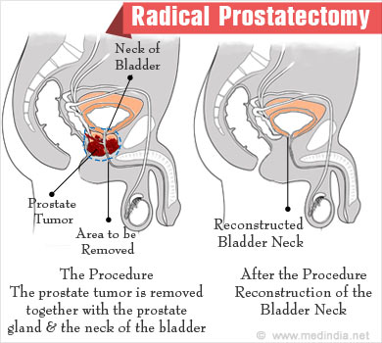
Surgery
Radical prostatectomy
Open
Laparoscopic
Robotic

Slide 31
Radiotherapy
External beam radiotherapy :
Radiations are directed from outside of the body
Brachytherapy :
Radiations are given to prostate by implanting radioactive seeds within the prostate

Slide 32
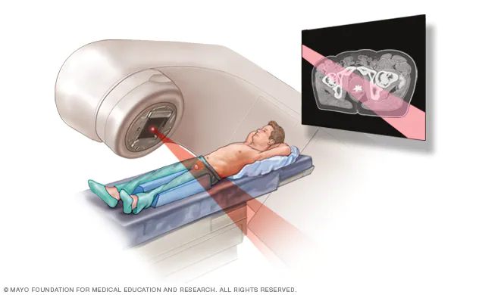
Brachytherapy
External beam radiotherapy :

Slide 33
Hormonal Therapy(ADT)
Prostate CA growth is testosterone dependent
This fact is utilized in the treatment and progression of prostatic CA by aiming to
Decrease testosterone production
- Testosterone action blockade

Slide 34
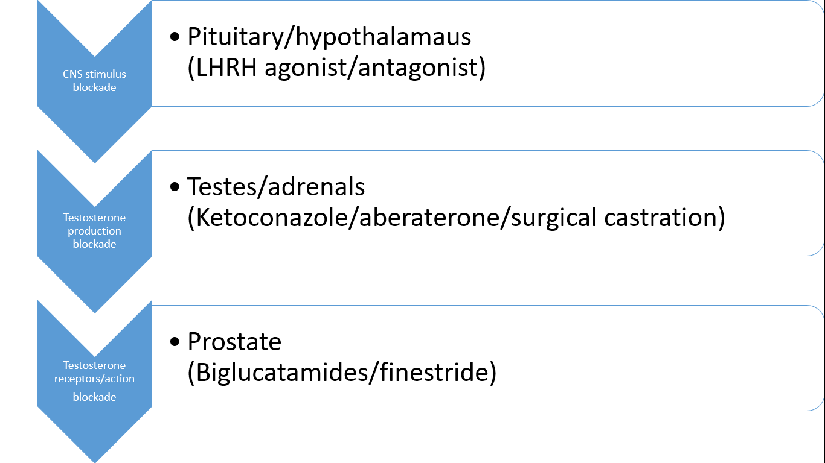

Slide 35
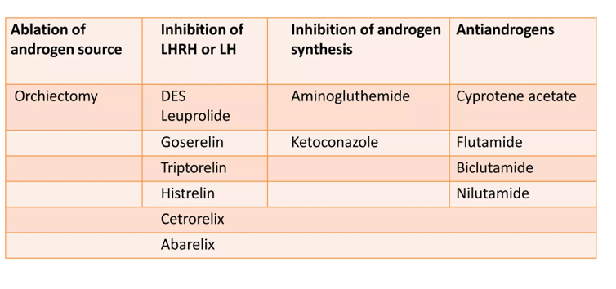

Slide 36
Chemotherapy
It is sometimes used in selective metastatic cases when hormone treatment failures occurs
Docetaxel, paclitaxel, doxorubicin and etoposide
Docetaxel with steroids if the first line of drug used in chemotherapy for CA prostate

Slide 37
Prognosis
5 year survival is 90 %
10 year survival is 80 %
‘Patients die with prostate cancer rather than of prostate cancer’

Slide 38
Biomedical Ethics
Informed consent should be taken before any medical or surgical treatment
Prognosis should be explained to patient and his family

Slide 39
Thank you

