Slide 1
BENIGN TUMORS OF OVARY
REPRODUCTIVE MODULE
4-011-2024
DR. AMARA AROOJ
ASSISTANT PROFESSOR, OBGYN
RMU, RAWALPINDI

Slide 2
UNIVERSITY MOTTO, VISION, VALUES & GOALS

Slide 3
SEQUENCE OF LGIS
Learning objectives
Related embryology, anatomy of ovary and physiology of menstrual cycle (Spiral integration 15%)
Benign tumors of ovary (core concept = 80%)
Research article related to topic (3%)
Ethics (2%)

Slide 4
LEARNING OBJECTIVES
At the end of the lecture students should be able to
Correlate the embryology ,anatomy and physiology with the development of ovarian cysts
Know the classification of benign ovarian tumors
Understand the clinical features and complications
Enumerate the basic diagnostic tests for ovarian disease
Outline the management plan
Formulate follow up plan

Slide 5
PROF UMER MODEL OF INTEGRATED LECTURE

Slide 6
Spiral integration with embryology
anatomy and physiology

Slide 11
DIAGNOSIS
Symptoms
Pelvic discomfort, pain, nausea, vomiting, pressure symptoms or incidental finding.
Signs
Abdominal/pelvic mass, separate from uterus.
Investigations
TVUSS/TAUSS
CT/MRI
Tumor markers (Ca 125, inhibin, Beta-hCG, AFP etc)
Pregnancy test,CRP/WCC

Slide 12
Benign Ovarian Cysts/Tumors
FUNCTIONAL (Young, adolescent, reproductive) | Follicular cyst Corpus luteal cyst Theca luteal cyst
INFLAMMATORY | Tubo-ovarian abscess endometrioma
GERM CELL (Young ) | Benign teratoma (dermoid cyst)
EPITHELIAL (older, post-menopausal) | Serous cystadenoma Mucinous cyst adenoma Brenner tumor
SEX CORD STROMAL | Fibroma Thecoma

Slide 13
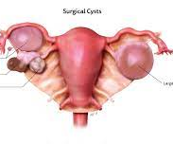
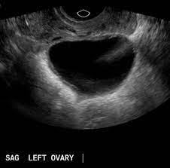
FUNCTIONAL OVARIAN CYSTS
Follicular Cyst
Etiology; uncertain
Size; 3-10 cm
Simple unilocular
Treatment; depends upon symptoms.
Conservative
Laproscopic excision.

Slide 14
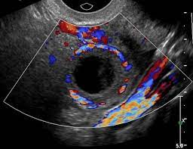
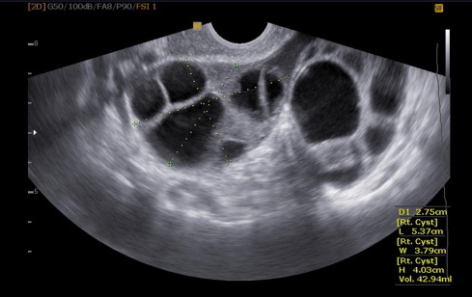
Corpus Luteal Cyst
Occur following ovulation
Pain in late cycle due to haemorrhage
Treatment; expectant with analgesics
Ovarian cystectomy
Theca Luteal Cyst
Associated with pregnancy
Incidental diagnosis
Resolve during pregnancy

Slide 15
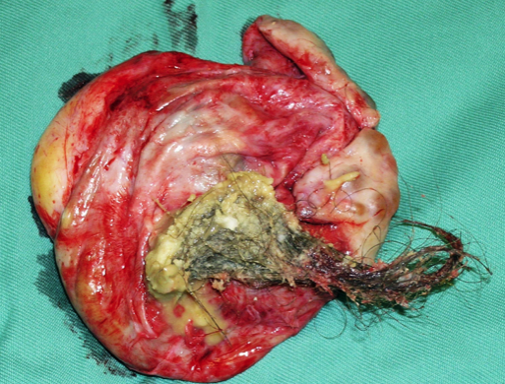
Germ Cell Tumors
Commonest ovarian tumor between 20-40 yrs
Dermoid cyst (mature cystic teratoma)
Fully differentiated tissue from all three embryonic layers ( hair, bone, teeth, skin, muscle, etc.)
10% B/L.
Malig transformation rare ;<2%.
Treatment; ovarian cystectomy

Slide 16
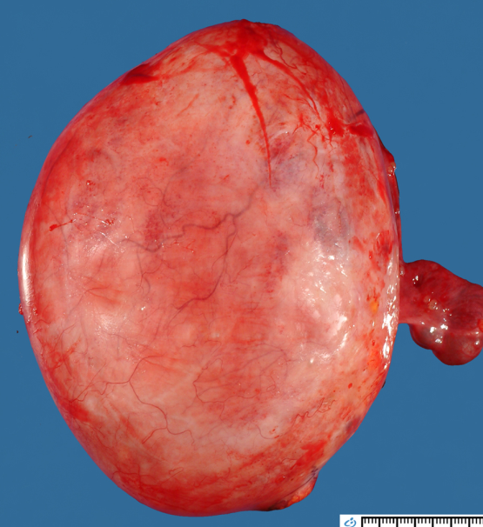
Epithelial tumors
Serous Cystadenoma;
Unilateral, unilocular
Mucinous Cystadenoma,
Multilocular, bilateral 10%
Brenner Tumor
Small size, incidental finding
Contain urothelial like epithelium and secret estrogen

Slide 17
Sex Cord Stromal Tumors
Ovarian fibroma
Solid tumor composed of stromal cells.
May present as Meig’s Syndrome
Thecoma
Benign estrogen secreting
Present with post-menopausal bleeding.

Slide 18
Other ovarian cysts
Fimbrial cysts
Paratubal cysts
Paraovarian cysts(Paraoopherons, wolfian ducts)
Inflammatory ovarian cysts
Endometriosis
Tubo-ovarian abscess

Slide 19
D/D of Pelvic Mass
Gynaecological | Benign/malig ovarian cyst, torsion, para-ovarian cyst, ectopic,hydr/pyo salpinx, TO abscess, tubal malig., pregnancy, fibroid, uterine malig.
Gastro-intestinal | Small/large bowl obstruction, diverticular/appendicular abscess, intussusception, malignanacy.
Urological | Hydronephrosis, pelvic kidney, renal/bladder malignancy
Other | Pelvic lymphocoele, peritoneal cyst, psoas muscle abscess, lymphoma, neuroblastoma, aortic aneurism.

Slide 20
CASE SCENARIO:1
A 28 years old P3 presents in OPD with an ultrasound report showing 5 into 6 cm clear thick wall cyst. She has complaint of mild lower abdominal pain for the last 3 days .Her LMP is 20 days back.
What is your diagnosis?
What will you advice her?

Slide 21
CASE SCENARIO:2
She again presents after two days in emergency with complaint of severe abdominal pain for the last 3 hours, vomiting and low grade fever. On examination, her pulse is 106beats /min, BP: 100/60mmHg,Temp: 99F.She is tender in lower abdomen.
What is your diagnosis?
How will you manage her?

Slide 22
COMPLICATIONS
Cyst torsion
Cyst rupture
Cyst haemorrhage
Malignancy

Slide 24
FOLLOW UP

Slide 25
RESEARCH
Farghaly SA. Current diagnosis and management of ovarian cysts. Clin Exp Obstet Gynecol. 2014;41(6):609-612.
RCOG Guidelines :62

Slide 26
ETHICS
Through and complete evaluation of ovarian cysts/masses
R/O pregnancy, malignancy
Timely referral
There are long-term reproductive consequences of inadvertently removing one or both ovaries.
Unnecessary surgery has an effect on patients’ physical and mental wellbeing.

