Slide 1
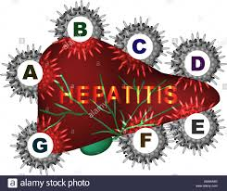
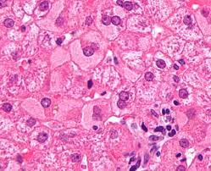
The different faces of hepatitis: types, causes and complications
Dr. Aqsa Naseer
Senior Registrar
Gastroenterology HFH , Rawalpindi

Slide 3
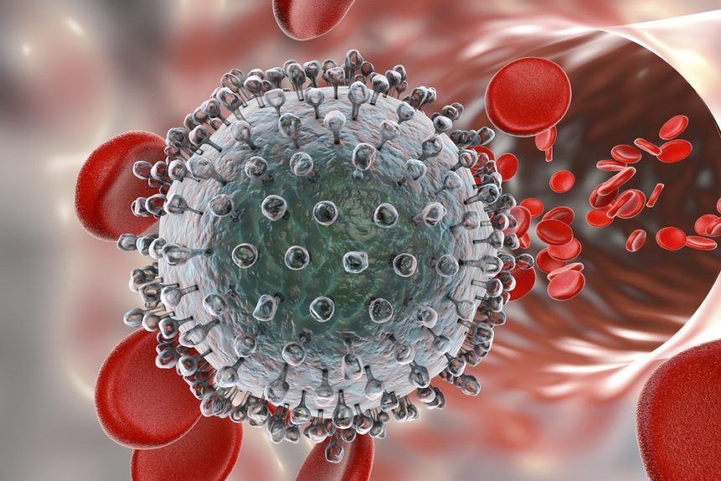
LEARNING OBJECTIVES
At the end of this lecture students of 3rd year should be able to
Define Acute & chronic hepatitis
Describe its Etiology, Clinical presentation
Diagnosis and Management
Know the methods of Prevention
Describe cirrhosis and its complications

Slide 4
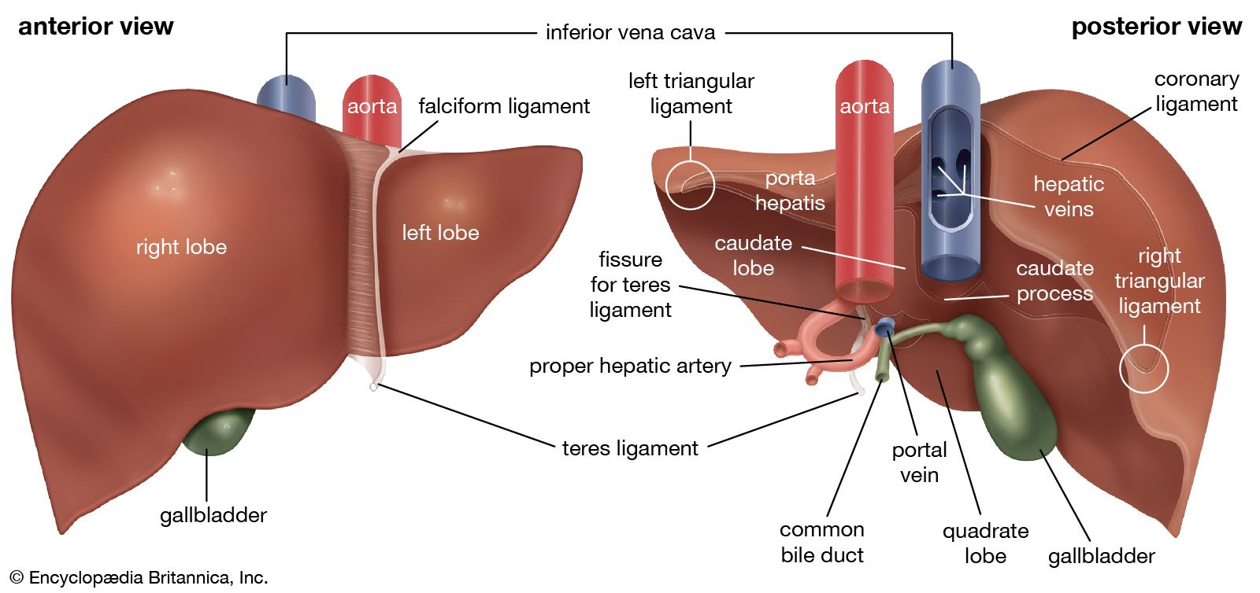
Anatomy of liver
VERTICAL INTEGRATION

Slide 5
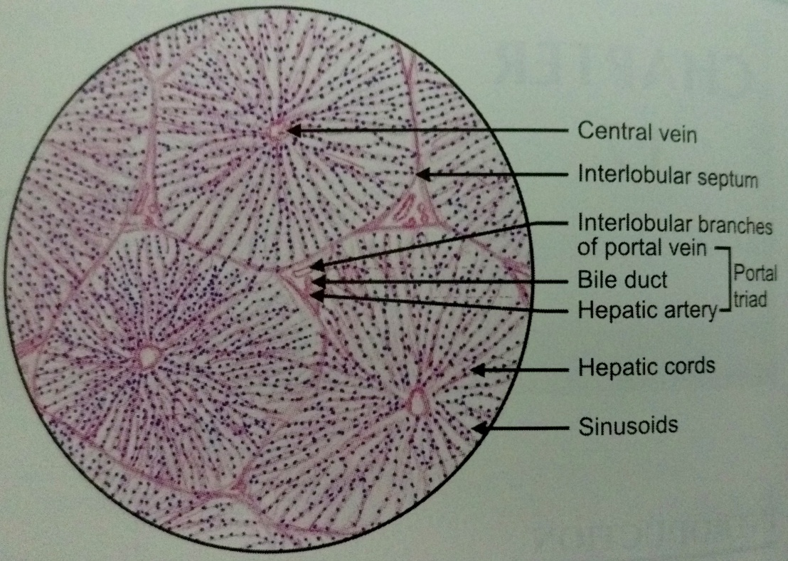
Liver Histology
VERTICAL INTEGRATION

Slide 6
Hepatitis
CORE SUBJECT
Hepatitis is a broad term that means inflammation of liver.
Etiology:
Viral hepatitis
Alcoholic hepatitis
Auto immune hepatitis
Nonalcoholic steatohepatitis
Drugs

Slide 7
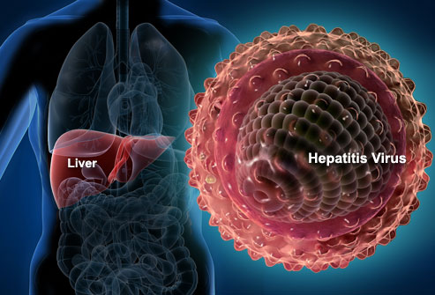
What is viral hepatitis
CORE SUBJECT
Viral hepatitis is a systemic disease with primary inflammation of the liver by any one of a heterogeneous group of hepatotropic viruses.
The most common causes of viral hepatitis are the five unrelated hepatotropic viruses Hepatitis A, Hepatitis B, Hepatitis C, Hepatitis D, and Hepatitis E.
In addition to the nominal hepatitis viruses, other viruses that can also cause liver inflammation include Herpes simplex, Cytomegalovirus, Epstein–Barr virus, or Yellow fever.

Slide 8
CORE SUBJECT
Acute Hepatitis:
Acute hepatitis can be defined as any syndrome that causes elevation of liver function tests (LFTs) for less than 6 months. Common causes include Hepatitis A, Hepatitis E virus, paracetamol, Wilson disease
Chronic Hepatitis:
defined as persistence of liver injury with raised aminotransferase levels or viral markers for more than 6 months. Common causes: Hepatitis B and Hepatitis C Virus
Acute Hepatic Failure:
is the appearance of severe complications(encephalopathy and coagulopathy) rapidly after the first signs of liver disease (such as jaundice).
Cirrhosis:
Replacement of liver tissue by fibrosis(scar tissue).These changes lead to loss of liver function

Slide 9
Pathophysiology of Hepatitis
HORIZONTAL INTEGRATION

Slide 10
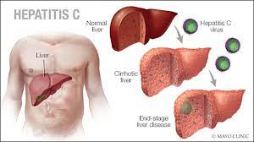
Complications:
Acute viral hepatitis: Chronic viral Hepatitis:
Acute liver failure Liver cirrhosis
Cholestatic hepatitis Hepatocellular Cancer
Relapsing hepatitis
Chronic liver disease
Aplastic anemia

Slide 11
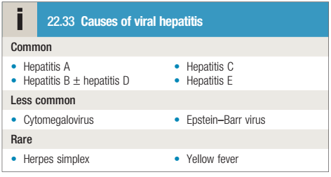
CORE SUBJECT

Slide 12
Hepatitis A
CORE SUBJECT
Hepatitis A (infectious hepatitis or epidemic jaundice) is an acute infectious disease caused by Hepatitis A virus (HAV).
Presentation: non-specific symptoms such as fever, chills, headache, fatigue, generalized weakness and aches and pains, followed by anorexia, nausea, vomiting, dark urine and jaundice.
The disease is benign with complete recovery in several weeks, chronic infection does not occurs
AGENT: The causative agent, the hepatitis A virus, is an enterovirus of the Picornaviridae family. It multiplies only in hepatocytes.

Slide 13
CORE SUBJECT
RESERVOIR OF INFECTION: The human cases are the only reservoir of infection.
PERIOD OF INFECTIVITY : The risk of transmitting HAV is greatest from 2 weeks before to 1 week after the onset of jaundice.
Mode of transmission: feco-oral route, by contaminated food or milk
Host factors a) AGE: Infection with HAV is more frequent among children than in adults. However, people from all ages may be infected if susceptible. b) SEX: Both sexes are equally susceptible. c) IMMUNITY: Immunity after attack probably lasts for life.
Incubation period: 2-7 weeks

Slide 14
VERTICAL INTEGRATION
Diagnosis:
Biochemical; A hepatocellular pattern of LFTs develops, with serum transaminases typically between 200 and 2000 U/L in an acute infection (usually lower and fluctuating in chronic infections). The plasma bilirubin reflects the degree of liver damage. The ALP rarely exceeds twice the upper limit of normal
Serological: Anti HAV of IgM type
Treatment: supportive, high calorie low fat diet, bed rest , plenty of fluids, antiemetic's
Prevention: improving hygiene and overcrowding
Active immunity: by inactivated virus vaccine
Passive immunization: immune serum globulin soon after exposure

Slide 15
Hepatitis B
CORE SUBJECT
An acute systemic infection with major pathology in the liver, caused by hepatitis B virus
The acute illness causes liver inflammation, vomiting, jaundice, and, rarely, death. Chronic hepatitis B may eventually cause cirrhosis and liver cancer. Hepatitis B is endemic throughout the world, especially in tropical & developing countries
AGENT: Hepatitis B Virus (HBV) -It is a complex, 42 nm double-shelled DNA virus originally known as ―Dane Particle. It replicates in liver cell
RESERVOIR OF INFECTION : -Men is the only reservoir of infection which can be spread either from carriers or from cases. Infective material: -Contaminated blood is the main source, -Virus has been found in body secretion such as saliva, vaginal secretion & Semen in infected material

Slide 16
CORE SUBJECT
Acute hepatitis B :
90% resolve by themselves; <1% develop fulminant hepatic failure.: Perinatal -1% Childhood -10%(1-5 yr. age) Late infection -30%(>5 yr. age) –
Chronic hepatitis B 2-10% progress to chronic state. Perinatal -95% Childhood -80% After 5 yr. of age -5-10%
Modes of Transmission: Injection drug use , Infected unscreened blood products, Tattoos/acupuncture needles, Sexual transmission, Close living quarters/playground play as a toddler , vertical transmission from HbsAg positive mother
Humoral and cellular response: -HBV has 3 distinct antigen: i. HBsAg, also known as ―Australian antigen, ii. HBcAg (core antigen) iii. HBeAg envelope antigen. They stimulate production of corresponding antibody.
Incubation Period :4-20 weeks (usually 60-90 days)

Slide 17
VERTICAL INTEGRATION
Diagnosis:
Liver function test
HBV DNA PCR
Liver biopsy: to determine grade and stage of fibrosis
Serology
1) HBsAg :- It is the first marker to appear in blood after infection.
2) Anti-HBs(HBsAb) :-Disappearance of HBsAg and the appearance of anti-HBs signals recovery from HBV infection, non-infectivity.
3) Anti-HBc :- IgM anti-HBc appears shortly after HBsAg is detect (HBcAg alone dose not appear in serum) IgM-HBc may also or can persist for 3-6 months or longer. IgG-HBc also appear during acute hepatitis B but persist indefinitely.
4) HBeAg :- HBeAg appear in blood concurrently with HBsAg, or soon afterwards. HBeAg indicate viral replication and infectivity. Persistence of HBeAg in serum beyond 3 month indicate an increased like hood of chronic hepatitis B

Slide 18
Treatment
Acute hepatitis B
Treatment is supportive with monitoring for acute liver failure, which occurs in less than 1% of cases. Full recovery occurs in 90–95% of adults following acute HBV infection. The remaining 5–10% develop a chronic hepatitis B infection that usually continues for life.
CHRONIC HEPATITIS B:
The goals of treatment are HBeAg seroconversion, reduction in HBV-DNA and normalization of the LFTs.
The indication for treatment is a high viral load in the presence of active hepatitis, as demonstrated by elevated serum transaminases and/or histological evidence of inflammation and fibrosis. Drugs:
Direct acting nucleotide analogue: Lamivudine, tenofovir, Entecavir, adefovir
Pegylated Interferon –a in children

Slide 19
Prevention
Active Immunization:
Recombinant vaccine (Engerix) containing HbsAg, scheduled at 0,1 and 6 months to at risk individuals
Passive Immunization:
Hepatitis B immunoglobulin ( containing antiHbs). This should be given within 48 hours, or at almost a week, of exposure to infected blood in circumstances likely to cause infection (e.g. needle stick injury, contamination of cuts or mucous membranes).
Vaccine can be given together with HBIg (active–passive immunization)
Neonates born to hepatitis B-infected mothers should be immunized at birth and given immunoglobulin. Hepatitis B serology should then be checked at 12 months of age.

Slide 20
Hepatitis C
CORE SUBJECT
Hepatitis C is an infectious disease affecting primarily the liver, caused by the hepatitis C virus (HCV).
The infection is often asymptomatic, but chronic infection can lead to scarring of the liver and ultimately to cirrhosis, which is generally apparent after many years.
It is estimated that 150–200 million people, or ~3% of the world's population, are living with chronic hepatitis C. About 50 to 80 % of patients progress to chronic hepatitis
HCV is a 50-60 nm virus with a linear, single stranded RNA genome, It is a member of the Hepacivirus genus in the family Flaviviridae.
Incubation period : 2-26 weeks

Slide 21
VERTICAL INTEGRATION
Mode of Transmission :
Intravenous Drug Use , Healthcare Exposure: Blood Transfusion, transfusion of Blood products,
Organ Transplant without HCV screening carry significant risk of infection. Hemodialysis ,
Accidental injuries with needles/sharps(3%) .Sexual/household exposure to anti-HCV-positive contact ,Multiple sex partners .
Vertical Transmission: Vertical transmission of hepatitis C from an infected mother to her child (3%)
Diagnosis:
LFTs may be normal or show fluctuating serum transaminases between 50 and 200 U/L.
Anti HCV antibodies ; takes 4 weeks to appear in serum and persist in body after viral clearance
PCR for HCV RNA
Liver Biopsy: to stage fibrosis in chronic infection

Slide 22
VERTICAL INTEGRATION
Treatment:
Direct acting antiviral agents ; protease inhibitors, nucleoside polymerase inhibitors ( sofosbuvir) And NS5A inhibitors ( daclatasvir, ledipasvir) given in combination
Sofosbuvir + velpatasvir + Ribavirin for 12 weeks
Liver transplantation : when complications of cirrhosis develop
Prevention
Only General Prophylaxis, such as blood, tissue, organ screening, is possible.
No specific active or passive immunizing agent is available.

Slide 23
RESEARCH

Slide 24
HEPATITIS D
CORE SUBJECT
classified as Hepatitis delta virus, is a disease caused by a small circular enveloped RNA virus. HDV is considered to be a sub viral satellite because it can propagate only in the presence of the hepatitis B virus (HBV).
RNA VIRUS 36-38nm particle
Incubation period: 6-9 weeks
Modes of transmission: The primary route of Transmission are believed to be similar to those of HBV
Clinical Features : Infection is dependent on HBV replication, as HBV provides an HBsAg envelop for HDV. Two types of infection are recognized, coinfection and superinfection.

Slide 25
VERTICAL INTEGRATION
In Coinfection, delta and HBV are transmitted together at the same time.
In Superinfection, delta infection occurs in a person already harboring HBV.
Diagnosis
Anti HDV antibodies IgM and IgG type
HDV RNA
Management:
Treatment of hepatitis B Prevents Hepatitis D
Chronic hepatitis D: Peg interferon

Slide 26
HEPATITIS E
CORE SUBJECT
Hepatitis E is caused by an RNA virus that is endemic in India and the Middle East.
Although Hepatitis E often causes an acute and self-limiting infection (in that it usually goes away by itself and the patient recover develops into an acute, severe liver disease, and is fatal in about 2% of all ) with low mortality rates. It bears a high risk of developing chronic hepatitis in immunocompromised patients with substantial mortality rates.
In pregnant women the disease is more often severe and is associated with a clinical syndrome called fulminant hepatic failure.

Slide 27
VERTICAL INTEGRATION
Mode of transmission:
Disease is spread via the fecal–oral route or through contaminated food; the virus is commonly present in uncooked pig-liver sausage in southern France, and this may be a route of infection. Incubation Period: 3-8 weeks
Diagnosis:
Anti HEV antibodies of IgM and IgG type
Treatment: supportive
Prevention: Avoid drinking water of unknown purity, uncooked shellfish, and uncooked fruit/vegetables not peeled or prepared by traveler

Slide 28
CORE SUBJECT

Slide 29
Liver Cirrhosis
CORE SUBJECT
Cirrhosis is characterized by diffuse hepatic fibrosis and nodule formation. It can occur at any age, has significant morbidity and is an important cause of premature death.
It is the most common cause of portal hypertension and its complications. Worldwide, the most common causes are chronic viral hepatitis, prolonged excessive alcohol consumption and NAFLD but any condition leading to persistent or recurrent hepatocyte death may lead to cirrhosis

Slide 30
Etiology
CORE SUBJECT

Slide 31
HORIZONTAL INTEGRATION

Slide 32
Clinical features
CORE SUBJECT

Slide 33
CORE SUBJECT

Slide 35
Management
VERTICAL INTEGRATION
Treatment of the underlying cause
Maintenance of nutrition and treatment of complications, including ascites, hepatic encephalopathy, portal hypertension and varices.
Once the diagnosis of cirrhosis is made, endoscopy should be performed to screen for oesophageal varices and repeated every 2 years.
As cirrhosis is associated with an increased risk of hepatocellular carcinoma, patients should be placed under regular surveillance for it with alpha feto protein levels and CT Scan
Chronic liver failure due to cirrhosis can also be treated by liver transplantation.

Slide 36
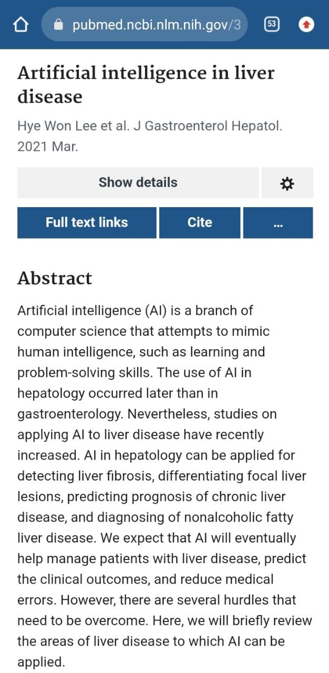
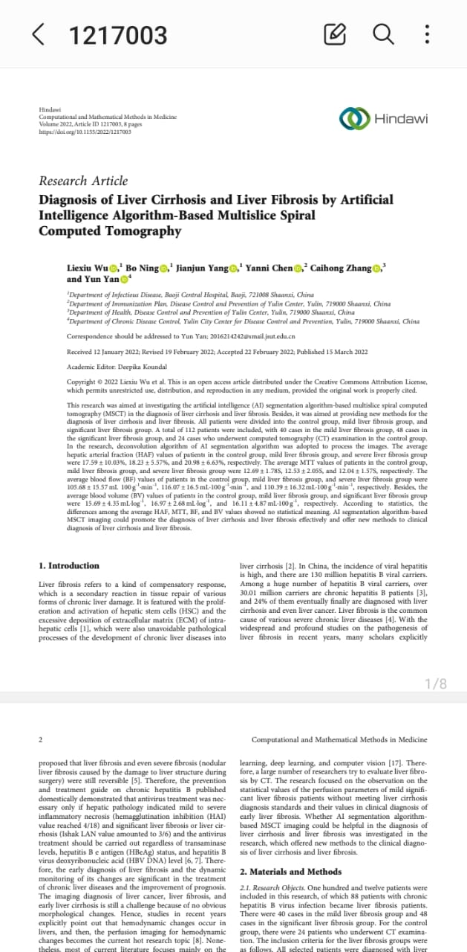
Role of AI in liver diseases
ARTIFICIAL INTELLIGENCE

Slide 37
MCQ
1. Which of the following virus is a DNA virus?
Hepatitis A Virus
Hepatitis B virus
Hepatitis C virus
Hepatitis D virus
Hepatitis E virus
Answer key = B

Slide 38
2. Which of the following is the method for active immunization against hepatitis B?
A. Pegylated interferon a
B. Lamivudine
C. Vaccine
D. Immune globulin
E. Entecavir
Answer key = C

Slide 39
3. A 14 years student presented with malaise, anorexia, low grade fever and jaundice for 5 days. On examination he is jaundiced, liver is enlarged. Serum bilirubin is 4.8 mg/dl, ALT is 800U/L and ALP is 160 U/L. what is your diagnosis?
A. Acute hepatitis
B. Chronic hepatitis
C. Liver cirrhosis
D. Hepatocellular carcinoma
E. Acute liver failure
Answer key = A

Slide 40
4. The route of transmission of hepatitis A virus is mostly through which of the following modes?
A. Injection drug use
B. Vertical transmission
C. Feco-oral route
D. Blood products
E. Hemodialysis
Answer key = C

Slide 41
5. Which of the following virus doesn’t causes chronic hepatitis?
A. Hepatitis B Virus
B. Hepatitis C Virus
C. Hepatitis D virus
D. Hepatitis A virus
E. Hepatitis E virus
Answer key = D

