Slide 1


Slide 2


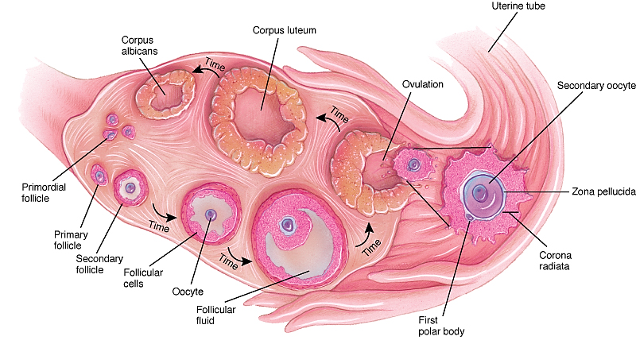
Foundation Module
1st Year MBBS(LGIS)
Gametogenesis: Oogenesis
Presented by:
Prof. Dr. Ayesha Yousaf
Date:04-03-2023
Updated on 23.01.2025

Slide 3
Motto, Vision, The Dream
Wisdom
Truth
Service
To impart evidence based research oriented medical education
To provide best possible patient care
To inculcate the values of mutual respect and ethical practice of medicine

Slide 4
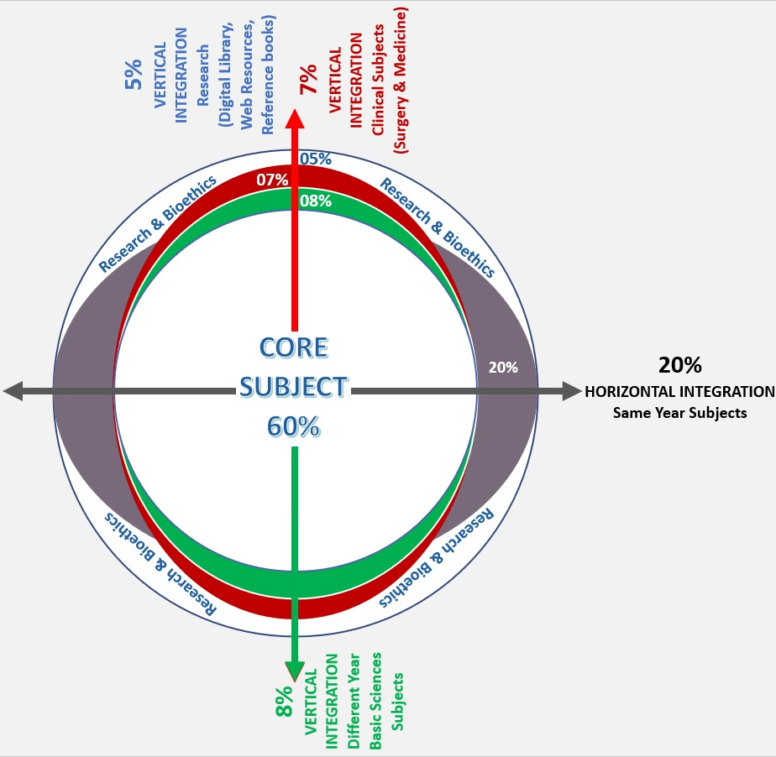
Professor Umar Model of Integrated Lecture
60%
CORE SUBJECT
20%
HORIZONTAL
INTEGRATION
Physiology
biochemistry
8%
VERTICAL INTEGRATION
Pathology
pharmacology
7%
VERTICAL INTEGRATION
Clinical integration
5%
VERTICAL INTEGRATION
Research, professionalism
Ethics
Digital library

Slide 5
Prof. Umar Teaching Strategy Model
Lecture available on website : https://rmur.edu.pk/department-of-anatomy/
SDL (Access and Read the Lecture on the Website Before Class)
SDL Assessment
1. The secondary occyte undergoes completion of the second maturation division:
Before ovulation
At fertilization
After ovulation
Prenatally
At puberty
2. Oogonia divide by mitosis during:
Their migration to gonadal ridges
Late fetal life
Postnatal life
Puberty to menopause
2nd to 5th month of prenatal life

Slide 6
Prof. Umar Teaching Strategy Model
Lecture available on website : https://rmur.edu.pk/department-of-anatomy/
SDL (Access and Read the Lecture on the Website Before Class)
SDL Assessment
3. In contrast to mitosis, the first meiotic division is characterized by:
Cytokinesis
Synthesis of DNA
Pairing of homologous chromosomes
Separation of chromatids into daughter cells.
None of the above.
4. Primordial germ cells migrate to the gonads from the:
Intermediate mesoderm
Wall of yolk sac
Lateral plate mesoderm
Endoderm of bilaminar disc
Splanchnic mesoderm

Slide 7
Prof. Umar Teaching Strategy Model
Lecture available on website : https://rmur.edu.pk/department-of-anatomy/
SDL (Access and Read the Lecture on the Website Before Class)
SDL Assessment
5. The follicle in which cavity first appears is :
Primary follicle
Antral follicle
Tertiary follicle
Secondary follicle
Primordial follicle

Slide 8
Learning Objectives
At the end of the lecture, students will be able to:
Describe anatomy of female reproductive system
Outline the functions of female reproductive system
Discuss role of female hormones during oogenesis
Define the role of oocyte maturation inhibitor factor
Compare and contrast different stages of oogenesis
Correlate with the clinical conditions
Practice the principles of bioethics in the related scenario
Apply strategic use of A.I in the given scenario
Read relevant research articles related to

Slide 9
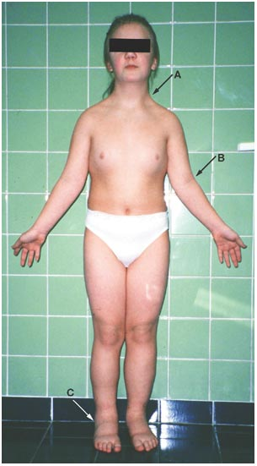
Interactive session
A 17 years old female was brought to the gynecology clinic for primary amenorrhea. Examination revealed lack of development of secondary sexual characteristics, short stature, webbed neck and widely spaced nipples. Karyotyping was performed and revealed XO chromosomal abnormality.

Slide 10
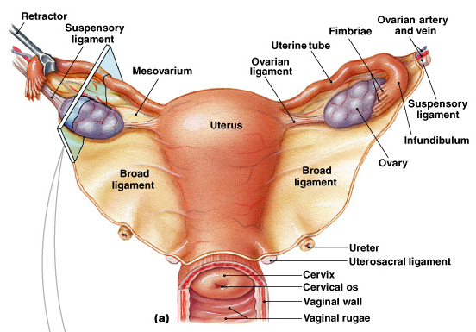
Core Knowledge
Female Reproductive 0rgans

Slide 11
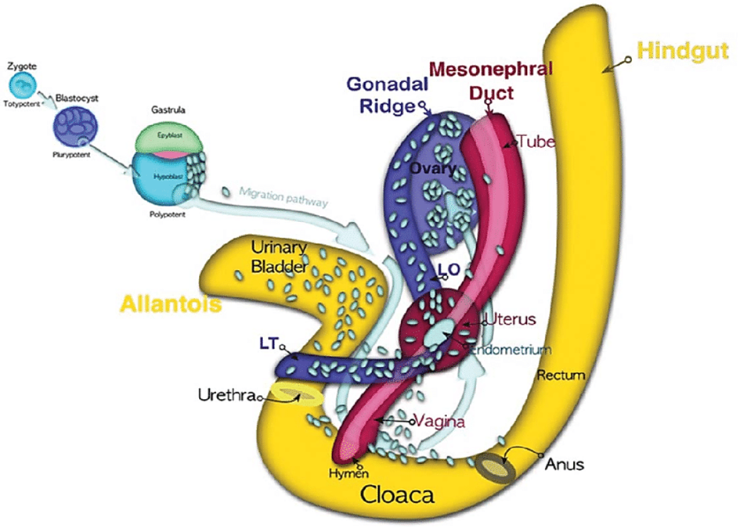
Core Knowledge
Germ Cell Migration

Slide 12
Oogenesis
Core Knowledge
It is the process whereby oogonia (Primordial Germ Cells) differentiate into mature oocytes. Also called ovum production
Begins before birth
Accelerates at puberty
Ends at menopause

Slide 13
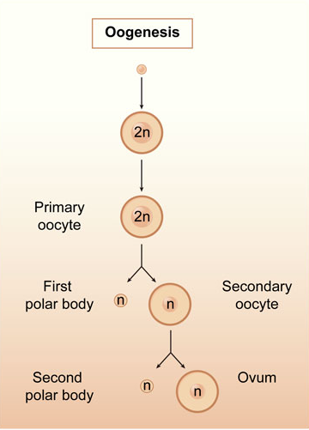
Maturation of oocytes before birth
Core Knowledge
PGCs arrived in the gonads differentiate into oogonia
Oogonia undergo a number of mitotic divisions by end of 3rd month, arranged in clusters surrounded by a layer of flat epithelial cells follicular cells derived from ovary
Majority of oogonia divide by mitosis but some of them arrest their cell division in prophase (diplotene) of meiosis-I and form primary oocytes.

Slide 14
Maturation of oocytes before birth
Core Knowledge
Oogonia increase rapidly in number
5th month number of germ cells in the ovary reaches its maximum – 7 million.
Cell death begins and many oogonia and primary oocytes degenerate and become atretic.

Slide 15
Maturation of oocytes before birth
Core Knowledge
By 7th month majority degenerate except for a few near the surface
All surviving oocytes have entered into meiosis 1 and individually surrounded by a layer of flat epithelial cells.
Near the time of the birth , all primary oocytes have started meiosis-I but arrested at diplotene stage of prophase.

Slide 16
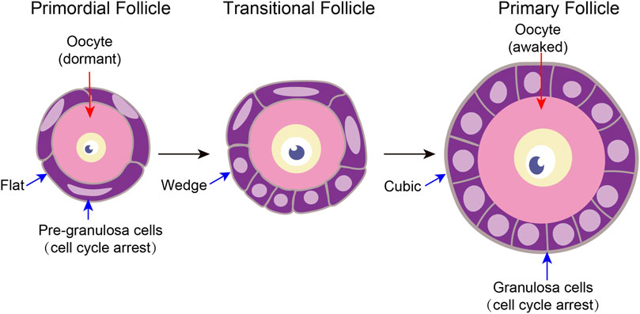
Primordial follicle
Core Knowledge
A primary oocyte surrounded by flat epithelial cells is Primordial Follicle.
Primary oocyte REMAIN ARRESTED in prophase and do not finish first meiotic division before puberty is reached.
This is due to oocyte maturation inhibitor (OMI) secreted by follicular cells.

Slide 17
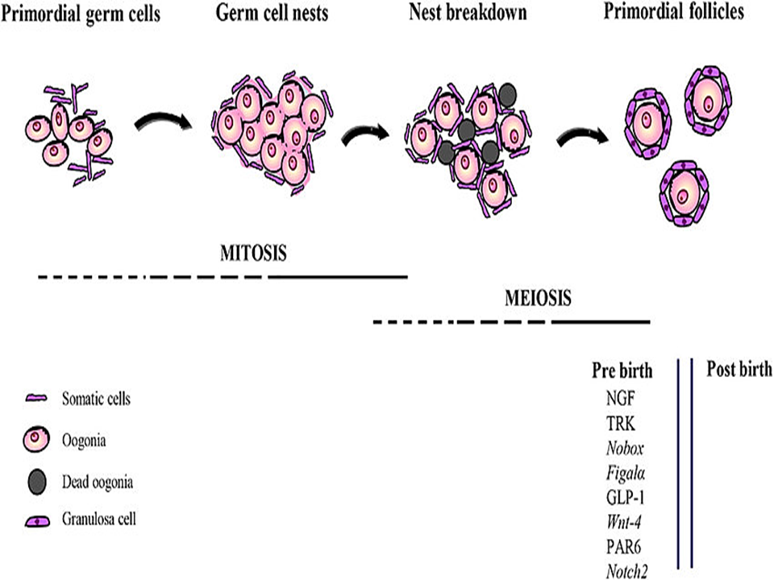
Core Knowledge
Primordial follicle

Slide 18
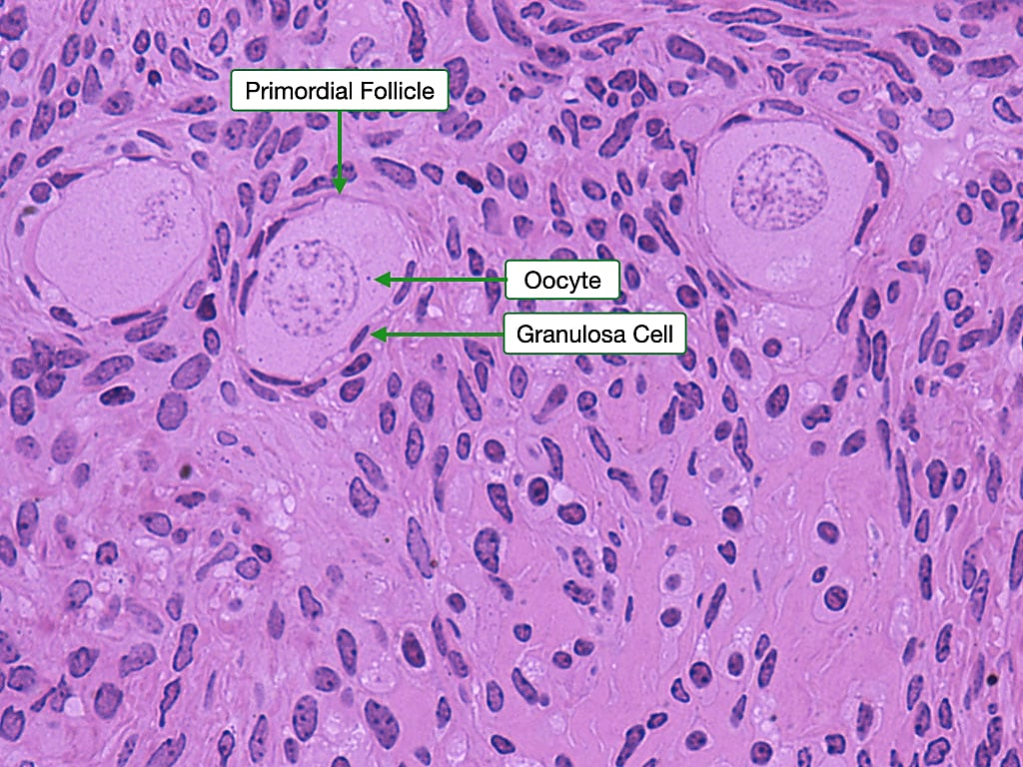
Core Knowledge
Primordial follicle

Slide 19
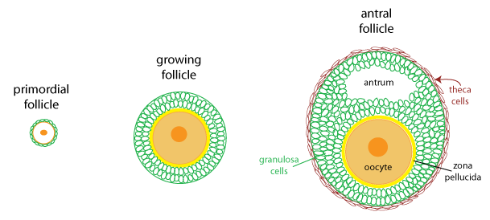
Maturation of oocytes continues at puberty
Core Knowledge
Number of primary oocytes at birth is estimated to vary from 600,000 – 800,000
During childhood most oocyte become atretic
At puberty number is almost 40,000
A fewer than 500 will be ovulated

Slide 20
Follicular Phase (pre-ovulatory phase)
Core Knowledge
Primordial follicle
Primary follicle
Secondary follicle
Tertiary follicle

Slide 21
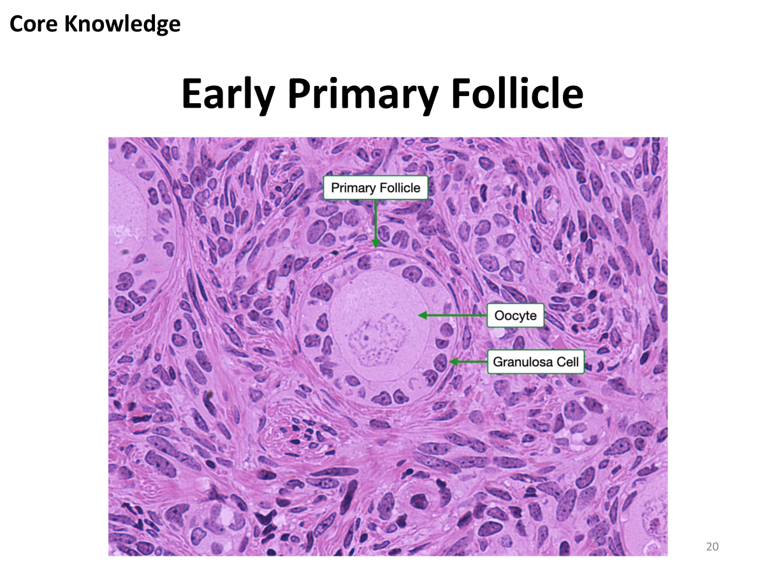
Primary Follicle
Core Knowledge
1. Unilaminar
As primordial follicles grow, surrounding follicular cells change from flat to single layer of cuboidal cells
Granulosa cells rest on basement membrane separating from ovarian connective tissue that forms Theca folliculi
Granulosa cells and oocyte Secrete-zona Pellucida

Slide 22
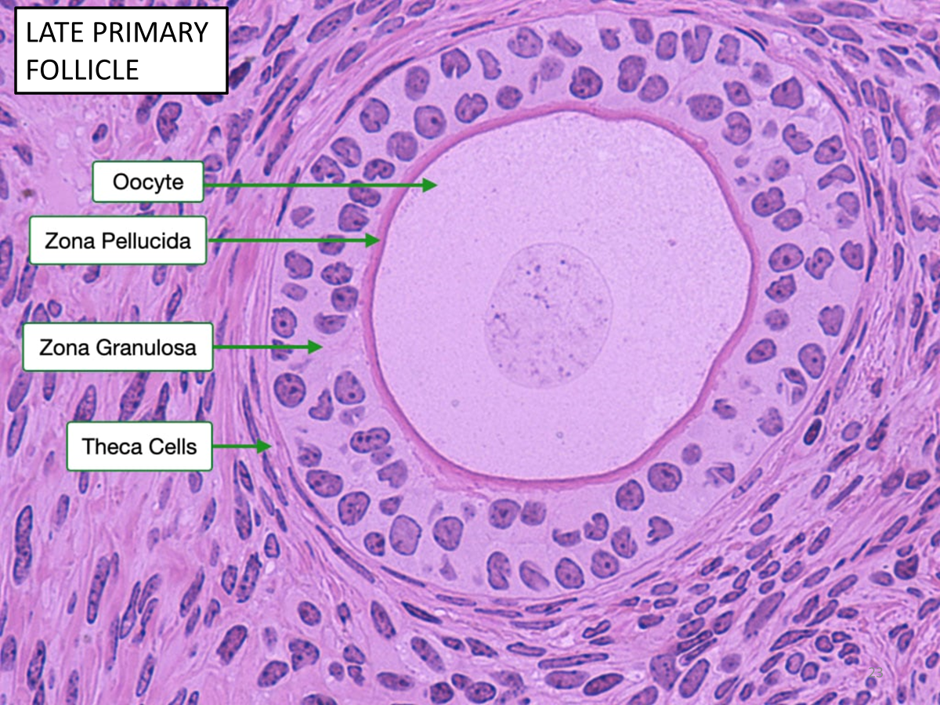
Primary follicle
Core Knowledge
2. Multi laminar
Follicular cells proliferate –stratified epithelium of Granulosa cells
Follicles grow and theca folliculi organize into:
1. Inner secretory layer Theca interna
2. Outer fibrous layer Theca externa

Slide 23
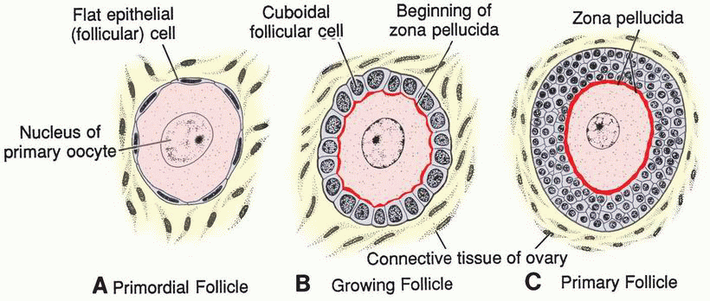
Core Knowledge
Primary follicle

Slide 24
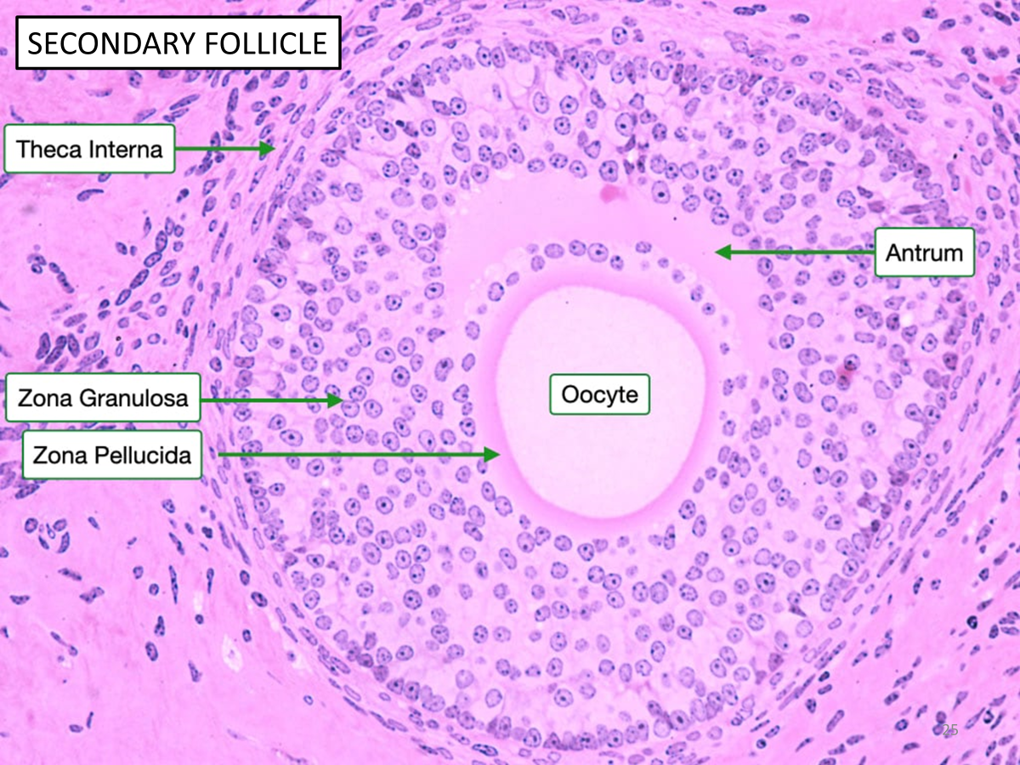
Secondary Follicle
Core Knowledge
Follicles grow, because of increase in size and number of granulosa cell-move deeper to cortex
Spaces appear between follicular cells
Spaces coalesce, granulosa cells reorganize them selves to form a large Cavity-antrum

Slide 25
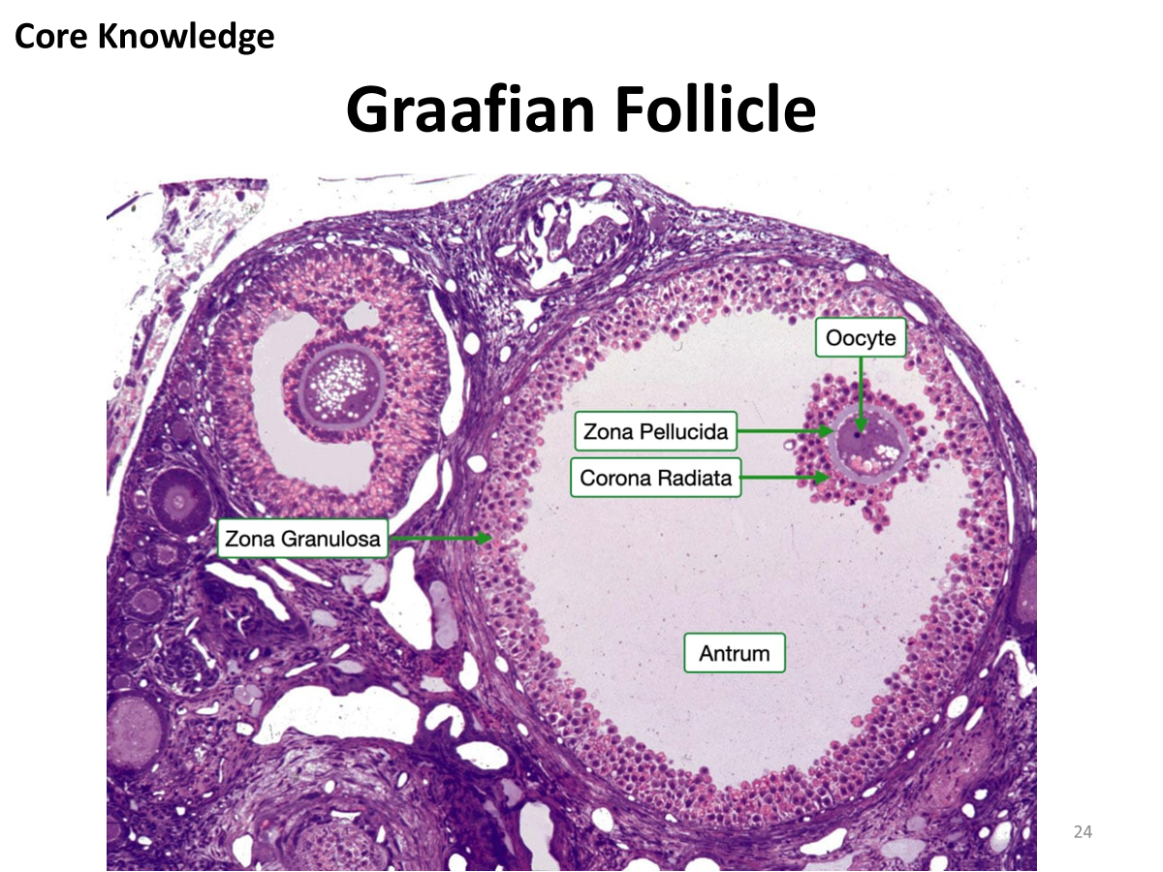
Tertiary or Graafian Follicle
Core Knowledge
Antrum is crescent shaped but enlarges
Granulosa cells surrounding oocyte remain intact and form Cumulus oophorus
Mature graafian follicle is surrounded by theca interna-steroid secretion
Theca externa merges with ovarian connective tissue
This stage encompasses approximately 37 hours before ovulation
At maturity surge in LH induces preovulatory growth phase

Slide 26
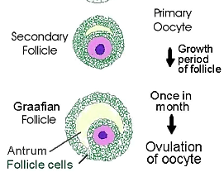
Core Knowledge
Tertiary Follicle

Slide 27
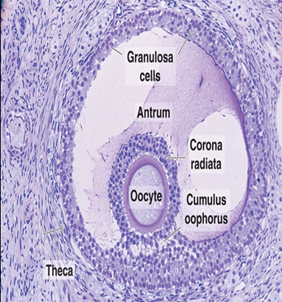
Tertiary or Graafian Follicle
Core Knowledge
Spans entire width of cortex
First meiotic division being completed: Primary oocyte divides into one secondary oocyte and one polar body
Cell enters Meiosis II but arrests in Metaphase for 3 hours before ovulation

Slide 28
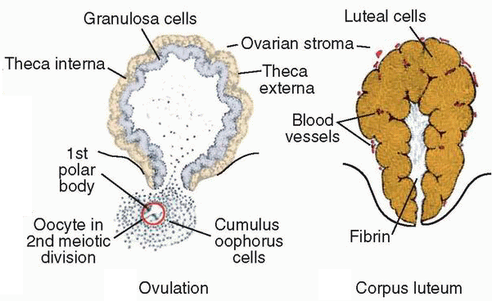
Ovulation
Horizontal Integration
Empty follicle forms corpus luteum which produces progesterone
Corpus luteum degenerates and becomes corpus albicans

Slide 29
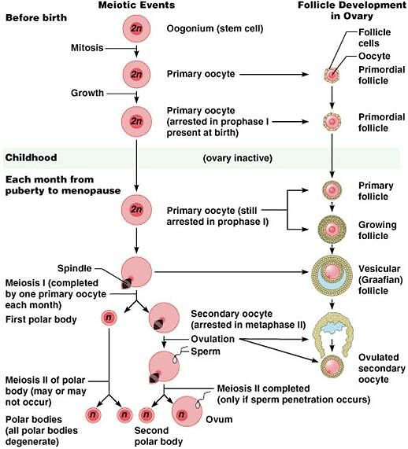
Oogenesis
Horizontal Integration

Slide 30
Differences between Spermatogenesis and Oogenesis
Horizontal Integration
Spermatogenesis | Oogenesis
1. Occurs in the testis. | 1. Occurs in the ovary.
2. Starts after puberty. | 2. Starts during fetal life.
3. Continues till old age. | 3. Ends at menopause (~45 years)
4. Every daughter spermatogonium gives rise to four equal spermatids. | 4. Every daughter oogonium gives rise to one ovum and three polar bodies.
5. Every spermatid transforms into a motile sperm. | 5. No stage of transformation occurs and the ovum is non-motile.

Slide 31
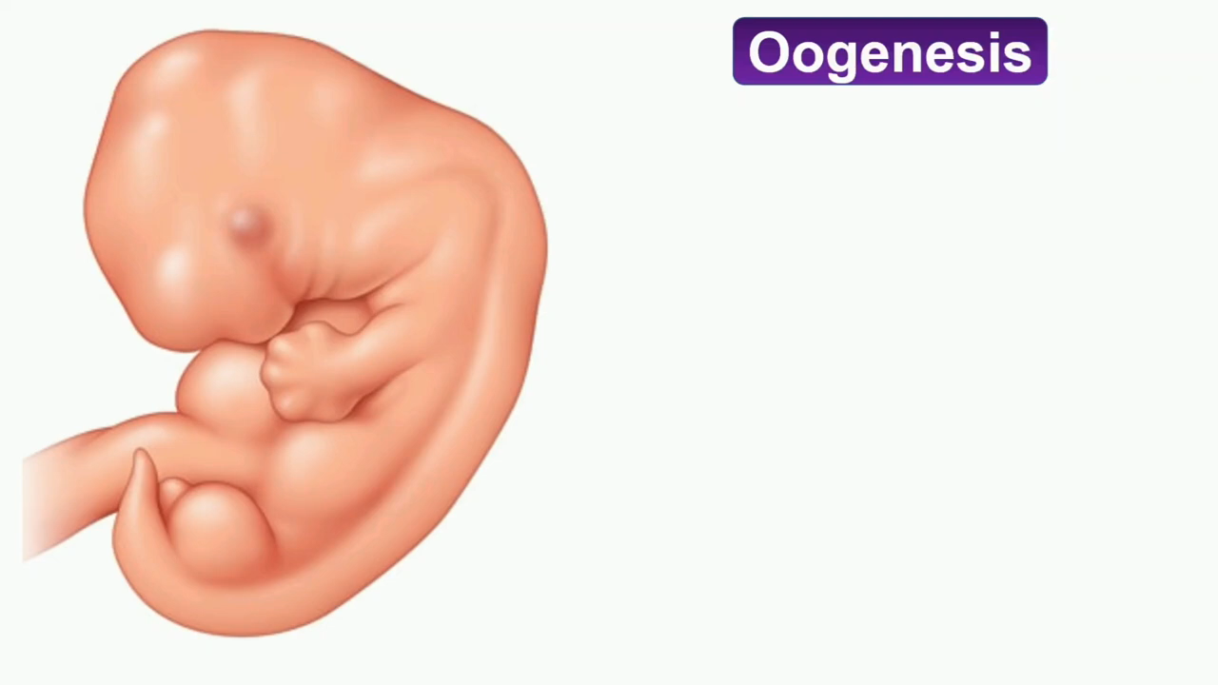
Let’s Recap

Slide 32

Trisomy 21-Down Syndrome
Vertical Integration
Caused by extra copy of chromosome 21 (trisomy 21) resulting from meiotic nondisjunction and in 75% cases nondisjunction occurs during oocyte formation
Incidence = 1 in 2,000 conceptuses for women under 25 years
Incidence increases with age of mother to 1 in 100 at the age of 40

Slide 33
Ethical Consideration of Down Syndrome
Spiral Integration
Bioethics
Emotional Support:
  Providing a safe space for parents to express their emotions, including any fears, grief, or concerns they may have.
Information and Education:
  Offering accurate and up-to-date information including medical aspects, developmental milestones, and available resources.
Parent-Child Relationship:
  Providing guidance on fostering a positive and nurturing relationship with their child.
  Discussing effective communication strategies that consider the child's unique needs.
Sibling and Family Dynamics:
  Addressing the impact of having a child with Down syndrome on siblings and the overall family dynamic.
  Offering strategies for fostering positive relationships among siblings.
Future Planning:
  Assisting parents in creating long-term plans for their child, including education, healthcare, and independent living considerations.
Self-Care:
  Encouraging parents to prioritize self-care to maintain their physical and emotional well-being.
  Discussing coping mechanisms and stress reduction strategies.

Slide 34
Managing Down Syndrome
Vertical Integration
Family Medicine
Early Intervention Services:
It involves physical therapy, occupational therapy, and speech therapy to address developmental delays and support the child's overall growth and well-being.
2. Regular Health Check-ups:
Children with Down syndrome may have specific health concerns, including heart defects, thyroid issues, and hearing problems. Regular check-ups with a pediatrician are essential to monitor growth, development, and address any health issues promptly.
3. Developmental Monitoring and Support:
Pediatricians and developmental specialists monitor the child's developmental milestones and provide support for any delays. Early identification and intervention for developmental challenges are critical.
4. Educational Support:
Collaboration with educators and special education services is important
5. Nutritional Guidance
. A pediatrician or nutritionist can provide guidance on a balanced diet and address any feeding concerns.
6. Speech and Language Therapy:
. Speech therapists work with the child to improve communication skills
.

Slide 35
Cytoplasmic maturation in human oocytes: an ultrastructural study
. .
Spiral Integration
Research Article
2021 Jan 4;104(1):106-116. doi: 10.1093/biolre/ioaa174.
Female fertility relies on successful egg development. Besides chromosome segregation, complex structural and biochemical changes in the cytoplasmic compartment are necessary to confer the female gamete the capacity to undergo normal fertilization and sustain embryonic development.

Slide 36
Learning Resources
Langman's Medical Embryology, 14th Edition
The Developing Human: Clinically Oriented Embryology KLM Embryology
Textbook of Clinical Embryology (Kevin Coward, Dagan Wells)
Google Scholar
Google images

Slide 37
Take Home Message
Empathy, sensitivity, and a patient-centered approach are fundamental when interacting with individuals with Down syndrome and their families.
Understanding the medical, developmental, and psychosocial aspects is key to providing comprehensive care.

Slide 38


