Slide 1
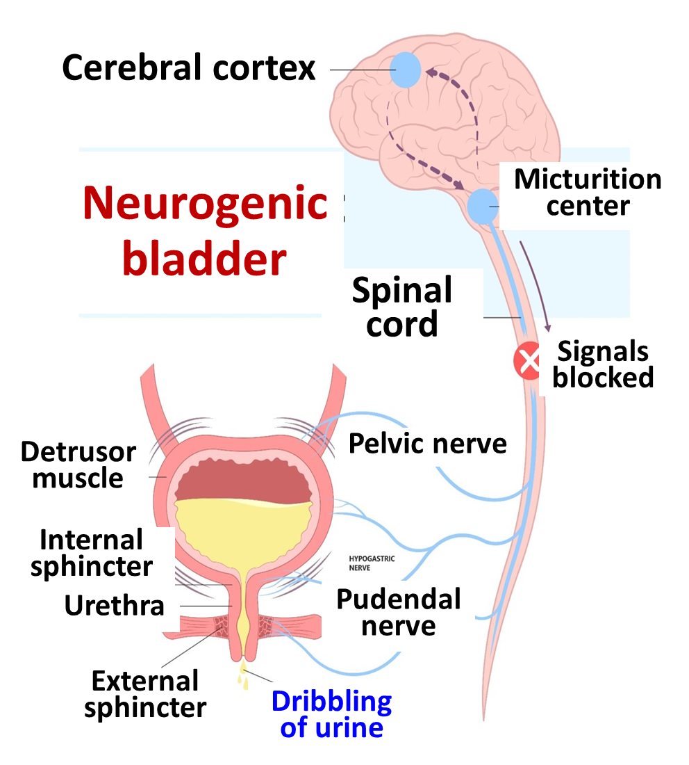

Slide 2
Ethical concerns
Patient is psychologically disturbed, needs moral support
Patient is hesitant to tell his/her problem, needs communication skills (Consider age, gender, education, etc.)
Questions should be precise, relevant to diagnose problem only (Abu Ali Sina)
Bladder is close to intimate areas
Take consent before examination, & expose body just enough
Examine female, in presence of another lady (To practice ‘Hadith’ of Prophet Mohammad (Peace, blessings be upon him)
Confidentiality, keep patient problem secret. Can discuss with colleagues (Patient’s Beneficence), students (Teaching), etc.

